Slide 1

Manage a staff WordPress user safely
START
Give each staff member their own login, assign the minimum safe role, and remove access without losing website content.
Beginner lesson | Administrator only | No shared logins
Staff access v1.1 | 1/13
Notes:
[Sources]
- Rebekah project training standard and client records in CLIENT-NOTES.md.
- Established WordPress user-role and cache workflow used by this project.
- No live WordPress login or website change was used to create this lesson.

Slide 2
Required WordPress access
1
WORDPRESS ROLE REQUIRED
Administrator
Only an Administrator should manage user accounts.
Do not give Administrator access for routine practitioner or event editing. Editor is sufficient for those tasks.
Staff access v1.1 | 2/13
Notes:
[Sources]
- Rebekah project training standard and client records in CLIENT-NOTES.md.
- Established WordPress user-role and cache workflow used by this project.
- No live WordPress login or website change was used to create this lesson.

Slide 3
Gather the approved account information first
2
BEFORE OPENING USERS
Full name | unique work email | approved role
Each person gets a separate account. Never reuse another person's username or password.
Staff access v1.1 | 3/13
Notes:
[Sources]
- Rebekah project training standard and client records in CLIENT-NOTES.md.
- Established WordPress user-role and cache workflow used by this project.
- No live WordPress login or website change was used to create this lesson.

Slide 4
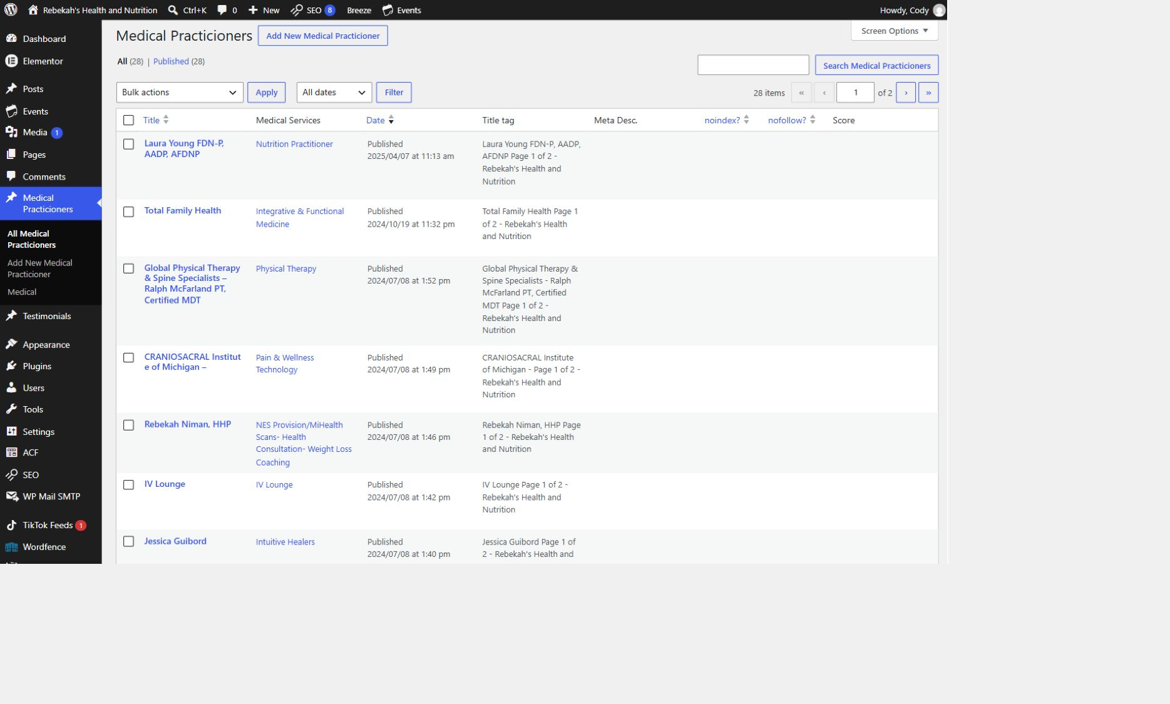
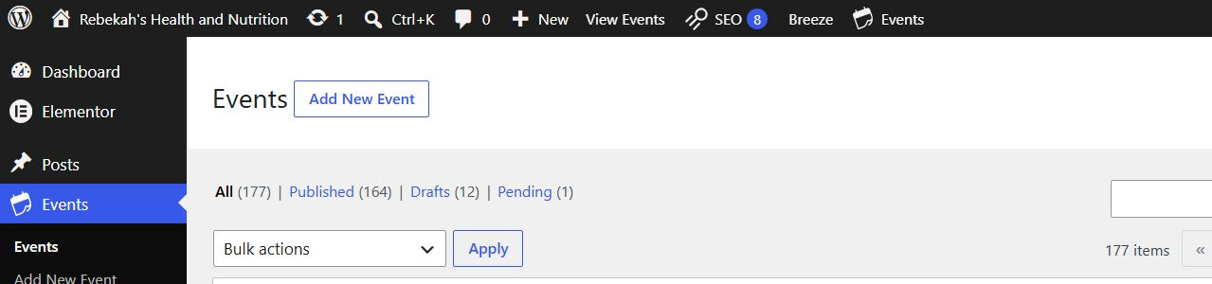
Open Users and choose the correct action
3
WHERE TO GO
Users > Add New User
DO THIS
LOOK HERE
WRITTEN STEPS
1. Confirm the person's identity.
2. Choose add, change, or remove.
3. Never edit an unfamiliar Administrator.
1. Click Medical Practicioners.
2. Click All Medical Practicioners.
3. Search by name if needed.
1. To add someone, select Add New User.
2. To change or remove someone, select All Users.
3. Stop if Users is missing; your account is not an Administrator.
Follow the steps in order. Stop when the screen does not match.
Staff access v1.1 | 4/13
Notes:
[Sources]
- Rebekah project training standard and client records in CLIENT-NOTES.md.
- Established WordPress user-role and cache workflow used by this project.
- No live WordPress login or website change was used to create this lesson.

Slide 5
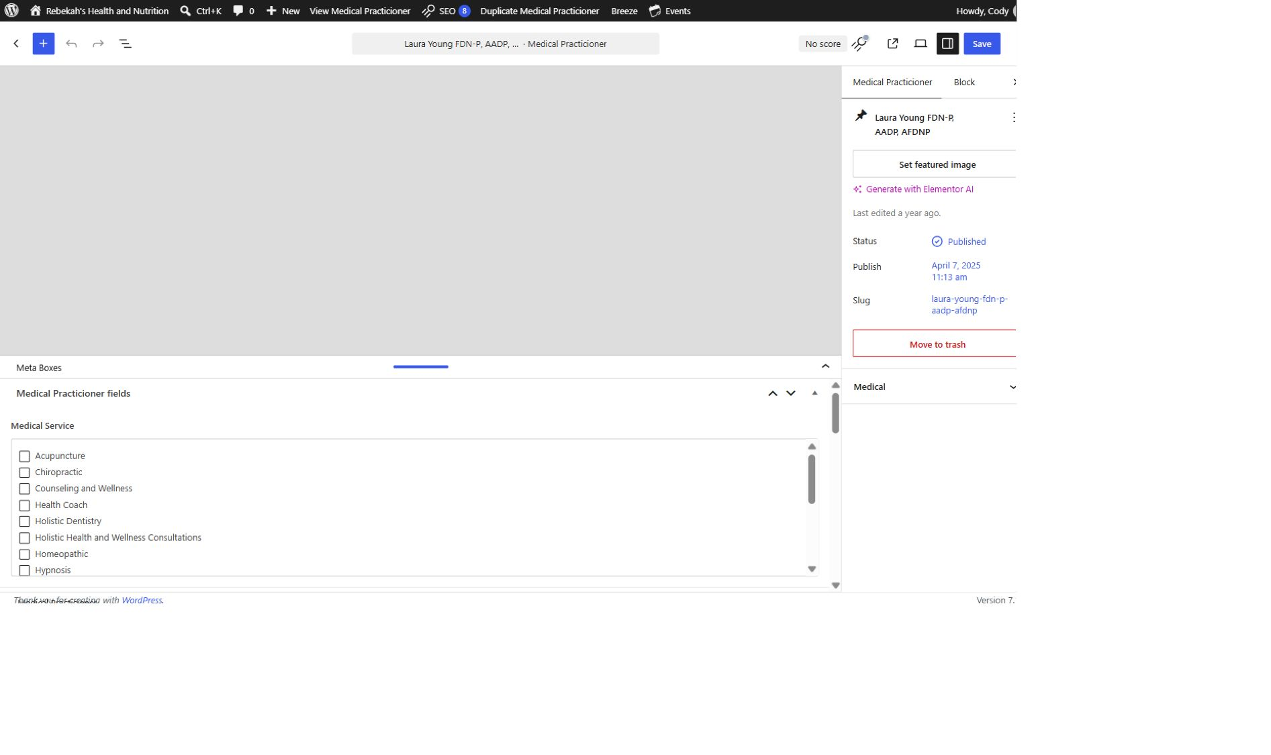
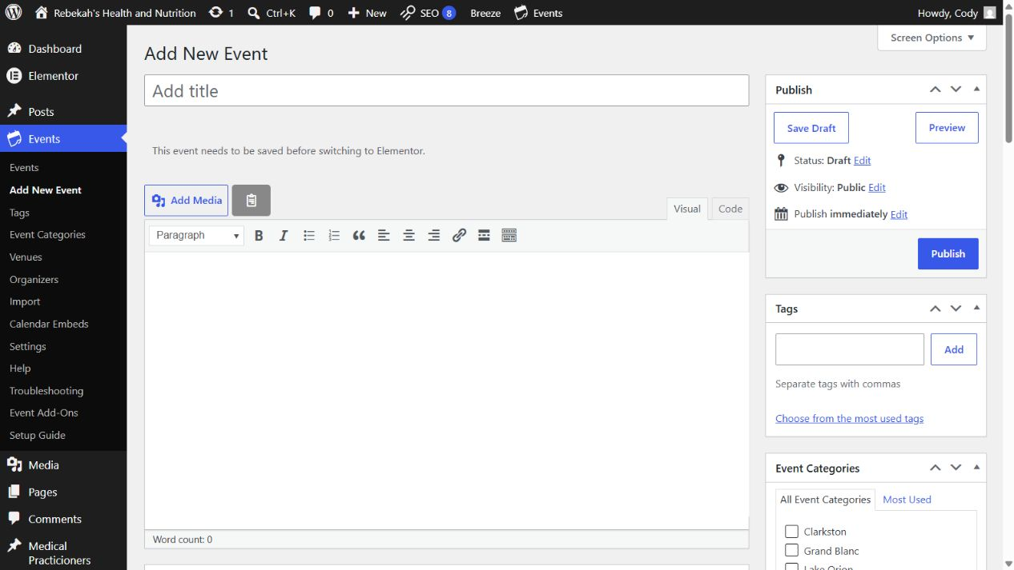
Create a permanent username and unique email
4
WHERE TO GO
DO THIS
Add New User > Account details
WRITTEN STEPS
1. Find Medical Service.
2. Check the approved category.
3. Uncheck incorrect categories.
1. Use one account per person.
2. Check the email twice.
3. Do not use a shared login.
LOOK HERE
1. Enter a simple username the staff member will recognize.
2. Enter that person's unique work email address.
3. A username cannot be changed later, so check spelling before continuing.
Follow the steps in order. Stop when the screen does not match.
Staff access v1.1 | 5/13
Notes:
[Sources]
- Rebekah project training standard and client records in CLIENT-NOTES.md.
- Established WordPress user-role and cache workflow used by this project.
- No live WordPress login or website change was used to create this lesson.

Slide 6
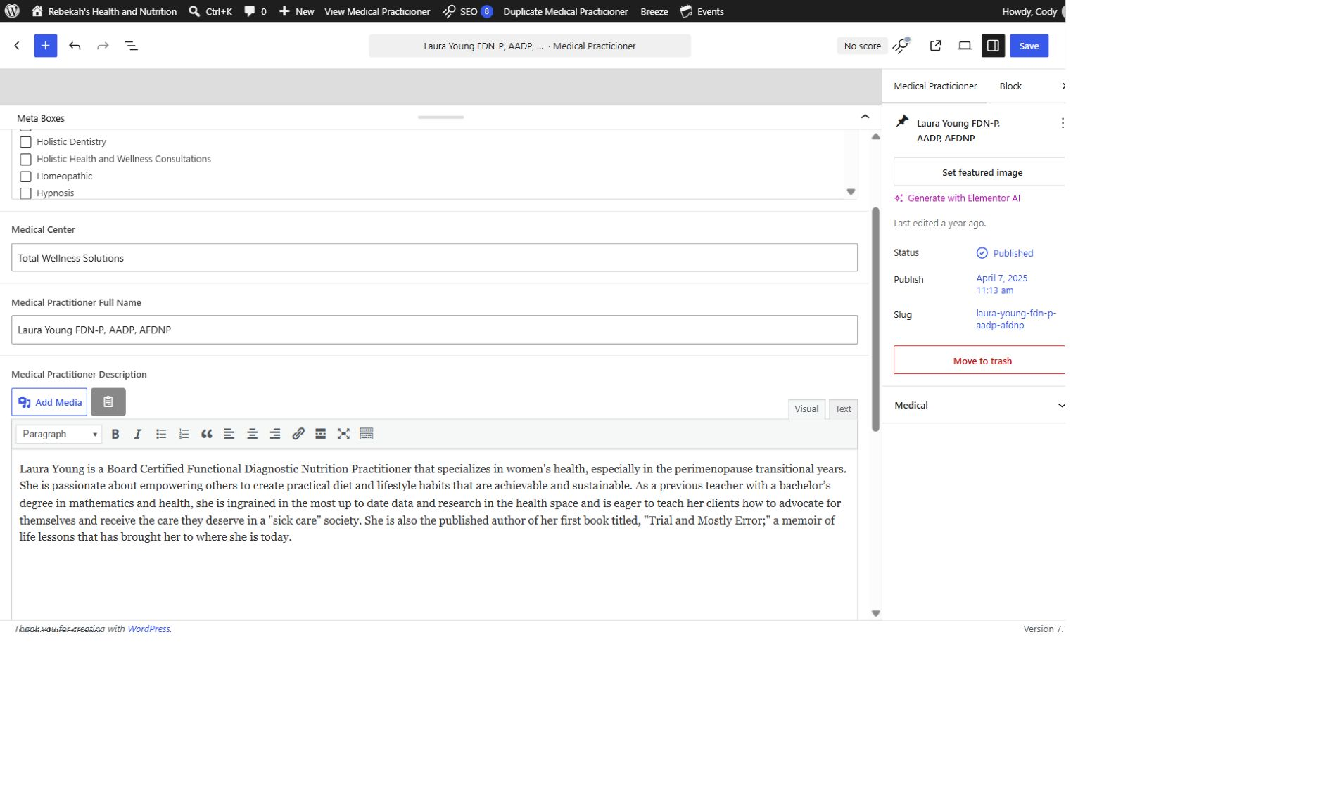
Complete the name and invitation settings
5
WHERE TO GO
DO THIS
Add New User > Name and notification
WRITTEN STEPS
1. Select Visual.
2. Replace the approved description.
3. Keep the paragraph breaks.
1. Use the real staff name.
2. Do not create an easy password.
3. Let WordPress send the invitation.
1. Enter the person's first and last name.
2. Leave the secure generated password in place.
3. Keep the user-notification option selected so WordPress sends the setup email.
LOOK HERE
Follow the steps in order. Stop when the screen does not match.
Staff access v1.1 | 6/13
Notes:
[Sources]
- Rebekah project training standard and client records in CLIENT-NOTES.md.
- Established WordPress user-role and cache workflow used by this project.
- No live WordPress login or website change was used to create this lesson.

Slide 7
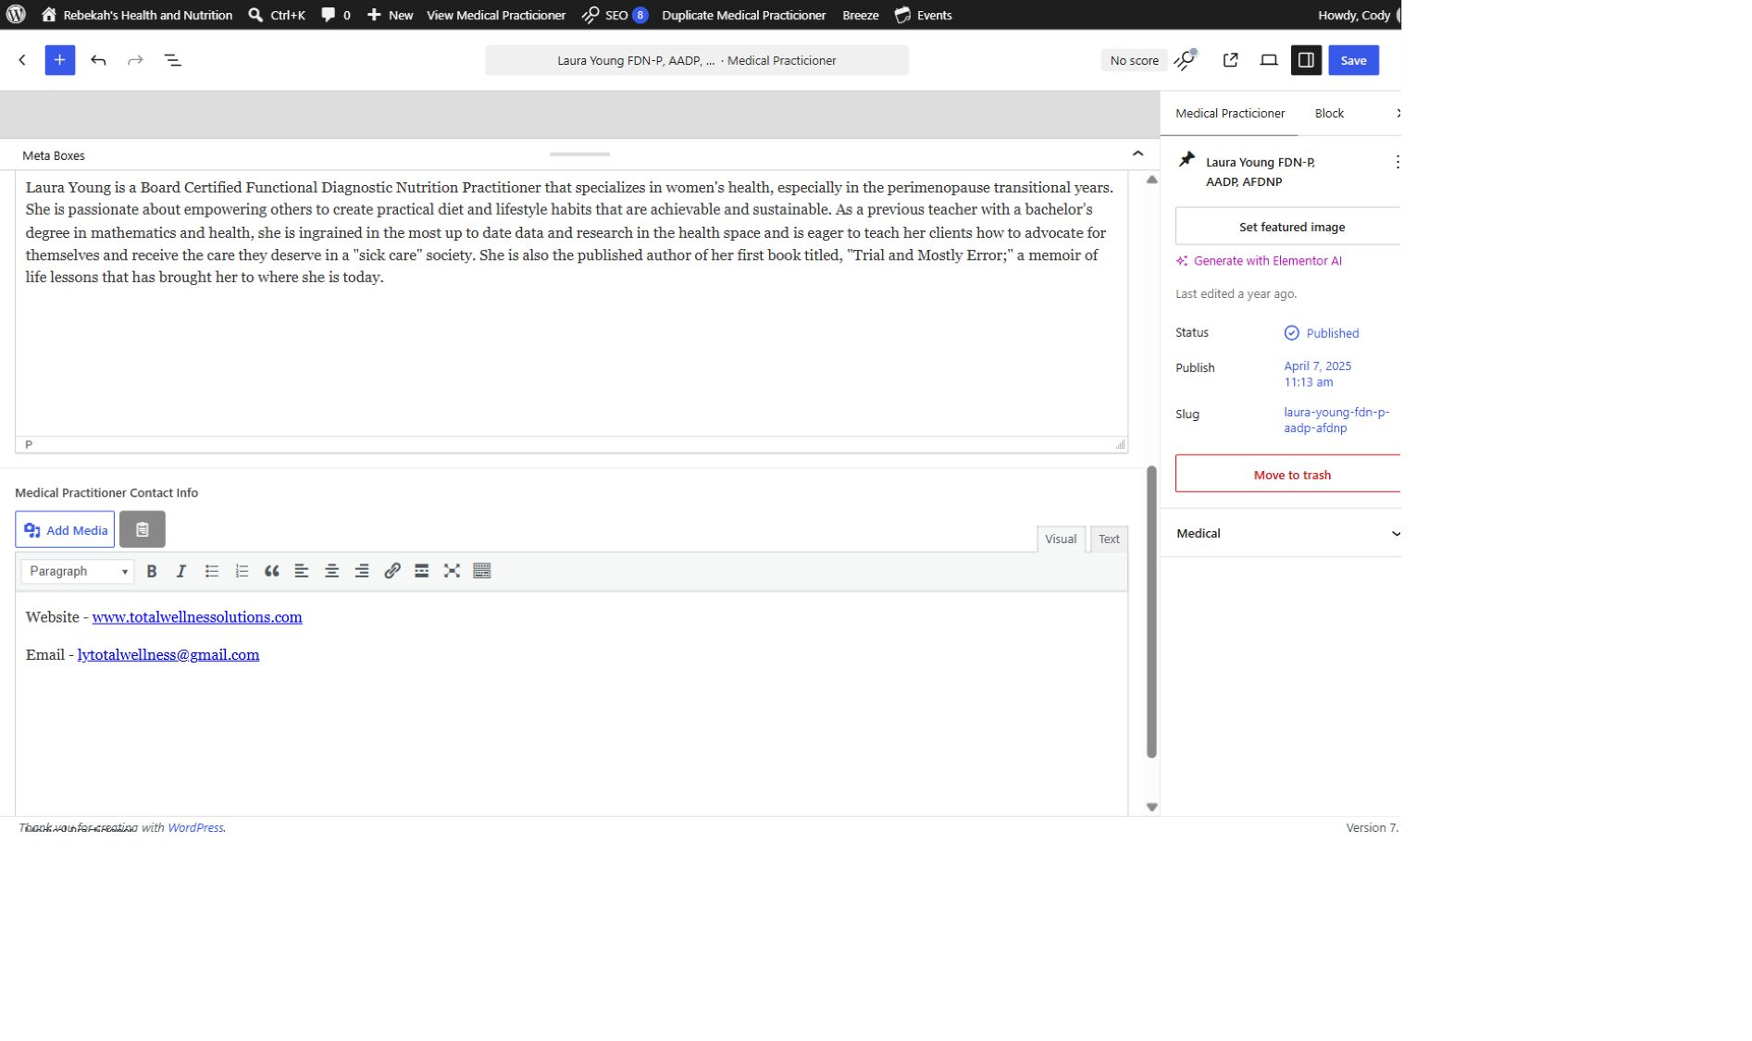
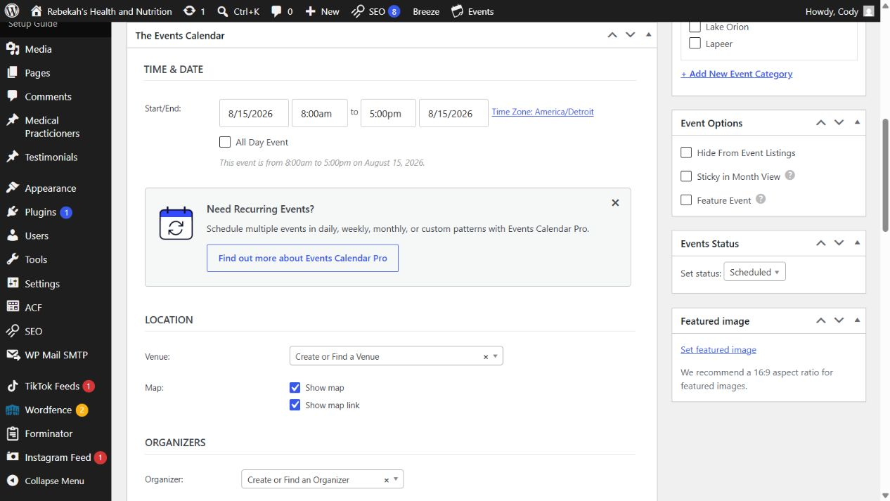
Choose the minimum role the person needs
6
WHERE TO GO
DO THIS
Add New User > Role
WRITTEN STEPS
1. Add only approved public details.
2. Test every link.
3. Remove outdated contact information.
1. Routine editing: Editor.
2. User management: Administrator.
3. Never upgrade access just to fix a menu.
LOOK HERE
1. Choose Editor for approved practitioner and event work.
2. Choose Administrator only for an owner or trusted website manager who must manage users and settings.
3. If the correct access is uncertain, stop and ask Blue Nova.
Follow the steps in order. Stop when the screen does not match.
Staff access v1.1 | 7/13
Notes:
[Sources]
- Rebekah project training standard and client records in CLIENT-NOTES.md.
- Established WordPress user-role and cache workflow used by this project.
- No live WordPress login or website change was used to create this lesson.

Slide 8
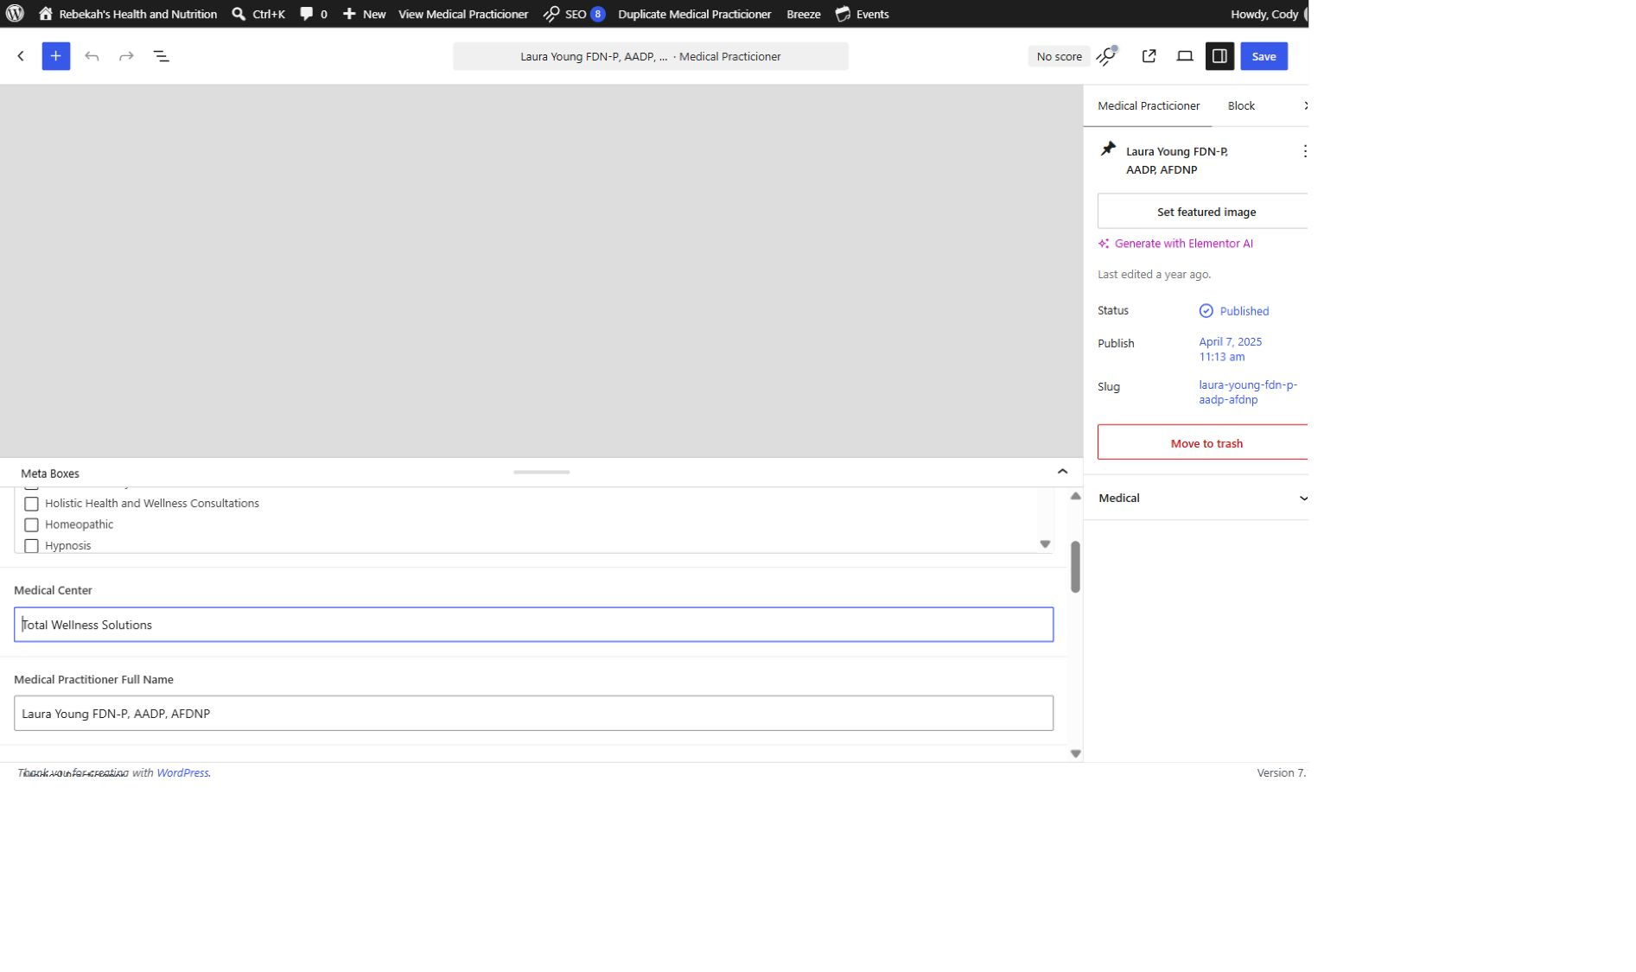
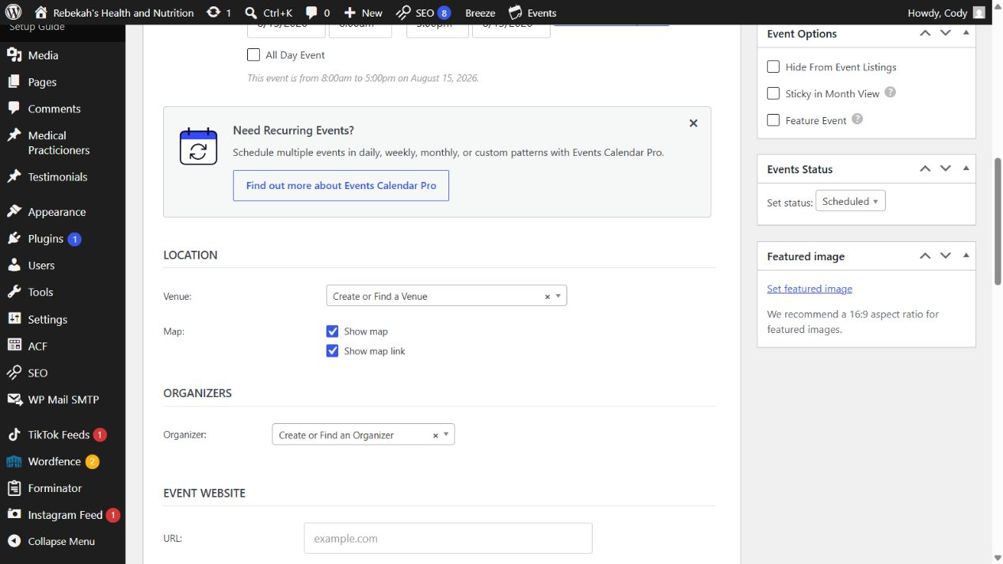
Add the user once and wait for confirmation
7
WHERE TO GO
DO THIS
Add New User > Add New User button
WRITTEN STEPS
1. Re-read every changed field.
2. Compare with the approved information.
3. Fix errors before saving.
1. Review before submitting.
2. Click once and wait.
3. Do not create a duplicate account.
1. Review every field before clicking the button.
2. Select Add New User one time, then wait for the success message.
3. If WordPress reports that the username or email already exists, stop and check All Users.
LOOK HERE
Follow the steps in order. Stop when the screen does not match.
Staff access v1.1 | 8/13
Notes:
[Sources]
- Rebekah project training standard and client records in CLIENT-NOTES.md.
- Established WordPress user-role and cache workflow used by this project.
- No live WordPress login or website change was used to create this lesson.

Slide 9
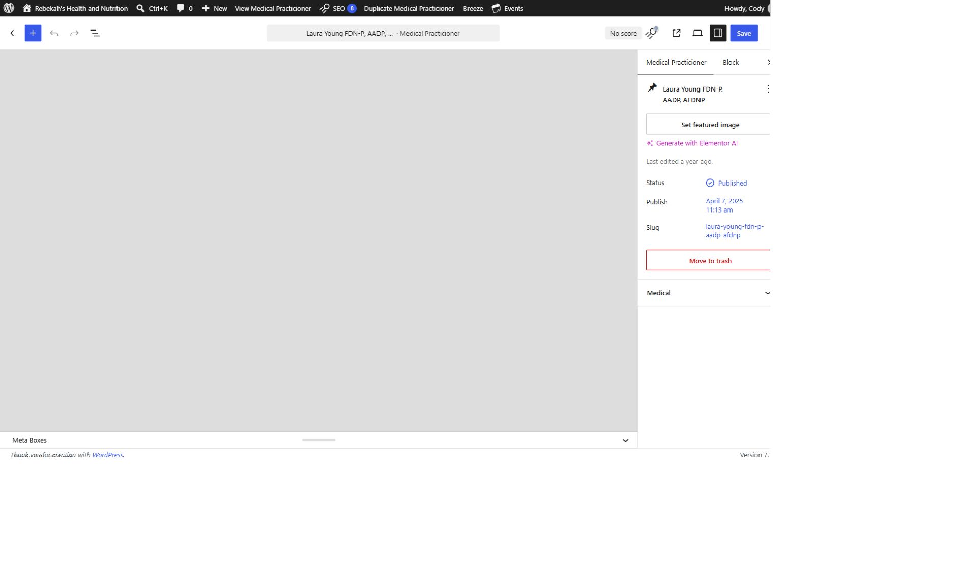
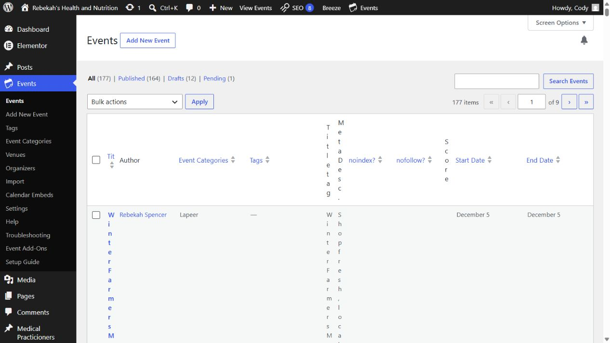
Have the staff member complete the first login
8
LOOK HERE
WHERE TO GO
DO THIS
Staff invitation email > Set password > Log in
WRITTEN STEPS
1. Click Save once.
2. Wait for confirmation.
3. Do not click repeatedly.
1. Use the invitation link.
2. Create a private strong password.
3. Confirm only the needed menus appear.
1. The staff member opens the WordPress invitation email.
2. They create a strong password that only they know.
3. They sign in at rebekahspureliving.com/wp-admin and confirm the required menu is visible.
Follow the steps in order. Stop when the screen does not match.
Staff access v1.1 | 9/13
Notes:
[Sources]
- Rebekah project training standard and client records in CLIENT-NOTES.md.
- Established WordPress user-role and cache workflow used by this project.
- No live WordPress login or website change was used to create this lesson.

Slide 10
Change an existing role carefully
9
WHERE TO GO
LOOK HERE
1. Return to the practitioner list.
2. Hover over the same row.
Users > All Users > Edit
DO THIS
3. Click Clear Cache.
1. Match both name and email.
2. Change only the Role field.
3. Recheck access after a new login.
1. Find the exact staff name and email.
2. Open Edit and choose the newly approved role.
3. Save once, then ask the staff member to sign out and sign back in.
Follow the steps in order. Stop when the screen does not match.
Staff access v1.1 | 10/13
Notes:
[Sources]
- Rebekah project training standard and client records in CLIENT-NOTES.md.
- Established WordPress user-role and cache workflow used by this project.
- No live WordPress login or website change was used to create this lesson.

Slide 11
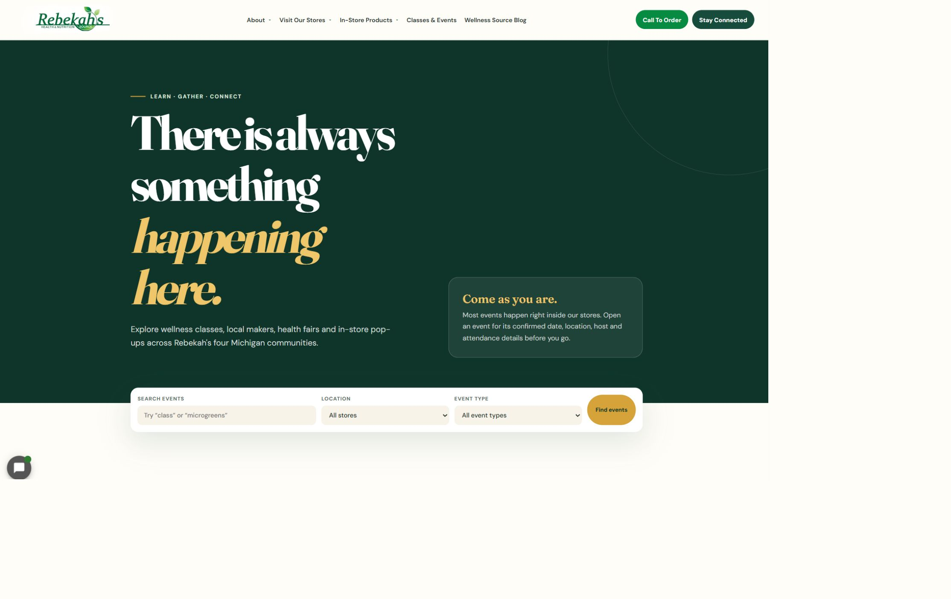
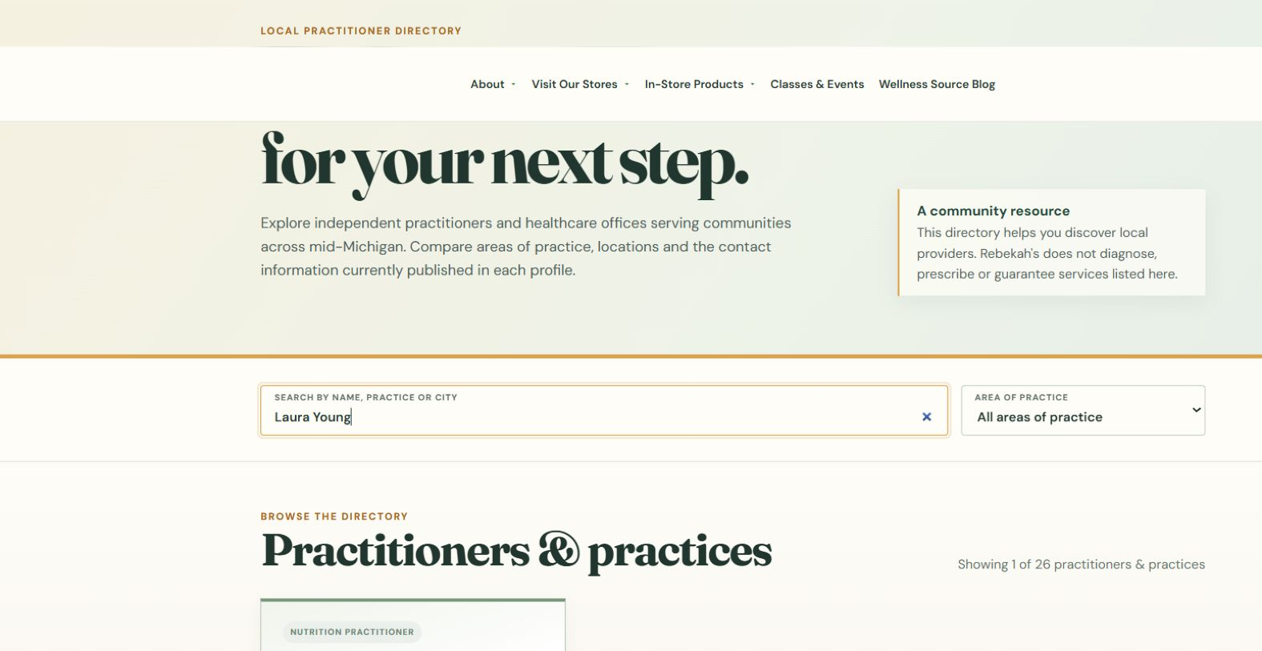
Use password reset instead of sharing passwords
10
WHERE TO GO
Users > All Users > Send password reset
DO THIS
LOOK HERE
1. Send the reset link.
2. Staff creates the new password.
3. Passwords stay private.
1. Use Send password reset when the person cannot sign in.
2. The staff member follows the private reset email.
3. Never ask them to send you their password, and never send a password by text or ordinary email.
Follow the steps in order. Stop when the screen does not match.
WRITTEN CHECK
1. Search the name.
2. Confirm the public details.
3. Check the links.
Staff access v1.1 | 11/13
Notes:
[Sources]
- Rebekah project training standard and client records in CLIENT-NOTES.md.
- Established WordPress user-role and cache workflow used by this project.
- No live WordPress login or website change was used to create this lesson.

Slide 12
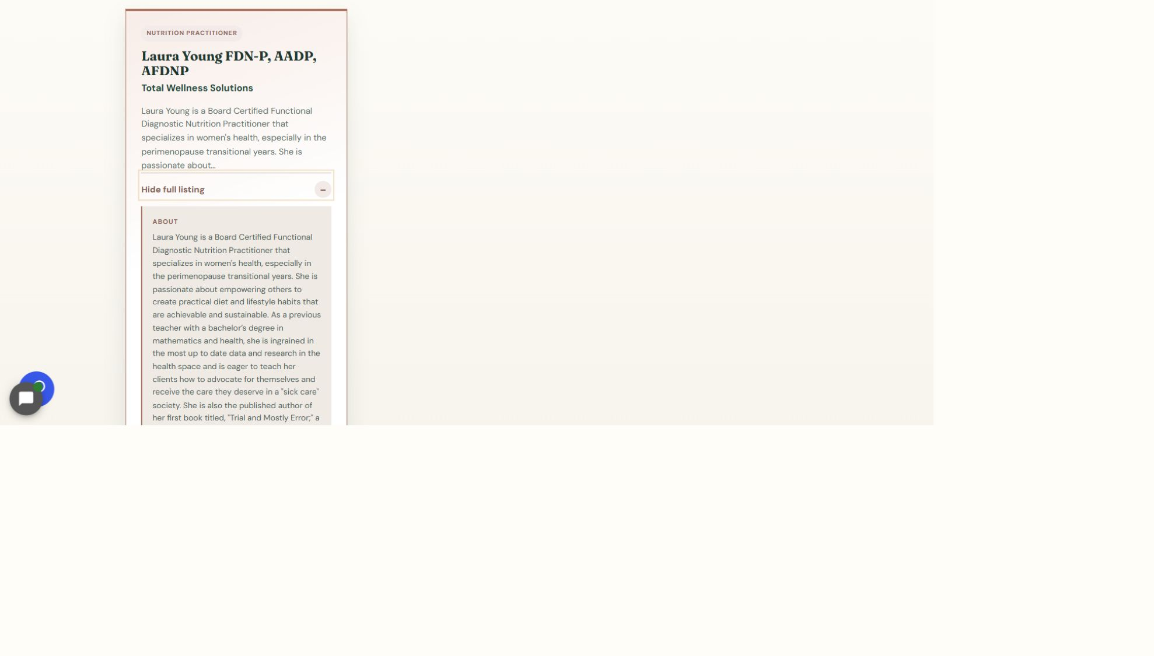
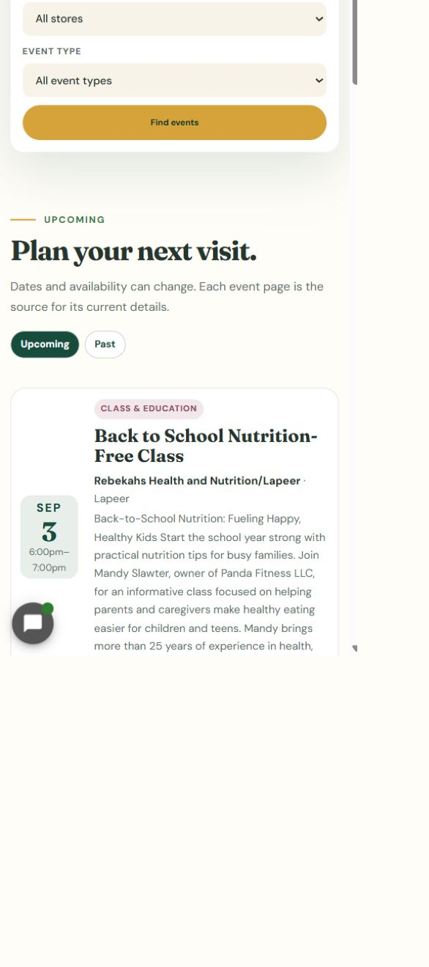
Remove access without deleting website content
11
LOOK HERE
WHERE TO GO
Users > All Users > Delete
DO THIS
WRITTEN STEPS
1. Click View full listing.
2. Check the full details and links.
3. Repeat the check on a phone.
1. Verify the exact account.
2. Reassign all content.
3. Confirm the old login no longer works.
1. Confirm the exact departing staff account before selecting Delete.
2. Choose Attribute all content to an approved continuing Administrator, such as Rebekah.
3. Never choose Delete all content unless Blue Nova has reviewed the account and approved it.
Follow the steps in order. Stop when the screen does not match.
Staff access v1.1 | 12/13
Notes:
[Sources]
- Rebekah project training standard and client records in CLIENT-NOTES.md.
- Established WordPress user-role and cache workflow used by this project.
- No live WordPress login or website change was used to create this lesson.

Slide 13
Finish by confirming the correct access
DONE
CONFIRM PERSON > MINIMUM ROLE > VERIFY ACCESS
Every staff member keeps a separate login. Remove access promptly when employment or duties change.
If you are unsure about a role, an Administrator, or content reassignment, stop and contact Blue Nova.
Staff access v1.1 | 13/13
Notes:
[Sources]
- Rebekah project training standard and client records in CLIENT-NOTES.md.
- Established WordPress user-role and cache workflow used by this project.
- No live WordPress login or website change was used to create this lesson.

