Slide 1

Clear the website cache safely
START
Use the smallest safe cache clear, refresh your browser, and verify the exact public page without changing server settings.
Beginner lesson | Live website | Use only after saving
Cache safety v1.1 | 1/13
Notes:
[Sources]
- Rebekah project training standard and client records in CLIENT-NOTES.md.
- Established WordPress user-role and cache workflow used by this project.
- No live WordPress login or website change was used to create this lesson.

Slide 2
Required WordPress access
1
WORDPRESS ROLE REQUIRED
Editor: record cache | Administrator: sitewide cache
Use only the cache control your role and instructions allow.
Do not give someone Administrator access only to clear cache. Ask Blue Nova when a sitewide or server purge is required.
Cache safety v1.1 | 2/13
Notes:
[Sources]
- Rebekah project training standard and client records in CLIENT-NOTES.md.
- Established WordPress user-role and cache workflow used by this project.
- No live WordPress login or website change was used to create this lesson.

Slide 3
Clear cache only when a saved change is stale
2
CACHE IS A VISIBILITY STEP
Save first | exact public URL | purge only what applies
Cache clearing does not save your work and does not correct wrong content.
Cache safety v1.1 | 3/13
Notes:
[Sources]
- Rebekah project training standard and client records in CLIENT-NOTES.md.
- Established WordPress user-role and cache workflow used by this project.
- No live WordPress login or website change was used to create this lesson.

Slide 4
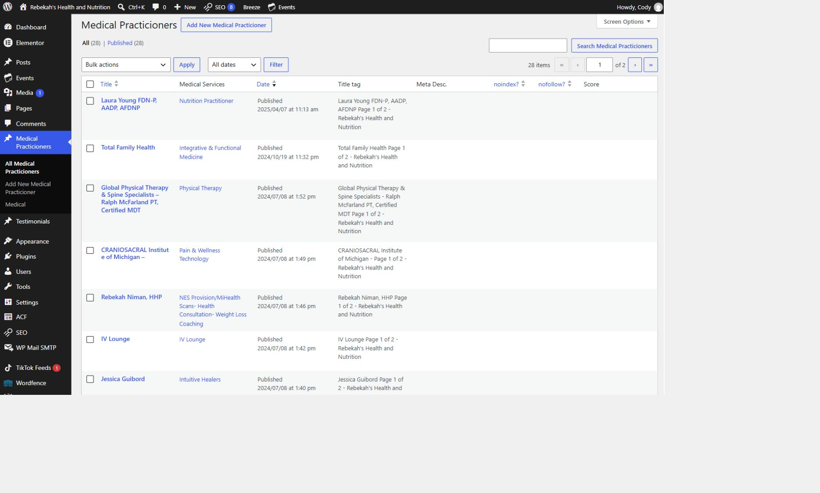
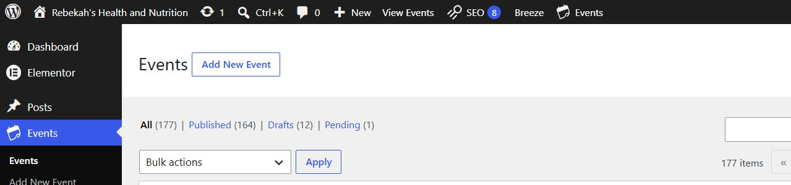
Save the correct item once before clearing cache
3
WHERE TO GO
Editor > Save, Update, or Publish
DO THIS
LOOK HERE
WRITTEN STEPS
1. Save first.
2. Wait for confirmation.
3. Keep the exact public URL.
1. Click Medical Practicioners.
2. Click All Medical Practicioners.
3. Search by name if needed.
1. Finish and review the approved change.
2. Select Save, Update, or Publish one time and wait for confirmation.
3. Copy the exact public URL that visitors use.
Follow the steps in order. Stop when the screen does not match.
Cache safety v1.1 | 4/13
Notes:
[Sources]
- Rebekah project training standard and client records in CLIENT-NOTES.md.
- Established WordPress user-role and cache workflow used by this project.
- No live WordPress login or website change was used to create this lesson.

Slide 5
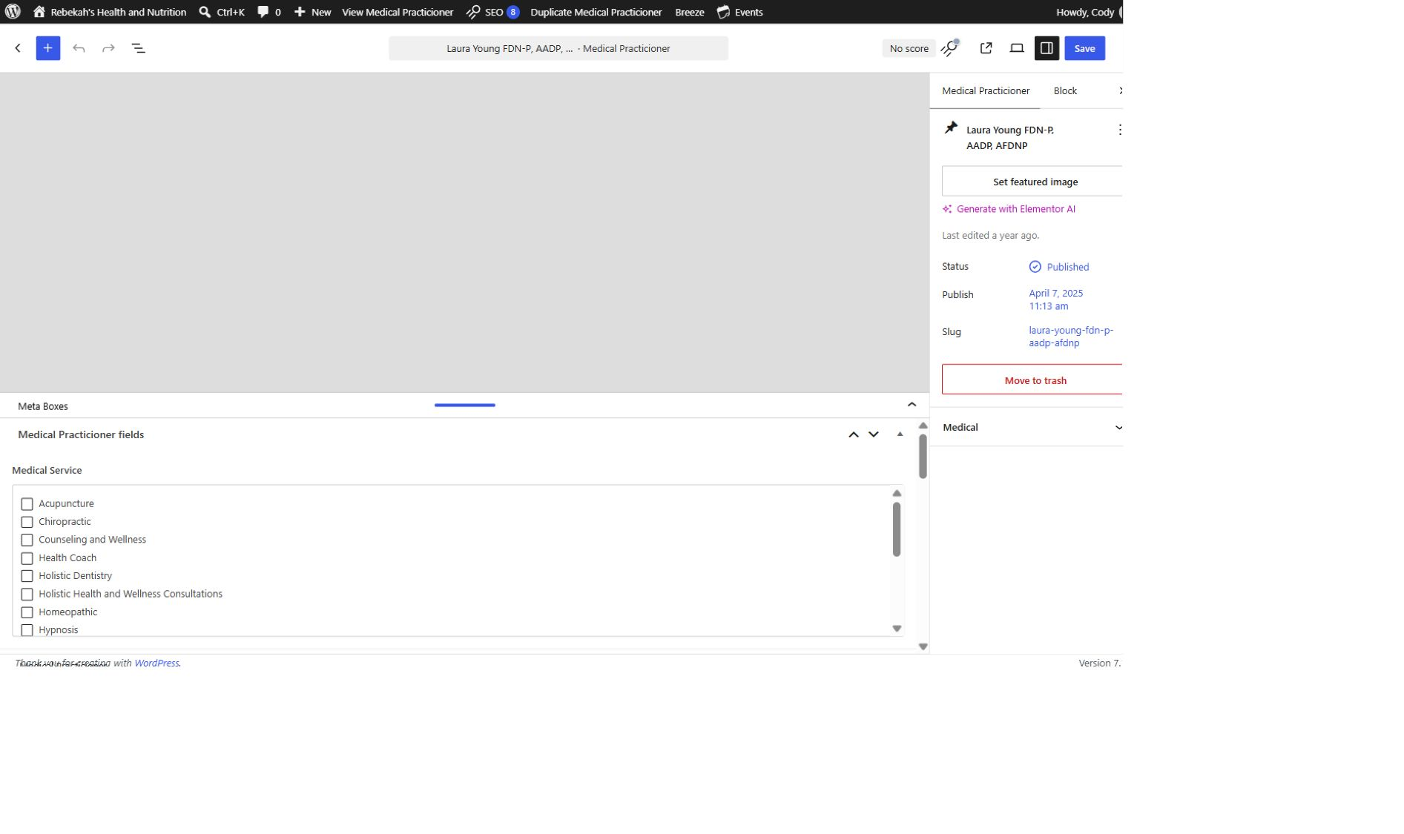
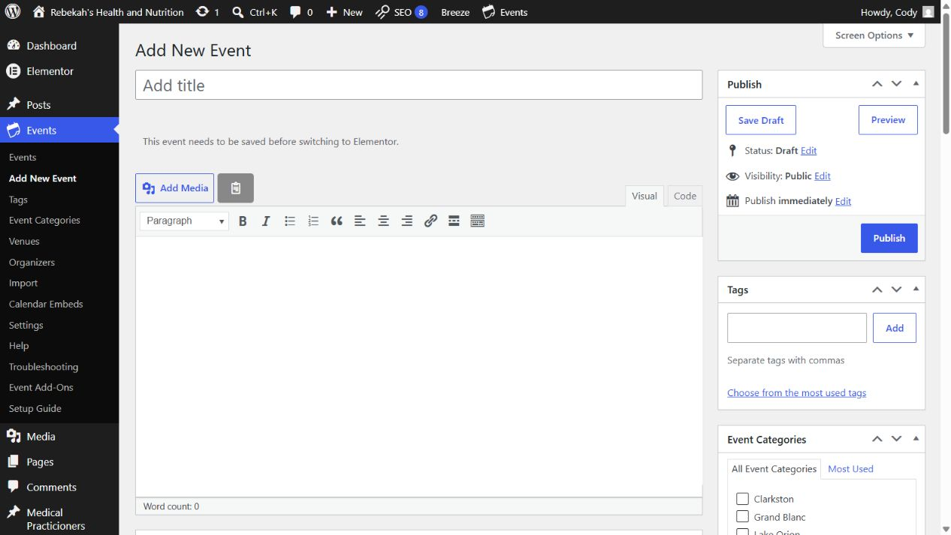
Start with the smallest applicable cache
4
WHERE TO GO
DO THIS
Content list > changed row > Clear Cache
WRITTEN STEPS
1. Find Medical Service.
2. Check the approved category.
3. Uncheck incorrect categories.
1. Match the exact item.
2. Use its Clear Cache action.
3. Do not purge unrelated content.
LOOK HERE
1. Return to the list that contains the item you changed.
2. Find the exact row and use its Clear Cache action when available.
3. Do not clear unrelated pages, products, events, or practitioner records.
Follow the steps in order. Stop when the screen does not match.
Cache safety v1.1 | 5/13
Notes:
[Sources]
- Rebekah project training standard and client records in CLIENT-NOTES.md.
- Established WordPress user-role and cache workflow used by this project.
- No live WordPress login or website change was used to create this lesson.

Slide 6
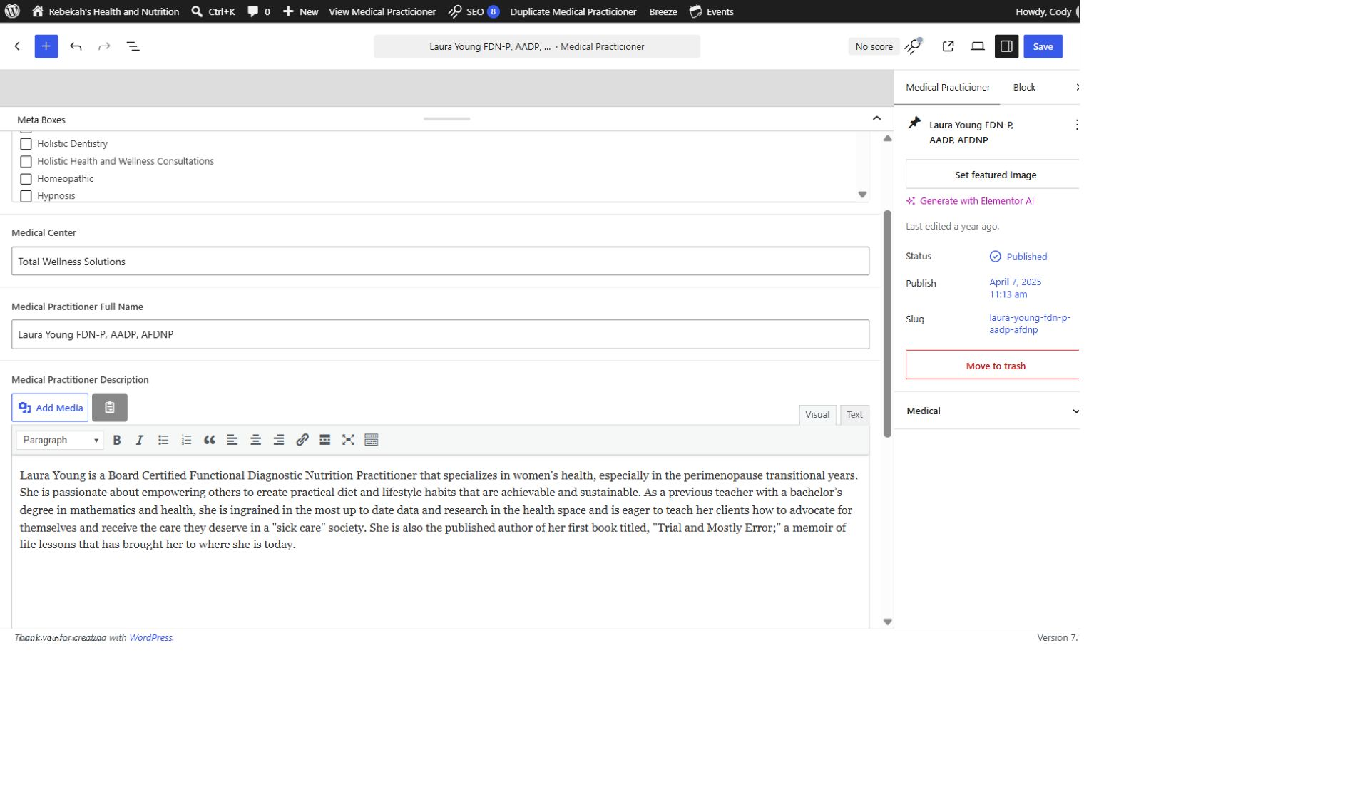
Refresh the browser without changing the URL
5
WHERE TO GO
DO THIS
Exact public URL > hard refresh
WRITTEN STEPS
1. Select Visual.
2. Replace the approved description.
3. Keep the paragraph breaks.
1. Use the canonical URL.
2. Perform one hard refresh.
3. Read the visible result.
1. Open the exact public URL with no extra question mark or test text.
2. On Windows press Control plus F5. On a Mac press Command, Shift, and R.
3. Confirm the visible page now shows the saved information.
LOOK HERE
Follow the steps in order. Stop when the screen does not match.
Cache safety v1.1 | 6/13
Notes:
[Sources]
- Rebekah project training standard and client records in CLIENT-NOTES.md.
- Established WordPress user-role and cache workflow used by this project.
- No live WordPress login or website change was used to create this lesson.

Slide 7
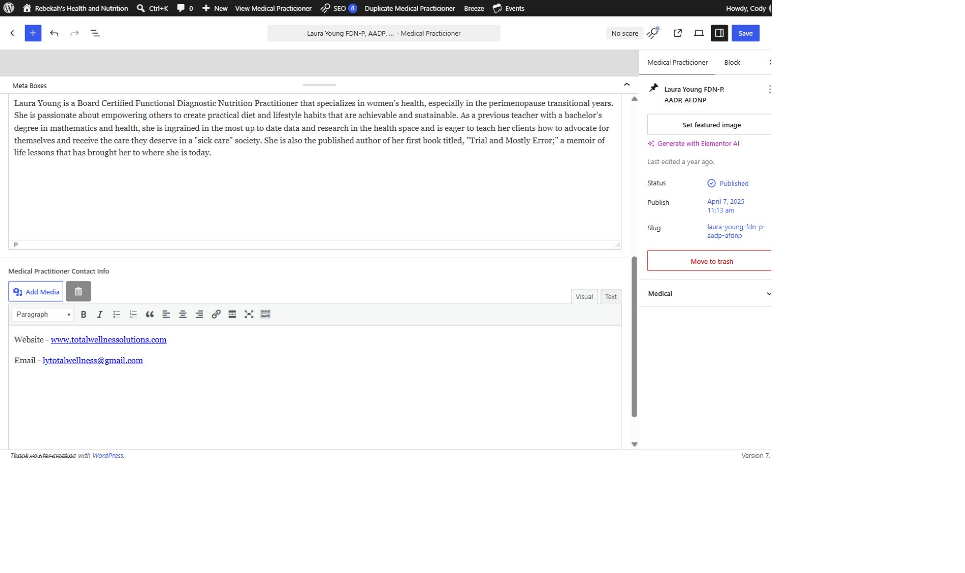
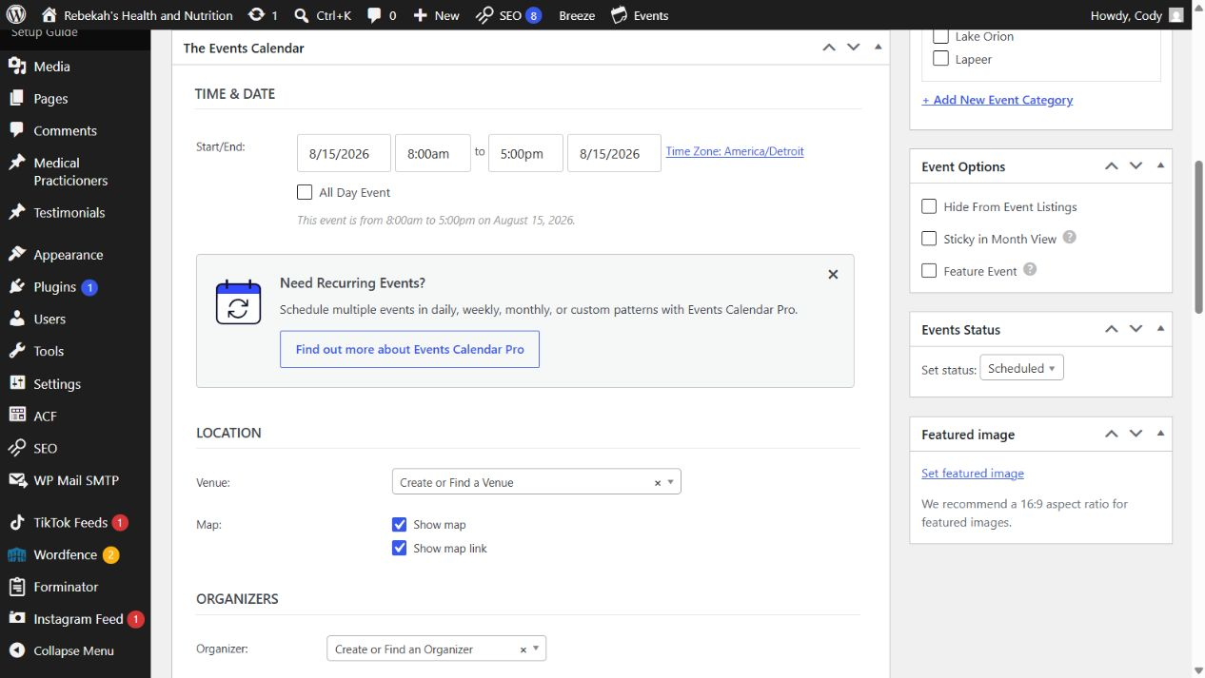
Check in a private window when the browser stays stale
6
WHERE TO GO
DO THIS
Private or Incognito window > exact public URL
WRITTEN STEPS
1. Add only approved public details.
2. Test every link.
3. Remove outdated contact information.
1. Open a private window.
2. Use the same URL.
3. Do not add cache-busting text.
LOOK HERE
1. Open a private or Incognito window.
2. Paste the same exact public URL.
3. A correct private-window result means the remaining problem was the regular browser cache.
Follow the steps in order. Stop when the screen does not match.
Cache safety v1.1 | 7/13
Notes:
[Sources]
- Rebekah project training standard and client records in CLIENT-NOTES.md.
- Established WordPress user-role and cache workflow used by this project.
- No live WordPress login or website change was used to create this lesson.

Slide 8
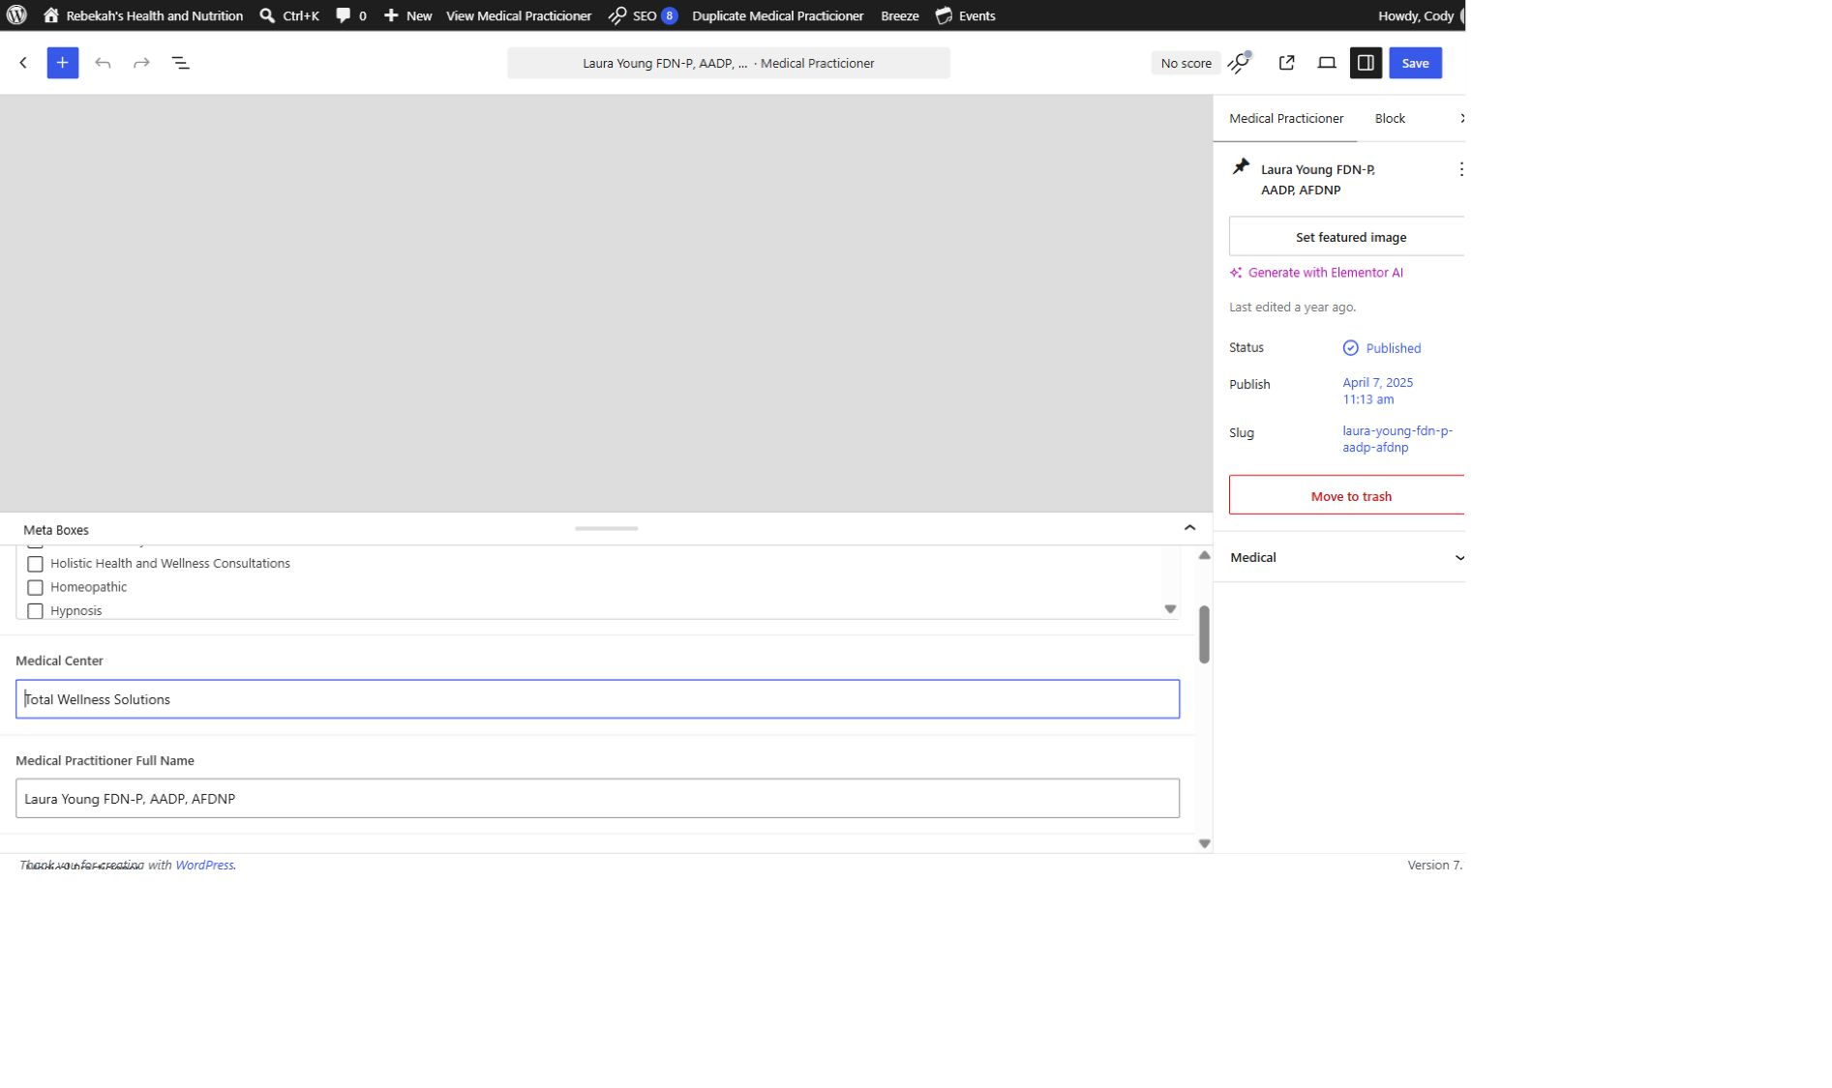
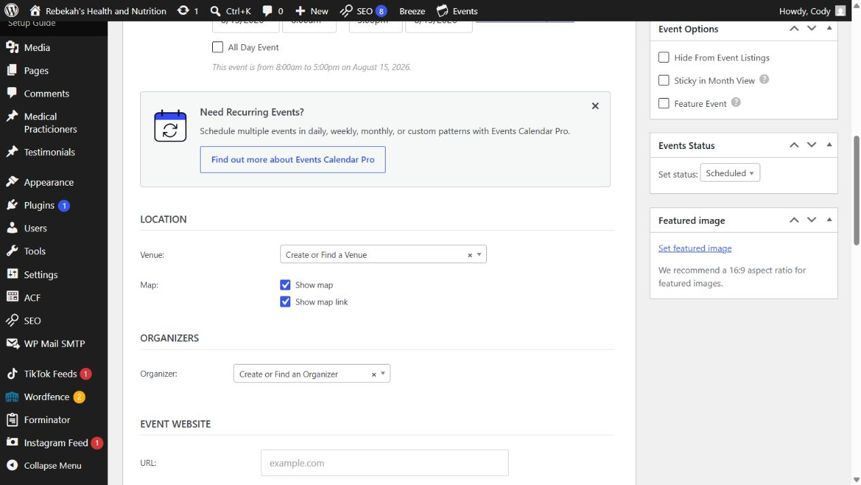
Use Breeze only when a broader purge is approved
7
WHERE TO GO
DO THIS
WordPress admin bar > Breeze > Purge All Cache
WRITTEN STEPS
1. Re-read every changed field.
2. Compare with the approved information.
3. Fix errors before saving.
1. Purge only when warranted.
2. Click once and wait.
3. Do not change settings.
1. Use this only when an approved saved change affects a shared page or several pages.
2. Select the approved Breeze purge one time and wait.
3. Do not change Breeze settings, preload options, minification, or optimization controls.
LOOK HERE
Follow the steps in order. Stop when the screen does not match.
Cache safety v1.1 | 8/13
Notes:
[Sources]
- Rebekah project training standard and client records in CLIENT-NOTES.md.
- Established WordPress user-role and cache workflow used by this project.
- No live WordPress login or website change was used to create this lesson.

Slide 9
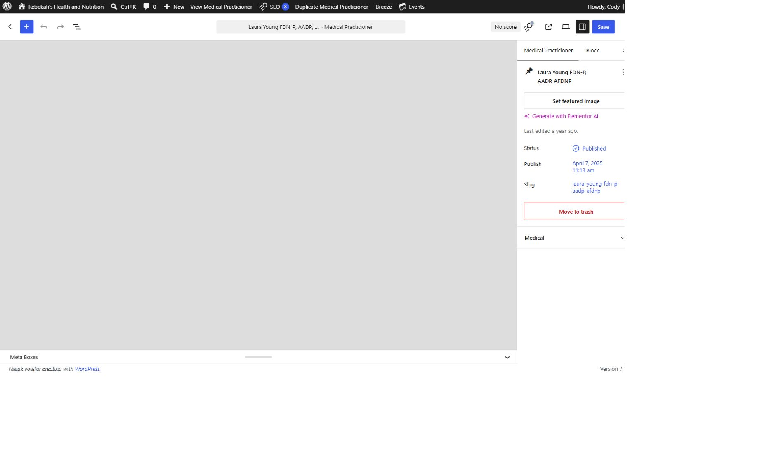
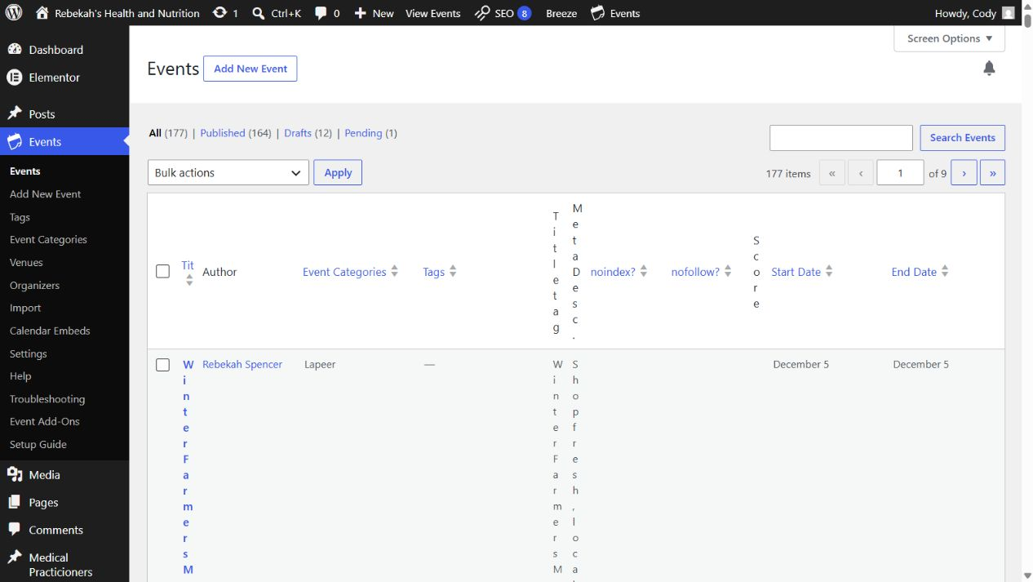
Leave Cloudways and Varnish controls to authorized users
8
LOOK HERE
WHERE TO GO
DO THIS
Approved Varnish purge control or Blue Nova
WRITTEN STEPS
1. Click Save once.
2. Wait for confirmation.
3. Do not click repeatedly.
1. Use only an approved purge.
2. Never change server settings.
3. Ask Blue Nova if the control is missing.
1. A Varnish purge may be needed when the correct content remains stale after the page and Breeze cache are cleared.
2. Use only the approved purge control if you were specifically authorized.
3. Do not open server settings, restart services, or disable Varnish.
Follow the steps in order. Stop when the screen does not match.
Cache safety v1.1 | 9/13
Notes:
[Sources]
- Rebekah project training standard and client records in CLIENT-NOTES.md.
- Established WordPress user-role and cache workflow used by this project.
- No live WordPress login or website change was used to create this lesson.

Slide 10
Never solve cache trouble with random settings
9
WHERE TO GO
LOOK HERE
1. Return to the practitioner list.
2. Hover over the same row.
STOP: unrelated cache and optimization controls
DO THIS
3. Click Clear Cache.
1. Do not repeat saves.
2. Do not purge everything.
3. Do not change plugins or servers.
1. Do not repeatedly click Update or Publish.
2. Do not clear object cache, Redis, CDN, database, image, or plugin caches unless Blue Nova directs you.
3. Do not install, disable, or configure optimization plugins.
Follow the steps in order. Stop when the screen does not match.
Cache safety v1.1 | 10/13
Notes:
[Sources]
- Rebekah project training standard and client records in CLIENT-NOTES.md.
- Established WordPress user-role and cache workflow used by this project.
- No live WordPress login or website change was used to create this lesson.

Slide 11
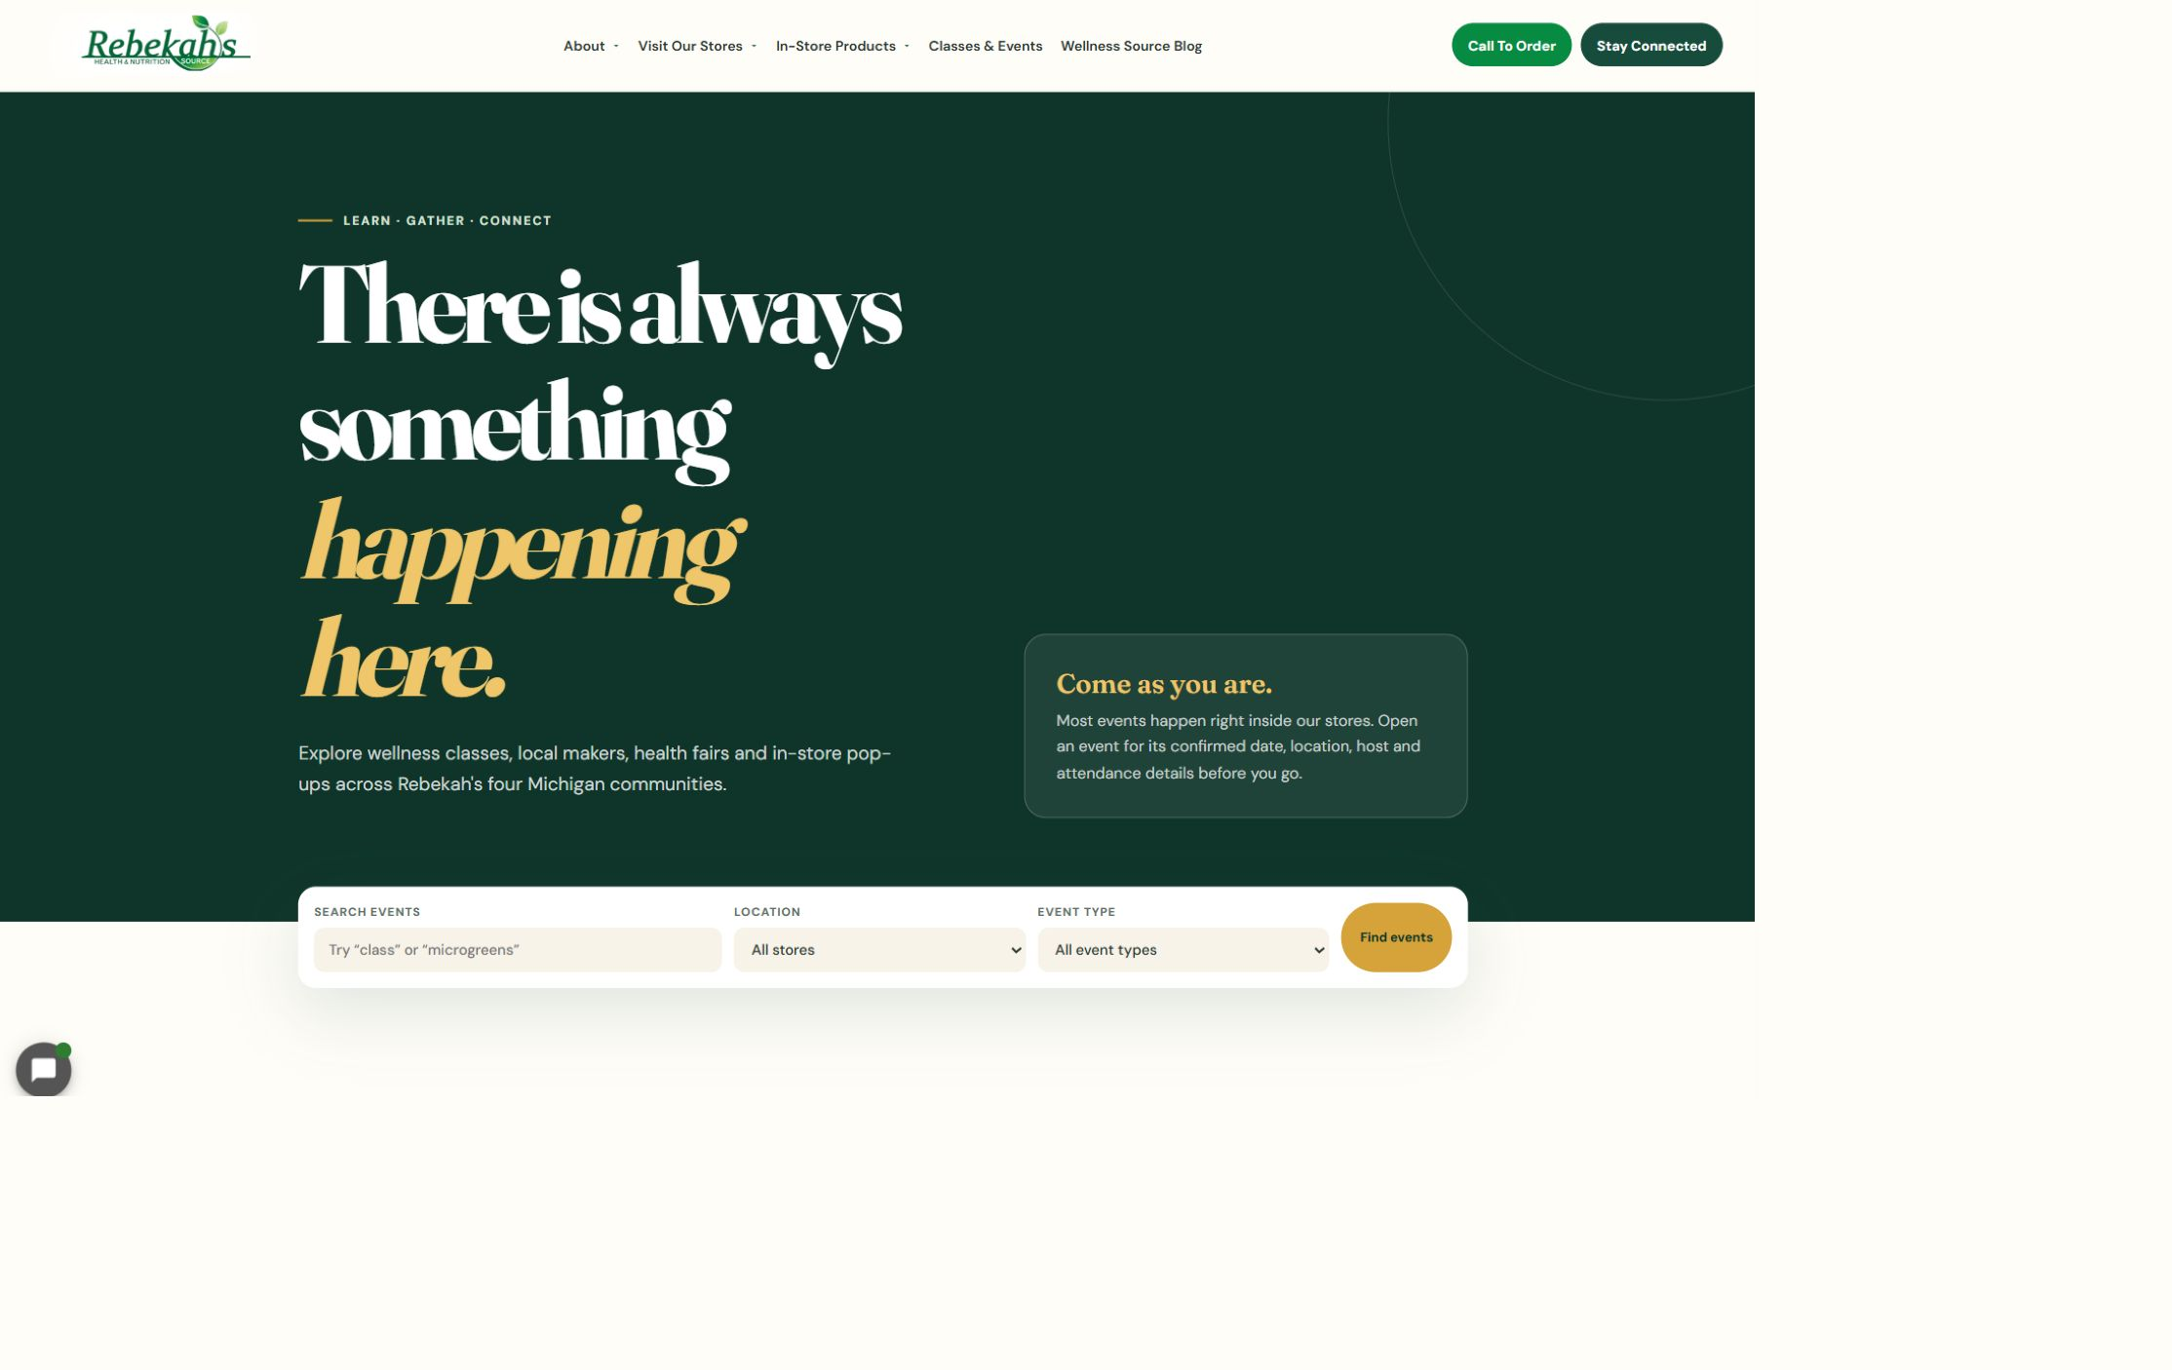
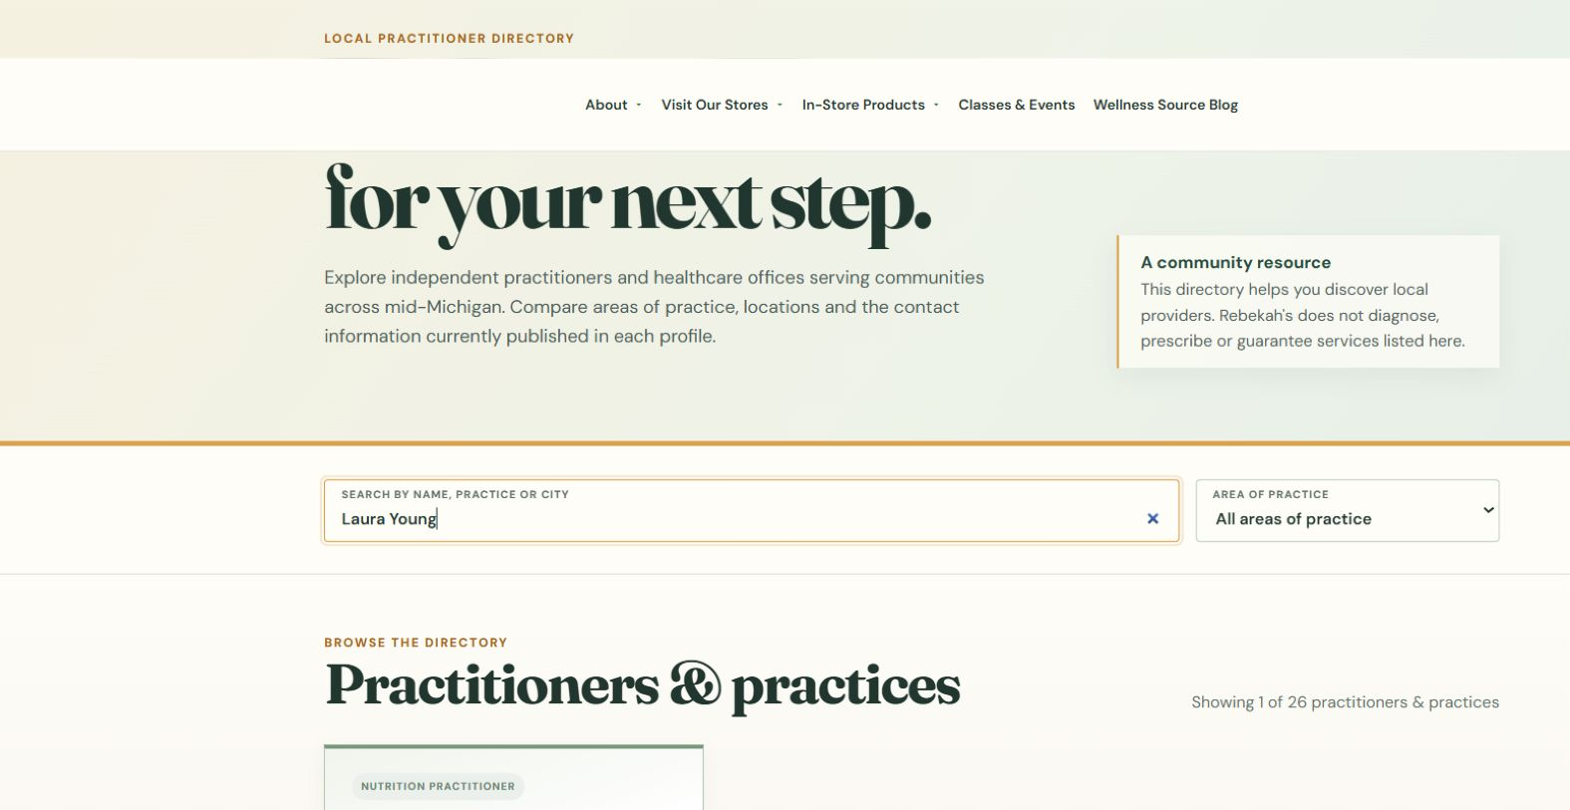
Verify the visible public result on desktop
10
WHERE TO GO
Exact public URL > desktop check
DO THIS
LOOK HERE
1. Check the visible change.
2. Test affected links.
3. Confirm the layout remains correct.
1. Read the exact changed text, image, date, link, or listing.
2. Click every public link affected by the change.
3. Confirm the page fits the screen and does not run off the side.
Follow the steps in order. Stop when the screen does not match.
WRITTEN CHECK
1. Search the name.
2. Confirm the public details.
3. Check the links.
Cache safety v1.1 | 11/13
Notes:
[Sources]
- Rebekah project training standard and client records in CLIENT-NOTES.md.
- Established WordPress user-role and cache workflow used by this project.
- No live WordPress login or website change was used to create this lesson.

Slide 12
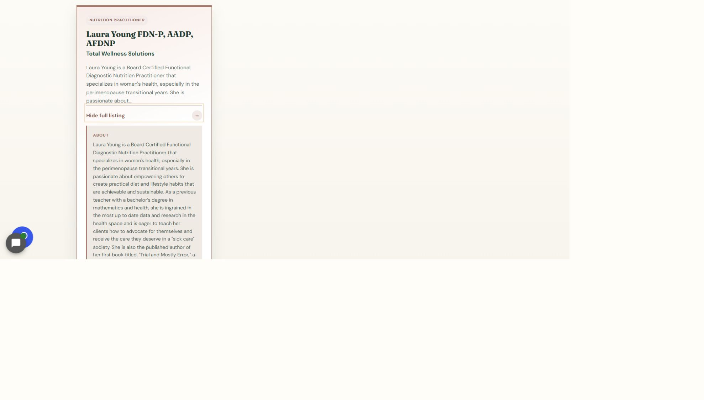
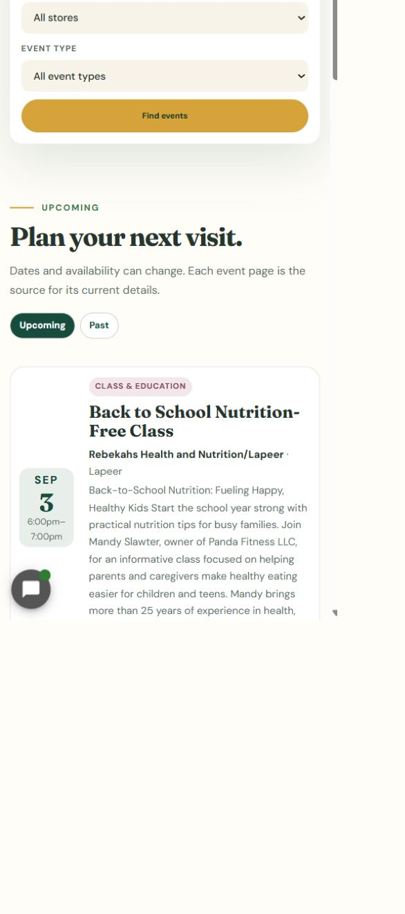
Repeat the check on a phone and know when to stop
11
LOOK HERE
WHERE TO GO
Exact public URL > phone-size check
DO THIS
WRITTEN STEPS
1. Click View full listing.
2. Check the full details and links.
3. Repeat the check on a phone.
1. Repeat at phone size.
2. Test buttons and links.
3. Escalate if still stale.
1. Check the same visible result at phone size.
2. Confirm text, images, buttons, and links remain readable and usable.
3. If the saved result is still missing, stop and contact Blue Nova instead of purging again.
Follow the steps in order. Stop when the screen does not match.
Cache safety v1.1 | 12/13
Notes:
[Sources]
- Rebekah project training standard and client records in CLIENT-NOTES.md.
- Established WordPress user-role and cache workflow used by this project.
- No live WordPress login or website change was used to create this lesson.

Slide 13
Always finish with the same three checks
DONE
SAVE > CLEAR APPLICABLE CACHE > VERIFY LIVE
Open the exact public URL with no extra address text, then check desktop and phone.
If the visible result is still wrong or missing, stop and contact Blue Nova.
Cache safety v1.1 | 13/13
Notes:
[Sources]
- Rebekah project training standard and client records in CLIENT-NOTES.md.
- Established WordPress user-role and cache workflow used by this project.
- No live WordPress login or website change was used to create this lesson.

