Slide 1

Create or update a blog post safely
START
Build an approved post as a draft, complete its category, image, links, and SEO, then preview and verify it publicly.
Beginner lesson | Editor is sufficient | No test post created
Blog editing v1.1 | 1/13
Notes:
[Sources]
- Rebekah project training standard and client records in CLIENT-NOTES.md.
- Existing first-party WordPress captures and approved workflow records.
- No test blog post, live content change, cache purge, media upload, or setting change was used to create this lesson.

Slide 2
Required WordPress access
1
WORDPRESS ROLE REQUIRED
Editor or Administrator
Editor access is enough for blog posts.
Do not use Administrator for routine writing. If Posts is missing, stop and ask the website administrator.
Blog editing v1.1 | 2/13
Notes:
[Sources]
- Rebekah project training standard and client records in CLIENT-NOTES.md.
- Existing first-party WordPress captures and approved workflow records.
- No test blog post, live content change, cache purge, media upload, or setting change was used to create this lesson.

Slide 3
Prepare the approved article materials first
2
BEFORE OPENING POSTS
final copy | approved category | featured image | links
Do not invent health claims, prices, dates, author details, or image rights.
Blog editing v1.1 | 3/13
Notes:
[Sources]
- Rebekah project training standard and client records in CLIENT-NOTES.md.
- Existing first-party WordPress captures and approved workflow records.
- No test blog post, live content change, cache purge, media upload, or setting change was used to create this lesson.

Slide 4
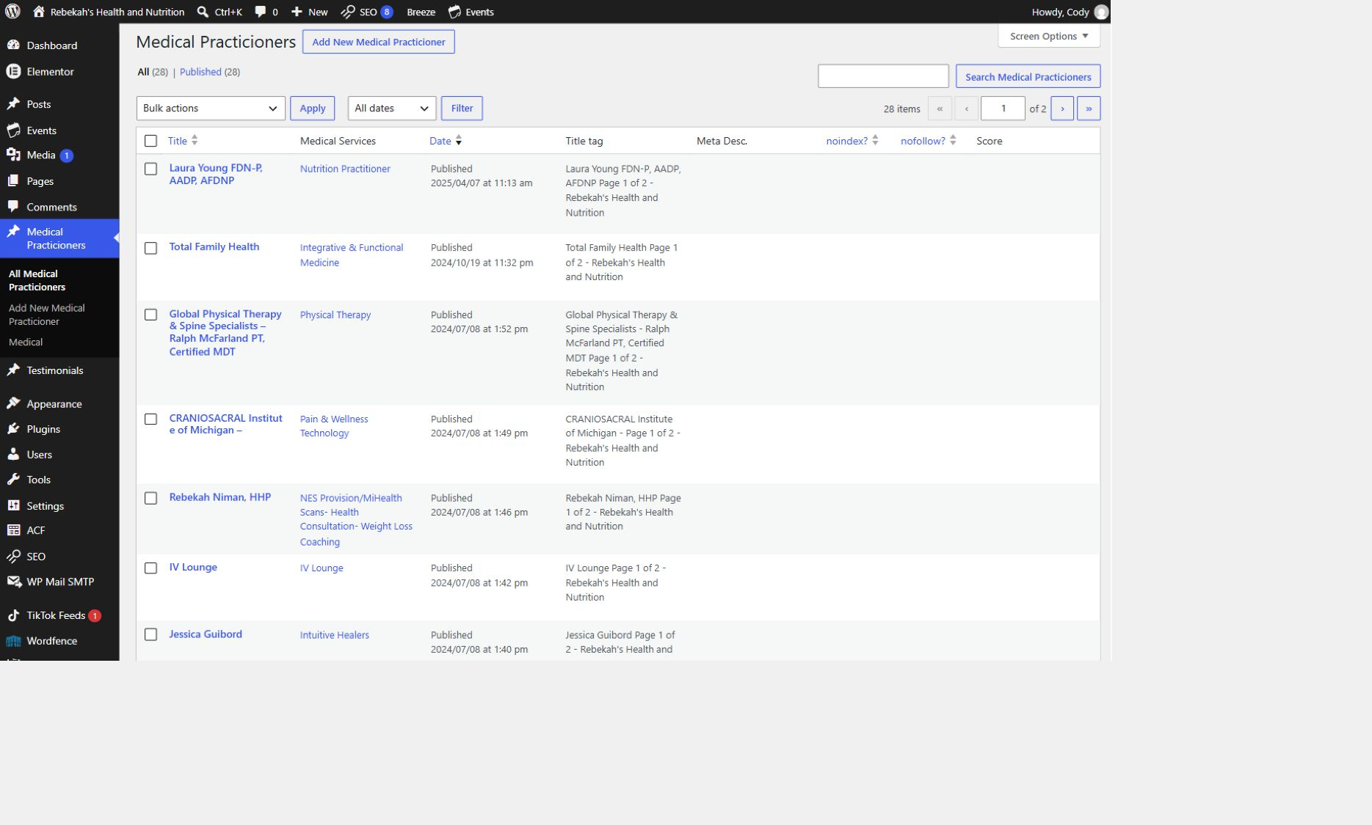
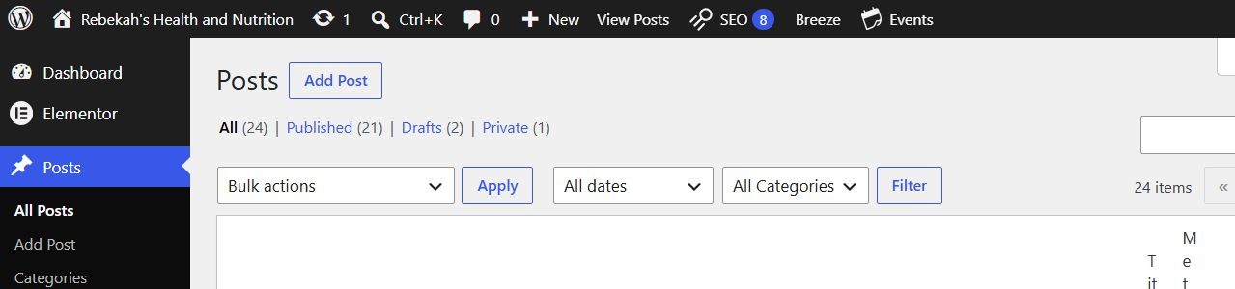
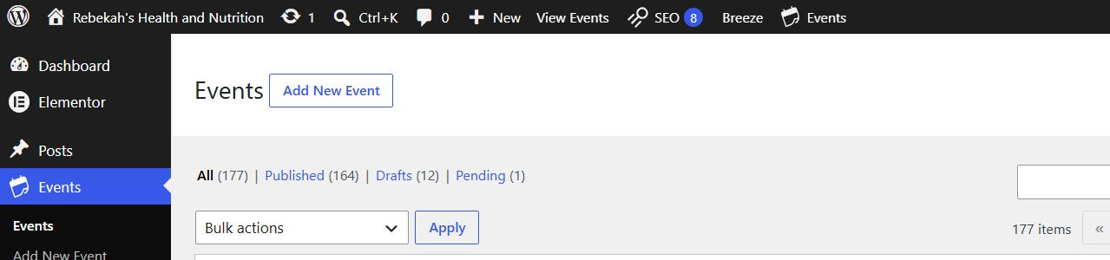
Open Posts and choose the correct action
3
DO THIS
LOOK HERE
WRITTEN STEPS
1. Choose new or existing.
2. Match the exact title.
3. Keep new work in Draft.
1. Click Medical Practicioners.
2. Click All Medical Practicioners.
3. Search by name if needed.
Posts > Add New Post or Posts > All Posts > Edit
1. Use Add New Post only for an approved new article.
2. For an update, match the exact title and author before selecting Edit.
3. Never overwrite another article because its title looks similar.
Blog editing v1.1 | 4/13
Notes:
[Sources]
- Rebekah project training standard and client records in CLIENT-NOTES.md.
- Existing first-party WordPress captures and approved workflow records.
- No test blog post, live content change, cache purge, media upload, or setting change was used to create this lesson.

Slide 5
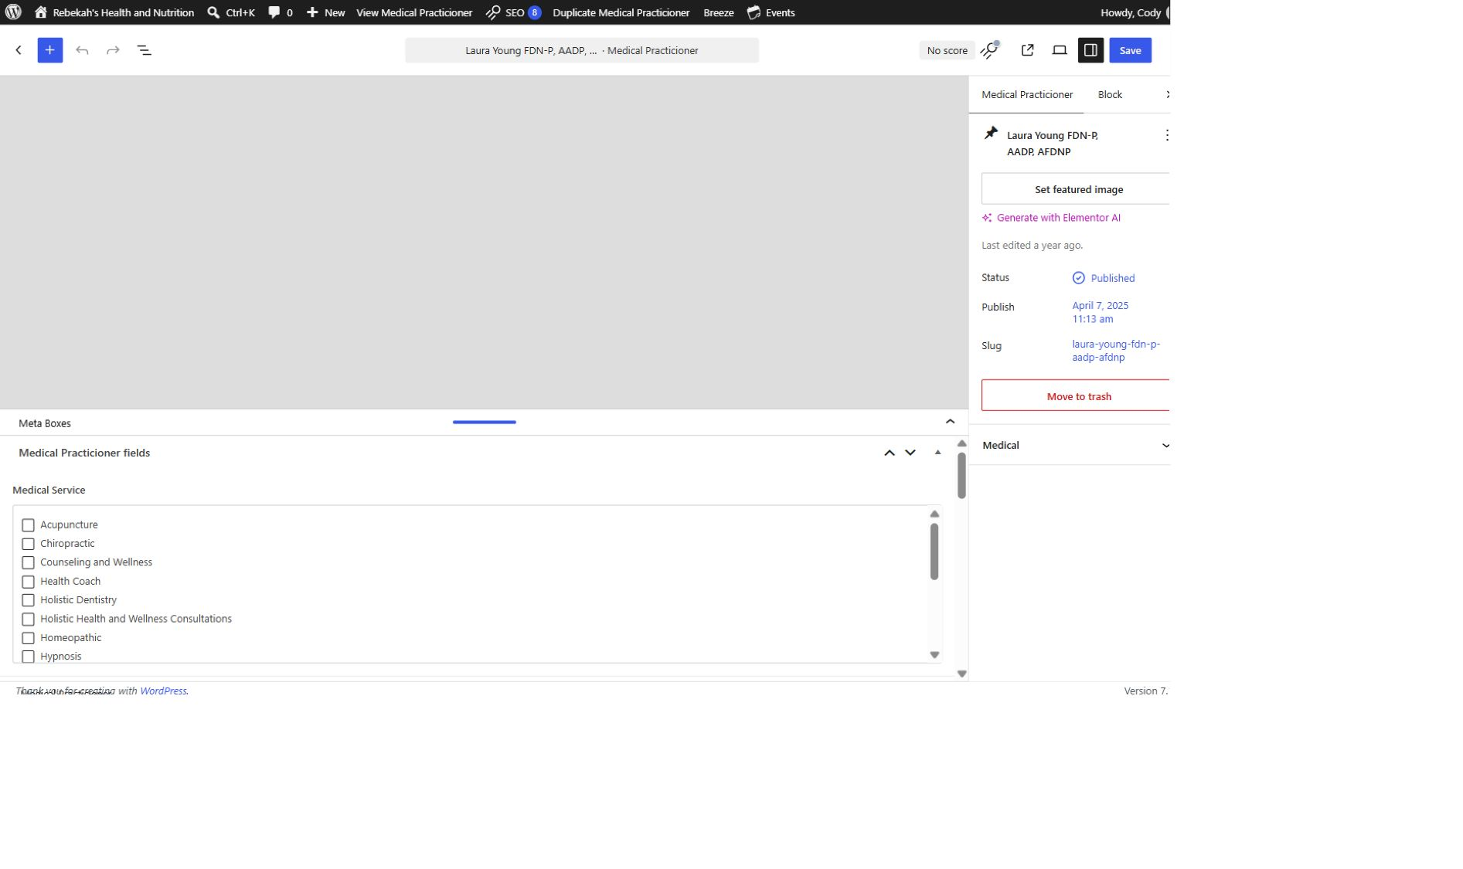
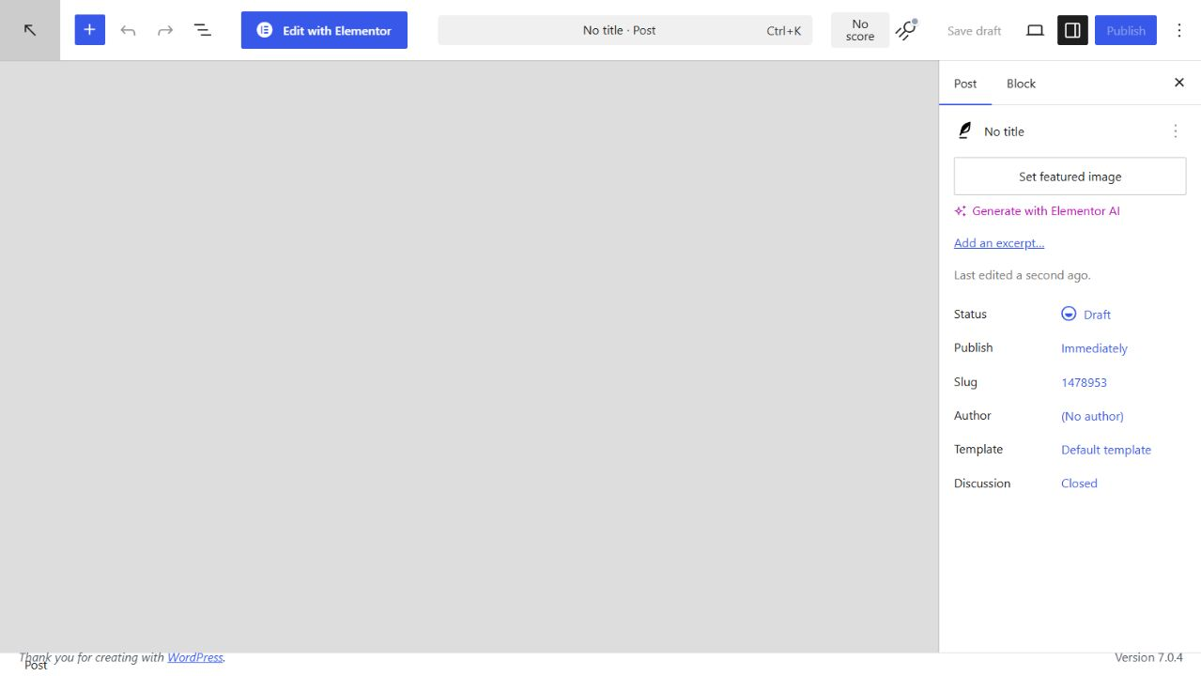
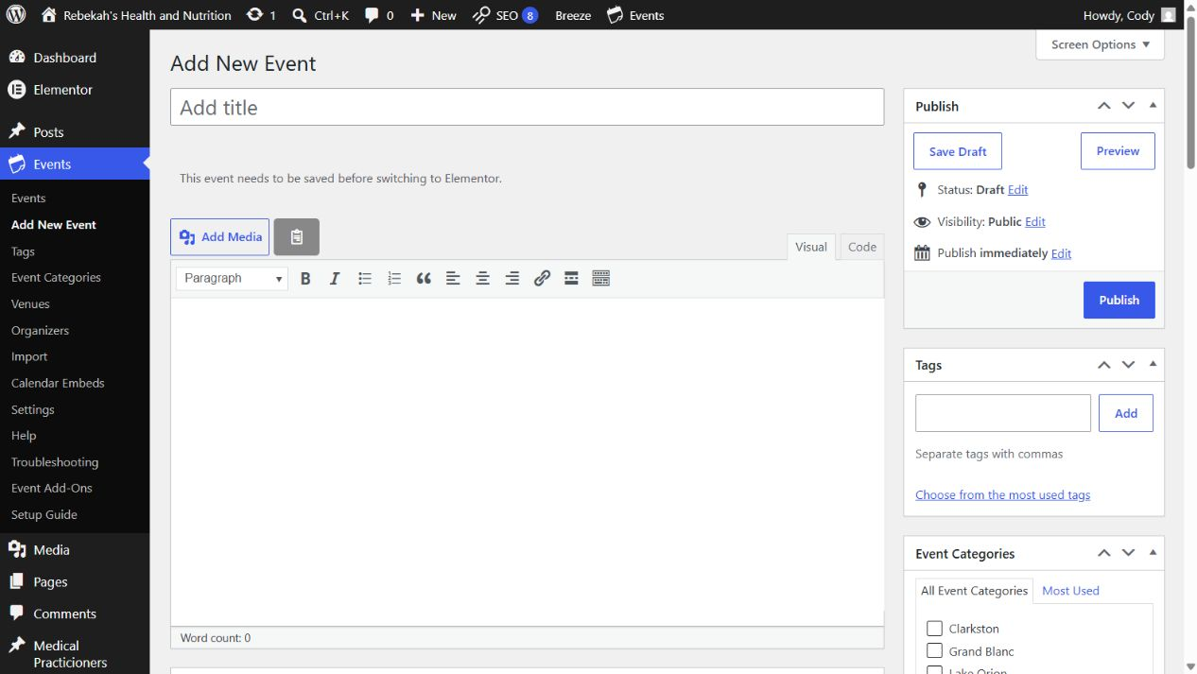
Enter the title and article in the main editor
4
DO THIS
WRITTEN STEPS
1. Find Medical Service.
2. Check the approved category.
3. Uncheck incorrect categories.
1. Use the approved title.
2. Format for easy reading.
3. Save Draft while working.
LOOK HERE
Post editor > title and Visual content area
1. Paste the approved title exactly.
2. Add the article in the main Visual editor using headings and short paragraphs.
3. Select Save Draft while working; do not publish incomplete copy.
Blog editing v1.1 | 5/13
Notes:
[Sources]
- Rebekah project training standard and client records in CLIENT-NOTES.md.
- Existing first-party WordPress captures and approved workflow records.
- No test blog post, live content change, cache purge, media upload, or setting change was used to create this lesson.

Slide 6
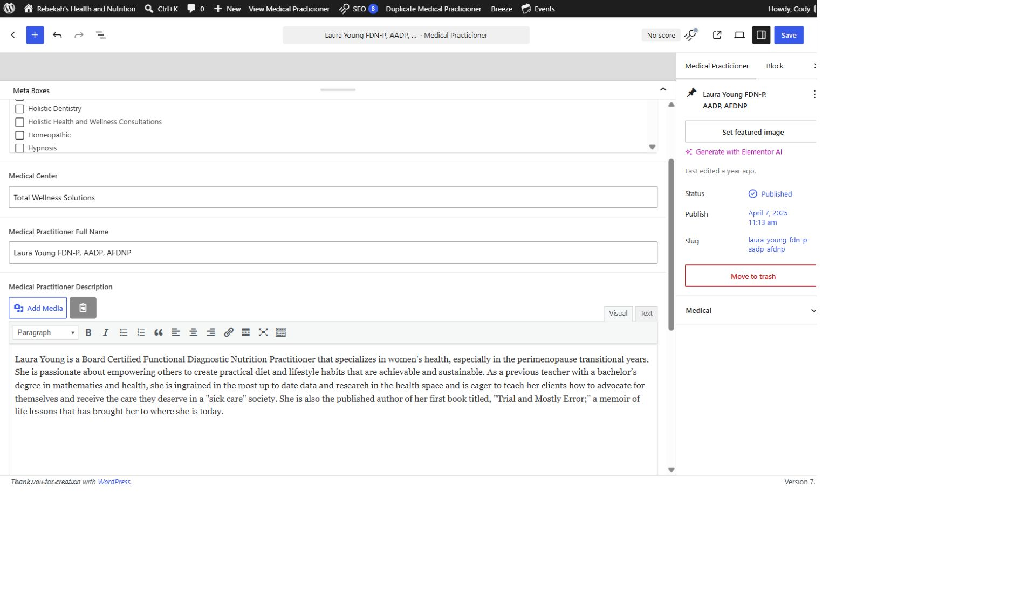
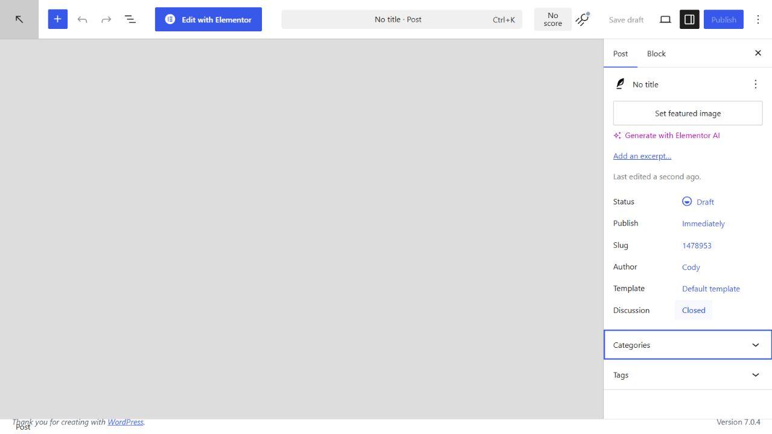
Choose the correct existing category
5
DO THIS
WRITTEN STEPS
1. Select Visual.
2. Replace the approved description.
3. Keep the paragraph breaks.
1. Choose an existing category.
2. Do not create categories.
3. Avoid unnecessary tags.
LOOK HERE
Post settings > Categories
1. Select the one approved category that best fits the article.
2. Do not create a new category or guess between categories.
3. Use tags only when the approved process specifically calls for them.
Blog editing v1.1 | 6/13
Notes:
[Sources]
- Rebekah project training standard and client records in CLIENT-NOTES.md.
- Existing first-party WordPress captures and approved workflow records.
- No test blog post, live content change, cache purge, media upload, or setting change was used to create this lesson.

Slide 7
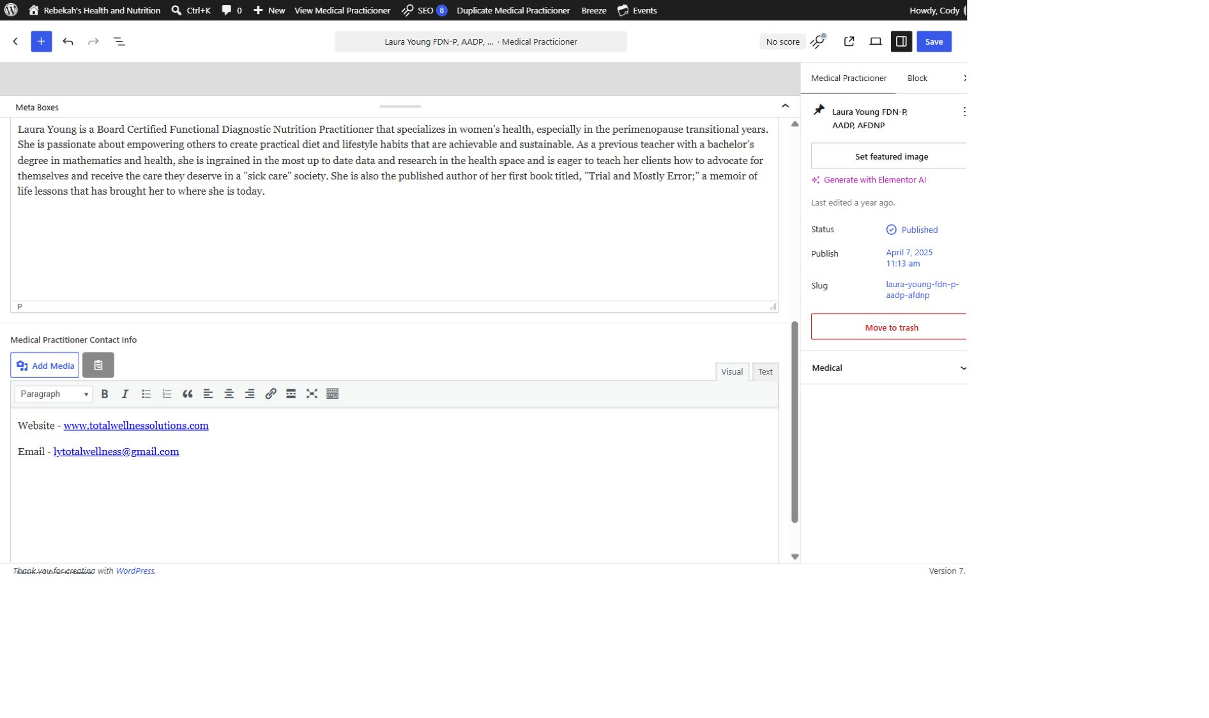
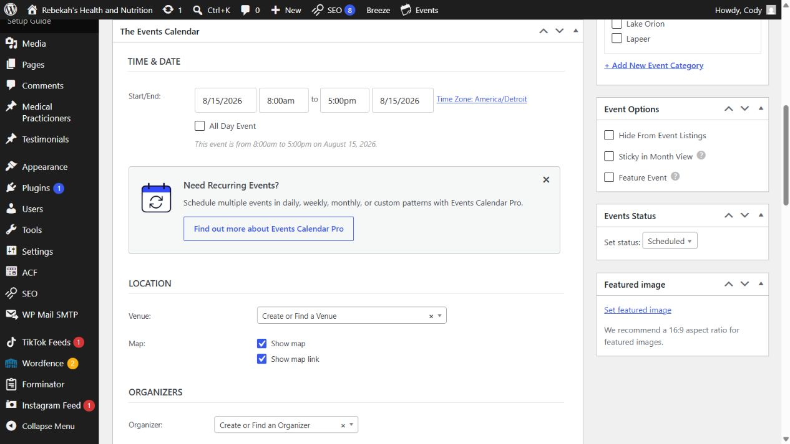
Add the featured image and accurate alt text
6
DO THIS
WRITTEN STEPS
1. Add only approved public details.
2. Test every link.
3. Remove outdated contact information.
1. Use the approved image.
2. Write useful alt text.
3. Check the crop.
LOOK HERE
Post settings > Featured image
1. Choose an approved landscape image that belongs to this article.
2. Use a clear filename and descriptive alt text for the image's purpose.
3. Do not use copyrighted, private, blurry, stretched, or unrelated imagery.
Blog editing v1.1 | 7/13
Notes:
[Sources]
- Rebekah project training standard and client records in CLIENT-NOTES.md.
- Existing first-party WordPress captures and approved workflow records.
- No test blog post, live content change, cache purge, media upload, or setting change was used to create this lesson.

Slide 8
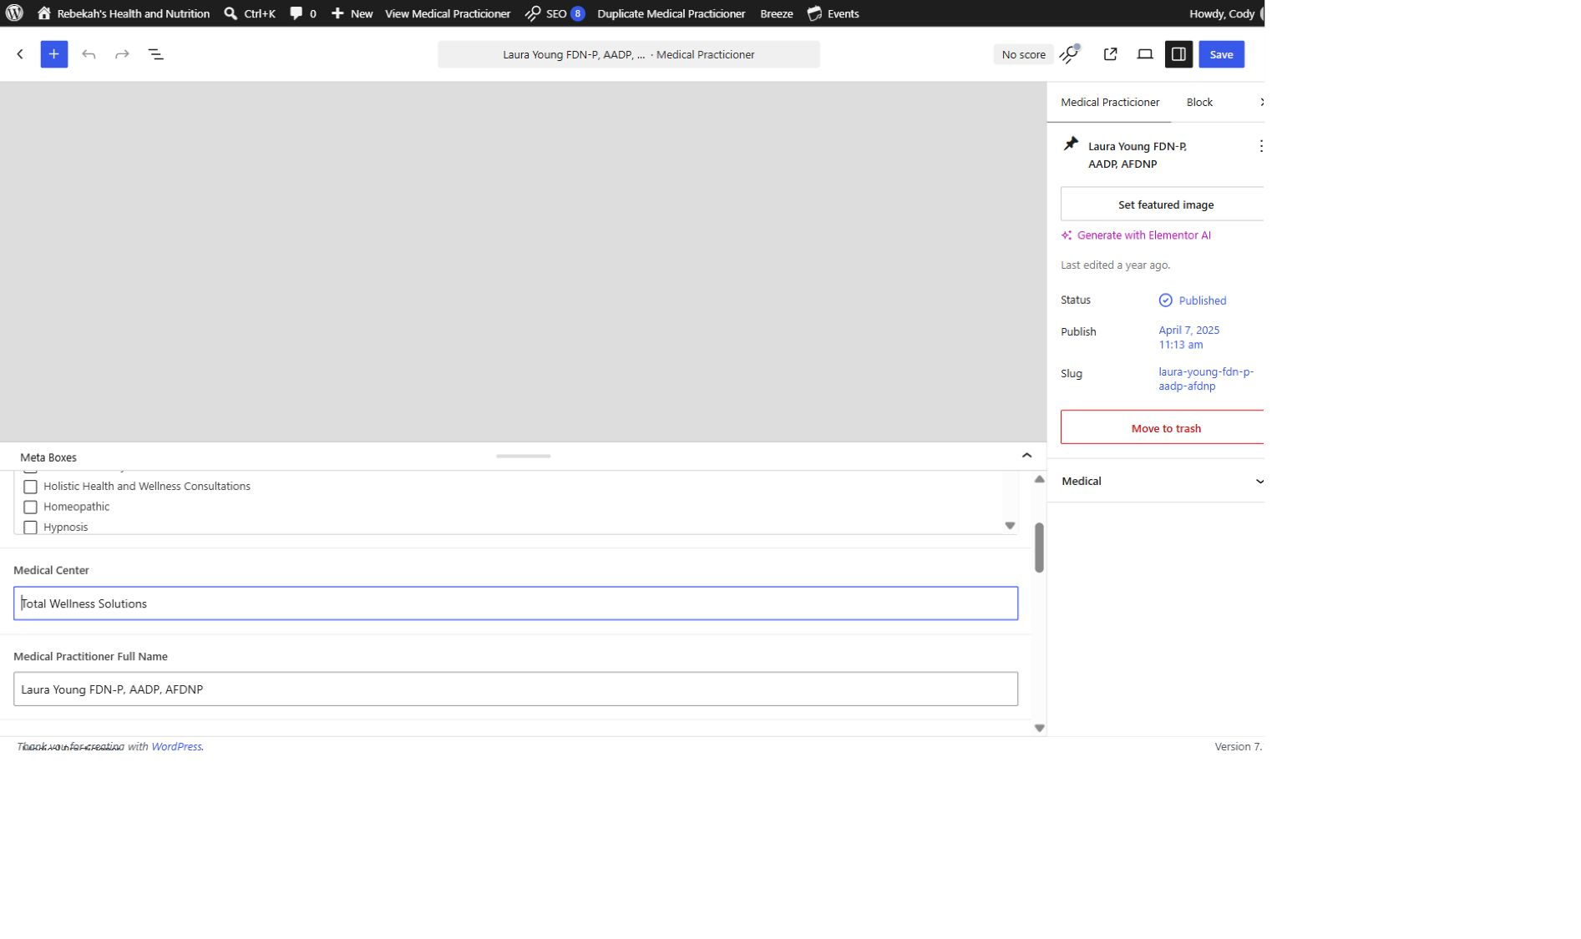
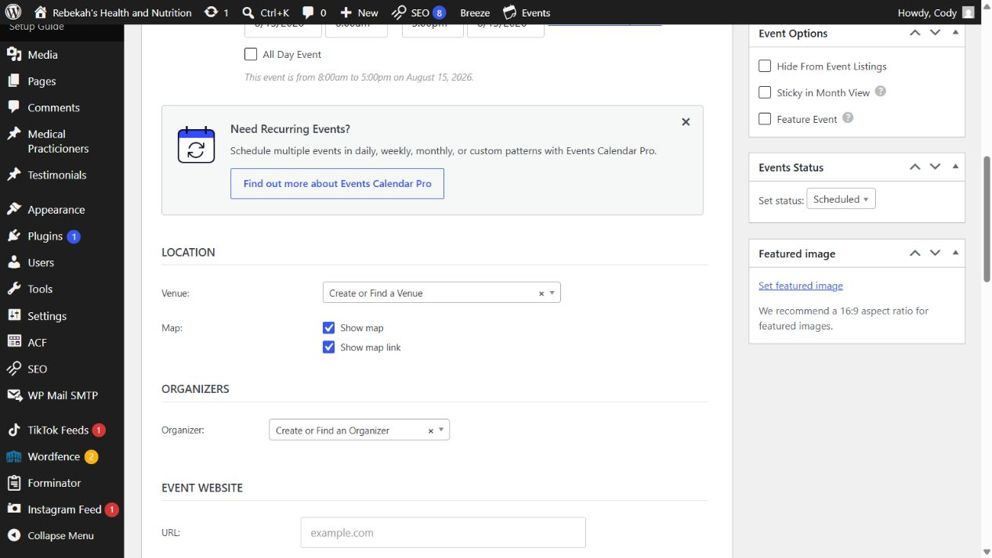
Add links without breaking the reading flow
7
DO THIS
WRITTEN STEPS
1. Re-read every changed field.
2. Compare with the approved information.
3. Fix errors before saving.
1. Select descriptive text.
2. Paste the correct URL.
3. Test every link.
LOOK HERE
Visual editor > select text > Link
1. Link descriptive words instead of pasting a long web address into the paragraph.
2. Use relevant internal links to Rebekah's pages or related articles.
3. Open an external link in a new tab only when appropriate, then test it.
Blog editing v1.1 | 8/13
Notes:
[Sources]
- Rebekah project training standard and client records in CLIENT-NOTES.md.
- Existing first-party WordPress captures and approved workflow records.
- No test blog post, live content change, cache purge, media upload, or setting change was used to create this lesson.

Slide 9
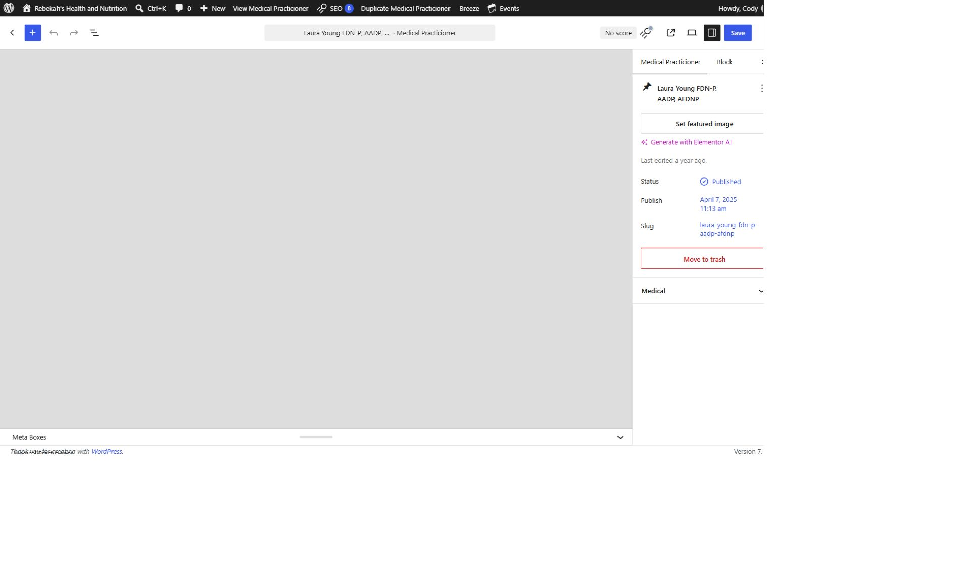
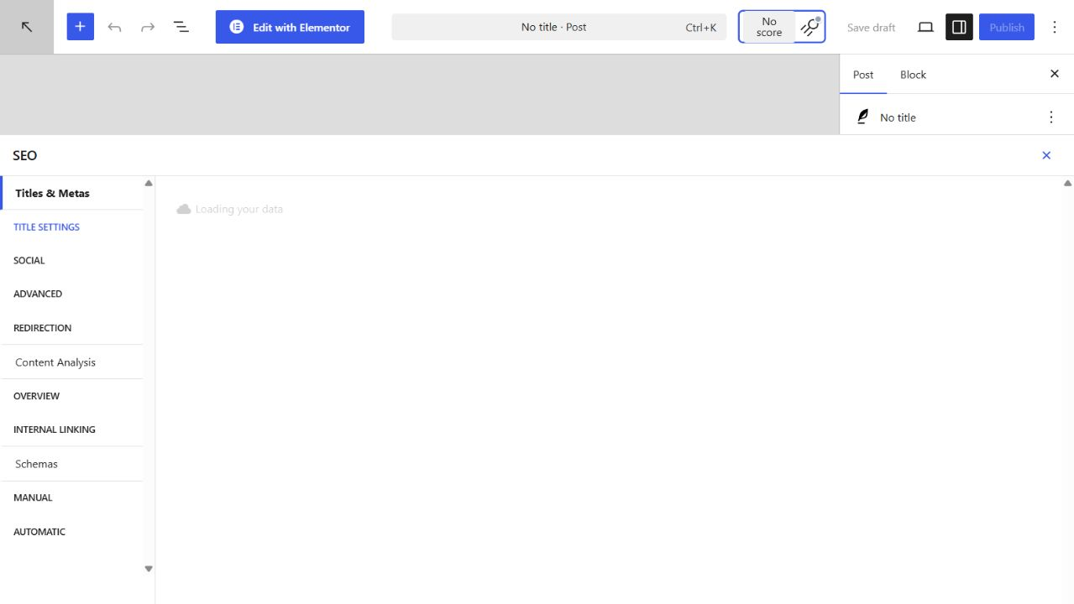
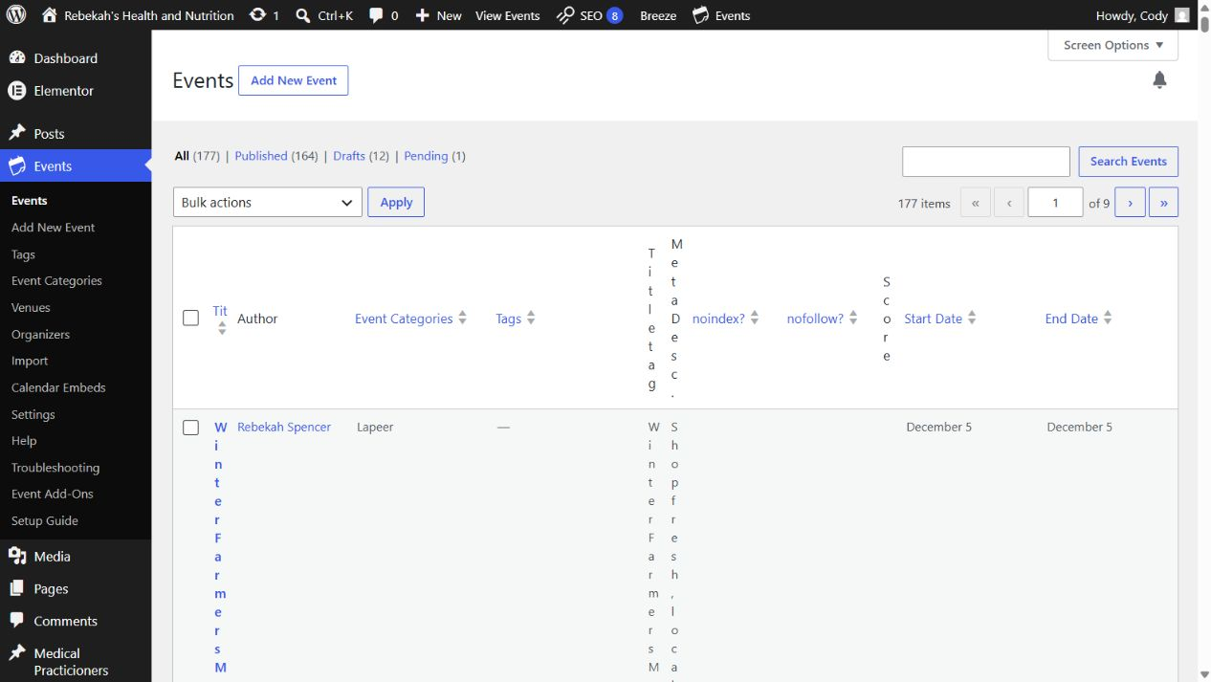
Complete the search title and description
8
LOOK HERE
DO THIS
WRITTEN STEPS
1. Click Save once.
2. Wait for confirmation.
3. Do not click repeatedly.
1. Use accurate wording.
2. Stay within the preview length.
3. Do not keyword-stuff.
SEOPress section > title and meta description
1. Use the approved search title and keep it natural.
2. Write a clear description that accurately summarizes the article.
3. Do not stuff locations, services, or repeated keywords into either field.
Blog editing v1.1 | 9/13
Notes:
[Sources]
- Rebekah project training standard and client records in CLIENT-NOTES.md.
- Existing first-party WordPress captures and approved workflow records.
- No test blog post, live content change, cache purge, media upload, or setting change was used to create this lesson.

Slide 10
Preview the full article before publishing
9
LOOK HERE
1. Return to the practitioner list.
2. Hover over the same row.
DO THIS
3. Click Clear Cache.
1. Preview before publishing.
2. Check desktop and phone.
3. Fix problems in Draft.
Post settings > Preview
1. Check the title, headings, spacing, image, category, links, and author.
2. Preview at desktop and phone size.
3. Return to the editor and correct anything uncertain while the post remains a draft.
Blog editing v1.1 | 10/13
Notes:
[Sources]
- Rebekah project training standard and client records in CLIENT-NOTES.md.
- Existing first-party WordPress captures and approved workflow records.
- No test blog post, live content change, cache purge, media upload, or setting change was used to create this lesson.

Slide 11
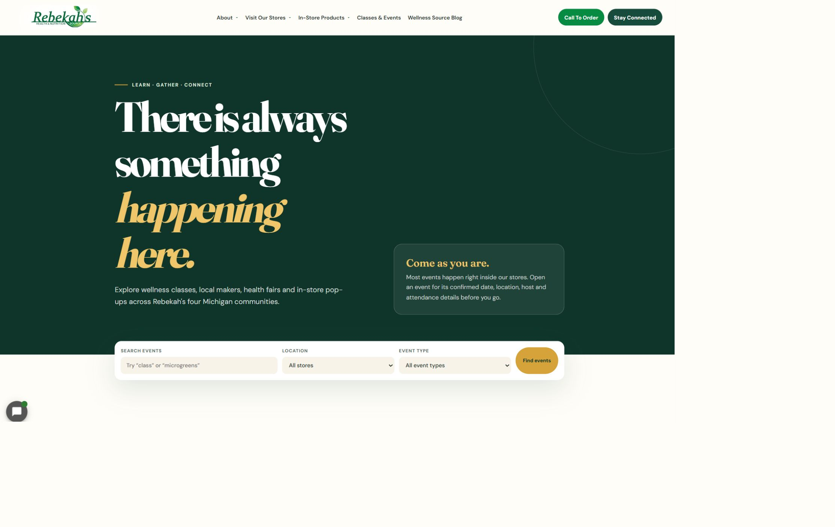
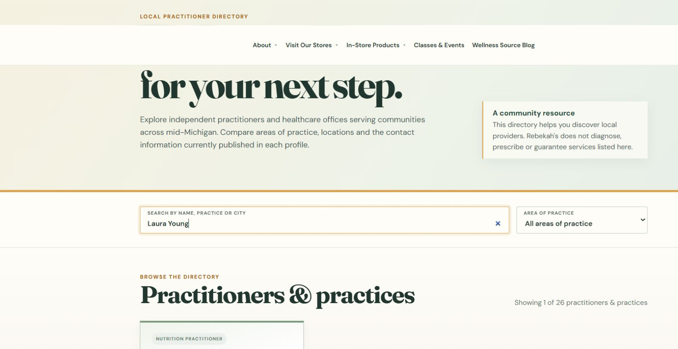
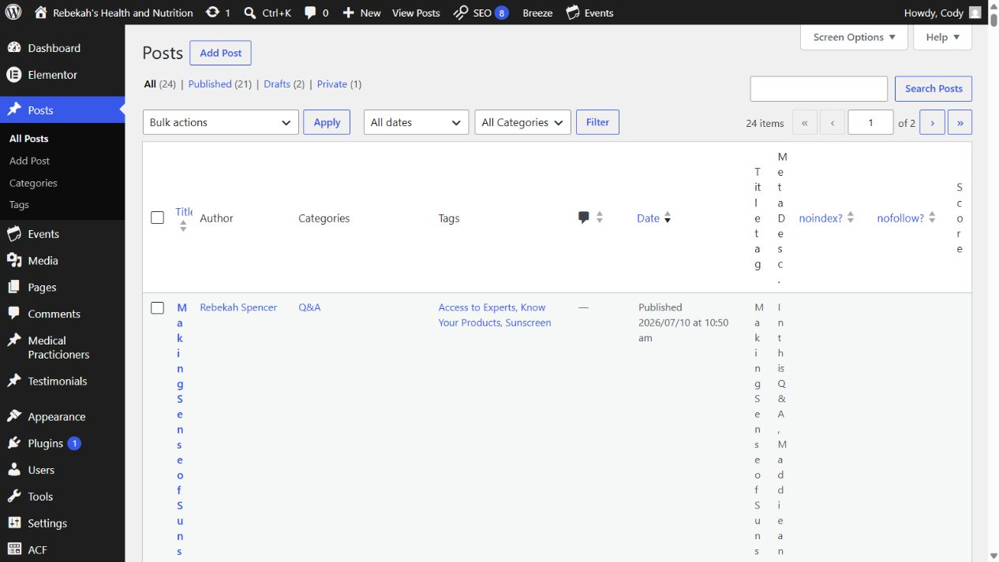
Publish or update once, then wait
10
DO THIS
LOOK HERE
1. Confirm approval.
2. Click once and wait.
3. Do not create a duplicate.
Post settings > Publish or Update
1. Use Publish only when the new article is complete and approved.
2. Use Update for an approved change to an existing post.
3. Select the button one time and wait for WordPress confirmation.
WRITTEN CHECK
1. Search the name.
2. Confirm the public details.
3. Check the links.
Blog editing v1.1 | 11/13
Notes:
[Sources]
- Rebekah project training standard and client records in CLIENT-NOTES.md.
- Existing first-party WordPress captures and approved workflow records.
- No test blog post, live content change, cache purge, media upload, or setting change was used to create this lesson.

Slide 12
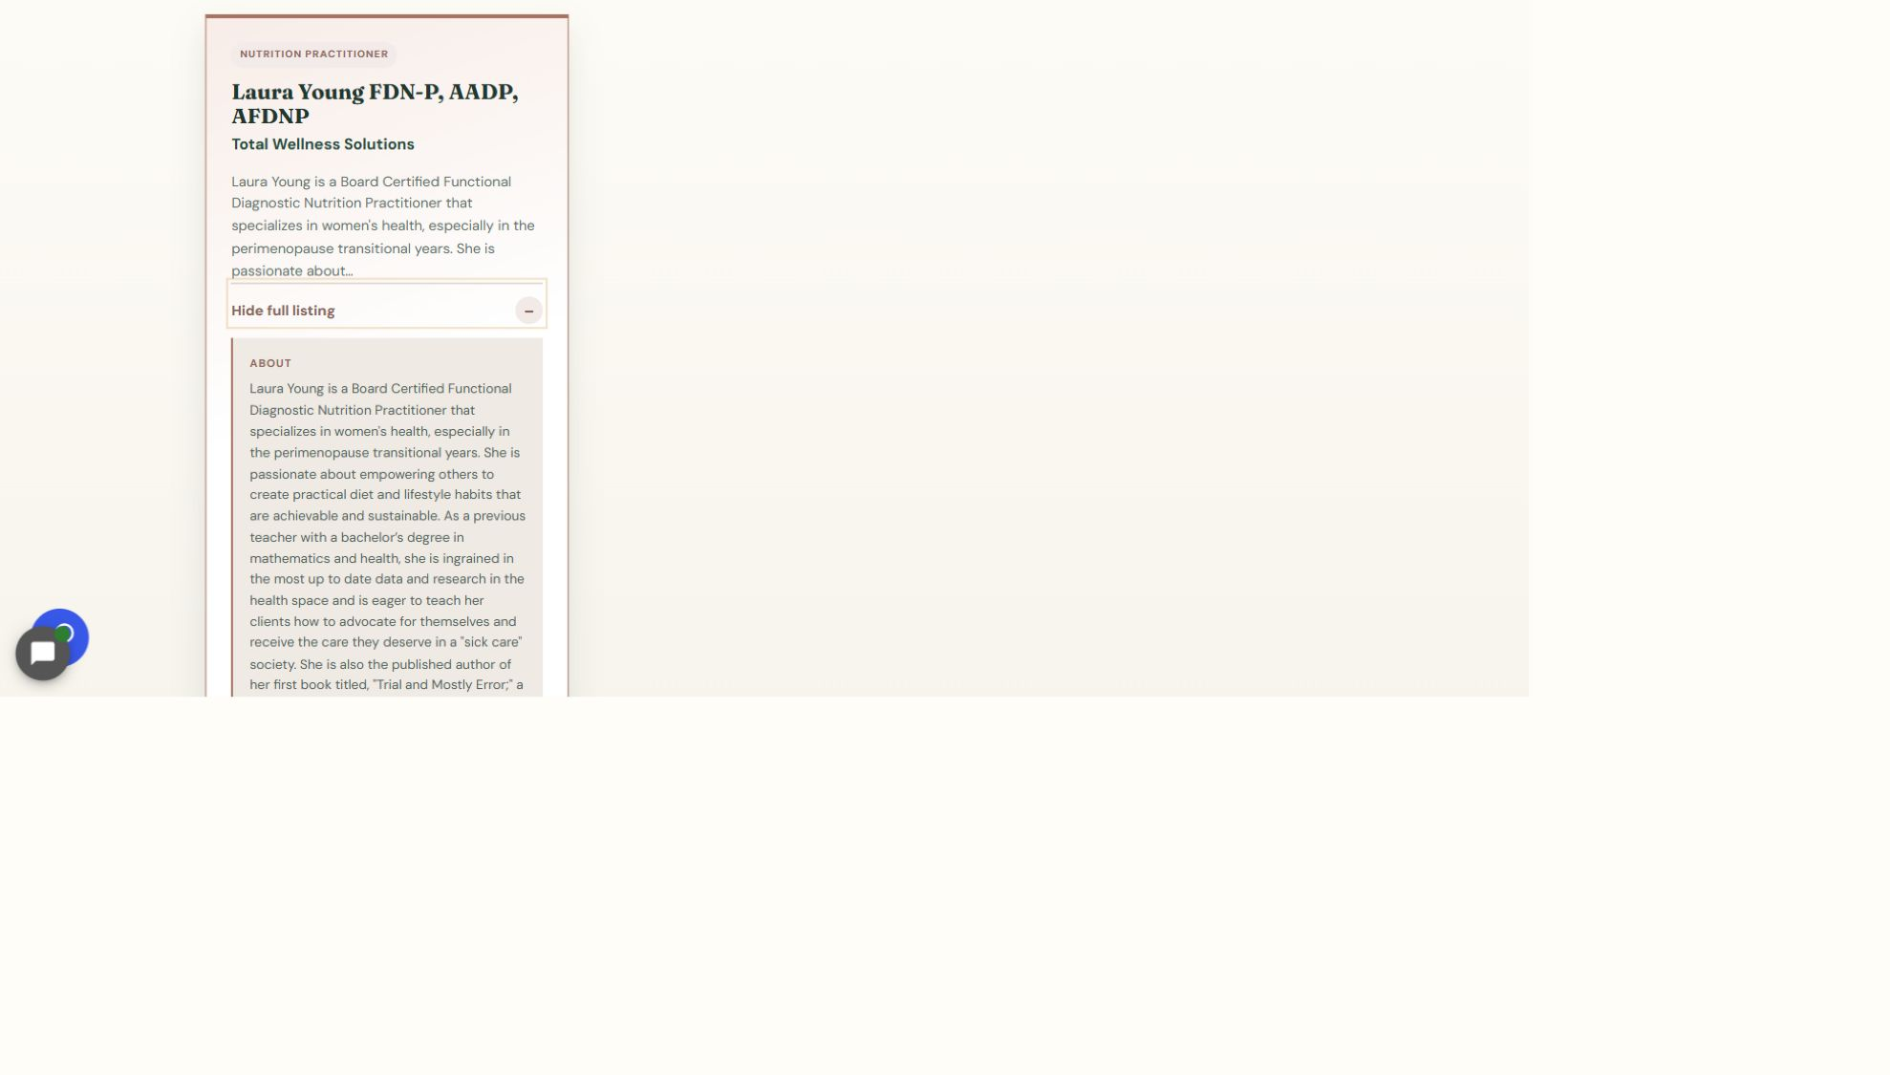
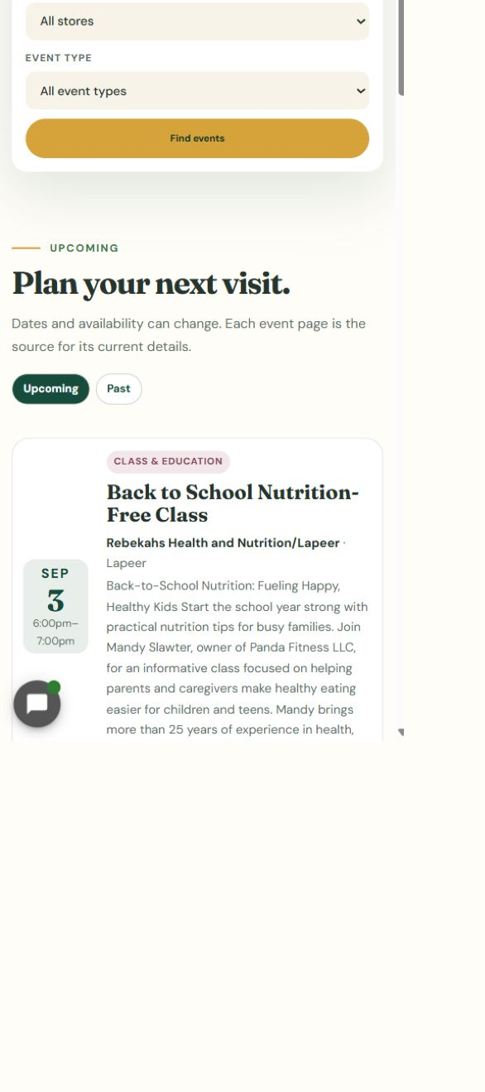
Clear the applicable cache and verify publicly
11
LOOK HERE
DO THIS
WRITTEN STEPS
1. Click View full listing.
2. Check the full details and links.
3. Repeat the check on a phone.
1. Clear applicable cache.
2. Open the exact URL.
3. Verify desktop and phone.
Changed post > Clear Cache > exact public article URL
1. Clear only the applicable post or approved page cache.
2. Open the exact public article URL with no extra address text.
3. Verify the visible article and Blog archive on desktop and phone.
Blog editing v1.1 | 12/13
Notes:
[Sources]
- Rebekah project training standard and client records in CLIENT-NOTES.md.
- Existing first-party WordPress captures and approved workflow records.
- No test blog post, live content change, cache purge, media upload, or setting change was used to create this lesson.

Slide 13
Always finish with the final verification
DONE
DRAFT > PREVIEW > PUBLISH ONCE > VERIFY LIVE
Check the exact public article and Blog archive on desktop and phone.
If the article, category, image, link, or live result is uncertain, stop and contact Blue Nova.
Blog editing v1.1 | 13/13
Notes:
[Sources]
- Rebekah project training standard and client records in CLIENT-NOTES.md.
- Existing first-party WordPress captures and approved workflow records.
- No test blog post, live content change, cache purge, media upload, or setting change was used to create this lesson.

