Slide 1

Upload and use images in the Media Library
START
Prepare an approved image, upload it once, write useful alt text, place it correctly, and verify the public result.
Beginner lesson | Editor is sufficient | Protect existing media
Media Library v1.1 | 1/13
Notes:
[Sources]
- Rebekah project training standard and client records in CLIENT-NOTES.md.
- Existing first-party WordPress captures and approved workflow records.
- No test blog post, live content change, cache purge, media upload, or setting change was used to create this lesson.

Slide 2
Required WordPress access
1
WORDPRESS ROLE REQUIRED
Editor or Administrator
Editor access is enough for routine image work.
Do not delete existing media, install image tools, or change upload settings unless Blue Nova directs you.
Media Library v1.1 | 2/13
Notes:
[Sources]
- Rebekah project training standard and client records in CLIENT-NOTES.md.
- Existing first-party WordPress captures and approved workflow records.
- No test blog post, live content change, cache purge, media upload, or setting change was used to create this lesson.

Slide 3
Prepare the image before opening WordPress
2
BEFORE UPLOADING
approved image | clear filename | correct crop | web-ready size
Never upload private records, unlicensed images, screenshots with personal information, or an image you cannot identify.
Media Library v1.1 | 3/13
Notes:
[Sources]
- Rebekah project training standard and client records in CLIENT-NOTES.md.
- Existing first-party WordPress captures and approved workflow records.
- No test blog post, live content change, cache purge, media upload, or setting change was used to create this lesson.

Slide 4
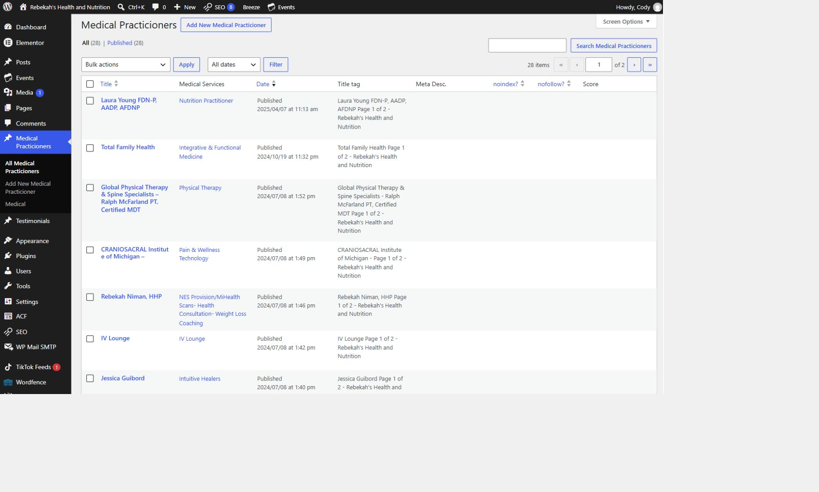
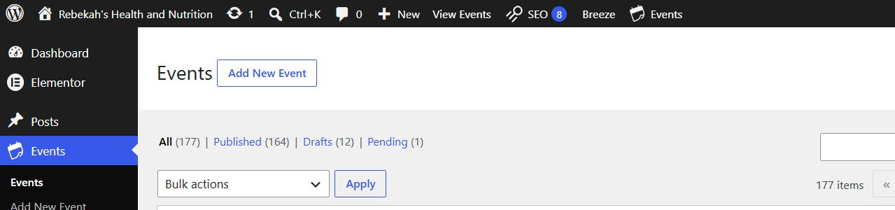
Open the Media Library and choose Add New
3
WHERE TO GO
Media > Library > Add New Media File
DO THIS
LOOK HERE
WRITTEN STEPS
1. Open Media Library.
2. Choose Add New.
3. Upload one approved file.
1. Click Medical Practicioners.
2. Click All Medical Practicioners.
3. Search by name if needed.
1. Use your own WordPress login and open Media in the left menu.
2. Select Add New Media File.
3. Upload only the approved final image, not several guesses.
Follow the steps in order. Stop when the screen does not match.
Media Library v1.1 | 4/13
Notes:
[Sources]
- Rebekah project training standard and client records in CLIENT-NOTES.md.
- Existing first-party WordPress captures and approved workflow records.
- No test blog post, live content change, cache purge, media upload, or setting change was used to create this lesson.

Slide 5
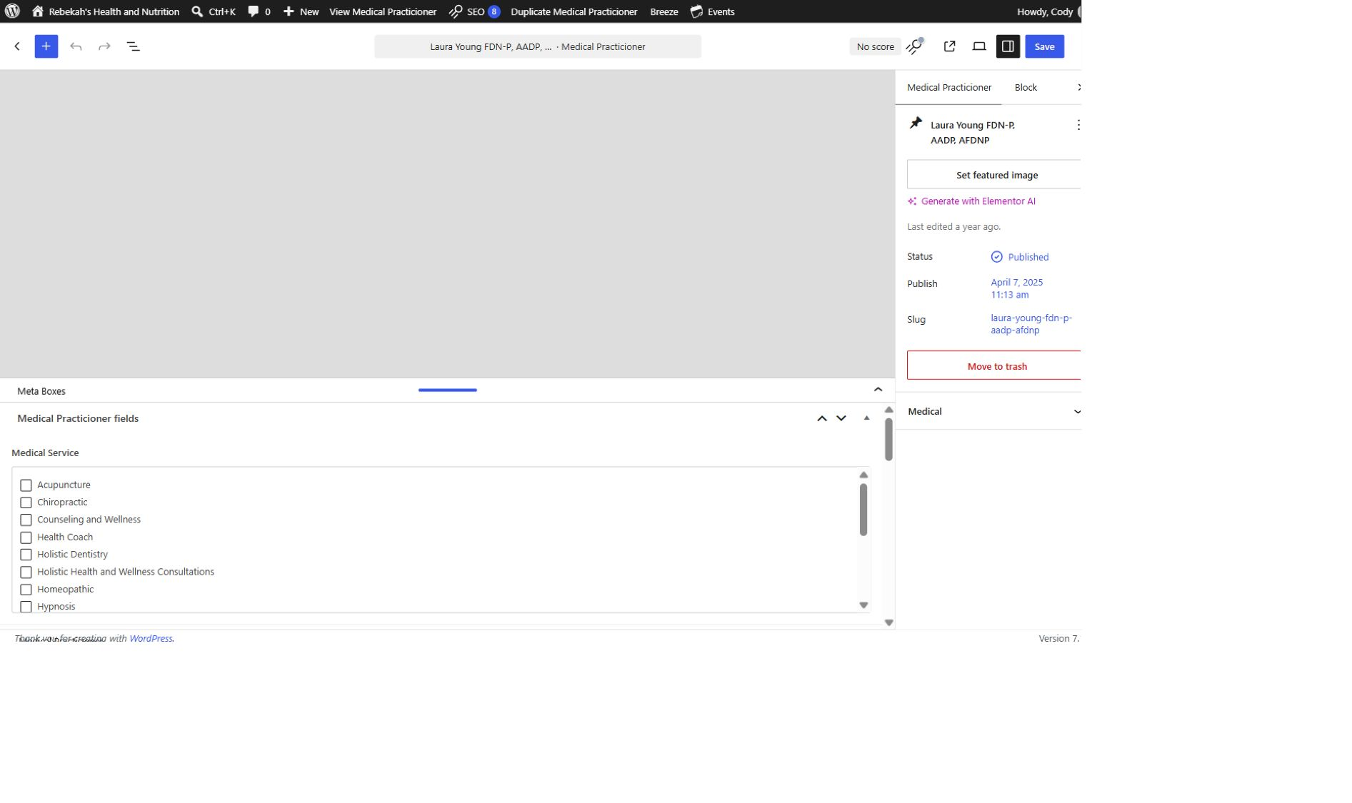
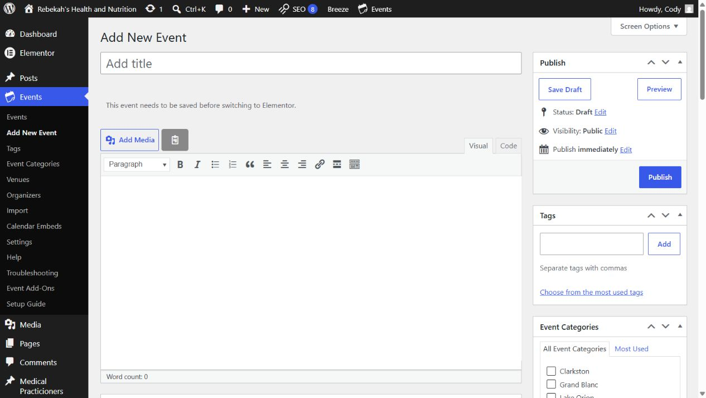
Use a clear filename before uploading
4
WHERE TO GO
DO THIS
Your computer > rename the approved file
WRITTEN STEPS
1. Find Medical Service.
2. Check the approved category.
3. Uncheck incorrect categories.
1. Rename before upload.
2. Use descriptive words.
3. Keep the extension.
LOOK HERE
1. Rename the file before upload using short lowercase words separated by hyphens.
2. Describe the subject, not an internal note such as final-final or image-one.
3. Keep the correct file extension, such as J P G, P N G, or Web P.
Follow the steps in order. Stop when the screen does not match.
Media Library v1.1 | 5/13
Notes:
[Sources]
- Rebekah project training standard and client records in CLIENT-NOTES.md.
- Existing first-party WordPress captures and approved workflow records.
- No test blog post, live content change, cache purge, media upload, or setting change was used to create this lesson.

Slide 6
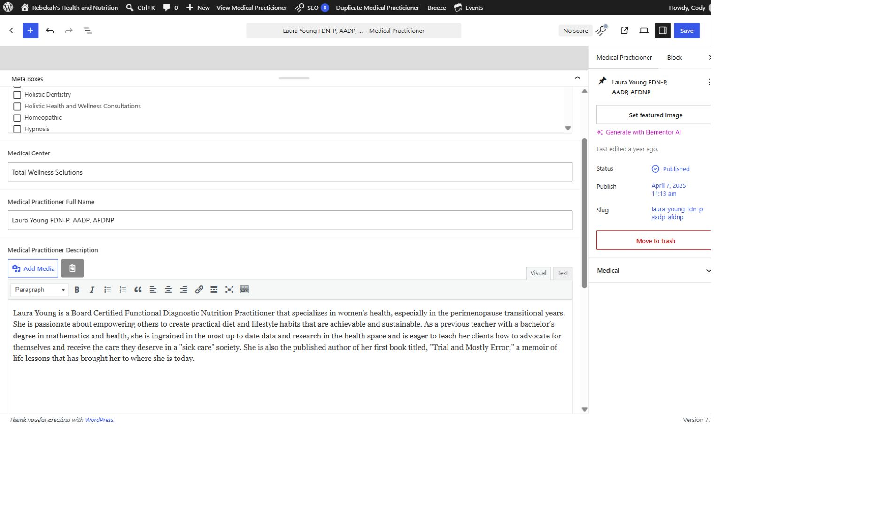
Choose the file and wait for the upload
5
WHERE TO GO
DO THIS
Add New Media File > Select Files
WRITTEN STEPS
1. Select Visual.
2. Replace the approved description.
3. Keep the paragraph breaks.
1. Select the exact file.
2. Wait for completion.
3. Do not create duplicates.
1. Select the exact approved file from the computer.
2. Wait until the progress indicator finishes and the attachment appears.
3. If WordPress reports an error, stop and read it instead of uploading duplicates.
LOOK HERE
Follow the steps in order. Stop when the screen does not match.
Media Library v1.1 | 6/13
Notes:
[Sources]
- Rebekah project training standard and client records in CLIENT-NOTES.md.
- Existing first-party WordPress captures and approved workflow records.
- No test blog post, live content change, cache purge, media upload, or setting change was used to create this lesson.

Slide 7
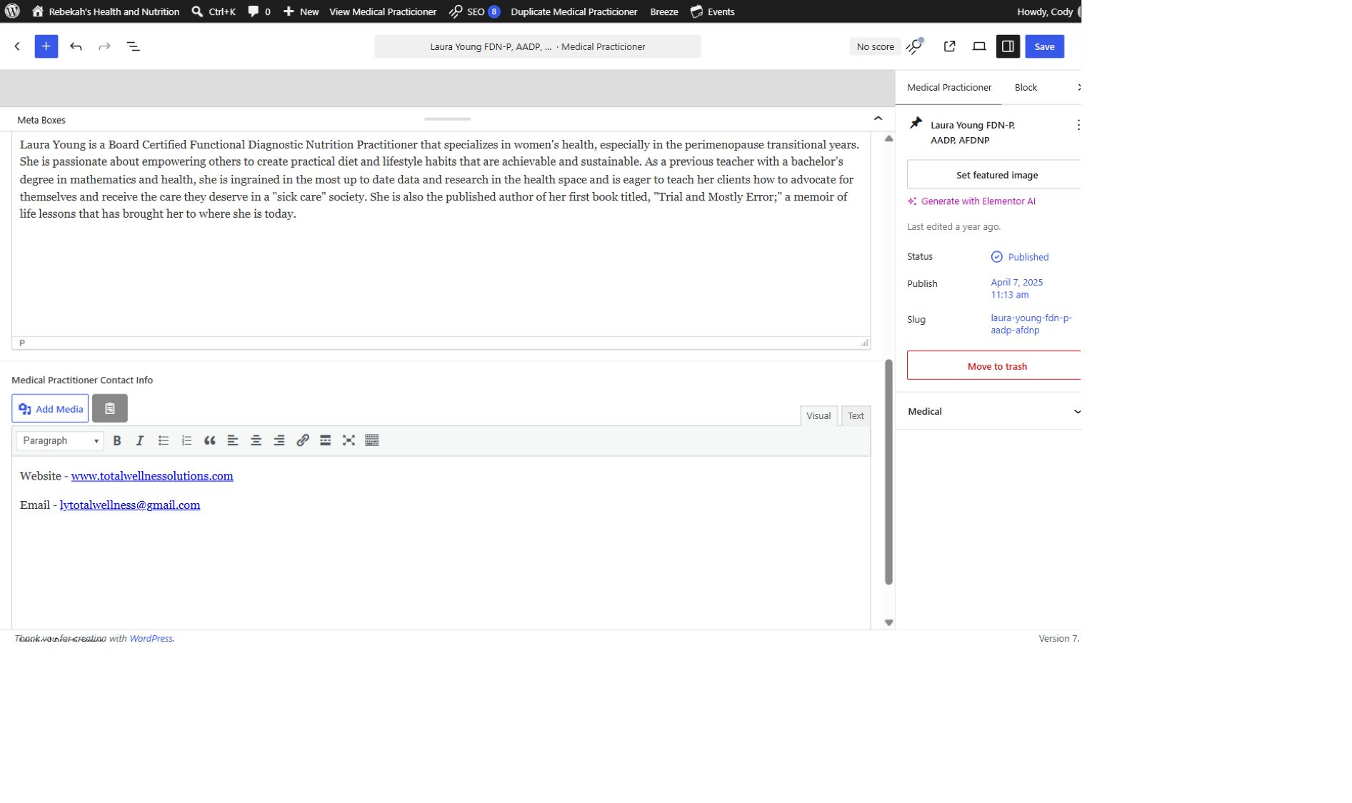
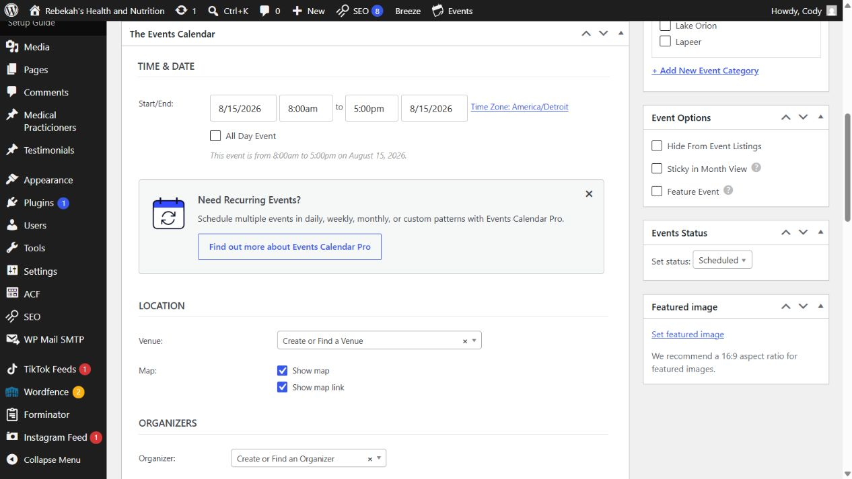
Write alt text for the image's purpose
6
WHERE TO GO
DO THIS
Attachment details > Alternative Text
WRITTEN STEPS
1. Add only approved public details.
2. Test every link.
3. Remove outdated contact information.
1. Describe the useful subject.
2. Keep it concise.
3. Do not keyword-stuff.
LOOK HERE
1. Describe the important subject and purpose in one short sentence or phrase.
2. Leave alt text empty only when the image is purely decorative and conveys no information.
3. Do not copy the filename or stuff keywords, locations, and services.
Follow the steps in order. Stop when the screen does not match.
Media Library v1.1 | 7/13
Notes:
[Sources]
- Rebekah project training standard and client records in CLIENT-NOTES.md.
- Existing first-party WordPress captures and approved workflow records.
- No test blog post, live content change, cache purge, media upload, or setting change was used to create this lesson.

Slide 8
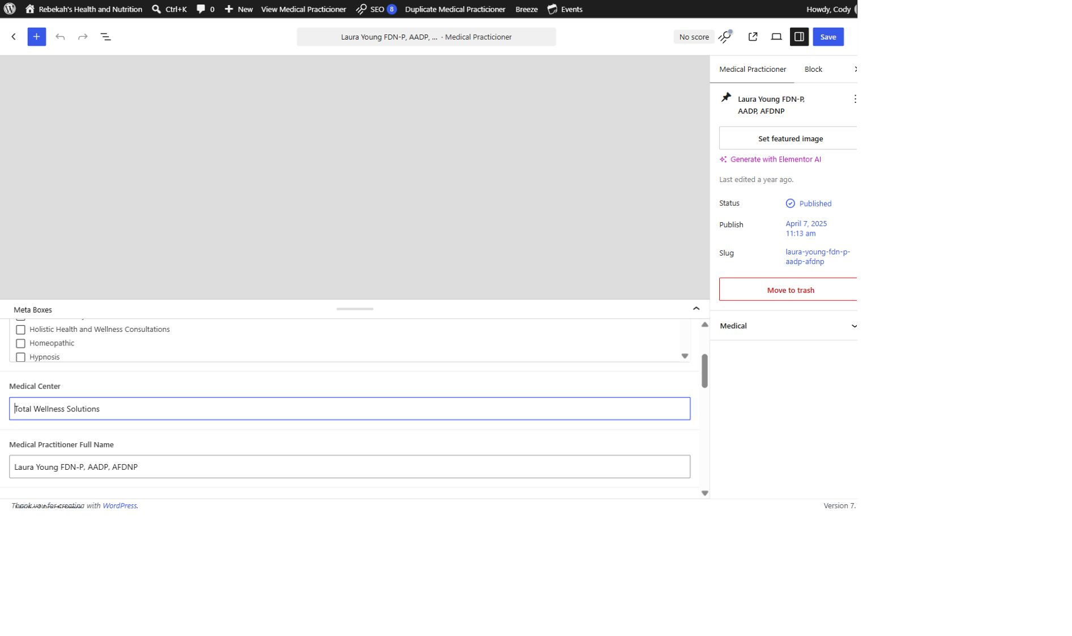
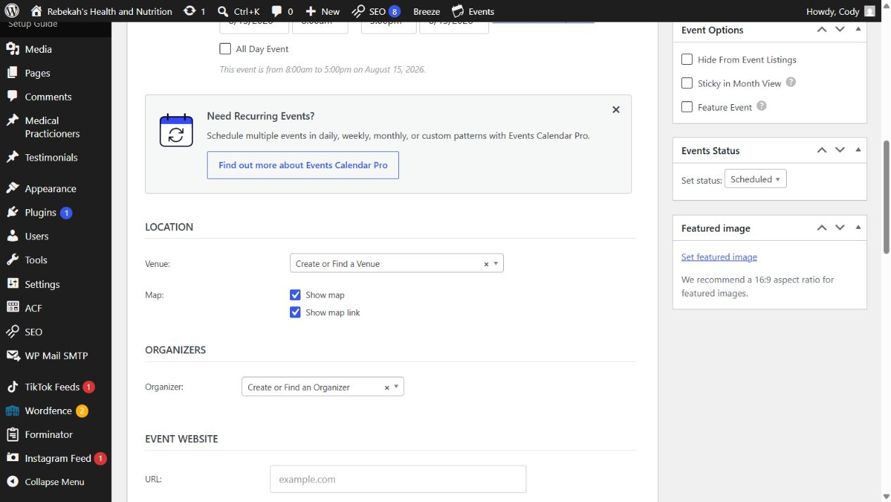
Use title, caption, and description carefully
7
WHERE TO GO
DO THIS
Attachment details > Title, Caption, Description
WRITTEN STEPS
1. Re-read every changed field.
2. Compare with the approved information.
3. Fix errors before saving.
1. Use a clear internal title.
2. Caption only when public.
3. Avoid unnecessary fields.
1. Use a readable Media Library title so staff can identify the asset.
2. Add a caption only when words should appear publicly under the image.
3. Use Description only when the site process specifically needs it.
LOOK HERE
Follow the steps in order. Stop when the screen does not match.
Media Library v1.1 | 8/13
Notes:
[Sources]
- Rebekah project training standard and client records in CLIENT-NOTES.md.
- Existing first-party WordPress captures and approved workflow records.
- No test blog post, live content change, cache purge, media upload, or setting change was used to create this lesson.

Slide 9
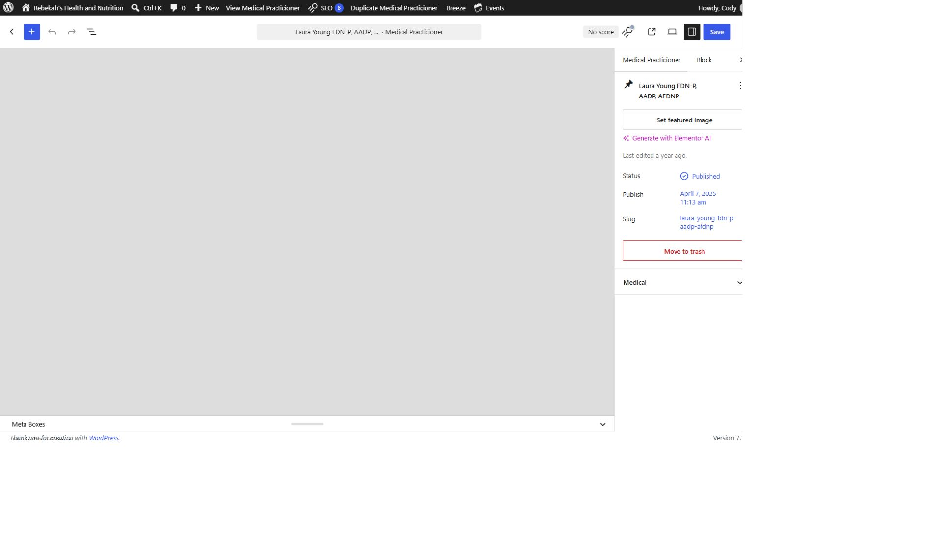
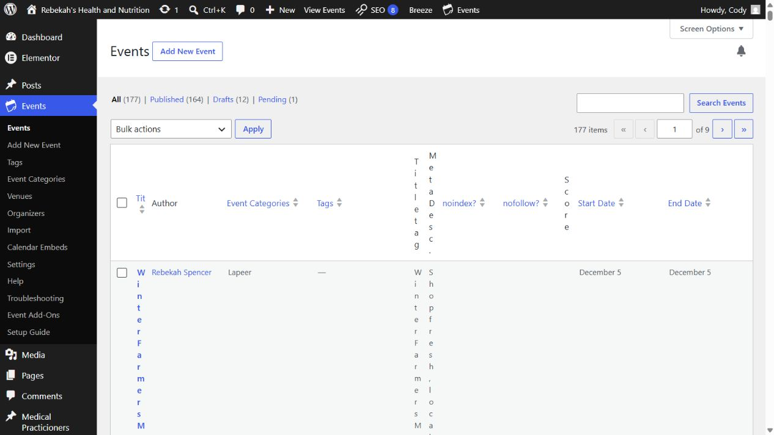
Insert media from the content or image control
8
LOOK HERE
WHERE TO GO
DO THIS
Page or post editor > Add Media or Featured image
WRITTEN STEPS
1. Click Save once.
2. Wait for confirmation.
3. Do not click repeatedly.
1. Open the correct content.
2. Choose the exact thumbnail.
3. Do not stretch the image.
1. Open the correct content item and its image control.
2. Choose the uploaded image from Media Library and confirm its thumbnail.
3. Use the intended image size and preserve the natural proportions.
Follow the steps in order. Stop when the screen does not match.
Media Library v1.1 | 9/13
Notes:
[Sources]
- Rebekah project training standard and client records in CLIENT-NOTES.md.
- Existing first-party WordPress captures and approved workflow records.
- No test blog post, live content change, cache purge, media upload, or setting change was used to create this lesson.

Slide 10
Replace an image without breaking old pages
9
WHERE TO GO
LOOK HERE
1. Return to the practitioner list.
2. Hover over the same row.
Upload new approved image > update the exact content item
DO THIS
3. Click Clear Cache.
1. Upload the replacement.
2. Update the correct content.
3. Keep old media until reviewed.
1. Upload the replacement as a new approved file unless Blue Nova provides a verified replacement tool.
2. Update the exact page, post, event, or practitioner to use it.
3. Do not delete the old media file because other pages may still use its URL.
Follow the steps in order. Stop when the screen does not match.
Media Library v1.1 | 10/13
Notes:
[Sources]
- Rebekah project training standard and client records in CLIENT-NOTES.md.
- Existing first-party WordPress captures and approved workflow records.
- No test blog post, live content change, cache purge, media upload, or setting change was used to create this lesson.

Slide 11
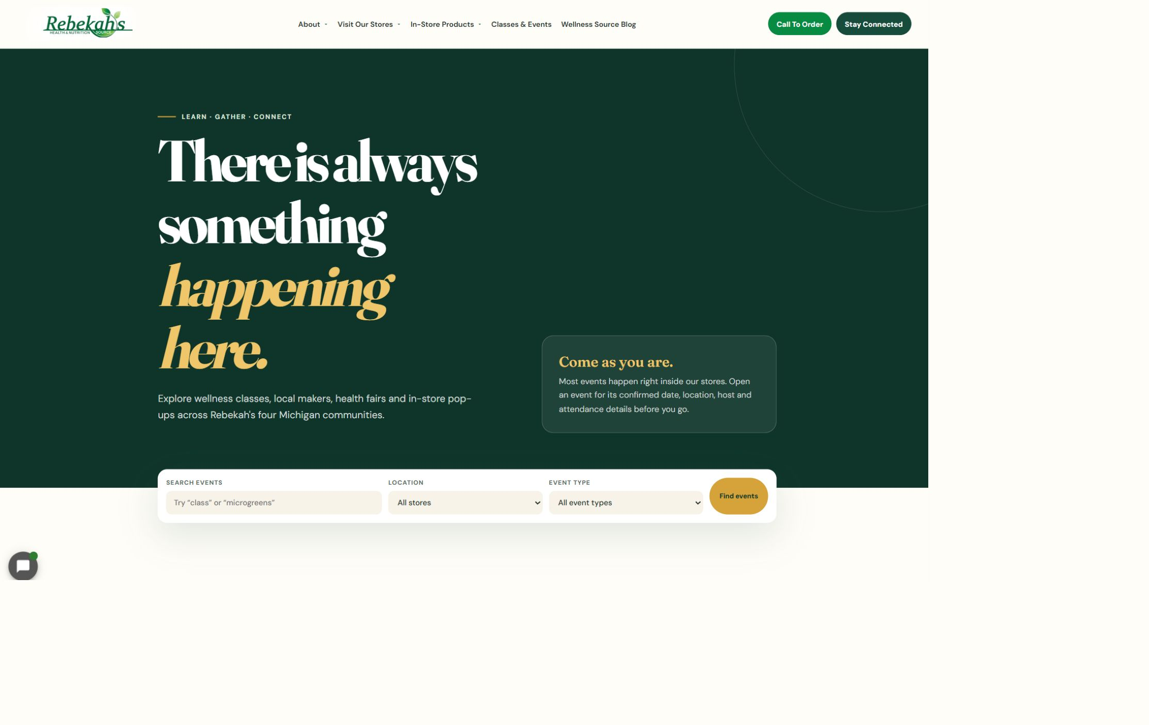
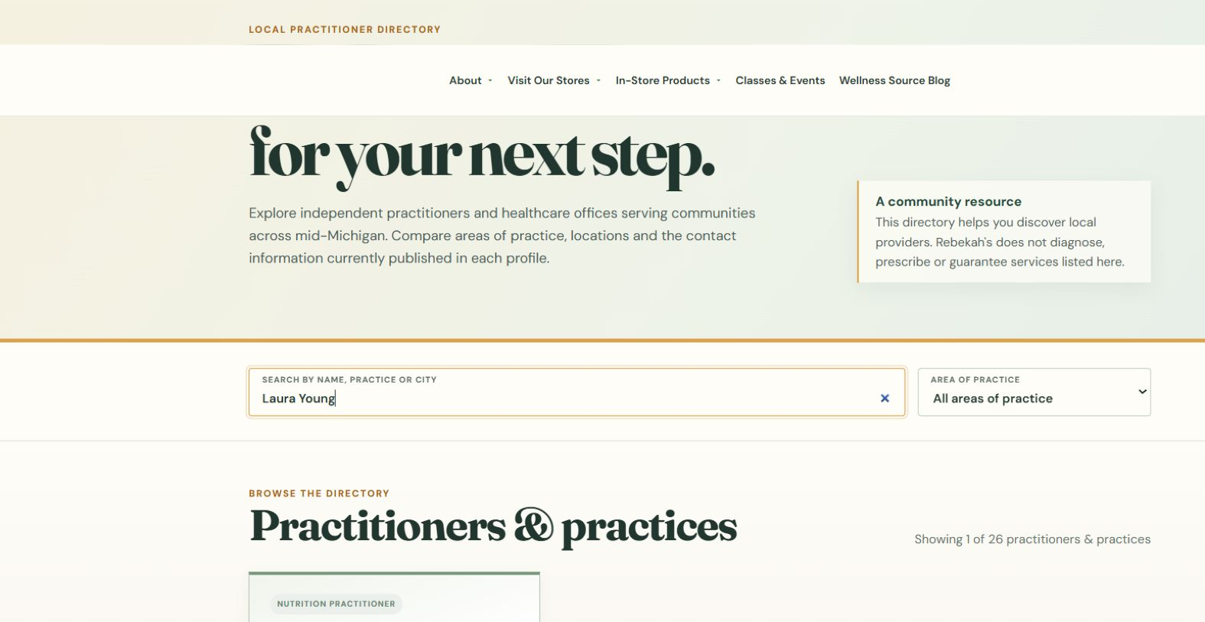
Save once and clear only the applicable cache
10
WHERE TO GO
Content editor > Save or Update > applicable Clear Cache
DO THIS
LOOK HERE
1. Review the placement.
2. Save once.
3. Clear applicable cache.
1. Review the visible crop, alt text, and placement.
2. Select Save or Update one time and wait.
3. Clear only the cache for the content that changed.
Follow the steps in order. Stop when the screen does not match.
WRITTEN CHECK
1. Search the name.
2. Confirm the public details.
3. Check the links.
Media Library v1.1 | 11/13
Notes:
[Sources]
- Rebekah project training standard and client records in CLIENT-NOTES.md.
- Existing first-party WordPress captures and approved workflow records.
- No test blog post, live content change, cache purge, media upload, or setting change was used to create this lesson.

Slide 12
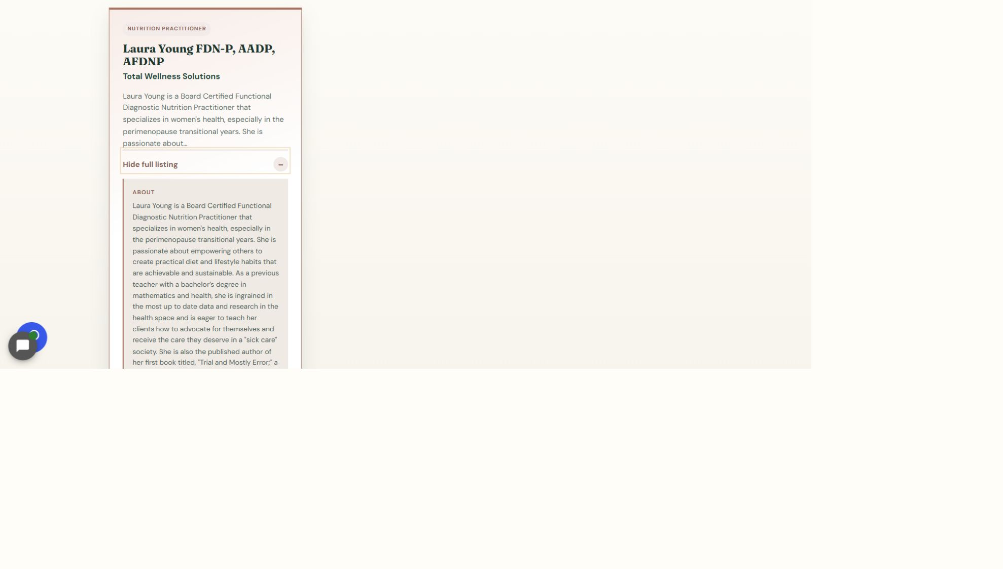
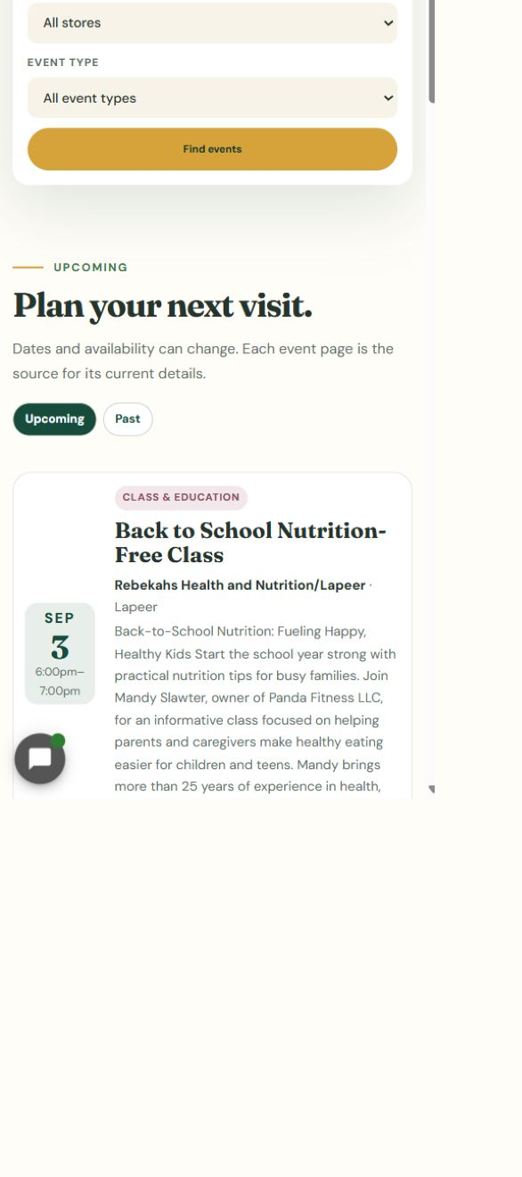
Verify the public image on desktop and phone
11
LOOK HERE
WHERE TO GO
Exact public URL > desktop and phone checks
DO THIS
WRITTEN STEPS
1. Click View full listing.
2. Check the full details and links.
3. Repeat the check on a phone.
1. Open the exact URL.
2. Check quality and crop.
3. Repeat on a phone.
1. Open the exact public page with no extra address text.
2. Confirm the correct image loads, remains sharp, and is not stretched or cropped badly.
3. Check the same image at phone size and test any linked image.
Follow the steps in order. Stop when the screen does not match.
Media Library v1.1 | 12/13
Notes:
[Sources]
- Rebekah project training standard and client records in CLIENT-NOTES.md.
- Existing first-party WordPress captures and approved workflow records.
- No test blog post, live content change, cache purge, media upload, or setting change was used to create this lesson.

Slide 13
Always finish with the final verification
DONE
UPLOAD ONCE > ALT TEXT > PLACE > SAVE > VERIFY
Protect existing media and verify the exact public page at desktop and phone sizes.
If an image is private, unlicensed, oversized, blurry, reused elsewhere, or difficult to replace, stop and contact Blue Nova.
Media Library v1.1 | 13/13
Notes:
[Sources]
- Rebekah project training standard and client records in CLIENT-NOTES.md.
- Existing first-party WordPress captures and approved workflow records.
- No test blog post, live content change, cache purge, media upload, or setting change was used to create this lesson.

