Slide 1

Website editing safety and recovery
START
Make only the approved change, protect the live website, verify the public result, and know exactly when to stop.
Beginner lesson | Use your own login | One approved change at a time
Editing safety v1.1 | 1/13
Notes:
[Sources]
- Rebekah project training standard and client records in CLIENT-NOTES.md.
- Existing first-party WordPress captures and approved workflow records.
- No test blog post, live content change, cache purge, media upload, or setting change was used to create this lesson.

Slide 2
Required WordPress access
1
WORDPRESS ROLE REQUIRED
Use the minimum role assigned to you
Editor is sufficient for routine approved content work.
Administrator controls, plugins, themes, users, servers, payments, and store integrations require separate authorization.
Editing safety v1.1 | 2/13
Notes:
[Sources]
- Rebekah project training standard and client records in CLIENT-NOTES.md.
- Existing first-party WordPress captures and approved workflow records.
- No test blog post, live content change, cache purge, media upload, or setting change was used to create this lesson.

Slide 3
Confirm the task before touching the editor
2
YOUR SAFE START
correct live domain | exact item | approved replacement information
If any part of the requested change is missing or unclear, stop before editing.
Editing safety v1.1 | 3/13
Notes:
[Sources]
- Rebekah project training standard and client records in CLIENT-NOTES.md.
- Existing first-party WordPress captures and approved workflow records.
- No test blog post, live content change, cache purge, media upload, or setting change was used to create this lesson.

Slide 4
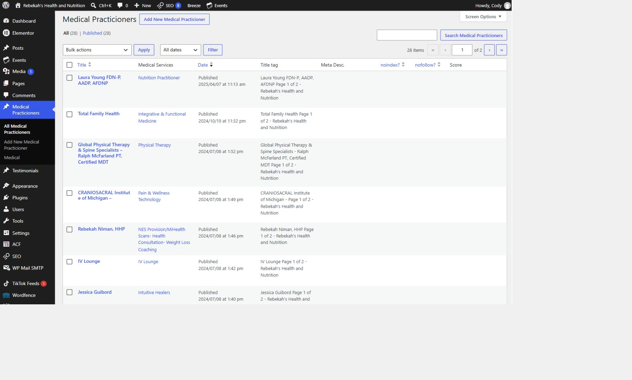
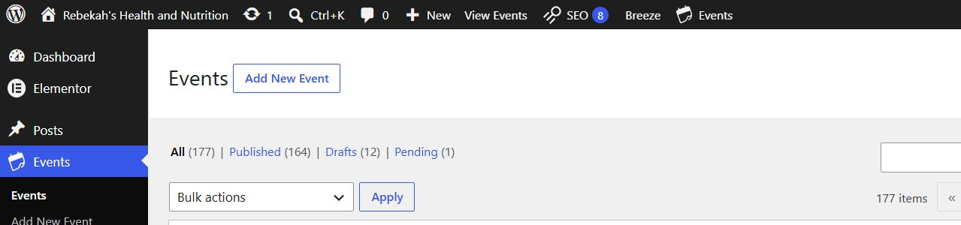
Confirm the live domain and your own login
3
WHERE TO GO
rebekahspureliving.com/wp-admin
DO THIS
LOOK HERE
WRITTEN STEPS
1. Check the domain.
2. Use your own account.
3. Never share logins.
1. Click Medical Practicioners.
2. Click All Medical Practicioners.
3. Search by name if needed.
1. Confirm the address begins with the live domain.
2. Use only your own named WordPress account.
3. Do not use an old staging address or another person's saved login.
Follow the steps in order. Stop when the screen does not match.
Editing safety v1.1 | 4/13
Notes:
[Sources]
- Rebekah project training standard and client records in CLIENT-NOTES.md.
- Existing first-party WordPress captures and approved workflow records.
- No test blog post, live content change, cache purge, media upload, or setting change was used to create this lesson.

Slide 5
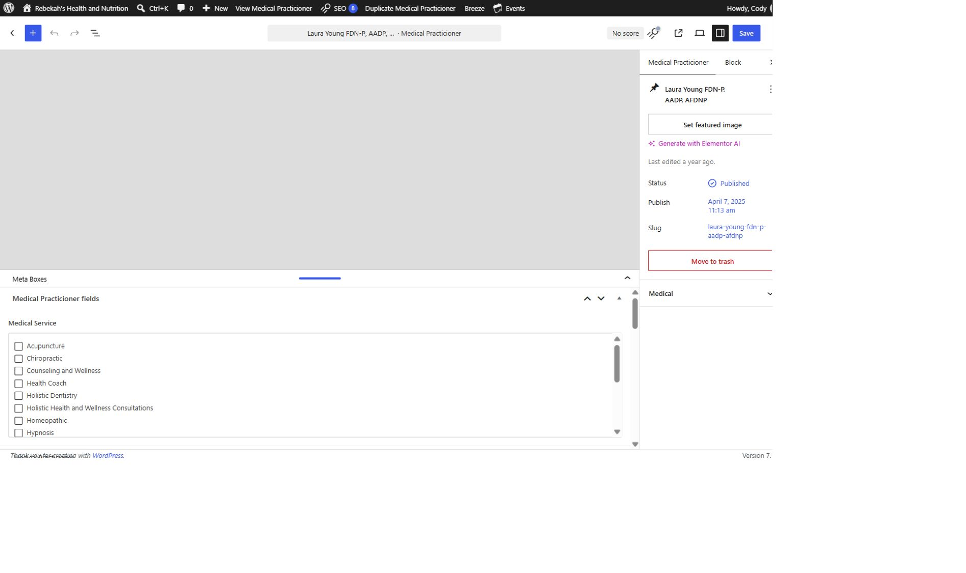
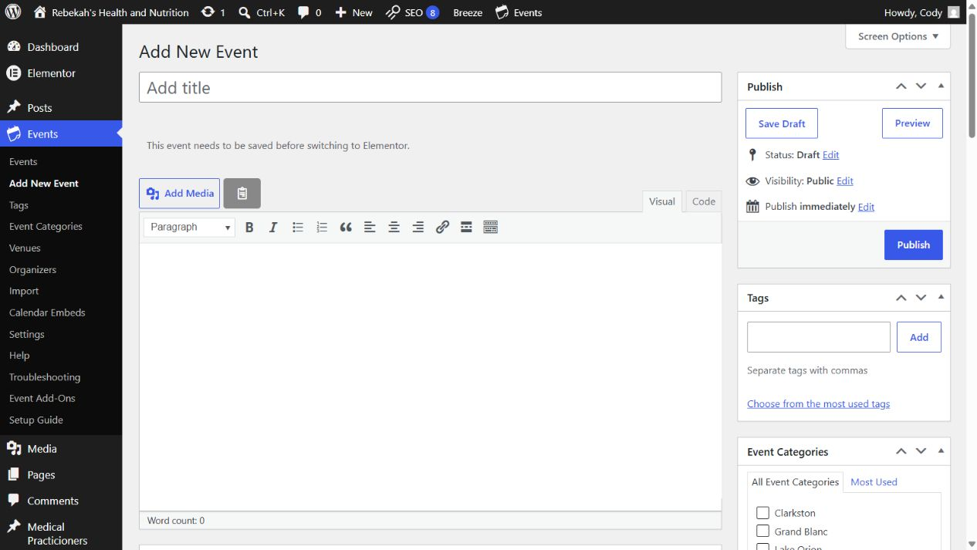
Open the exact item named in the request
4
WHERE TO GO
DO THIS
Correct content list > match title, name, or date > Edit
WRITTEN STEPS
1. Find Medical Service.
2. Check the approved category.
3. Uncheck incorrect categories.
1. Open the correct section.
2. Match identifying details.
3. Stop when uncertain.
LOOK HERE
1. Choose the correct section, such as Practitioners, Events, Posts, or Pages.
2. Match the exact title, name, store, and date before selecting Edit.
3. If two records look similar, stop and confirm which one is correct.
Follow the steps in order. Stop when the screen does not match.
Editing safety v1.1 | 5/13
Notes:
[Sources]
- Rebekah project training standard and client records in CLIENT-NOTES.md.
- Existing first-party WordPress captures and approved workflow records.
- No test blog post, live content change, cache purge, media upload, or setting change was used to create this lesson.

Slide 6
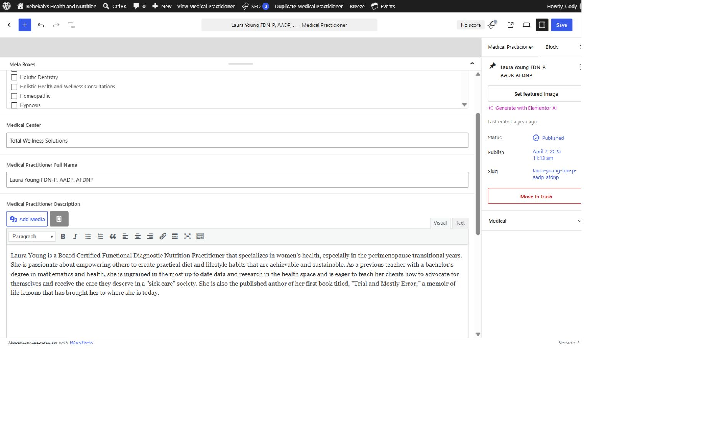
Change only the approved fields
5
WHERE TO GO
DO THIS
Editor > exact field named in the request
WRITTEN STEPS
1. Select Visual.
2. Replace the approved description.
3. Keep the paragraph breaks.
1. Touch only named fields.
2. Do not redesign.
3. Compare old and new.
1. Leave unrelated text, images, categories, links, dates, and settings unchanged.
2. Do not redesign the page while making a content correction.
3. Review the old value and the approved replacement before typing.
LOOK HERE
Follow the steps in order. Stop when the screen does not match.
Editing safety v1.1 | 6/13
Notes:
[Sources]
- Rebekah project training standard and client records in CLIENT-NOTES.md.
- Existing first-party WordPress captures and approved workflow records.
- No test blog post, live content change, cache purge, media upload, or setting change was used to create this lesson.

Slide 7
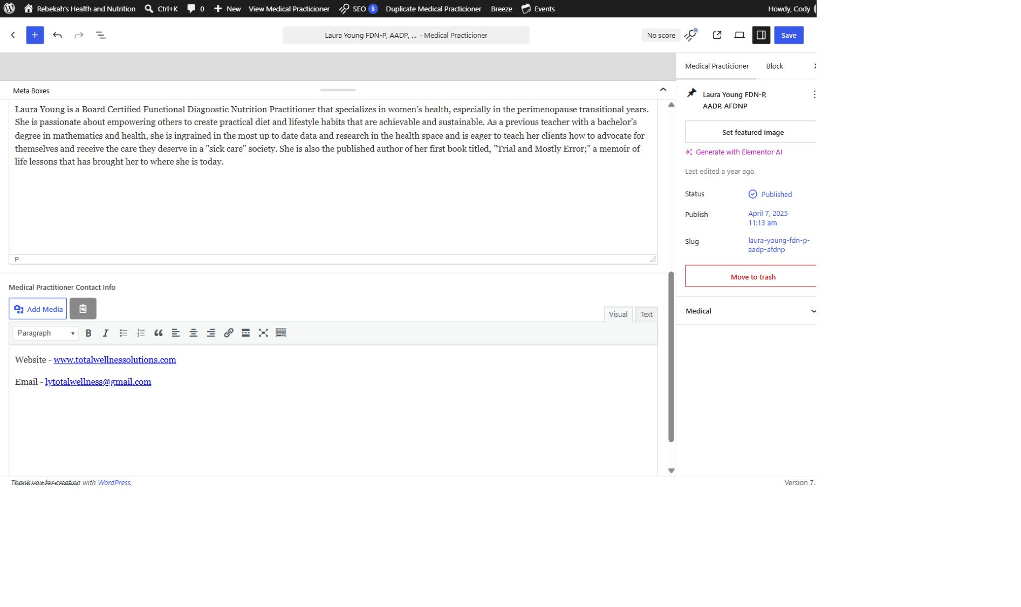
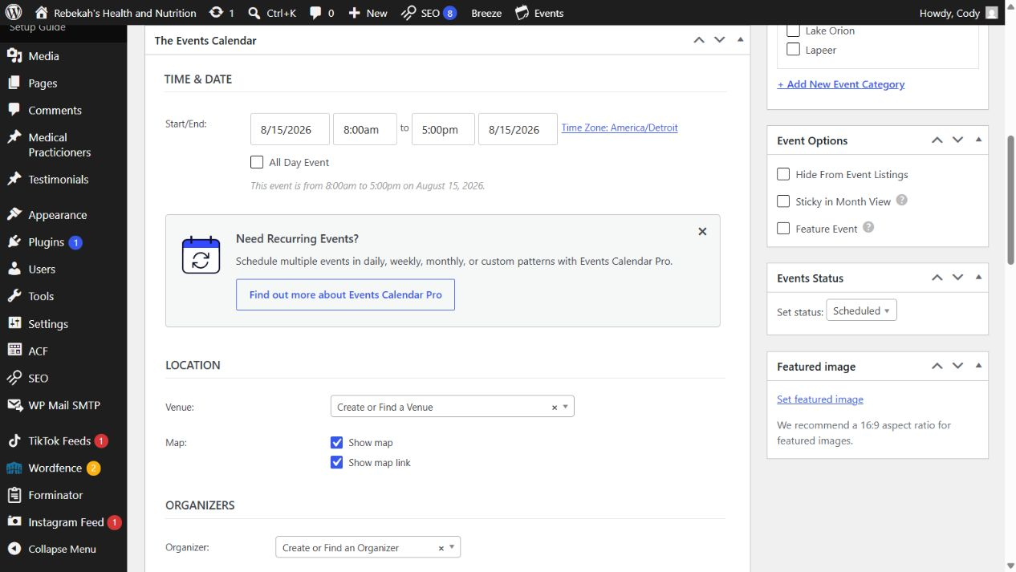
Keep new or uncertain work in Draft
6
WHERE TO GO
DO THIS
Status > Draft > Save Draft > Preview
WRITTEN STEPS
1. Add only approved public details.
2. Test every link.
3. Remove outdated contact information.
1. Keep new work in Draft.
2. Preview privately.
3. Publish only after approval.
LOOK HERE
1. Use Draft for new content until every required detail is complete and approved.
2. Preview the result before publishing.
3. Do not use Publish just to see what the page might look like.
Follow the steps in order. Stop when the screen does not match.
Editing safety v1.1 | 7/13
Notes:
[Sources]
- Rebekah project training standard and client records in CLIENT-NOTES.md.
- Existing first-party WordPress captures and approved workflow records.
- No test blog post, live content change, cache purge, media upload, or setting change was used to create this lesson.

Slide 8
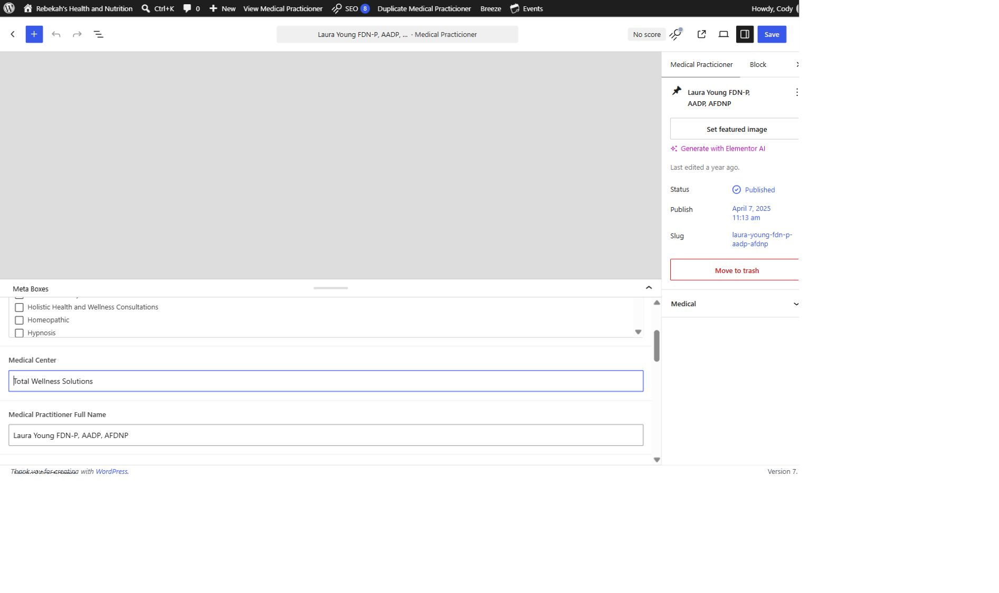
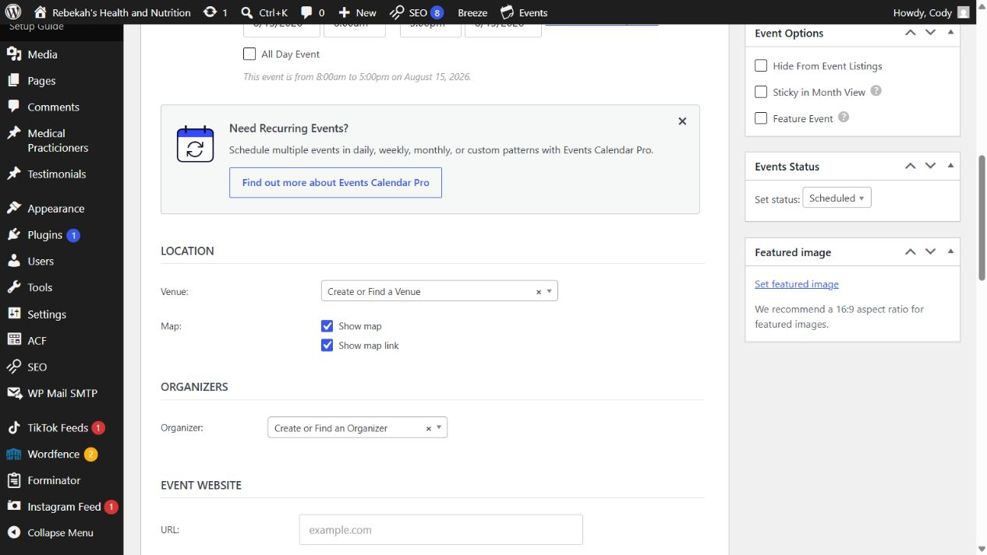
Do not change design, plugins, or server controls
7
WHERE TO GO
DO THIS
STOP: Appearance, Plugins, Settings, Cloudways, payment, and store controls
WRITTEN STEPS
1. Re-read every changed field.
2. Compare with the approved information.
3. Fix errors before saving.
1. Leave technical controls alone.
2. Record what you saw.
3. Contact Blue Nova.
1. Routine editors should not enter these areas.
2. Do not install, update, disable, configure, reconnect, or restart anything.
3. Take a screenshot of the problem and contact Blue Nova.
LOOK HERE
Follow the steps in order. Stop when the screen does not match.
Editing safety v1.1 | 8/13
Notes:
[Sources]
- Rebekah project training standard and client records in CLIENT-NOTES.md.
- Existing first-party WordPress captures and approved workflow records.
- No test blog post, live content change, cache purge, media upload, or setting change was used to create this lesson.

Slide 9
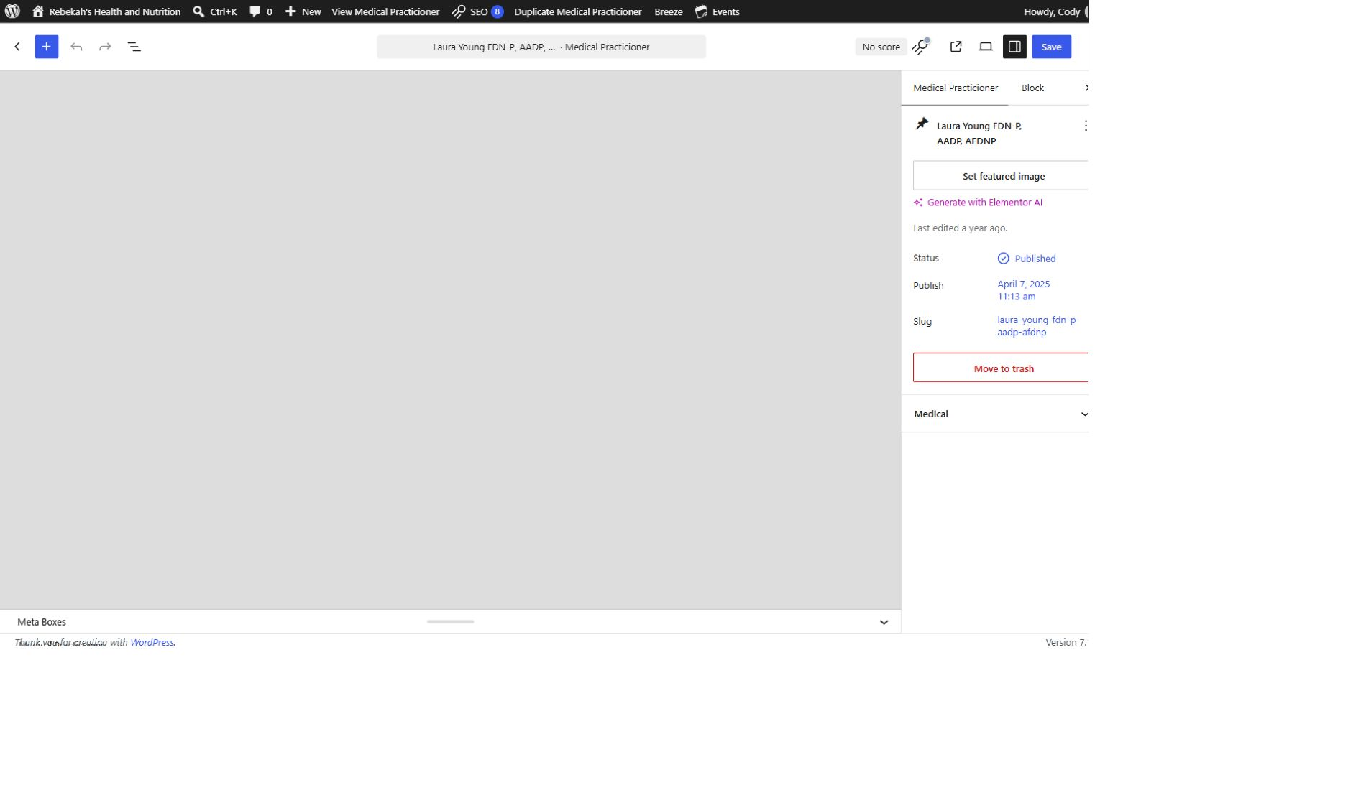
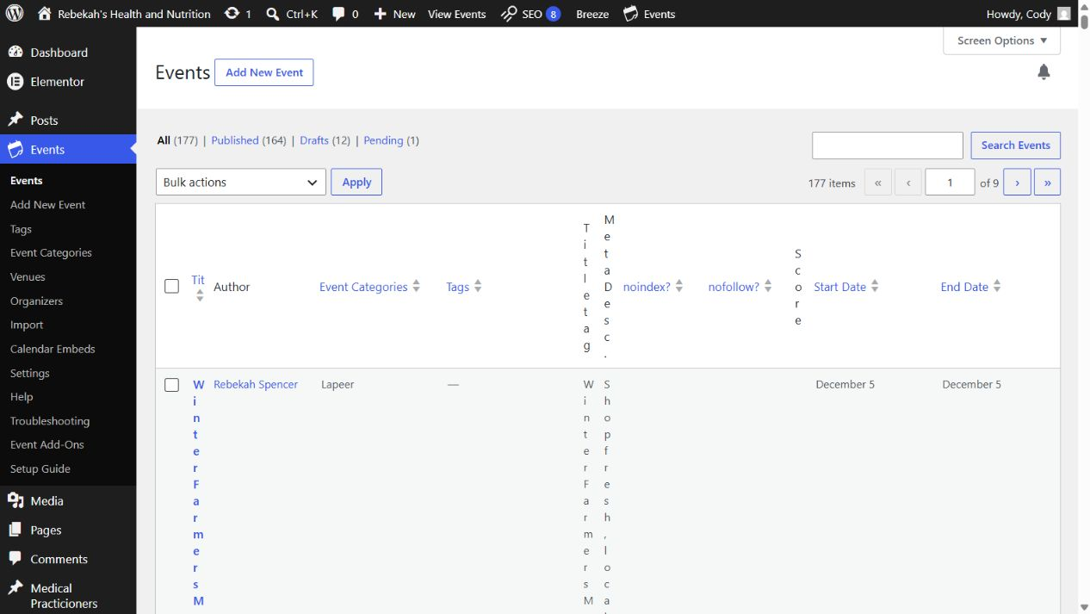
Review images, links, dates, and public claims
8
LOOK HERE
WHERE TO GO
DO THIS
Preview > read and test the complete changed section
WRITTEN STEPS
1. Click Save once.
2. Wait for confirmation.
3. Do not click repeatedly.
1. Check images.
2. Test links.
3. Recheck sensitive facts.
1. Confirm images are approved, clear, and correctly cropped.
2. Open every changed link and verify its destination.
3. Recheck dates, times, prices, health wording, addresses, phone numbers, and names.
Follow the steps in order. Stop when the screen does not match.
Editing safety v1.1 | 9/13
Notes:
[Sources]
- Rebekah project training standard and client records in CLIENT-NOTES.md.
- Existing first-party WordPress captures and approved workflow records.
- No test blog post, live content change, cache purge, media upload, or setting change was used to create this lesson.

Slide 10
Save once and wait for confirmation
9
WHERE TO GO
LOOK HERE
1. Return to the practitioner list.
2. Hover over the same row.
Save, Update, or Publish button
DO THIS
3. Click Clear Cache.
1. Choose the correct action.
2. Click once.
3. Wait for confirmation.
1. Choose the one correct save action for the task.
2. Select it one time and wait for WordPress to confirm.
3. Do not click repeatedly or leave while WordPress is still saving.
Follow the steps in order. Stop when the screen does not match.
Editing safety v1.1 | 10/13
Notes:
[Sources]
- Rebekah project training standard and client records in CLIENT-NOTES.md.
- Existing first-party WordPress captures and approved workflow records.
- No test blog post, live content change, cache purge, media upload, or setting change was used to create this lesson.

Slide 11
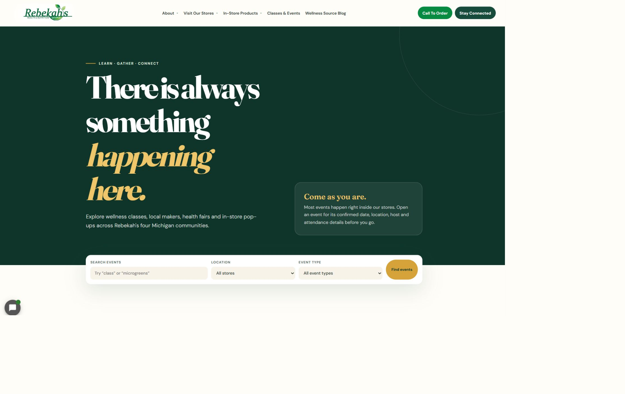
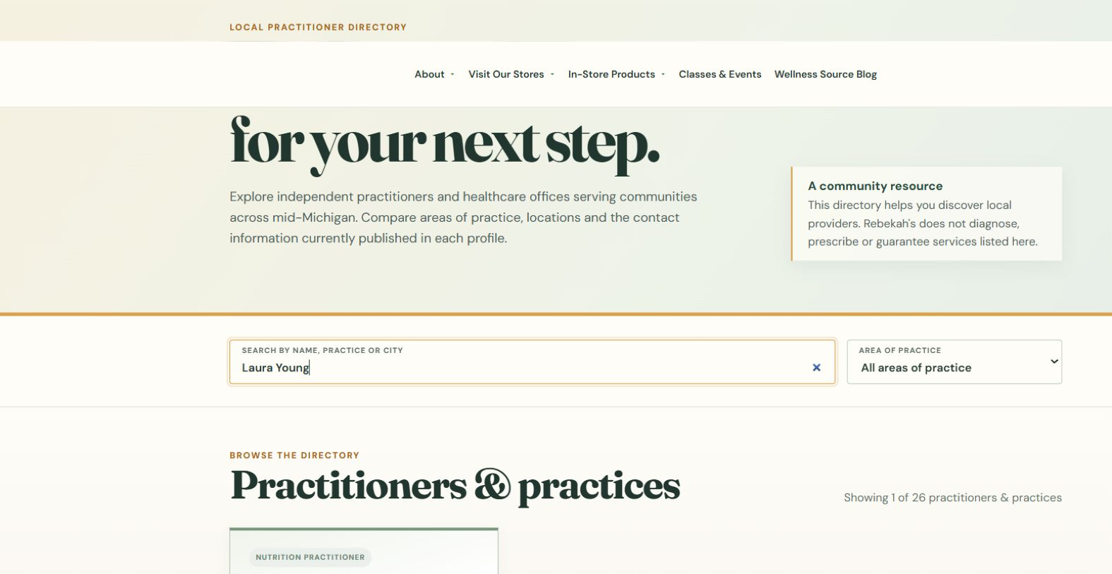
Clear only the applicable cache
10
WHERE TO GO
Changed record or approved cache control > Clear Cache
DO THIS
LOOK HERE
1. Use the smallest clear.
2. Purge once.
3. Do not change settings.
1. Start with the exact record or page cache when available.
2. Use broader Breeze or Varnish purges only when approved.
3. Never change cache, plugin, server, or optimization settings.
Follow the steps in order. Stop when the screen does not match.
WRITTEN CHECK
1. Search the name.
2. Confirm the public details.
3. Check the links.
Editing safety v1.1 | 11/13
Notes:
[Sources]
- Rebekah project training standard and client records in CLIENT-NOTES.md.
- Existing first-party WordPress captures and approved workflow records.
- No test blog post, live content change, cache purge, media upload, or setting change was used to create this lesson.

Slide 12
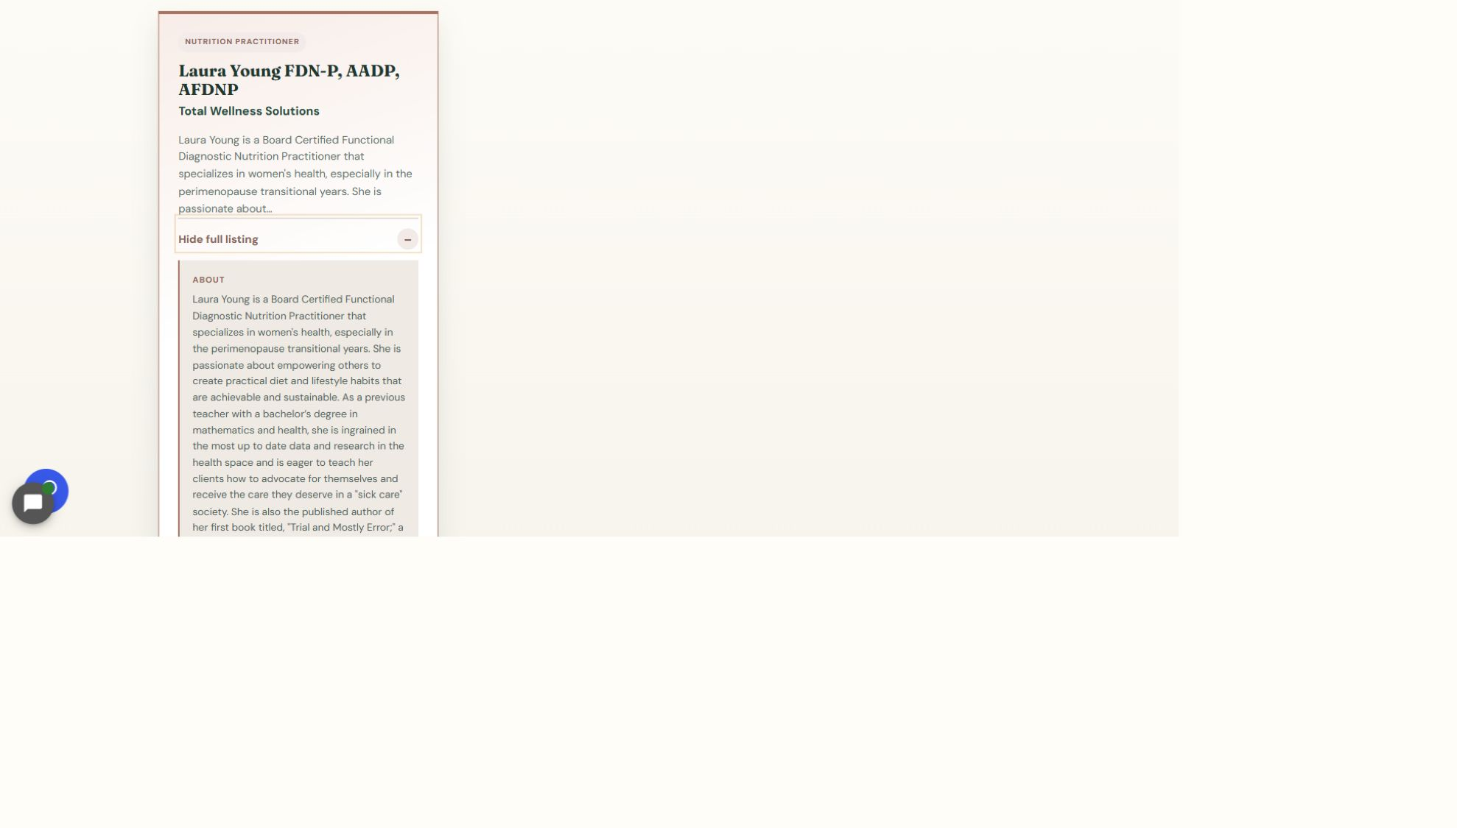
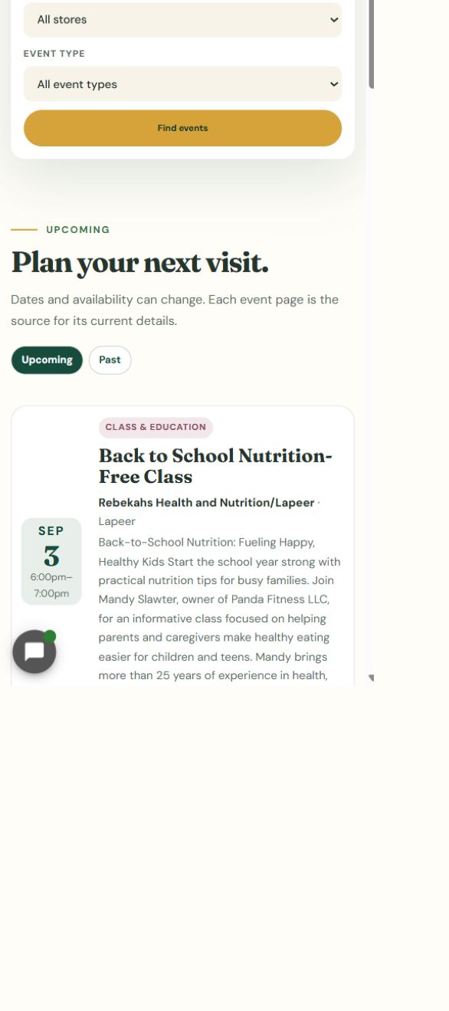
Verify publicly and stop if the result is wrong
11
LOOK HERE
WHERE TO GO
Exact canonical public URL > desktop and phone
DO THIS
WRITTEN STEPS
1. Click View full listing.
2. Check the full details and links.
3. Repeat the check on a phone.
1. Check the exact URL.
2. Verify desktop and phone.
3. Stop when incorrect.
1. Open the exact public URL with no cache-busting text.
2. Confirm the visible change and test affected controls at desktop and phone sizes.
3. If the result is wrong, missing, or broken, stop; do not keep saving or purging.
Follow the steps in order. Stop when the screen does not match.
Editing safety v1.1 | 12/13
Notes:
[Sources]
- Rebekah project training standard and client records in CLIENT-NOTES.md.
- Existing first-party WordPress captures and approved workflow records.
- No test blog post, live content change, cache purge, media upload, or setting change was used to create this lesson.

Slide 13
Know when to stop and ask for help
DONE
CORRECT ITEM > APPROVED CHANGE > SAVE ONCE > VERIFY
Protect the live site by making one controlled change and checking the exact public result.
When the screen, task, permission, save result, or public page does not match, stop and contact Blue Nova.
Editing safety v1.1 | 13/13
Notes:
[Sources]
- Rebekah project training standard and client records in CLIENT-NOTES.md.
- Existing first-party WordPress captures and approved workflow records.
- No test blog post, live content change, cache purge, media upload, or setting change was used to create this lesson.

