Slide 1
HR Analytics Dashboard – Employee Insights 2025
Based on company HR data (2024–2025)
Presented by
Nora
Data Entry Executive
📧 shreyaalphaguha@gmail.com
Date: November 2025

Slide 2
Objectives of HR Data Analysis
To analyze employee attrition patterns and key influencing factors.
To identify trends in job satisfaction and compensation.
To provide insights for improving retention and employee engagement.
To visualize HR data for quick decision-making.

Slide 3
About the Dataset
Data Source: Company HR records (2024–2025)
Total Employees: 1,470
Key Variables: Age, Gender, Department, Job Role, Monthly Income, Attrition, Job Satisfaction, Work-Life Balance, etc.
Tools Used: Microsoft Excel (Pivot Tables, Charts, and Dashboard).

Slide 4
Key Metrics
Overall Attrition Rate = 16.12%
Department-wise Attrition :
Average Monthly Income = ₹6502.31*
Job Satisfaction Index= 2.73 (moderately satisfied**)
Department | Count of Attrition
Human Resources | 63
Research & Development | 961
Sales | 446
Grand Total | 1470
Notes:
*(Sum of Monthly Income/total employees = ₹9559309​/1470)
**Interpretation of Job Satisfaction Levels:
Employees scoring near 1 exhibit very low satisfaction, while those near 2 show moderate dissatisfaction. Scores around 3 indicate general satisfaction, and those near 4 reflect high satisfaction and positive engagement.

Slide 5
Work-Life Balance Score: 2.76
Work-Life Balance Score=Total Employees/Total Weighted Score​= 4059/1470=2.76 (on a 4-point scale)
Work-life balance and satisfaction levels being below 3 indicate potential areas for HR improvement.
Average Years at Company= 7 (approx.)*
Employees tend to stay around 7 years on average, suggesting reasonable retention despite a moderate attrition rate.
Work-Life Balance Rating | No. of Employees | Weighted Score
1 | 80 | 1*80= 80
2 | 344 | 2*344= 688
3 | 893 | 3*893= 2679
4 | 153 | 4*153= 612
Total | 1470 | 4059
Notes:
*Average Years at Company =(∑(Years at company × No. of Employees)) ÷(Σ Employees)

Slide 6
Key Metrics Summary
Metric | Value | Interpretation
Overall Attrition Rate | 16.12% | Moderate attrition
Average Monthly Income | ₹6,502.31 | Mid-range pay
Job Satisfaction Index | 2.73 | Moderately satisfied
Work-Life Balance Score | 2.76 | Balanced, slightly above average
Average Years at Company | 7 years | Moderate tenure

Slide 7
Visual Insights – Attrition
Employee Attrition Analysis

Slide 11
Attrition Analysis Summary
1. Department-wise:
Research & Development shows the highest attrition (961), followed by Sales (446) and Human Resources (63).
Indicates higher turnover in technical and client-facing roles.
2. Job Role-wise:
Major contributors: Sales Executive (326), Research Scientist (292), and Laboratory Technician (259).
Leadership roles like Manager (102) and Research Director (80) show lower attrition.
3. Gender-wise:
Males (150) have a higher attrition count compared to females (87).
4. Overall Insights:
Attrition is concentrated in mid-level technical and sales roles.
Indicates need for retention strategies in high-stress or field-based positions.

Slide 12
Visual Insights – Satisfaction & Compensation
Job Satisfaction and Compensation Trends

Slide 16
Attrition Correlation Insights
1. Job Satisfaction vs Attrition
Highest attrition among employees with medium (73) and low satisfaction (66).
Attrition declines with higher satisfaction levels.
2. Monthly Income vs Job Level
Income rises consistently with job level (₹2,786 ₹19,191).
Indicates clear pay hierarchy, but mid-level employees may face stagnation issues.
3. Work-Life Balance vs Attrition
Attrition peaks at balance level 3 (127 employees), showing that moderate balance perception doesn’t ensure retention.
Both poor and excellent balance levels show fewer exits.
Analytical Link:
Employees with lower satisfaction or moderate work-life balance tend to leave more often, regardless of income growth.
This suggests qualitative workplace factors (like satisfaction and work-life balance) influence attrition more than pay alone.

Slide 17
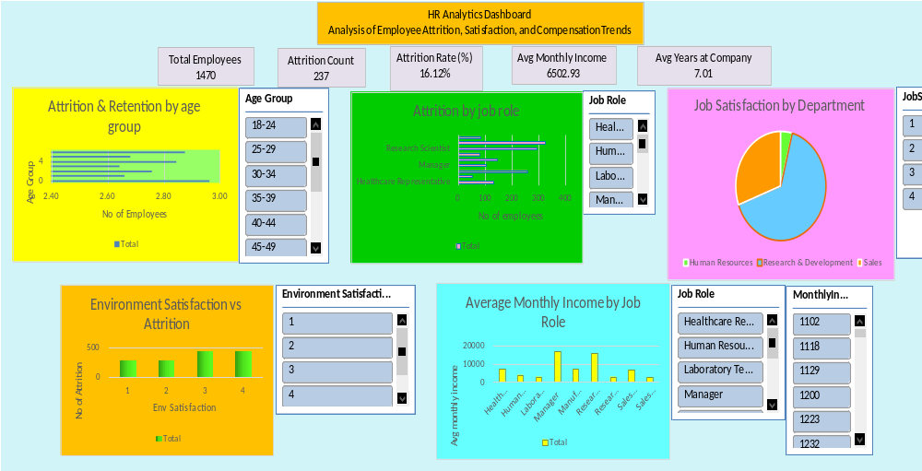

Slide 18
Attrition Analysis and Key Insights

Slide 22
Key Attrition Insights
1. Higher attrition is observed among younger (ages 24–35) and single employees, indicating early-career instability and lower organizational attachment.
2. Research & Development (961) and Sales (446) departments show the maximum turnover, whereas HR records the least attrition.
3. Employees with better work-life balance ratings (3–4) demonstrate stronger retention, highlighting the importance of work-life support initiatives.

Slide 23
Recommendations
1. Strengthen Retention & Engagement
Focus on younger and single employees through mentorship and growth programs.
Conduct stay interviews to identify key motivators and turnover triggers.
2. Enhance Job Satisfaction & Career Growth
Offer skill-building and role rotation opportunities to reduce stagnation.
Recognize and reward high performers regularly to boost morale.
3. Optimize Departmental Policies
Provide tailored workload and incentive structures in R&D and Sales.
Encourage interdepartmental collaboration for a better work environment.
4. Promote Work-Life Balance
Implement flexible schedules and wellness initiatives.
Train managers to proactively address workload stress.
5. Reassess Compensation & Recognition Systems
Align pay scales with contributions and performance.
Communicate promotion criteria transparently.
6. Leverage Data-Driven HR Decisions
Maintain a live dashboard to track satisfaction, retention, and performance trends.
Use predictive analytics to anticipate attrition and workforce needs.

Slide 24
Thank You

