Slide 1
Poster guidance
WHO IS YOUR AUDIENCE
Community of PEOPLE interested in Microsoft Azure and architecting Azure solutions.
WHAT SHOULD YOUR AUDIENCE TAKE AWAY? (factual)
They need to understand the core topics covered by the 70-535 exam.
WHAT DO YOU WANT YOUR AUDIENCE TO KNOW? (feeling)
They need to leave with a positive feeling that there is a visual quick reference guide for studies and solution design.
HOW IS THE POSTER PRINTED?
Paper: (1) Satin 160 gsm (Standard) (White) - All Pages
Page Size: Custom (16.5417 x23.3889)
Final Size: Print on 16.54 x 23.39
DO NOT PRINT THIS SLIDE!

Slide 2
Infrastructure as a Service (IaaS)c
Web Apps
Serverless and Microservices
Virtual Machines
High Performance Compute
App Service Plans
Redis Cache
Functions
Containers
Availability Set
2 fault domains for classic
3 fault domains for Resource Manager deployments
5 update domains
Scale Set
Max 100 VMs
Max 1000 VMs with placement groups (auto scale)
Managed disks needed for large scale sets
VM Series
A0-7, Av2, B General purpose
F Compute optimised
D,E,G Memory optimised
L Storage optimised
N Graphic GPU optimised
H High performance computing
Join VMs to domain
Enable Azure AD Domain Services
HPC Workload Series
A8-11 General purpose
N Graphic GPU optimised
H High performance computing
HPC Pack
Windows Server 2012, 2016, and Linux
Create HPC clusters on-prem
Azure Batch
Most cost-effective option for scientific calculations
Cloud-native HPC solution
HPC head node and compute nodes
Virtual Machine Scale Sets (VMSS)
VMs using RDMA are placed in same VMSS
Virtual Network
Azure Blob Storage for node disks
Hybrid HPC solution
ExpressRoute to connect cloud with on-prem
VPN Gateway endpoint between cloud and on-prem
Free and Shared
Basic
Up to 3 instances (manual)
Standard
Up to 10 instances (auto scale)
5 Slots
Daily backups
Azure Traffic Manager
Premium
Up to 20 instances (auto scale)
20 Slots
Daily backups
Azure Traffic Manager
Isolated
App Service Environment (ASE) – scalable, secure
Up to 100 instances/plan or 100 plans with one instance
Basic
Ideal for development, testing, and non-critical work
No SLA
Standard
Ideal for production and cost effective
Data replication between two nodes
High availability SLA
Premium
Redis persistence
Create workloads > 53GB
Ability to isolate
Serverless compute service
Event-driven actions and triggers
HTTP-based API endpoints (HTTP triggers)
Timer triggers
Programming Languages
C#, F#, Node.js, Java, PHP, PowerShell, Batch, JavaScript, Python, Typescript
Plans
Consumption App Service Plan (cost effective)
Other App Service Plans
Azure Container Instances (ACI)
One ACI = one Docker container
Role Based Access Control (RBAC)
Short-running workloads
Azure Container Services (AKS)
Load balancing
Orchestration
Long running workloads
Deployments vs Migrations
API Management
Cloud Infrastructure Ready
Host on VMs as-is
Cloud DevOps Ready
Use containers to develop and deploy
Decouple application from infrastructure
Cloud Optimised
Modernise mission critical application
Traffic Manager
Service that exposes different apps as APIs
API Gateway
Bridge between app and outside world
Enhanced security, policies, authentication
Caching, throttling
API Management Portal
Define custom APIs
Package APIs into open or protected products
Developer Portal
Developers can access APIs and documentation
Hybrid Applications
Scalability
Routing methods
Performance, Weighted, Priority, Geographic
Handle load & locate closest geo region at DNS level
Service Fabric
Relay Service
Data Management Gateway
Up
Select different (better) Service Plan
Out
Scale out Web App manually or automatically
Logic Apps
Orchestration Platform
Cloud and on-prem
Container orchestration
Lifecycle Management
Service developer (creates microservices)
Application developer (creates applications)
Application administrator (creates config & packages)
Operator (deploys, monitors, maintains)
Hybrid Connections
Establish a rendezvous point in the cloud
On-prem app connects using HTTP/ Sockets to cloud
WCF Relays (Service Bus Relays)
On-prem app uses WCG bindings to connect to Srv Bus
Data-integration service
Create workflows to automate data move + transform
Connect to ML, HDInsight, Data Lake Analytics
Data sent over HTTP using certificates
No firewall ports need to be opened
Web APIs
Workflow Driven
Integration with cloud and on-prem services
BizTalk, …
App Service VNet Integration
Multiple programming languages
ASP.NET, Core, Angular, React.js, Java, Python
Securing Web API
Azure AD
Azure AD B2C – with Facebook and Google providers
Active Directory Federated Services (ADFS)
API Management – policies, API keys, throttling, …
IoT Hub vs Event Hub
App Service Hybrid Connections
Content Delivery Network (CDN)
Connects Azure and on-prem applications using TCP
Uses Azure Relay Service
Part of App Service and is a separate Azure feature
Enables access from app to other services
Deploy app inside a VNet
Access services within same VNet (VMs, DBs, …)
TCP or UDP
Cache static content to multiple regions
IoT Hub – Two-way communication Azure ←→ Devices
Cost effective data ingest, on-way communication from Devices → Azure - Service Bus
AD Application Proxy
On-Premise Data Gateway
Architecting Microsoft Azure Solutions ¹
Access on-prem web apps from the cloud
Provides single sign on (SSO) + secure remote access
Connector – lightweight agent on on-prem server
External endpoint – direct URL or access via MyApps
Bridge between on-prem data sources and Azure
Uses Service Bus
Azure -> Analytics, Logic Apps, Flow, Power Apps, …
On-Prem -> SQL Server, SQL Analytics, SharePoint, …
Scalable Data Implementations
Storage Solutions
Networking
Data Catalog
Data Factory
Storage and Replication
Blob Storage
Virtual Network
Load Balancer
Provides central repository
One catalog per tenant
Sources – Blob Storage, Data Lake, QL Server, Oracle, …
Cloud Service for big data processing and analytics
Data pipelines, activities, datasets, linked services, triggers, pipeline ru, parameters, control flow
Available in - East US, East US2, West Europe
General-purpose v1
Classic, does not support latest features.
General-purpose v2
Newest, that combines v1 and blob storage
Latest features at a reduction in costs
Blob storage
Same features as storage v2 acc, but only block blobs.
Replication (X redundant storage)
Locally – 3 copies within data center
Zone – US East 2 and US Central, 3 datacenter copies
Geo – three regional copies
Unstructured data – VHDs, images, audio, etc.
Max 1TB page blob, 200GB block blob
Access tiers
Hot – optimised for frequently accessed data
Cool – Suitable for backups and not often viewed data
Archive – set at blob level, cannot be read or modified
VNets
Max 50 VNets per subscription
Subnets
Max 1000 subnets per VNet
Max 10 VNet connections (peering) per subscription
Pubic Address
Max 60 public dynamic addresses per subscription
Max 20 public static addresses per subscription
Private Address
Max 4096 private addresses per VNet
DNS
DNS for multiple VNets requires own DNS server
Load Balancing
Transport Layer 4
Any protocol
Azure VMs and Cloud service endpoints
VNet: Internet and internal facing
Endpoint monitoring: Supported via probes
Types
Basic
Standard … up to 1000 VMs, HA ports, and NSG.
SQL Data Warehouse
Data Lake
Table Storage
Massive Parallel Processing (MPP)
Uses Hadoop/Spark and Machine Learning for insights
Uses Data Movement Service (DMS) between nodes
Big data storage and analytics service
Based on Hadoop Yes Another Resource Negotiator (YARN)
Solutions - Store, Analytics, and HDInsights
Data Lake Store
Storage repository for big data workloads
Unlimited structured, semi-, and unstructured data
Data Lake Analytics
Uses serverless approach
Pas-as-you-go, monthly commitment
Uses U-SQL to analyse the data
HDInsights
Deploys Hadoop components in form of clusters in cloud
Opensource service for analysing and processing data
Apache Hadoop, Spark, HBase, Storm, Kafka, Interactive Q
Microsoft R Server
Semi-structured, non-relational data
Suitable for datasets without complex joins
Access via OData and LINA queries
Max 500TB data
Application Gateway
File Storage
Traffic Manager
Gateway
DNS level
Application level 7
HTTP and HTTPS
VNet: Any public or internal IP address
Endpoint monitoring: Supported via probes
SSL
SSL off loading to avoid costly decryption
Firewall
Web Application Firewall (WAF)
Create file shares in the cloud
Access with Server Massage Block (SMB) protocol
Cached fast access on Win Server using Azure File Sync
Queue Storage
Traffic management
DNS level
Any protocol
VMs, Cloud Service, Web Apps, and external endpoints
VNet: Internet facing
Endpoint monitoring: HTTP/HTTPS GET
Load balancing
Use with load balancer for high-avail and high-per
Analysis Services
Asynchronous processing of messages
REST.API supports GET, PUT, and PEEK
Messages max 64KB and max 7days lifetime
Same architecture as SQL Server Analysis
Enterprise grade data modelling in the cloud
StorSimple
MySQL
Integrated storage spanning on-rem an cloud
iSCSI and SMB support
StorSimple Virtual Array
Hyper-V 2000 R2 and VMWare 5.5
iSCSI server (AN) or File Server (NAS).
StorSimple 8000 Series
Leased physical device
Virtual Appliance Manager replicates data to cloud
Disk Storage
Network Security
External Connectivity
Open source relational database
Used by PHP developers, CMS WordPress
ACID, replication, Performance, security, extensibility, concurrency, JSON support
Pricing
Basic – 1TB, 4 CPUs, locally redundancy
General Purpose – 1TB, 4 CPUs, local+geo redundancy
Memory Optimised – 1TB, 5 CPUs, local+geo red.
Used for VMs stored in Az Blob storage as page blobs.
Standard – unmanaged HDD disk drives. LRS and GRS redundancy only.
Premium – SDD, high-performance disk support
DMZ
Network Security Groups (NSG)
User Defined Routes (UDR)
Firewalls
Network Security Groups
Inbound and outbound rules
Checked between VMs, VNets, and other services
Applied to one or more subnets or network interfaces
Low order numbers are higher priority
User Defined Rules
Create UDRs & IP forwarding by creating a routing table
Virtual Network Service Tunneling
Force external traffic through a site-to-site VPN tunnel
Web Application Firewall
Part of Application Gateway and based on OWASP 3.0
Can protect max 20 applications behind an App G/W
Examples: SQL Injection, Cross-Site Scripting, Bots, …
Azure VPN
Basic – max 10 site-site, 128 point-site, avg 100Mbps
VpnGw1 – max 30 site-site, 128 point-site, avg 650Mbps
VpnGw2 – max 30 site-site, 128 point-site, avg 1Gbps
VpnGw3 – max 30 site-site, 128 point-site, avg 1.25Gbps
Site-to-site
Requires Routing and Remote Access Service (RRAS)
Internet Protocol Security (IPSec) connection
Internet Key Exchange (IKE) management protocol
Point-to-site
Connect IKE2 or Secure Socket Tunneling Protocol (SSTP)
No RRAS device required
VNet-to-Vnet
Max 10 VNet connections (peering) per subscription
ExpressRoute
Any-to-Ant (IPVPN) – provider sets up secure connection
Point-to-Point Ethernet –two provider connections
Co-Located at Cloud Exchange – two cross connections
Maximum 10GB
SQL Database
Relational database
Elastic Database Pools (eDTUs)
Individual databases (DTUs)
High availability, geo-replication, failover groups
Backup and Recovery
Basic – 7 days retention
Standard and Premium – 35 days
Restore - Point-in-time, deleted DB, Geo, and Az Recovery Vault
SQL Server Stretch Database
Move or archive cold data from on-premises SQL Server to Azure SQL
PostgresSQL
Cosmos DB Storage
Search
Open source relational database
Open Source, ACID, Replication, Performance, Security, Concurrency, JSON, JSON Indexing, Extensibility
Premium Azure Table Storage
Multi-model and globally distributed database
Low latency, high availability, high performance
APIs
SQL, MongoDB, Gremlin (Graph), Table, Cassandra
Rich search experience over Azure storage
SQL Database, CosmosDB, Blob Storage
Text search, analysis, and linguistic analysis
Tiers
Free, Basic
Standard S1^{25GB,50 indexes}, S2^{100,200}/S3^{200GB}/HD^{1000 indexes}
AJATO Transformations Limited | 2018.09 | github.com/wpschaub/Quick-Reference-Posters

Slide 3
Securing Resources
Securing Data
Governance and Policies
Active Directory
AD Connect
Key Vault
SQL Database Security
Role-Based Access Control
Resource Policies
Directory and identity management
Plans – Free (no SLA, 500k objects), Basic, Premium P1/P2
Protocols – OAuth 2.0, OpenID Connect
Endpoint V1
Work and school accounts
Azure Active Directory Library (ADAL)
Endpoint V2
Work, school, and personal accounts
Microsoft Authentication Library (MSAL)
Microsoft Graph
Connects multi services and provides single endpoint
AAD is integrated in Microsoft Graph
Synchronise on-prem AD identities with Azure
AAD password hash synchronisation
User passwords hashes synched between AD and AAD
Hash synched with any change
Provides single sign-on (SSO)
AAD pass-through authentication
Passwords are not synchronised, but validated on-prem
Provides single sign-on (SSO)
Store cryptographic keys and secrets
Service Tiers: Standard and Premium
Hardware Security Modules (HSM) with Premium
Security for data in transit, rest, and in use
HTTPS – security in transit
Transparent Data Encryption – security at rest
Always Encrypted – data in use, AlwaysEncrypted columns
Implement the principle of least permissions
Roles in Azure can be added to a scope
Scope cam be subscription, Resource Group, or Web App
Set 2000 role assignments from Portal, PS, CLI, Rest API
Built-in Roles: Owner, Reader, Contributor
Define and enforce rules and actions for resources
NOT about users, groups, or application access
Apply governance strategy
Example: All VMs use managed disks
AD Privileged Identity Mngt.
AD Identity Protection
AD Business to Consumer B2C
Disk Encryption
Manage and control access inside an Az AD tenant
Az AD Prem P2 or Enterprise Mobility + Security E5 feature
Grant permanent or temporary role access
Flow: User request, review, approval, notification, action, monitor
Premium protection for Az identities
Detect identity based issues
Detect compromised identities
Policies: MFA registration, user risk, sign-in risk
AD Federation Services
Cloud identity management for mobile and web apps
Leveraged using MSAL
Social Accounts – Facebook, Google, LinkedInn
Enterprise Accounts – OpenID Connect, SAM
Local accounts – email/user and password
App must be registered inside Azure B2C tenant
Encrypt Windows and Linux VMs
Windows – Bitlocker
Linux – dm-crypt
Authentication provider for external users to on-prem
WEB SSO for federated users accessing on-prem apps, using Azure AD Connect
Web Services (WS) – WS-Federation compatible
No external user account management – own credentials using Security Assertion Markup Language (SAML)
Install on-prem of Azure VM and use MS Graph.
Security Center
Operations Management Suite
Advanced Thread Protection and Security Mngt.
Features:
Centralised policy management
Continuous security assessment
Actionable recommendations
Advanced Cloud protection
Prioritised alerts and incidents
Integrated security solutions
Tiers: Free and Standard (hybrid environments)
Advanced Threat Detection
Activity group, campaign, and threat summary report
Az Endpoint Protection
Anti malware protection for Az and on-prem VMw
AD Business to Business B2B
Hybrid cloud and data management tool
Manage on-prem and Az infrastructure
Azure, AWS, Win Server, Linux, VMWare and OpenStack
Services:
Security and Compliance Solution
Security and Audit
Security Domains
Notable Issues
Detection
Thread Intelligence
Multi-Factor Authentication
Enables organizations to work safely with others
Enabled by default for all AAD tenants
Integrated with Office 365
AD Premium Features requires license ration of 5:1 Every AS Premium licence = five external users
Set conditions for users, for example, enforce MFA
Use policies to delegate permissions
AD Managed Service Identity
Storage Encryption
Two step verification (MFA)
Know – password
Have – phone, verification app, 3rd party OAuth tokens
Are - biometrics
Managed identity for resources in Azure
Service Principal only known within bounds of Az resources
Assign appropriate Role-based Access Control (RBAC)
Encryption for data at rest
Storage Service Encryption (SSE)
Written to storage account using 256-bit AES encryption
Set with Portal, PowerShell. CLI, and REST API
Operations Automation Strategies
Operation Automation
Autoscaling Strategy
Architecting Microsoft Azure Solutions ²
Automation ensures consistency and saves time
Development, testing, acceptance, and production
PowerShell – create resources and configure
Desired State Configuration (DSC) – enforce config
Features: Configurations, Resources, Local Config Mgr.
Azure Automation
Process Automation – automate management
Configuration Management – DSC, PowerShell
Update Management – Cloud + on-prem environments
Shared capabilities
3rd Party
Chef – virtual and physical config management, Windows + Linux + Mac
Puppet
Azure Event Grid – supports automation tasks
Azure Logic Apps – supports call to automation runbooks
Azure DevOps – CI/CD
Meet performance and SLA requirements
Vertical scaling – change VM sizes
Horizontal Scaling – add / resource resources
Strategies
Monitoring and alerting
Decision Making Logic – automation runbooks
Az Monitoring Scale – integrated in Az Monitor
App Architectures – Service Fabric scales horizontally
AI, IoT, and Media Services
Cognitive Services
Bot Service
Create modern, intelligent applications, with AI/ML
Artificial Intelligence (AI) & Machine Learning (ML)
Services: Vision, Speech, Language, Knowledge, Search
Vision – Categorise, moderate, classify, index, … images
Speech – Speech enabled, recognition, translate
Language – LUIS, spelling, linguistic, text analysis, web, …
KB – Personal experience, train AI to converse naturally
Search – Bing, autosuggest, entity and custom search
Environment to build and deploy bots
Freeform communication
Tiers
Free – up to 10,000 messages
Standard S1 – pay for 1,000 messages at a time, SLA
Monitoring and Logging
Messaging Services
Log Analytics
Monitor
Machine Learning
IoT Hub, Event Hubs, IoT Edge
Storage Queue
Service Bus
Collects and analyzes log files from resources
Azure and on-prem resources
Analysis tools – OMS, Security Center, AI, PowerBI
Monitoring solution in Az Portal
Infrastructure metrics and logs for Az services
Capabilities:
Activity Log – info on all types of events
Diagnostics Settings – info on events within specific srv
Metrics – time-based metric points for resources
Alerts – View and manage Az alerts
Algorithms to apply complex math calc to big data
Tools
Machine Learning Studio – drag/drop predictive models
Leaning Workbench – end-end science solution
AI Gallery – community-driven solutions
ML Modules – out-box models for analyzing data
Data Science VMs – preconfigured workloads
Internet of Things (IoT) Hub
Send massive amounts of data to Az for processing
Bi-directional, secure and routable communication
Scale up to millions of connected devices
Integrated with Azure Monitor
Tiers: Basic (8k msg/day), S1 (400k), S2 (6M), S3 (300M)
Event Hub
Ingress of device data streams
One-way communication
Aggregated metrics monitoring
Tiers: Basic (100 connect), Standard (1K), Dedicated (25K)
IoT Edge
Installed at the edge of on-prem network, DMZ
Collect device data and send to IoT Hub
Asynchronous processing of messages
Messages up to 64KB in size
7 days retention maximum
Messages become visible after 30sec if not deleted
Multiple receivers
Reliable, brokered messaging system
Ideal for Integration and IoT scenarios
Messages up to 256KB (basic) and 1MB (premium)
Queues – first in first out (FIFO), one consumer
Sessions – grouping of messages by session ID
Topics – Publish/subscribe by multiple consumers
Subscriptions – Apps connect to sub to get to topics
WCF Relays – gateway for on-prem WCF services to Azure
Tiers – Basic, Standard (topics, tx, sessions), Premium
Advisor
Service Health
Stream Analytics
Helps you follow best practices for Az deployments
High Availability
Security
Performance
Costs
Az Portal Dashboard showing resource issues
Views
Service issues
Planned Maintenance
Resource Health
Health Alerts
Pipeline for event processing and real-time analysis
Sources – Apps, sensors, IoT Hub, Event Hub, Blog storage
Targets – Data Lake, PowerBI, SQL data Warehouse
Queue or Bus?
Media Services
Time Series Insights
Queues - Standard queuing with messages up to 64KB
Brokering at enterprise scale with messages up to 1MB, transactions, and sessions - Service Bus
Network Watcher
Application Insights
Secure and high-quality streaming and storage
Flow – Upload → Encode → Secure → Analyse
Cognitive Azure Media Analytics
Indexer, Hyper lapse, Motion detect, summarize, character recognition, face recognition, and moderation
Provide valuable insights into IoT data
DB storage for massive amounts of data
Sources – IoT Hub, Event Hub
Join data – metadata, telemetry, and visualise
Features – Integration, storage, visualization, query
Event Grid
Notification Hubs
Az resource network monitoring for network comms
Capabilities
Topology
IP flow velocity
Next Hop
Security Group View
VPN diagnostics
Packet Capture
Connection Troubleshooting
Monitoring solution for cross-platform apps
Az and on-prem apps
Events
Rate data
Exceptions
Page views and performance
Diagnostic logs
Custom Events
Integration
Event management across Azure resources
Apps are notified when an event happens
Throughput of millions of events and 24h retry
Publishers – Az subscriptions, Event Hubs, Topics, IoT Hub, Resource Groups, Blob storage, Service Bus, V2 storage, …
Push notifications from backends to mobile
Scenarios – Send codes, notifications, news
Tiers
Free – 1 million messages / month
Basic – 10 million messages / month
Standards – 10 million messages / month
IoT Hub vs Event Hub
IoT Hub – Two-way communication
One-way communication for cost effective data ingest – Event Hub
AJATO Transformations Limited | 2018.09 | github.com/wpschaub/Quick-Reference-Posters

Slide 4
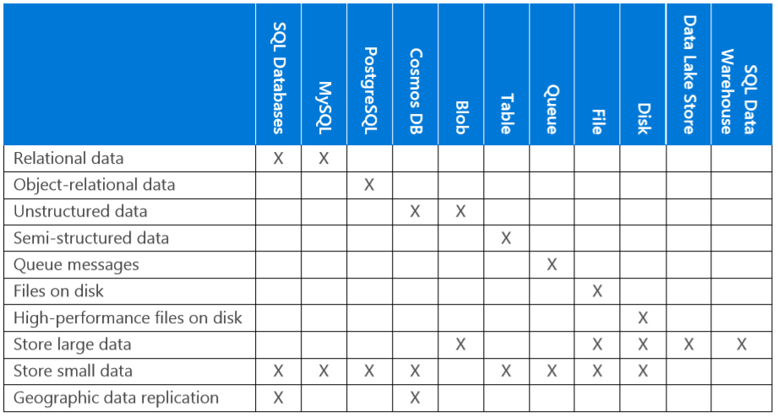
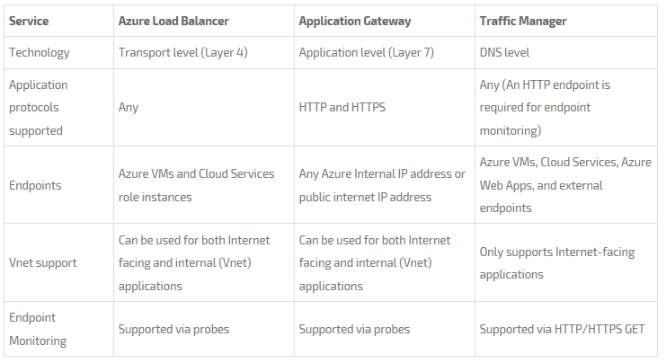
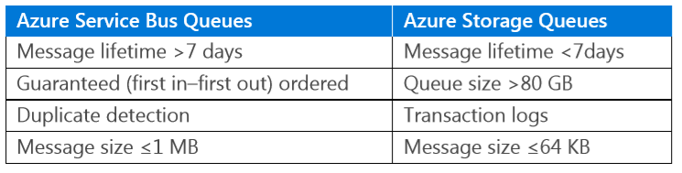
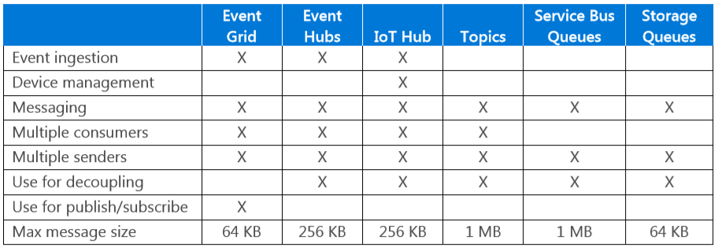


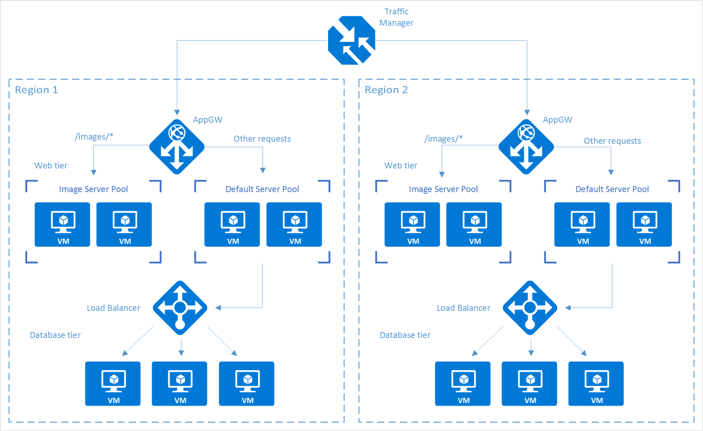
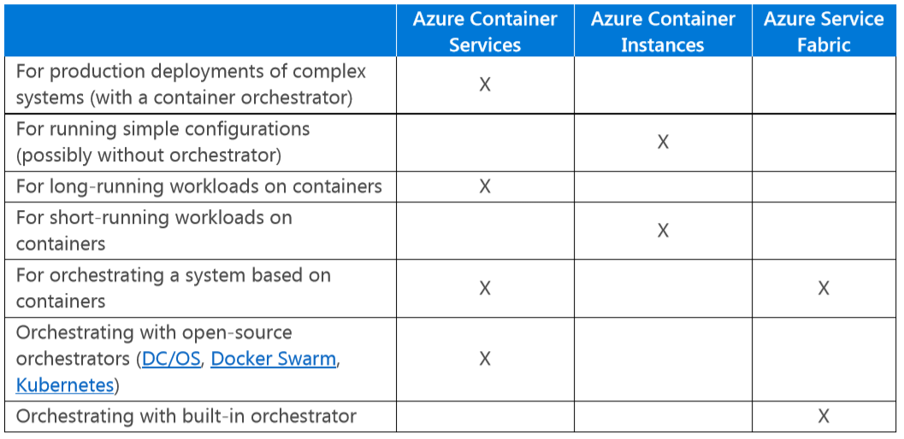
Storage Options
Architecting Microsoft Azure Solutions ³
Service for Msg/Events
Containerisation
Azure Service for Containers
Kubernetes )
DC/OS, Docker Swarm,
AJATO Transformations Limited | 2018.09 | github.com/wpschaub/Quick-Reference-Posters
AJATO Transformations Limited | 2018.09 | github.com/wpschaub/Quick-Reference-Posters

