Slide 1
A parallel algorithm for constructing multiple independent spanning trees in bubble-sort networks
S. Ahmed Ryan i220781
M. Zubair Adnan i220789
Abdullah Saleem i220882

Slide 2
Contents
Terminologies
The Problem
The Solution
Example
Advantage
Our Approach

Slide 3
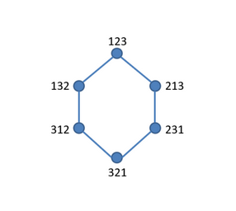
1. Graph
A graph G is defined as:
G=(V,E)
Where:
V is a non-empty set of vertices.
E is a set of edges, where each edge is a pair of vertices from V.

Slide 4

1. Spanning Tree
A spanning tree of a graph is a subgraph that:
Is a tree (i.e., no cycles)
Connects all vertices of the graph
Contains exactly (V - 1) edges for V vertices

Slide 5
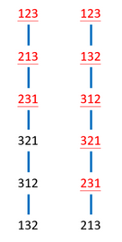
1. Independent Spanning Tree
Multiple spanning trees rooted at the same vertex
For any other vertex v, the paths from v to the root in different trees:
Are node-independent: they share no intermediate nodes.
Or edge-independent: they share no common edges.
Used to ensure fault-tolerant routing: if one path fails, others still work.

Slide 6
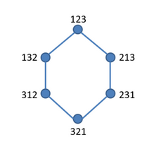
1. Bubble-Sort Network (Bn)
A graph where:
Each vertex = a permutation of n elements (like 123, 213, 321 for n=3)
An edge exists if one permutation can be reached from another by swapping adjacent elements
Called bubble-sort network because:
It mimics the steps of bubble sort, where adjacent elements are swapped to sort a list

Slide 7
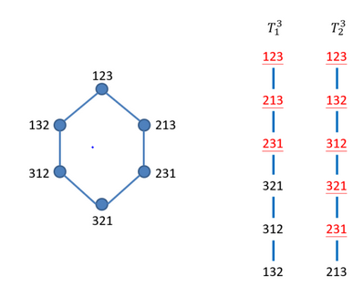
2. The Problem
Finding Independent Spanning Trees in a Bubble-Sort Network.
Previously, recursive algorithms were used
This paper proposes an algorithm that can be made parallel.
For a selected root node, generates n-1 Independent Spanning Trees

Slide 8
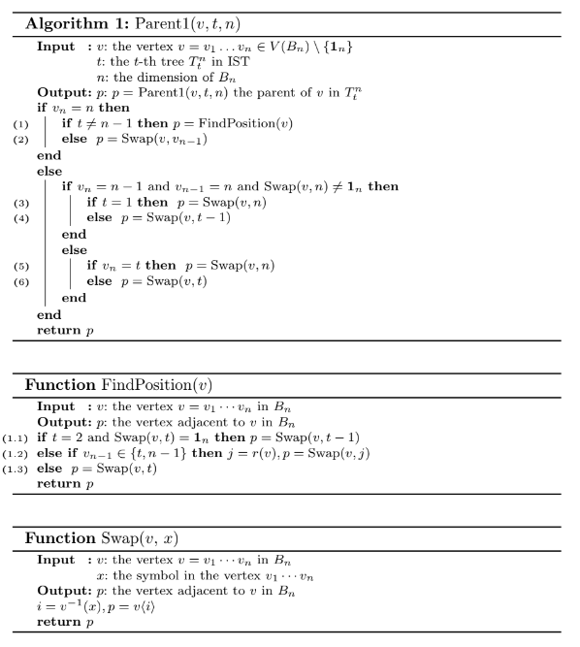
3. The Solution
The idea is to take a vertex, the tree it is part of and dimension of the network and to find its parent.
Continue this process until you reach the root node.
You will have an Independent Spanning Tree.

Slide 9
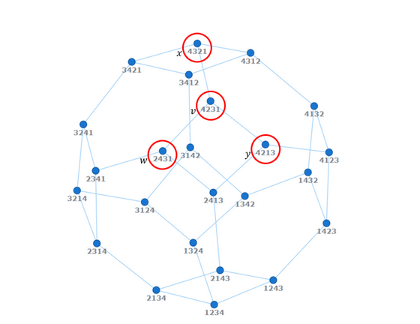
4. Another Example
Bubble-Sort Network with N = 4

Slide 10
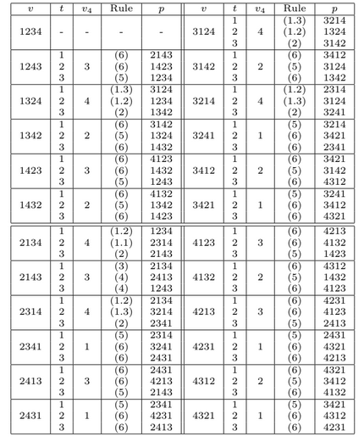
4. Construct Table Once

Slide 11
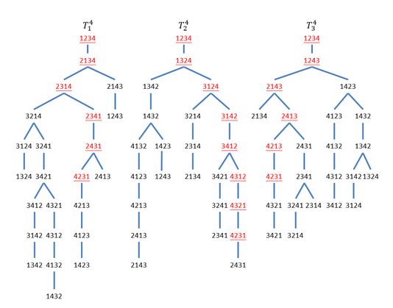
4. Corresponding ISTs

Slide 12
5. Advantage and Complexity
Can be made parallelized
Parent Computation done in constant time
Time Complexity Asymptotically is O(n! * n)

Slide 13
6. Our Approach
We aim to use MPI for inter node communication
OpenMP for intra-node communication
The idea is to efficiently divide the vertices amongst the nodes, and each node can independently find the parent of each vertex and populate the table.

