Slide 1

Predicting 30-Day Hospital Readmission
A leakage-aware, interpretable, and fairness-audited machine learning pipeline
for the UCI Diabetes 130-US Hospitals dataset
Capstone Project | Hospital Readmission Risk Analytics

Slide 2
The Problem & Why It Matters
$26B/yr
HRRP
HF • COPD • Pneumonia
Estimated annual US cost of
preventable hospital readmissions
Medicare penalizes hospitals for
excess 30-day readmissions
Conditions most heavily targeted
by readmission penalty programs
Project Goal
Predict which patients are at risk of readmission within 30 days of discharge, using structured EHR data — then translate that risk score into a concrete, tiered clinical intervention, not just a number.
✓ Build a leak-free, honestly-evaluated predictive model
✓ Explain predictions with SHAP — not a black box
✓ Audit and mitigate demographic performance gaps
✓ Design a real intervention & deployment pathway
Hospital Readmission Risk Prediction
2

Slide 3

Dataset Overview
UCI Diabetes 130-US Hospitals Dataset (1999–2008)
101,766
71,518
23%
7.96 : 1
Total inpatient encounters
Unique patients
Patients with multiple
encounters (leakage risk)
Class imbalance ratio
(not-readmitted : readmitted)
Why patient overlap matters
Our fix: patient-grouped splitting
16,773 patients appear more than once in the data. A naive random split can place the same patient's encounters in both training and test sets — letting the model partially memorize patient identity instead of learning genuine risk patterns.
Stratified 70 / 15 / 15 train–validation–test split, grouped by patient_nbr — verified with zero patient overlap across all three splits.
30-day target: 11,357 readmitted vs. 90,409 not readmitted (pre-filtering)
Hospital Readmission Risk Prediction
3

Slide 4

Data Quality & Preprocessing
Missing data — handled by type, not blindly imputed
Removing a hidden artifact
Feature | Missing | Treatment
weight | 96.9% | Dropped → kept as binary flag
max_glu_serum | 94.7% | Dropped → kept as binary flag
A1Cresult | 83.3% | Dropped → kept as binary flag
medical_specialty | 49.1% | Explicit “Unknown” category
payer_code | 39.6% | Explicit “Unknown” category
Discharge codes 11, 19, 20, 21 denote patient death. A deceased patient cannot be readmitted — keeping these rows creates a spurious “never-readmitted” signal that distorts both the model and later fairness comparisons.
Removed 1,652 of 101,766 encounters (1.62%)
Feature engineering & split
num_med_changes
total_visits_prior
Patient-grouped 70/15/15 split
Collapses ~20 near-constant drug columns into one meaningful signal
Sum of prior outpatient, emergency, and inpatient visits
Zero patient overlap across train, validation, and test
Hospital Readmission Risk Prediction
4

Slide 5

Exploratory Analysis: A Hard, Imbalanced Problem
Top predictive signals found in EDA
Prior inpatient visits (number_inpatient) show the clearest separation between classes
Longer time_in_hospital correlates with lower same-admission risk of quick return
Feature correlation is modest overall — no single feature dominates linearly
Confirms need for a non-trivial model, not simple rule-based scoring
Imbalance ratio: 7.83 : 1 after excluding expired-patient encounters
Hospital Readmission Risk Prediction
5

Slide 6

Modeling Approach
Logistic Regression
Random Forest
Decision Tree
XGBoost
Linear baseline (mandatory)
Bagged ensemble
Interpretable tree baseline
Gradient-boosted ensemble
Logistic Regression, Random Forest, and XGBoost tuned via GridSearchCV • Stratified 5-fold cross-validation
A leakage bug we found — and fixed
SMOTE was originally applied once, globally, before cross-validation. Synthetic minority samples could then leak across fold boundaries — Random Forest and Decision Tree showed 90%+ recall during cross-validation, but under 5% recall on the untouched validation set.
The fix: SMOTE moved inside an imblearn Pipeline, refit fresh within every CV fold and every GridSearchCV inner fold — no synthetic sample ever crosses a fold boundary.
Hospital Readmission Risk Prediction
6

Slide 7

Methodology Pipeline
From raw encounters to a deployed, calibrated risk score
Raw data
Cleaning & filtering
Feature engineering
Patient-grouped split
101,766 encounters, 50 columns
Drop near-empty fields, remove expired-patient rows
num_med_changes, total_visits_prior, encodings
70 / 15 / 15, zero patient overlap
SMOTE inside CV folds
Train 4 models
GridSearchCV tuning
Threshold selection
imblearn Pipeline — no leakage across folds
Logistic Regression, RF, Decision Tree, XGBoost
3 of 4 models tuned, stratified 5-fold CV
Matched-recall comparison → XGBoost @ 0.12
Final model: XGBoost @ threshold 0.12
ROC-AUC 0.679 • Recall 63.7% • SHAP + fairness audited
Hospital Readmission Risk Prediction
7

Slide 8

Model Results — Validation Set
After fixing the SMOTE cross-validation leakage
Model | Accuracy | Precision | Recall | ROC-AUC
Logistic Regression | 0.642 | 0.176 | 0.588 | 0.668
Random Forest | 0.822 | 0.226 | 0.236 | 0.649
Decision Tree | 0.850 | 0.270 | 0.188 | 0.636
XGBoost | 0.887 | 0.484 | 0.017* | 0.679
Best ranking model
XGBoost
ROC-AUC 0.679
Highest area under the ROC curve of all four models — but its default-threshold recall is misleadingly low, addressed next.
* at default 0.5 threshold — misleading in isolation, see next slide
5-fold cross-validated recall (mean): LR 0.578 • RF 0.211 • DT 0.175 • XGBoost 0.009 — all consistent with validation, confirming the leakage fix held
Hospital Readmission Risk Prediction
8

Slide 9

Threshold Selection: Recall Over Precision
Clinical cost asymmetry: a missed high-risk patient (false negative) can mean a preventable readmission. An unnecessary follow-up call (false positive) costs only staff time. This project deliberately optimizes for recall over precision.
Model | Threshold | Recall | Precision | ROC-AUC
XGBoost | 0.12 | 0.637 | 0.176 | 0.679
Logistic Regression | 0.49 | 0.614 | 0.172 | 0.668
Random Forest | 0.37 | 0.626 | 0.166 | 0.649
Decision Tree | 0.30 | 0.632 | 0.160 | 0.636
Final deployed model
XGBoost @ 0.12
Best recall (63.7%) and best ROC-AUC among all models at this operating point. Logistic Regression's precision edge (+0.07pp) is within noise — not a deciding factor.
Compared at a matched recall of ~60–64%, so the comparison is fair across models
Hospital Readmission Risk Prediction
9

Slide 10

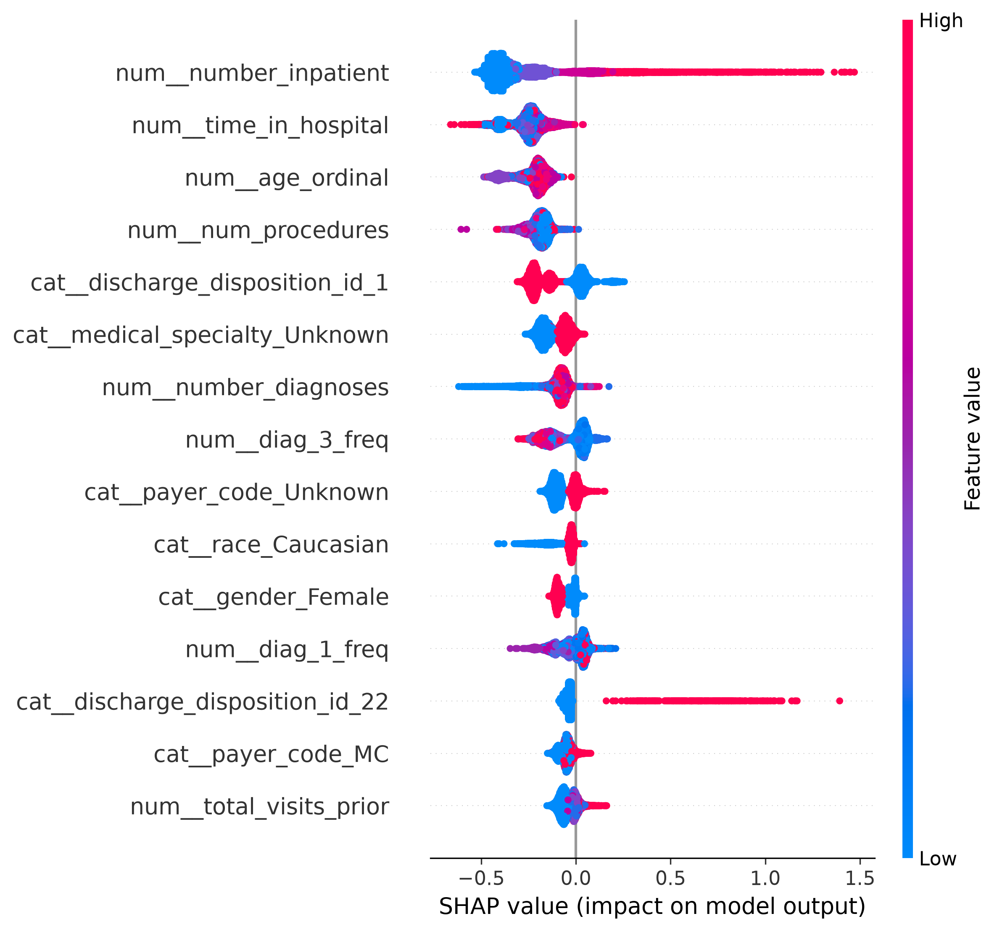
Interpretability: What Drives the Model?
SHAP (SHapley Additive exPlanations) on the final XGBoost model
Top predictors, ranked by mean |SHAP value|
number_inpatient
Prior inpatient visits — strongest signal, matches clinical literature
time_in_hospital
Current stay length
age_ordinal
Patient age band
num_procedures
Procedures performed this stay
discharge_disposition_id_1
Discharged directly home
An earlier version surfaced discharge_disposition_id_11 (“Expired”) in the top 10 — the artifact removed in preprocessing (see slide 4).
Hospital Readmission Risk Prediction
10

Slide 11

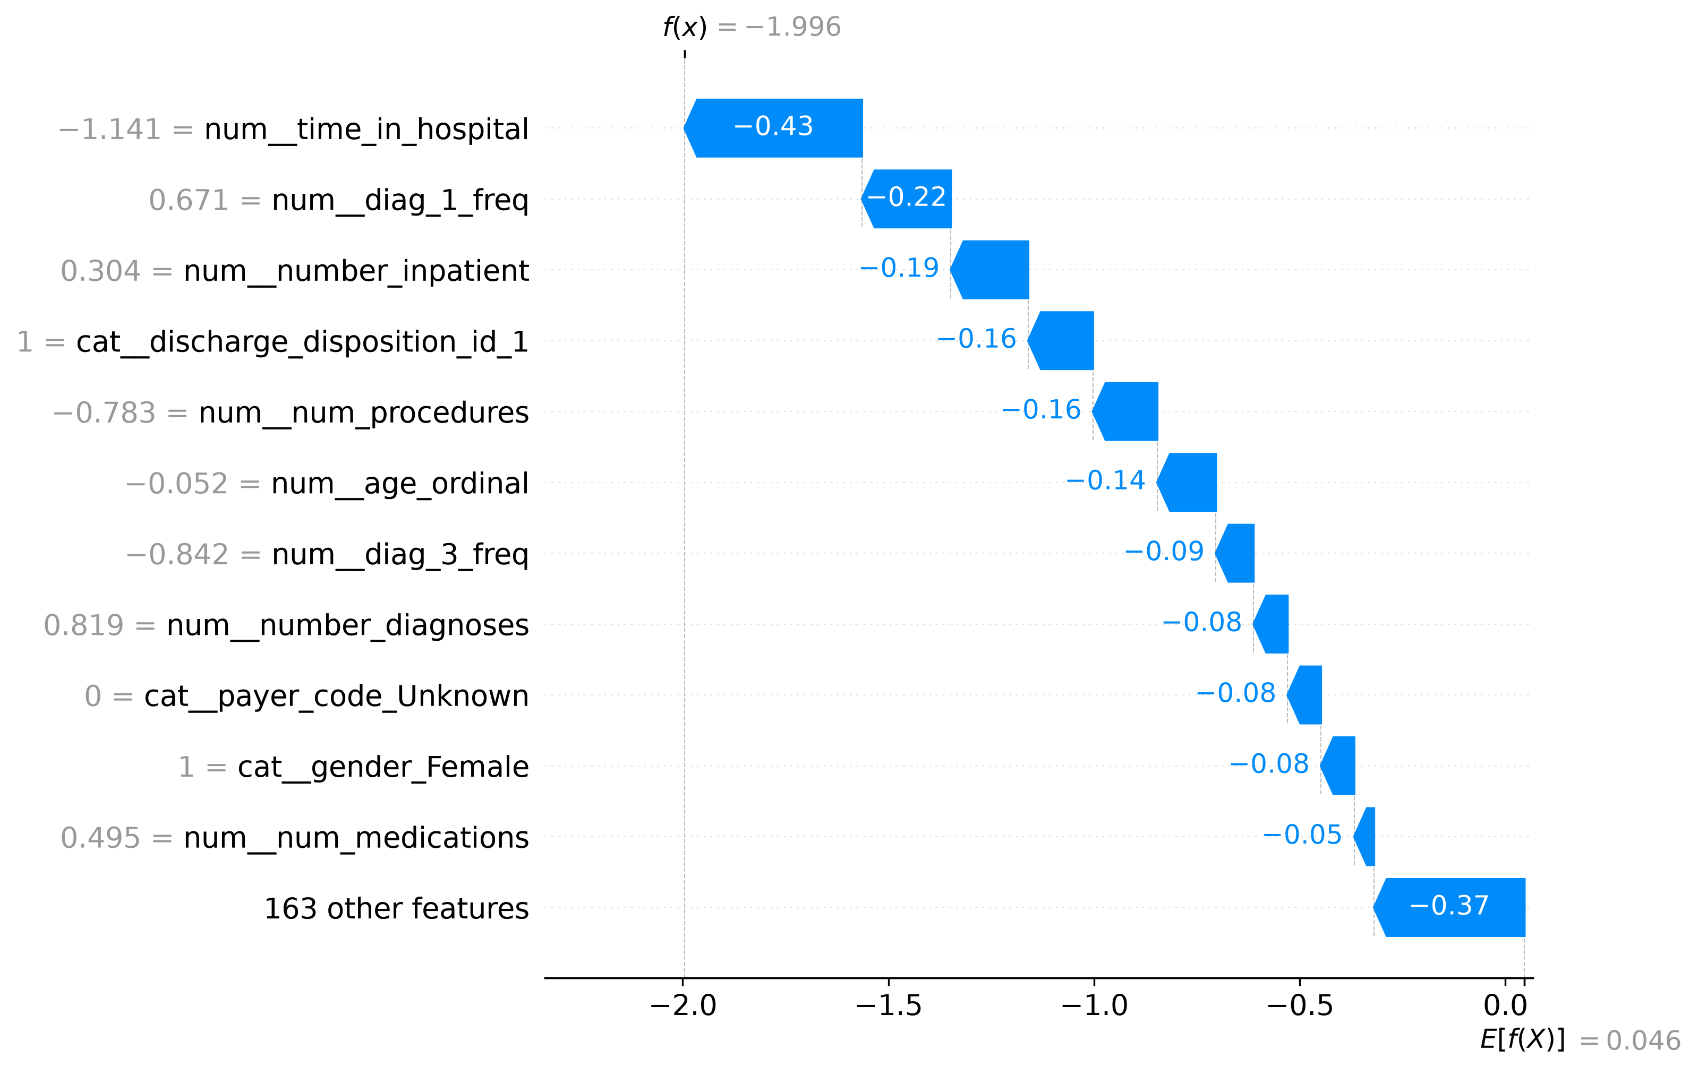
Case Study: A Patient the Model Missed
SHAP waterfall — false negative example
Why this patient slipped through
This patient was actually readmitted, but was scored low-risk. The model's strongest feature — prior inpatient visits — was below average for them, and an unusually long current stay reinforced a false impression of stability.
Key takeaway: administrative utilization history cannot capture clinical deterioration or social factors emerging after discharge — a genuine ceiling on what these features can predict.
Hospital Readmission Risk Prediction
11

Slide 12

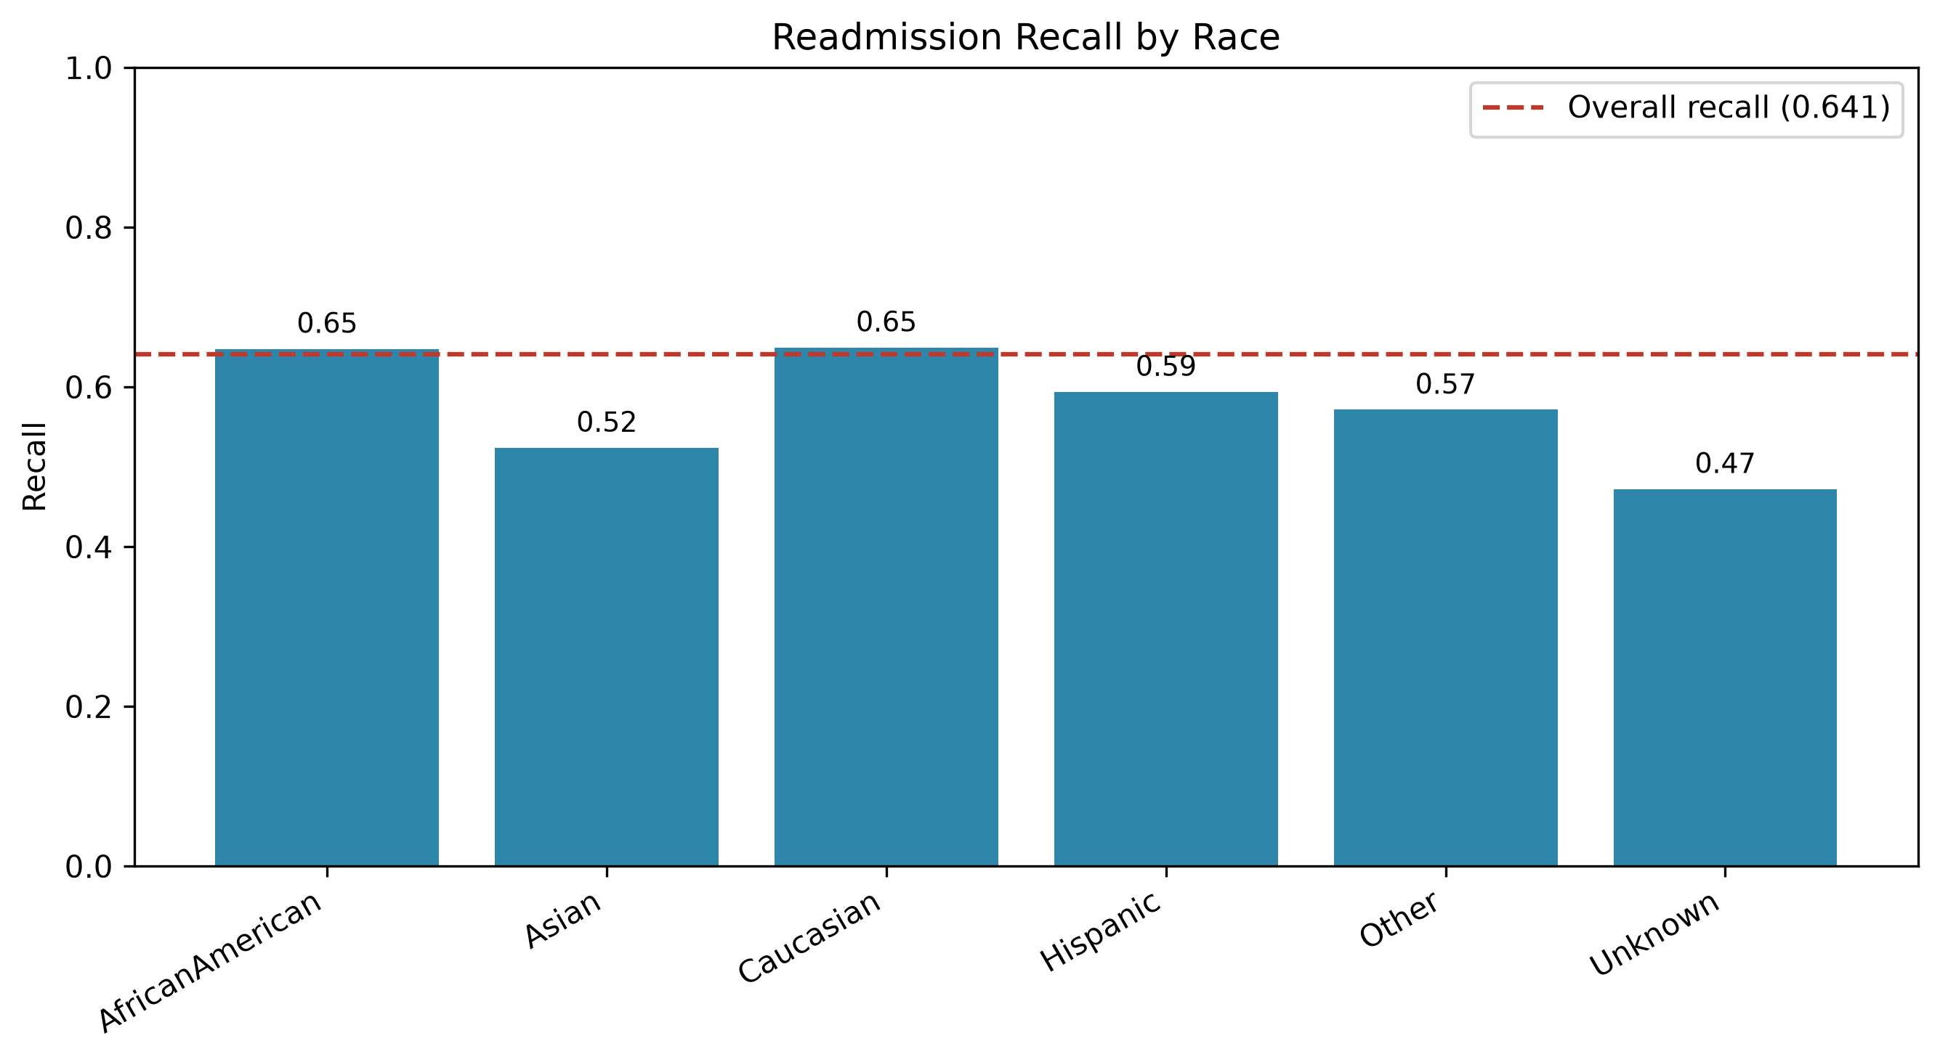
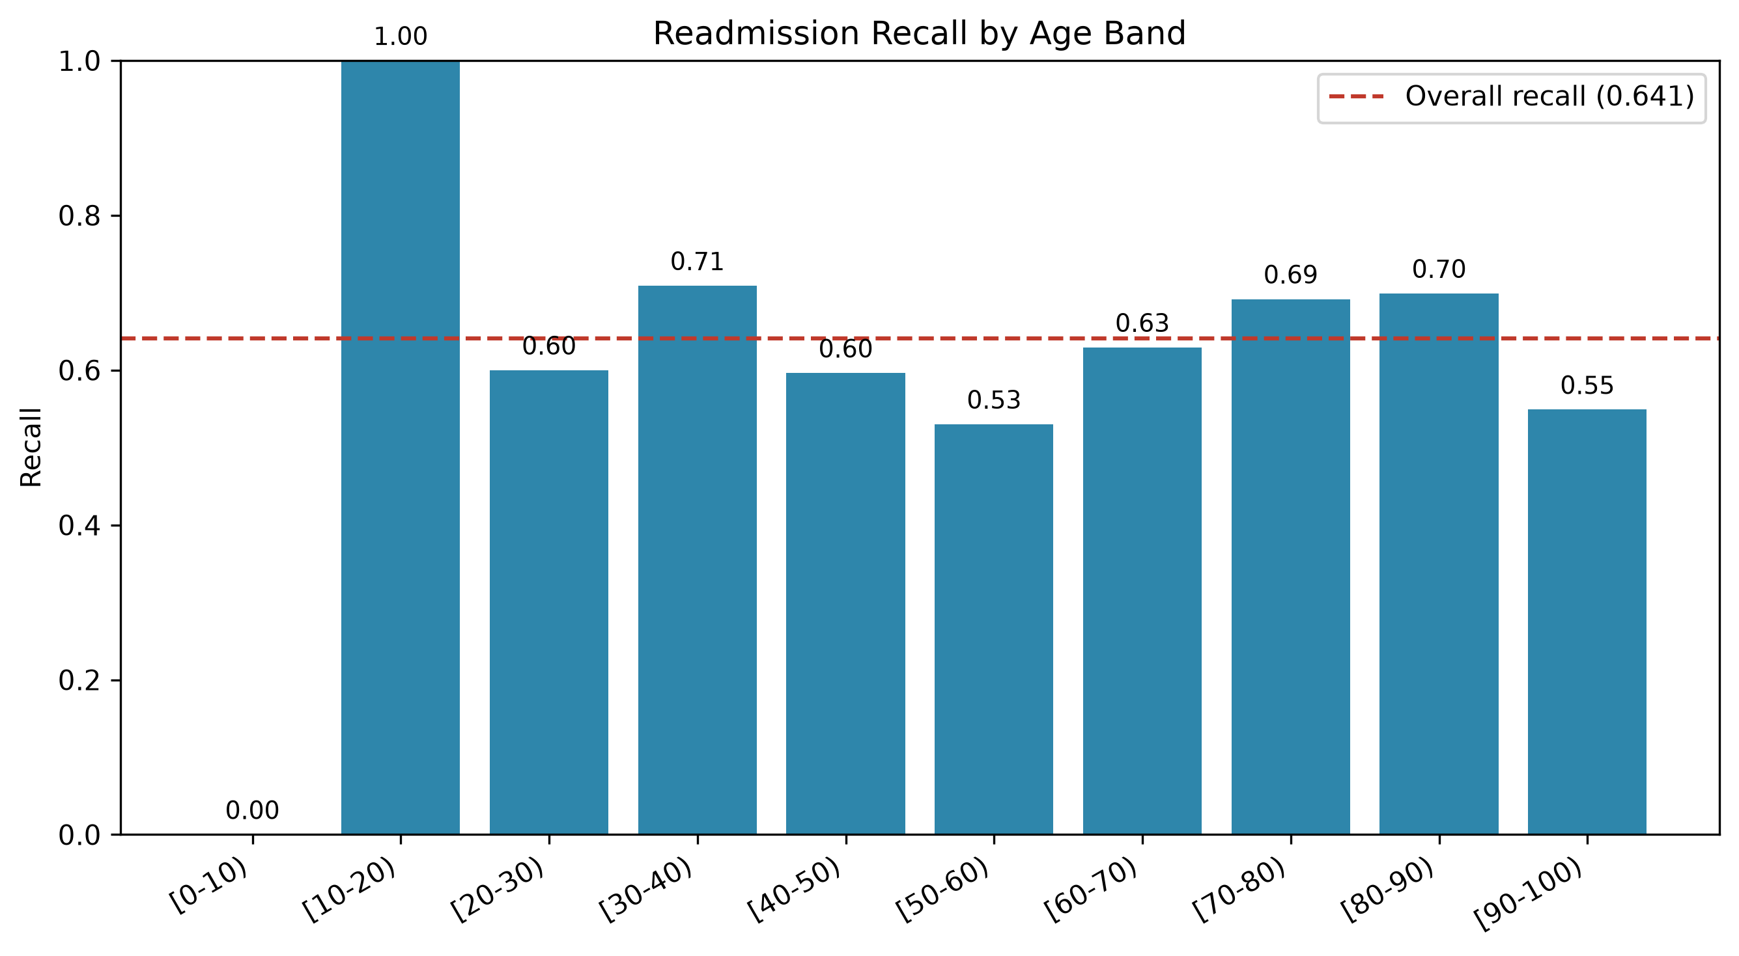
Fairness Analysis: Recall Across Subgroups
Test-set recall at the deployed 0.12 threshold (overall = 0.641)
Real, credible gap found: age band [50–60)
With a large, trustworthy sample (n=2,592), this group's recall is 0.530 vs. 0.641 overall — an 11-point real gap. The two largest race groups (African American, Caucasian; n>2,700 each) sit at parity, ~0.65 recall each. Smaller subgroups (Asian, Hispanic, Unknown) trend lower, most likely reflecting underrepresentation rather than model bias.
Hospital Readmission Risk Prediction
12

Slide 13

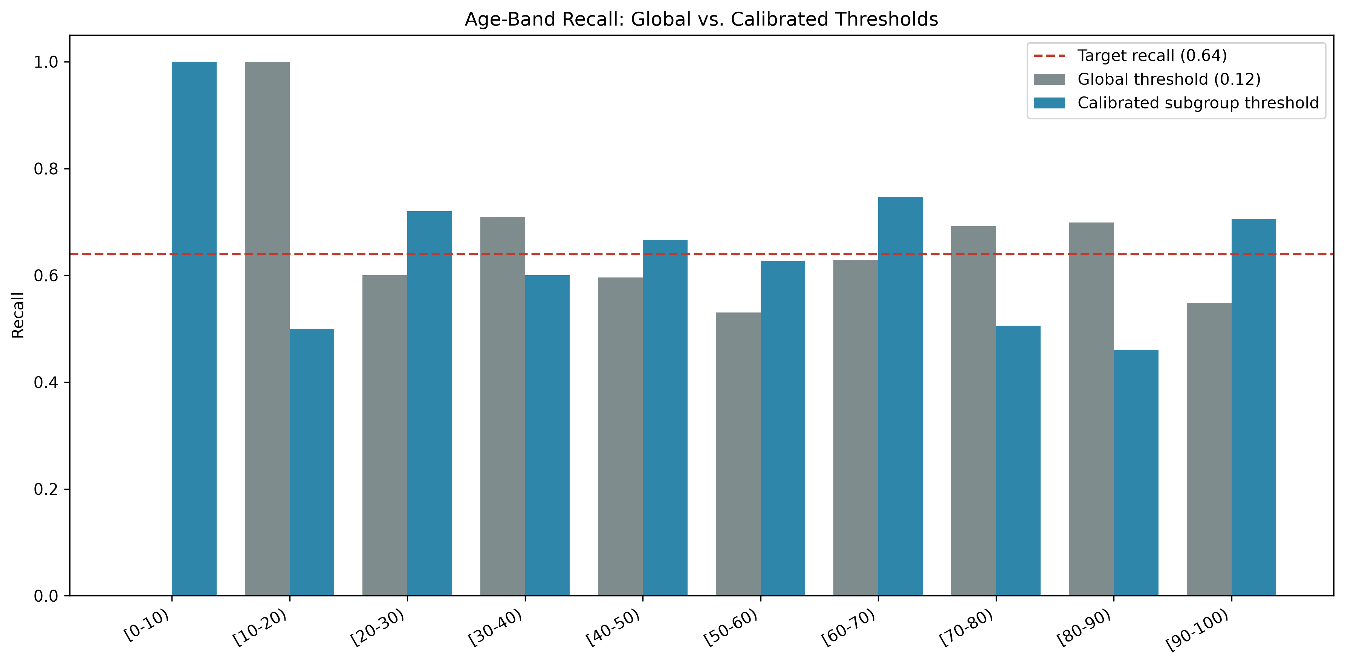
Mitigation: Subgroup Threshold Calibration
Result for [50–60)
0.530 → 0.627
Recall improvement after lowering the group's threshold from 0.12 to 0.10
Cost: precision fell by ~1.6 percentage points (0.178 → 0.162)
Honest caveat: recalibrating one age band shifted others — [70–80) and [80–90) recall declined. Per-subgroup thresholds are not a free lunch and require clinical and governance sign-off before deployment, not a silent statistical fix.
Hospital Readmission Risk Prediction
13

Slide 14

Ethics & Governance
HIPAA & GDPR
HL7 FHIR
De-identification, role-based access control, and full audit logging for any patient data used by the model.
The standard hospital EHR systems would use to feed structured patient data into the model in production.
Patient consent
Clinician override
Patients should be informed that an algorithmic risk assessment is part of their discharge planning.
The model is decision support, not an automated decision — a clinician can always override it using information the model cannot see.
Hospital Readmission Risk Prediction
14

Slide 15
From Risk Score to Clinical Action
4 data-driven risk tiers, justified by observed 30-day readmission rate
Low Risk
8,786
6.9%
Standard discharge instructions, routine primary-care follow-up
[0.00–0.12)
patients
observed rate
Moderate Risk
4,367
14.0%
Follow-up call within 72 hrs + medication reconciliation
[0.12–0.20)
patients
observed rate
High Risk
1,584
22.9%
Project BOOST: teach-back, pre-discharge appointment, 48-hr call
[0.20–0.35)
patients
observed rate
Very High Risk
260
41.5%
Care Transitions Intervention: coach, 72-hr home visit, 30-day calls
[0.35–1.00]
patients
observed rate
Grounded in Project BOOST (Society of Hospital Medicine) and the Care Transitions Intervention model
Hospital Readmission Risk Prediction
15

Slide 16

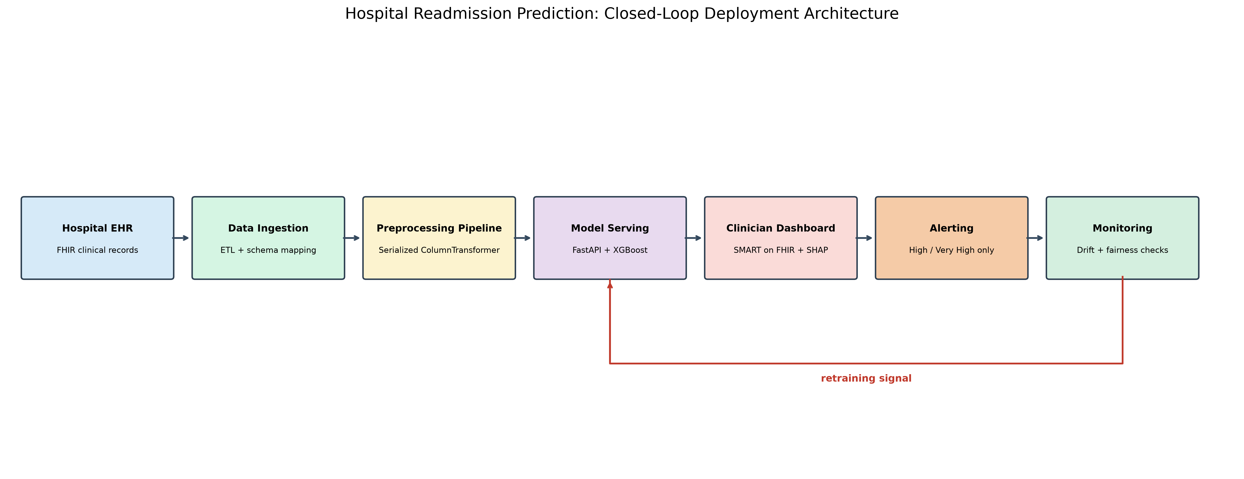
Deployment Architecture
A closed feedback loop, not a one-time launch
Ingestion (HL7 FHIR) → Preprocessing (serialized pipeline) → Model serving (FastAPI/Docker) → Clinician dashboard → Selective alerting → Drift & fairness monitoring
Hospital Readmission Risk Prediction
16

Slide 17

Live Demo
Hosted Streamlit application, publicly accessible
Try it yourself
30-Day Hospital Readmission Risk
hospital-readmission-capstone
-aa44rabxhs6wftu3fn5sdy
.streamlit.app
Predicted 30-day readmission probability
25.4%
✓ Preset low-risk & high-risk example patients
HIGH RISK
✓ Full editable form for any patient profile
Recommended: Project BOOST-style structured discharge — teach-back education, appointment scheduled before discharge, and a follow-up call within 48 hours.
✓ Runs the real, saved preprocessing + XGBoost pipeline
✓ Returns probability, risk tier, and intervention text
Decision-support prototype — not a validated clinical tool
Hospital Readmission Risk Prediction
17

Slide 18

Limitations
Modest performance ceiling
Small-subgroup uncertainty
ROC-AUC of ~0.68 is consistent with published readmission-prediction literature — this is a genuinely hard problem, not an implementation shortfall.
Fairness metrics for the smallest race and age subgroups (n<300) carry wide uncertainty and should not be over-interpreted as bias.
Thin Very High Risk sample
Threshold calibration trade-offs
Only 260 test patients (n=31 at the extreme end) fall in this tier — its 41.5% observed rate is directionally reliable but less precise than other tiers.
Fixing one subgroup's recall gap shifted performance in others — any per-group threshold needs governance review, not automatic deployment.
Hospital Readmission Risk Prediction
18

Slide 19

Conclusion & Key Takeaways
1
Built a leak-free, patient-grouped, honestly cross-validated readmission model — XGBoost at threshold 0.12, ROC-AUC 0.679, recall 63.7%
2
Found and fixed a real SMOTE cross-validation leakage bug and a data artifact (expired patients) before finalizing the model
3
Made the model explainable with SHAP, including an honest false-negative case study, not just headline accuracy
4
Audited fairness across race, gender, and age; found and partially mitigated a real recall gap in the [50–60) age band
5
Translated risk scores into 4 literature-grounded, actionable clinical intervention tiers
6
Designed a full deployment architecture and shipped a working, publicly hosted demo application
Hospital Readmission Risk Prediction
19

Slide 20

References
[1] Kansagara, D., et al. (2011). Risk prediction models for hospital readmission: a systematic review. JAMA, 306(15), 1688–1698.
[2] Strack, B., et al. (2014). Impact of HbA1c measurement on hospital readmission rates. BioMed Research International.
[3] Chawla, N. V., et al. (2002). SMOTE: Synthetic Minority Over-sampling Technique. JAIR, 16, 321–357.
[4] Lundberg, S. M., & Lee, S.-I. (2017). A Unified Approach to Interpreting Model Predictions. NeurIPS.
[5] Coleman, E. A., et al. (2006). The Care Transitions Intervention. Archives of Internal Medicine, 166(17), 1822–1828.
[6] Society of Hospital Medicine. Project BOOST Implementation Guide.
[7] UCI Machine Learning Repository. Diabetes 130-US Hospitals for Years 1999–2008 Data Set.
Thank you — Questions?
Full code, notebooks, results, and the live demo app are available in the project GitHub repository.

