Slide 1
MetaverseProgramming
Final Project
By Natalie Böhm – 2023130175

Slide 2
Project
HungerGames meets MazeRunner
Maze
Inventory
Flashlight
Map??
NPC Enemies -> Ghosts
Healthsystem
Treasure
Chatting System

Slide 3
Demonstration Of the Game

Slide 4
Remarkable achievements
Trigger Events
Chatting System
Inventory
https://www.youtube.com/watch?v=AoD_F1fSFFg&list=WL&index=1&t=489s
Use of Classes
Canvas

Slide 5
Challanging Aspects
Inventory
NPCs
Photon Connection

Slide 6
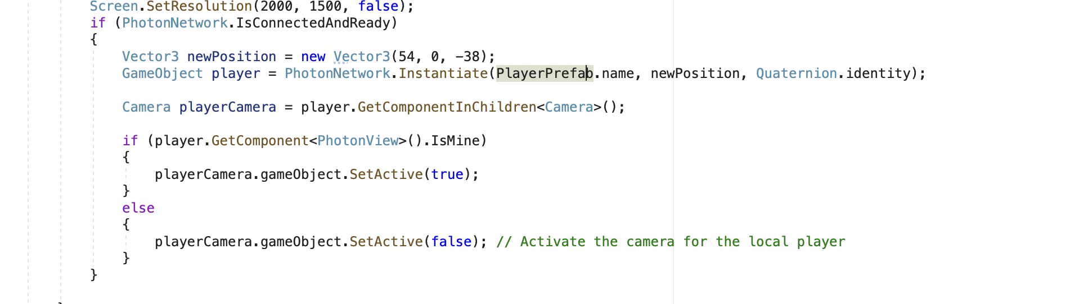
Problem While Programming

Slide 7
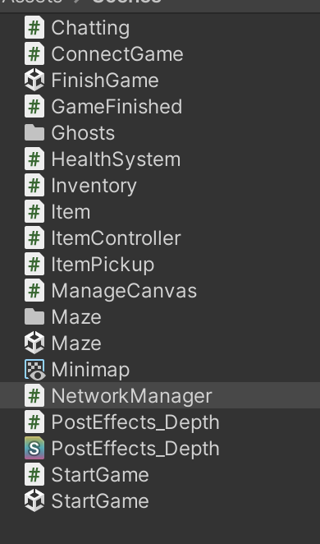
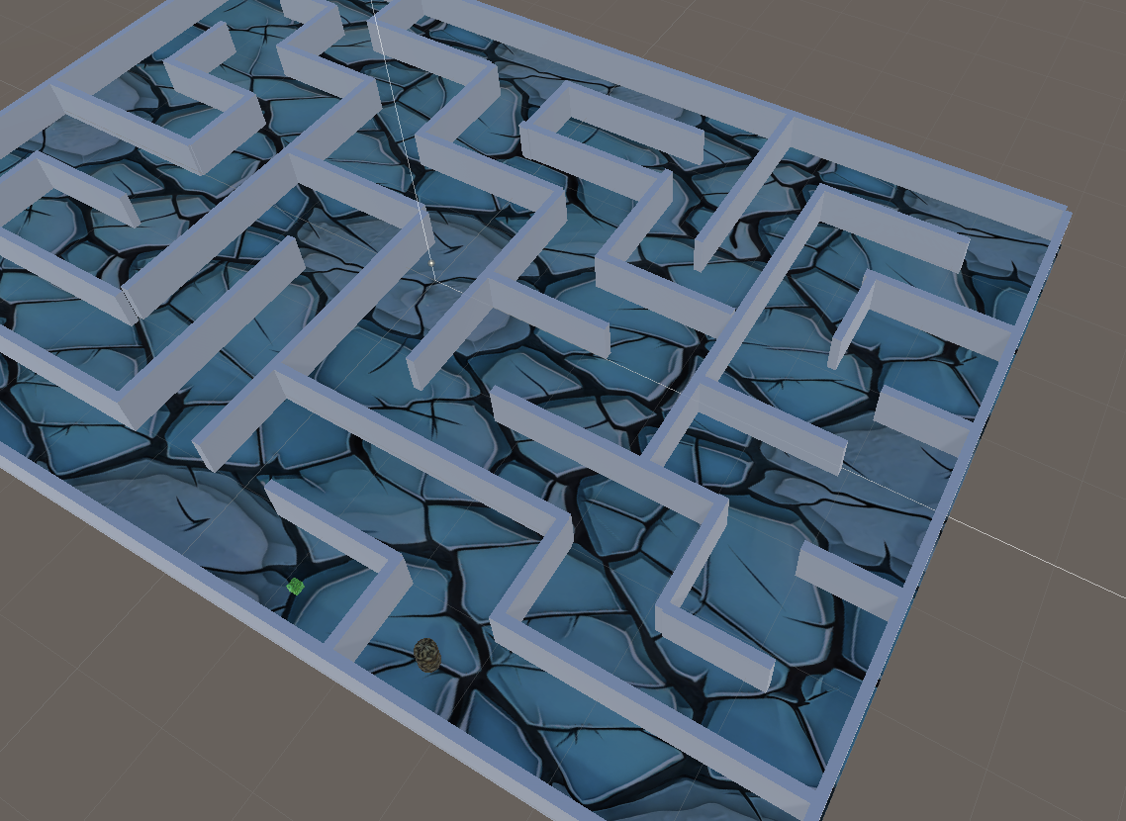
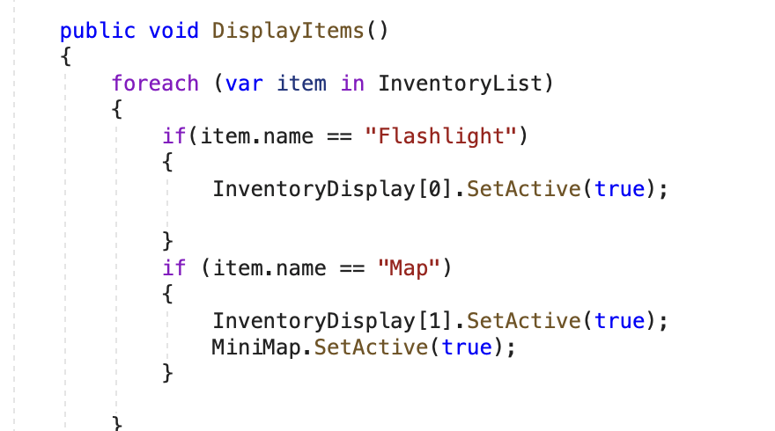

critical enquiry
More Structure
Design
Scripts -> Hardcoded Variables
Game Objects

Slide 8

Possible Further development
Other Items to collect
Keys
More Intelligent Ghosts

