Slide 1

Project Report
INTRODUCTION
1.1 Overview
Here is the android chatting app named as "Kuruvi", It has individual user to communicate between one user and another
1.2 Purpose
A chat application makes it easy to communicate with people anywhere in the world by sending and receiving messages in real time. With a web or mobile chat app, users are able to receive the same engaging and lively interactions through custom messaging features, just as they would in person

Slide 2
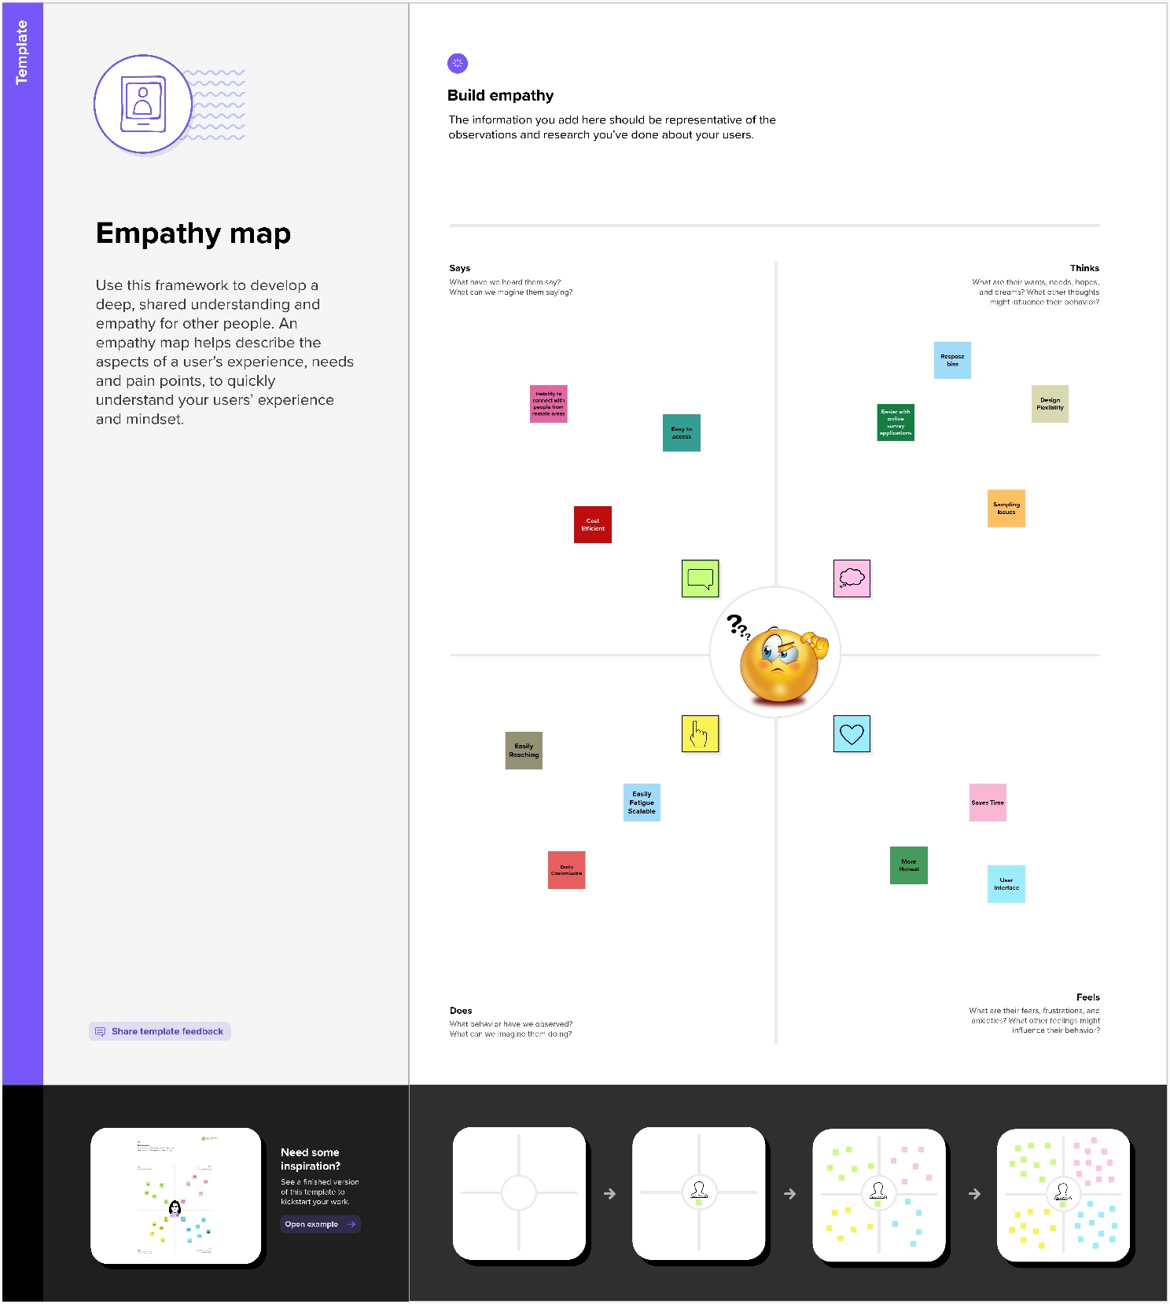
Problem Definition & Design Thinking
2.1 Empathy Map

Slide 3
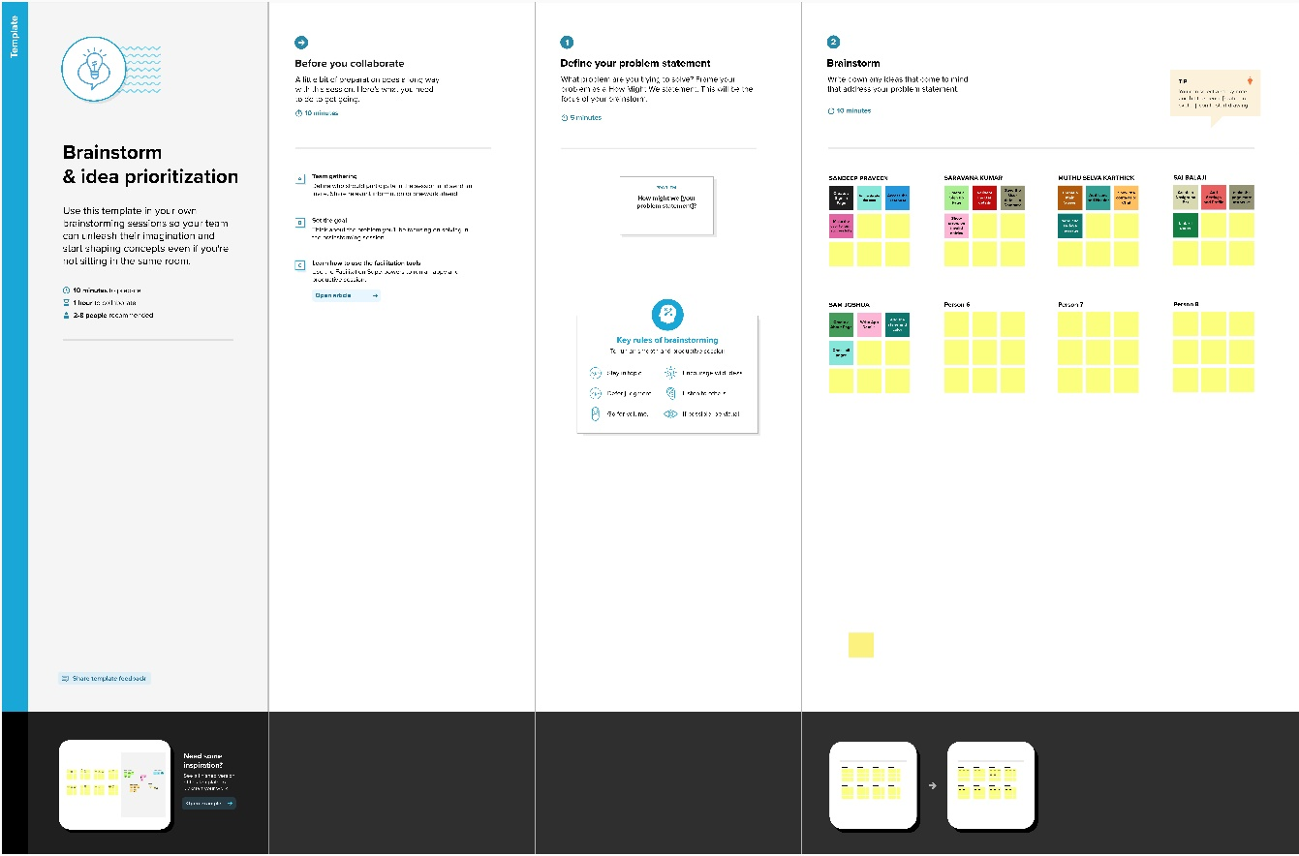
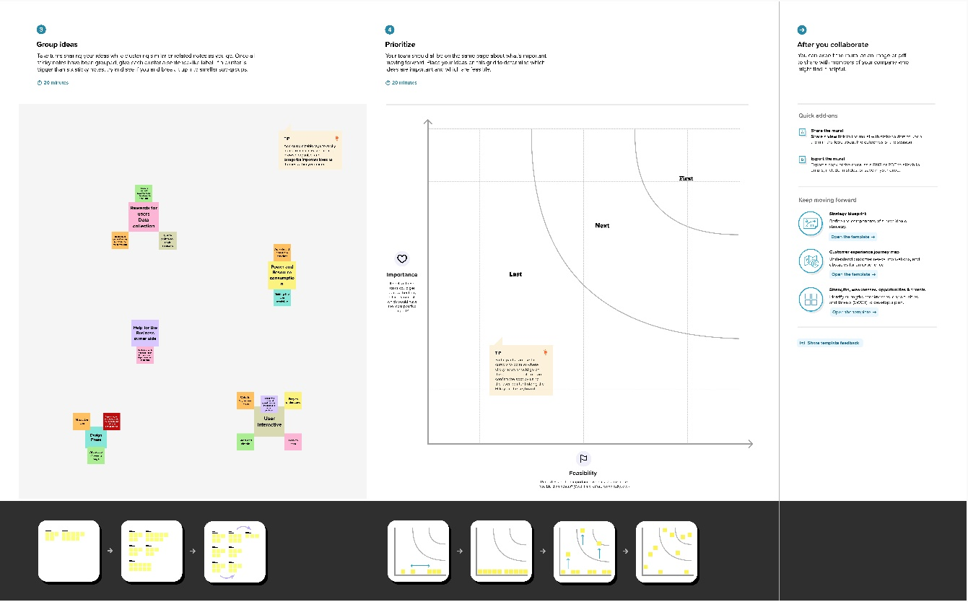
2.2 Ideation & Brainstorming Map

Slide 4



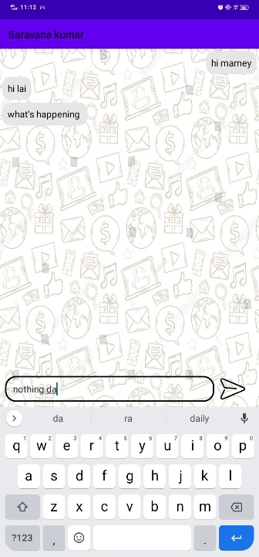
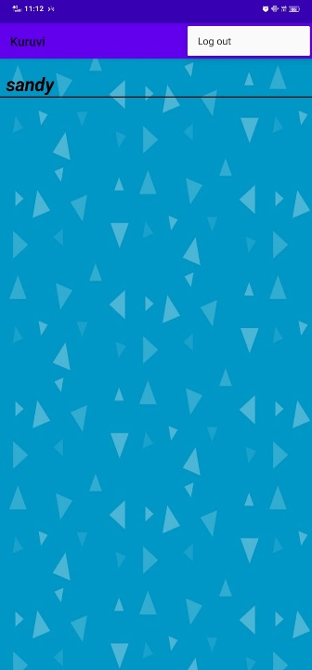
3 RESULT Output

Slide 5
4 ADVANTAGES & DISADVANTAGES
Advantages
Anonymity
The chance to meet new people with different views
The opportunity to get perspectives from around the world
Easy to find people based on your age, gender identity, sexual orientation, interests, and goals (whether you're looking for social support or dating)
Free and easy to use
Offers unbiased opinions
Disadvantages
You can't be sure other people are being honest or that they are who they say they are
If you are feeling vulnerable, people online might try to take advantage of you
Building relationships online can result in your spending less time with friends and family

Slide 6
5 APPLICATIONS
Chatting app allows you to communicate with your customers in web chat rooms.
It enables you to send and receive messages. Chatting apps make it easier, simpler
faster to connect with everyone and it is also easy to use.
There are many types of chatting apps and everyone has its own format, design, and functions.
6 CONCLUSION
The chat app provides a better and more flexible chat system.
Developed with the latest technology in the way of providing a reliable system.
The main advantage of the system is instant messaging, real-world communication, added security, group chat, etc.

Slide 7
7 FUTURE SCOPE
Chat is essentially human-driven workflow
Chat apps have been popular for use in sales and support engagement
The majority of bots are being used today to provide answers to simple and quick questions
Chat apps are great at answering simple or even complex
Messenger, cellular companies and other messaging options claim they provide end-to-end encryption
8 APPENDIX
Source Code
Visit: blueprincesandy/ChatConnect---A-Real-Time-Chat-and-Communication-App (github.com)

