Slide 1


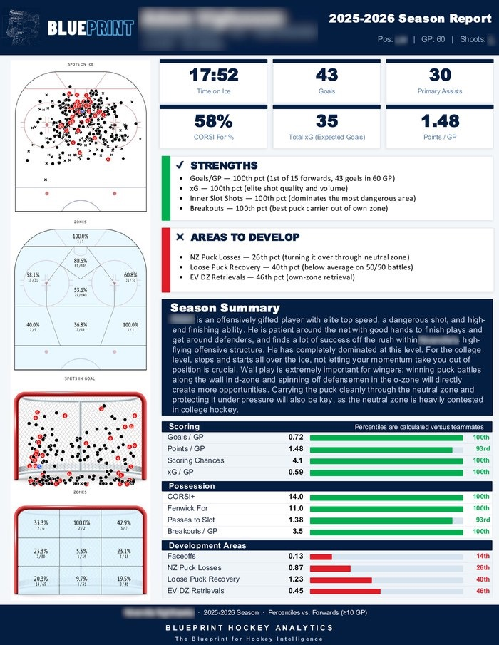

Get yours built.
Same rigor, same breakdown,
built for your own player
Get a quote ↗
blueprinthockeyanalytics.com

