Slide 1

Farouk Jiwa
Director – Private Sector & Development
CARE Enterprise Partners, CARE Canada
www.care.ca
farouk@care.ca

Slide 2
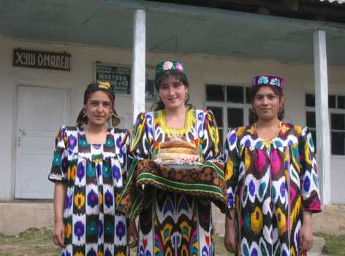
The role of partnerships in adaptation to climate change in Tajikistan

Slide 3
Climate change in Tajikistan
From 1961-1990 the annual mean temperature increased in the lowlands, while decreasing slightly in the mountains of central Tajikistan
Increases in snow stock have been recorded in most of the foothills and low mountains, while in the higher altitude areas it has decreased
The observed trends in precipitation vary, with reductions observed in some parts of the country, including the central hills and valleys, and increases in some higher altitude areas
The GoT has identified the water resources and agricultural sectors as the most vulnerable to climate change
It is clear that the impacts of climate change in different regions of Tajikistan will be varied and complicated, and will require adaptation strategies specific to the local context

Slide 4
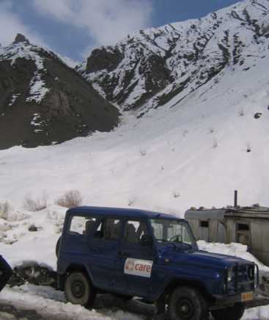
The Adaptation to Climate Change in Tajikistan (ACCT) Project
Project Goal: to strengthen institutional and technical capacities to effectively respond and adapt to adverse effects of climate change
Project is managed by CARE Canada and implemented by CARE Tajikistan, with financial support from CIDA
This pilot project works in three different Jamoats (sub-district administrative units) in Varzob District in western Tajikistan
The target villages are located at three different altitudes in three different climatic zones within the same watershed
Total number of households: 50 (direct) & 200 (indirectly)

Slide 5
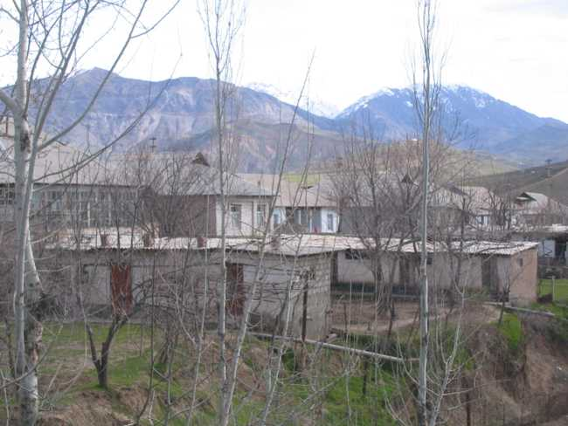
ACCT Target Villages
Obizak
1296 m

Slide 6
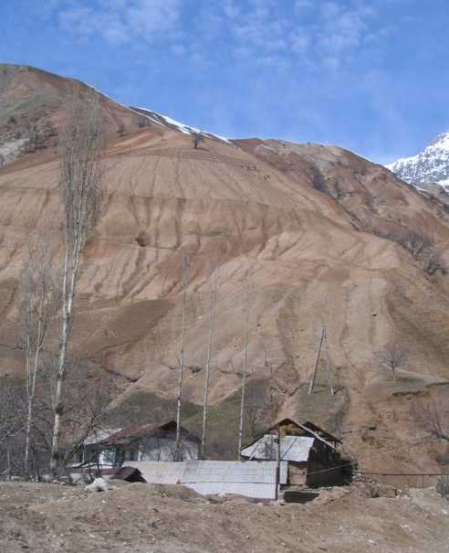
ACCT Target Villages
Pishambe
1700 m

Slide 7
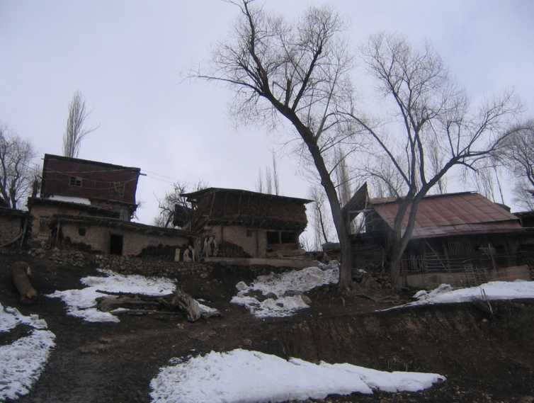
ACCT Target Villages
Panjhok
2159 m

Slide 8
Vulnerability to climate change in target villages
Project design is grounded in participatory vulnerability assessment which examined priority vulnerability issues and their impact on well-being
Assessments were conducted separately for men and women to identify gender differences in vulnerability and priorities
Key climate-related vulnerability issues identified in the communities:
Panjhok: changes in winter season, increasing snow accumulation
Pishambe: mudflows
Obizak: landslides, erosion (indirectly affected by climate change)
Key areas of well-being impacted included livestock, orchards and gardens

Slide 9
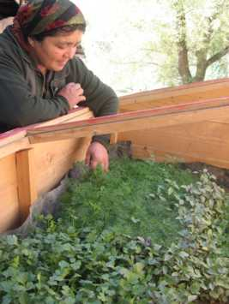
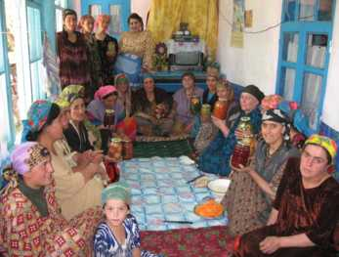
Adaptation strategies for Panjhok
Cold frames will lengthen growing season for 15 households
Training on food preservation will improve food security during the winter for 220 families
Notes:
Firouz, you need to decide: are we talking about Panjhok or all three kishlaks??? This is crucial….
543 households or individuals. If we provided 15 cold frames in Panjkhok that means 15 households + new order
Again, could you please check if the project has actually trained representatives of 220 households
I thought the project made the stoves for schools. Am I correct? If yes, we should rephrase the sentence as “Energy efficient stoves installed in 3 schools will decrease use of coal by 1,5 MT per stove, benefit XX number of students, and demonstrate benefits of using energy efficient stoves to parents and all members of target communities.
I slightly changed the text
I thought that we had trained more beneficiaries than 50 for this line item. I checked our last quarterly report and we reported that 194 participants attended soil erosion and 223 participant attended grant management training, please add land management and energy efficiency trainings. I think it would be better if we report the number of individuals directly effected by the training instead of households.
I just made some minor changes

Slide 10
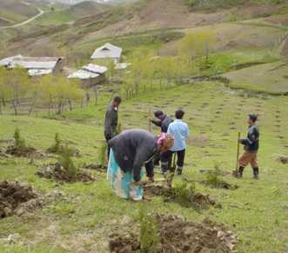
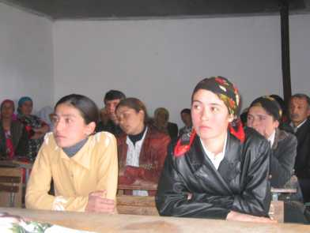
Adaptation strategies for Panjhok
Tree planting will stabilize slopes and gullies, protecting 30 households and one school from erosion and landslides
Winterization of the village school will conserve energy and improve the educational experience for 87 students
Notes:
Firouz, you need to decide: are we talking about Panjhok or all three kishlaks??? This is crucial….
543 households or individuals. If we provided 15 cold frames in Panjkhok that means 15 households + new order
Again, could you please check if the project has actually trained representatives of 220 households
I thought the project made the stoves for schools. Am I correct? If yes, we should rephrase the sentence as “Energy efficient stoves installed in 3 schools will decrease use of coal by 1,5 MT per stove, benefit XX number of students, and demonstrate benefits of using energy efficient stoves to parents and all members of target communities.
I slightly changed the text
I thought that we had trained more beneficiaries than 50 for this line item. I checked our last quarterly report and we reported that 194 participants attended soil erosion and 223 participant attended grant management training, please add land management and energy efficiency trainings. I think it would be better if we report the number of individuals directly effected by the training instead of households.
I just made some minor changes

Slide 11
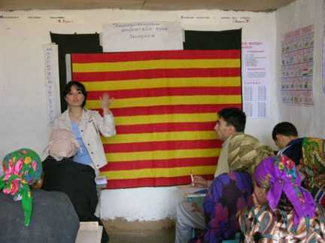
Partnerships with local NGOs
Partnerships have been formed with two local NGOs:
For the Earth, an environmental NGO based in Dushanbe
Nilufar, a small social development NGO in Varzob District
For the Earth has been engaged to develop awareness raising materials and to work with communities on school retrofitting
Nilufar is conducting training sessions for community members on energy efficiency and sustainable natural resource management for adaptation
Training of trainers approach has been adopted for NGO partnerships
The project has also formed informal linkages with the Foundation to Support Civil Initiatives in Tajikistan, NGO Institute of Human Ecology, and the Ecological Youth Center in Dushanbe
Notes:
I slightly changed the text
I slightly changed the text. Also, please add the number of beneficiaries.
I have slightly changed this one as well.

Slide 12
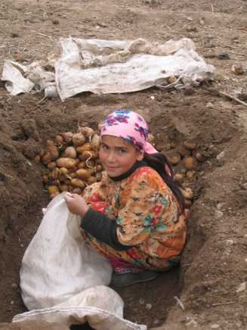
Benefits of partnering with local NGOs
Partnering with local NGOs has helped to build local capacity to address climate change issues
Local NGOs have invaluable local experience which allows them to work effectively in the target communities
Local NGOs and project communities jointly learn and tackle vulnerability problems
This leads to the identification of locally appropriate adaptation strategies and facilitates technology transfer, knowledge sharing and optimization of resources and talents
Notes:
1. I slightly changed the text

Slide 13
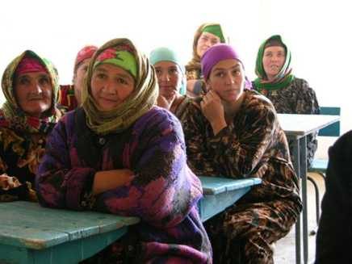
Partnerships with local government - Jamoats
ACCT has partnered with the sub-district administrative units (Jamoats) for each of the target villages
This collaboration with Jamoats and village-level authorities is intended to promote good governance in the target area
Partnerships with Jamoats are grounded in participation, with approaches designed to promote involvement of members of target communities in local planning and decision making.
Jamoats are now engaged in raising awareness of environment and climate issues and sustainable local development at the village level – they are promoting the slogan “Green works!”
Notes:
I slightly changed the text.

Slide 14
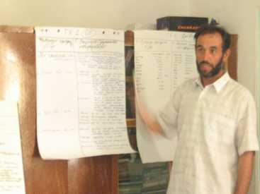
Benefits of partnering with local government
Partnering with local government agencies increases sustainability of project activities at the village level
Experienced local government partners support the project, evaluate project activities, and provide constructive feedback and advice
The project benefits from their understanding of local dynamics, in particular the socioeconomic issues that influence vulnerability and people’s ability to adapt
The Jamoats benefit through increased understanding of climate change and vulnerability issues, which in turn benefits communities as they have increased access to information and technologies for adaptation
Notes:
I slightly changed the text

Slide 15
Conclusions and Lessons Learned
Partnerships are key to achieving community-level adaptation objectives
Involving local government institutions in project activities can lead to positive changes in the governance structure – in this case, local communities are becoming more involved in planning and decision-making, and governments have incorporated climate change adaptation activities into their semi-annual plans
Mutual agreement with both local authorities and community members helped find better solutions for adaptation and address adverse effects of climate change by the local communities.
Working with groups disaggregated by gender was a completely new approach for effective dissemination of climate change related information and adaptation strategies on the village level
A longer timeline is needed for pilot adaptation projects in order to effectively build capacity and to allow time to monitor adaptation strategies

