Slide 1
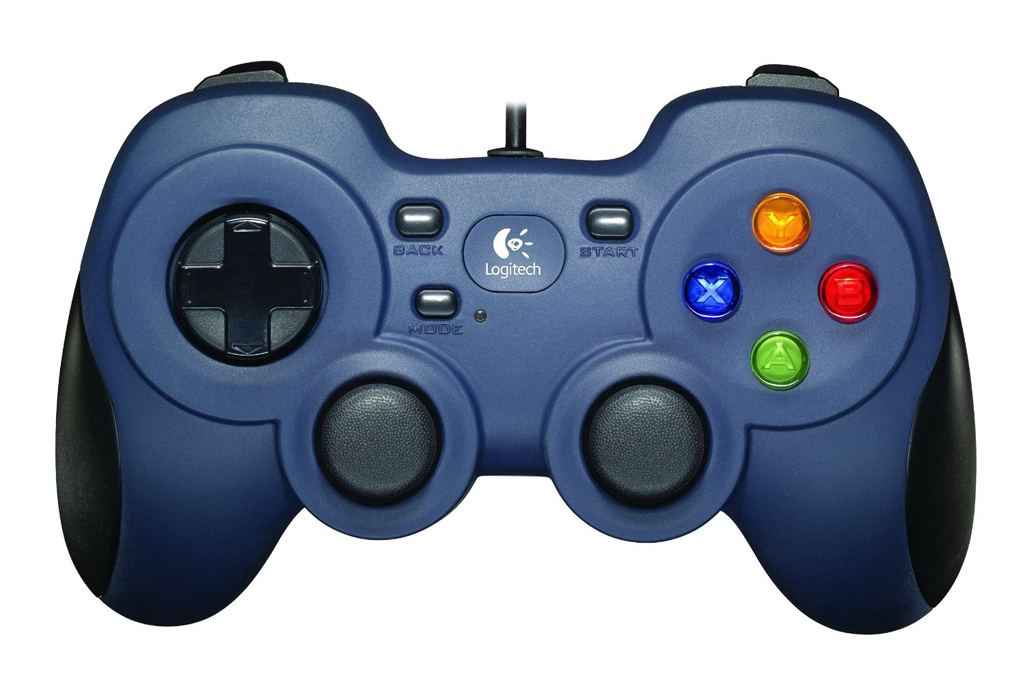
Camera Tilt Up
Camera Tilt Down
Increase Gain
[Trim Pitch Forward]
Disarm
Arm
Shift
Decrease Gain
[Trim Pitch Backward]
Stabilize Mode
Depth Hold Mode
Manual Mode
Lights Up
[Trim Roll Left]
Lights Down
[Trim Roll Right]
Forward
Ascend
Lateral
Left
Lateral
Right
Yaw
Left
Yaw
Right
Camera Tilt Center
(Push Joystick In)
Toggle Input Hold
(Push Joystick In)
Reverse
Descend

