Slide 1
Steel Segmentation
New Augmentation vs Old Augmentation
23 May 22

Slide 2
Augmentation Details
Augmentation 1 Augmentation 2
Magnification - 1-2.5x
Sliding Window - 5 Pixels
Random Intensity - 0-10
Random Gamma - 1-10
Horizontal and vertical Flip
Rotation - upto 10 Degrees
Magnification - 1-2.5x
Sliding Window - 5 Pixels
Random Intensity - 0-10
Random Gamma - 1-10
Horizontal and vertical Flip
Rotation - upto 90 Degrees

Slide 3
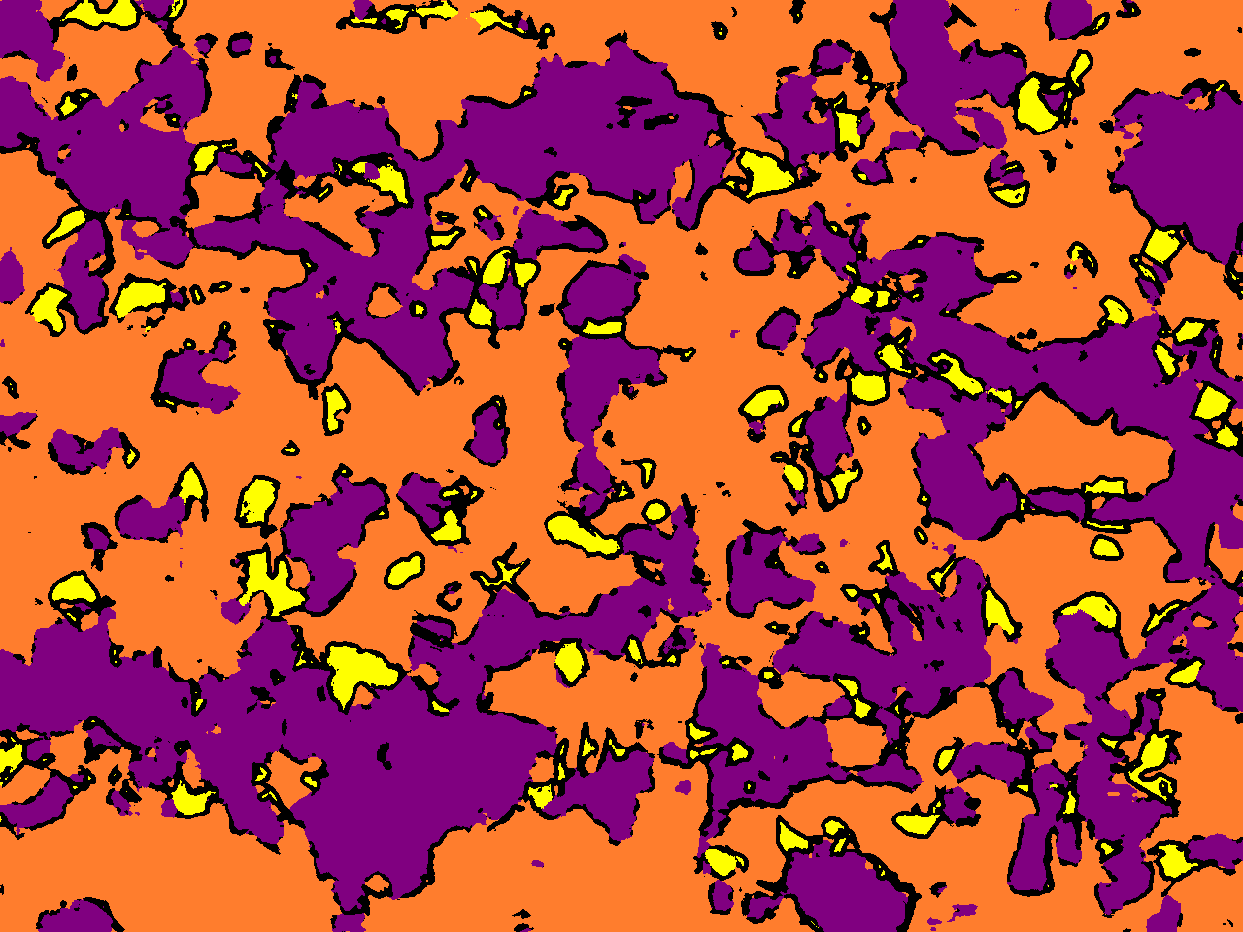
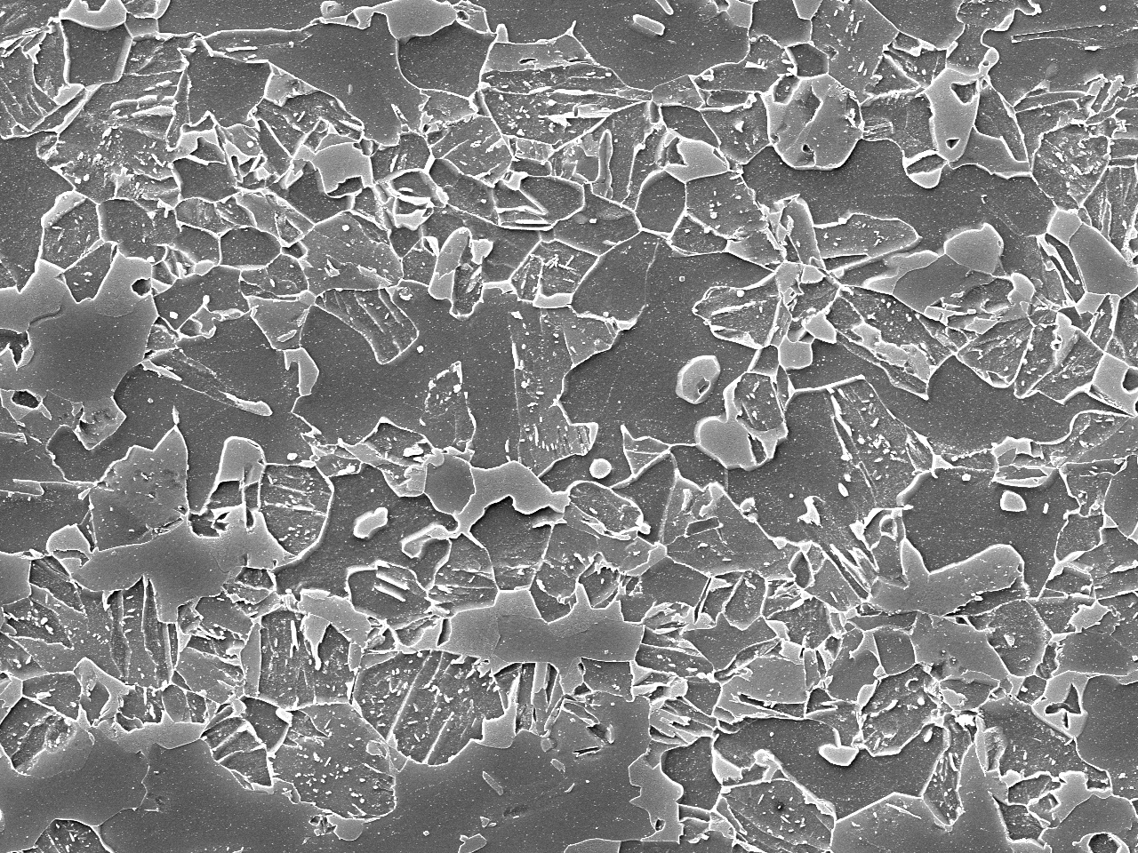
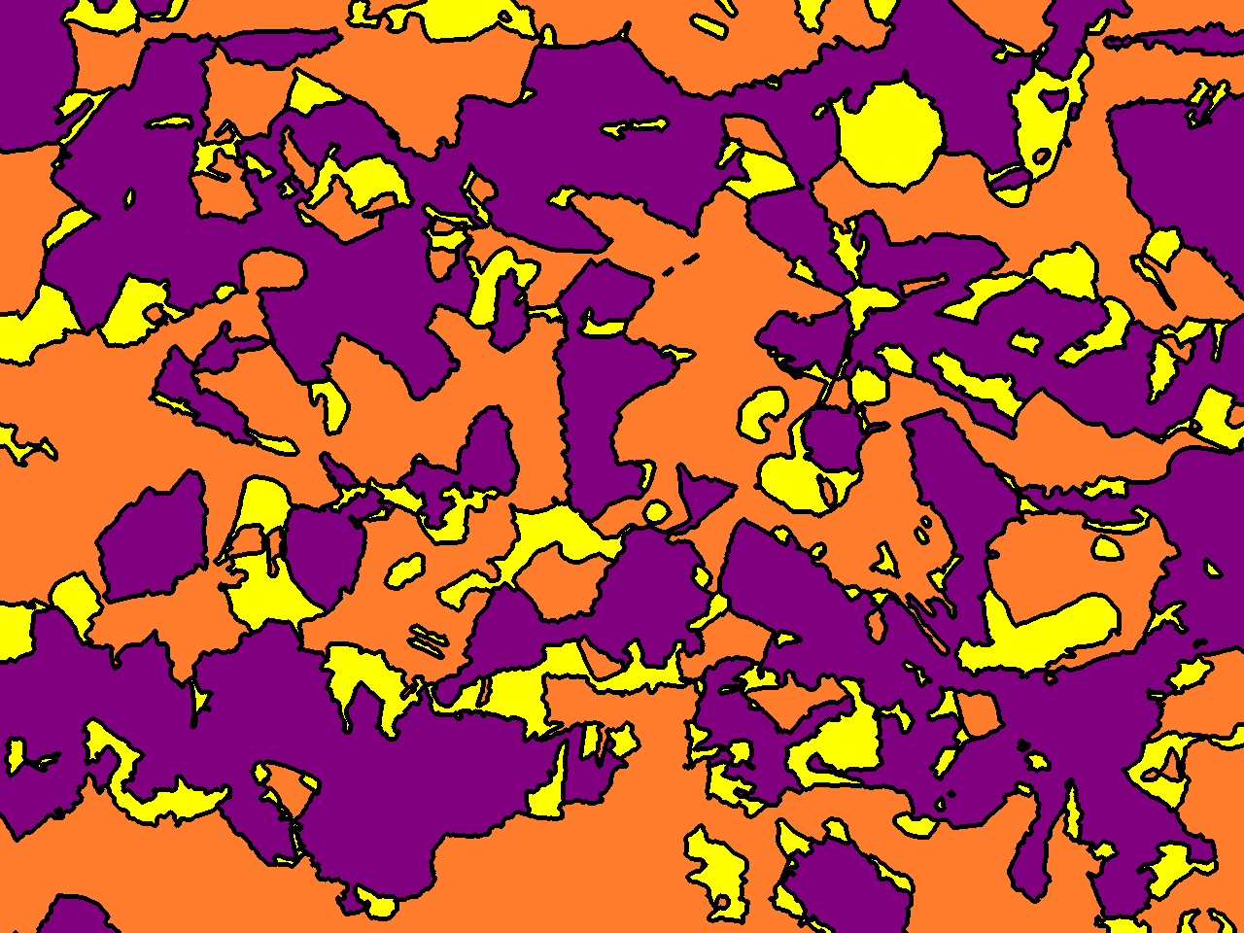
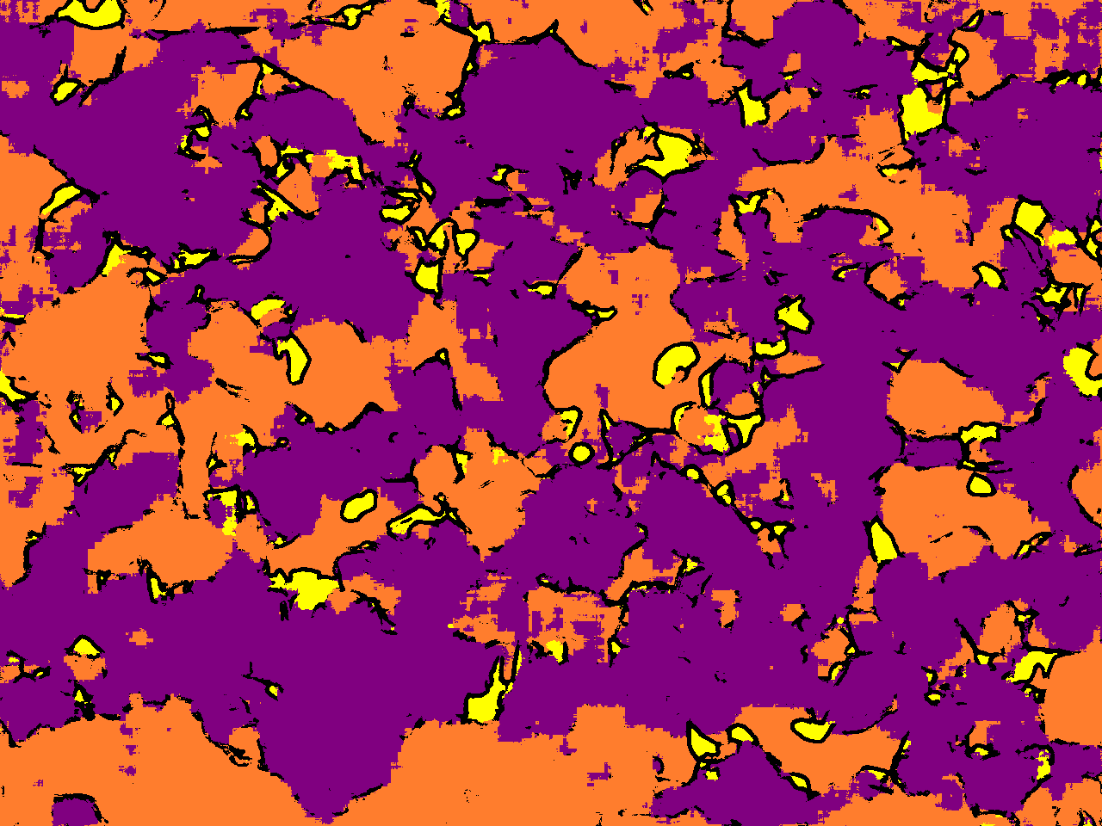
Results
Ratio
Accuracy
3.54
49.96
32.57
13.92
70.9
33.15
91.06
69.77
70.95
Test1 A type
Ratio
9.89
38.03
37.77
14.32
Augmentation 1
Ratio
Accuracy
3.12
33.93
53.66
9.28
65.8
25.56
66.92
85.51
38.64
Augmentation 2

Slide 4
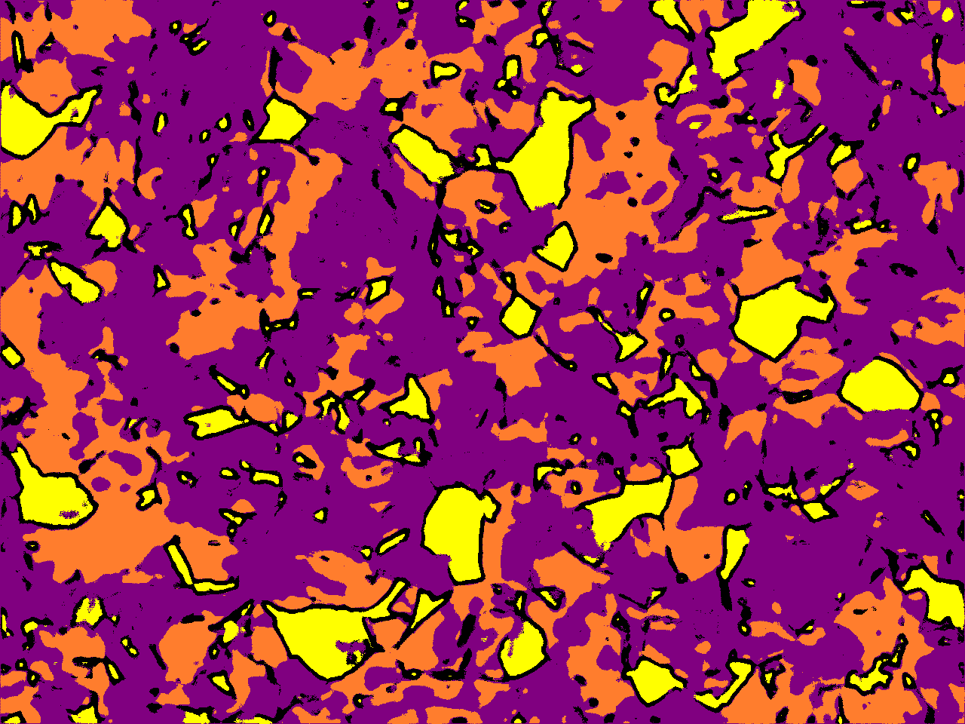
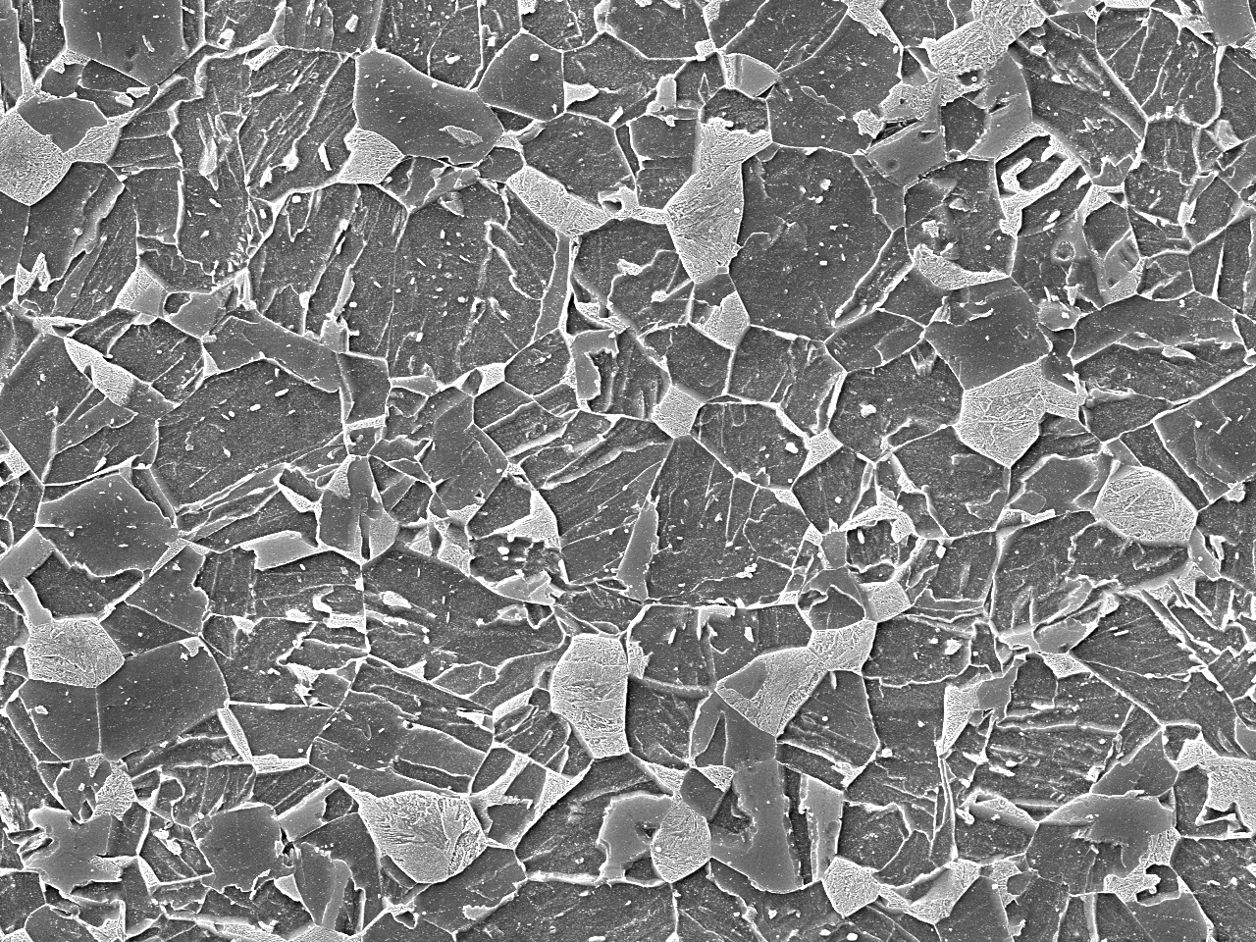
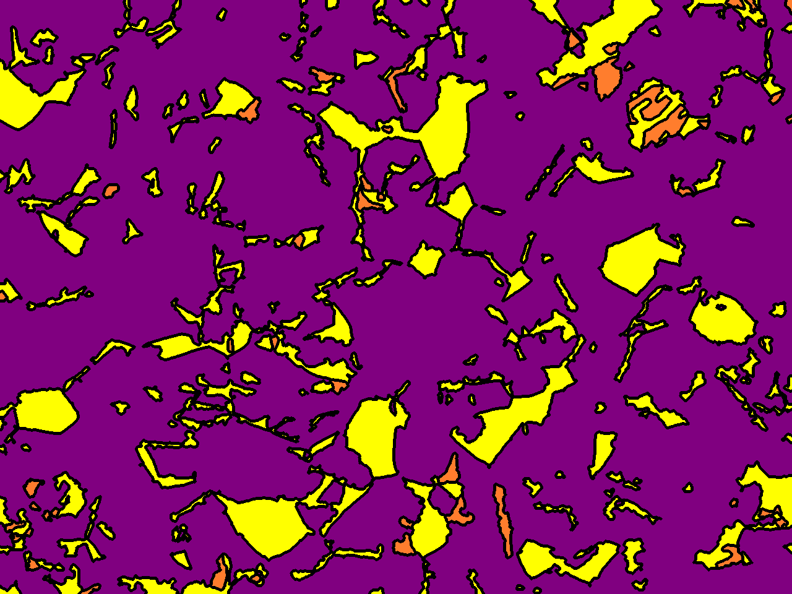
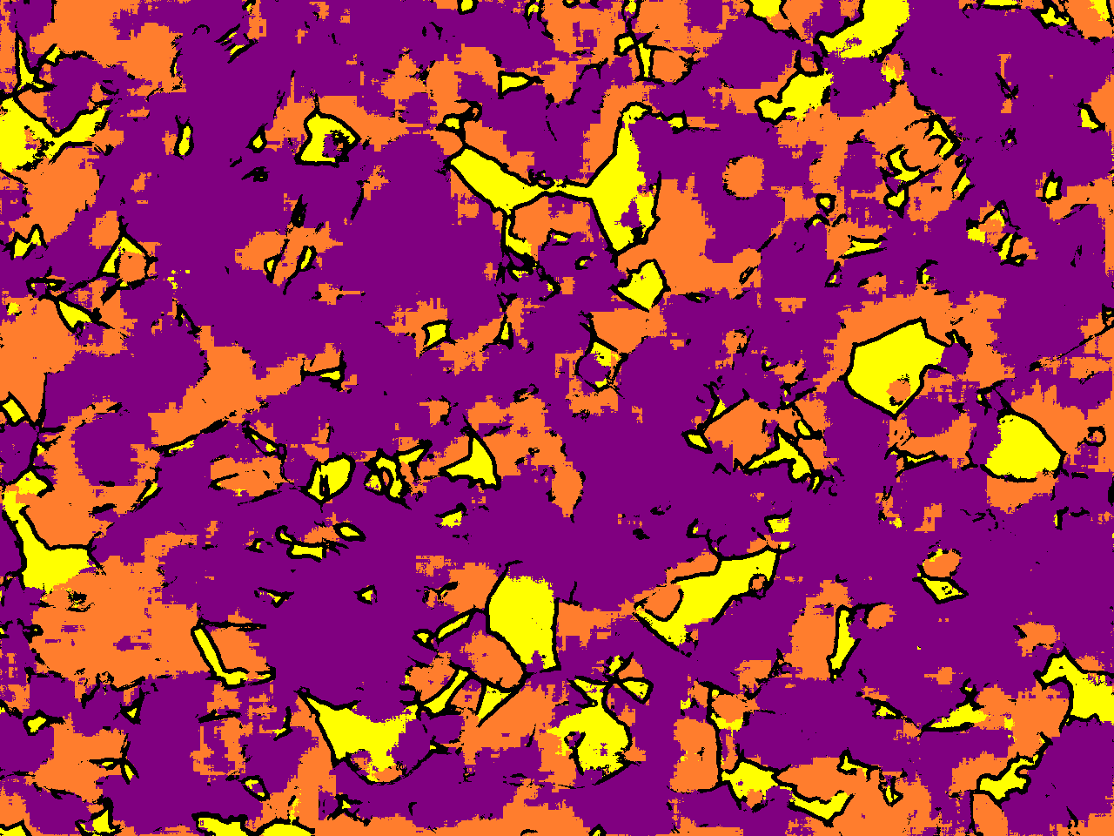
Results
Ratio
Accuracy
8.5
24.89
55.4
11.21
62.5
69.52
30.13
64.5
48.54
Test2 D3 type
Ratio
11.36
1.03
73.93
13.68
Augmentation 1
Ratio
Accuracy
7.31
24.41
58.85
9.43
62.4
56.53
50.87
67.16
42.75
Augmentation 2

Slide 5
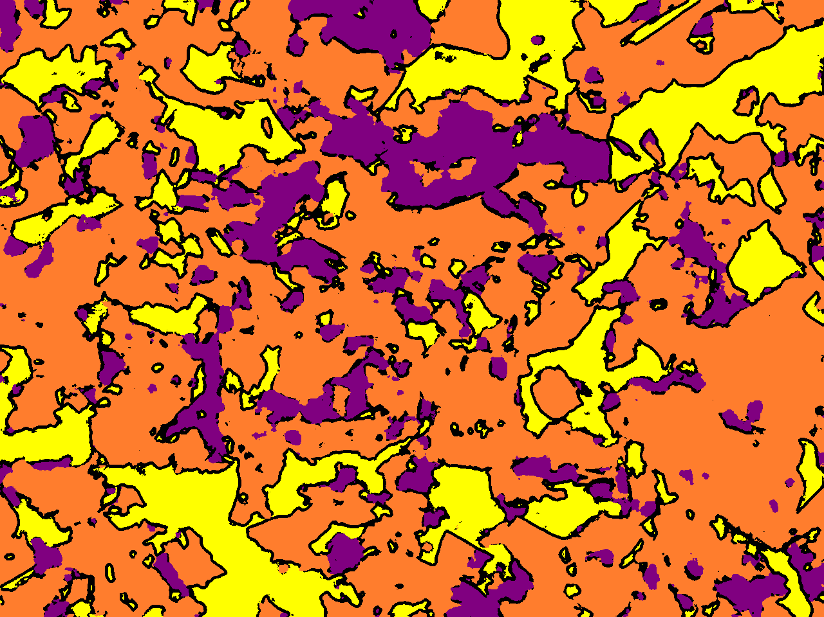
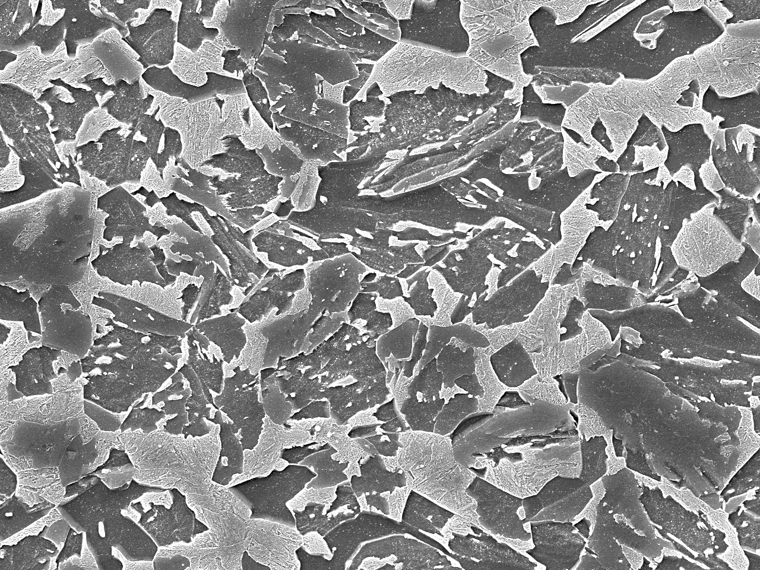
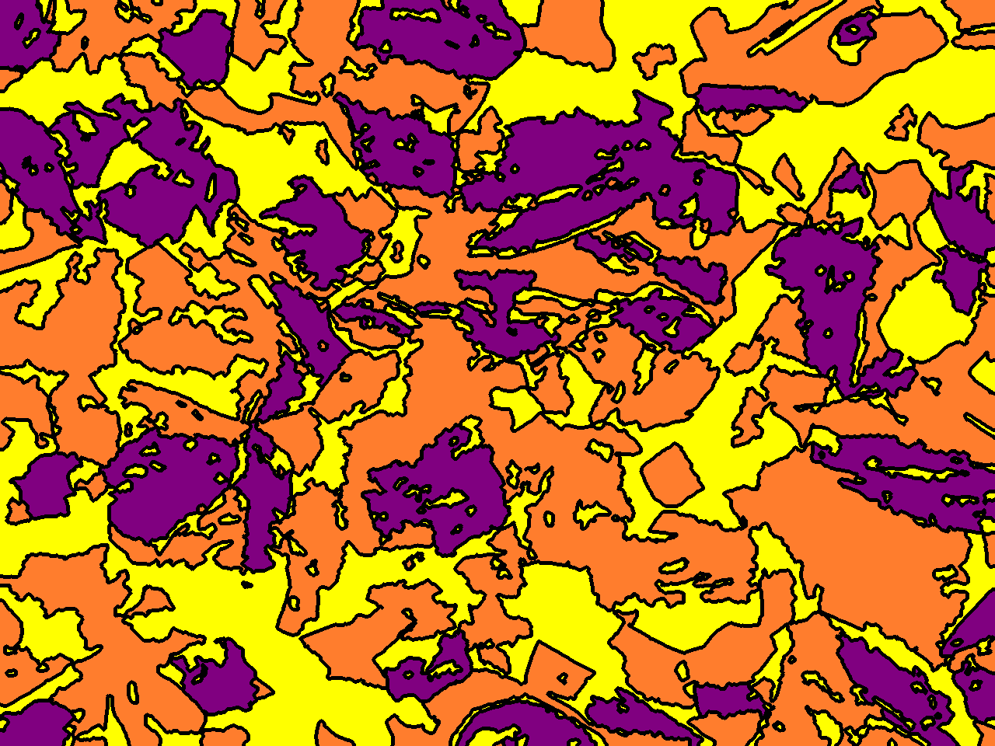
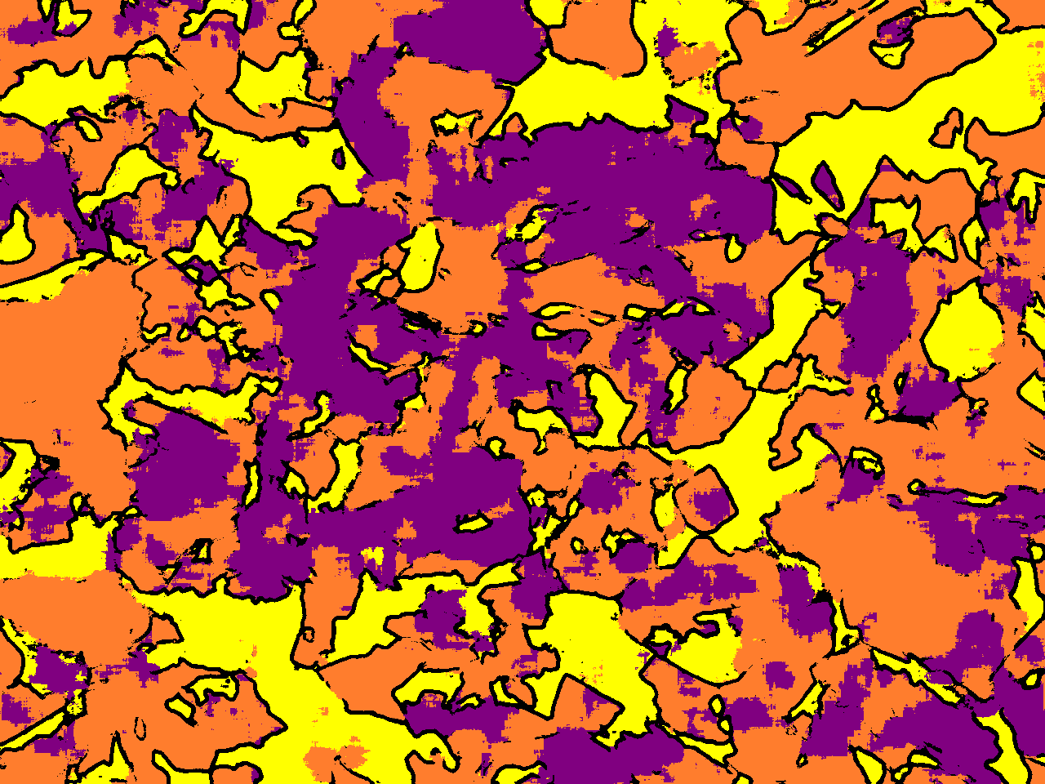
Results
Ratio
Accuracy
18.67
52.83
13.79
14.7
65.02
69.99
87.61
35.35
45.75
Test3 H2 type
Ratio
25.38
35.95
18.61
20.06
Augmentation 1
Ratio
Accuracy
19.88
40.37
26.97
12.79
67.9
74.97
75.17
65.04
48.96
Augmentation 2

Slide 6
Observation
4 Class ReLU | x3000 | x5000 | A type | D3 Type | H2 Type
Augmentation 1 | 80.04 (0.7979) | 84.94 (0.8469) | 70.95 (0.707) | 62.53 (0.6228) | 65.02 (0.6477)
Augmentation 2 | 77.68 (0.7623) | 78.48 (0.7823) | 65.80 (0.6535) | 62.44 (0.6198) | 67.96 (0.6752)
Accuracy (DICE)
Using Rotation of 90 degrees did not perform well compared to using rotation of just 10 degrees

