Slide 1
Proposal Preparation
07-31
Bishal

Slide 2
Some Medical Dataset Guide
Datasets–
GlaS - Link
Kvasir-SEG - Link
CVC-ClinicDB - Link
Data Science Bowl - Link
ISIC-2020 - Link
BraTS 2020 - Link
Cancer Instance Segmentation and Classification - Link
Breast Cancer Detection - Link
Breast UltraSound Image - Link
OpenEDS – Open Eyes Dataset – Link
MoNuSeg (Multi-Organ Nuclei Segmentation) – Link
Lung Image Database Consortium image collection (LIDC-IDRI) - Link
Hot Datasets

Slide 3
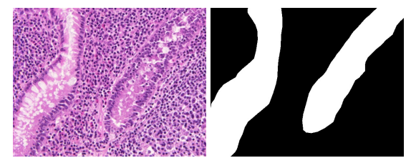
1. GlaS Dataset
Challenges
Variation in gland appearances: Glands in histology images have significant variability in size, shape, and texture. This variability can pose a challenge for many machine learning algorithms, which may struggle to learn a robust model capable of accurately segmenting glands across such a wide range of appearances.
Inter-glandular spatial interactions: Often, gland structures are packed closely together, making it challenging to distinguish between individual glands. Algorithms need to learn to recognize the tiny spaces between glands, which can be particularly difficult given the irregular shapes and diverse sizes of glands.
Labeling inconsistency:
Limited size:
Imbalanced class distribution:
When working with the GlaS dataset, it is essential to employ strategies that can address these challenges. Addressing the issue of overfitting, use of appropriate loss functions, and instance segmentation methods can help deal with issues of shape variability, spatial interaction between glands, and class imbalance.

Slide 4
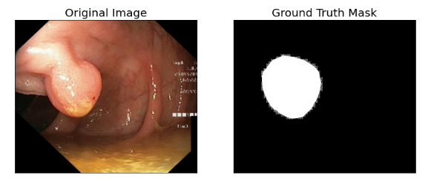
2. Kvasir-SEG Dataset
Challenges
Variability in appearances: The polyps in the dataset exhibit a large variety in size, color, and shape. Some polyps can be flat and subtle, while others can be well-circumscribed and protruding. These variations make it challenging for a model to generalize well across all the different types of polyps .
Lighting conditions and quality of images: As the images are captured during endoscopy procedures, the lighting conditions may not be consistent across all images. Shadows, reflection, and variations in illumination can pose challenges in the segmentation process.
Background complexity: The gastrointestinal tract images contain a lot of texture and structure (e.g., folds of the intestine, blood vessels). This complex background can often confuse models, leading to false positives .
Imbalanced class distribution
Proper Augmentation, Apt Loss function and class imbalance problem should be addressed

Slide 5
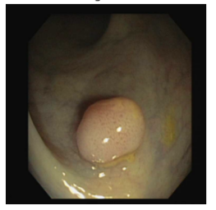
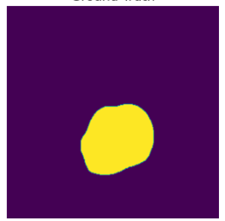
3. CVC-ClinicDB Dataset
Challenges
Image quality: Colonoscopy images in the CVC-ClinicDB dataset may contain artifacts such as blurring, noise, and illumination changes, which can occur during the endoscopic procedure. These factors can degrade the image quality and make the task of segmentation more challenging.
Polyp variability: Polyps in the dataset exhibit significant variability in size, shape, texture, and color. This can cause difficulties in learning a robust model for accurate polyp detection and segmentation.
Background complexity: The background of these endoscopic images can contain a variety of other structures like blood vessels, mucus, and intestinal folds, which may confuse the model, leading to false positives.
Class imbalance: Just like in many other medical image datasets, the number of pixels corresponding to polyps (positive class) is much less than the non-polyp pixels (negative class). This can cause the model to be biased towards the majority class and perform poorly on the minority class.
Limited data: The dataset is relatively small, containing only 612 frames. This small number of images can lead to overfitting and reduces the model's ability to generalize well to new, unseen data.
Proper Augmentation, Apt Loss function and class imbalance problem should be addressed

Slide 6
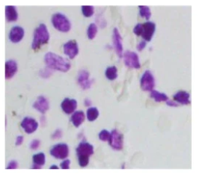
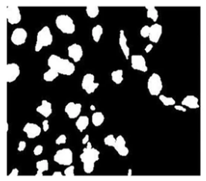
4. Data Science Bowl Dataset
Challenges
The Data Science Bowl focused on nuclear segmentation in microscopy images, which is a critical task for identifying each individual cell in experiments. Issues that can be faced while working on the dataset are as follows.
Variability of Images: The dataset comprises a wide variety of images collected under different conditions, which can be beneficial for training robust models but also makes the task more challenging. The images differ in terms of lighting conditions, magnification, cell types, staining methods, and overall image quality.
Complexity of Cell Clustering: The nuclei in these images often touch or overlap, making it hard to separate them correctly. This problem is particularly challenging for standard image segmentation algorithms that might struggle to identify the boundaries between adjacent or overlapping objects.
Limited size: Similar to many other medical datasets, the number of images is not very large. This limited size can lead to overfitting and poor generalization to unseen data.
Class imbalance

Slide 7
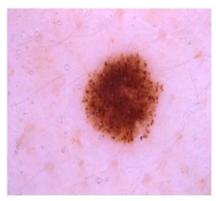
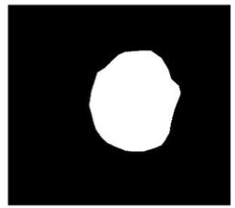
5. ISIC-2020 Dataset
Dataset is a collection of dermoscopic images associated with the ISIC (International Skin Imaging Collaboration) 2020 Challenge. This dataset contains images of a wide variety of skin lesions and is commonly used for skin lesion classification, segmentation, and detection tasks.
Common Challenges include -
Variability in Skin Lesions: The lesions in the dataset exhibit a wide range of shapes, colors, sizes, and textures. Additionally, there is a wide diversity in the types of skin lesions, including benign lesions (e.g., nevi) and various types of skin cancer (e.g., melanoma, basal cell carcinoma). This high variability can make it challenging for a model to accurately classify and segment the skin lesions.
Image Quality and Acquisition Conditions: Images can differ greatly in terms of lighting, scale, and angle of view. There may also be differences in image quality due to the use of different imaging devices, techniques, and resolutions.
Class Imbalance: There is a significant imbalance between the number of benign and malignant cases in the dataset, with benign cases being more common. This imbalance can lead to a bias in the model's predictions.
Boundary Ambiguity: For some skin lesions, the boundary between the lesion and healthy skin may not be well-defined, making the segmentation task more challenging.

Slide 8
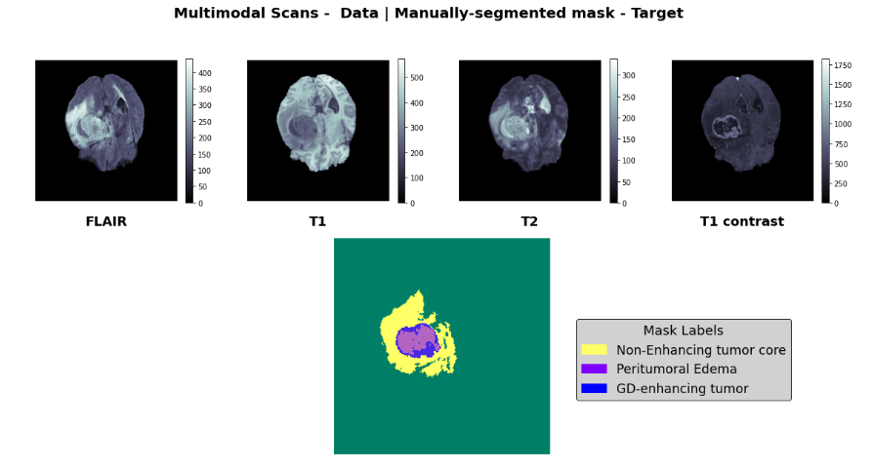
6. BraTS 2020 Dataset
Challenges –
Multimodality of Images: BraTS dataset comprises four different MRI modalities: T1, T1-Gd (T1 post-contrast gadolinium-enhanced), T2, and T2-FLAIR (T2 Fluid Attenuated Inversion Recovery). Each modality offers different information about the tissues and the tumors, making it crucial for a model to be able to integrate these different sources of information effectively.
Inter-patient Variability: Brain tumors can vary greatly in terms of their size, shape, location, and level of malignancy from patient to patient. Models must be robust enough to handle this variability and still perform accurate segmentation.
Intra-tumor Heterogeneity
Noise and Artifacts
Imbalance in Classes

Slide 9
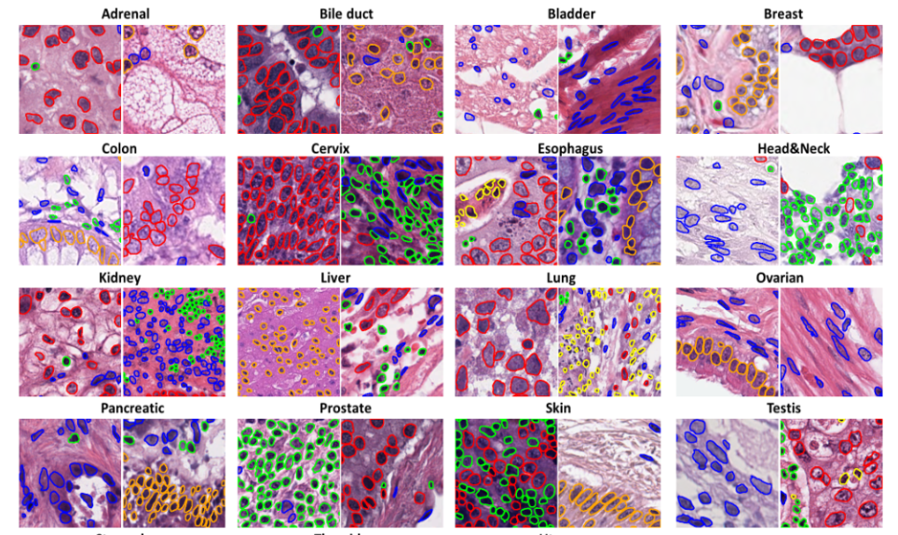
7. Cancer Instance Segmentation and Classification Dataset
Challenges –
This dataset, also known as PanNuke, contains semi automatically generated nuclei instance segmentation and classification images with exhaustive nuclei labels across 19 different tissue types. The dataset consists of 481 visual fields, of which 312 are randomly sampled from more than 20K whole slide images at different magnifications, from multiple data sources.
Variability in nuclei instances: The nuclei images in the dataset exhibit a wide range of shapes, colors, sizes, and textures.
Class Imbalance

Slide 10
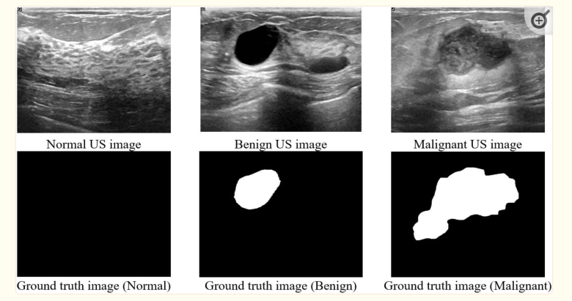
9. Breast UltraSound Image Dataset (BUSI)
Challenges –
Image Quality: Ultrasound images are typically noisy and have lower resolution compared to other medical imaging modalities like MRI or CT. Additionally, ultrasound images are often subject to artifacts that can complicate the analysis.
Inter-observer Variability: The interpretation of ultrasound images can be somewhat subjective and there can be significant inter-observer variability.
Intra-class Variation and Inter-class Similarity: Lesions may exhibit high variability in appearance (intra-class variation) and benign and malignant lesions can appear very similar (inter-class similarity), making the classification task challenging.
Imbalanced Classes

Slide 11
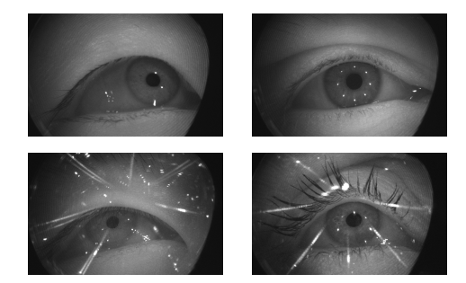
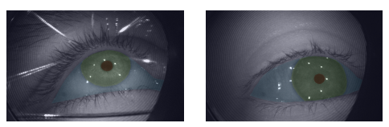
10. OpenEDS – Open Eyes Dataset
Annotations
Without Glasses
With Glasses
Challenges –
Varied eye properties – People have varied eye properties which can be tricky to perform proper pixel-by-pixel segmentation.
Varied Lighting Conditions and Eye States: The dataset includes images with different illumination conditions and varying states of the eye (open, partially open, closed), which can make segmentation more difficult.
High-resolution Images: The dataset includes high-resolution images (around 4000x3000 pixels), which can increase the computational requirements for training models.

Slide 12
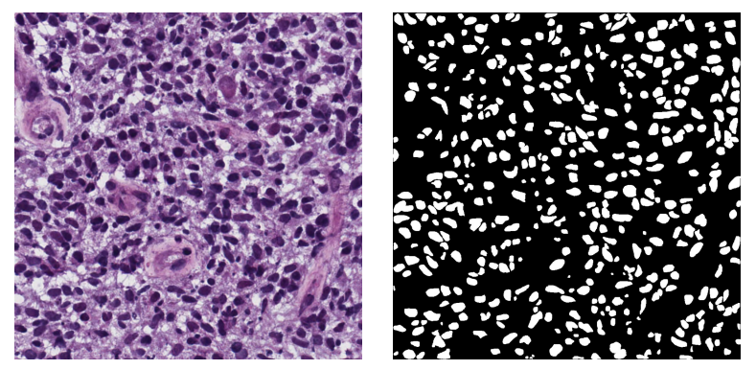
11. MoNuSeg (Multi-Organ Nuclei Segmentation)
Challenges –
Image Quality and Complexity: Histopathology images are complex with varied color, shape, size, and texture of nuclei. Image quality can be inconsistent, with variations in staining and imaging conditions across samples.
Intra-class Variation and Inter-class Overlap: There is substantial variability in the appearance of nuclei (intra-class variation), and other cellular structures can look similar to nuclei (inter-class overlap), complicating the segmentation task.
Data Imbalance: The dataset is relatively small for deep learning applications, and there may also be imbalances in the number of images from different organs.

Slide 13
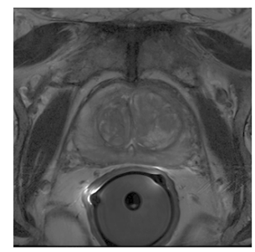
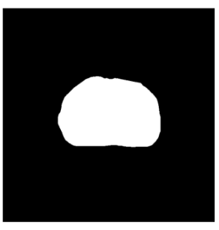
12. Lung Image Database Consortium image collection (LIDC-IDRI)
Challenges –
Inter-rater Variability: Different radiologists can make different judgements about what constitutes a nodule and how its boundaries should be defined, leading to discrepancies in the ground truth labels.
Size of the Dataset: The large size of the dataset (over 1000 CT scans, each with several hundred slices) and the high resolution of the images (typically 512x512 pixels per slice) can pose computational challenges.
Class Imbalance: The majority of regions in lung CT scans are healthy tissue, while only a small proportion are nodules, leading to a class imbalance problem.

Slide 14
Obervations
We can focus in 2D datasets more and try to outperform previous works
Main common challenges in the datasets include –
Data Imbalance
Capturing Structure
Noise and artefacts
After Careful consideration, MoNuSeg (Multi-Organ Nuclei Segmentation) dataset can be cosidered for the segmentation task.

Slide 15
MoNUSeg Dataset
Recent papers with SOTA performance –
Model/Paper | Dice | IoU
Unet | 79.43 | 65.99
Unet++ | 79.49 | 66.04
MedAdapterSAM | 80.34 | 67.33
AutoSAM | 82.42 | 70.17
MaxVitUnet | 82.15 | 70.30
Published 23-06-10
Published 23-07-20

Slide 16
AutoSAM
The paper proposes an end-to-end approach to improve segmentation mask accuracy for medical images.
Auxiliary Prompt Encoder Network: The paper introduces an auxiliary prompt encoder network that generates a surrogate prompt for the Segment Anything Model (SAM) given an input image. This encoder is trained via gradients provided by a frozen SAM.
No Fine-Tuning Required: The method does not require further fine-tuning of the SAM, which makes it easy to implement and avoids the need to find a suitable training schedule for SAM fine-tuning.
State-of-the-Art Results: Without further fine-tuning, the authors obtain state-of-the-art results on multiple medical images and video benchmarks.
Unmodified SAM Network: The main SAM network is not modified, which simplifies the implementation of the method.

Slide 17
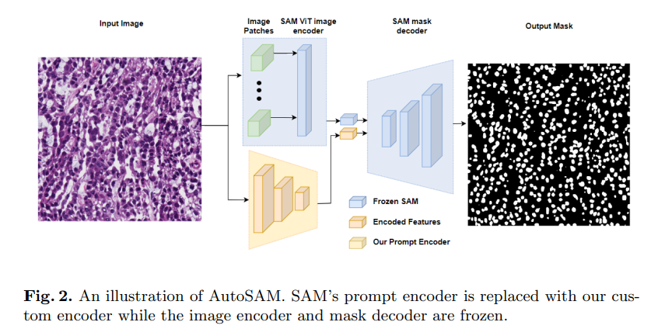
AutoSAM
In AutoSAM, the authors replace SAM's prompt encoder with a custom encoder that operates on the same input image as the main network. This custom encoder is trained via gradients provided by a frozen SAM. The encoder network that they train employs the Harmonic Dense Net as its backbone and has significantly fewer learnable parameters than SAM’s own decoders.
The authors also train a surrogate decoder to gain insight into the information provided by the encoder they train. This surrogate decoder learns a mapping from the space of encoded images to the corresponding ground truth mask. Despite its size, this surrogate decoder often produces a reasonable segmentation mask,

Slide 18
MaxViT-UNet
The paper presents MaxViT-UNet, a hybrid vision transformer (CNN-Transformer) for medical image segmentation.
MaxViT-UNet: The authors propose a novel architecture that combines the strengths of Convolutional Neural Networks (CNNs) and Transformers. This hybrid model is designed to enhance the discriminating capacity between object and background regions, which improves the efficiency of image segmentation.
Multi-Axis Self-Attention Mechanism: The model uses a multi-axis self-attention mechanism. This allows it to focus on different parts of the image, which can be particularly useful for complex medical images where important features can be scattered across the image.
Performance: MaxViT-UNet outperformed previous CNN-based and Transformer-based techniques on standard datasets. This indicates that the hybrid approach can effectively leverage the strengths of both CNNs and Transformers.

Slide 19
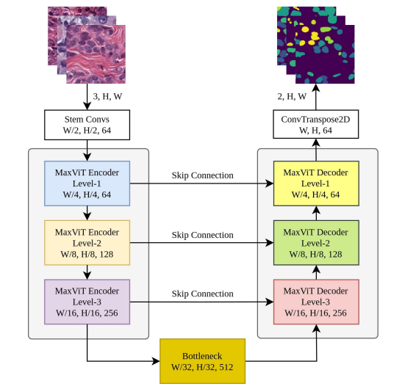
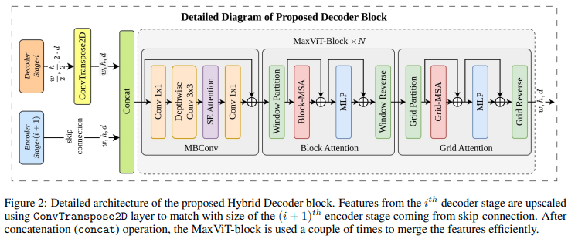
MaxViT-UNet

Slide 20
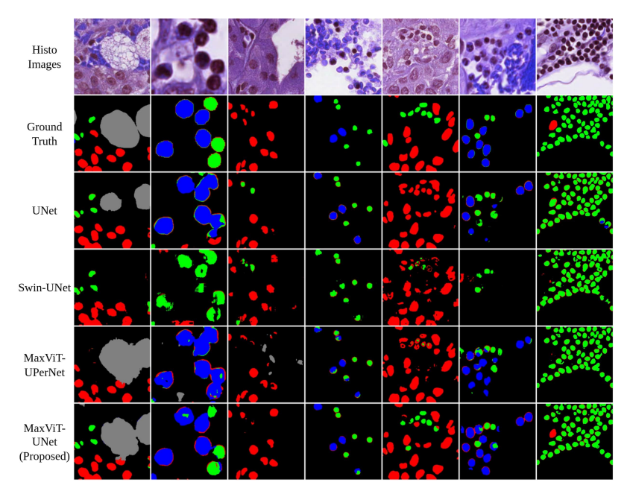
MaxViT-UNet

Slide 21
Need for further Research
Although AutoSAM produced SOTA output, it primarily focused on encoding the image mask into the SAM without any finetuning. The model is still similar to the SAM as the weights used aren’t altered. We believe this accuracy can be improved with better image encoding along with finetuning SAM for the nuclei segmentation.
The resultant images output by MaxViT-Unet are of very low resolution and suffer from positional encoding inconsistencies.
There is a need to segment the nuclei with better accuracy and more precision

Slide 22
We propose to implement the following -
Employ a new Unet model with more enhanced encoding like UNet3+ and more deep connections for lightweight and efficient segmentation.
Address the issue of class imbalance
Finding proper structures of nuclei in the image
Addressing the issue of positional encoding
Use SAM with input conditioning
Create a new input encoder to process image metadata as input to SAM like class ratios to produce a centric result with higher accuracy.
FineTune SAM for domain adaptation.

Slide 23
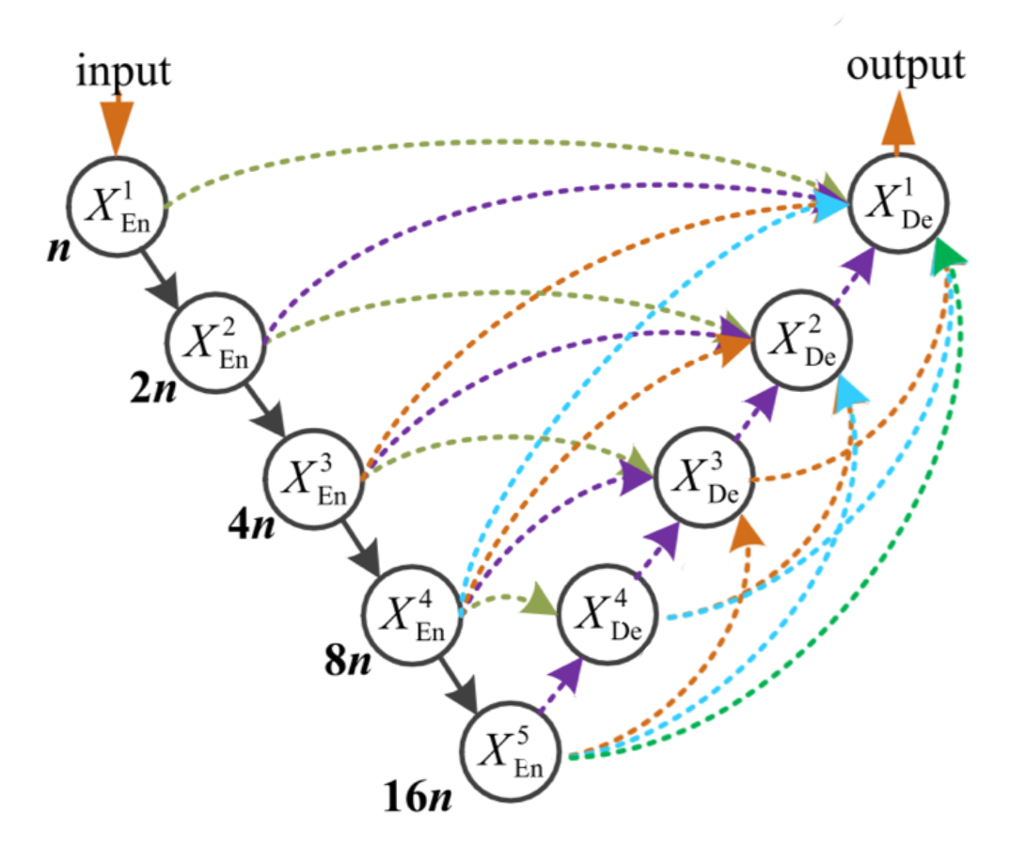
Methodology for Unet Model
Uses Multi-Scale skip connection strategy to capture local as well as global features.
Introduces deep supervision into the model by adding auxiliary supervision to each decoder and increases efficiency.
Each decoder is to receive feature maps from all lower-level encoders. This can help to better preserve spatial information and improve the model's ability to capture fine details.
Each of the encoders additionally use atrous convolutions to capture larger contexts without loosing resolution

Slide 24
Methodology for Unet Model
Hybrid Loss Function
Jaccard Loss (Intersection over Union Loss): This loss function is directly related to the Intersection over Union (IoU) metric, which is often used to evaluate segmentation models. It encourages overlap between the predicted and ground truth segmentation masks, which can help the model to accurately capture the shapes of the objects.
Focal Loss: Focal loss is designed to address class imbalance by down-weighting the contribution of easy examples and focusing more on hard examples. This can be particularly useful in segmentation tasks where the objects of interest are much smaller or less frequent than the background.
MS-SSIM Loss: MS-SSIM loss measures the structural similarity between two images at multiple scales. This can help the model to capture both local details and global structures, which can be beneficial for complex segmentation tasks.
By combining these loss functions, you could potentially get a model that is good at capturing the shapes of the objects (Jaccard loss), robust to class imbalance (Focal loss), and able to capture both local details and global structures (MS-SSIM loss).

Slide 25
Methodology for Unet Model
Evaluation Criterion
Dice and IoU often times don’t assess the evaluation of a segmentation task and miss key details. We thereby aim to use a combination of dice, iou, class-wise accuracy and class distribution ratio to properly evaluate the results.

