Slide 1

Project presentation on
Graph-based Hybrid Recommendation System with
Application to Movie Recommendation
Implementation
Bishal, Salohidin, Hyunjin
2024-06-24

Slide 2
Dataset Analysis
Dataset | Users | Items | Ratings | Rating scale | Density | Side info
ML 100k | 943 | 1682 | 100,000 | [1-5] | 6.3% | Job, gender, age
ML 1M | 6040 | 3900 | 1,000,209 | [1-5] | 1.4% | Job, gender, age
Book-crossing | 278,858 | 271,379 | 1,149,780 | [1-10] | 0.0015% | Age, location
Due to lack of time and dataset quality, we only performed experiments on MovieLens Dataset

Slide 3
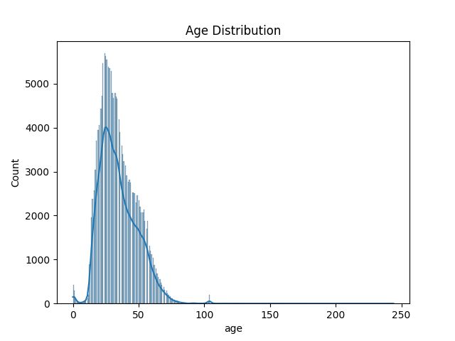
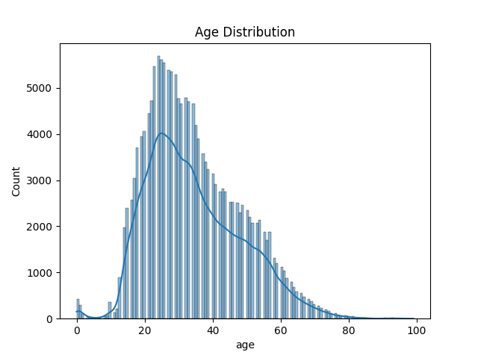
Dataset Analysis – Book Crossing
Age distribution
Preprocessed
Original

Slide 4
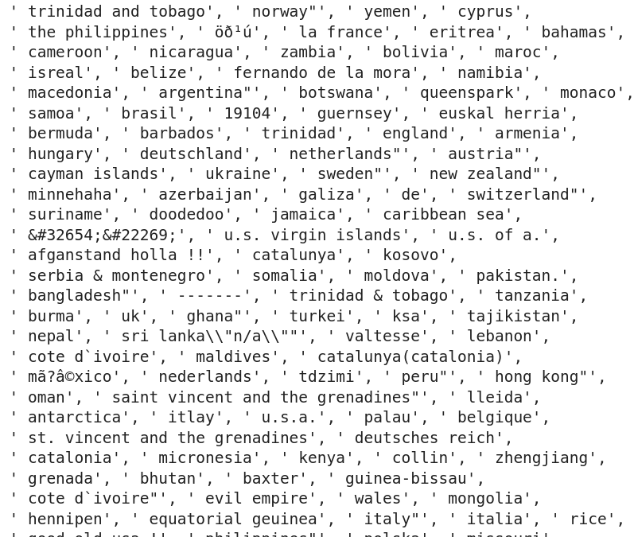
Dataset Analysis – Book Crossing
Location
# of unique locations after preprocessing: 709
So many inaccurate inputs.
Sample from unique values in location after preprocessing

Slide 5
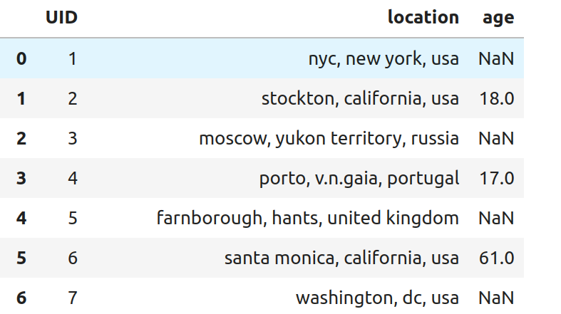
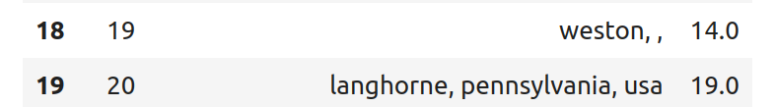
Dataset Analysis
Dataset info: User side information comparison
Information Type | MovieLens 100K Missing Values | MovieLens 1M Missing Values | Book-Crossing Missing Values
User ID | None | None | None
Age | None | Some missing/outliers | Many missing/invalid values
Gender | None | None | Not provided
Occupation | None | None | Not provided
Zip-code | None | Some missing/incomplete | Not provided
Location | Not provided | Not provided | Some missing/unspecified
Book Crossing
Movie Lens
% of empty values in age: 40%

Slide 6
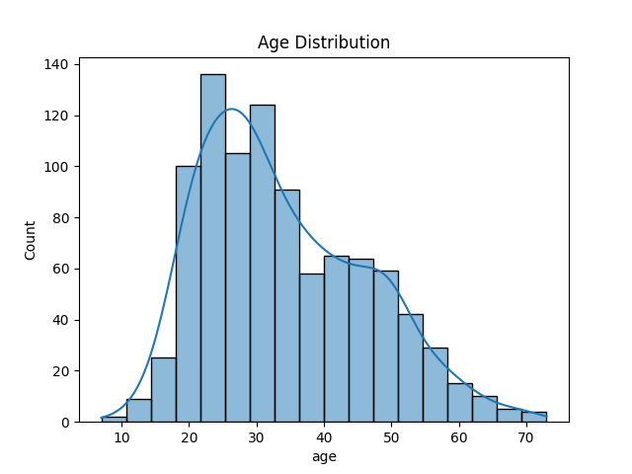
Dataset Analysis – Movie Lens
100K ML
Age Distribution

Slide 7
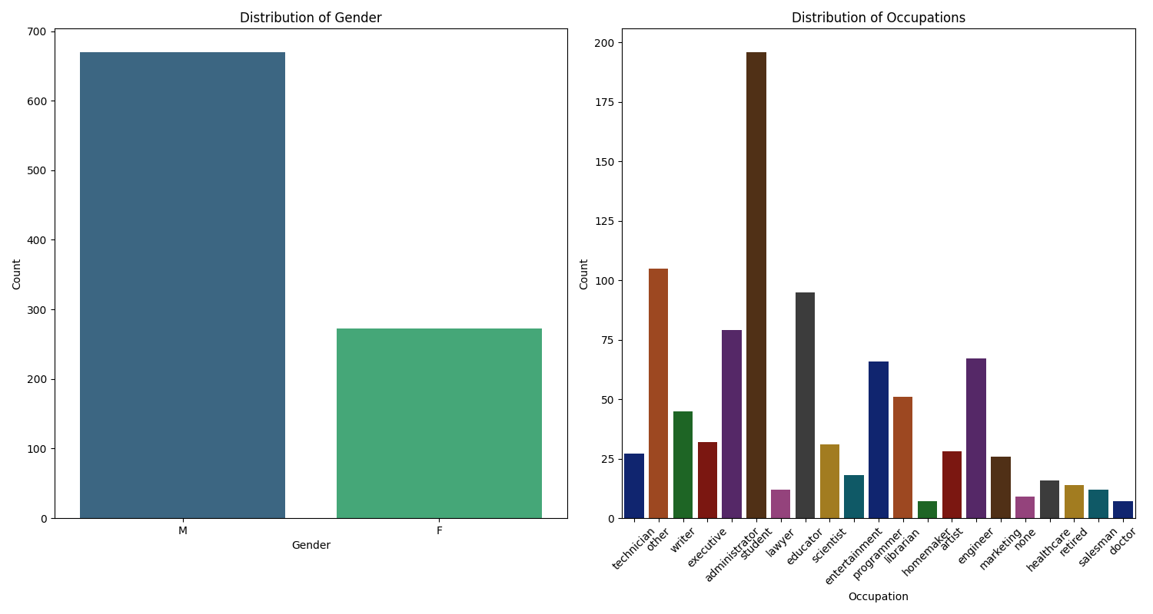
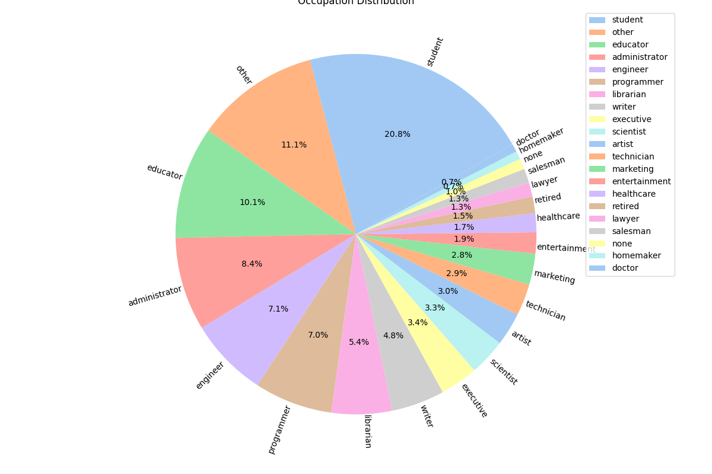
Dataset Analysis – Movie Lens
100K ML
Gender / Occupation Distribution

Slide 8
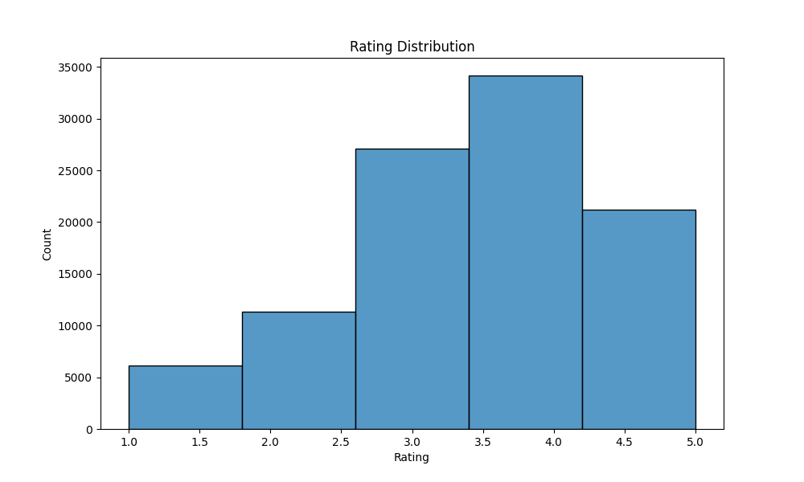
Dataset Analysis – Movie Lens
100K ML
Rating Distribution

Slide 9
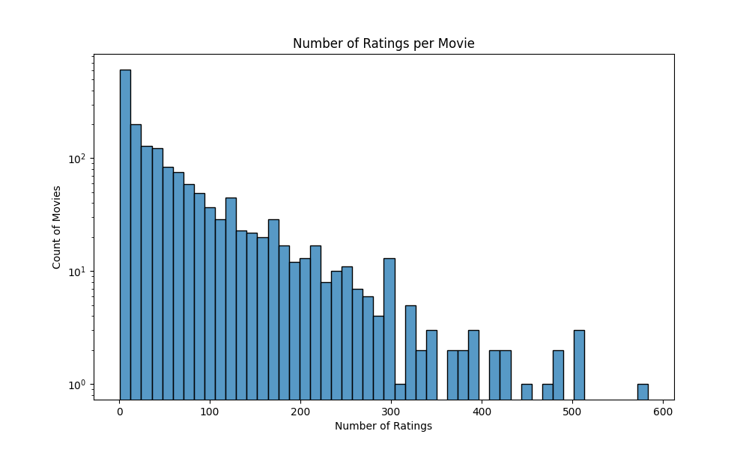
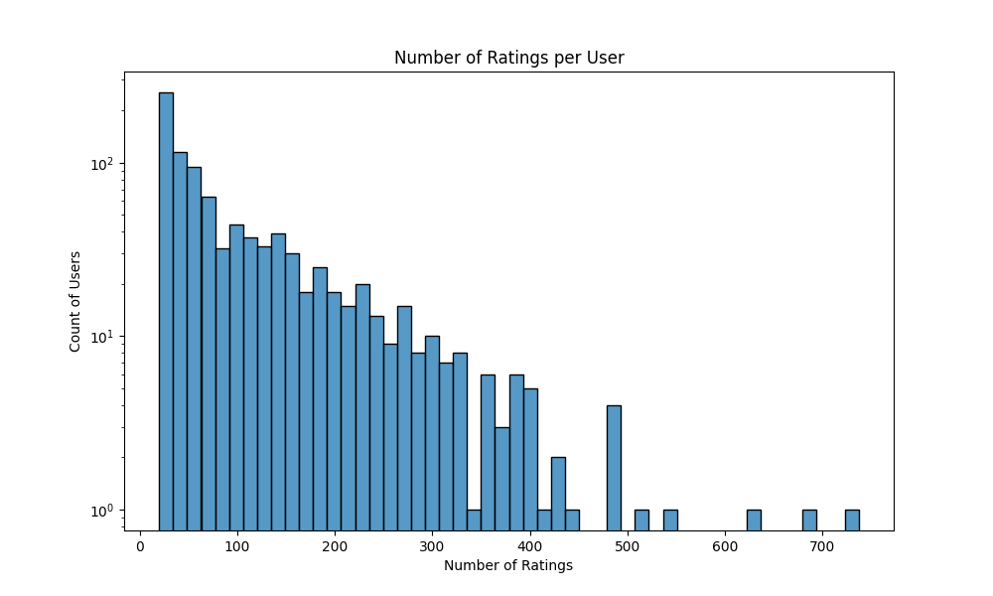
Dataset Analysis – Movie Lens
100K ML
Rating per Movie / per User Distribution

Slide 10
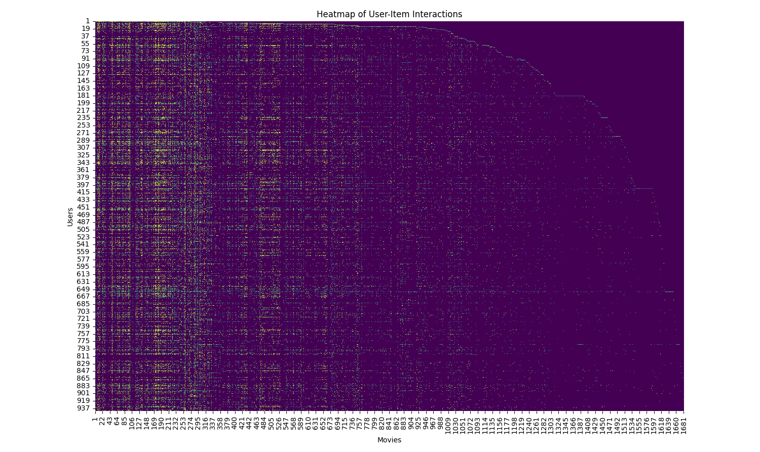
Dataset Analysis – Movie Lens
100K ML
Data Sparsity Visualization

Slide 11
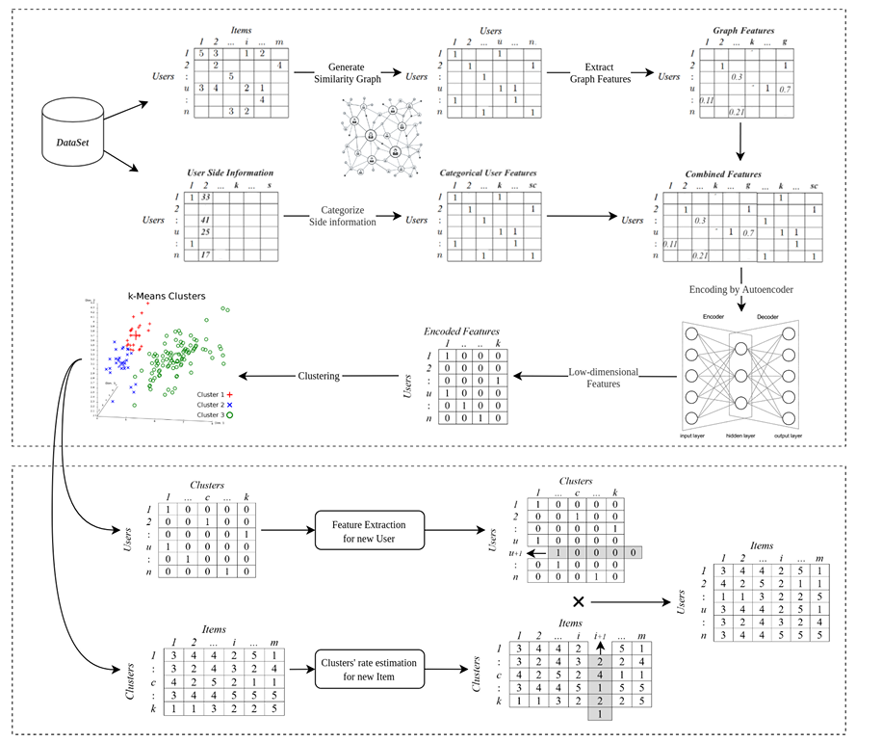
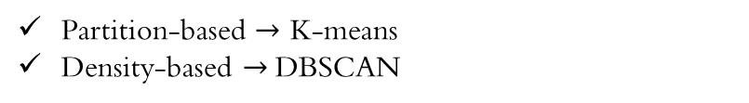
Model Pipeline
Provided
Partition-based $→$ K-means
Density-based $→$DBSCAN

Slide 12
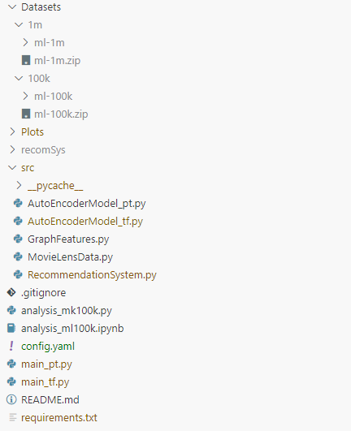
Code Walkthrough - Structure
Dataset
Auto Encoder
Graph Feature Extraction (Given)
Data Loader
Prediction Model
Data Analysis
Main execution file
Environment requirements

Slide 13
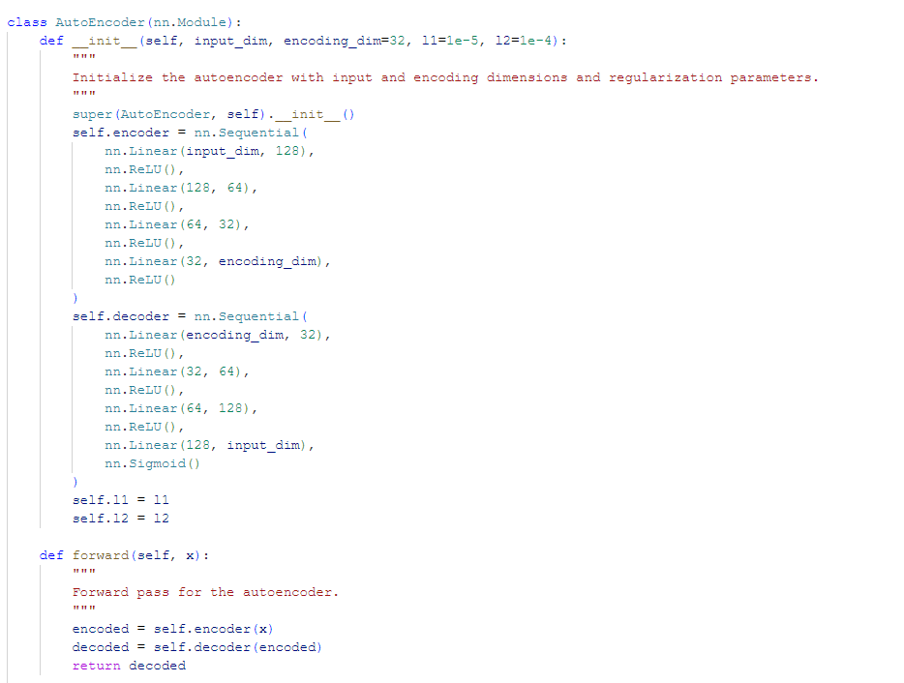
Code Walkthrough – Auto Encoder
2-Layer Auto Encoder as described in the paper

Slide 14
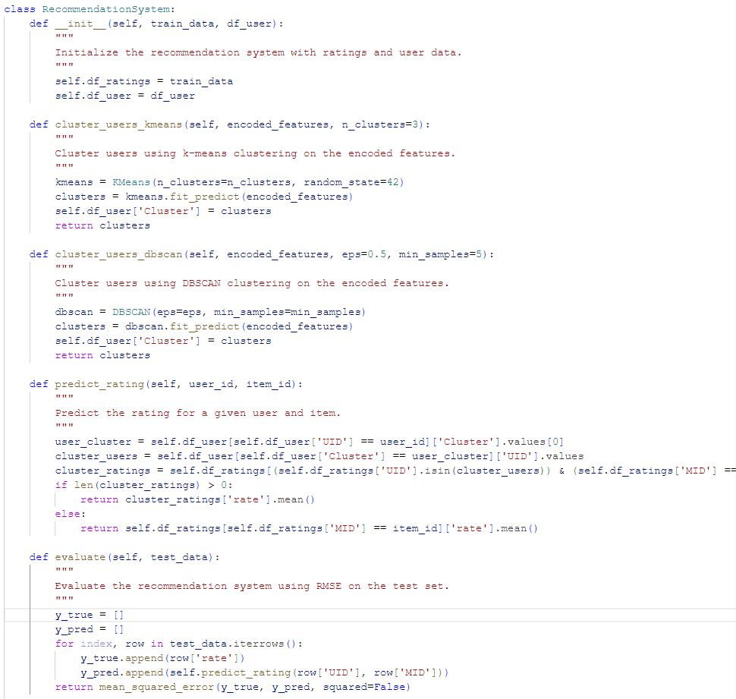
Code Walkthrough – Prediction System
Use K-Means to cluster users and encoded features
Use DBSCAN to cluster users and encoded features
Predict rating for a given user/item
To run evaluation on Test set

Slide 15
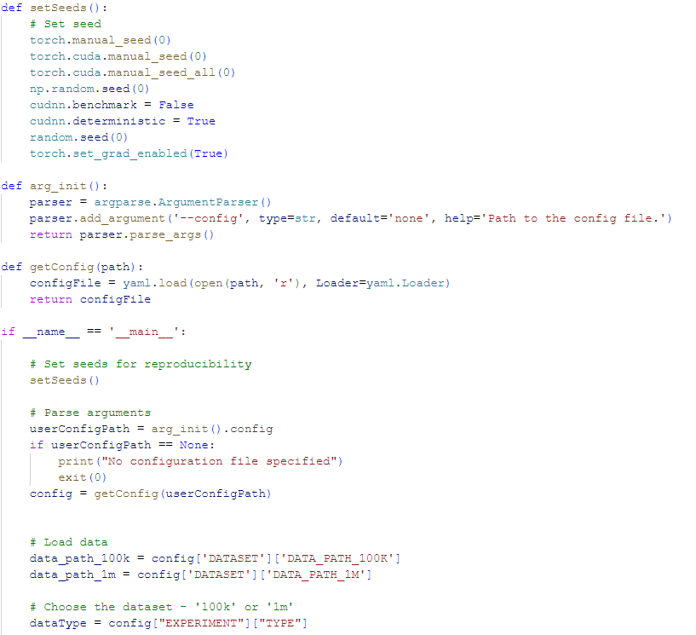
Code Walkthrough – Execution
Set seeds for reproducibility
Setup experiment parameters using a config file
Setting data parameters

Slide 16
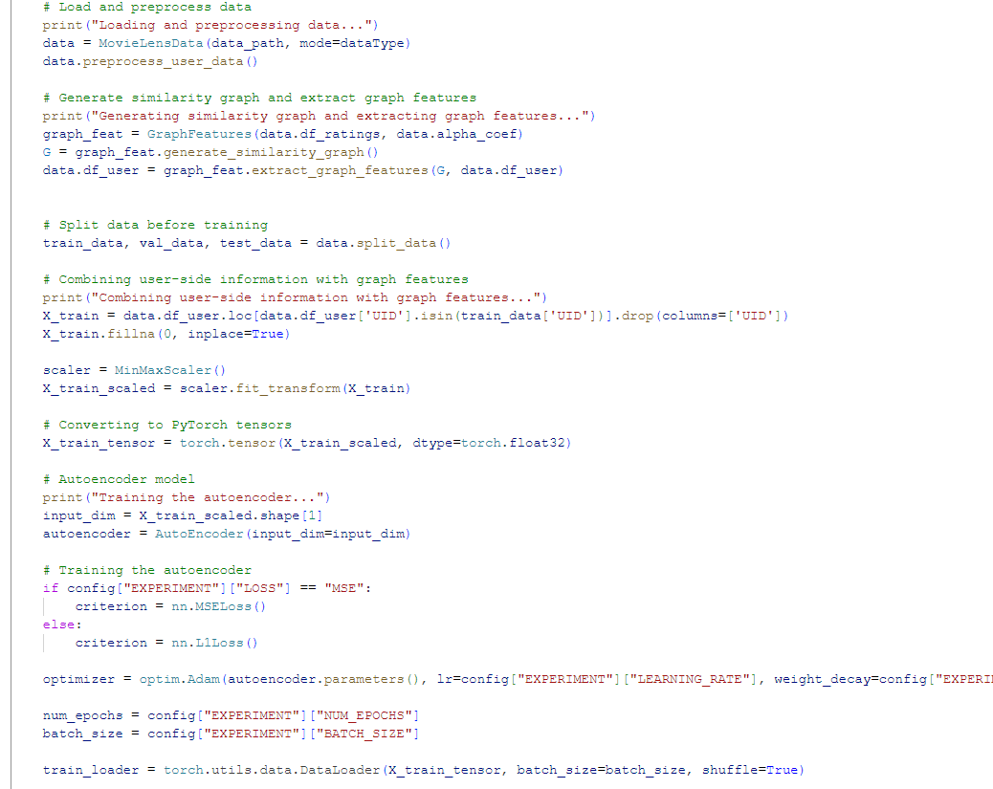
Code Walkthrough – Execution
Data Loader
Extract Graph features
Split data into Train, Val and Test sets
Combine user side info with graph features
Auto encoder training initialization

Slide 17
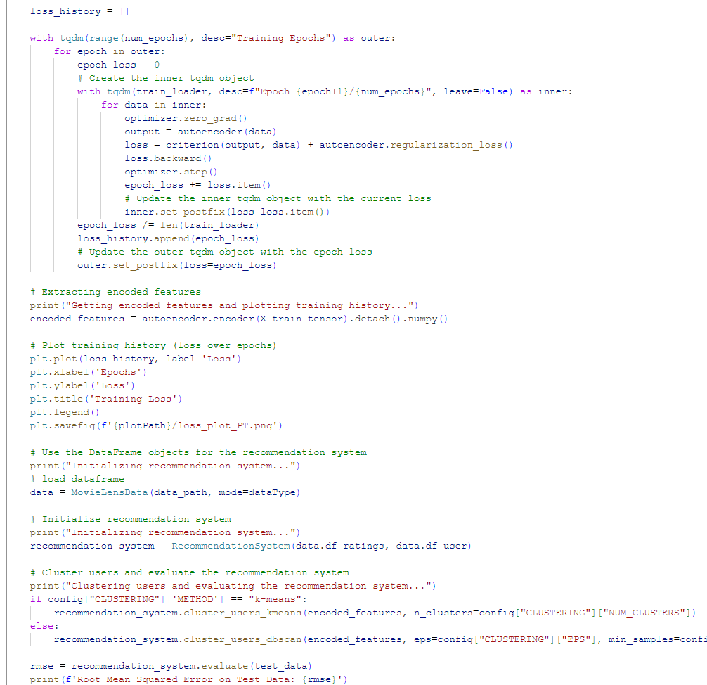
Code Walkthrough – Execution
Auto encoder training
Prediction evaluation

Slide 18
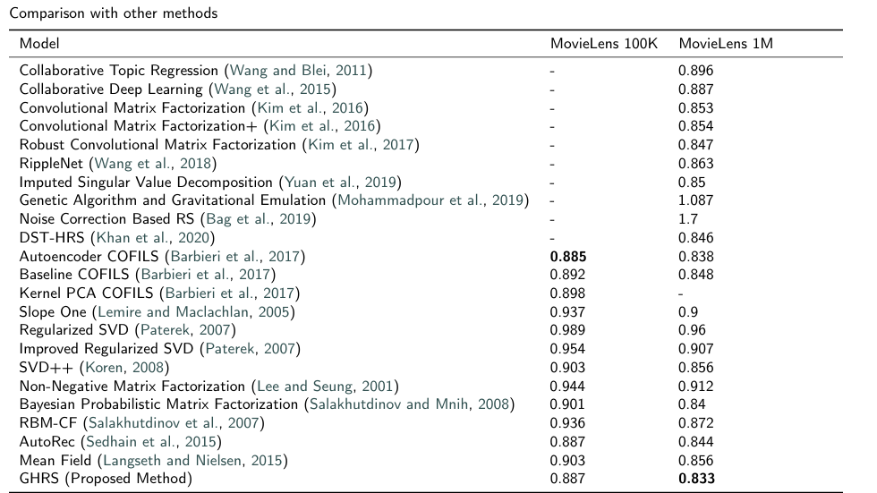



RMSE Comparison
Batch Size
256
# Epochs
200
Clustering
K-Means
#clusters
8
Clustering
DBSCAN
eps
0.4
Min samples
15
Loss
MSE
Optimizer
Adam
PyTorch/ TensorFlow
$±$ 0.07~0.12
GHRS (Our implementation)
0.913
0.862
GHRS (Our implementation) w DBSCAN
0.904
0.9$\%↑$
0.848
1.4$\%↑$

Slide 19
Ablation Studies
Batch Size
256
# Epochs
200
Clustering
K-Means
#clusters
8
Loss
MSE
Learning Rate | MovieLens 100K | MovieLens 1M
0.1 | 0.939 | 0.878
0.01 | 0.913 | 0.862
0.001 | 0.917 | 0.869
0.0001 | 0.926 | 0.884
Optimizer
Adam
PyTorch/ TensorFlow
$±$ 0.07~0.12
Learning Rate of 0.01 was found out to be optimal
Weight Decay | MovieLens 100K | MovieLens 1M
0.1 | 0.916 | 0.865
0.2 | 0.913 | 0.862
0.5 | 0.921 | 0.878
0.7 | 0.938 | 0.89
Weight Decay of 0.2 was found out to be optimal

Slide 20
Ablation Studies
LR
0.01
# Epochs
200
Clustering
K-Means
#clusters
8
Loss
MSE
Optimizer
Adam
PyTorch/ TensorFlow
$±$ 0.07~0.12
Batch Size | MovieLens 100K | MovieLens 1M
64 | 0.992 | 0.986
128 | 0.946 | 0.941
256 | 0.913 | 0.862
512 | 0.937 | 0.912
Batch Size of 256 was found out to be optimal

Slide 21
Ablation Studies
Batch Size
256
LR
0.01
# Epochs
200
Clustering
DBSCAN
Min samples
10
Eps. | MovieLens 100K | MovieLens 1M
0.2 | 0.992 | 0.986
0.4 | 0.905 | 0.851
0.6 | 0.913 | 0.848
0.8 | 0.937 | 0.912
Loss
MSE
Optimizer
Adam
PyTorch/ TensorFlow
$±$ 0.07~0.12
Eps.
0.4
Min Samples | MovieLens 100K | MovieLens 1M
5 | 0.918 | 0.863
10 | 0.912 | 0.856
15 | 0.904 | 0.848
20 | 0.919 | 0.866
30 | 0.924 | 0.878
Optimal Eps. and Min samples for DBSCAN was found to be 0.4 and 15 respectively

Slide 22
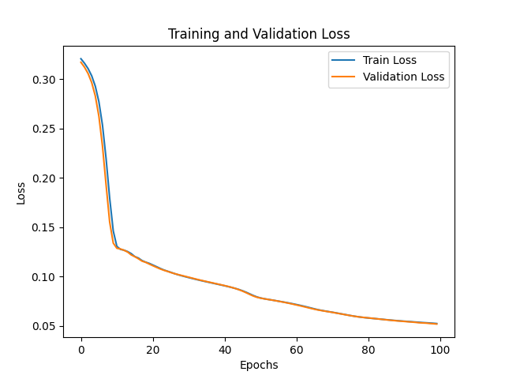
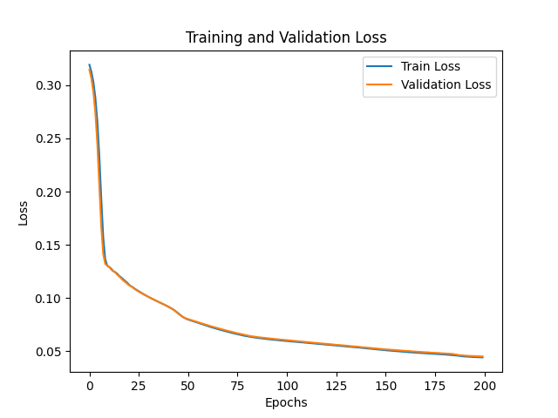
Auto Encoder Training Graph
Initial Run
w/ Optimal Parameters

