Slide 1

Project Plan
Implementation of
GHRS: Graph-based Hybrid Recommendation System
Bishal, Salohidin, Hyunjin
06-03-2024

Slide 2
Why GHRS?
A Survey of Collaborative Filtering-Based Recommender Systems - From Traditional Methods to Hybrid Methods Based on Social Networks
No
Evaluating Collaborative Filtering Recommender Algorithms - A Survey
No
A Deep Learning Based Trust- and Tag-Aware Recommender System
No
Robust Collaborative Filtering Recommendation With User-Item-Trust Records
No
IntegrateCF: Integrating Explicit and Implicit Feedback Based on Deep Learning Collaborative Filtering Algorithm
No
Semantic-Enhanced Neural Collaborative Filtering Models in Recommender Systems
No
GHRS - Graph-Based Hybrid Recommendation System with Application to Movie Recommendation
Partial
Personalized Recommendation System Based on Knowledge Embedding and Historical Behavior
No
Time saving and robust implementation
SOTA results in ML100K

Slide 3
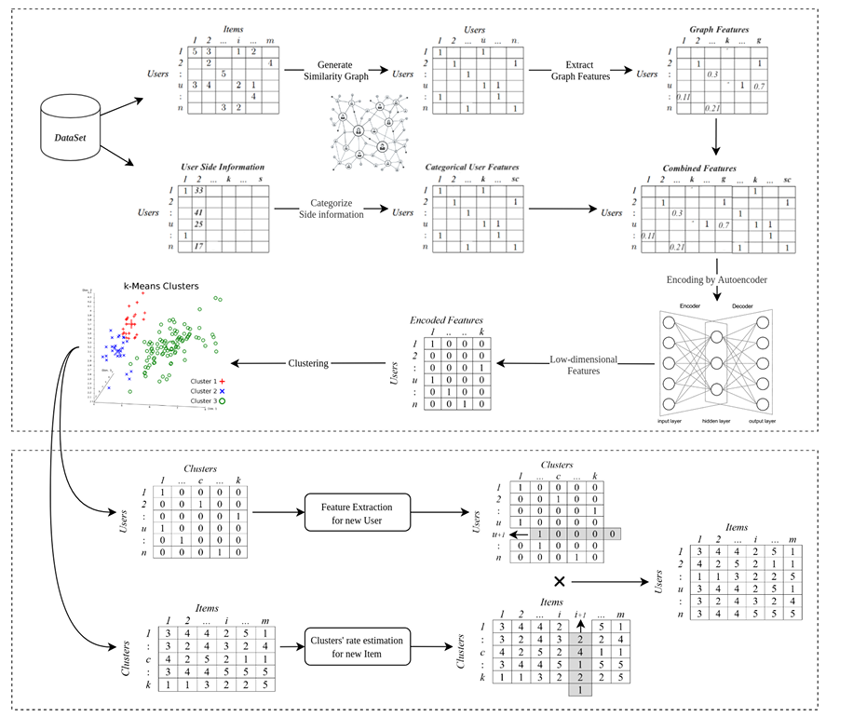
Framework of GHRS
Necessary Modules -
Dataset
Extraction of Graph Features
Autoencoder
Clustering
New Feature Prediction

Slide 4
Framework of GHRS
Necessary Modules -
Dataset
Movie Lens
Other (Having similar properties that of movie lens)
Extraction of Graph Features
Autoencoder
Clustering
New Feature Prediction

Slide 5
Framework of GHRS
Necessary Modules -
Dataset
Extraction of Graph Modules
Code provided by the authors in GitHub.
Autoencoder
Clustering
New Feature Prediction

Slide 6
Framework of GHRS
Necessary Modules -
Dataset
Extraction of Graph Modules
Autoencoder
Model an autoencoder for the RS.
Clustering
New Feature Prediction

Slide 7
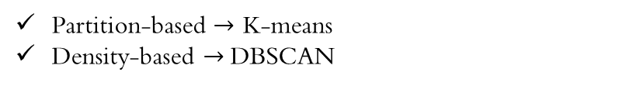
Framework of GHRS
Necessary Modules -
Dataset
Extraction of Graph Modules
Autoencoder
Clustering
Partition-based $→$ K-means
Density-based $→$DBSCAN
Simple and efficient
Robust to noise and outliers
New Feature Prediction

Slide 8
Framework of GHRS
Necessary Modules -
Dataset
Extraction of Graph Modules
Autoencoder
Clustering
New Feature prediction
Predict for new user
Predict for new item

Slide 9
Task Relegation
Week 1
Week 2
Week 3
Dataset Preparation
Hyunjin
Dataset Analysis and Review
Din
Model Structure and Pipeline
Bishal
Structing of codebase and dataloaders for both TF and PT
Evaluation Criterion
(Status Report Presentation)
Hyunjin
Selection and understanding of proper evaluation criterion
Model Initial Training
Bishal
Din
Autoencoder, Clustering
Optimization
Din
Bishal
Hyperparameter and other optimizations
Evaluation
Hyunjin
Perform final evaluations
Final Presentation
Hyunjin
Din
Organize data and presentation preparation
Bishal

Slide 10
Productivity Association
Notion
We have created a notion page, and all workflow management will be performed there.
Meetings
We have set up a weekly meeting every Wednesday to post status update and fill in knowledge void.
Kakao Talk
We also have a Kakaotalk group for immediate assistance.
GitHub
The codebase will be managed through private GitHub repository and will be made public after final presentation.

