Slide 1
UltraViolet

Slide 2
Introduction
UltraViolet is platform for emulating large scale software defined networks with containerized capabilities.
It runs on multiple physical machines and emulates the whole network.
It is a combination of
MaxiNet – distributed emulation of network
ContainerNet – provides containerized capabilities
Requirement - A minimum of two physical machines running on Ubuntu 18.04 that are able to reach each other.

Slide 3
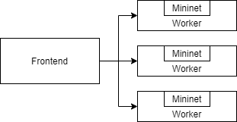
MiniNet, MaxiNet, ContainerNet & UltraViolet
Mininet is a tool for emulating a realistic virtual network, running real kernel, switch and application code, on a single machine.
MaxiNet uses Mininet to emulate network topology on a cluster of machines.
It uses Pyro4 for communicating between the systems.
It is written in Python2.7 and doesn’t support dynamism.
ContainerNet is a MiniNet fork that allows to use Docker containers as hosts in emulated network topologies on a single machine.
UltraViolet exported MaxiNet to python3 and replaced MiniNet with ContainerNet and also added support for runtime changes in topology, resource utilization, etc.

Slide 4
Operators of UltraViolet
Frontend
Workers
Runs all the control logic of an experiment.
Determines when to run which command
Partitions and distributes the virtual network onto the workers
Keeps a list of which node resides on which worker
Has a CLI to interact with the emulated experiment
Physical machines that are used to compute the emulation.

Slide 5
Operators of UltraViolet
Frontend
Worker
The script for the experiment
Worker
ContainerNet
Mininet Instance
Nodes
MaxiNet
Metis
Nodes
Logs and other information

Slide 6
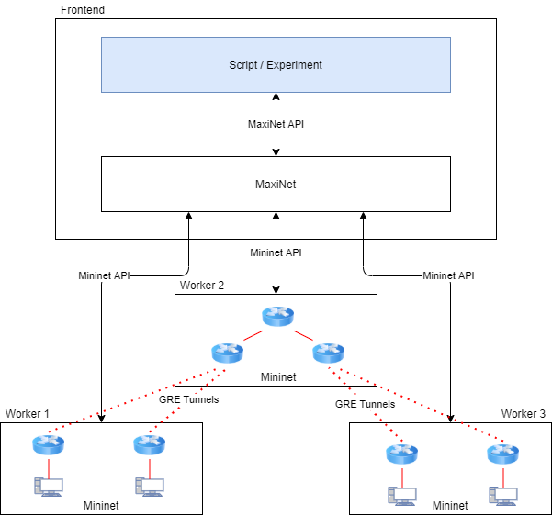
Working
UltraViolet uses Maxinet to connect multiple unmodified Mininet instances running on different workers.
A centralized API is present for accessing this cluster of Mininet instances.
GRE tunnels are used to interconnect nodes emulated on different workers.
UltraViolet works as
a front end for Containernet that sets up all the Mininet instances,
Invokes commands at the nodes,
Sets up tunnels required for proper connectivity.
Metis

Slide 7
Working
A network experiment can use UltraViolet to set up, control and shut down a virtual network by using the MaxiNet APIs.
The MaxiNet APIs are very similar to the Mininet APIs.
The emulation as such happens on a pool of workers. These workers are controlled by MaxiNet using the Mininet API.
Communication between MaxiNet and Mininet happens through RPC calls.
For partitioning a virtual network onto several workers graph partitioning library METIS is used.
Metis

Slide 8
Metis Partitioning
For n workers, METIS computes n partitions of near equal weight.
The goal of the partitioning process is to confine most of the emulated traffic locally to the workers.
The optimization criteria that is used for partitioning is minimal edge cut.
Edge weights in the partitioning process are proportional to the bandwidth limits specified in the virtual topology.
Node weights in the partitioning process are chosen to be proportional to the corresponding node degree in the virtual topology.
This is done because a node with a higher number of links is likely to forward more traffic, thus causing more load to the worker

Slide 9
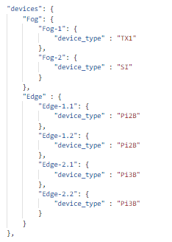
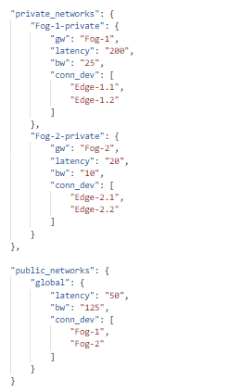
Features
Exclusive to UltraViolet
It can emulate thousands of nodes using a handful of physical machines and linearly scales the virtual network size with the number of physical machines.
The topology and network configuration can be written in a JSON file and provided to UltraViolet to emulate.
IP addresses can be configured from the provided JSON file or can also be automatically assigned by UltraViolet.
JSON content example

Slide 10
Features
*topo is the topology object
Containers can be created on hosts using Docker images.
topo.addHost("f1", ip="10.0.0.10", cls=Docker, dimage="ubuntu:trusty")
Links created between hosts or switches can support the following configurations –
topo.addLink(f1, s1, bw = "5m", delay="50ms")
Bandwidth
Delay (transmit delay)
Jitter
Loss
Latency
Enable/Disable GRO (Aaggregate multiple incoming packets belonging to the same stream)
Enable/Disable HFSC, TBF packet scheduling

Slide 11
Features
*topo is the topology object
*exp is the experiment object
Multiple Network Interface Cards can be associated with a single host, but has to be reinitialized after the experiment starts.
topo.addLink(f1, s2, intfName1="f1-eth1", params1={'ip':'10.0.2/8'})
exp.get_node("f1").cmd("ifconfig f1-eth0 10.0.0.10 netmask 255.255.255.0")
f1 ifconfig f1-eth0 10.0.0.10 netmask 255.255.255.0
New hosts, switches and links between them can be dynamically added in the runtime of the experiment.
addhost h10 wid=0 cls=Docker ip=10.0.0.3 dimage=ubuntu:trusty
addswitch s10 wid=0
addlink node1=f1 node2=f2 autoconf=true bw=25 delay=50ms intfname1=f1- eth1 params={'ip':'10.0.2/8'}
In CLI>
In CLI>
Optional
In CLI>
In CLI>

Slide 12
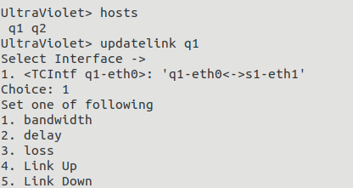
Features
A link can be reconfigured to change its properties in the runtime including Link up/down.
CPU/Memory limit for the hosts can be predefined before the experiment starts. They also can be modified in the runtime of the experiment
CPU quota, CPU period, CPU shares, cores (which core to use, ex – {0},{1}, {0-1})
exp.get_node("f1").updateCpuLimit(10000, 10000, 1, "0-1")
exp.get_node("f1").updateMemoryLimit(300000)

Slide 13
Features
File transfer between Frontend and the workers.
Monitoring – Logs CPU, Memory and Network usage of workers (in progress)
Static Mapping of nodes (hosts and switches) to workers.
mapping = {"h1": 0,
"h2": 0,
"h3": 1,
"s1": 0,
"s2": 0,
"s3": 1
}
exp = maxinet.Experiment(cluster, topo, nodemapping=mapping)
exp.setup()
Execute dpctl commands at switch
Create terminal to execute code directly inside the containers (in progress)

Slide 14
set(Violet) – set(UltraViolet)
Ability to mount volume inside the container.
Disk Space usage limitation
Mimicking device failures (recovery ?)
Automatic cloud provisions.
Ability to emulate the sensor data

Slide 15
Things to do
Deployment of UltraViolet on Cluster
Benchmarking
Terminal and Monitor function of UltraViolet
Volume Mount inside the containers
Documentation
What else ?

Slide 16
Thank You

