Slide 1


TU Final Defense on Southwestern Chatbot
Bachelor’s in Computer Application
Project-II – CAPJ356
Presented By
Shisham Poudel (6-20-530-30-2020)

Slide 2
Table of Contents
Introduction
Problem Statement
Objectives
Scope and Limitations
Methodology
Literature Review
Functional and Non Functional Requirement
Feasibility Study
Tools and Technology
Diagrams
Algorithm Details
Result Analysis
Conclusion
References

Slide 3
Introduction
Southwestern chatbot is a computer program that simulates and processes human conversation (either written or spoken)
It use natural language processing (NLP) to understand and generate human language
Enhance student experience by providing instant assistance and information related to college
Offers details about Southwestern College, including location, fees, courses, college environment, parking, and more.

Slide 4
Problem Statement
High Volume of Repetitive Queries
Limited Query Responses

Slide 5
Objectives
To provide detailed information about college and majors
To reduce the need for in-person visits or calls

Slide 6
Scope
Provide information on admission requirements, deadlines, application processes, and required documents.
Offer information on campus facilities, events, clubs, and extracurricular activities.
Handle FAQs about college policies, procedures, campus services, and administrative contacts.

Slide 7
Limitations
It is mainly focus in backend rather than UI
Chatbot may not respond to all queries of users.

Slide 8
Methodology
Develop the system using HTML, CSS and JavaScript for frontend and python and datasets for backend.
• This project adopted agile technique
• Use LSTM Algorithm

Slide 9
Literature Review
Ncell Maya
Launched by Ncell in 2018
Developed in partnership with Verloop, an Indian AI and customer service automation platform.
Offers a wide range of services, including mobile data plans, balance inquiries, and customer support.

Slide 10
Continued…
2. Wordlink's Chatbot
AI-driven virtual assistant for customer support
Handles internet & NETTV issues, password recovery, and account management.
Available 24/7 via WorldLink website and WhatsApp.
Services: Efficiency, consistency, ease of use

Slide 11
Functional Requirements
The user shall ask the queries
The user shall be able to view the responses
The user shall be able to listen the response.

Slide 12
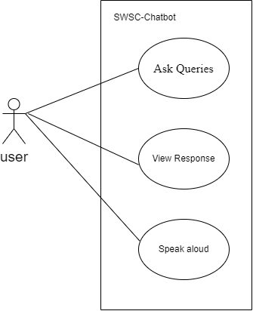
Use Case Diagram

Slide 13
Non-Functional Requirements
The system must have simple and user-friendly UI
The system is available 24/7
The system must have a good response
The system must be maintainable

Slide 14
Feasibility Study
Technical Feasibility
Operational Feasibility
Economic Feasibility
Schedule Feasibility

Slide 15
Tools and Technology
HTML, CSS
JavaScript
Python
Flask

Slide 16
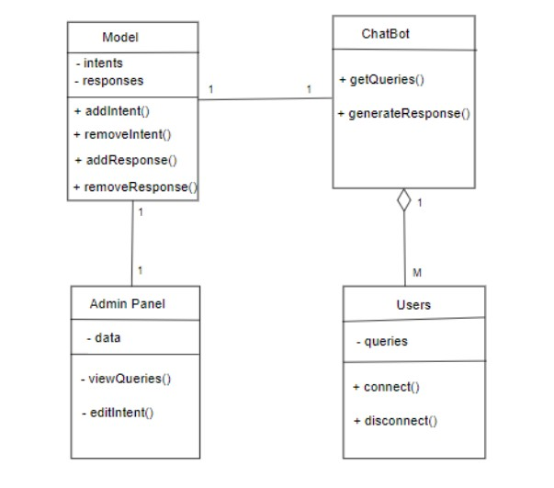
Diagrams: Class Diagram

Slide 17
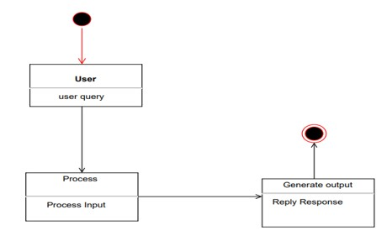
State Diagram

Slide 18
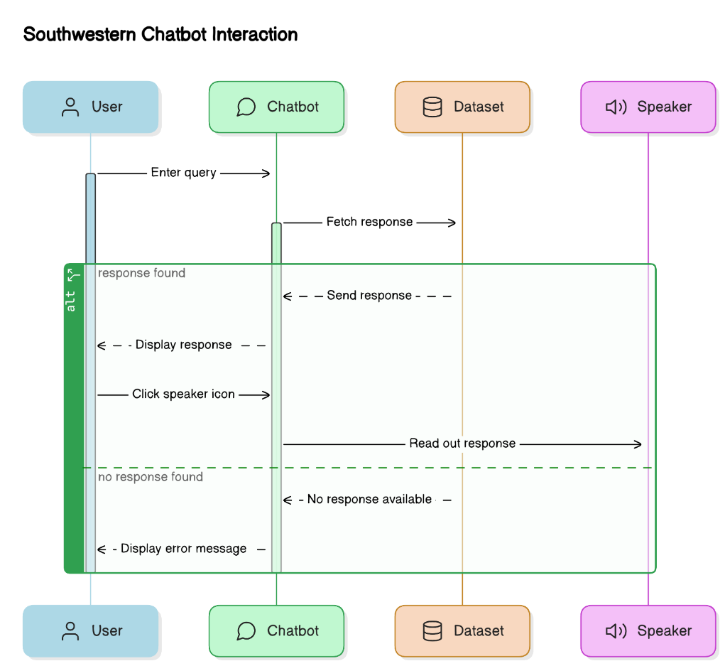
Sequence Diagram

Slide 19
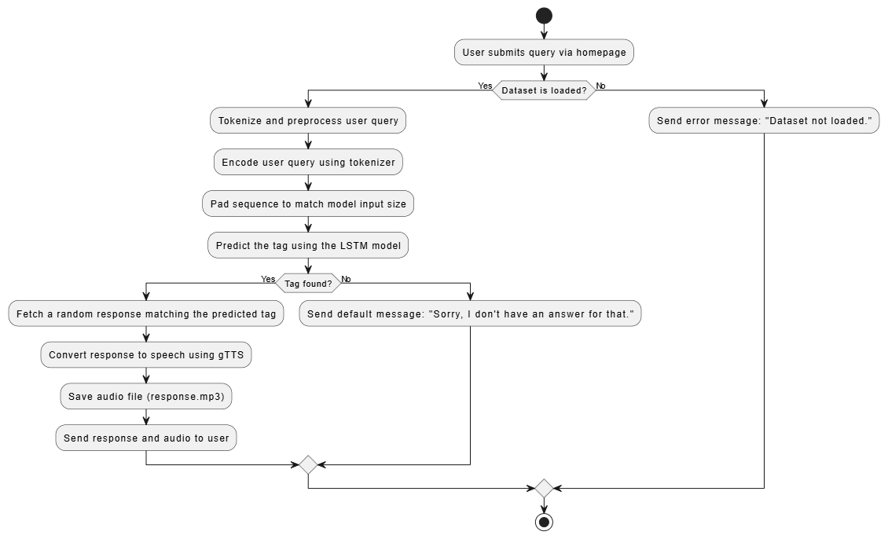
Activity Diagram

Slide 20
Algorithm Details (LSTM)
Long Short-Term Memory (LSTM) is a type of recurrent neural network (RNN) designed for handling sequential data.
It processes text data to classify user queries and provide appropriate responses.
Understands the context and relationships of words in a sequence.
It ensures that the chatbot delivers contextually relevant replies.

Slide 21
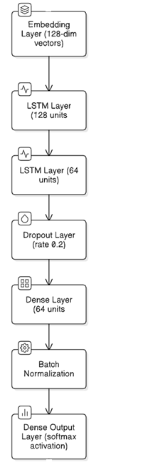
Continued…

Slide 22
Description of Algorithm
A Sequential LSTM model is used
An Embedding layer for converting words into dense vectors.
Two stacked LSTM layers to capture sequential patterns in the input data.
A Dropout layer to prevent overfitting.
A Dense layer with a tanh activation function for better feature learning.
A Batch Normalization layer to stabilize training.
A final Dense output layer with a softmax activation for multi-class classification

Slide 23
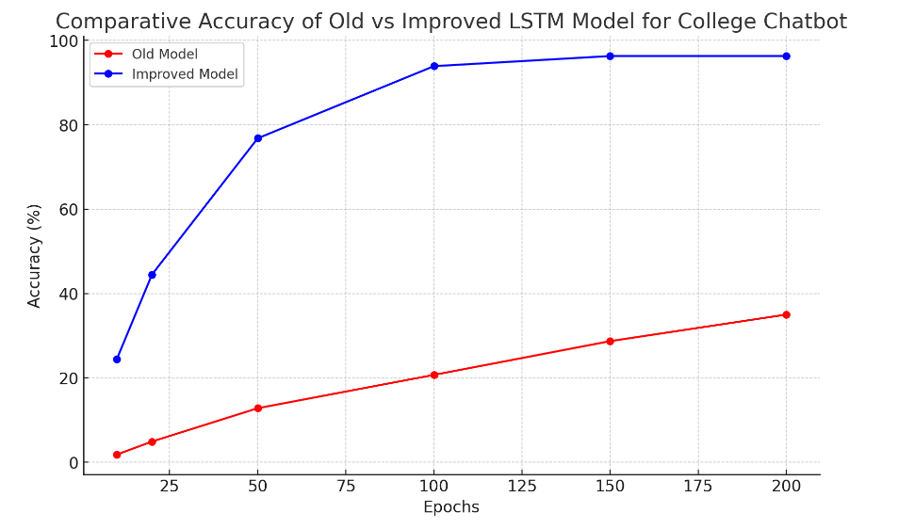
Result analysis

Slide 24
Conclusion
Enhances information accessibility for the Southwestern College community.
Uses NLP and LSTM networks for efficient query handling.
Provides quick and accurate responses to a wide range of queries.
Ensures easy access and optimal performance for all users.

Slide 25
References

Slide 26
Thank you!

