Slide 1

Blueseer ERP

Slide 2
Overview
Architecture
Client / Server Notes
Menu Driven
Security
Customization
JasperViewer/JFreeCharts
Features
Benefits / Conclusions

Slide 3



Architecture
Client
Server
(Windows or Linux)
Client
Database (MySQL)
residing on Server
Client running BlueSeer
Desktop
Application
Client
Client
Client can be installed on Windows or Linux
JRE required on Client
Client

Slide 4
Client-Side
Java Run Time (JRE) required on clients
Any Client OS that supports JRE will work
Client Desktop GUI application
“Heavy Lifting” done by clients

Slide 5
Server-Side
MySQL database engine required for Prod
(Demo version comes with SQLite)
Very little server-side processing except Database and scheduled jobs
Windows or Linux can host database

Slide 6
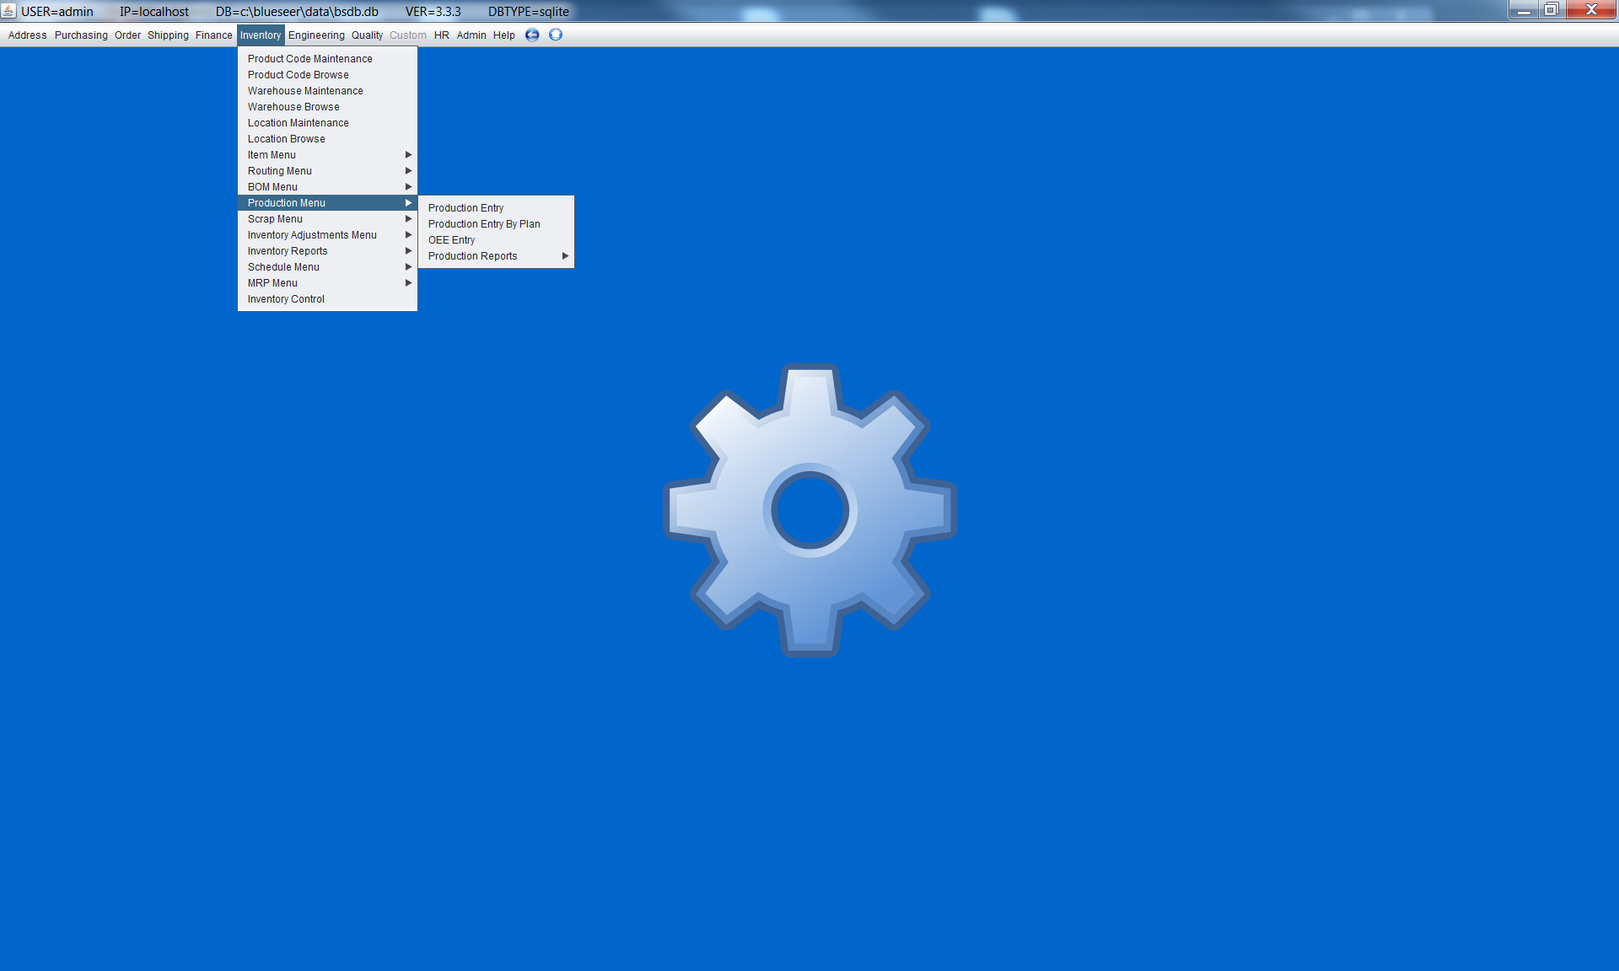
100% Menu Driven

Slide 7
Security
Menu access assigned by Administration
Each user can have distinct access to menus
Application level security (Default)
Implied login security is optional
Menus have optional visible toggle

Slide 8
Customizable
Blueseer is a NetBeans Project
All menus are individual JPanels
New Menu = New JPanel
Menu and JPanel Class stored as database record and administrated via Application
Custom directory for overriding default menu class paths

Slide 9
Features
Double Entry General Ledger
Auto Reporting Ledger Entries by Product Code
Standard Costing (5 elements)
Multiple Level Bill Of Material
Accounts Receivable
Accounts Payable
Inventory Tracking
Production Reporting
Scheduling
MRP
Warehouse Management
Transportation Management
EDI
Label Generation and Scanning

Slide 10
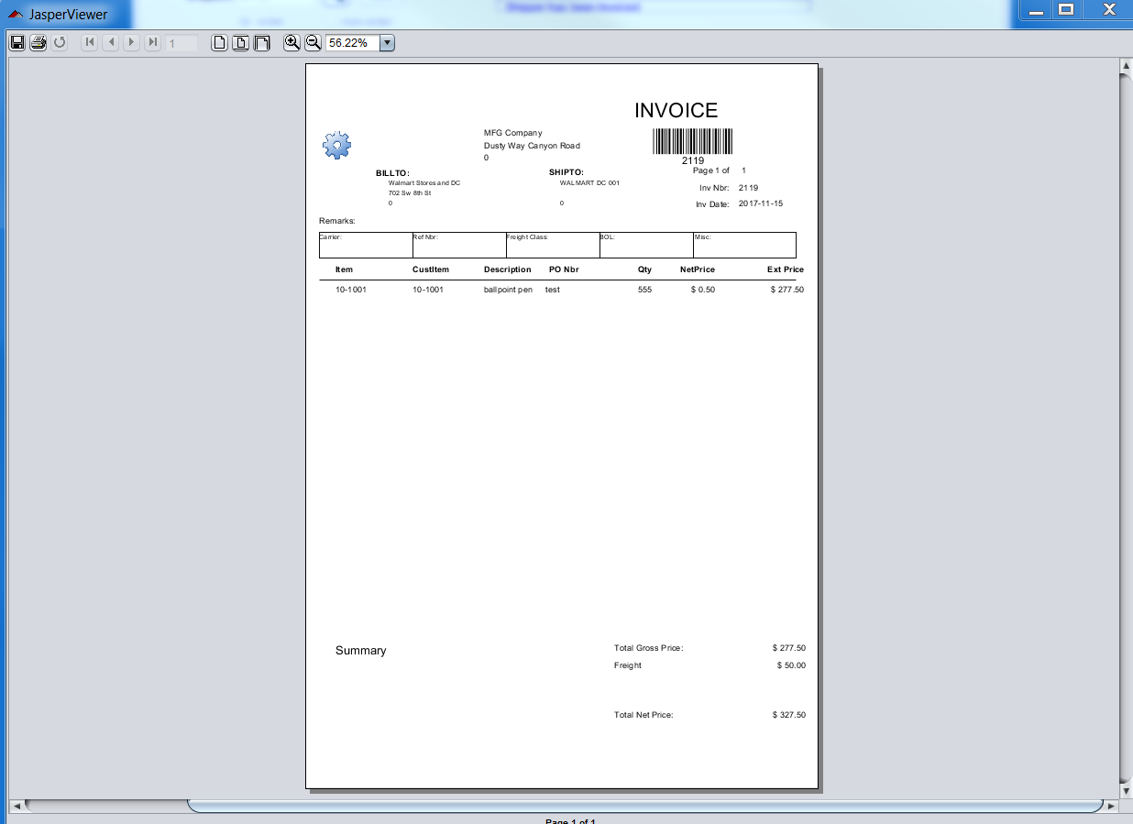
JasperView for Print/Reports

Slide 11
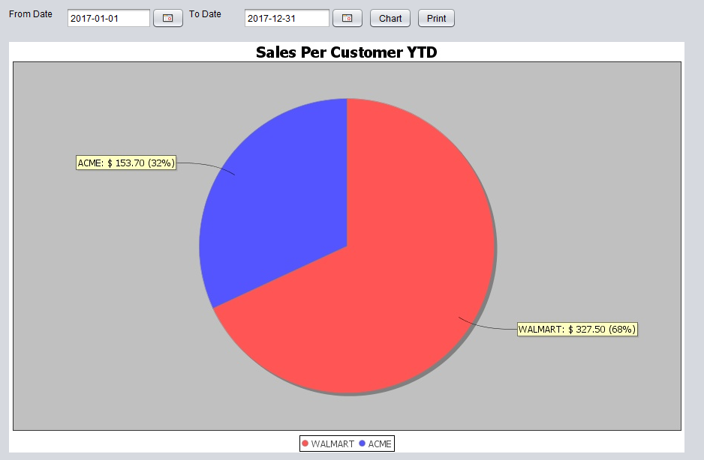
Charts using JFreeChart library

Slide 12
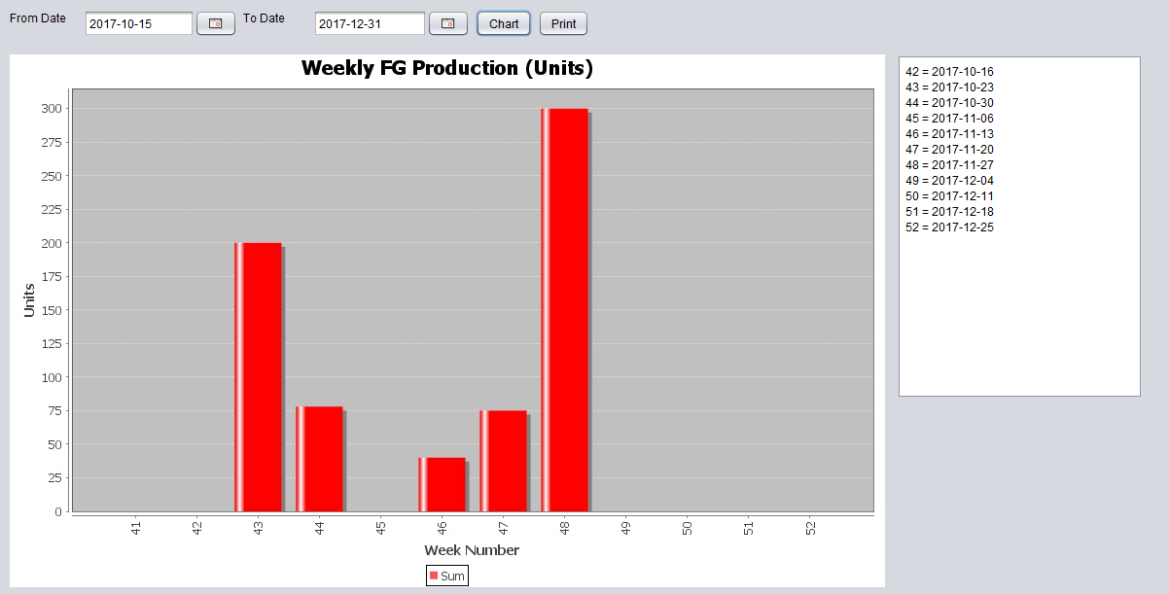
Production Reporting

Slide 13
Benefits / Conclusions
A free open source ERP
A free development stack (Java / MySQL)
Larger pool of Java / DB developers to keep costs lower as opposed to proprietary technology
Easily customizable with generic functionality right out of the box
Cost primarily a function of implementation and customization
Vastly more cost effective than proprietary software
Community of developers to support and/or customize

