Slide 1
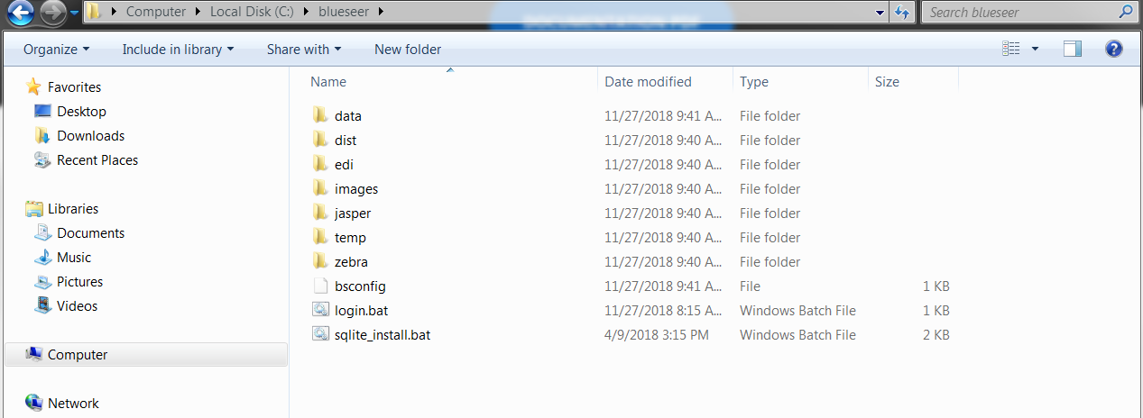
Installation of BlueSeer
SQLite Version
Download blueseer.sqlite.win.zip
Create directory c:\blueseer
Extract contents of zip file into c:\blueseer directory
Once extracted, you should see directory contents as follow:

Slide 2
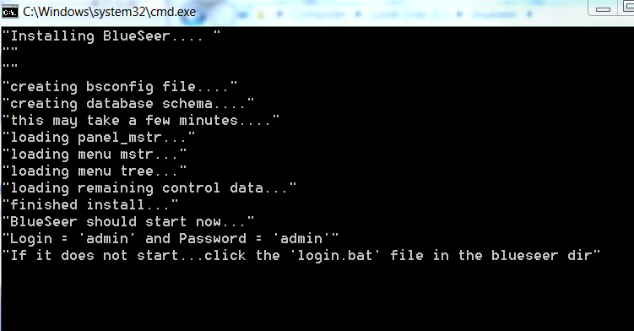
DoubleClick the sqlite_install.bat file. The bat file will then produce the following output. NOTE: the screen should NOT immediately dissappear...if it does...see troubleshooting below.

Slide 3
Once the command prompt window dissappears, the application should start.
To login, use 'admin' for the userid and 'admin' for the password
You're done!
If you have any issues with the install, please send an email to services@blueseer.com.
Most likely reasons for installation failure:
  Your Environment variable 'PATH' does not have the Java JRE bin in it. To test: open a cmd window and type 'java -version'....if it returns with 'not recognized', the your either your Path Variable must be adjusted to include the Java JRE bin directory OR java is not installed. (SEE LAST SLIDE)
  If java is NOT previously installed, download the following zip which has the Java JRE embedded: blueseer.install.demo.win32.withJRE.zip ...or install Java yourself.
  Security...you do not have administrator rights to install the application

Slide 4
Add Java JRE to your PATH variable
Click 'Start' and then right-click 'Computer'
Click 'Properties'
Click 'Advanced System Settings'
Click 'Environment Variables'
Under System Variables, highlight the 'Path' Variable and click 'Edit'
At the end of 'Variable Value' type a ';' and then the path to your JRE installation...typically c:\Program Files\Java\jre1.8.0_121\bin
Click 'Ok' and close the dialog windows.
Then close old CMD window and open a 'new' CMD prompt and type 'java -version'. It should return a valid version. You're set....Java is now in your Path.

