Slide 1
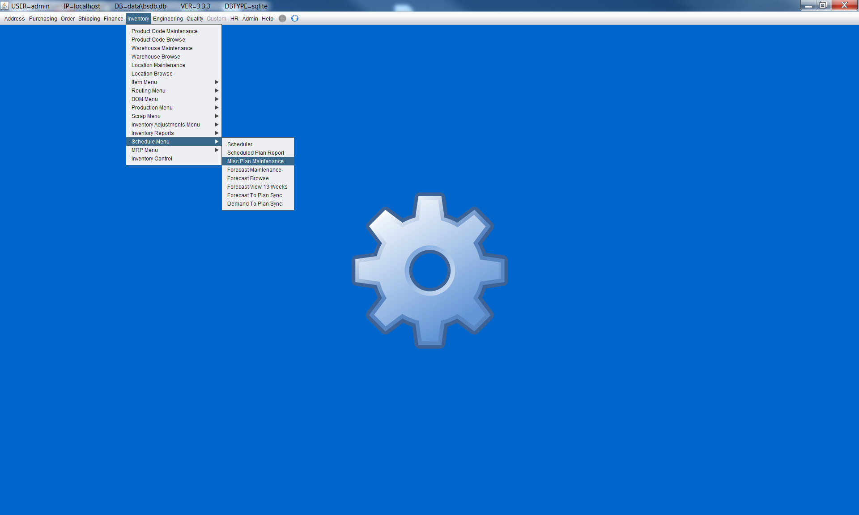

Slide 2
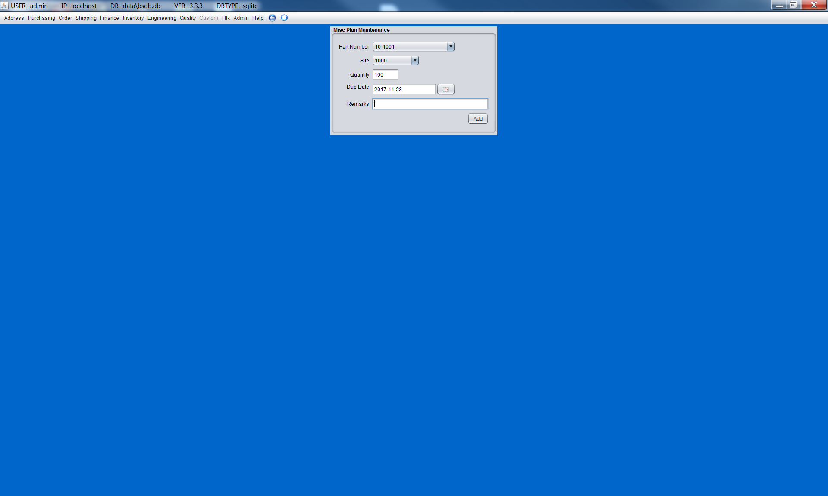
Enter 3 records....qty 100, Date 11/28 ; qty 200, Date 11/29, etc

Slide 3


Slide 4
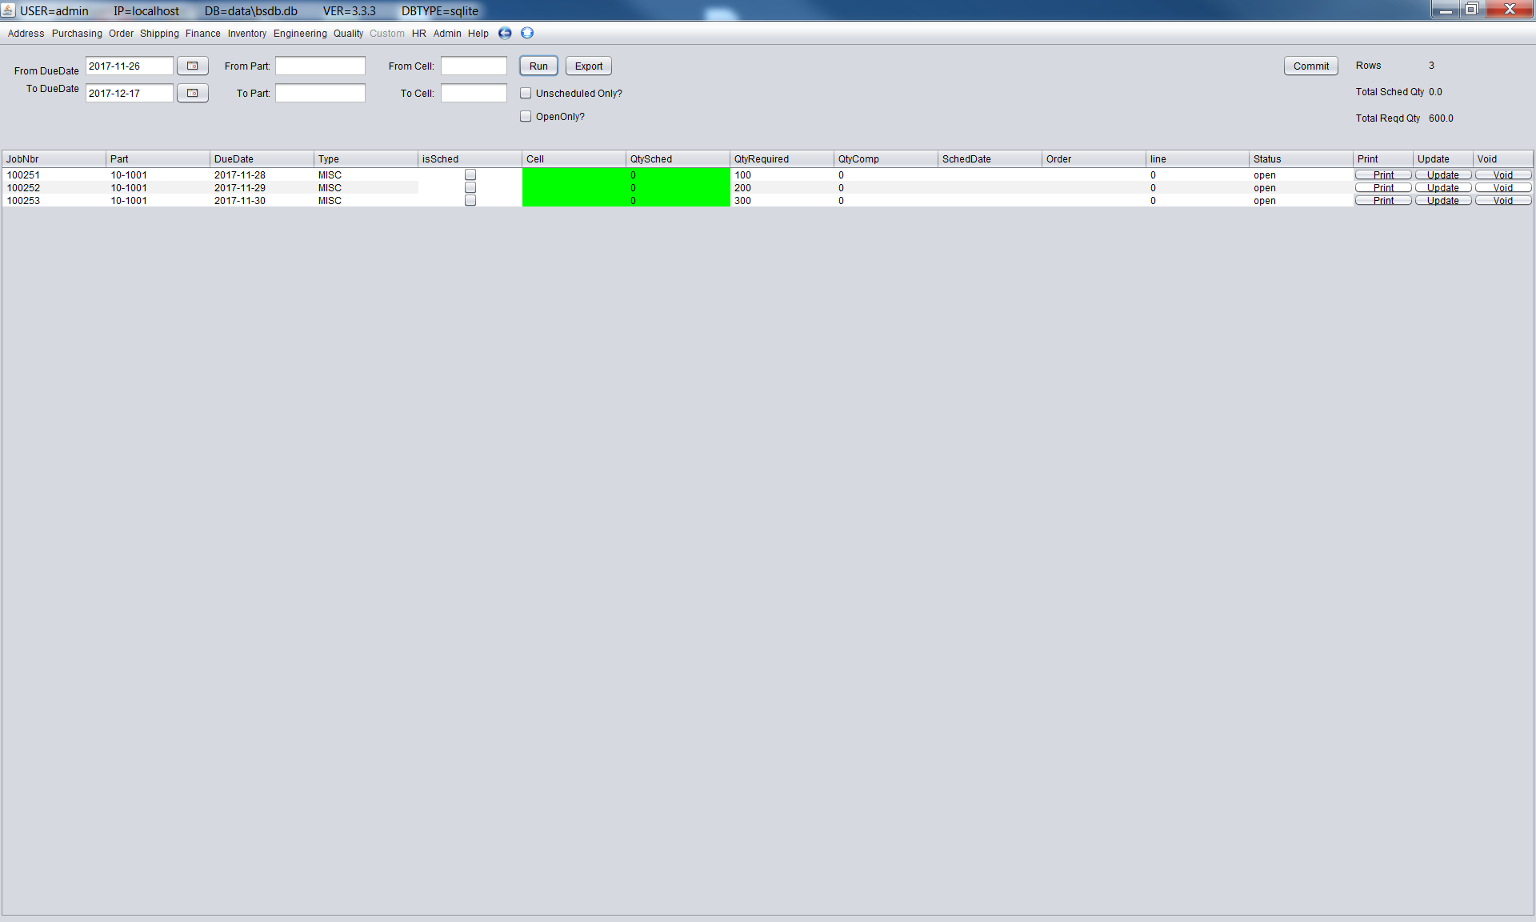
Click 'Run'
All unscheduled records will appear as green. You must enter a Cell (anything) and a QtySched. When these two fields are non-blank...click 'Commit' and it will commit any schedules that are non-blank. Then Click 'Run' again...and click 'Print' on any record. The duedate and qty will show on the master ticket. See next slide.

Slide 5
