Slide 1

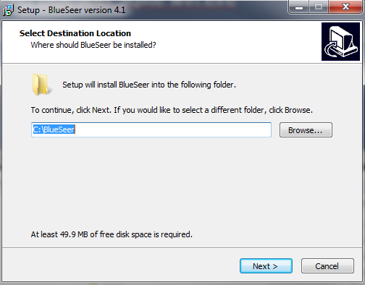
Installation of BlueSeer
SQLite Version
Download blueseer.sqlite.win.exe
Accept default Location to install package and click Next

Slide 2
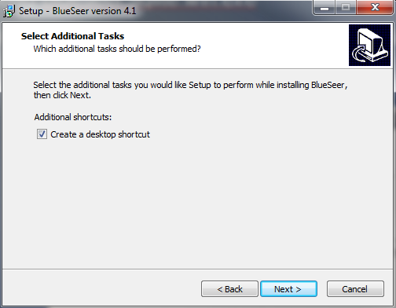
Installation of BlueSeer
SQLite Version
Accept default options for additional tasks and click Next

Slide 3
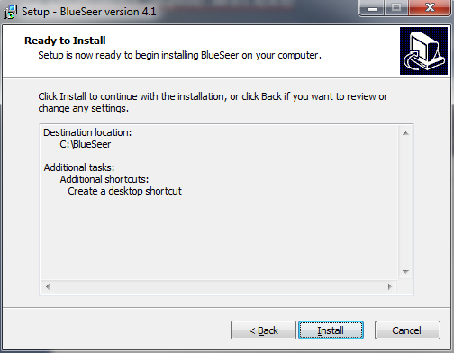
Installation of BlueSeer
SQLite Version
Click Install

Slide 4
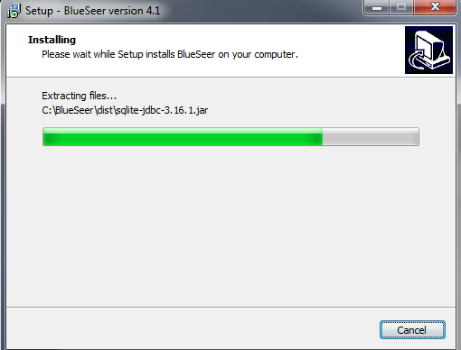
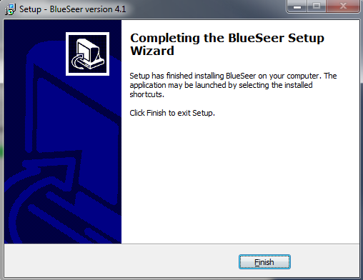
Installation of BlueSeer
SQLite Version
The package will install.....when finished click 'Finish'
You should have a desktop icon and an icon in the start menu to start the application (login and password are: 'admin' and 'admin')
Enjoy. :)

Slide 5
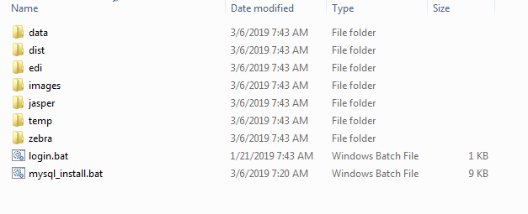
Installation of BlueSeer
MySQL Version On Windows
NOTE: MySQL 8 has a security feature with a default value of disabled that prevents importing of data from local files. This must be enabled before the script can load/install blueseer to MySQL. See last slide below for how-to enable this feature.
Download blueseer.mysql.win.zip
Create directory c:\blueseer
Extract contents of zip file into c:\blueseer directory
Once extracted, you should see directory contents as follow:

Slide 6
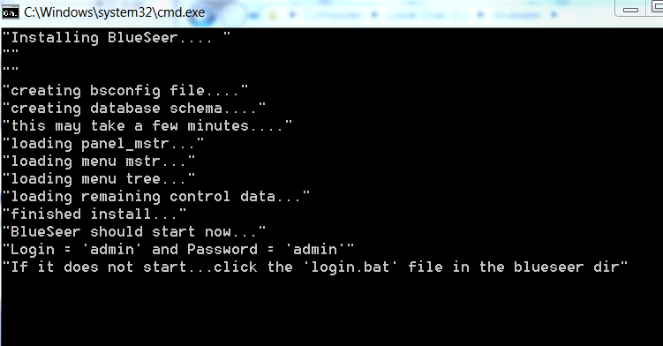
DoubleClick the mysql_install.bat file. The bat file will then produce the following output. NOTE: the screen should NOT immediately dissappear...if it does...see troubleshooting below.
Note: The dialogue will ask you for the IP address of the MySQL server as well as for the MySQL admin password. Provide these values when the script requests.

Slide 7
Once the command prompt window disappears, the application should start.
To login, use 'admin' for the userid and 'admin' for the password
You're done!
If you have any issues with the install, please send an email to services@blueseer.com.
Most likely reasons for installation failure:
  Your Environment variable 'PATH' does not have the Java JRE bin in it. To test: open a cmd window and type 'java -version'....if it returns with 'not recognized', the your either your Path Variable must be adjusted to include the Java JRE bin directory OR java is not installed. (SEE LAST SLIDE)
  You do not have the correct MySQL Admin password or Mysql installation
  ‘Load Data Local’ MySQL 8 feature is disabled…must enable feature to load/install BlueSeer
  Security...you do not have administrator rights to install the application

Slide 8
Installing on multiple clients
Once you've install on one client, you can copy c:\blueseer directory to another client PC that also has java installed
NOTE: Do not run the install bat file on the other client(s)...The install script should be ran once on the initial client....running it again will overwrite the database you created on the first client install.
You can copy and paste c:\blueseer directory on as many clients as you require. The folder contains a bsconfig file that points to the MySQL server.

Slide 9
Add Java JRE to your PATH variable
Click 'Start' and then right-click 'Computer'
Click 'Properties'
Click 'Advanced System Settings'
Click 'Environment Variables'
Under System Variables, highlight the 'Path' Variable and click 'Edit'
At the end of 'Variable Value' type a ';' and then the path to your JRE installation...typically c:\Program Files\Java\jre1.8.0_121\bin
Click 'Ok' and close the dialog windows.
Then close old CMD window and open a 'new' CMD prompt and type 'java -version'. It should return a valid version. You're set....Java is now in your Path.

Slide 10
MySQL 8 Load Data Local Security Issue
You may get the error “ERROR 1148: The used command is not allowed with this MySQL version”.
This error is a default feature of MySQL 8 that prevents by default the loading of data using the command Load Data INFILE. BlueSeer uses this command within it’s script to preload data into the MySQL database during install.
To show the variable in question, log into mysql and run the following command:
SHOW GLOBAL VARIABLES LIKE ‘local_infile’; // it’s probably ‘false’ or ‘off’
To Enable…Type :
SET GLOBAL local_infile = true;
You may want to restart your mysql server and make sure the variable is still ‘On’.
See MySQL link for more detail of work around:
dev.mysql.com/doc/refman/8.0/en/load-data-local.html

