Slide 1
NY_Citi_Tab
Winter 2018 - 2019

Slide 2
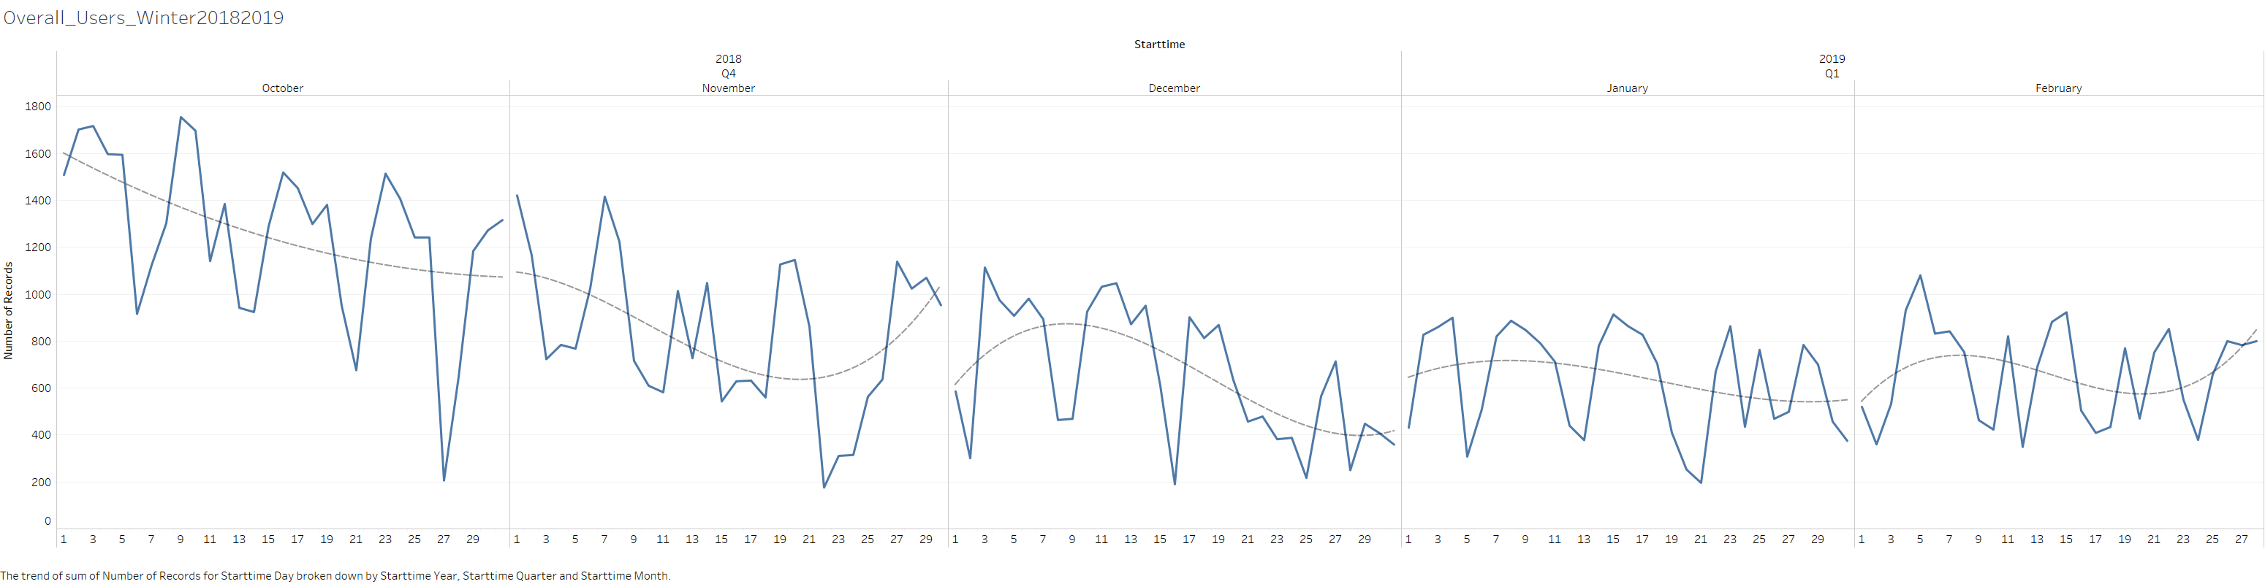
Ridership did not completely drop in the New York winter, despite a polar vortex.

Slide 3
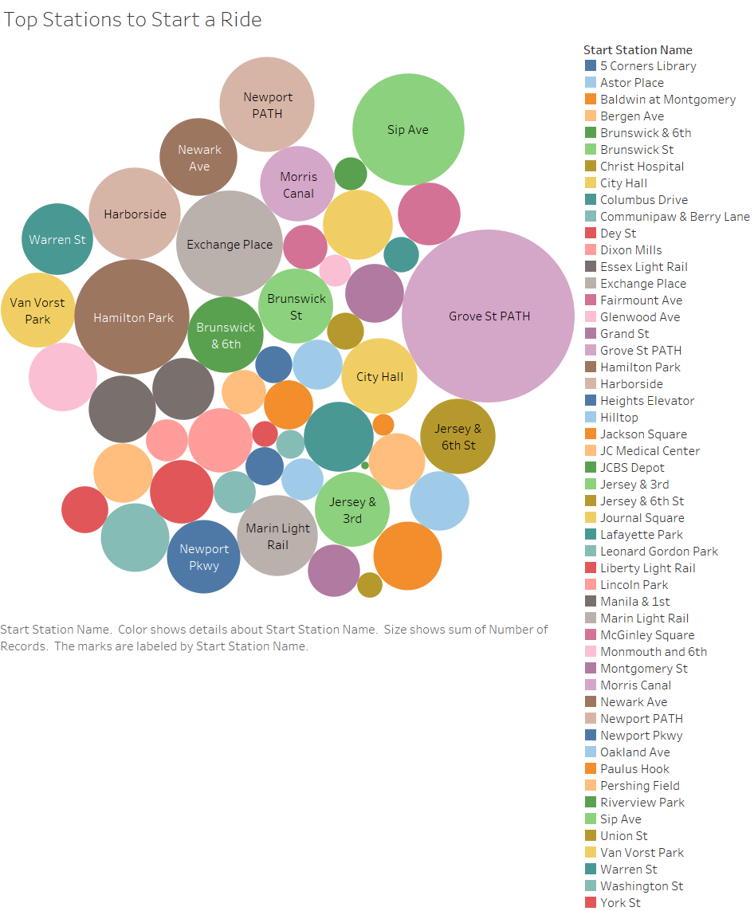
The most popular bike stations where users started their rides included one near City Hall.

Slide 4
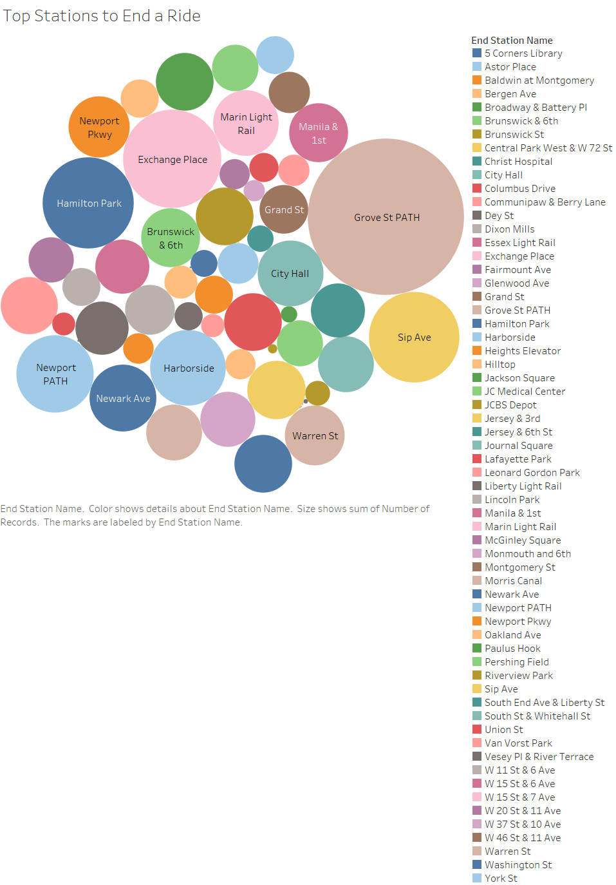
The most popular bike stations where users ended their rides. These were roughly the as start stations.

Slide 5
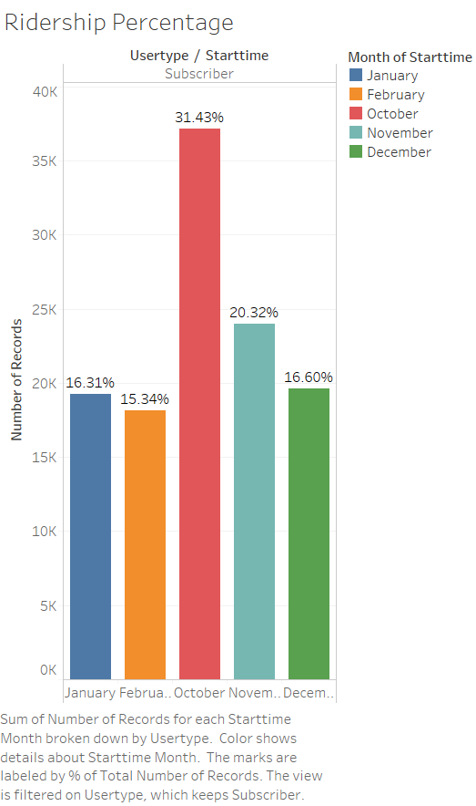
Subscribers to the Citi program rode more often in October than in the colder Winter months, but not by much more.

Slide 6
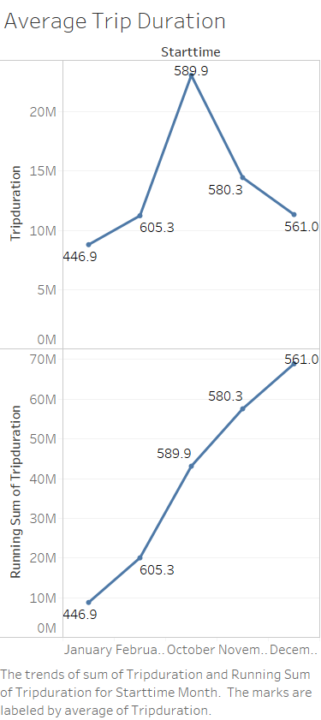
In fact, the trip duration in February and November were quite similar.

Slide 7
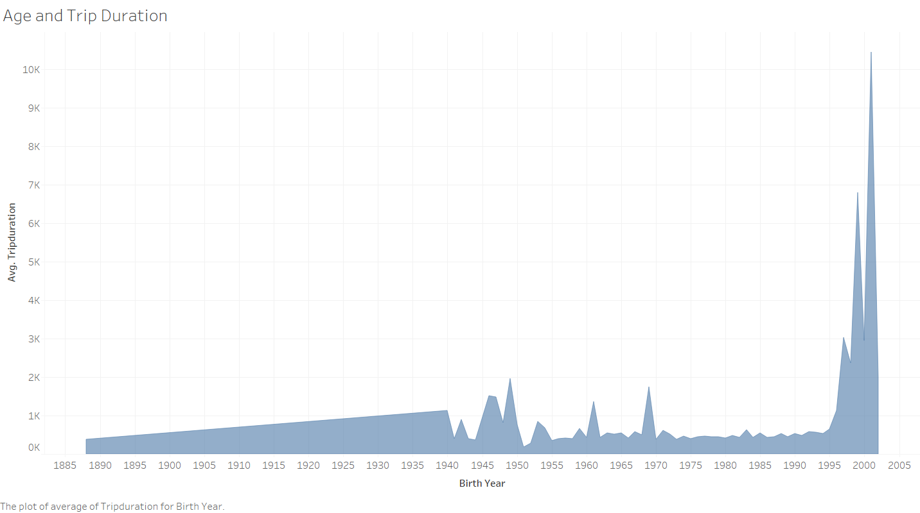
Most riders were born between 1995 and 2003, however, that did not keep older riders from using the service in the wintertime.

Slide 8
Conclusion
Winter months and age did not impede the ridership.
More exploration of the type of rider needs, such as whether they need pedal assist for longer rides and older rider ages, is needed.
This preliminary analysis shows a high number of riders, even before the traffic jam law takes effect. We should examine the effect of the new traffic jam fine on ridership to establish if Citi needs more bikes.

