Slide 1
Supervised Learning Lecture 4: Advanced Approaches
Tho Quan
qttho@hcmut.edu.vn

Slide 2
Agenda
SVM and Kernel Method
Perceptron and ANN
Feature Selection

Slide 3
Text classification: Up until now and today
Previously: 3 algorithms for text classification
Vector space classification using centroids and hyperplanes that split them
Simple, linear discriminant classifier; perhaps too simple
(or maybe not*)
K Nearest Neighbor classification
Simple, expensive at test time, high variance, non-linear
Naive Bayes classifier
Today
SVMs
Some empirical evaluation and comparison
Notes:
*Li and Yiming Yang 2003 ICML give very good performance from Rocchio, whereas Dumais et al. don’t

Slide 4
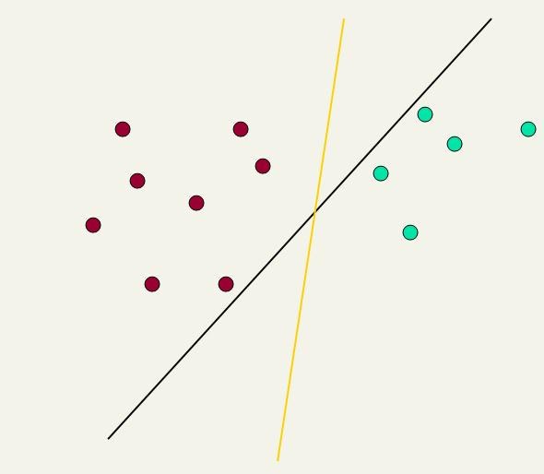
Linear classifiers: Which Hyperplane?
Ch. 15
Lots of possible solutions for a, b, c.
Some methods find a separating hyperplane, but not the optimal one [according to some criterion of expected goodness]
E.g., perceptron
Support Vector Machine (SVM) finds an optimal* solution.
Maximizes the distance between the hyperplane and the “difficult points” close to decision boundary
One intuition: if there are no points near the decision surface, then there are no very uncertain classification decisions
This line represents the decision boundary:
ax + by − c = 0
Notes:
But note that Naïve Bayes also finds an optimal solution … just under a different definition of optimality.

Slide 5
Another intuition
Sec. 15.1
If you have to place a fat separator between classes, you have less choices, and so the capacity of the model has been decreased

Slide 6
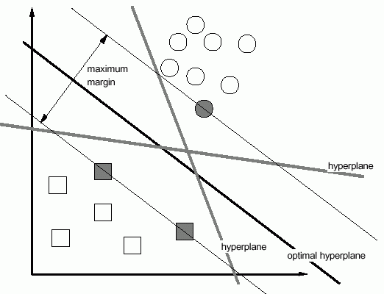
Maximization of margin
Among all discriminating hyperplanes there is one that is clearly better.

Slide 7
Maximization of margin
g(X)=+1
g(X)=−1
g(X)> +1
g(X)< −1
1/||W||
X′
g(X)=W^{T}X+W₀ is the discriminant function, g(X)/||W|| is the distance
and the best discriminating hyperplane should maximize the distance between the g(X)=0 plane and the data samples.

Slide 8
Linear Support Vector Machine (SVM)
Sec. 15.1
ρ
w^{T}x_{a} + b = 1
Hyperplane
w^{T} x + b = 0
Extra scale constraint:
min_{i=1,…,n} |w^{T}x_{i} + b| = 1
This implies:
w^{T}(x_{a}–x_{b}) = 2
ρ = ||x_{a}–x_{b}||₂ = 2/||w||₂
w^{T}x_{b} + b = -1
w^{T} x + b = 0

Slide 9
Solving the Optimization Problem
Sec. 15.1
This is now optimizing a quadratic function subject to linear constraints
Quadratic optimization problems are a well-known class of mathematical programming problem, and many (intricate) algorithms exist for solving them (with many special ones built for SVMs)
The solution involves constructing a dual problem where a Lagrange multiplier α_{i} is associated with every constraint in the primary problem:
Find w and b such that
Φ(w) =½ w^{T}w is minimized;
and for all {(x_{i} ,y_{i})}: y_{i} (w^{T}x_{i} + b) ≥ 1
Find α₁…α_{N} such that
Q(α) =Σα_{i} - ½ΣΣα_{i}α_{j}y_{i}y_{j}x_{i}^{T}x_{j} is maximized and
(1) Σα_{i}y_{i} = 0
(2) α_{i} ≥ 0 for all α_{i}

Slide 10
The Optimization Problem Solution
Sec. 15.1
The solution has the form:
Each non-zero α_{i} indicates that corresponding x_{i} is a support vector.
Then the classifying function will have the form:
Notice that it relies on an inner product between the test point x and the support vectors x_{i}
We will return to this later.
w =Σα_{i}y_{i}x_{i} b= y_{k}- w^{T}x_{k} for any x_{k} such that α_{k}≠ 0
f(x) = Σα_{i}y_{i}x_{i}^{T}x + b

Slide 11
Linear SVMs: Summary
Sec. 15.2.1
The classifier is a separating hyperplane.
The most “important” training points are the support vectors; they define the hyperplane.
Quadratic optimization algorithms can identify which training points x_{i} are support vectors with non-zero Lagrangian multipliers α_{i}.
Both in the dual formulation of the problem and in the solution, training points appear only inside inner products:
Find α₁…α_{N} such that
Q(α) =Σα_{i} - ½ΣΣα_{i}α_{j}y_{i}y_{j}x_{i}^{T}x_{j} is maximized and
(1) Σα_{i}y_{i} = 0
(2) 0 ≤ α_{i} ≤ C for all α_{i}
f(x) = Σα_{i}y_{i}x_{i}^{T}x + b

Slide 12
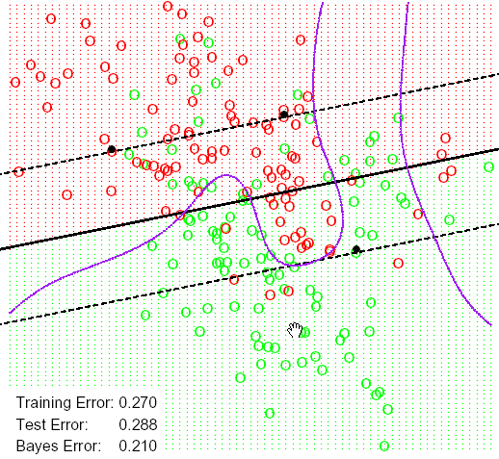
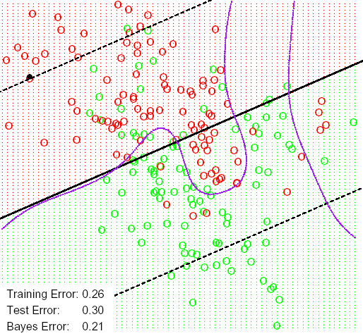
Non-linear separation
With C=10000, with C=0.01, larger margin better around decision plane, but not worse overall,
data from mixture of Gaussians (Hasti et. al, Fig. 12.2)

Slide 13
Non-linear SVMs: Feature spaces
Sec. 15.2.3
General idea: the original feature space can always be mapped to some higher-dimensional feature space where the training set is separable:
Φ: x → φ(x)

Slide 14
The “Kernel Trick”
Sec. 15.2.3
The linear classifier relies on an inner product between vectors K(x_{i},x_{j})=x_{i}^{T}x_{j}
If every datapoint is mapped into high-dimensional space via some transformation Φ: x → φ(x), the inner product becomes:
K(x_{i},x_{j})= φ(x_{i}) ^{T}φ(x_{j})
A kernel function is some function that corresponds to an inner product in some expanded feature space.
Example:
2-dimensional vectors x=[x₁ x₂]; let K(x_{i},x_{j})=(1 + x_{i}^{T}x_{j})²,
Need to show that K(x_{i},x_{j})= φ(x_{i}) ^{T}φ(x_{j}):
K(x_{i},x_{j})=(1 + x_{i}^{T}x_{j})²,= 1+ x_{i1}²x_{j1}² + 2 x_{i1}x_{j1} x_{i2}x_{j2}+ x_{i2}²x_{j2}² + 2x_{i1}x_{j1} + 2x_{i2}x_{j2}=
= [1 x_{i1}² √2 x_{i1}x_{i2} x_{i2}² √2x_{i1} √2x_{i2}]^{T} [1 x_{j1}² √2 x_{j1}x_{j2} x_{j2}² √2x_{j1} √2x_{j2}]
= φ(x_{i}) ^{T}φ(x_{j}) where φ(x) = [1 x₁² √2 x₁x₂ x₂² √2x₁ √2x₂]

Slide 15
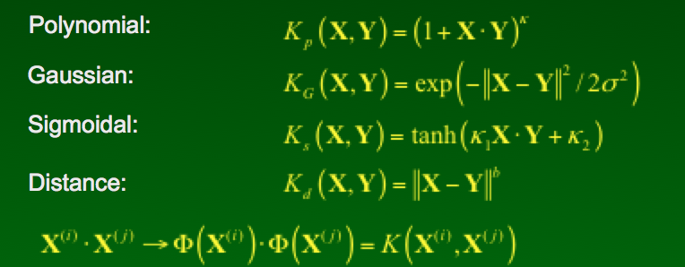
Some popular kernels

Slide 16
Some applications
A few interesting applications, with highly competitive results:
On-line Handwriting Recognition, zip codes
3D object recognition
Stock forecasting
Intrusion Detection Systems (IDSs)
Image classification
Detecting Steganography in digital images
Medical applications: diagnostics, survival rates ...
Technical: Combustion Engine Knock Detection
Elementary Particle Identification in High Energy Physics
Bioinformatics: protein properties, genomics, microarrays
Information retrieval, text categorization

Slide 17
Artificial Neural Network
“Simulating” biological neural systems
Consisting of many nodes or neurons linked by weighted interconnections
Paralleling many competing optimization hypothesis
Input patterns (vectors) ➔output patterns
Supervised
Unsupervised

Slide 18
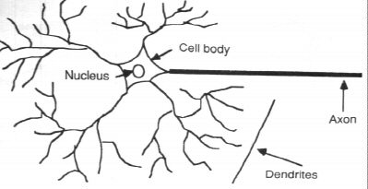
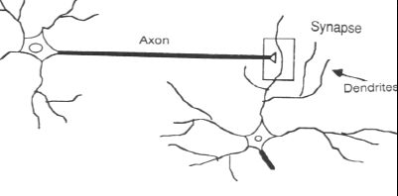
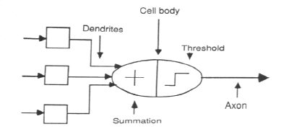

Slide 19
ANN Applications
Nonlinear estimation
Classification
Clustering
Pattern recognition

Slide 20
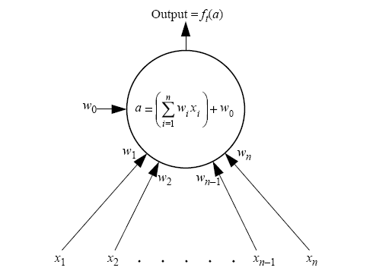
Neural Activation

Slide 21
Neural Activation

Slide 22
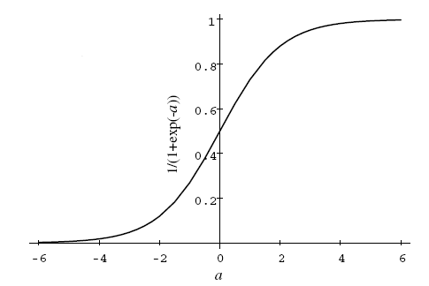

Slide 23
Single-multi layer perceptrons
Perceptrons are organized as layers
Each neuron is totally connected to ones in above and below, not in the same layers
Multilayer Perceptron (MLP) or feedforward networks
Input – Hidden – Output layers
No hidden ➔ single layer perceptron (SLP)

Slide 24
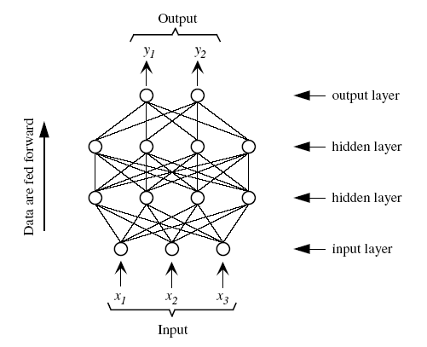

Slide 25
Classification Problem
Winner takes all rules
Separation of state space

Slide 26
Classification Problem
Winner takes all rules
Separation of state space
No hidden, 2 input, 1 output

Slide 27
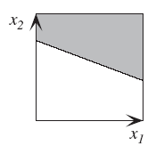

Slide 28
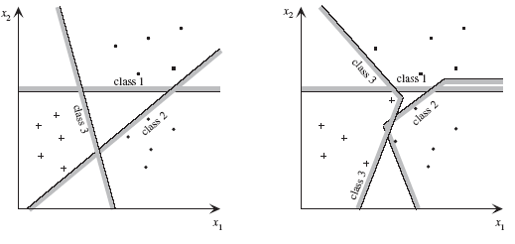

Slide 29
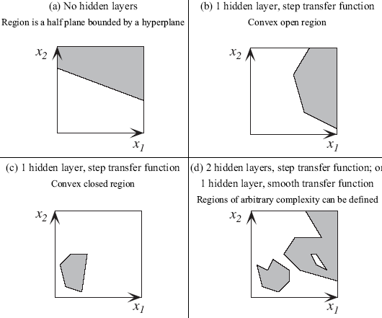

Slide 30
Training perceptrons
At node B_{i}, connected to A_{j}, output from A_{j} is y_{Aj}
w_{Bii} = y_{Aj}

Slide 31
Training perceptrons
At node B_{i}, connected to A_{j}, output from A_{j} is y_{Aj}
w_{Bii} = δ_{Bi}y_{Aj}
δ_{Bi:} associated error term

Slide 32
Training perceptrons
At node B_{i}, connected to A_{j}, output from A_{j} is y_{Aj}
w_{Bii} = ηδ_{Bi}y_{Aj}
η: learning rate

Slide 33
Training perceptrons
At node B_{i}, connected to A_{j}, output from A_{j} is y_{Aj}
w_{Bii} = ηδ_{Bi}y_{Aj} + α(w_{Bij})
α: momentum

Slide 34
Training perceptrons
At node B_{i}, connected to A_{j}, output from A_{j} is y_{Aj}
w_{Bii} = ηδ_{Bi}y_{Aj} + α(w_{Bij})

Slide 35
Training perceptrons
At node B_{i}, connected to A_{j}, output from A_{j} is y_{Aj}
w_{Bii} = ηδ_{Bi}y_{Aj} + α(w_{Bij})
Output layer:
δ_{Bi} = f’_{t}(y_{Bi})(d_{i}-y_{Bi})=y_{Bi}(1-y_{Bi})(d_{i}-y_{Bi})

Slide 36
Training perceptrons
At node B_{i}, connected to A_{j}, output from A_{j} is y_{Aj}
w_{Bii} = ηδ_{Bi}y_{Aj} + α(w_{Bij})
Hidden layer:
δ_{Bi} = f’_{t}(y_{Bi})∑δ_{Bi} w_{Bij} =y_{Bi}(1-y_{Bi}) ∑δ_{Bi} w_{Bij}

Slide 37
Training perceptrons
Algorithm: Figure 8.7

Slide 38
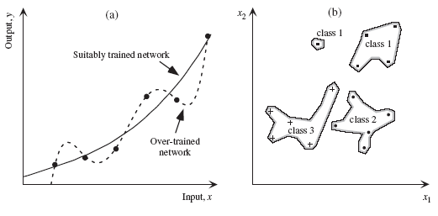
Over-training

Slide 39
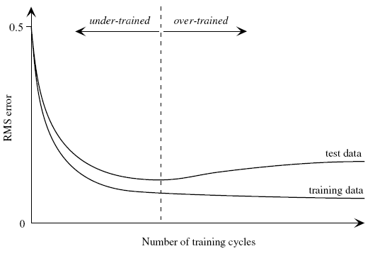
Under-training vs. over-training

Slide 40
Feature Selection
Why we need FS:
to improve performance (in terms of speed, predictive power, simplicity of the model).
to visualize the data for model selection.
To reduce dimensionality and remove noise.
Feature Selection is a process that chooses an optimal subset of features according to a certain criterion.

Slide 41

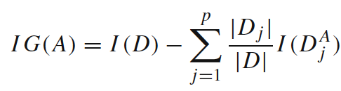
Perspectives: Selection Criteria
Information Measures.
Information serves to measure the uncertainty of the receiver when she/he receives a message.
Shannon’s Entropy:
Information gain:

Slide 42
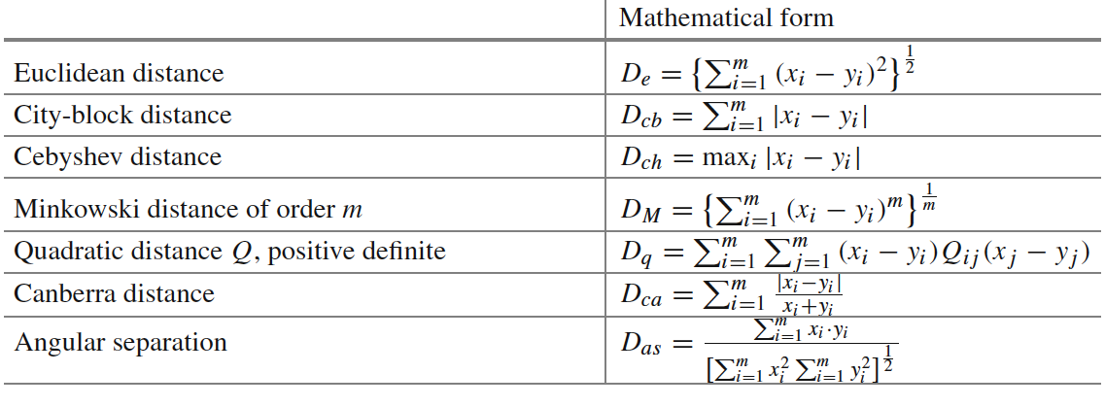
Perspectives: Selection Criteria
Distance Measures.
Measures of separability, discrimination or divergence measures . The most typical is derived from distance between the class conditional density functions.

Slide 43
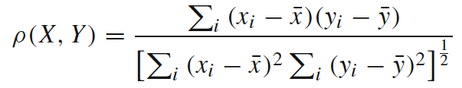
Perspectives: Selection Criteria
Dependence Measures.
known as measures of association or correlation.
Its main goal is to quantify how strongly two variables are correlated or present some association with each other, in such way that knowing the value of one of them, we can derive the value for the other.
Pearson correlation coefficient:

Slide 44
Perspectives: Selection Criteria
Consistency Measures.
They attempt to find a minimum number of features that separate classes as the full set of features can.
They aim to achieve P(C|FullSet) = P(C|SubSet).
An inconsistency is defined as the case of two examples with the same inputs (same feature values) but with different output feature values (classes in classification).

Slide 45

Case Study: Digitalized Bank

Slide 46
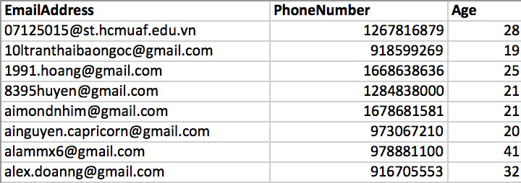
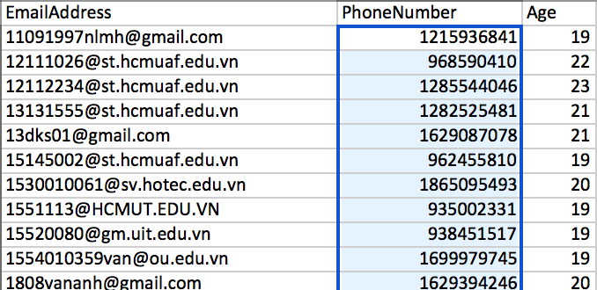
Good vs Not Good

Slide 47
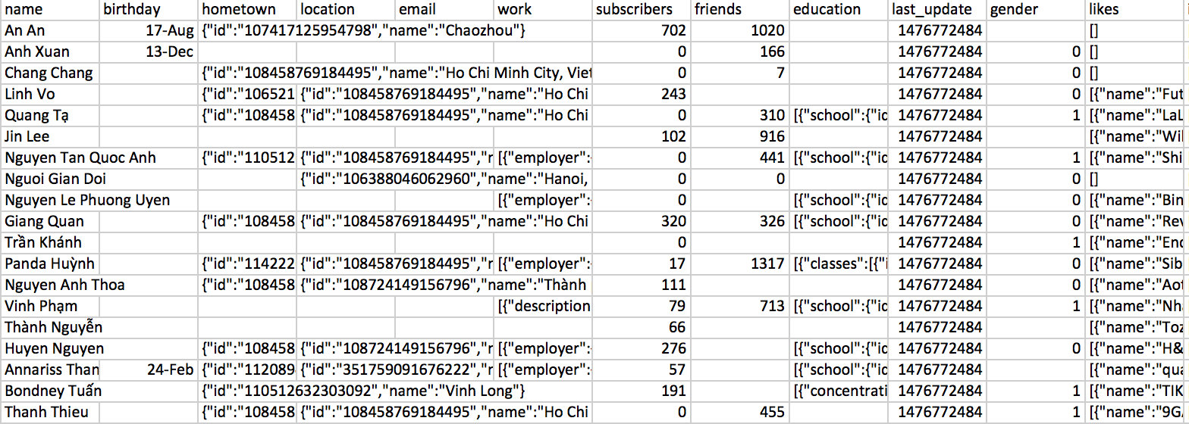
Enriched Database

Slide 48
Raw information

Slide 49
Feature Selection
hometown
subscriber_count
friends_count
gender
subscribedto_count
Education occupation
relationship status languages
age
likes scores
book
Interests games
Groups
Movies music
Sports television locations

Slide 50
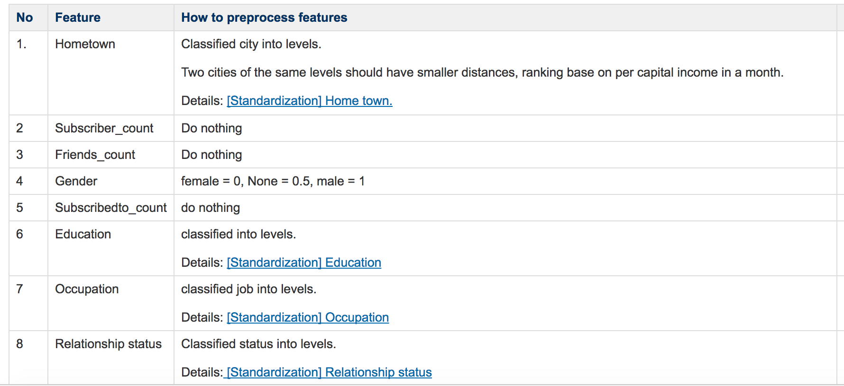
Normalization

