Slide 1
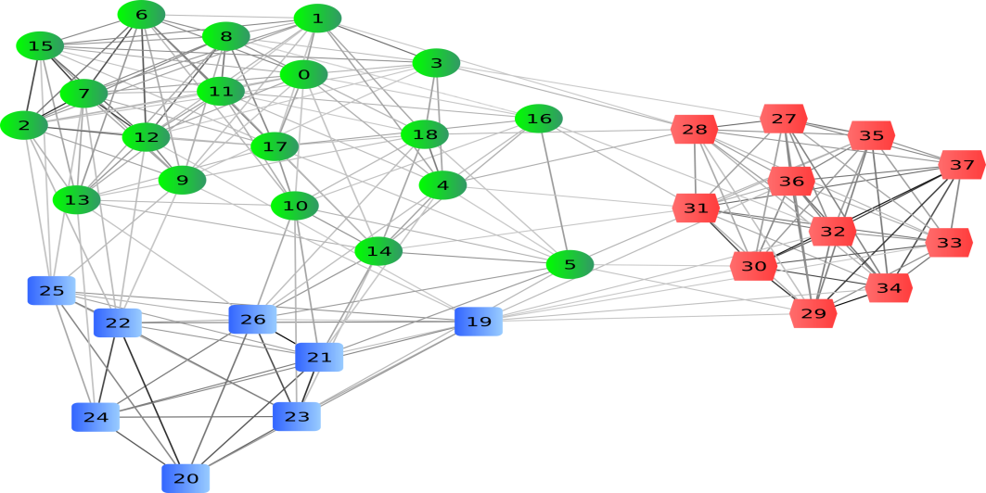
Clustering

Slide 2
Content
Introduction
Hierarchical Agglomerative Clustering (HAC)
K-Means
Applications of clustering

Slide 3
Introduction
What is clustering?
Clustering: the process of grouping a set of objects into classes of similar objects
Most common form of unsupervised learning
➔ Flat Clustering vs. Hierarchical clustering

Slide 4
Flat Clustering

Slide 5
Flat Clustering

Slide 6
Hierarchical Clustering
Build a tree-based hierarchical taxonomy (dendrogram).
animal
vertebrate
invertebrate
fish reptile amphibian mammal worm insect crustacean

Slide 7
Clustering
Flat clustering
Hierarchical clustering
K-Means
Agglomerative (bottom-up)
Divisive (top-down)
Hierarchical Agglomerative Clustering (HAC)

Slide 8
Content
Introduction
Hierarchical Agglomerative Clustering (HAC)
K-Means
Applications of clustering

Slide 9
Hierarchical Agglomerative Clustering (HAC)
Assumes a similarity function for determining the similarity of two instances.
Starts with all instances in a separate cluster and then repeatedly joins the two clusters that are most similar until there is only one cluster.
The history of merging forms a binary tree or hierarchy.

Slide 10
Hierarchical Agglomerative Clustering (HAC)
How to compute similarity of two
clusters each possibly containing multiple
instances?
Single Link
Complete Link
Centroid
Group Average

Slide 11
Single Link Agglomerative Clustering
Single Link: Similarity of two most similar members.

Slide 12
Complete Link Agglomerative Clustering
Complete Link: Similarity of two least similar members.

Slide 13
Centroid Agglomerative Clustering
Centroid : Average inter-similarity

Slide 14
Group Average Agglomerative Clustering
Group Average: Average similarity between members.

Slide 15
Content
Introduction
Hierarchical Agglomerative Clustering (HAC)
K-Means
Applications of clustering

Slide 16
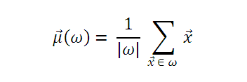
Overview about k-means
K-means is the most important flat clustering.
Objective is minimizing Euclide distance of the documents from their clusters center.
A cluster center is defined as vector :

Slide 17
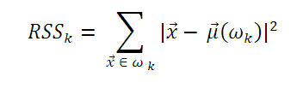
Overview about k-means
A measure of how well the centroids represent the members of their clus-ters is the residual sum of squares or RSS, the squared distance of each vector from its centroid summed over all vectors:

Slide 18
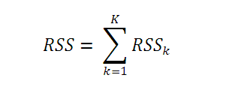
Overview about k-means
The goal of k-means is minimize RSS:

Slide 19
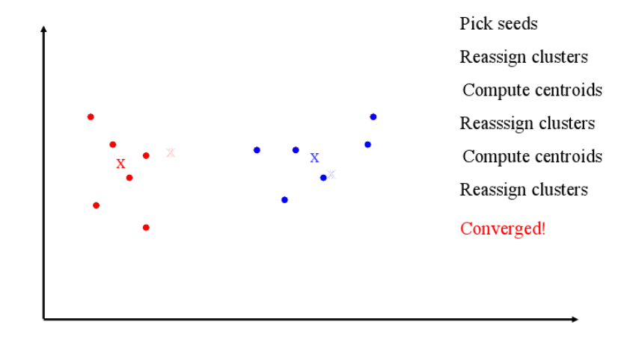
Algorithm - overview

Slide 20
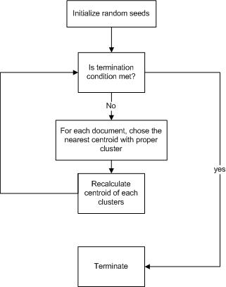
Algorithm - overview

Slide 21
Algorithm - overview
Algorithm of k means is a “learning” algorithm. The algorithm iteratively yield a result by adapting the result to problem and finding a better result than before.
The ﬁrst step of K-means is to select as initial cluster centers K randomly selected documents, the seeds. The algorithm then moves the cluster centers around in space in order to minimize RSS, this is done iteratively by repeating two steps until a stopping criterion is met.

Slide 22
Evaluation and Assessment
Davies–Bouldin index : low intra cluster, and high inter centroid point. ( smallest is the best)
Dunn index: dense and well seperated cluster
Silhouette coefficient

Slide 23
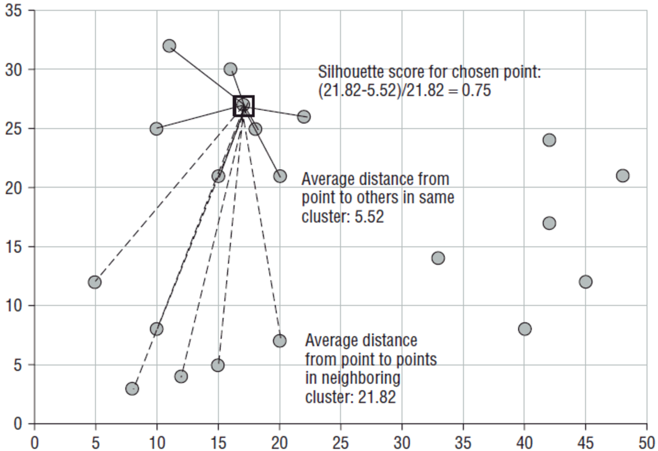
Silhouette

Slide 24
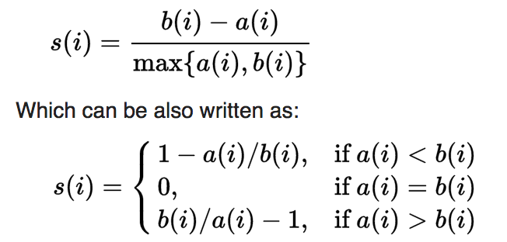
Some formulas

Slide 25
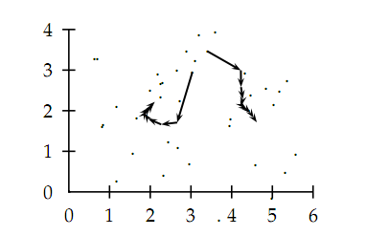
Algorithm - overview

Slide 26
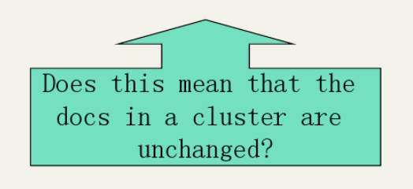
Algorithm – termination condition
A fixed number of iterations.
Doc partition unchanged.
Centroid positions don’t change.

Slide 27
Algorithm – time complexity
Computing distance between doc and cluster is O(m) where m is the dimensionality of the vectors.
Reassigning clusters: O(Kn) distance computations, or O(Knm).
Computing centroids: Each doc gets added once to some centroid: O(nm).
Assume these two steps are each done once for I iterations: O(IKnm).

Slide 28
Algorithm - features
How do we know that RSS value decrease and Kmeans converge?
➔ algorithm eventually converge in a local optimum
Disadvantage of choosing “bad” seeds is it could yield suboptimal results:
Outliers seeds.
Empty clusters.
Heuristic for chossing seeds:
Try many starting points, choose the best clustering.
Choose seeds from hierarchical clustering methods.
Notes:
Take care, however, to break ties consistently, e.g., by assigning a document to the clus-
ter with the lowest index if there are several equidistant centroids. Other-
wise, the algorithm can cycle forever in a loop of clusterings that have the
same cost. ?????

Slide 29

Algorithm - features
Example showing
sensitivity to seeds
In the above, if you start
with B and E as centroids
you converge to {A,B,C}
and {D,E,F}
If you start with D and F
you converge to
{A,B,D,E} {C,F}

Slide 30

Algorithm – how many cluster?
A naive approach would be to select the optimal value of K according to the objective function, namely the value of K that minimizes RSS
Incur some cost when added one more cluster.

Slide 31
Content
Introduction
Hierarchical Agglomerative Clustering (HAC)
K-Means
Applications of clustering

Slide 32
Applications of clustering
Cluster hypothesis: Documents in the same cluster behave similarly with respect to relevance to information needs.

Slide 33
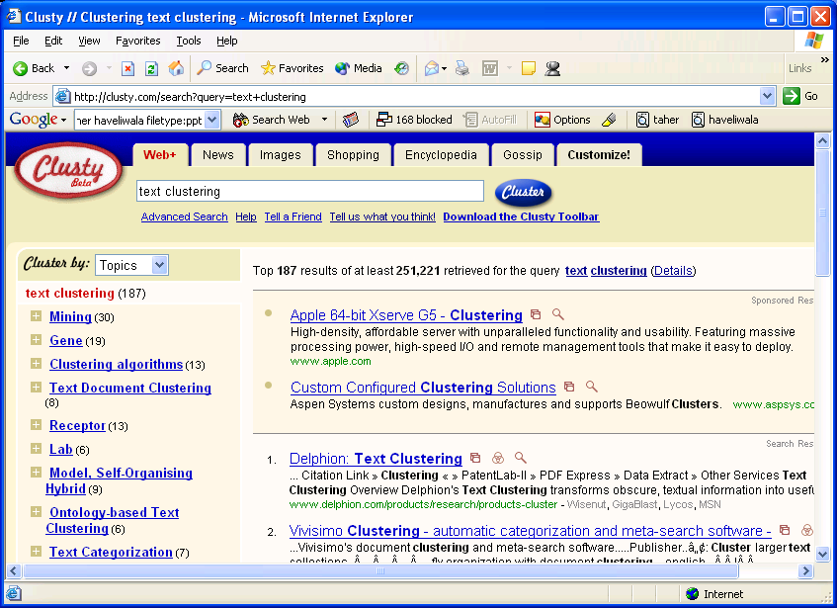
Applications of clustering
Group search results

Slide 34
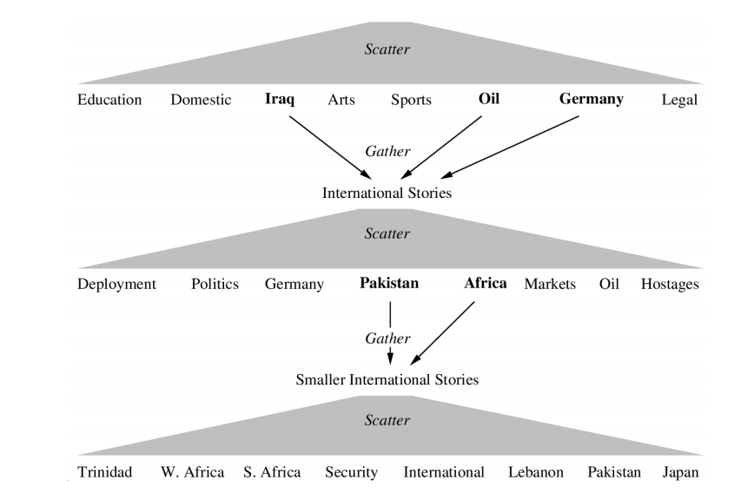
Applications of clustering

Slide 35
Summary
Introduction
Hierarchical Agglomerative Clustering (HAC)
K-Means
Applications of clustering

