Slide 1
Unsupervised Learning Lecture 3: Naïve Bayes Classifier and Evaluation Scheme
Tho Quan
qttho@hcmut.edu.vn

Slide 2
Agenda
Discriminative vs. Generative Classifiers
Naïve Bayes Classifier
Evaluation scheme: which method is better?
NB for Text Classification and IR Metrics

Slide 3
Classification Methodologies
There are three methodologies:
a) Model a classification rule directly
Examples: k-NN, linear classifier, SVM, neural nets, ..
b) Model the probability of class memberships given input data
Examples: logistic regression, probabilistic neural nets (softmax),…
c) Make a probabilistic model of data within each class
Examples: Naive Bayes….

Slide 4
Classification of Classifications
 | Probabilistic | Non-Probabilistic
Discriminative | Logistic Regression Probabilistic neural nets …….. | K-nn Linear classifier SVM Neural networks ……
Generative | Naïve Bayes …… | N.A. (?)

Slide 5
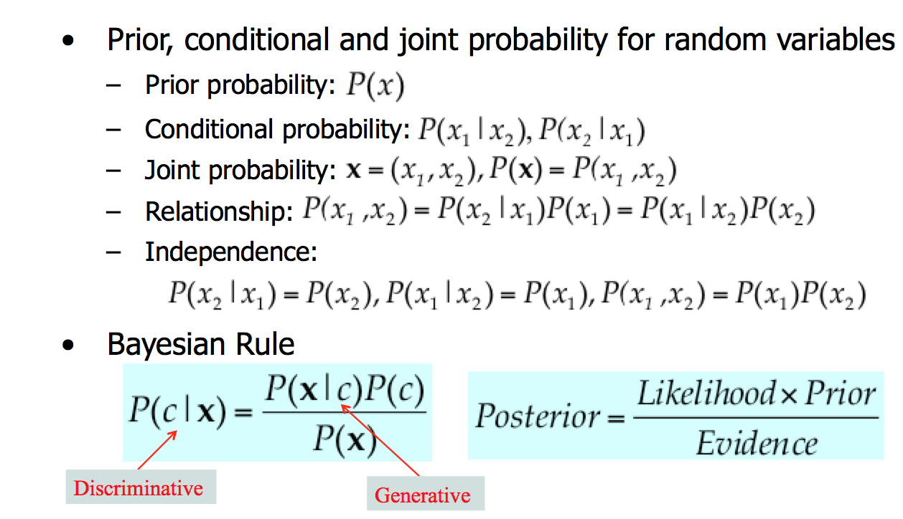
Probability Basics

Slide 6
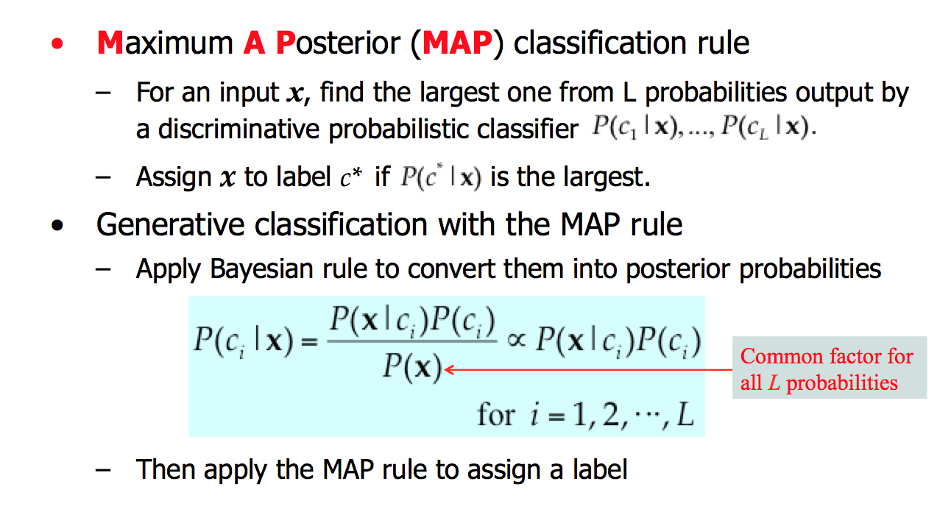
Probabilistic Classification Principle

Slide 7
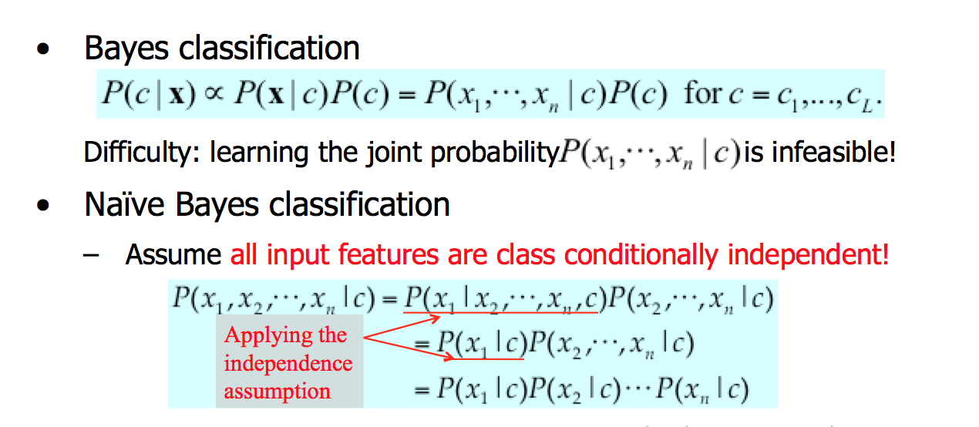
Naïve Bayes

Slide 8
Summarization for Example
Bayes’ Theorem

Slide 9
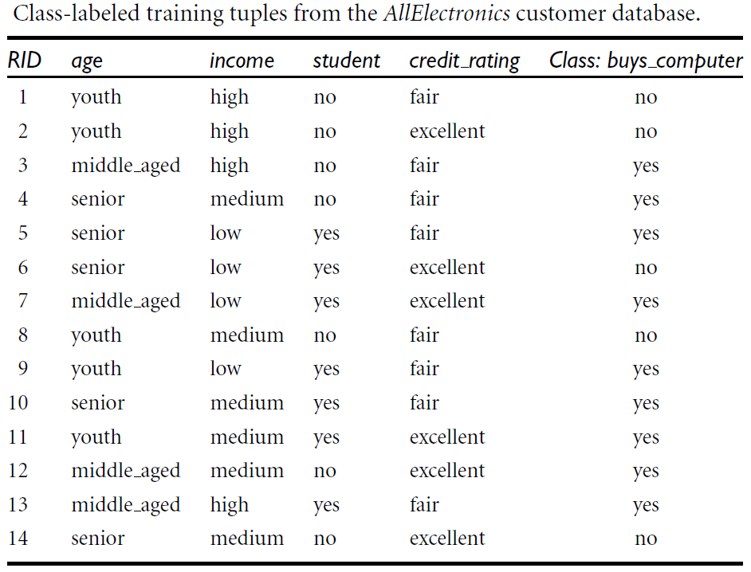
Training tuples

Slide 10
Naïve Bayesian Classification
D is a training set.
Each tuple: X = (x₁, x₂, …, x_{n}).
m classes: C_{i}, i=1..m
P(buys_computer=yes | age=youth, income=medium
student=yes, credit_rating=fair)
→ We maximize P(C_{i} | X).

Slide 11
Naïve Bayesian Classification
P(C_{i}) = |C_{i,D}|/|D|
Or: P(C₁) = P(C₂) = .. = P(C_{m})

Slide 12
Naïve Bayesian Classification
Compute P(X | C_{i}):
Assume: Class conditional independence
Class label of X is C_{i}
P(C_{i}|X) > P(C_{j}|X) với 1<=j<=m, j<>i

Slide 13
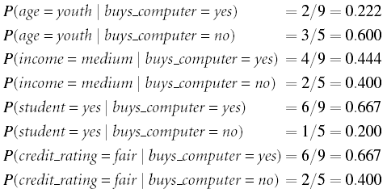

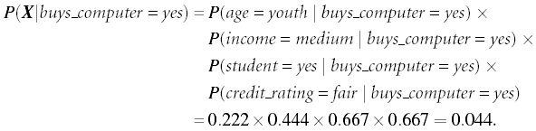
Example
C₁ = {X’|X’.buys_computer = yes}
C₂ = {X’’|X’’.buys_computer = no}
→ X ∈ C₁

Slide 14
Zero probability
Zero probability elimination
1,000 tuples: 0 tuples with income = low, 990 tuples with income = medium, and 10 tuples with income = high.
Using the Laplacian correction
→Assume that our training database, D, is so large that adding one to each count that we need would only make a negligible difference in the estimated probability value, yet would conveniently avoid the case of probability values of zero.
we pretend that we have 1 more tuple for each income-value pair.

Slide 15
Zero probability
Suppose a dataset with 1000 tuples, income=low (0), income= medium (990), and income = high (10)
Use Laplacian correction (or Laplacian estimator)
Adding 1 to each case
Prob(income = low) = 1/1003
Prob(income = medium) = 991/1003
Prob(income = high) = 11/1003
to their “uncorrected” counterparts

Slide 16
Model Evaluation and Selection
Evaluation metrics: How can we measure accuracy? Other metrics to consider?
Use validation test set of class-labeled tuples instead of training set when assessing accuracy
Methods for estimating a classifier’s accuracy:
Holdout method, random subsampling
Cross-validation

Slide 17
Classifier Evaluation Metrics: Confusion Matrix
Confusion Matrix:
Actual class\Predicted class | C₁ | ¬ C₁
C₁ | True Positives (TP) | False Negatives (FN)
¬ C₁ | False Positives (FP) | True Negatives (TN)
Example of Confusion Matrix:
Actual class\Predicted class | buy_computer = yes | buy_computer = no | Total
buy_computer = yes | 6954 | 46 | 7000
buy_computer = no | 412 | 2588 | 3000
Total | 7366 | 2634 | 10000
Given m classes, an entry, CM_{i,j} in a confusion matrix indicates # of tuples in class i that were labeled by the classifier as class j
May have extra rows/columns to provide totals

Slide 18
Classifier Evaluation Metrics: Accuracy, Error Rate, Sensitivity and Specificity
A\P | C | ¬C
C | TP | FN | P
¬C | FP | TN | N
 | P’ | N’ | All
Class Imbalance Problem:
One class may be rare, e.g. fraud, or HIV-positive
Significant majority of the negative class and minority of the positive class
Sensitivity: True Positive recognition rate
Sensitivity = TP/P
Specificity: True Negative recognition rate
Specificity = TN/N
Classifier Accuracy, or recognition rate: percentage of test set tuples that are correctly classified
Accuracy = (TP + TN)/All
Error rate: 1 – accuracy, or
Error rate = (FP + FN)/All

Slide 19
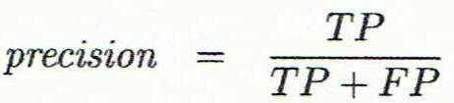
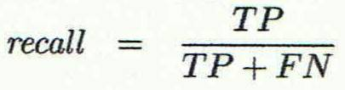
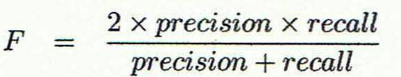
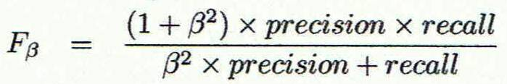
Classifier Evaluation Metrics: Precision and Recall, and F-measures
Precision: exactness – what % of tuples that the classifier labeled as positive are actually positive
Recall: completeness – what % of positive tuples did the classifier label as positive?
Perfect score is 1.0
Inverse relationship between precision & recall
F measure (F₁ or F-score): harmonic mean of precision and recall,
F_{ß}: weighted measure of precision and recall
assigns ß times as much weight to recall as to precision

Slide 20
Classifier Evaluation Metrics: Example
Actual Class\Predicted class | cancer = yes | cancer = no | Total | Recognition(%)
cancer = yes | 90 | 210 | 300 | 30.00 (sensitivity
cancer = no | 140 | 9560 | 9700 | 98.56 (specificity)
Total | 230 | 9770 | 10000 | 96.40 (accuracy)
Precision = 90/230 = 39.13% Recall = 90/300 = 30.00%

Slide 21
Evaluating Classifier Accuracy: Holdout & Cross-Validation Methods
Holdout method
Given data is randomly partitioned into two independent sets
Training set (e.g., 2/3) for model construction
Test set (e.g., 1/3) for accuracy estimation
Random sampling: a variation of holdout
Repeat holdout k times, accuracy = avg. of the accuracies obtained
Cross-validation (k-fold, where k = 10 is most popular)
Randomly partition the data into k mutually exclusive subsets, each approximately equal size
At i-th iteration, use D_{i} as test set and others as training set
Leave-one-out: k folds where k = # of tuples, for small sized data
*Stratified cross-validation*: folds are stratified so that class dist. in each fold is approx. the same as that in the initial data

Slide 22
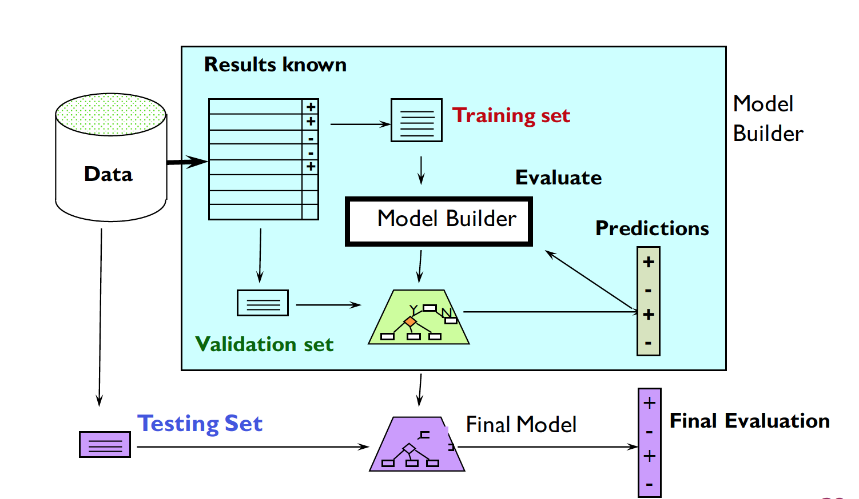
Train, Validation, Test

Slide 23
Uses of NB classification
Text Classification
Spam Filtering
Hybrid Recommender System
Recommender Systems apply machine learning and data mining techniques for filtering unseen information and can predict whether a user would like a given resource
Online Application
Simple Emotion Modeling

Slide 24
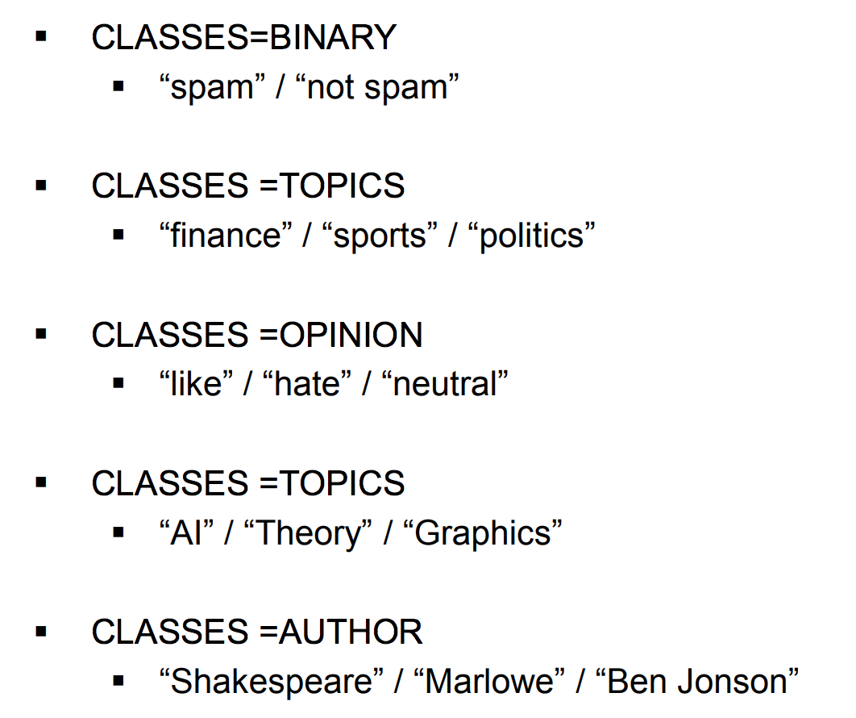
Examples of Text Classification

Slide 25
Naive Bayes for Text Categorization
Attributes are text positions, values are words.
Still too many possibilities
Assume that classification is independent of the positions of the words
Use same parameters for each position
Result is bag of words model (over tokens not types)

Slide 26
Naïve Bayes: Learning
From training corpus, extract Vocabulary
Calculate required P(c_{j}) and P(x_{k} | c_{j}) terms
For each c_{j} in C do
docs_{j} ← subset of documents for which the target class is c_{j}
Text_{j} ← single document containing all docs_{j}
for each word x_{k} in Vocabulary
n_{k} ← number of occurrences of x_{k} in Text_{j}

Slide 27
Naïve Bayes: Classifying
positions ← all word positions in current document which contain tokens found in Vocabulary
Return c_{NB}, where

