Slide 1
wasp1 tile
integration
WASP1 / CPU TILE
DESIGN SPEC + VERIFICATION
RV32I + Zicsr
frontend + I-cache + D-cache
valid/ready I/D memory ports

Slide 2
Why tile exists
One PC owner
Frontend owns boot, sequential fetch, buffering, and redirect reload.
No hidden state
Tile contains structural wiring only; child modules retain every register and FSM.
Two independent ports
I-cache and D-cache remain separate initiators for later AHB integration.

Slide 3
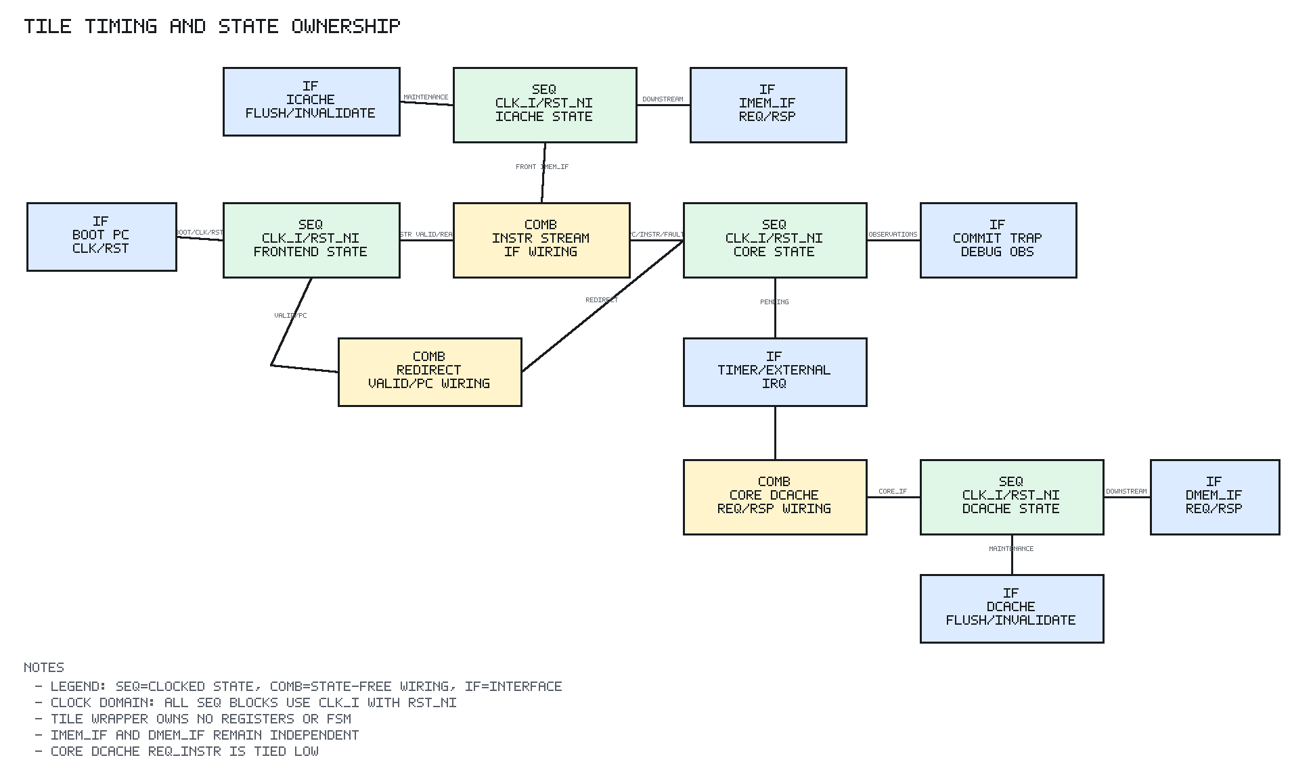
Complete tile architecture
Four verified blocks form one execution tile.
Green = SEQ state on clk_i/rst_ni
Yellow = COMB wiring
Blue = IF boundary
The wrapper introduces no register, queue, or arbitration state.

Slide 4
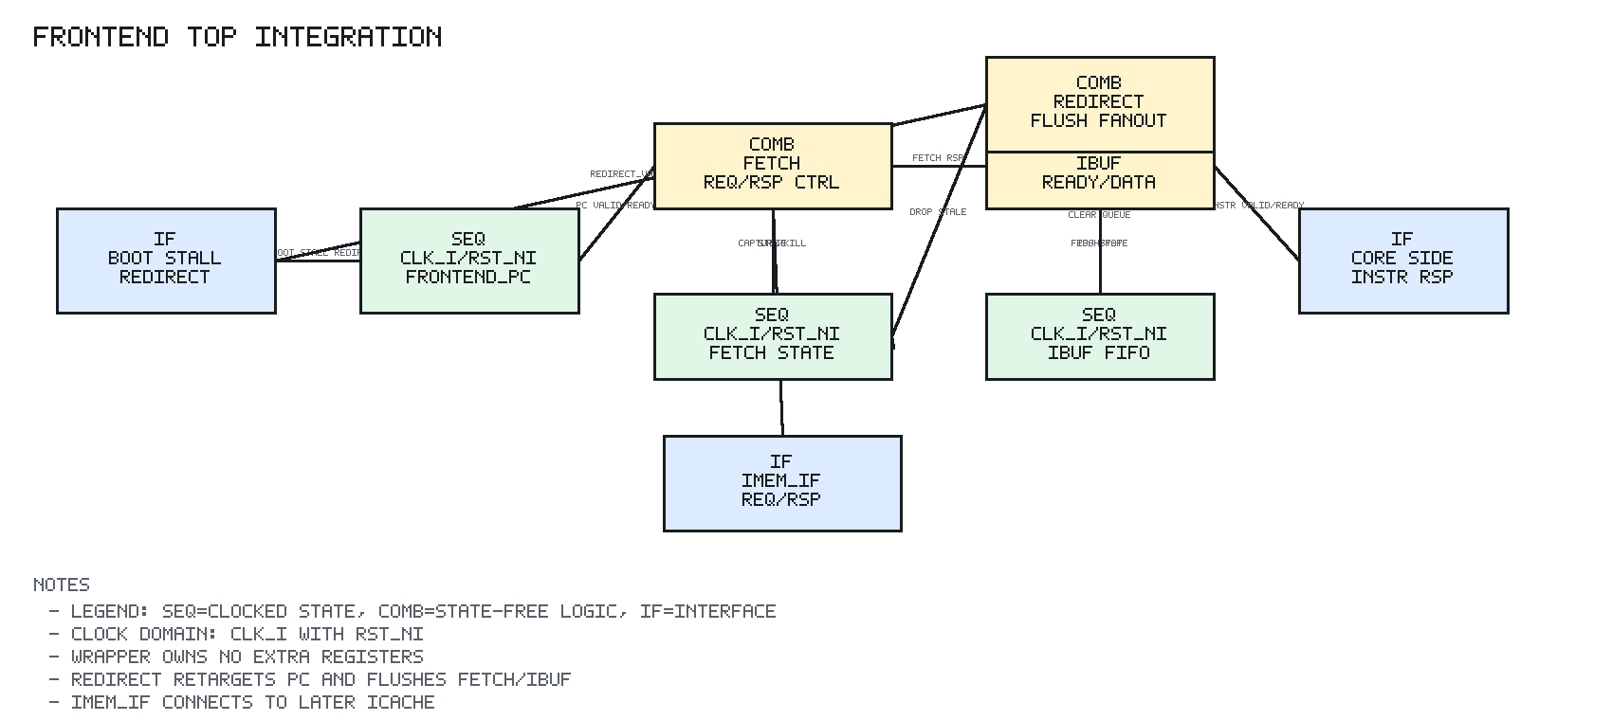
Instruction path
frontend emits a word fetch request.
I-cache serves hits or refills one 16-byte line.
The instruction buffer decouples cache latency from core acceptance.
Branch/trap/MRET redirects flush younger fetch work and reload the frontend PC.

Slide 5
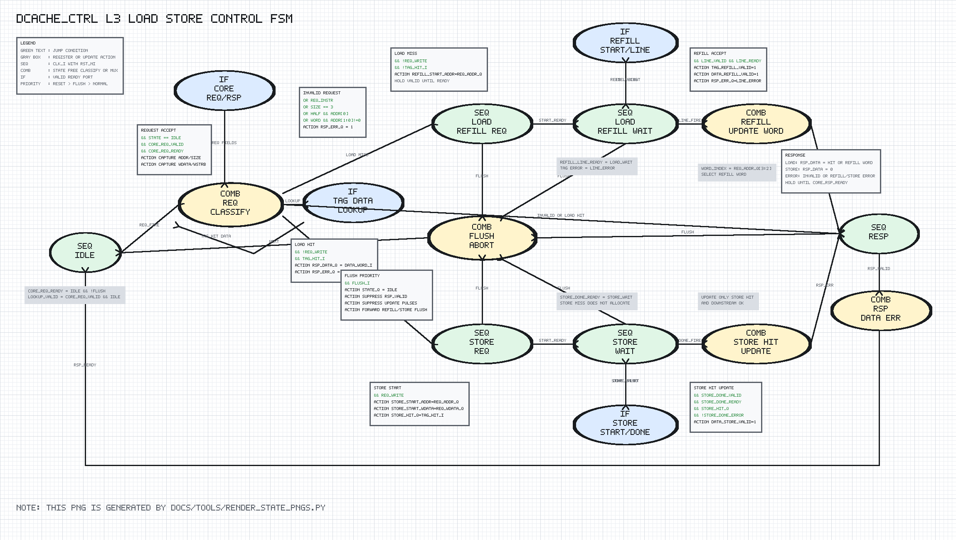
Data-cache policy
Load hit: return selected cached word.
Load miss: refill four words, allocate line, return requested word.
Store: always write through.
Store hit: update cached bytes only after downstream success.
Store miss: no allocation.

Slide 6
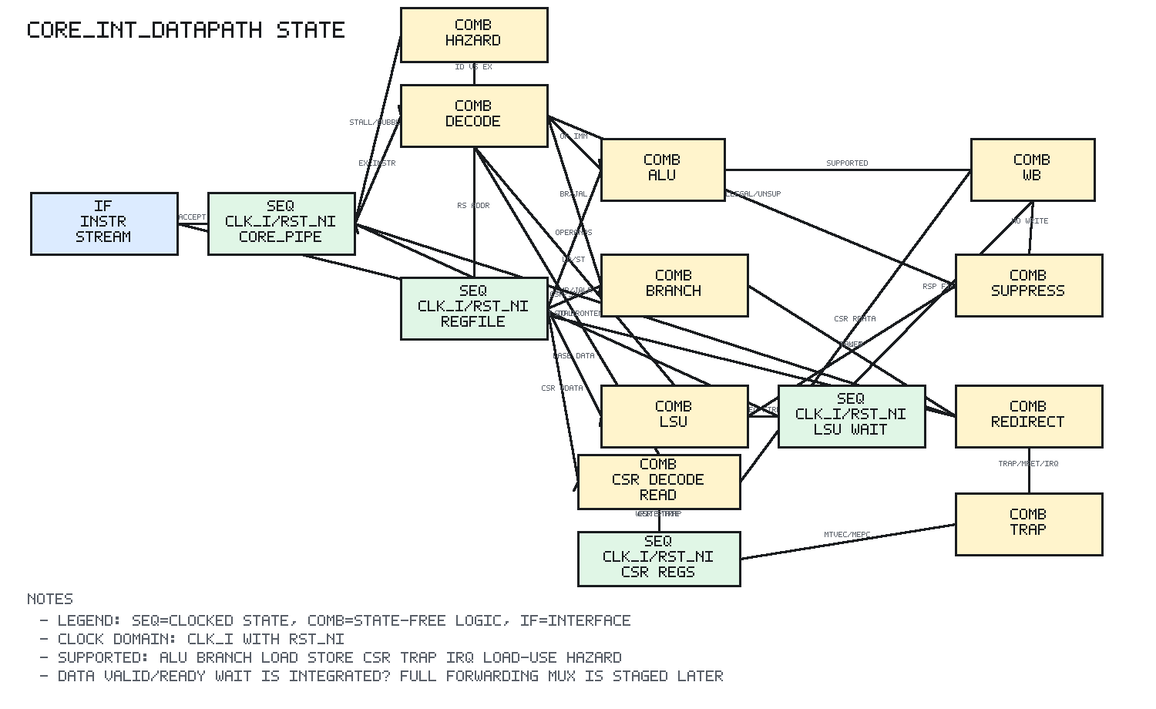
LSU valid/ready
Exactly one LSU request may be outstanding.
The core holds payload and pipeline state until request acceptance.
It waits for rsp_valid && rsp_ready before retirement.
Errors suppress writeback and assert lsu_fault_o.

Slide 7
Cache maintenance semantics
Invalidate
Clear tag-valid state; resident data is no longer a hit.
Flush active work
Abort controller/refill/store and suppress completion.
Recover
System coordination restarts the architectural request path.
TAG STATE
IN-FLIGHT WORK
NEXT REQUEST

Slide 8
Verification logic
Execute real RV32I
Programs check commits, redirects, hazards, and traps at the tile boundary.
Stress both ports
Independent models add deterministic ready backpressure and response latency.
Prove cache effects
Counts distinguish refill, resident hit, invalidate, flush, and error paths.

Slide 9
Measured integration evidence
71 I-memory beats
Refill, error recovery, and interrupt-program traffic.
18 D-memory ops
17 refill reads + 1 successful write-through store.
22 checks PASS
10 redirects, 2 hazards, 2 invalidates, 2 IRQ classes, 2 flushes.
INSTRUCTION
DATA
CROSS-MODULE

Slide 10
Result and boundary
Verified complete tile
Frontend, core, I-cache, and D-cache operate together under latency and backpressure.
Portable implementation
Generic, IC, and Xilinx Virtex-7 lint retain identical visible behavior.
Next integration level
AHB-Lite adaptation and I/D arbitration belong above tile.

