Slide 1
Forensics
KC2 Forensics Walkthrough
Pivoting from IT to OT
BTV Forensics Crew: B4nd1t0, OmenScan, n3tl0kr, Gyle_dC

Slide 2
Agenda
Overview
Forensics Process
Incident Walkthrough
Key Takeaway
Call to Action

Slide 3
Overview

Slide 4

Overview - Background
Magnum Tempus is a leader in Fintech who recently acquired an oil rig outfit called Tombstone.
Magnum Tempus environment is Information Technology (IT) while Tombstone is Operational Technology (OT)
During merger activities, a critical network storage device failed causing a significant outage.
Employees from both companies continued to access the infrastructure during the disaster recovery event.
A recent backup was not available but a snapshot from one year ago was successfully restored.

Slide 5



Kill Chain Overview
19:54 – 21:28 UTC
21:29 – 22:02 UTC
21:49 – 22:01 UTC
Linux Server
IOT-ENG-WKST
iot-jumpbox
172.16.40.100
172.16.50.20
172.16.50.19
DC
21:36 – 21:47 UTC
172.16.50.100
During the IT outage, malicious actors took advantage of the lack of visibility
After initial access, several reconnaissance activities were found and confirmed
WKST?? (NetShare)
172.16.50.146
Notes:
Intent: This will cover the activity and timeframe of the attack as a quick overview, then each point will become detailed.
Script/Talking Points
Blah
Source
Data here
(Will remove or modify later)
Objective – Recon
LOLBin, Recon, RDP
Access Creds from Emergency Share
Recon, Stop PLC Action
Impact: Anomaly detected by user in internal email

Slide 6
Collecting Evidence

Slide 7

Collecting Evidence - Endpoint
Velociraptor was leveraged for the analyst to efficiently and quickly capture data from multiple endpoints.
Full disk images can be collected in order to maintain a defensible investigation.
Raw memory was also collected in a similar manner which provides a great deal of insight into volatile operations at the time of the triage.

Slide 8

Collecting Evidence - Network
In addition to the ad-hoc collection of endpoint artifacts, network telemetry is invaluable during an incident and can mean the difference in a successful forensic investigation.
For Magnum Tempus, Splunk and Security Onion were used for collection and correlation of log data, telemetry and network intrusion alerting.

Slide 9
Disclaimer
Investigation is still ongoing
Linux Server and Domain Controller are under review
Data provided by IR team during initial triage
Not all desired artifacts were available
Utilities like Sysmon can improve visibility on an endpoint, this walkthrough will also leverage manual filesystem analysis
Notes:
Intent: Provide the audience a picture of the background information of the company and the dependencies, the situation, and the response that has led to the current point.
Script/Talking Points
Blah
Source
Data here

Slide 10
Incident Analysis

Slide 11
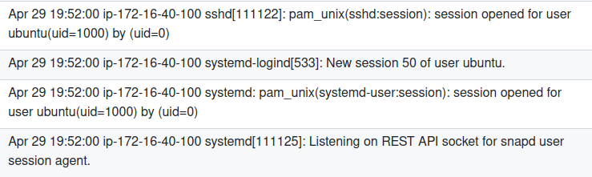
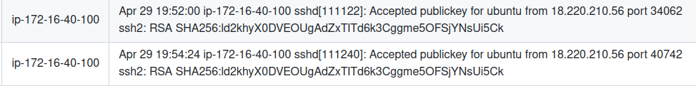
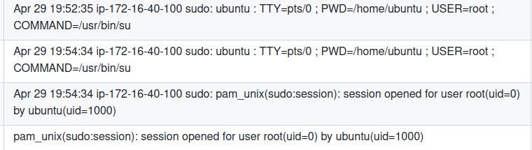
Initial Access – Linux Server
19:52 UTC – Earliest indicator of intrusion
19:54 UTC – Privilege Escalation to root
Attacker Infrastructure – 18.220.210.56
Notes:
Intent: Details of the surrounding activity will go here.
Script/Talking Points
Blah
What I will be able to prove:
1. When the actor got into the network
2. Where they came from and what is considered their operating infrastructure
3. When did they escalate their privileges to root
4. The toolsets that they used
a. Curl for additional unknown files
b. Python related tools crackmapexec
c. git toolsets (Responder and DFSCoerce)
d. Use of Kerbrute
Source
Data here

Slide 12
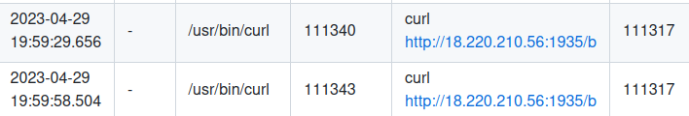
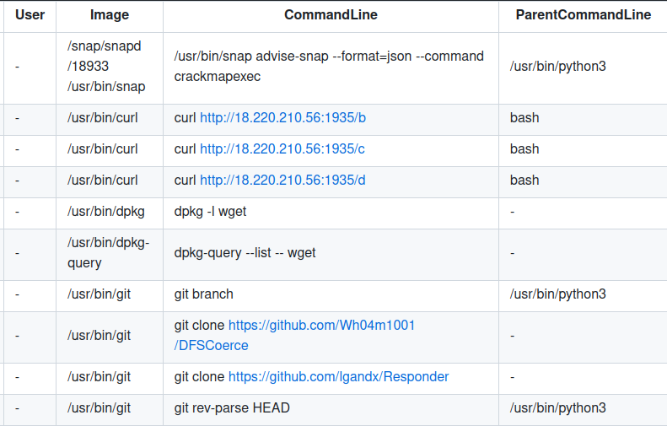
Initial Access – Linux Server
19:59 UTC – Access to Operational Infrastructure
Additional tooling identified
Notes:
Intent: Details of the surrounding activity will go here.
Script/Talking Points
Blah
Source
Data here

Slide 13
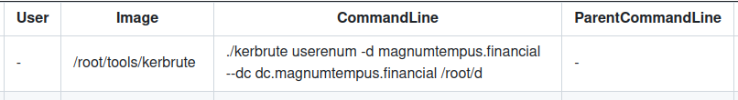
Active Directory Attacks
Kerberos User Enumeration
AD attacks against DC
Kerbrute
Password Spray
Brute Force
SMB Enumeration
CrackMapExec
AD Enumeration
DC
172.16.50.100
RDP/SMB Connect
DFSCoerce
NTLM Relay Attack
Responder
Collect NTLMv2 hash via LLMNR Poisoning
Notes:
Intent: This slide is important to cover the Active Directory attacks that were likely used, as we do have evidence that one of them were used, so it'slikely the others were used as well.
Script/Talking Points
CrackMapExec - SMB Enumeration, AD Enumeration, and RDP Connect
Kerbrute - Focused on Kerberos connection, able to do password spray or even brute force
DFSCoerce - Used to attack the domain controller
Responder - Challenge and dump hashes
Source
General Attacks
https://david-oneill-4444.medium.com/active-directory-attacks-46ac2c7d7186
CrackMapExec
https://systemweakness.com/crackmapexec-smb-ad-enumeration-simplified-21e603927f44
https://github.com/mpgn/CrackMapExec
DFSCoerce
https://github.com/Wh04m1001/DFSCoerce
https://www.malwarebytes.com/blog/news/2022/06/dfscoerce-a-new-ntlm-relay-attack-can-take-control-over-a-windows-domain
Kerbrute
https://www.hackingarticles.in/a-detailed-guide-on-kerbrute/

Slide 14
Pivot into IoT-ENG-WKST
21:29 UTC – 22:02 UTC

Slide 15
Login Detection – Event IDs
21:29 UTC
RemoteConnectionManager / Operational
1149: User authentication succeeded: User / Domain / Source Network IP
41: Begin session arbitration
4672: Special Privileges
Security
Windows Event Log
LocalSessionManager / Operational
21: Session logon succeeded
4648: Explicit Credentials
22: Shell start notification received
4624: Successful Logon
RdpCoreTS / Operational
131: Server accepted TCP connection from source IP
Remote Terminal
Event Logs
(Requires Enabling)
104: Client Time Zone
Artifact(s): Windows Event Logs
Tool(s) Used: Chainsaw, Event Viewer, Event Log Explorer
Notes:
Intent: Cover the logs that detected the initial access into the network. Logs are the simplest way to get a timeline.
Script/Talking Points
Windows event logs is one of the most important ways of conducting intrusion analysis
As the workstation is considered a high-value asset, Terminal Event Logs were
Source
Data here
Review:
Security Yes
System Yes
Sysmon No
Microsoft-Windows-TerminalServices-RemoteConnectionManager/Operational No
Microsoft-Windows-TerminalServices-RemoteConnectionManager/Admin No
Microsoft-Windows-TerminalServices-RDPClient/Operational No
Microsoft-Windows-TerminalServices-LocalSessionManager/Operational No
Microsoft-Windows-RemoteDesktopServices-RdpCoreTS/Operational - IP address and timezone
131: Server accepted a new TCP connection fron client 172.16.40.100:60822
104: Client timezone is [-5] hour from UTC;
Microsoft-Windows-TerminalServices-RemoteConnectionManager/Operational - Stands out on its own
EventID 1149: User authentication succeeded: User: seth.morgan / Domain: / Source Network Address: 172.16.40.100
Microsoft-Windows-TerminalServices-RemoteConnectionManager/Admin - Supplement
EventID 1158 - Remote Desktop Service accepted a connection from IP address 172.16.10.93
Microsoft-Windows-TerminalServices-LocalSessionManager/Operational - Stands out
41: Begin session arbitration: User: MAGNUMTEMPUS\seth.morgan; Session ID: 3
21: Remote Desktop Services: Session logon succeeded: User: MAGNUMTEMPUS\seth.morgan; Session ID: 3; Source Network Address: 172.16.40.100
22: Remote Desktop Services: Shell start notification received

Slide 16
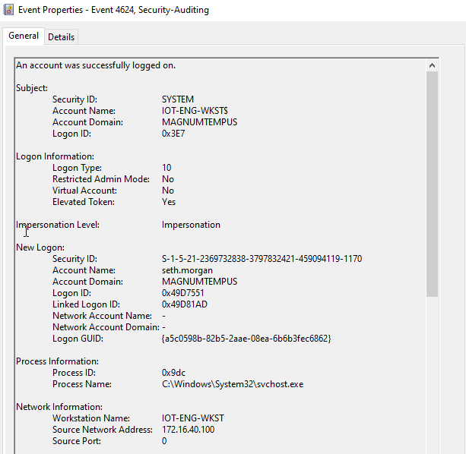
Lateral Movement - IoT-ENG-WKST
Remote Interaction
Logon Type: 10
seth.morgan
Account Name
172.16.40.100
Source Network Address
Artifact(s): Windows Event Logs
Tool(s) Used: Event Viewer
Notes:
Intent: This is an example for how the analyst can detect the log-on activity from the Security Event Logs, particularly the Remote Interaction and from where.
Script/Talking Points
As an example, 09:29 UTC is when the attacker logged on
Logon Type is important to review, as this indicates the access through RDP
The account name is important to collect on as well as the source IP address to understand where they pivoted from
Source
Data here
What are the keypoints? Logon Type: 10 – Implies Remote Session
New Logon and Account Name:
Network Information: The workstation and where they’re connecting from
Windows Security Log Event ID 4624 - An account was successfully logged on (ultimatewindowssecurity.com)

Slide 17
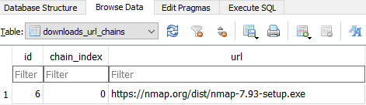
Nmap Access and Execution
Shimcache
Amcache
Where was file downloaded from?
Browser Data
Where was file downloaded to?
Artifact(s): Browser Data, Shimcache, Amcache
Tool(s) Used: DB Browser SQLite, AmcacheParser, AppCompatCacheParser
Notes:
Intent: Highlight one of the activities that the attacker did while on the network: download and execute nmap.
Script/Talking Points
Prefetch would usually be an artifact to find
Windows Server as host does not include Prefetch
Activity was initially found in Sysmon, but can also be found if reviewing for Shimcache and Amcache
Emphasize that Shimcache does not completely mean that the file was executed
Source
Data here

Slide 18
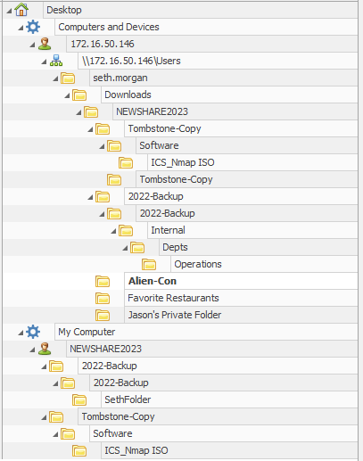
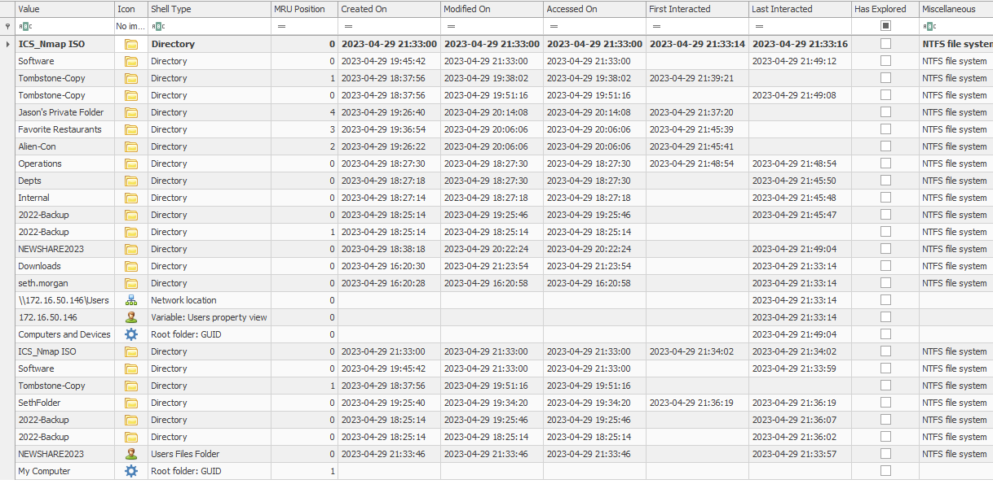
Data Access - Shellbags
Artifact(s): NTUser.dat (Shellbags)
Tool(s) Used: Shellbag Explorer
Shellbag Explorer
Notes:
Intent: Sentence/paragraph here.
Script/Talking Points
Blah
Source
Data here

Slide 19
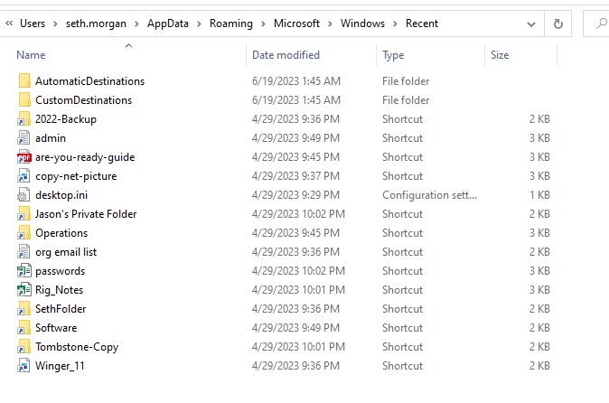
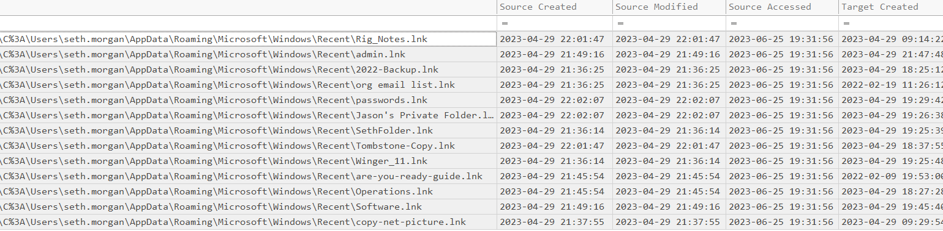
Data Access – Recent Files
Closely related to Jumplist and Windows MRU
Highlights files of interest to attacker
Artifacts: Recent Files, Lnk Files
Tools Used: LECmd, Timeline Explorer
Notes:
Intent: Highlight one of the activities that the attacker did while on the network: file and folder access through lnk files.
Script/Talking Points
Blah
Source
What is a Windows Recents Folder Artifact? - Cyber Triage

Slide 20
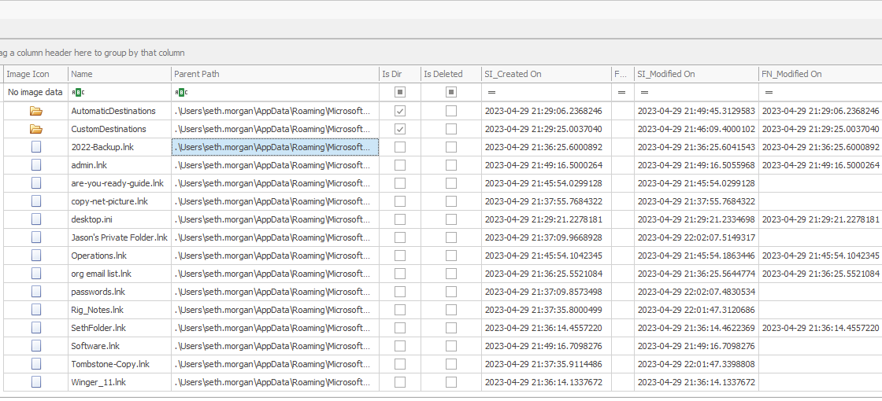
Data Access – Recent Files/MFT
MFT Metadata
$Standard_Information ($SI) - Windows would display to the end user
$File_Name ($FN) - Only modified by Windows kernel
Recent Files showcase files that were opened via LNK files
Artifact(s): $MFT, Recent Files
Tool(s) Used: MFT Explorer
Notes:
Intent: Highlight one of the activities that the attacker did while on the network: file and folder access via MFT.
Script/Talking Points
Blah
Source
https://www.magnetforensics.com/blog/expose-evidence-of-timestomping-with-the-ntfs-timestamp-mismatch-artifact-in-magnet-axiom-4-4/

Slide 21
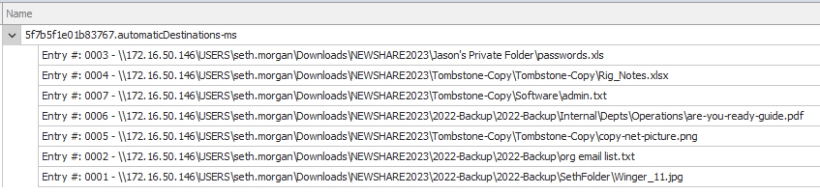
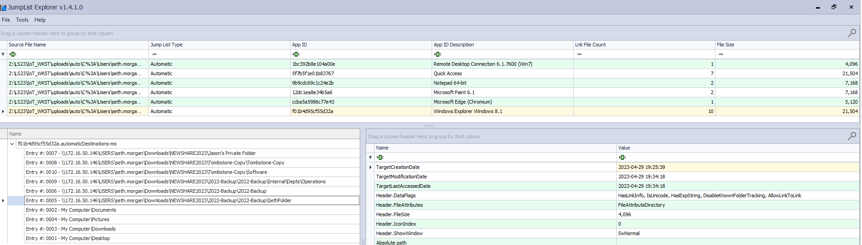
Data Access – Jump List
Showcases recently viewed files
Shows location of the file that the user viewed
Identifies what associated executable was used
…Including…
Artifacts: Recent Files (automaticDestinations-ms, CustomDestinations-ms)
Tools Used: Jumplist Explorer
Notes:
Intent: Highlight one of the activities that the attacker did while on the network: file and folder access through Jumplists.
Script/Talking Points
Blah
Source
https://frsecure.com/blog/windows-forensics-execution/
https://artifacts-kb.readthedocs.io/en/latest/sources/windows/JumpLists.html

Slide 22
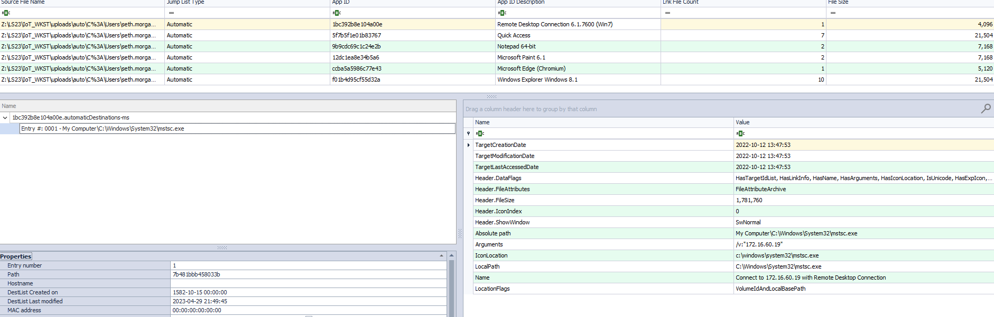
Lateral Movement to IoTJumpbox
21:49 UTC – Execution of Remote Desktop Connection to Jumpbox
Artifact(s): Jumplist
Tool(s) Used: Jumplist Explorer
Notes:
Intent: Sentence/paragraph here.
Script/Talking Points
Blah
Source
Data here

Slide 23
Pivot into OT Environment
21:49 UTC – 22:01 UTC

Slide 24
Lateral Movement – Event IDs
21:49 UTC
1024: RDP ClientActiveX is trying to connect to server
Security
Windows Event Log
RDPClient / Operational
1029: Base64(SHA256)UserName)) is…
4648: Explicit Credentials
1027: Connected to domain(XX) with session #
Remote Terminal
Event Logs
(Requires Enabling)
Artifact(s): Windows Event Logs
Tool(s) Used: Chainsaw, Event Viewer, Event Log Explorer
Notes:
Intent: Cover the logs that detected the initial access into the network. Logs are the simplest way to get a timeline.
Script/Talking Points
Windows event logs is one of the most important ways of conducting intrusion analysis
As the workstation is considered a high-value asset, Terminal Event Logs were
Source
Data here
Microsoft-Windows-TerminalServices-RDPClient/Operational - Stands out
1024 - RDP ClientActiveX is trying to connect to server (172.16.60.19)
1029 - Base64(SHA256(UserName)) is = omDUw7DU8fTIDIjScBzBMBeDoZd5gZW3JEQTMdPMjcM=-
1027 - Connected to domain (IOT-JUMPBOX) with session 1

Slide 25
Exiting Jumpbox – Event IDs
22:01 UTC
1105: The multi-transport connection has been disconnected.
Windows Event Log
RDPClient / Operational
1026: RDP ClientActiveX has been disconnected (Reason = X)
Remote Terminal
Event Logs
(Requires Enabling)
Artifact(s): Windows Event Logs
Tool(s) Used: Chainsaw, Event Viewer, Event Log Explorer
Notes:
Intent: Cover the logs that detected the initial access into the network. Logs are the simplest way to get a timeline.
Script/Talking Points
Windows event logs is one of the most important ways of conducting intrusion analysis
As the workstation is considered a high-value asset, Terminal Event Logs were
Source
Data here
22:01 UTC - Exiting iot-Jumpbox
Microsoft-Windows-TerminalServices-RDPClient/Operational - Sands out
1105 - The multi-transport connection has been disconnected.
1026 - RDP ClientActiveX has been disconnected (Reason= 1)
Window Close.

Slide 26
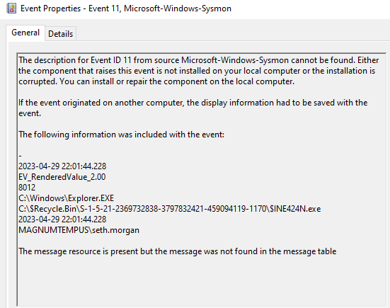
Anti-Forensics - Deletion
22:01 UTC - Evidence of File Deletion
What was deleted?
$INE424N.exe
Artifact(s): Windows Event Logs
Tool(s) Used: Event Log Explorer, Event Viewer
Notes:
Intent: Highlight “anti-forensic” technique (file deletion) and how Sysmon was a good indicator to investigate further.
Script/Talking Points
Attacker used “file deletion” as an anti-forensics technique in order to clean up their tracks
Sysmon picked up on data deletion by a file creation into the Recycling bin
Context was to what was deleted is currently unknown
Source
https://www.litigationsupporttipofthenight.com/single-post/2020/06/22/windows-recycle-bin-i-and-r-files
https://atalaysblog.wordpress.com/2019/03/19/recycle-bin-forensics/
Artifacts Used:
Microsoft-Windows-Sysmon/Operational
$Extend\$UsnJrnl:$J
Existing File
Tools:
Event Log Explorer
RBCmd – Zimmerman Tools
Timeline Explorer

Slide 27
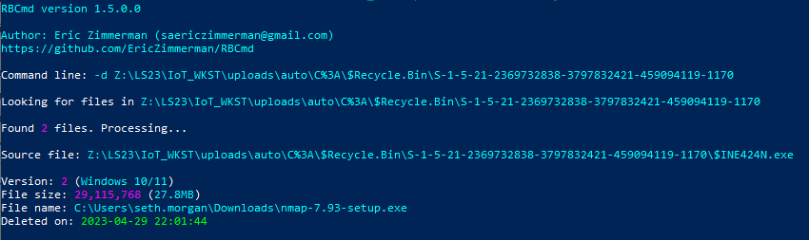
Anti-Forensics – Deletion (Pt2)
Recycling Bin Metadata
$I contains file metadata
$R contains file content
Artifact(s): Recycling Bin $I File
Tool(s) Used: RBCmd
Notes:
Intent: Explore deeper from what Sysmon found to identify the file through Recycling Bin Forensics and tools used for it.
Script/Talking Points
Give an overview of Recycling Bin forensics and distinguish between the $I and $R file
Showcase the RBCmd results that it was nmap that was deleted.
Source
Data here
Artifacts Used:
Microsoft-Windows-Sysmon/Operational
$Extend\$UsnJrnl:$J
Existing File
Tools:
Event Log Explorer
RBCmd – Zimmerman Tools
Timeline Explorer

Slide 28
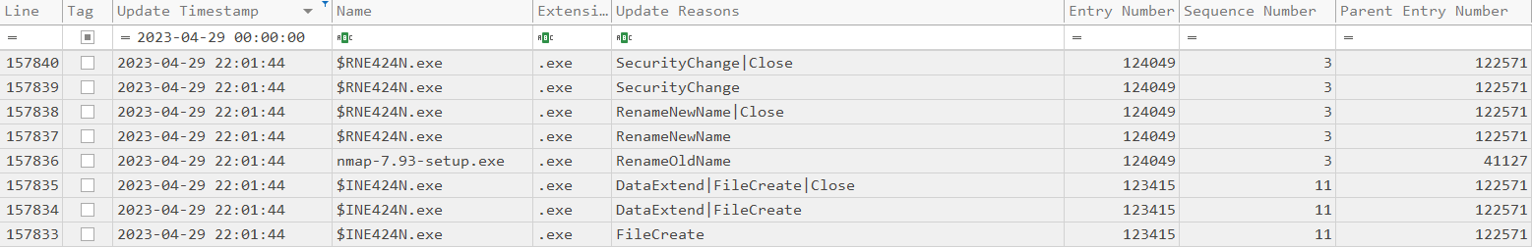
Anti-Forensics – Deletion (Pt3)
USN Journal
Keeps track of changes on both files and directories
Artifact(s): $EXTEND\$UsnJrnl
Tool(s) Used: MFTCmd, Timeline Explorer
Notes:
Intent: Review the activity of when and how the file was deleted through Filesystem Forensics.
Script/Talking Points
$UsnJournal keeps track of changes to files and directories along with a code as to what change occurred
MFTCmd was ran against $UsnJrnl
Highlight that this is used to corroborate that the file was nmap-7.93-setup.exe that was deleted as well as the time of deletion (21:01 UTC)
Source
Data here
Artifacts Used:
Microsoft-Windows-Sysmon/Operational
$Extend\$UsnJrnl:$J
Existing File
Tools:
Event Log Explorer
RBCmd – Zimmerman Tools
Timeline Explorer

Slide 29
Egress from Host – Event IDs
22:02 UTC
39: Session # has been disconnected by session #
Security
Windows Event Log
LocalSessionManager / Operational
40: Session # has been disconnected, reason code #
4634: An account was logged off
Remote Terminal
Event Logs
(Requires Enabling)
24: Remote Desktop Services: Session disconnected: USER / Source Network Address.
Artifact(s): Windows Event Logs
Tool(s) Used: Chainsaw, Event Viewer, Event Log Explorer
Notes:
Intent: Cover the logs that detected the initial access into the network. Logs are the simplest way to get a timeline.
Script/Talking Points
Windows event logs is one of the most important ways of conducting intrusion analysis
As the workstation is considered a high-value asset, Terminal Event Logs were
Source
Data here
22:02 UTC - Exiting IoT-ENG-WKST
Security
4634: An account was logged off
Microsoft-Windows-TerminalServices-LocalSessionManager/Operational - Stands out
39: Session 5 has been disconnected by session 5
40: Session 5 has been disconnected, reason code 11
24: Remote Desktop Services: Session has disconnected: User: MAGNUMTEMPUS\seth.morgan ; Session ID: 5; Source Network Address: 172.16.40.100
Microsoft-Windows-RemoteDesktopServices-RdpCoreTS/Operational - Supplement
148: The channels was closed between the server and the client (many channels have this EventID)

Slide 30
Dead End
… or is it?

Slide 31

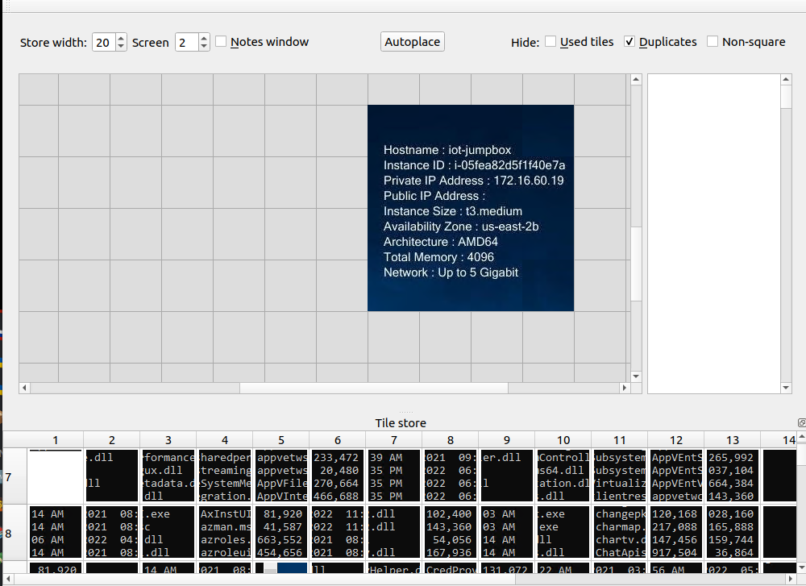
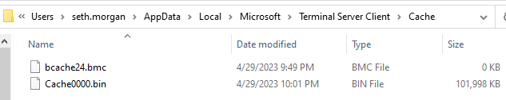
RDP Cache – The Crystal Ball
RDP Bitmap Cache
Legacy artifact stored locally used to reduce latency and speed up session
Only stored on client facilitating connection
BMC Tools
Processes cache into bitmap files
RDP Cache Stitcher
Enables putting bitmap files together (like jigsaw puzzles!)
Artifact(s): RDP Cache
Tool(s) Used: BMC-Tools, RDPCacheStitcher
Notes:
Intent: Introduce what RDP Cache is and why this is important for the investigation
Script/Talking Points
Blah
Source
https://hejelylab.github.io/blog/IRC/RDP-Bitmap-Cache
https://medium.com/@ronald.craft/blind-forensics-with-the-rdp-bitmap-cache-16e0c202f91c

Slide 32
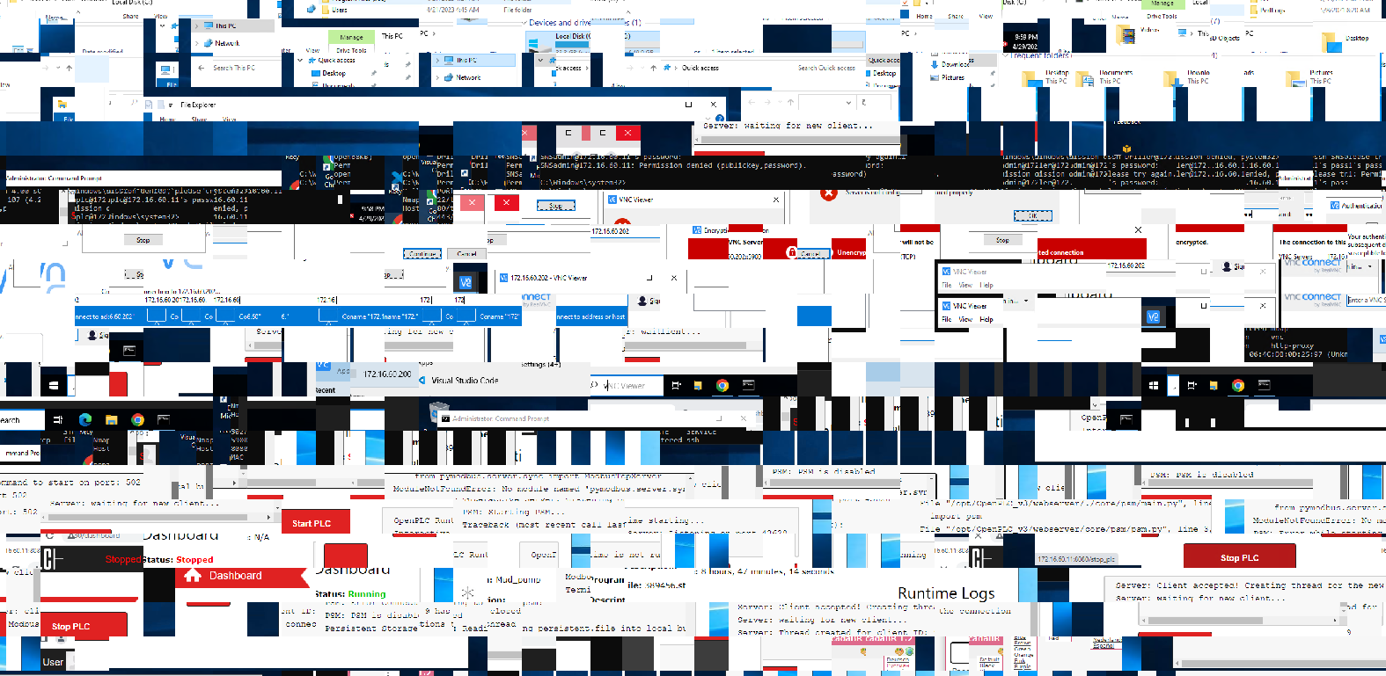
BMC Tools – Drawback of Collage
Notes:
Intent: Sentence/paragraph here.
Script/Talking Points
Blah
Source
Data here

Slide 33
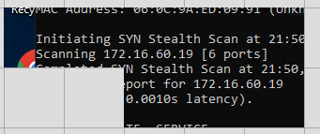
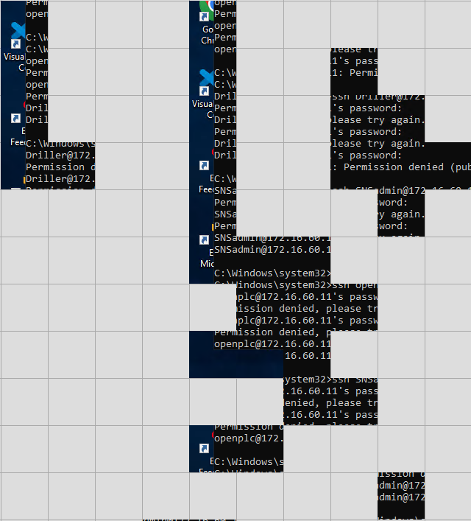

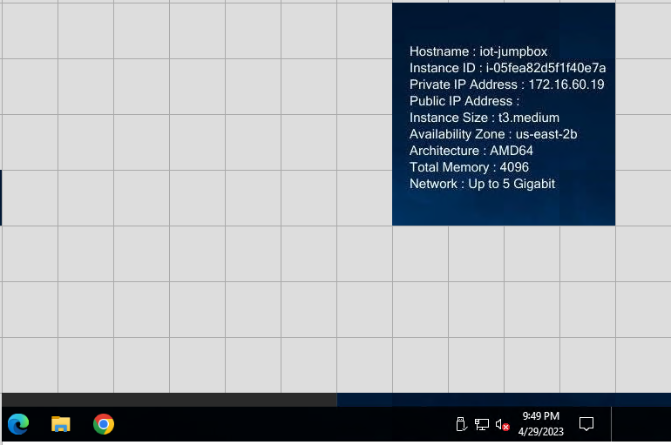
RDP Activity
21:49 UTC – 21:50 UTC
Actor conducted nmap scanning within environment
Notes:
Intent: Sentence/paragraph here.
Script/Talking Points
Blah
Source
Data here

Slide 34
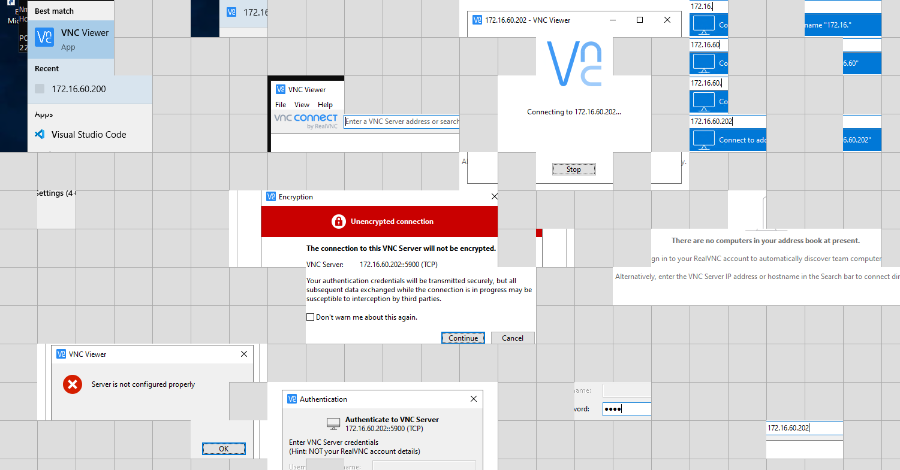
RDP Activity
Attempted login via SSH and VNC
Attempts unsuccessful

Slide 35
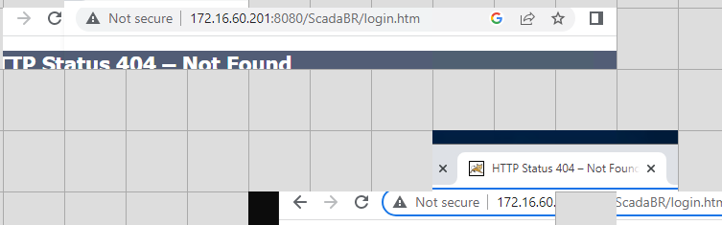
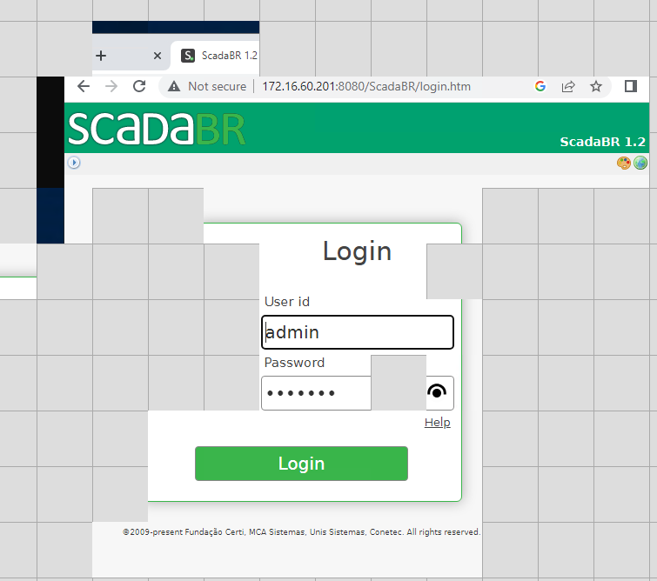
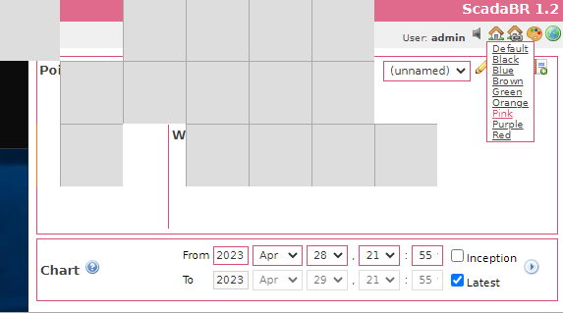
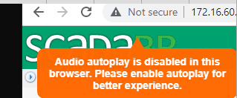
RDP Activity
21:55 UTC
Searched around for accessing SCADA login page
Successfully logged in
Notes:
Intent: Sentence/paragraph here.
Script/Talking Points
Blah
Source
Data here

Slide 36
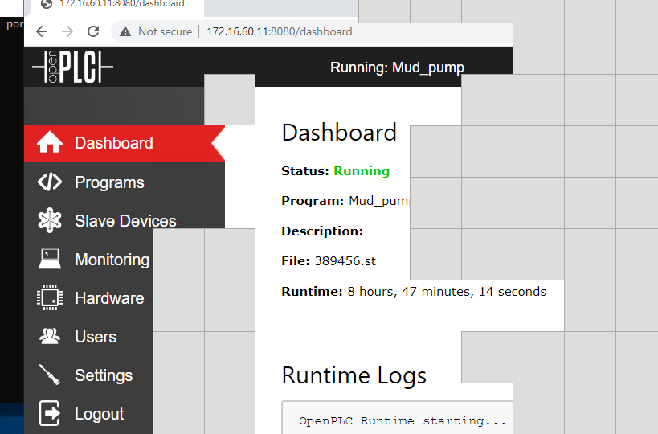
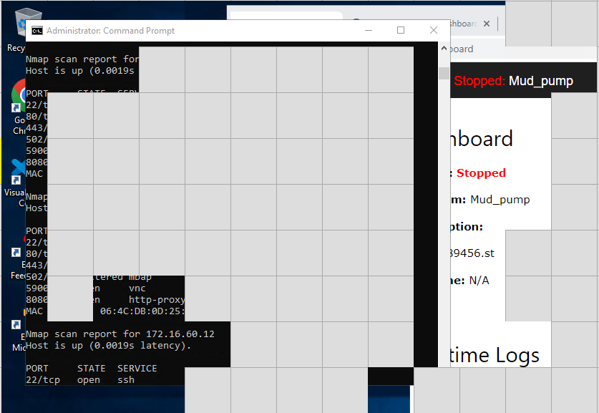
RDP Activity
Accessed PLC
Stopped PLC program from running
Notes:
Intent: Sentence/paragraph here.
Script/Talking Points
Blah
Source
Data here

Slide 37
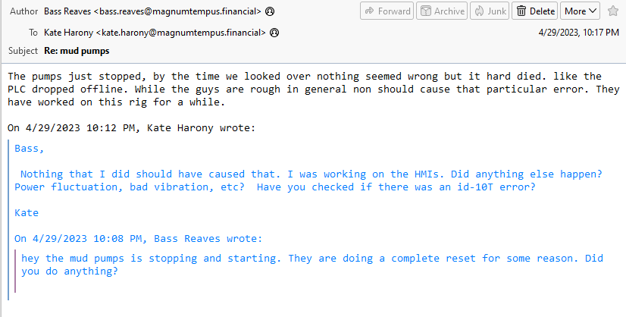
Impact
Confidentiality
Integrity
Activity was noticed in email exchange between OT representatives
Availability is priority within the triad (AIC)
Compared to CIA in IT
OT controls physical infrastructure that mean life and death
Availability
Notes:
Intent: This section should drive home the reason why OT security is very important for IT professionals.
Script/Talking Points
Blah
Source
Data here

Slide 38
Key Takeaways

Slide 39
Key Takeaway
Operational Technology (OT)’s focus on AIC vs Information Technology (IT)’s focus on CIA leads to different prioritizations
Infrastructure covers multiple areas of digital forensics (Linux, Windows, Active Directory)
Recommend enabling additional logging on key servers (i.e. Remote Terminal on environments that require RDP access)
Notes:
Intent: Sentence/paragraph here.
Script/Talking Points
Blah
Source
Data here

Slide 40

Challenge
Unresolved questions…
What workstation was used as a network share?
Type of server was used for SCADA-BR?
.. And more!
Jump into the BTV Capture the Flag (CTF)!
Notes:
Intent: This is the call to action for the participants.
Script/Talking Points
Blah
Source
“We Want You” by tribalium81. https://stock.adobe.com/contributor/202550385/tribalium81?load_type=author&prev_url=detail&asset_id=268789636

Slide 41
Summary
Overview
Forensics Process
Incident Walkthrough
Key Takeaway
Call to Action

