Slide 1
Threat Hunting
(n)Map Exploration:
A Great Time in Remote Destinations

Slide 2
whoami
Samunoske
Blue Team enthusiast
SOC Team Member
Tinkerer
Instructor
Student

Slide 3
what are we learning today?
Reconnaissance in a security/threat hunt context.
Ways that adversaries can identify points of exploitation within an environment.
Commonly abused services that adversaries use
Converting a Threat Hunt from hypothesis to completion
Tools we have at our disposal and what can we do with them

Slide 4
what is reconnaissance?
A process of obtaining information associated with a particular target.
In Security-context, building a map of a particular environment.
Not always malicious in nature.

Slide 5
what are some ways to conduct reconnaissance?
Not on network?
  Open Source Intelligence (OSINT)
What if you’re IN the network?
  Built-in Operating System Tools
  Vulnerability Scanning Tools
  Network Scanning Tools
Enumeration

Slide 6
what is the situation?
I work as a member in the Magnum Tempus Security Team.
I was asked to come up with a Threat Hunt to show to the greater security team.
I need to be able to walk others through how to conduct this hunt and then provide a template for what I find.
We are conducting this Threat Hunt over the day April 29th, 2023.

Slide 7
what is your hypothesis?
All Threat Hunts need to start with a hypothesis in mind.
We presume there is reconnaissance activity in the network.
I start with a broad hypothesis:
  The company has reconnaissance activity within the network.
This is a good starting point, but far too broad.
Refining the hypothesis more, we come up with:
  Malicious reconnaissance activity is occurring in the Magnum Tempus environment.

Slide 8
be sure to note:
A lot of what we’re going to be doing here are queries specific to the Splunk query language.
The overall concepts of the Threat Hunt can be adapted to any query language/log platform.
There are also online applications that can convert the query syntax from one language to another language, but we will not be discussing that here.

Slide 9
let’s go!
We need to start with a query in Splunk, but we need to know the data sources we have available.
We could start by searching across all data within the query:
  index=*
This is bad practice and a great way to get server admins mad at you. We might want to use a query to see what indexes we have available:
  | eventcount summarize=false index=* | dedup index | fields index
The above query narrows down to just the log data sources

Slide 10
where do we start?
When I think of reconnaissance, I normally think of a Linux system. We can choose the Linux index we discovered earlier
  index=”linux”
Remember the time frame - adjust filters accordingly.
This, undoubtedly would end up with a large number of entries. Let’s refine more.
I’ll start with looking for one of the more common reconnaissance/enumeration tools known/in use: nmap
  index=”linux” (nmap)

Slide 11
building the query
This query appears to have no entries.
  index=”linux” (nmap)
Let’s go back to our index list. Is there another we can use?
  sysmonforlinux
We need to modify the query to include sysmonforlinux:
  index=”sysmonforlinux” (nmap)
This also results in no events. Did we do something wrong?

Slide 12

psa: a note about note-taking
Pro Tip:
During and throughout the Threat Hunting process, one should take good notes.

Slide 13
building the query
So far we have no events in Linux for nmap activity. Let’s look at another network scanner that could be in use, masscan:
  index IN (linux,sysmonforlinux) (nmap OR masscan)
Okay, so we still have 0 hits for any network scanning activity (based on the tools we’ve queried for)
Let’s see what we can do next.

Slide 14

can we get better results?

Slide 15
refining the query
Our initial assumption was that the reconnaissance would originate from a Linux-based system. Our logs would indicate this is not the case.
We should pivot to look at Microsoft Windows systems.
Let’s take the last query and modify it for Windows:
  index IN (windows,sysmon) (nmap)
We have hits!

Slide 16
digesting the results
182 hits for nmap activity within the logs. This is a lot of logs, but let’s see what system is associated with the most activity.
  wkst16.magnumtempus.financial has the majority of activity. Let’s adjust the query and only focus on this system.
This is the new query:
  index IN (windows,sysmon) (nmap) AND host="wkst16.magnumtempus.financial"
This query ends up with 152 events related to nmap.

Slide 17

digging deeper

Slide 18
digging deeper
Let’s scroll through some of these entries - nothing really stands out all that much.
Of note, this asset is associated with the user Seth Morgan, an IT Engineer with the organization.
This could be expected/normal behavior. Let’s pivot again.

Slide 19
reminder: notes are important!

Slide 20
digging deeper
We’ll take a look at the entries, excluding the wkst16 system:
  index IN (windows,sysmon) (nmap) AND NOT host="wkst16.magnumtempus.financial"
We now have 29 events with this query.
The top host by log volume for this query is iot-eng-wkst.magnumtempus.financial
Time to modify our query once more:
  index IN (windows,sysmon) (nmap) AND host="iot-eng-wkst.magnumtempus.financial"

Slide 21
digging deeper
Let’s scroll through the entries and see if anything stands out
We see Seth Morgan’s name again associated with this asset.
Many of the top entries are extremely similar:
  The account appears to be connecting over the network from the source IP Address 172.16.50.20 to the destination IP Address 172.16.60.19 via port 3389.
This is very interesting. Let’s go down the rabbit hole.

Slide 22
why is this interesting?
Port 3389 is associated with Microsoft Remote Desktop Protocol (RDP).
This allows remote access to a system over a network or over the Internet
  DISCLAIMER: It’s not recommended to have RDP exposed publicly over the Internet. You have been warned.
Why would Seth be trying to connect from system 172.16.50.20 towards 172.16.60.19 over RDP? Let’s find out.

Slide 23
tunnel vision
At this point, it feels like we might need to find out what the system 172.16.60.19 is. Let’s start a new query to see what this system is. We’ll get back to the original query shortly.
Time to build the new query, but this one should be relatively easy:
  index=* 172.16.60.19
This yields a LOT of events in Splunk. Let’s look at the hosts list in the side bar.

Slide 24
new query results
Okay, so looking here, we see the top asset that shows up is this one:
  iot-jumpbox.magnumtempus.financial
For those who might not know, a jumpbox is a system that is set up as a kind of intermediary between two networks to make it easier for users to access a network that might be highly secured.
At this point, we should probably see if this system has any connection to the nmap activity we’ve seen.

Slide 25
another modification
Time to pick up the original query:
  index IN (windows,sysmon) (nmap) AND host="iot-eng-wkst.magnumtempus.financial"
We will take this and use the hostname we just discovered here to come up with this query:
  index IN (windows,sysmon) (nmap) AND host="iot-jumpbox"
Let’s run this and see what the results are!

Slide 26
getting closer
We only see a few entries for this query, but these are extremely curious:
  First of all, we see a local admin user IOT-JUMPBOX\iotadmin performing actions on this system.
  The first entry we see has a file creation in the C:\Windows\SysWOW64 folder for “a.nmap”
  The second entry appears to be a command line entry for the nmap application running:
    nmap 172.16.60.0/24 -p 22,5900,8080,80,443,502 -oA a -v
The second entry we will want to try to parse to understand what’s going on with that command line.

Slide 27
nmap - a breakdown
nmap 172.16.60.0/24 -p 22,5900,8080,80,443,502 -oA a -v
nmap is calling the scanning application
172.16.60.0/24 is asking to scan for all systems between the IP Addresses of 172.16.60.1 and 172.16.60.254
-p 22,5900,8080,80,443,502 is probing the specific ports shown in the list. We will dive into each port soon.
-oA a is asking nmap to save the results in a file with the name a.nmap. We saw this file creation in Splunk in the SysWOW64 folder.
-v is for verbose (detailed) logging when running a scan

Slide 28
reminder: notes are important!

Slide 29
nmap - looking at the ports now
nmap 172.16.60.0/24 -p 22,5900,8080,80,443,502 -oA a -v
Let’s take a look at the ports being scanned now:
  22: SSH (Remote Access)
  5900: Virtual Network Computing (Remote Access)
  8080: HTTP (Web Server)
  80: HTTP (Web Server)
  443: HTTPS (Secure Web Server)
  502: Modbus (Industrial Control Port)

Slide 30
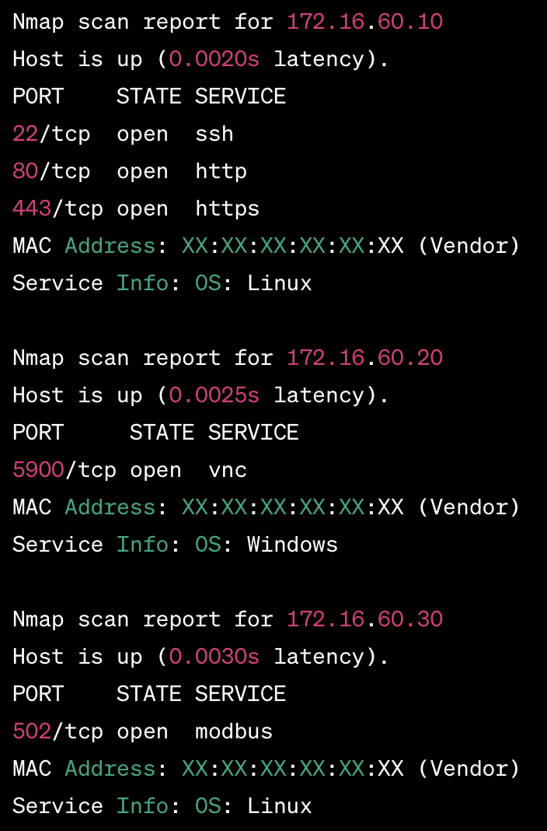
nmap - example scan look

Slide 31
what did we uncover?
We have a local admin user on the jumpbox attempt to run some commands.
The user ran the scanner tool to enumerate multiple common ports associated with Remote Access and common web server ports.
The user attempted to enumerate uncommon ports (in context of a normal user) that’s associated with industrial control devices. This is the most interesting part of our detection because we have Industrial Control Systems (ICS) within our environment.

Slide 32
what’s next?
This would be a great time to pause our activities and provide this information to the next team to investigate further.
Did we 100% prove malicious activity?
  Not quite, without further contextual data.
Should this be reported as suspicious activity?
  Absolutely. The activity is questionable and does not align with what we would expect.
Now we need to review our notes and prepare our threat hunter template.

Slide 33
threat hunter template
Playbook Title: Detecting Reconnaissance in Company Environment
Mitre Tactic: T1046 - Network Service Discovery
Mitre Sub Technique: N/A
Hypothesis: Malicious reconnaissance activity is occurring in the Magnum Tempus environment.
Proposed Detection Query: index IN (windows,sysmon) (nmap) AND host="iot-jumpbox"
Simulation Details: NONE
Hunter Limitations/Observation Notes: Network traffic flow logs were not available during this hunt. Having access to these logs could add additional context for the search. Also of note, all of the fields were not parsed within the logging platform, making queries slightly less efficient and not as readable.
Hunt Findings: There may be some fishy activity occurring, since we detected probing on an uncommon port associated with PLC/SCADA

