Slide 1
Forensics
Forensics 101
Part 1

Slide 2
Agenda
Digital Forensics Overview
Data Acquisition Overview
Necessity of Digital Forensics
Value Behind Digital Forensics
Notes:
Purpose: This is to ensure alignment to the agreed upon outline.
Video 1
What is Forensics
- Process Overview (Collection, Examination, Analysis, Reporting)
- Evidence Sources: File, Memory, Network, Logs
- Acquisition & Tools: Open Source + Paid Tools that are commonly used to acquire and analyze
When is a digital forensics investigation needed?
- Unauthorized Access: Network Intrusion, Insider Threat
- Employee Misconduct
- Various Criminal misconduct - Theft, Destruction, duplication, infringement of intellectual property
- Operational Troubleshooting - is it DNS or is it Cozy Bear?
- Data Recovery
- Compliance & Regulation
Why is it valuable?
- Ensures that when responding to active incidents that fact driven information can be used to drive the IR process of containment, eradication & recovery
- Can drive a proactive approach to strengthening security procedures and controls to prevent future attacks from occurring
- Can be used to secure evidence and prosecution of individuals and organizations

Slide 3
Digital Forensics Overview

Slide 4
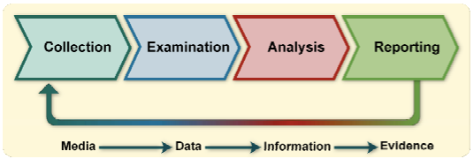
Digital Forensics Overview
Art & Science
Art: Choice, tool usage, interpretation of results
Science: Tools and methods (process)
Four Phase Forensic Process
Collection: Identify, label, acquire from media
Examination: Process and extract data
Analysis: Derive and deconstruct into information
Reporting: Describe and exhibit the evidence
“A branch of forensic science that focuses on identifying, acquiring, processing, analyzing, and reporting on data stored electronically.”
Notes:
Purpose: Establish a baseline definition of what Digital Forensics
Sources
Eoghan Casey. Digital Evidence and Computer Crime, Third Edition. ISBN 978-0-12-374268-1 -- Elsevier Academic Press
National Institute of Standards and Technology, Special Publication 800-61 Revision 1, Computer Security Incident Handling guide, September 2007, Computer Security Incident Handling Guide, March 2008.
Interpol. Digital Forensics. https://www.interpol.int/en/How-we-work/Innovation/Digital-forensics
SCRIPT:
TALK: There are multiple ways that can be used to define "digital forensics", but in the end, you can consider it a branch of forensic science that's used to identify, acquire, process, analyze, and report on evidences found electronically. It's value has been used to answer questions in interest to a legal system, but its applicability has grown to general IT-related matters, or more popularly, incident response. The most important takeaway with this definition is that it's focused on "digital information", used with proven methods, yet those tools and methods are generally acceptable.
One of the coolest things about digital forensics that it's an art and science. There is a certain methodology required to getting to the answers needed to answer important questions and there are specific tools required in order to collect the evidence needed answer the question, but the art lies in the ability to analyze and interpret the data collected and with the growth of open-source tools, there are a good variety of tools that can help arrive at the answer. Granted, those tools need to be tested as they can lead you astray if badly configured.
To the earlier point, we go back to the science as a methodology, or process, is required.

Slide 5
Digital Forensics Branches
Internet of Things (IoT)
MacOS
Chip
Cloud
Digital Forensics
Linux
Mobile
Network
Computer (Windows)
Notes:
Purpose: Inform the audience how “digital forensics” has grown as a field, starting off from “computer” and have split into multiple fields and now require specialists of those fields.

Slide 6
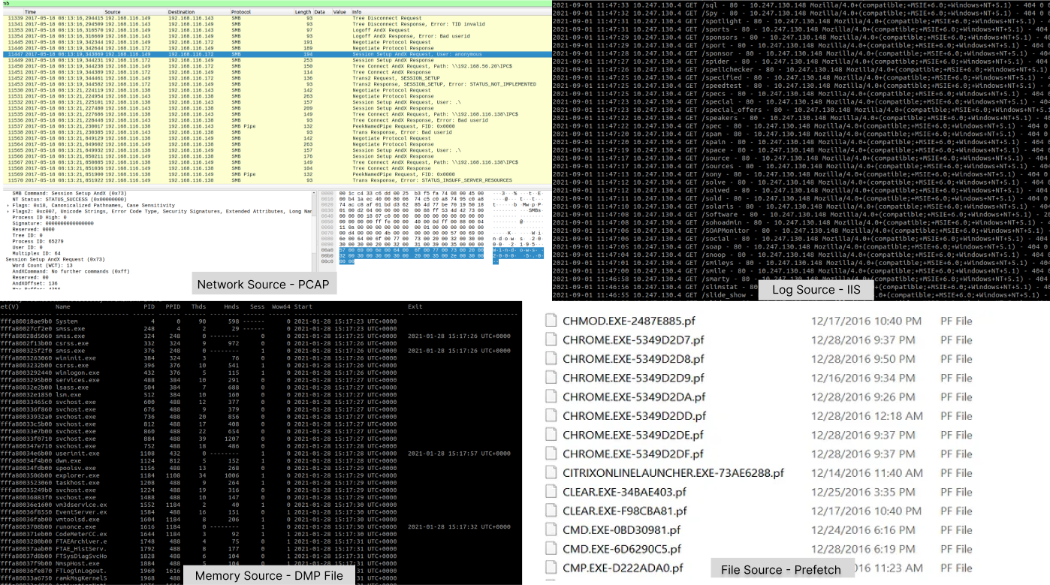
Digital Evidence
Key Definitions
Artifact: Remnants of an event left behind on the system
Evidence: an item or information proffered to make the existence of a fact more or less probable (Cornell Law School)
Evidence Sources
File
Network
Log
Memory
Notes:
Purpose: This will focus on the sources where the evidence can be acquired. Describe the difference between ‘artifact’ and ‘evidence’ and then detail the sources and how they are acquired.
Sources
Altheide, C. (2011). Digital Forensics With Open Source Tools. (1st Edition). Syngress. ISBN: 978-1-59749-586-8
Definition of Artifact (pg 2)
Cornell Law School. Evidence. https://www.law.cornell.edu/wex/evidence
Matt B. 2016, December 29. Windows Wednesday: Prefetch Files. Medium. https://bromiley.medium.com/windows-wednesday-prefetch-files-683f6ab5b9db
Evidence Sources
Memory Source - SANS ICS CTF Level3 Challenge 2022
Network Source - Packet Capture - CyberMAN 2022 (Romanian Military) CTF
File Source - See Matt B reference.
Log Source - Internal CTF
SCRIPT
Not every artifact will be used as evidence, but the evidence will be the collection of the artifacts found and presented.

Slide 7
Data Acquisition

Slide 8
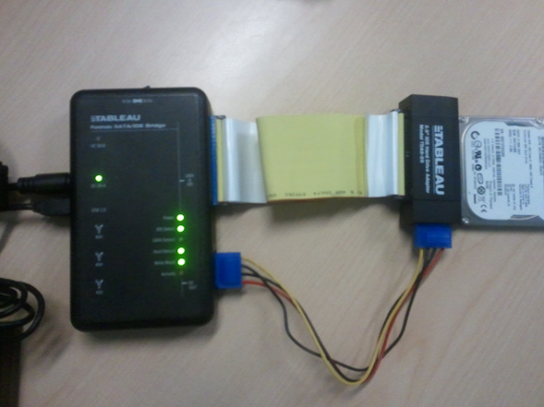
Data Acquisition Overview
The act of collecting a copy of the system in order to preserve potential evidence from the scene.
Imaging: Exact copy (bit-by-bit) of the original data
Authenticity verified via hashing algorithm
Write-blockers help prevent tampering during acquisition
Two types: File System and Memory (Volatile)
Planning Considerations
Volatile vs Non-Volatile
Livebox vs Deadbox
Local vs Remote
Triage or Full-Disk
Transfer Collection Point (SMB, SFTP, Cloud)
Notes:
Purpose: Give an overview and explicitly discuss Data Acquisition. We typically will analyze the data given, but there is not enough discussion about the acquisition stage and how it can and has been acquired. This will follow by covering the tools covered; both commercial and open-source.
Sources
Eoghan Casey. Digital Evidence and Computer Crime, Third Edition. ISBN 978-0-12-374268-1 -- Elsevier Academic Press (Pg 210 6.3.4. Preservation)
Forensicsferret. 2011, April 27. Imaging with the Tableau T35e and Encase. The Forensics Ferret Blog. https://forensicsferret.wordpress.com/2011/04/27/imaging-with-the-tableau-t35e-and-encase/
Holt, T. (2018). "Cybercrime and Digital Forensics" An Introduction. (Second Edition). Routledge. Pg.527
umairalizafar. (2022). Windows Forensics 1. TryHackMe. https://tryhackme.com/room/windowsforensics1

Slide 9





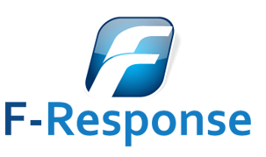




Data Acquisition and Analysis Tools
COMMERCIAL | OPEN-SOURCE
enCase Forensic by OpenText | Kroll Artifact Parser and Extractor (KAPE) by Eric Zimmerman
Forensic Toolkit (FTK) [including Imager] by Exterro | Autopsy by BasisTech
F-Response by F-Response/Agile Risk Management LLC | Velociraptor by Mike Cohen (acquired by Rapid7)
Axiom Magnet by Magnet Forensics | CyLR by Alan Orlikoski (updated by Chapin Bryce)
Belkasoft Evidence Cengooter X & R by Belkasoft | Volatility Framework by The Volatility Foundation
X-Ways Forensics by X-Ways Software Technology AG
Notes:
Purpose: This will follow by covering the tools covered; both commercial and open-source.
Sources
umairalizafar. (2022). Windows Forensics 1. TryHackMe. https://tryhackme.com/room/windowsforensics1
Orlikoski, A. (2021) https://github.com/orlikoski/CyLR
Talking Points:
While FTK Imager is free, it is still considered a commercial tool because of it being proprietary and linked with its licensed FTK software. It is just free but with limitations. It’s also worth pointing out that Volatility is only an analysis tool that is linked with memory forensics and cannot do acquisition.

Slide 10
Necessity & Value

Slide 11
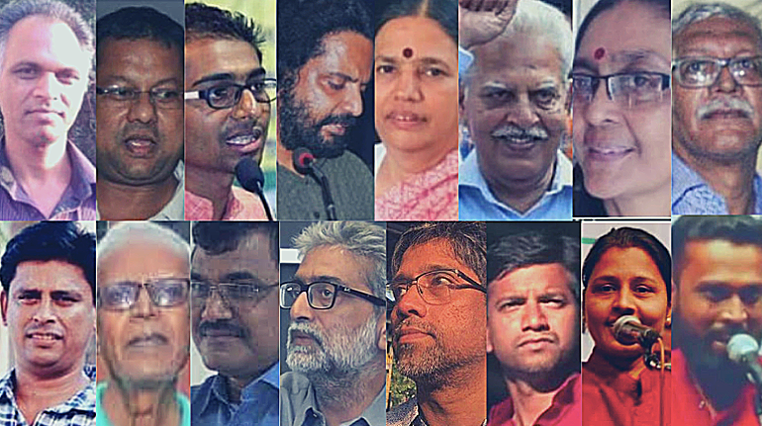
Necessity of Digital Forensics
Rapid adoption of technology into daily lives
Work from home (WFH) and associated risks
Use Cases
Unauthorized Access
Employee Misconduct
Criminal Cases
Bhima Koregaon (BK) Case - Rona Wilson/”Modified Elephant” Campaign (2018-2022)
Troubleshooting/Data Recovery
Compliance and Regulation
Notes:
Purpose: Establish why digital forensics has become a necessity in keeping up with [time/era] as technology adopts within the daily lives and include a few important use cases and their impact.
Sources
Abrams, L. 2023, February 27. LastPass: DevOps engineer hacked to steal password vault data in 2022 breach. BleepingComputer. https://www.bleepingcomputer.com/news/security/lastpass-devops-engineer-hacked-to-steal-password-vault-data-in-2022-breach/
Greenberg, A. 2022, June 16. "Police Linked to Hacking Campaign to Frame Indian Activists". Wired. https://www.wired.com/story/modified-elephant-planted-evidence-hacking-police/
SCRIPT: Why do we need digital forensics.
- Re-emphasize the change of climate of the world becoming more computer-oriented from the computers to cellphones.
- Opportunities opened up with remote working due to the pandemic-- even with return to work and hybrid, there are opportunities.
- More data, more need to store it within the cloud
Follow the Use Cases
Bhima Koregaon Case
https://eclipseforensics.com/3-famous-cases-solved-through-digital-forensics/
https://thewire.in/rights/bhima-koregaon-arrests-activists-arsenal-report
https://www.wired.com/story/modified-elephant-planted-evidence-hacking-police/

Slide 12
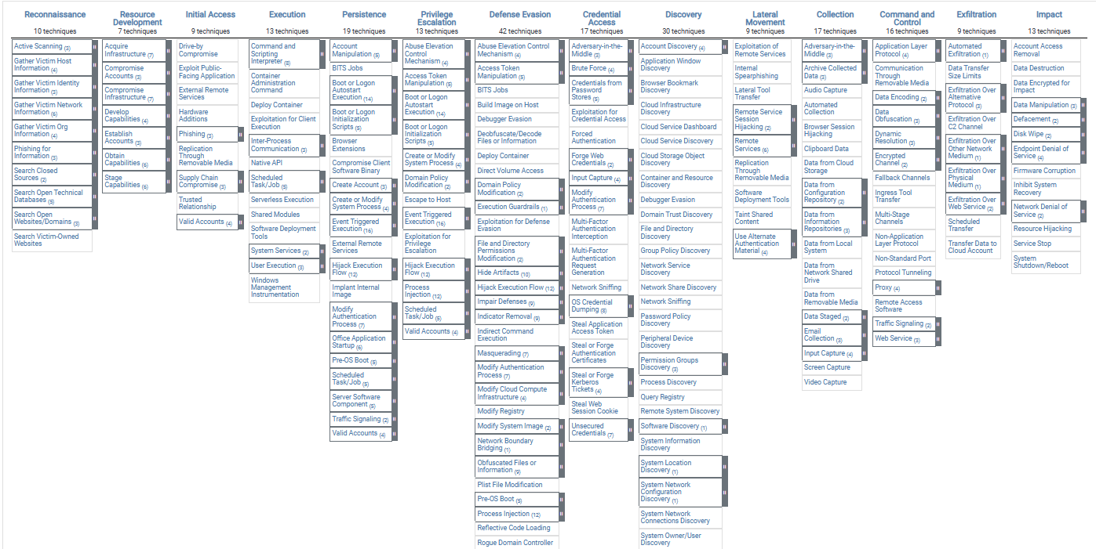
Value Behind Digital Forensics
Role in General IT
Root Cause Analysis (RCA)
Role in Cyber Defense
Information Sharing
Role in Legal Cases
Line between Innocence or Guilty
Notes:
Purpose: As opposed to the necessity, this will highlight the value that Digital Forensics to bring across multiple fields.
Sources
MITRE. (2022). ATT&CK v12.1. https://attack.mitre.org/tactics/enterprise/

Slide 13
References
Altheide, C. (2011). Digital Forensics With Open Source Tools. (1st Edition). Syngress. ISBN: 978-1-59749-586-8
Abrams, L. 2023, February 27. LastPass: DevOps engineer hacked to steal password vault data in 2022 breach. BleepingComputer. https://www.bleepingcomputer.com/news/security/lastpass-devops-engineer-hacked-to-steal-password-vault-data-in-2022-breach/
Cornell Law School. Evidence. https://www.law.cornell.edu/wex/evidence
Eoghan Casey. Digital Evidence and Computer Crime, Third Edition. ISBN 978-0-12-374268-1 -- Elsevier Academic Press
Forensicsferret. 2011, April 27. Imaging with the Tableau T35e and Encase. The Forensics Ferret Blog. https://forensicsferret.wordpress.com/2011/04/27/imaging-with-the-tableau-t35e-and-encase/
Greenberg, A. 2022, June 16. "Police Linked to Hacking Campaign to Frame Indian Activists". Wired. https://www.wired.com/story/modified-elephant-planted-evidence-hacking-police/
Holt, T. (2018). "Cybercrime and Digital Forensics" An Introduction. (Second Edition). Routledge. Pg.527
Interpol. Digital Forensics. https://www.interpol.int/en/How-we-work/Innovation/Digital-forensics
Matt B. 2016, December 29. Windows Wednesday: Prefetch Files. Medium. https://bromiley.medium.com/windows-wednesday-prefetch-files-683f6ab5b9db
MITRE. (2022). ATT&CK v12.1. https://attack.mitre.org/tactics/enterprise/
National Institute of Standards and Technology, Special Publication 800-61 Revision 1, Computer Security Incident Handling guide, September 2007, Computer Security Incident Handling Guide, March 2008.
Orlikoski, A. (2021) https://github.com/orlikoski/CyLR
umairalizafar. (2022). Windows Forensics 1. TryHackMe. https://tryhackme.com/room/windowsforensics1
Notes:
Purpose: Finally List all of the References that contributed to the course. Collect from each Notes of each slide for the respective video.

