Slide 1
Forensics
Forensics 101
Part 2

Slide 2
Agenda
Supporting Digital Forensic Team
Expectations of Digital Forensics
Common Career Paths & Training
Notes:
Purpose: This is to ensure alignment to the agreed upon outline.
Video 2
Who is part of a Digital Forensics Team and who typically supports them?
- Forensic Examiners (Including e-Discovery)
- Incident Response
- Security Operations
- Malware Analysts & Reverse Engineers
- Threat intelligence
What is expected of a Digital Forensics Examiner?
- Reporting/ Preparing data for inquiries and audits
- Court Testimonies
- Working in close conjunction with Legal Teams & Law Enforcement
Common Career paths & Training
- Where do Forensics folks come from? (SOC/IR, Sys Admins, Law Enforcement Officials)
- Private Industry (Internal DF, Consulting, Law Firms)
- Public Industry (Three letters agencies, Federal, Cities, States)
- Training - Shameless Blue Team Village plug!

Slide 3
Supporting the Digital Forensics Team

Slide 4
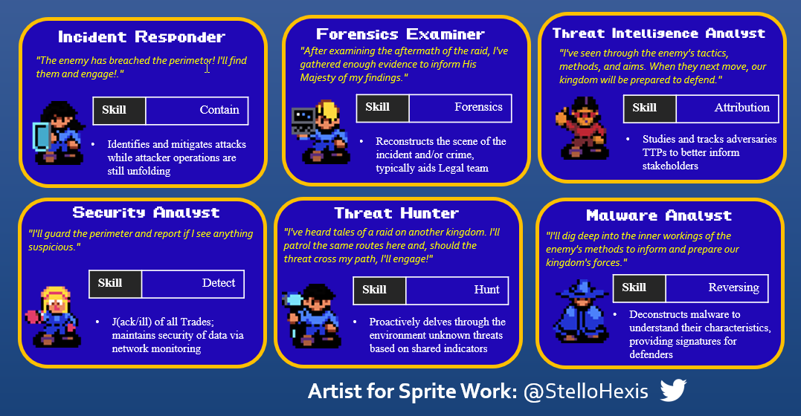
Supporting the Digital Forensics Team
Forensic Examiners
including E-discovery
Incident Response
Security Operations
Malware Analysts & Reverse Engineers
Cyber Threat Intelligence
Notes:
Purpose: Highlight key players who regularly rely on Digital Forensics results and support them too.
Clarify the difference between Digital Forensics and E-discovery
“E-discovery is a form of digital investigation that attempts to find evidence in email, business communications and other data that could be used in litigation or criminal proceedings. The traditional discovery process is standard during litigation, but e-discovery is specific to digital evidence. This evidence could include data from email accounts, instant messages, social profiles, online documents, databases, internal applications, digital images, website content and any other electronic information that could be used during civil and criminal litigation.”
Sources
B4nd1t0. 2022. Bandit’s Bytes. https://banditsbytes.net/
2022, January 20. What Is E-Discovery? Proofpoint. https://www.proofpoint.com/au/threat-reference/e-discovery

Slide 5
Expectations on the Digital Forensics Team

Slide 6

Expectations
Reporting/Data Preparation
Reporting typically can be centered around one incident involving a single system, or multiple – even hundreds of systems!
It is up to the Digital Forensics Examiner to be able to paint a picture, and provide a narrative into what, how and why an incident occurred.
Notes:
Purpose: Cover the output that’s expected from a forensics analysis and how that output can help.
Sources
2022, November 7. Write a Forensic Report Step by Step. Salvation Data Technology. https://www.salvationdata.com/work-tips/write-a-forensic-report/

Slide 7

Expectations
Court Testimonies
Potential to called to provide expert witness testimonies in court cases on a report, or its findings
Responsibilities may include
Organizing, and maintaining chain of custody for all evidence
Testing, interpreting, quantifying and communicating any findings via a presentation and/or responses to questions posed by legal counsel
Notes:
Purpose: Cover the additional expectations in the reporting, but add with court-related matters.
Sources
Horsman, G. and Shavers, B. (2022). “Who is the digital forensic expert and what is their expertise?” WIREs Forensic Science. doi:https://doi.org/10.1002/wfs2.1453. https://wires.onlinelibrary.wiley.com/doi/full/10.1002/wfs2.1453
2020, May 22. Tingey Injury Law Firm. Unsplash. https://unsplash.com/@tingeyinjurylawfirm

Slide 8

Expectations
Coordination with Legal Teams and Law Enforcement
Legal requirement to notify relevant law enforcement agencies upon disclosure of data breach attributed to criminal group
Conducting knowledge sharing (IOCs and findings) and receiving them from law enforcement to use in their ongoing digital forensics investigation.
Notes:
Purpose: Cover the additional expectations in the reporting, but add with court-related matters.
Sources
2020, May 22. Tingey Injury Law Firm. Unsplash. https://unsplash.com/@tingeyinjurylawfirm

Slide 9
Career Paths & Training

Slide 10
Common Career Paths
Where do Digital Forensics people typically start?
SOC/IR, System Administrators, IT Professionals, Law Enforcement Officials
Private Industry
Internal Digital Forensics, Consulting, Law Firms
Public
Intelligence Agencies, Federal/State/City government units
Notes:
Purpose: Give a typical path that someone can go within their career, whether in the public or private sector.
Sources
N/A

Slide 11






Training Opportunities
TryHackMe
Learning Paths: SOC Level 1
Security Blue
Blue Team Level 1 & 2 (BTL1, BTL2)
Antisyphon - Home of “Pay What You Can” Training
SOC Core Skills w/ John Strand
Advanced Endpoint Investigations w/ Jake Williams or Alissa Torres
Markus Schober (Collaboration w/ TCM Security)
Practical Windows Forensics
INE/eLearn Security
eLearnSecurity Certified Digital Forensics Professional (eCDFP)
13Cubed
Investigating Windows Endpoints
ENISA CERT free online training materials
Digital forensics, Introduction to network forensics
edX Computer Forensics online course
Notes:
Purpose: Providing a list of affordable opportunities for people to get involved with Digital Forensics via training.
Sources
2014, November. Training for Cybersecurity Specialists. ENISA: https://www.enisa.europa.eu/topics/training-and-exercises/trainings-for-cybersecurity-specialists/online-training-material
Pan, Y. 2017. CYBER502x - Digital Forensics. Rochester Institute of Technology (RIT). https://www.edx.org/course/computer-forensics
2023. Investigating Windows Endpoints. 13Cubed. https://training.13cubed.com/investigating-windows-endpoints
2018. TryHackMe. https://tryhackme.com/
2020. BlueYard - Blue Team Challenges. CyberDefenders. https://cyberdefenders.org/blueteam-ctf-challenges/
eLearnSecurity Certified Digital Forensics Professional (eCDFP). INE. https://ine.com/learning/certifications/internal/elearnsecurity-certified-digital-forensics-professional
Antisyphon Training. https://www.antisyphontraining.com/
2022. Markius Schober. TCM Security. https://academy.tcm-sec.com/p/practical-windows-forensics

Slide 12
Training Opportunities - SANS
Host in-Depth
IR & Threat Hunt-Driven
Host in-Depth
MacOS
Linux
FOR518 - Mac and iOS Forensic Analysis and Incident Response
FOR608 – Enterprise-Class Incident Response & Threat Hunting
FOR577 - Linux Incident Response and Threat Hunting
Cloud
FOR508 – Advanced Incident Response, Threat Hunting, and Digital Forensics
Mobile
FOR509 - Enterprise Cloud Forensics and Incident Response
FOR585 - Smartphone Forensic Analysis In-Depth
SEC504 – Hacker Tools, Techniques, Exploits, and Incident Handling
Computer (Windows)
Network
FOR500 – Windows Forensics Analysis
FOR578 – Advanced Network Forensics: Threat Hunting, and Incident Response
FOR498 – Battlefield Forensics & Data Acquisition Course
Notes:
Purpose: Place SANS Institute within its own category for training due to the diversity, and unfortunately, more expensive end that requires corporate/government sponsorship to receive training.
Sources
Insert Sources

Slide 13


Cyber Ranges
Cyber Range – No Set-up Required
TryHackMe – Newbie-friendly platform from IT fundamentals to multiple disciplines
RangeForce – Community Edition – Offers training modules on tools such as YARA, Splunk
Let’s Defend – Focuses on daily SOC duties to Incident Response
Blue Team Labs Online – Blue Team answer to HackTheBox
Setup Necessary
SocVel – CTF focused on analyzing triaged data of compromised hosts
CyberDefenders – BlueYard – Variety of labs from old Flare-On to Boss of the SOC
Notes:
Purpose: Provide Blue Team-oriented ranges.
Sources
Speshock, J. (2021, July 28). Cybersecurity Blue Team Guide. Medium. https://medium.com/@joshuaspeshock/cybersecurity-blue-team-guide-d6f51ba5c437

Slide 14
References
Antisyphon Training. https://www.antisyphontraining.com/
B4nd1t0. 2022. Bandit’s Bytes. https://banditsbytes.net/
2020. BlueYard - Blue Team Challenges. CyberDefenders. https://cyberdefenders.org/blueteam-ctf-challenges/
eLearnSecurity Certified Digital Forensics Professional (eCDFP). INE. https://ine.com/learning/certifications/internal/elearnsecurity-certified-digital-forensics-professional
Horsman, G. and Shavers, B. (2022). “Who is the digital forensic expert and what is their expertise?” WIREs Forensic Science. doi:https://doi.org/10.1002/wfs2.1453. https://wires.onlinelibrary.wiley.com/doi/full/10.1002/wfs2.1453
2014, November. Training for Cybersecurity Specialists. ENISA: https://www.enisa.europa.eu/topics/training-and-exercises/trainings-for-cybersecurity-specialists/online-training-material
2023. Investigating Windows Endpoints. 13Cubed. https://training.13cubed.com/investigating-windows-endpoints
Pan, Y. 2017. CYBER502x - Digital Forensics. Rochester Institute of Technology (RIT). https://www.edx.org/course/computer-forensics
Schober, M. 2022. TCM Security. https://academy.tcm-sec.com/p/practical-windows-forensics
Tingey. 2020, May 22. Tingey Injury Law Firm. Unsplash. https://unsplash.com/@tingeyinjurylawfirm
2018. TryHackMe. https://tryhackme.com/
2022, January 20. What Is E-Discovery? Proofpoint. https://www.proofpoint.com/au/threat-reference/e-discovery
2022, November 7. Write a Forensic Report Step by Step. Salvation Data Technology. https://www.salvationdata.com/work-tips/write-a-forensic-report/
Notes:
Purpose: Finally List all of the References that contributed to the course. Collect from each Notes of each slide for the respective video.

