Slide 1
Health and Wellness Center Resources
Reaching out to those in need
Tee, Alexis,
Erin, Ruben
Date 10/27/2017
Class HCI-436

Slide 2

Problem
How services of the Health and Wellness center are unutilized among students who need services.

Slide 3
Research Methods
Interviews
Personal Experience
Professor Advisement
Online research with mental health agencies
Consulting with Health and wellness center
Competitive Analysis

Slide 4
Research Results: Secondary
1 in 5 students meet the requirements for a mental health condition. Nearly ¾ of mental health conditions emerge by age 24.
Anxiety disorders, such as GAD, are one of the most common mental health problems on college campuses.
The National Eating Disorders Association (NEDA) reports that full-blown eating disorders typically begin between 18 and 21 years of age.
When it comes to college athletes, there’s a fear of admitting a weakness because you don’t want to be perceived as weak.
Those who are enrolled in full-time college program are twice as likely to abuse drugs and alcohol than those who don’t attend college.
American Psychological Association- 82% of female and 71% of male Americans reported stress-related health problems.

Slide 5
Research Results: Primary
Stigma
Confidentiality
Hectic Schedule
Stress
Not aware of programs
Weakness
Notes:
Students feel there is a stigma surrounding seeking help for mental health
Confidentiality is a huge issue
Most students have a hectic schedule
They’re stressed out
They aren’t aware of the health programs available to them on campus
They fear that seeking help with mental or emotional issues would make them seem weak

Slide 6

Primary Persona: Josh
Bio/Demographic
Senior
Moved to the area a decade ago.
35
Married
Behavior
Depression
Alcoholism
Moody
Stories/Scenarios
Starts semester strong
Starts drinking
Misses a lot of classes
Marital issues
Goals/Needs
Needs help catching up
Needs support to stop drinking
Needs accommodations

Slide 7
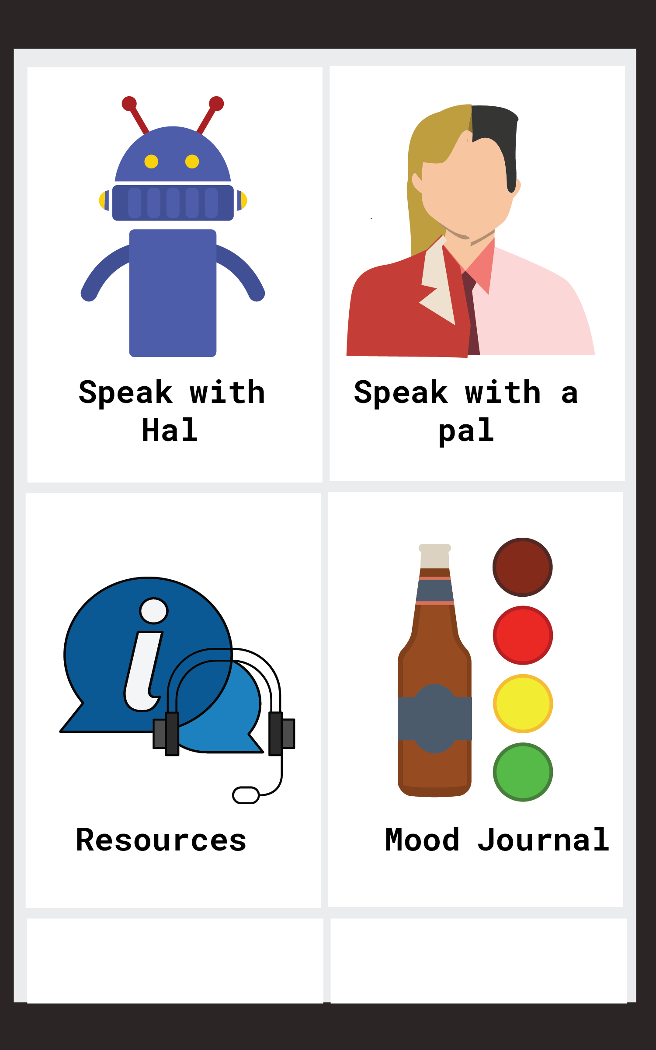
Possible Solution
MyPalHal
“A social connection therapy app”
Place your screenshot here
Chat with a bot
Chat with a person
Seek on campus resources
Track your progress

Slide 8
MyPalHal exists to provide students with substance abuse issues with support. In doing so, it delivers personal interaction and emotional support to users. Towards that end, it offers communication, support groups, and professional health resources.

Slide 9
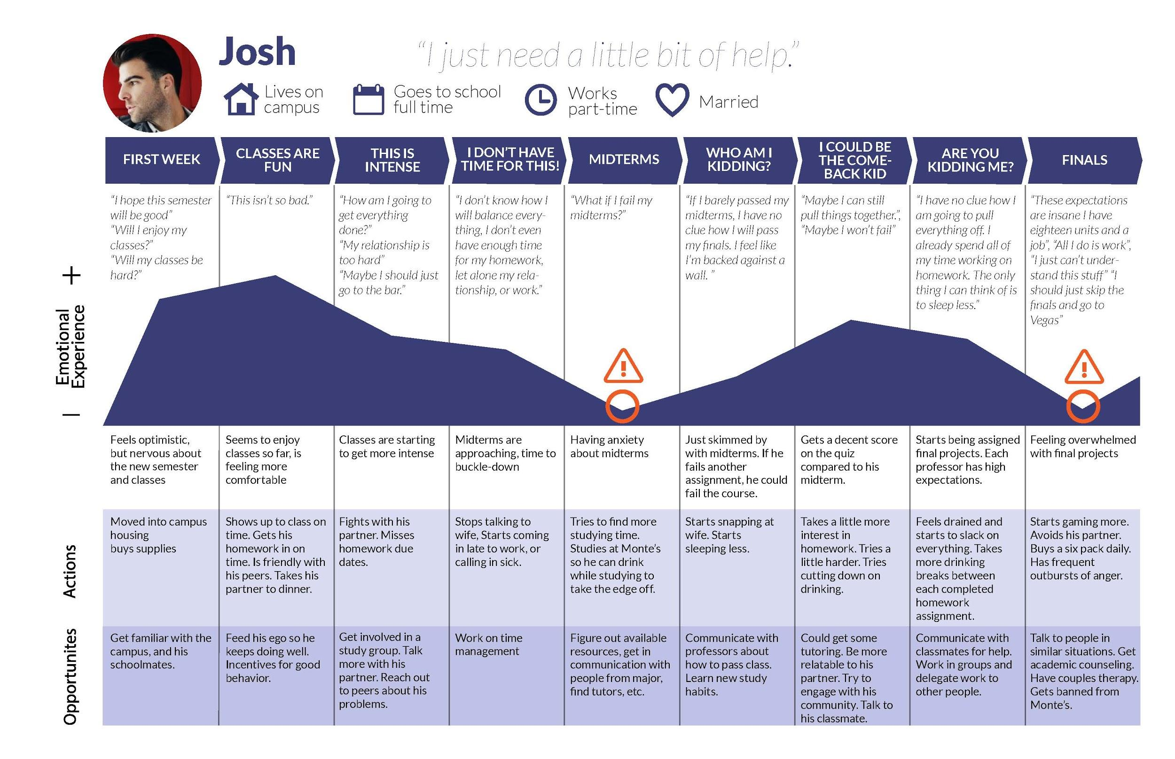

Slide 10
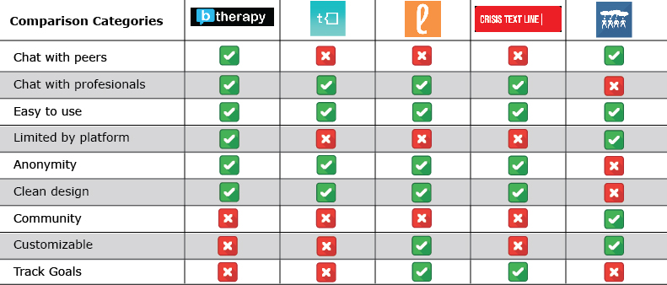
Comparative Products

Slide 11
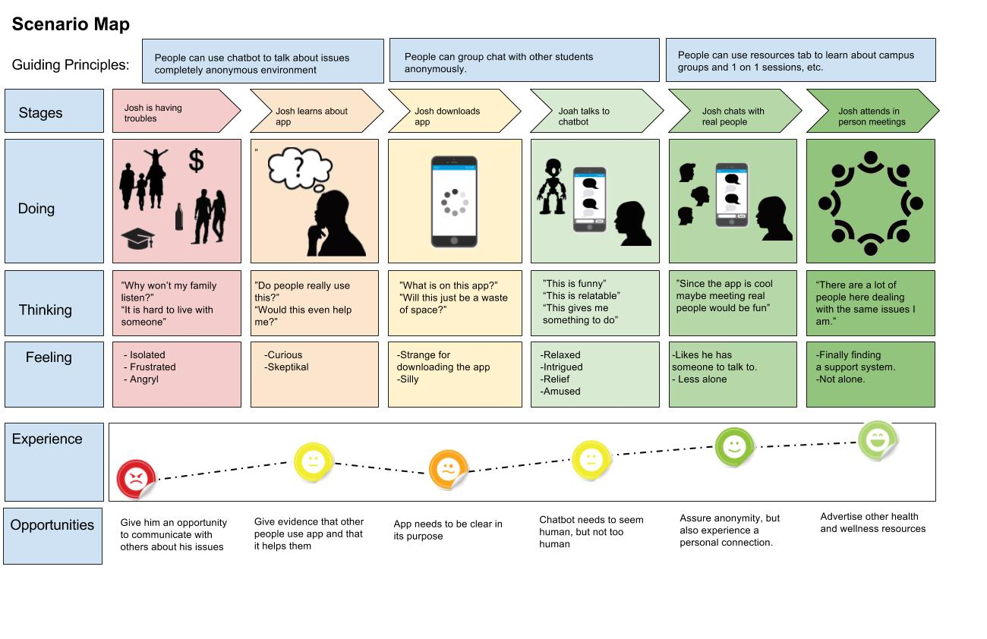

Slide 12
Thank You
Any questions?

