Slide 1

Import(icon)
Browse previous search
Protein
Organism
(optional)
Keyword
(optional)
Search PubMed
Notes:
Main page
Call CreateDatabase(filename) // initialization database

Slide 2

Import(icon)
Browse previous search
Protein
Organism
(optional)
Keyword
(optional)
Search PubMed
Notes:
Mouse move over “Protein” to view help document

Slide 3
Import(icon)
Browse previous search
Protein
Please enter protein/gene identifiers
For example, MAVS, gag, MP etc.
Organism
(optional)
Keyword
(optional)
Search PubMed
Notes:
Help document for protein

Slide 4
Import(icon)
Browse previous search
Protein
Organism
(optional)
Keyword
(optional)
Search PubMed
Notes:
Mouse move over “Organism” to view help document

Slide 5
Import(icon)
Browse previous search
Protein
Organism
(optional)
Please enter organisms
For example, human, monkey etc.
Keyword
(optional)
Search PubMed
Notes:
Help document for organism

Slide 6
Import(icon)
Browse previous search
Protein
Organism
(optional)
Keyword
(optional)
Search PubMed
Notes:
Mouse move over “Keyword” to view help document

Slide 7
Import(icon)
Browse previous search
Protein
Organism
(optional)
Keyword
(optional)
Please enter keywords
For example, HIV, activator etc.
Search PubMed
Notes:
Help document for keyword

Slide 8
Import(icon)
Browse previous search
Protein
Organism
(optional)
Keyword
(optional)
Search PubMed
Notes:
Click “Import” to invoke open file dialog

Slide 9
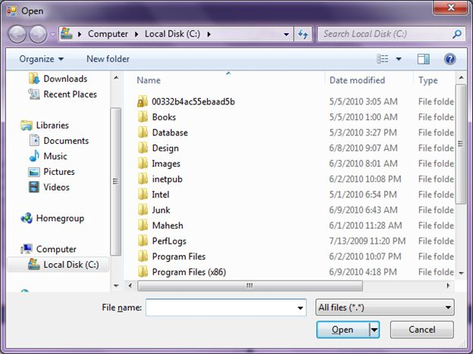
Import(icon)
Browse previous search
Protein
Organism
(optional)
Keyword
(optional)
Search PubMed
Notes:
Default path: Computer/Local Disk(C:)

Slide 10
Import(icon)
Browse previous search
PRRT3
LYNX1
ST6GAL2
CSPG4
XYLT2
MB
CXCL16
Protein
Organism
(optional)
Human
Keyword
(optional)
Search PubMed
Notes:
Open file dialog call FillInTextBox function to fill in protein textbox.
In this case, keyword = null

Slide 11
Import(icon)
Browse previous search
PRRT3
LYNX1
ST6GAL2
CSPG4
XYLT2
MB
CXCL16
Protein
Organism
(optional)
Human
Keyword
(optional)
Search PubMed
Notes:
Click “Search PubMed” button

Slide 12

Import(icon)
Browse previous search
PRRT3
LYNX1
ST6GAL2
CSPG4
XYLT2
MB
CXCL16
Protein
Retrieving count number from PubMed…80%
Organism
(optional)
Human
Keyword
(optional)
Search PubMed
Notes:
Parse proteinList,
Call getCountAndIds(protein, organism, keyword);
-If it’s duplicate input, retrieve from database
-If not duplicate, run a new searching
-In networking, idList is filled, parse to data table. T_Query, T_Protein, T_Organism, T_Keyword, T_QuerySession tables are filled in.

Slide 13
+
+[[
Hit Count Summary
Number of publication | Protein
13311994 | PRRT3
15 | LYNX1
6 | ST6GAL2
45 | CSPG4
11 | XYLT2
27943 | MB
224 | CXCL16
43 | IGFALS
21 | SPRN
1 | VSTM2B
1 2 3 4 5 6 7 8…20 21
Notes:
Switch to the new tab
Original table is ordered by user input default.
Display 10 protein each page. User will be able to access to more pages by clicking page number at bottom.
Datagrid sorting & paging

Slide 14

+
+[[
Hit Count Summary
Number of publication | Protein
13311994 | PRRT3
15 | LYNX1
6 | ST6GAL2
45 | CSPG4
11 | XYLT2
27943 | MB
224 | CXCL16
43 | IGFALS
21 | SPRN
1 | VSTM2B
1 2 3 4 5 6 7 8…20 21
Notes:
Mouse move over “Hit Count Summary” to view help document

Slide 15
+
+[[
Hit Count Summary
Click on publication number to view article list
Number of publication | Protein
13311994 | PRRT3
15 | LYNX1
6 | ST6GAL2
45 | CSPG4
11 | XYLT2
27943 | MB
224 | CXCL16
43 | IGFALS
21 | SPRN
1 | VSTM2B
1 2 3 4 5 6 7 8…20 21
Notes:
Help document of searching info

Slide 16
+
+[[
Hit Count Summary
Number of publication | Protein
13311994 | PRRT3
15 | LYNX1
6 | ST6GAL2
45 | CSPG4
11 | XYLT2
27943 | MB
224 | CXCL16
43 | IGFALS
21 | SPRN
1 | VSTM2B
1 2 3 4 5 6 7 8…20 21
Notes:
Sort protein low to high

Slide 17

+
+[[
Hit Count Summary
Number of publication | Protein
13311994 | PRRT3
15 | LYNX1
6 | ST6GAL2
45 | CSPG4
11 | XYLT2
27943 | MB
224 | CXCL16
43 | IGFALS
21 | SPRN
1 | VSTM2B
1 2 3 4 5 6 7 8…20 21
Notes:
Table should be sorted based on number of literature, in the order of low to high.

Slide 18
+
+[[
Hit Count Summary
Number of publication | Protein
13311994 | PRRT3
15 | LYNX1
6 | ST6GAL2
45 | CSPG4
11 | XYLT2
27943 | MB
224 | CXCL16
43 | IGFALS
21 | SPRN
1 | VSTM2B
1 2 3 4 5 6 7 8…20 21
Notes:
When user click count number, call
DataTable GetArticleInformation()
Returns T_Articles
Using IdList
Fill in T_Articles, T_Author, T_Journal etc.

Slide 19
+
+[[
Hit Count Summary
Number of publication | Protein
13311994 | PRRT3
15 | LYNX1
6 | ST6GAL2
45 | CSPG4
11 | XYLT2
27943 | MB
224 | CXCL16
43 | IGFALS
21 | SPRN
1 | VSTM2B
Retrieving article information from PubMed…80%
1 2 3 4 5 6 7 8…20 21
Notes:
Retrieving article list

Slide 20
+
+
15 results
Export to txt(icon)
Title | Authors | Year | Journal
Water-soluble LYNX1 residues important for interaction with muscle-type and/or neuronal nicotinic receptors | Lyukmanova EN,…Tsetlin VI | 2013 | J Biol Chem
[Bacterial expression of water-soluble domain of Lynx1, endogenic neuromodulator of humannicotinic acetylcholine receptors] | Shulepko MA, … Kirpichnikov MP | 2011 | Bioorg Khim
The α7 nicotinic acetylcholine receptor complex: one, two or multiple drug targets? | Thomsen MS, Mikkelsen JD. | 2012 | Curr Drug Targets
NMR structure and action on nicotinic acetylcholine receptors of water-soluble domain of humanLYNX1. | Lyukmanova EN… Kirpichnikov MP | 2011 | J Biol Chem
1 2
Notes:
Switch to the new tab
Default category: Title, Authors, Year, Journal
Default year: all years
Default Language: all languages
Default journal: all journals
Data grid paging & filtering

Slide 21
+
+
15 results
Export to txt(icon)
Title | Authors | Year | Journal
Water-soluble LYNX1 residues important for interaction with muscle-type and/or neuronal nicotinic receptors | Lyukmanova EN,…Tsetlin VI | 2013 | J Biol Chem
[Bacterial expression of water-soluble domain of Lynx1, endogenic neuromodulator of humannicotinic acetylcholine receptors] | Shulepko MA, … Kirpichnikov MP | 2011 | Bioorg Khim
The α7 nicotinic acetylcholine receptor complex: one, two or multiple drug targets? | Thomsen MS, Mikkelsen JD. | 2012 | Curr Drug Targets
NMR structure and action on nicotinic acetylcholine receptors of water-soluble domain of humanLYNX1. | Lyukmanova EN… Kirpichnikov MP | 2011 | J Biol Chem
1 2
Notes:
Click article title to view specific article

Slide 22
+
+
15 results
Export to txt(icon)
Title | Authors | Year | Journal
Water-soluble LYNX1 residues important for interaction with muscle-type and/or neuronal nicotinic receptors | Lyukmanova EN,…Tsetlin VI | 2013 | J Biol Chem
[Bacterial expression of water-soluble domain of Lynx1, endogenic neuromodulator of humannicotinic acetylcholine receptors] | Shulepko MA, … Kirpichnikov MP | 2011 | Bioorg Khim
The α7 nicotinic acetylcholine receptor complex: one, two or multiple drug targets? | Thomsen MS, Mikkelsen JD. | 2012 | Curr Drug Targets
NMR structure and action on nicotinic acetylcholine receptors of water-soluble domain of humanLYNX1. | Lyukmanova EN… Kirpichnikov MP | 2011 | J Biol Chem
Go to PubMed?
Yes No
1 2
Notes:
Click article title to view specific article
Provide user some meta data before open web browser

Slide 23
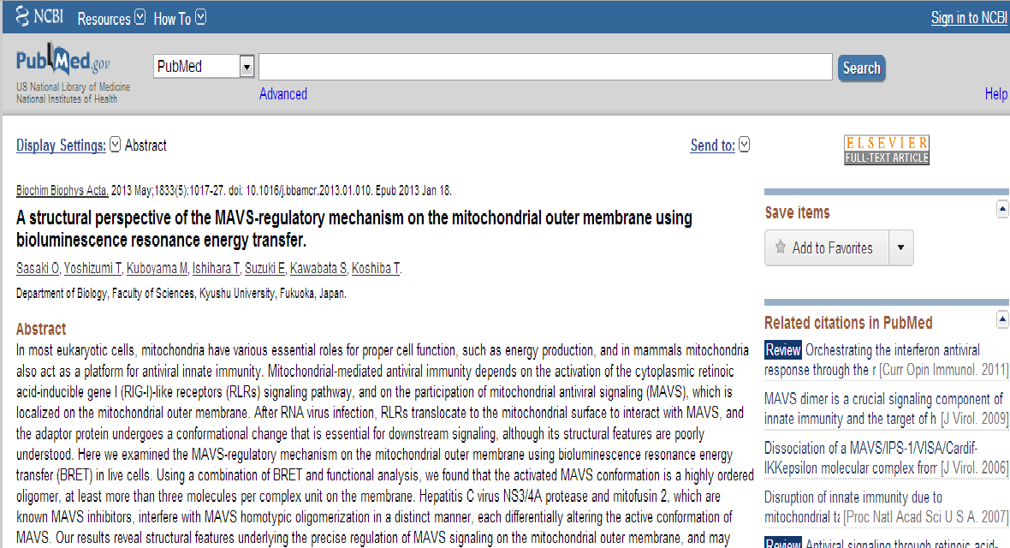
Notes:
Web Browser PubMed website

Slide 24

+
+
15 results
Export to txt(icon)
Title | Authors | Year | Journal
Water-soluble LYNX1 residues important for interaction with muscle-type and/or neuronal nicotinic receptors | Lyukmanova EN,…Tsetlin VI | 2013 | J Biol Chem
[Bacterial expression of water-soluble domain of Lynx1, endogenic neuromodulator of humannicotinic acetylcholine receptors] | Shulepko MA, … Kirpichnikov MP | 2011 | Bioorg Khim
The α7 nicotinic acetylcholine receptor complex: one, two or multiple drug targets? | Thomsen MS, Mikkelsen JD. | 2012 | Curr Drug Targets
NMR structure and action on nicotinic acetylcholine receptors of water-soluble domain of humanLYNX1. | Lyukmanova EN… Kirpichnikov MP | 2011 | J Biol Chem
1 2
Notes:
When use close program, save query into database
Call DataSet getDataSet() // for database
Call copyDataSetToDatabase(dataset, filename)

Slide 25
Import(icon)
Browse previous search
Protein
Organism
Keyword
Search PubMed
Notes:
The user click “Browse previous search”
//Load query input from database into textboxes.
Void LoadPreviousQuery()
Get T_QuerySession table, find the last session
- Load input query(protein, organism, keyword)

Slide 26
Import(icon)
Browse previous search
PRRT3
LYNX1
ST6GAL2
CSPG4
XYLT2
MB
CXCL16
Protein
Organism
(optional)
Human
Keyword
(optional)
Search PubMed

