Slide 1


Team 3:
Pham Thanh Truong 20194460 Phan Manh Tuan 20194461
Workloads
TOPIC 7:
Demonstration of types of viruses and its mechanism

Slide 2
Problem statement

Slide 3
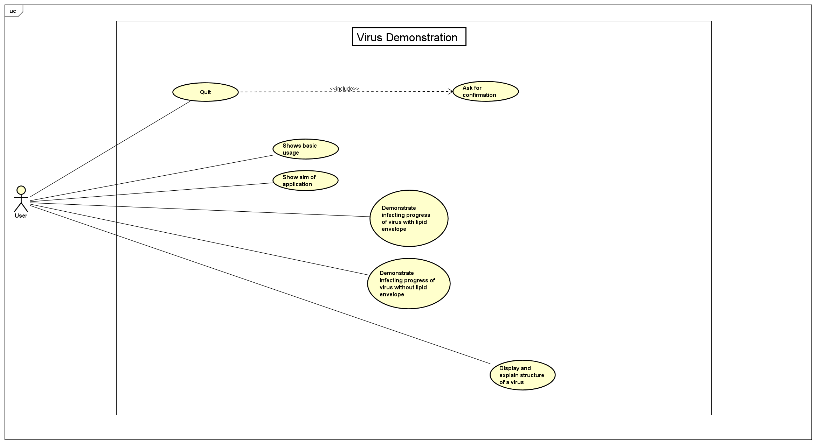
UseCase Diagram

Slide 4
General Class Diagram

Slide 5
Detail Class Diagram

Slide 6
Detail Class Diagram

Slide 7
OOP Techniques

Slide 8
OOP Techniques

Slide 9
Demo Scenario

