Slide 1
Virtual Deck
a mobile application to replace your deck of cards
developed by Joseph Faraci and Trevor Buchan
For SteelHacks 2016

Slide 2
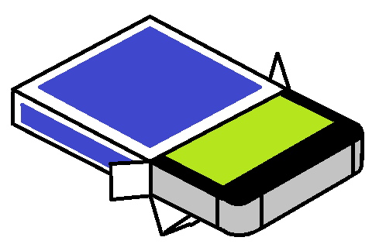
Goals and Achievements
We set out to create an app that would closely emulate a physical, standard pack of playing cards
We successfully designed a way to do this, but were unable to fully implement the app.
We were able to create several sample classes to describe how all of the objects would be instantiated and interact with each other.

Slide 3
Overview
The Virtual Deck is extremely generalized, so that almost any game that can be played with physical cards can be played using the app.
THIS WAS NOT INTENDED TO BE AN ONLINE GAME
We did not intend to allow players to connect to others via the internet.
Furthermore, players would only be able to successfully play a game while in the same room with each other, just like they would with a physical pack of cards.

Slide 4
Design
The app would start by prompting users to start a game.
It would then search for other Bluetooth enabled mobile phones to connect to.
The players would select each other’s phones and allow connection.

Slide 5
Design (cont.)
After connecting, one player would be prompted to indicate the number of standard packs to be included in the deck.
This would be analogous to combining several physical decks (as many casinos do at Blackjack tables).

Slide 6
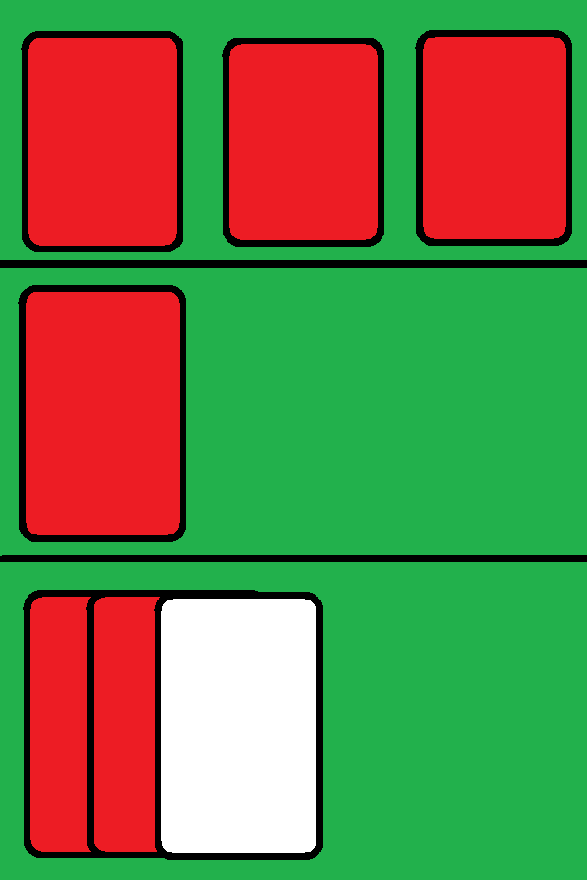
Design (cont.)
The players would then be presented with a screen with three sections, similar to this:

Slide 7
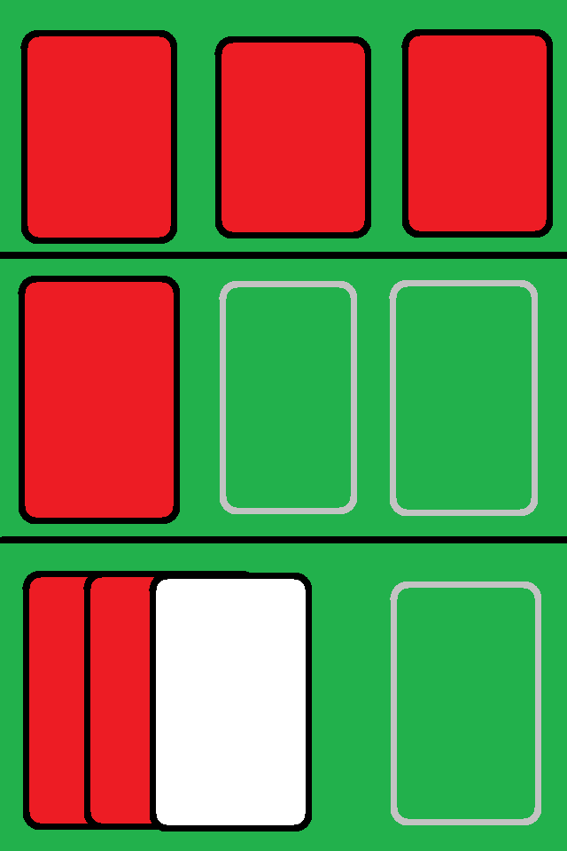
Design (cont.)
Other players’ hands
The deck and discard piles
The player’s hand and played cards

Slide 8
Design (cont.)
Each player would be able to see the deck, but not the cards in it. Initially, this is the only field with any cards in it.
Each player would be able to see their own hand, and well as any cards that they would play (such as laying down a hand for poker).
The hand of the other players would also be represented, but the cards would not be able to be seen by the player.
The other players’ section would also be used to display cards that the other players “laid down.”

Slide 9
Design (cont.)
Option to add more piles

Slide 10
Design (cont.)
There are also empty fields. Players can add new “piles” to the game. The players can define whether these are face up or face down piles.

Slide 11
Design (cont.)
Every player is able to draw cards from the deck, give cards to other players, and place cards in the discard pile. This would be achieved by simply dragging and dropping cards.
In order to allow use in as many games as possible, these movements (and similar ones) would be the only rules enforced by the app. No turns or rounds are defined.
But what is keeping players from cheating?

Slide 12
Design (cont.)
Every time that a card is moved, all other players will be notified. It is up to the other players, not the app, to enforce the rules of the game.
Note that this is exactly how physical card games work. Nothing is stopping players from drawing extra cards, except for the watchful eyes of their competitors.
However, Virtual Deck does have the added benefit of keeping players from sneaking peeks at other hands.

Slide 13
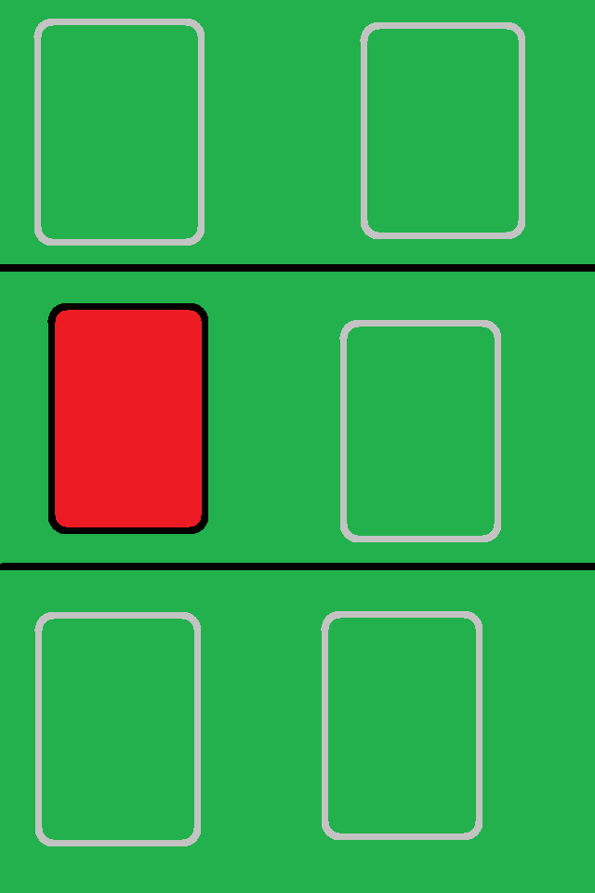
Example
Take this sample game of Go Fish with three players for example.
The game starts, and only the deck is displayed
Player 1
Player 2
Player 3

Slide 14
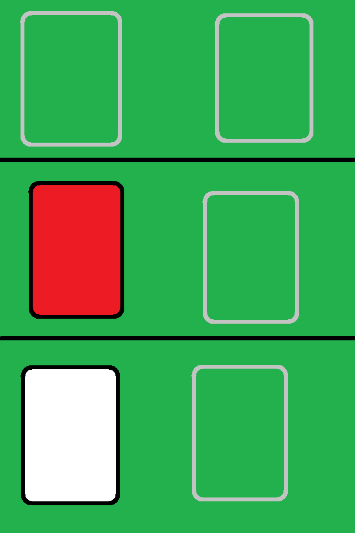
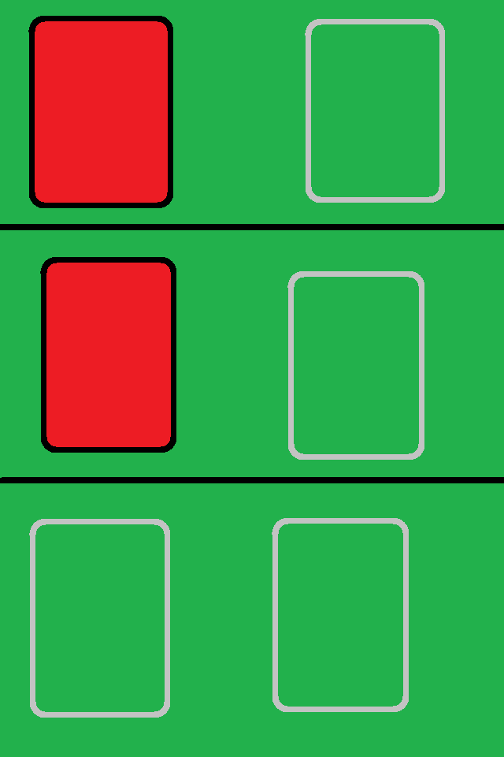
Example (cont.)
Player one draws a card.
The other players are notified.
Player 1
Player 2
Player 3
Player 1 has drawn a card
Player 1 has drawn a card

Slide 15
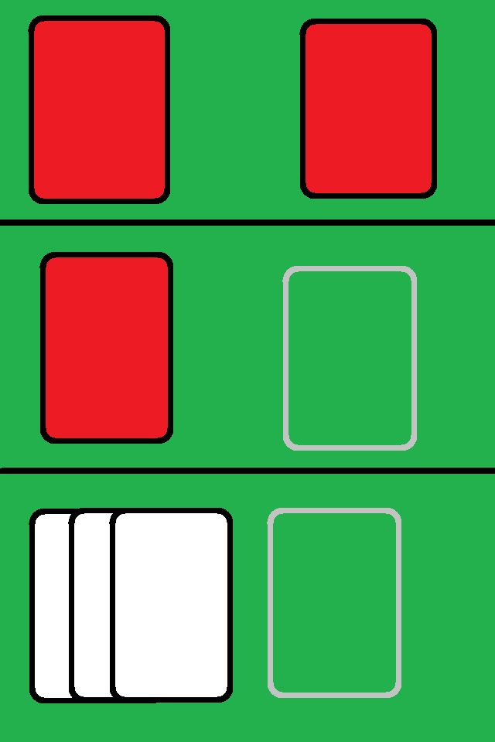
Example (cont.)
This continues until each player has drawn the correct number of cards.
Player 1
Player 2
Player 3

Slide 16
Example (cont.)
Suppose Player 1 now verbally asks Player 2 if they have any 3s.
Player 1
Player 2
Player 3

Slide 17
Example (cont.)
Suppose Player 2 responds “Go Fish”.
Player 1 draws from the deck.
Player 1
Player 2
Player 3

Slide 18
Example (cont.)
Suppose Player 2 now verbally asks Player 3 if they have any 4s.
Player 1
Player 2
Player 3

Slide 19
Example (cont.)
Player 3 has two 4s, and moves them to Player 2’s hand.
Player 1
Player 2
Player 3

Slide 20
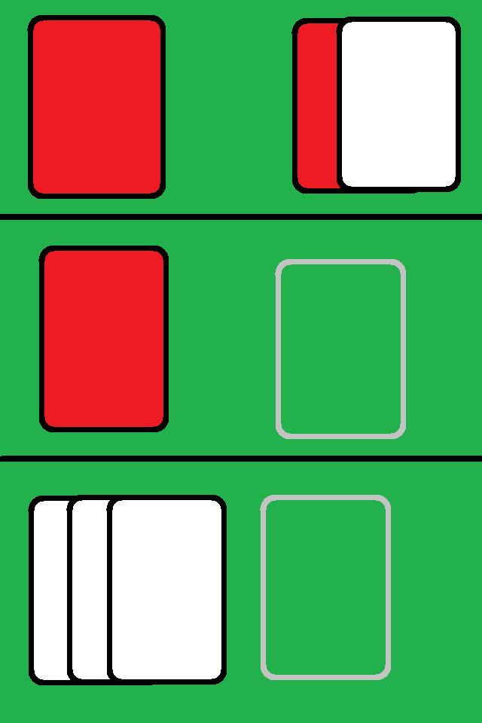
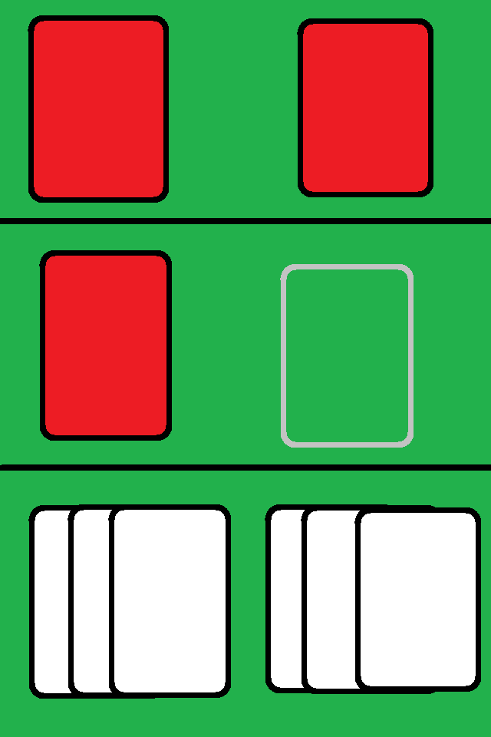
Example (cont.)
Player 2 had two 4s, so they now hold all four. They can create a new face up pile in their own field to move these cards to.
Player 1
Player 2
Player 3

Slide 21
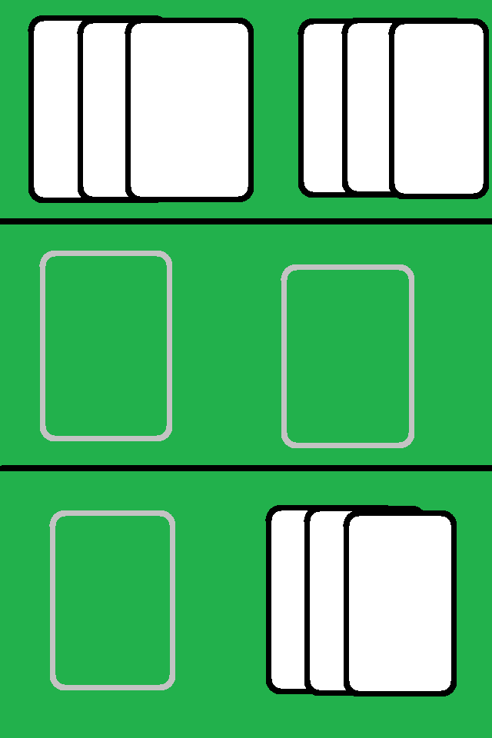
Example (cont.)
After several rounds, the deck is empty, and all books have been completed.
Player 1
Player 2
Player 3

Slide 22
Example (cont.)
The players count who has the most completed groups of ranks, and decide the winner.
Player 1
Player 2
Player 3

Slide 23
Example (cont.)
Notice that the app did not keep track of how many full sets each player had. It also did not mediate communication between players.
Player 1
Player 2
Player 3

Slide 24
Design (cont.)
We planned to achieve this using several classes and data structures.
While we weren’t able to fully develop the app, we did create some Java classes to show how we planned to implement it.

Slide 25
Classes
Card
Cards are the main objects in our design. We created a class to represent them. This class does not include visual assets, and is not meant to actually be implemented. It is only the basic framework for what we hoped to use in the finished product.
The class Card includes the following variables:
int rank; //the face value of the card
int suit; //the suit of the card, represented by the integers from 0 to 3
boolean faceUp; //determines whether the card is face up or down

Slide 26
Classes (cont.)
Pile
Pile is a data structure that holds Card objects in an array list. It is used to represent decks, hands, discard piles, etc.
It includes one instant variable:
ArrayList<Card> pile; //the Array List that holds Card objects
Player
Player objects hold each player’s ID and hands.
It includes the variables:
String name; //The player’s ID in a string form. “Player 1”, “Player 2”, etc.
int id; //The player’s ID. Each player is assigned an integer ID from 0 and up.
ArrayList<Pile> hand; //An arraylist to hold every pile in the player’s hand

Slide 27
Classes (cont.)
These classes are not final, and are not meant to be used in actual implementation of the app.
The classes have not been tested, and are only a framework.

Slide 28
Moving Foward
Obviously, this was not finished during SteelHacks 2016, and will not be finished nor attempted at later hackathons.
However, both of us have expressed an interest in revisiting the project in the future for our own enrichment.
In addition to the implementation of what we have described in this presentation, we would like to add other features, such as different methods of shuffling the deck to emulate shuffling techniques used by humans, some advanced card movements (rapid passing of cards for games like Spoons, for example), etc.

