Slide 1
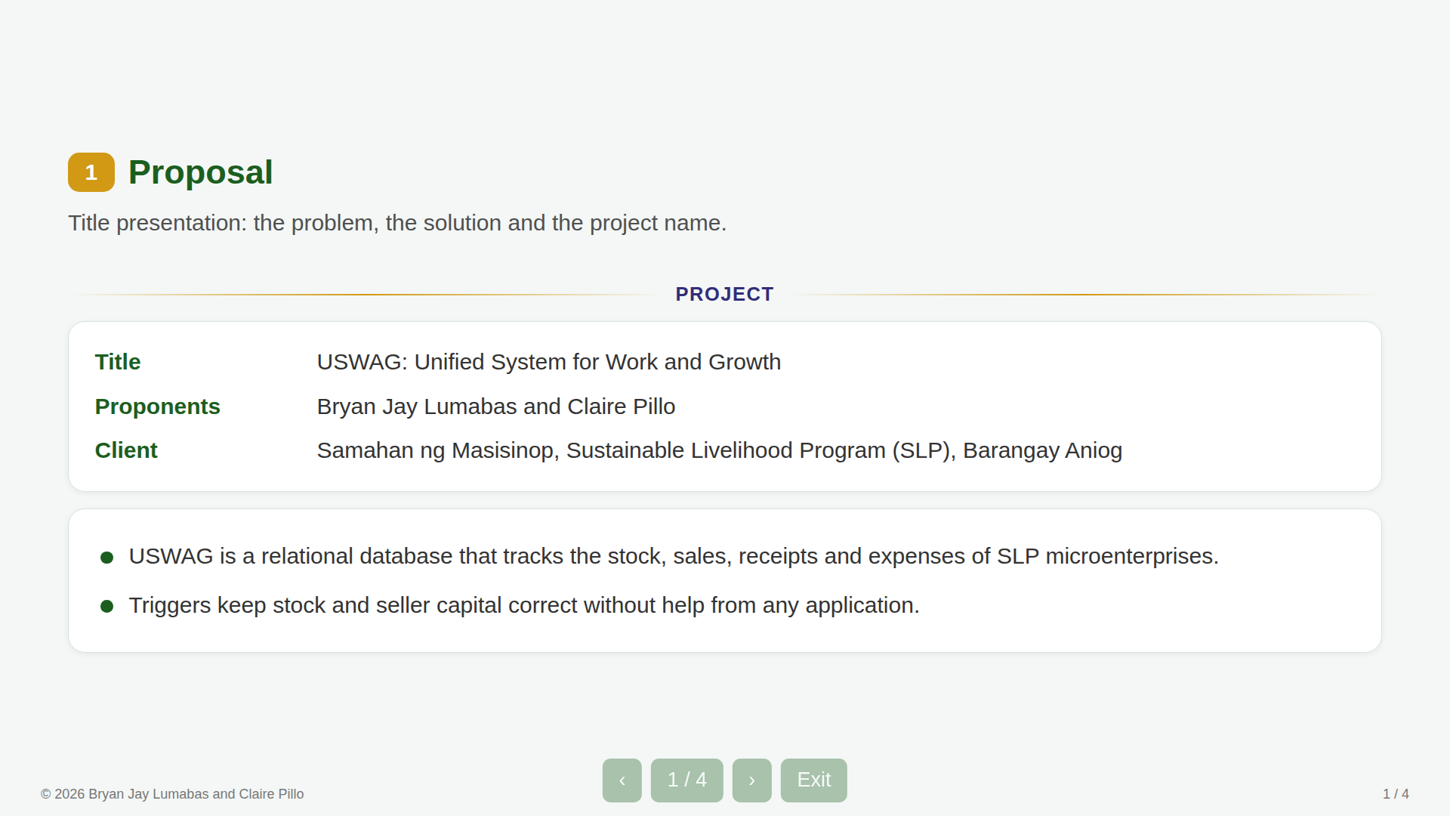
Notes:
01 phase1-proposal s1

Slide 2
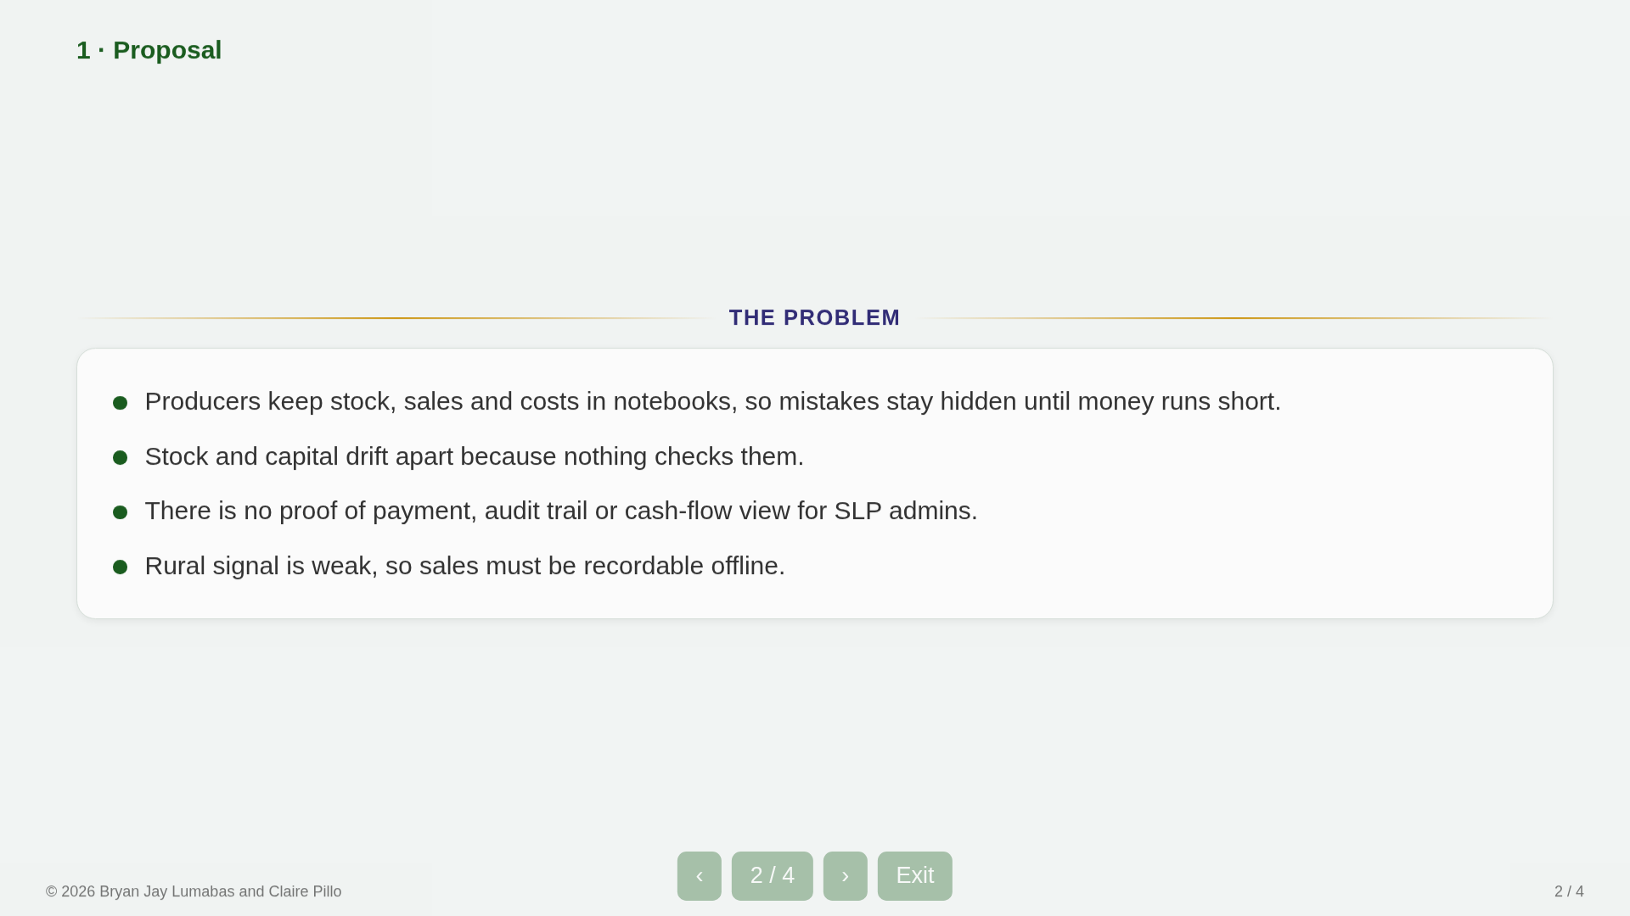
Notes:
02 phase1-proposal s2

Slide 3
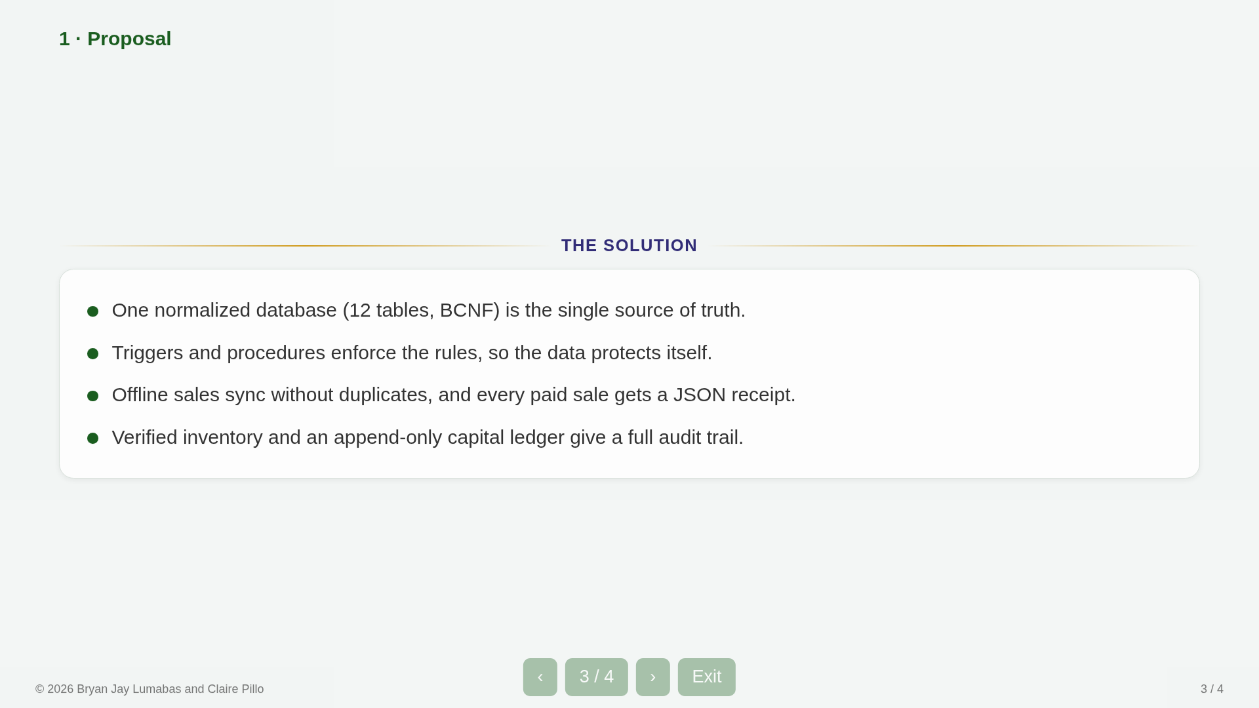
Notes:
03 phase1-proposal s3

Slide 4
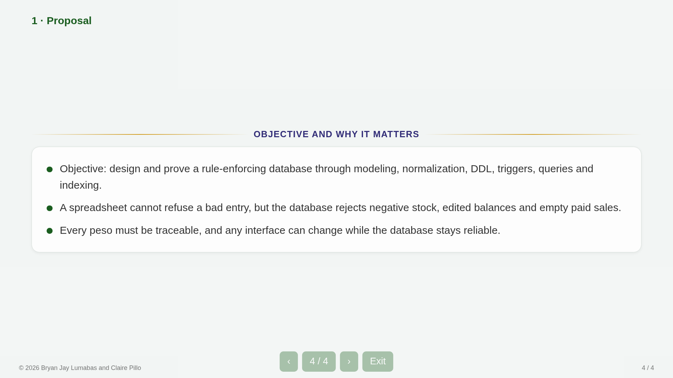
Notes:
04 phase1-proposal s4

Slide 5
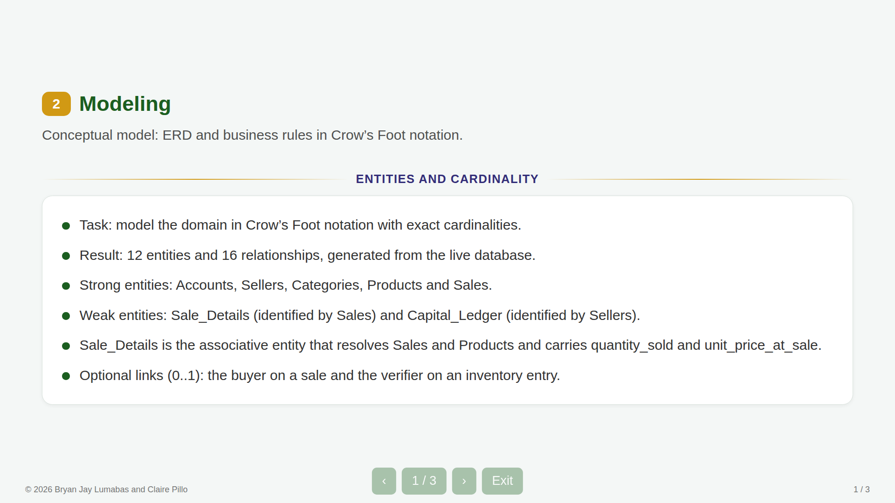
Notes:
05 phase2-modeling s1

Slide 6
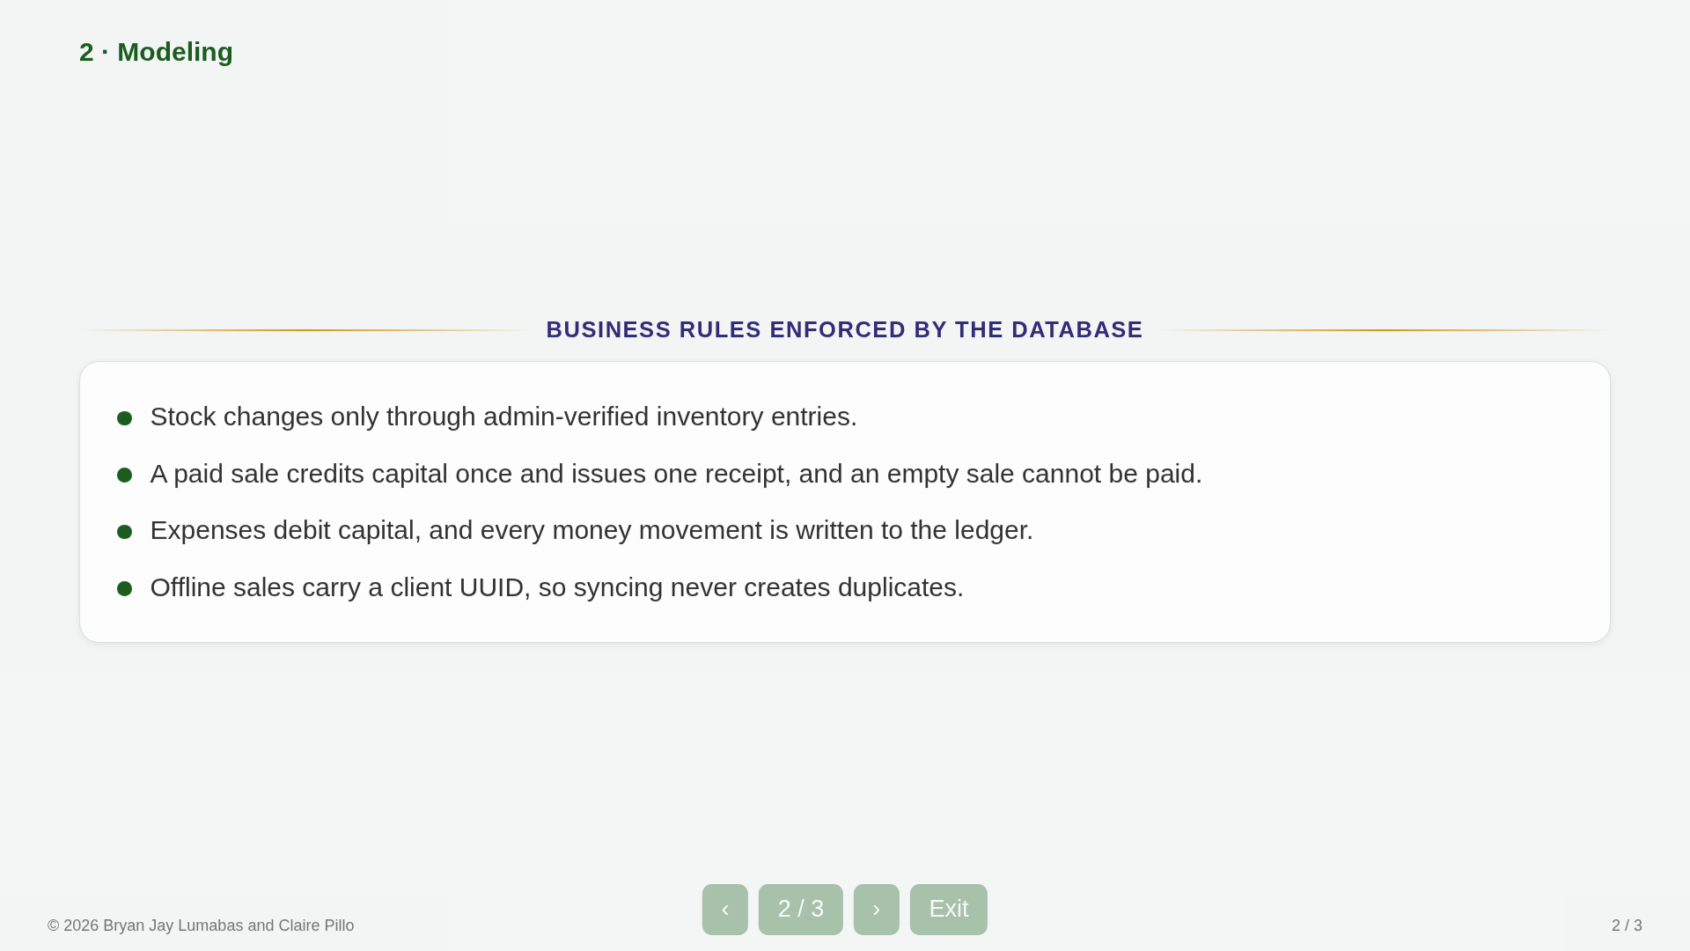
Notes:
06 phase2-modeling s2

Slide 7
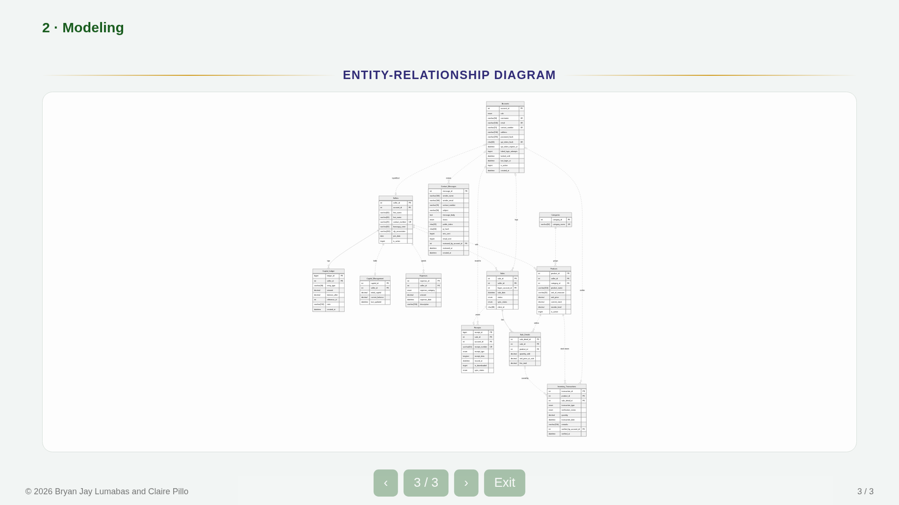
Notes:
07 phase2-modeling s3

Slide 8
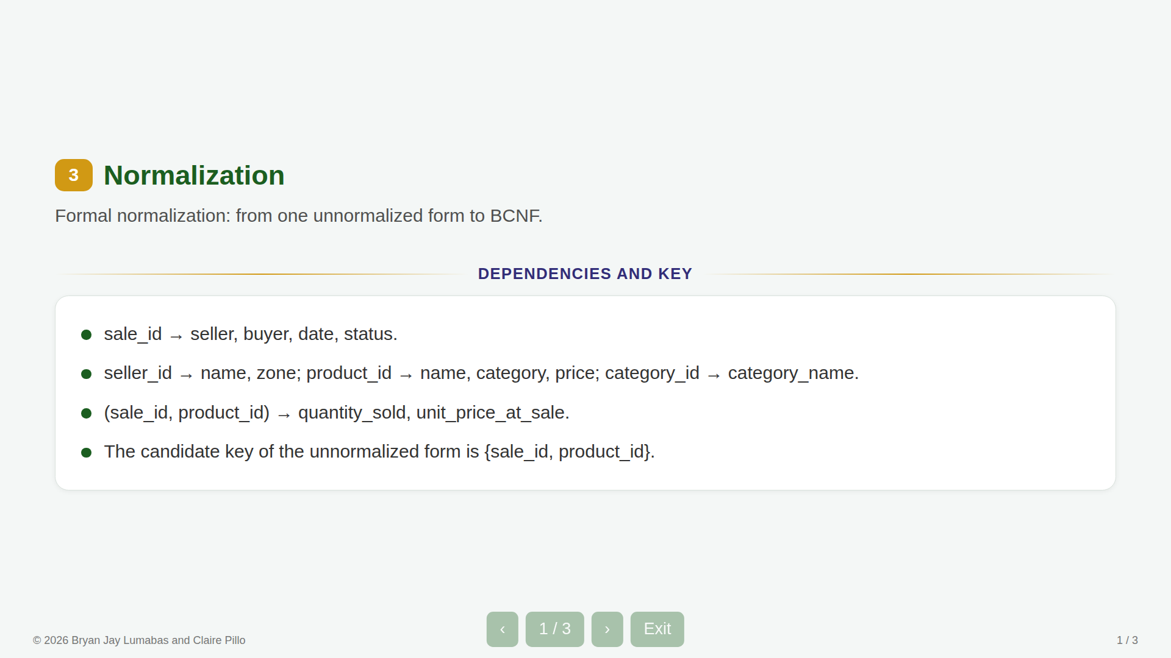
Notes:
08 phase3-normalization s1

Slide 9
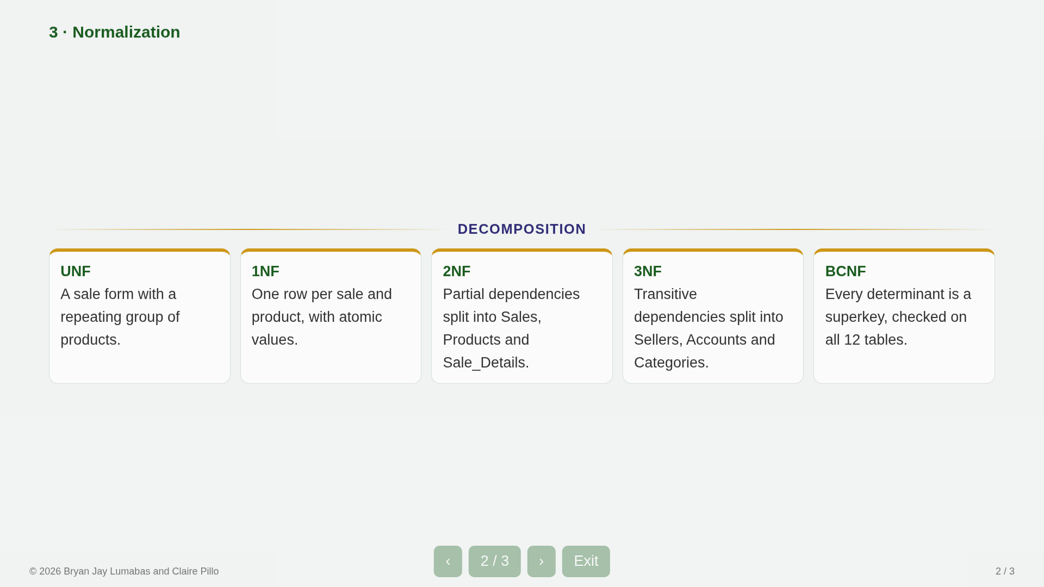
Notes:
09 phase3-normalization s2

Slide 10
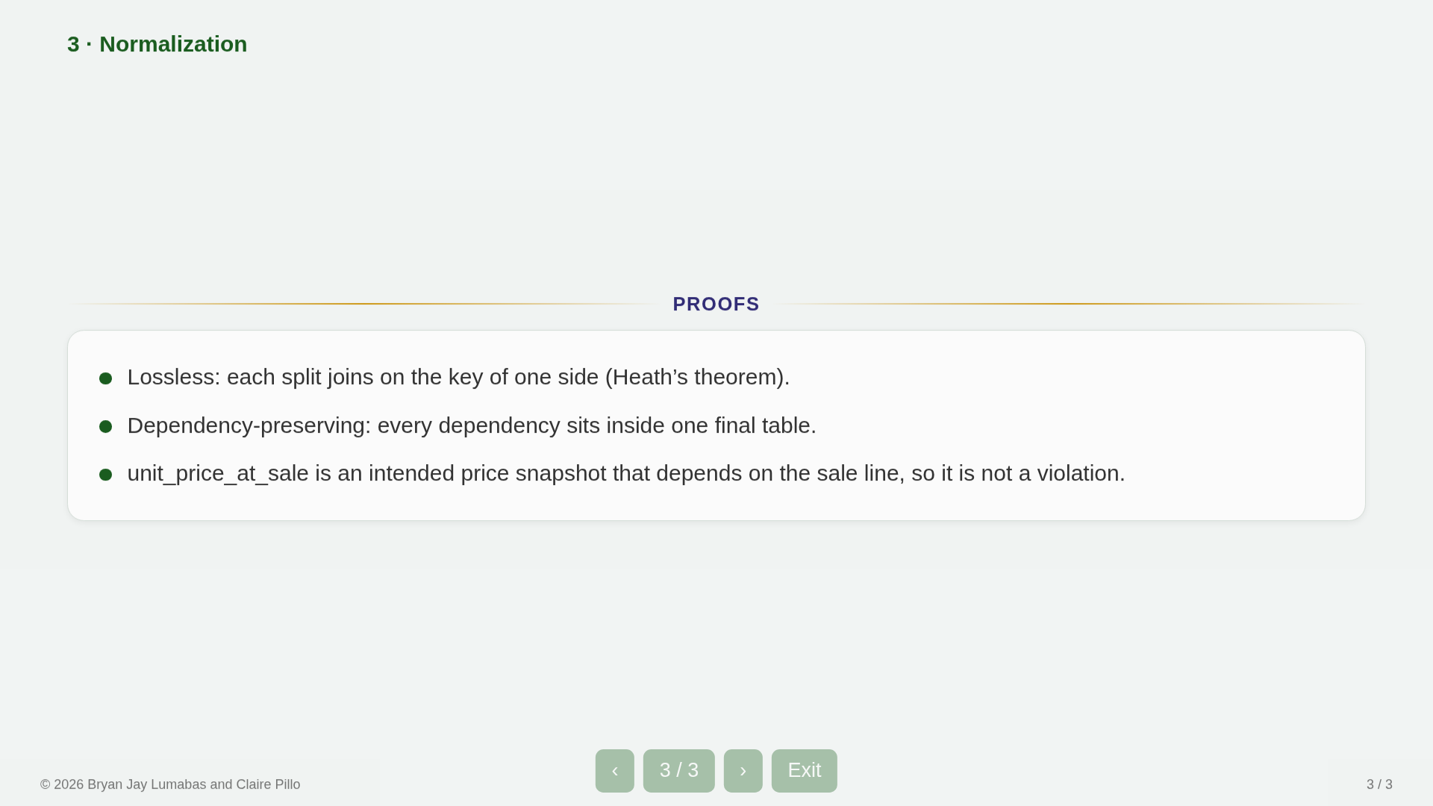
Notes:
10 phase3-normalization s3

Slide 11
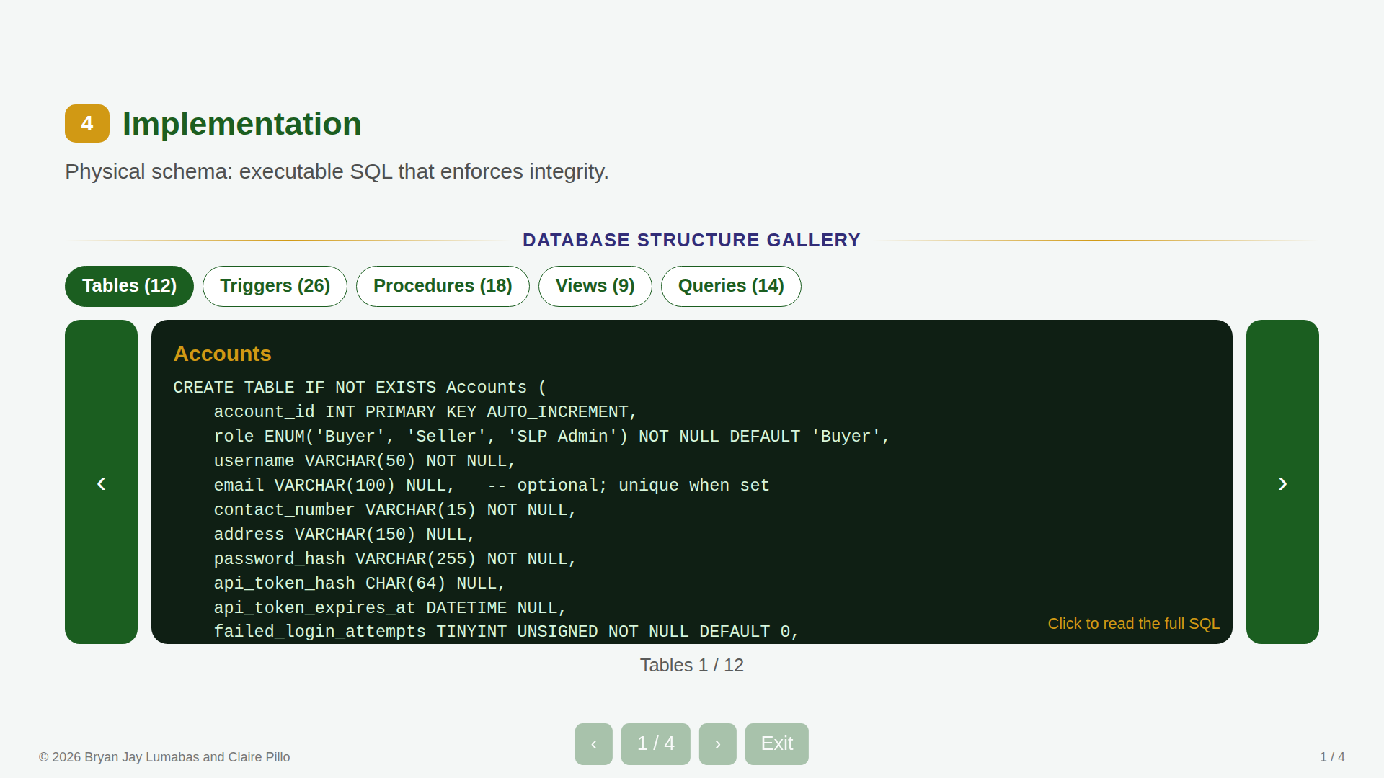
Notes:
11 phase4-implementation s1

Slide 12
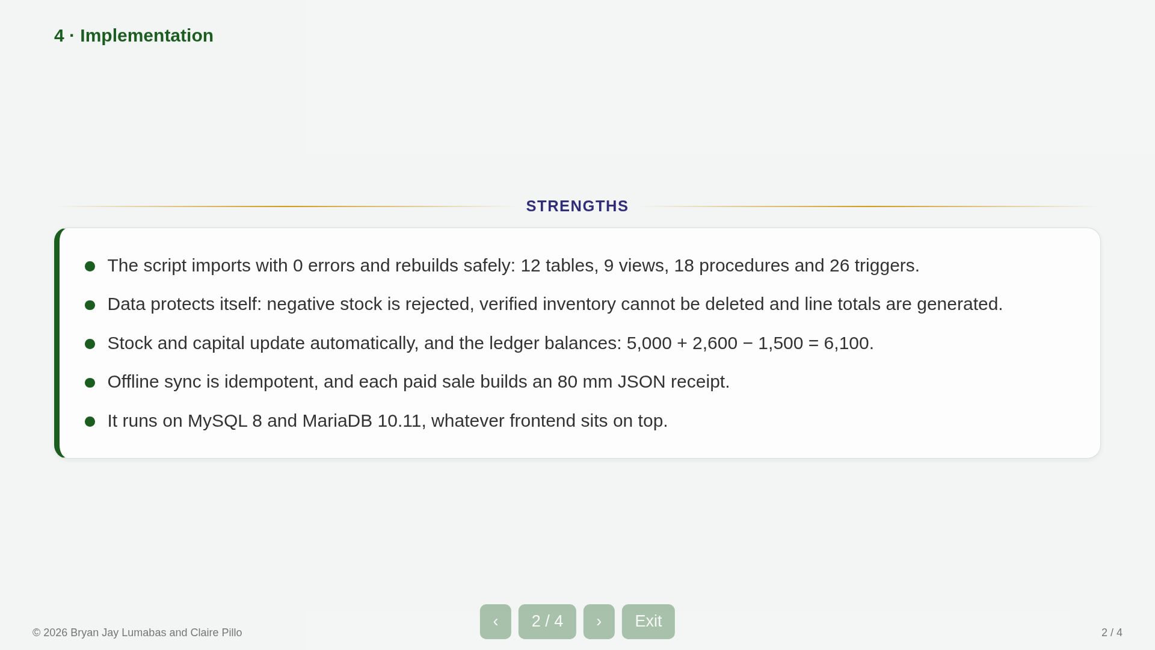
Notes:
12 phase4-implementation s2

Slide 13
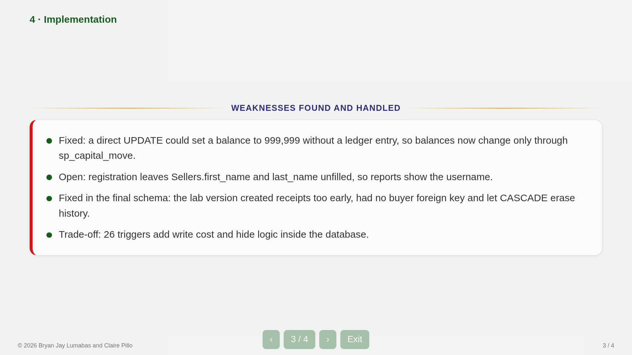
Notes:
13 phase4-implementation s3

Slide 14
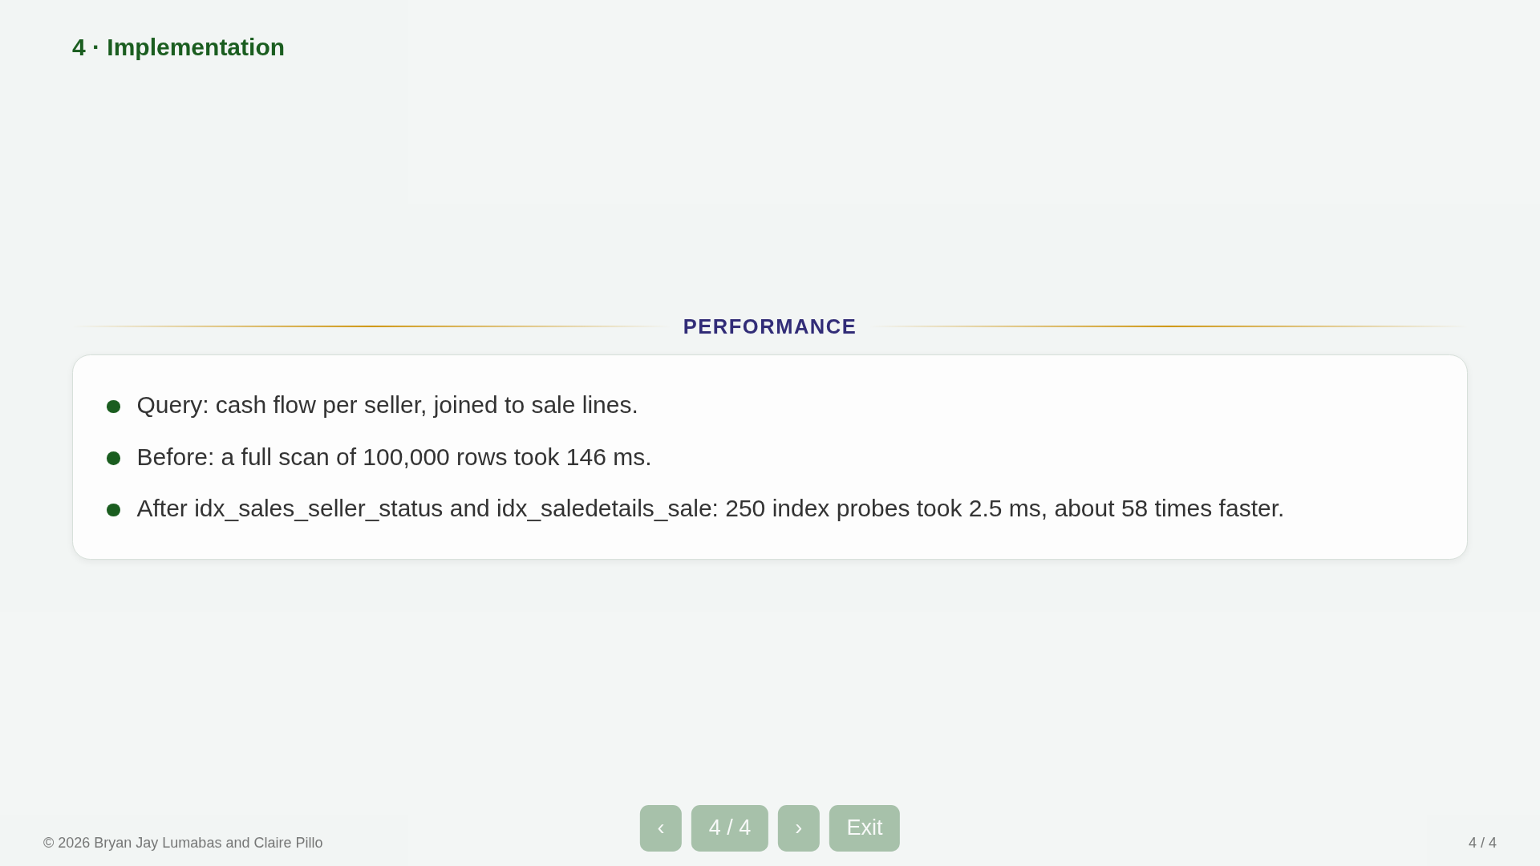
Notes:
14 phase4-implementation s4

Slide 15
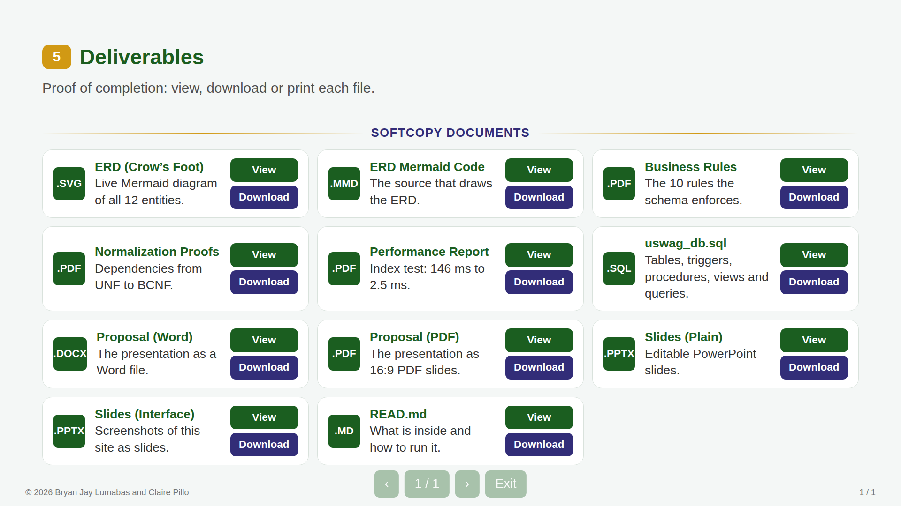
Notes:
15 phase5-deliverables s1

