Slide 1
USWAG
Unified System for Work and Growth
Project Proposal · Advanced Relational Database Systems
Bryan Jay Lumabas and Claire Pillo

Slide 2
1 · Proposal
Project
Title | USWAG: Unified System for Work and Growth
Proponents | Bryan Jay Lumabas and Claire Pillo
Client | Samahan ng Masisinop, Sustainable Livelihood Program (SLP), Barangay Aniog
USWAG is a relational database that tracks the stock, sales, receipts and expenses of SLP microenterprises.
Triggers keep stock and seller capital correct without help from any application.
Notes:
Proposal: Project

Slide 3
1 · Proposal
The Problem
Producers keep stock, sales and costs in notebooks, so mistakes stay hidden until money runs short.
Stock and capital drift apart because nothing checks them.
There is no proof of payment, audit trail or cash-flow view for SLP admins.
Rural signal is weak, so sales must be recordable offline.
Notes:
Proposal: The Problem

Slide 4
1 · Proposal
The Solution
One normalized database (12 tables, BCNF) is the single source of truth.
Triggers and procedures enforce the rules, so the data protects itself.
Offline sales sync without duplicates, and every paid sale gets a JSON receipt.
Verified inventory and an append-only capital ledger give a full audit trail.
Notes:
Proposal: The Solution

Slide 5
1 · Proposal
Objective and Why It Matters
Objective: design and prove a rule-enforcing database through modeling, normalization, DDL, triggers, queries and indexing.
A spreadsheet cannot refuse a bad entry, but the database rejects negative stock, edited balances and empty paid sales.
Every peso must be traceable, and any interface can change while the database stays reliable.
Notes:
Proposal: Objective and Why It Matters

Slide 6
2 · Modeling
Entities and Cardinality
Task: model the domain in Crow’s Foot notation with exact cardinalities.
Result: 12 entities and 16 relationships, generated from the live database.
Strong entities: Accounts, Sellers, Categories, Products and Sales.
Weak entities: Sale_Details (identified by Sales) and Capital_Ledger (identified by Sellers).
Sale_Details is the associative entity that resolves Sales and Products and carries quantity_sold and unit_price_at_sale.
Optional links (0..1): the buyer on a sale and the verifier on an inventory entry.
Notes:
Modeling: Entities and Cardinality

Slide 7
2 · Modeling
Business Rules Enforced by the Database
Stock changes only through admin-verified inventory entries.
A paid sale credits capital once and issues one receipt, and an empty sale cannot be paid.
Expenses debit capital, and every money movement is written to the ledger.
Offline sales carry a client UUID, so syncing never creates duplicates.
Notes:
Modeling: Business Rules Enforced by the Database

Slide 8
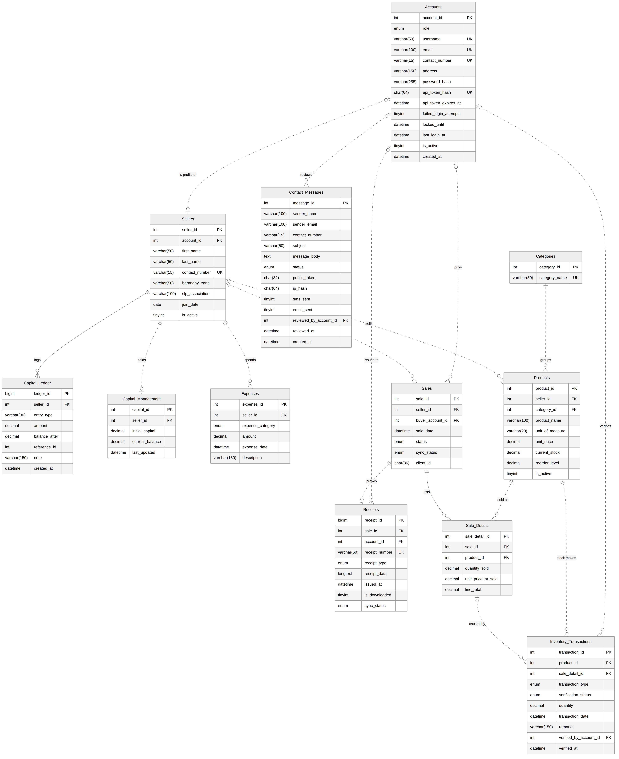
2 · Modeling
Entity-Relationship Diagram
Crow’s Foot ERD from Mermaid (12 entities, 16 relationships)
Notes:
Modeling: Entity-Relationship Diagram

Slide 9
3 · Normalization
Dependencies and Key
sale_id → seller, buyer, date, status.
seller_id → name, zone; product_id → name, category, price; category_id → category_name.
(sale_id, product_id) → quantity_sold, unit_price_at_sale.
The candidate key of the unnormalized form is {sale_id, product_id}.
Notes:
Normalization: Dependencies and Key

Slide 10
3 · Normalization
Decomposition
UNF
1NF
2NF
3NF
BCNF
A sale form with a repeating group of products.
One row per sale and product, with atomic values.
Partial dependencies split into Sales, Products and Sale_Details.
Transitive dependencies split into Sellers, Accounts and Categories.
Every determinant is a superkey, checked on all 12 tables.
Notes:
Normalization: Decomposition

Slide 11
3 · Normalization
Proofs
Lossless: each split joins on the key of one side (Heath’s theorem).
Dependency-preserving: every dependency sits inside one final table.
unit_price_at_sale is an intended price snapshot that depends on the sale line, so it is not a violation.
Notes:
Normalization: Proofs

Slide 12
4 · Implementation
Database Structure Gallery
Tables (12): Accounts, Sellers, Categories, Products, Sales, Sale_Details, Inventory_Transactions, Expenses, Capital_Management, Capital_Ledger, Receipts, Contact_Messages
Triggers (26): trg_sellers_ai, trg_capital_bu, trg_ledger_bu, trg_ledger_bd, trg_expenses_ai, trg_expenses_bu, trg_expenses_au, trg_expenses_ad, and more
Procedures (18): sp_capital_move, sp_create_sale, sp_add_sale_item, sp_finalize_sale, sp_sync_offline_sales, sp_register_account, sp_get_login, and more
Views (9): vw_seller_cash_flow, vw_inventory_audit, vw_offline_queue, vw_category_sales, vw_low_stock, and more
Queries (14): cash flow, inventory audit, offline queue, category sales, low stock, integrity checks.
Notes:
Implementation: Database Structure Gallery

Slide 13
4 · Implementation
Strengths
The script imports with 0 errors and rebuilds safely: 12 tables, 9 views, 18 procedures and 26 triggers.
Data protects itself: negative stock is rejected, verified inventory cannot be deleted and line totals are generated.
Stock and capital update automatically, and the ledger balances: 5,000 + 2,600 − 1,500 = 6,100.
Offline sync is idempotent, and each paid sale builds an 80 mm JSON receipt.
It runs on MySQL 8 and MariaDB 10.11, whatever frontend sits on top.
Notes:
Implementation: Strengths

Slide 14
4 · Implementation
Weaknesses Found and Handled
Fixed: a direct UPDATE could set a balance to 999,999 without a ledger entry, so balances now change only through sp_capital_move.
Open: registration leaves Sellers.first_name and last_name unfilled, so reports show the username.
Fixed in the final schema: the lab version created receipts too early, had no buyer foreign key and let CASCADE erase history.
Trade-off: 26 triggers add write cost and hide logic inside the database.
Notes:
Implementation: Weaknesses Found and Handled

Slide 15
4 · Implementation
Performance
Query: cash flow per seller, joined to sale lines.
Before: a full scan of 100,000 rows took 146 ms.
After idx_sales_seller_status and idx_saledetails_sale: 250 index probes took 2.5 ms, about 58 times faster.
Notes:
Implementation: Performance

Slide 16
5 · Deliverables
Softcopy Documents
.SVG | ERD (Crow’s Foot) | Live Mermaid diagram of all 12 entities.
.MMD | ERD Mermaid Code | The source that draws the ERD.
.PDF | Business Rules | The 10 rules the schema enforces.
.PDF | Normalization Proofs | Dependencies from UNF to BCNF.
.PDF | Performance Report | Index test: 146 ms to 2.5 ms.
.SQL | uswag_db.sql | Tables, triggers, procedures, views and queries.
.DOCX | Proposal (Word) | The presentation as a Word file.
.PDF | Proposal (PDF) | The presentation as 16:9 PDF slides.
.PPTX | Slides (Plain) | Editable PowerPoint slides.
.PPTX | Slides (Interface) | Screenshots of this site as slides.
.MD | READ.md | What is inside and how to run it.
Notes:
Deliverables: Softcopy Documents

