Slide 1

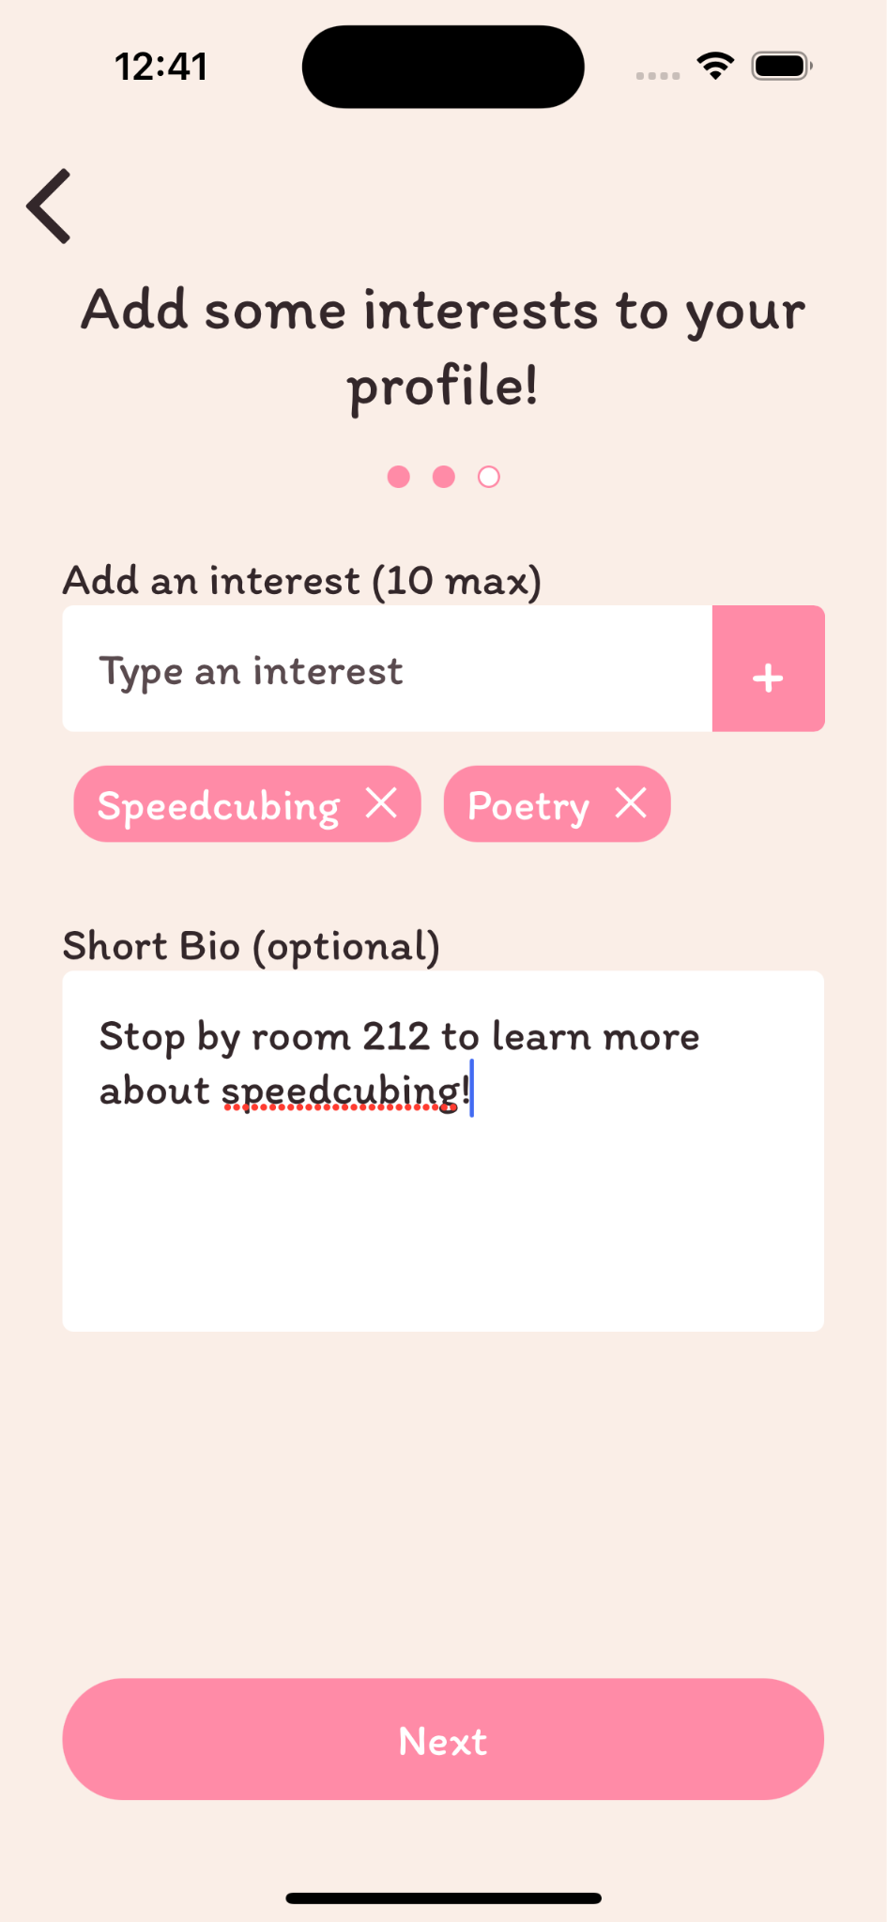
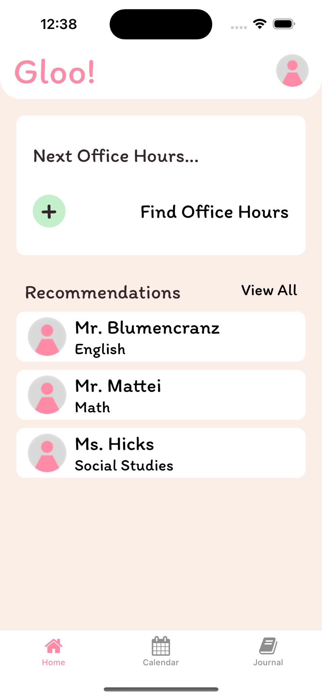
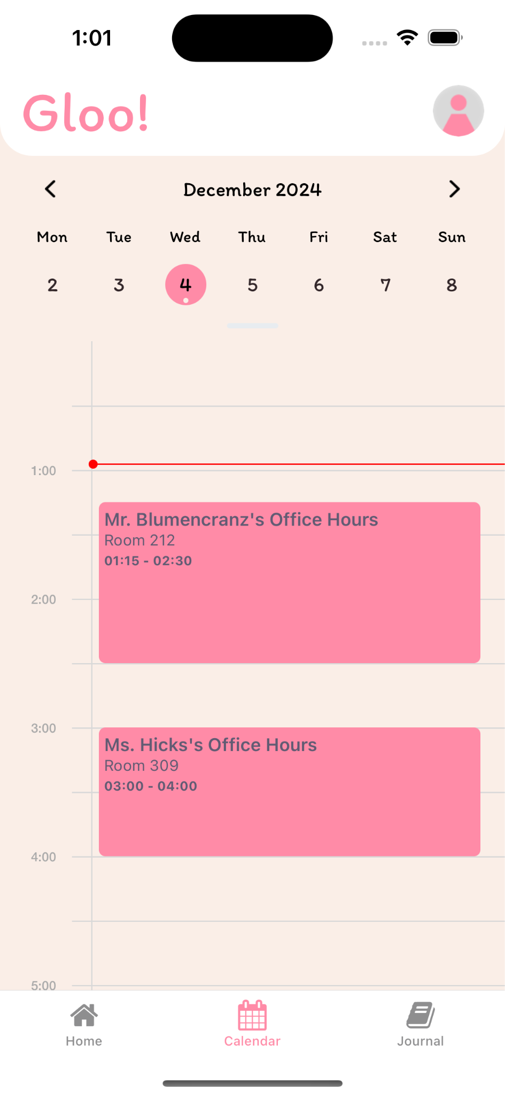
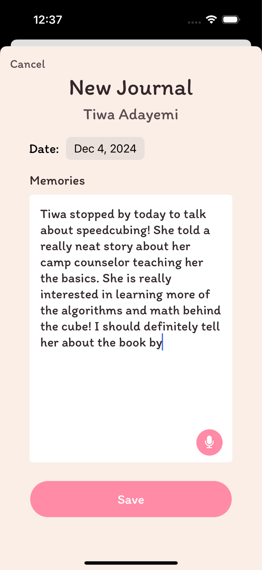


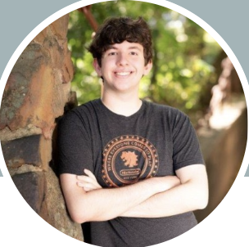
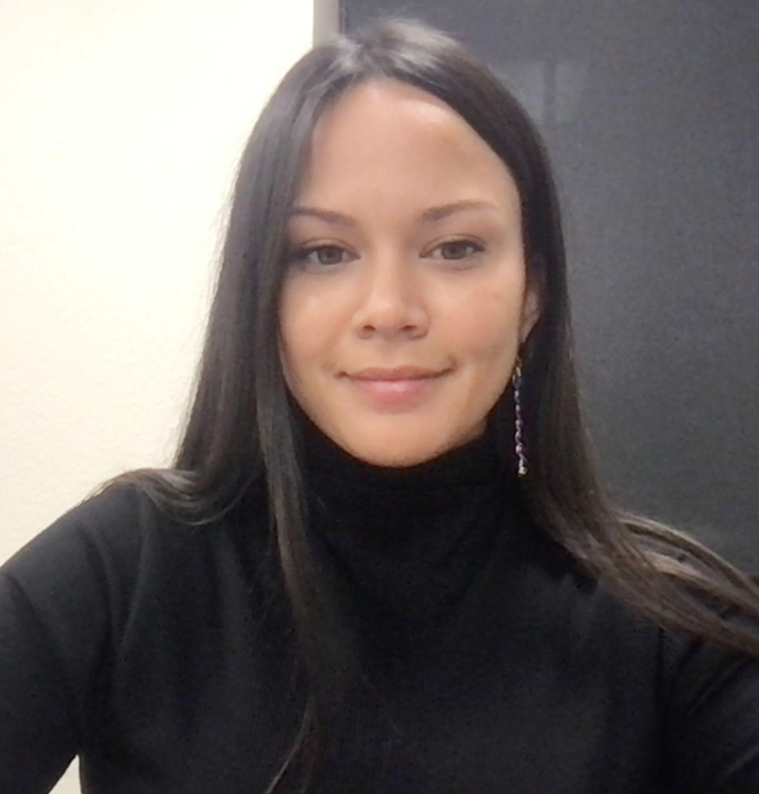
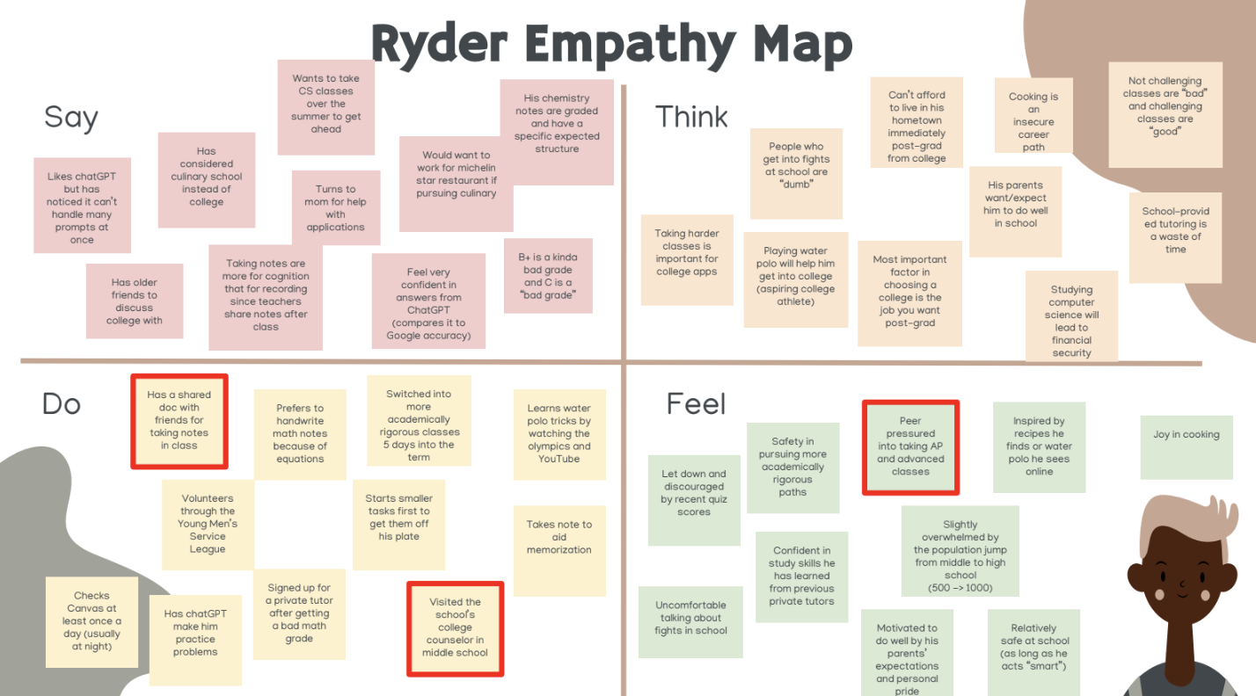
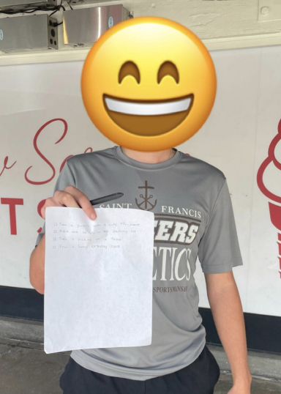
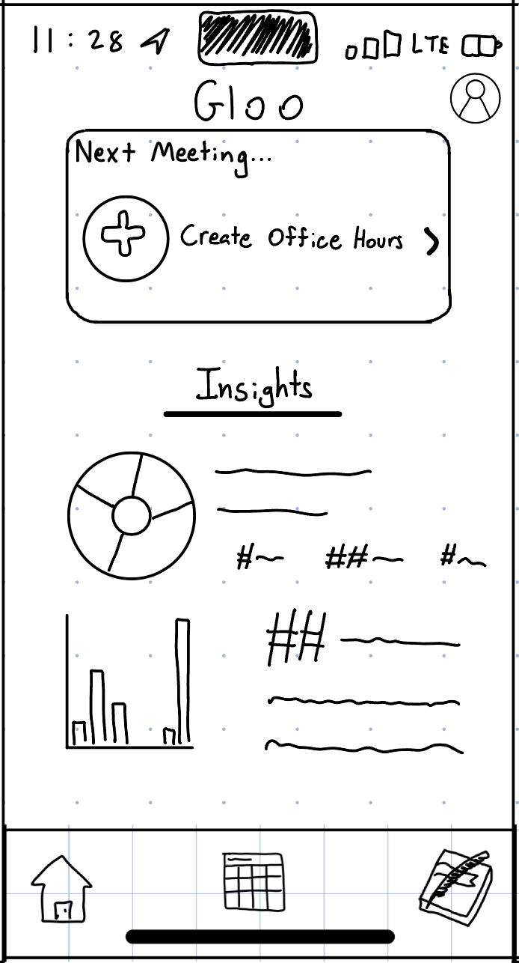
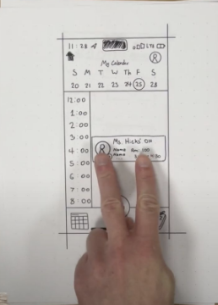
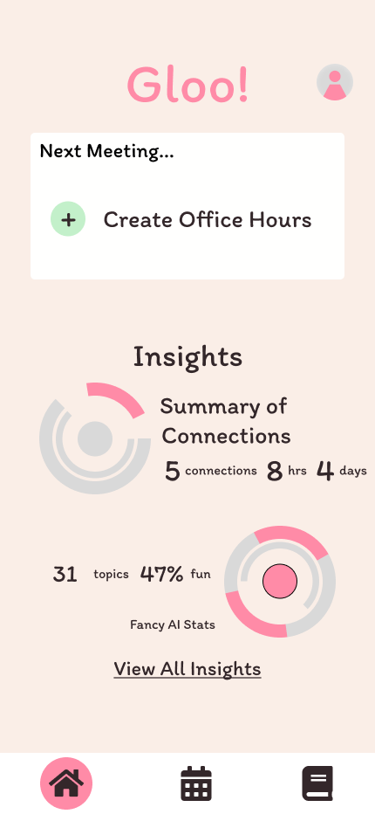
GLOO
Making student-teacher connections that stick!
Problem
In larger high schools, students feel isolated and overwhelmed while teachers have a hard time connecting with and advocating for them.
Solution
Gloo provides interest-based, AI-generated teacher mentor recommendations to students, allows teachers to share meeting availability, and offers journaling for users to reflect on and remember interactions.
Share Interests!
Find Teachers!
Connect!
Reflect!
Process
Needfinding
Assumptions
Lo-Fi
Testing
Med-Fi
Justin B., Monica H., Matthew M., and Alison R. CS147 Autumn 2024 https://hci.stanford.edu/courses/cs147/2024/au/projects/AI-in-Classroom/Gloo

