Slide 1

Steal a Seeker
A solo stealth game for Solana Mobile
Recover the phone.
Survive the escape.
CLOCK IN 2026 · Development review
Notes:
Original project artwork. Current development review, not an official Solana endorsement. Source: repository game and UI.

Slide 2
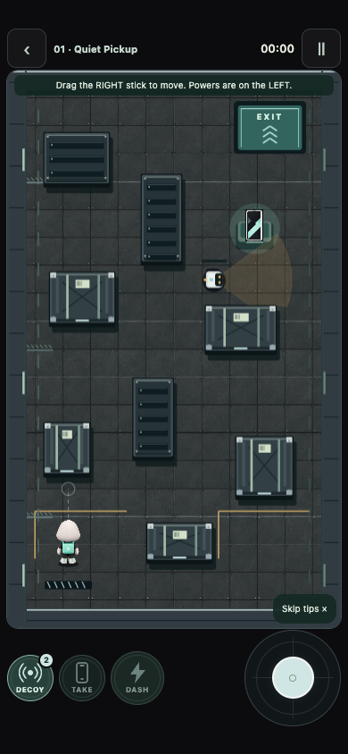
The theft changes the run
Before pickup, watch patrols and use cover.
After pickup, guards accelerate and receive periodic position reports.
A decoy buys time. A dash spends phone charge.
Notes:
Browser gameplay screenshot. Rules: src/game/level.ts and src/game/guards.ts. Guard speed ramps from 2.2x to 2.8x over 20 seconds after alarm. Position reports every four seconds. This is not physical Android evidence.

Slide 3
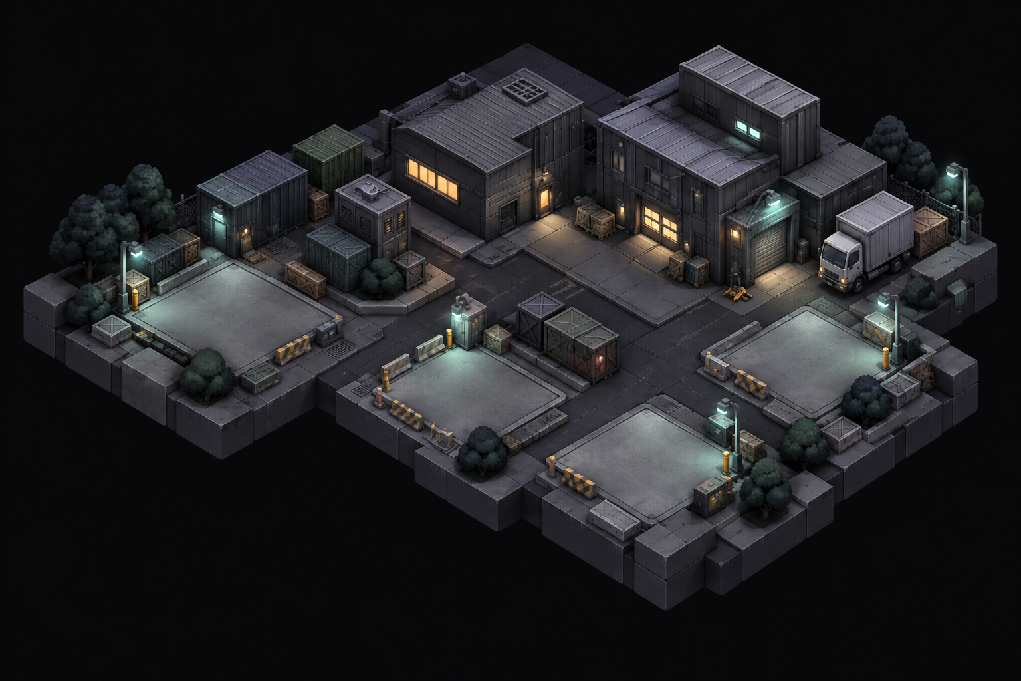
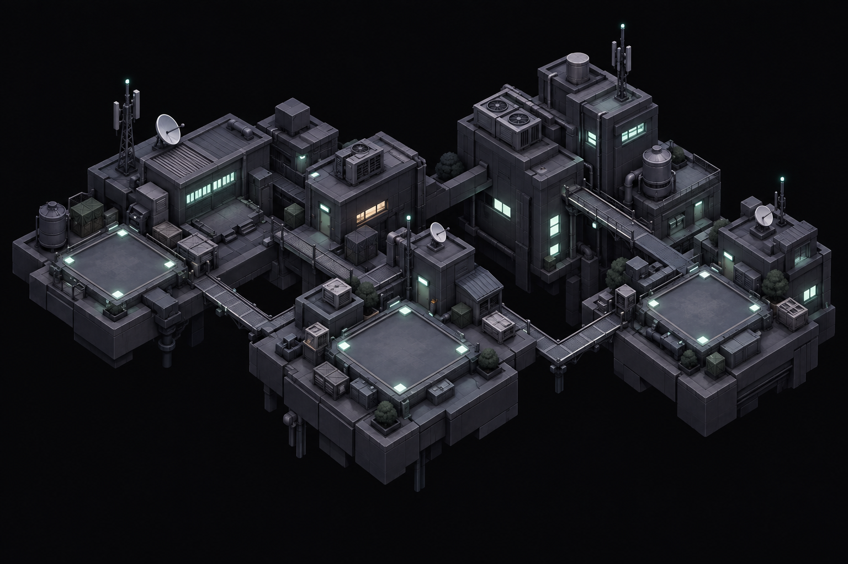

Twelve missions across three districts
Warehouse
Rooftops
Powerworks / Vault
Learn patrols, cover and battery limits.
Cross exposed lanes and time moving gates.
Switch circuits, open relays and recover multiple targets.
Notes:
District images are authored game assets, not gameplay screenshots. Source: src/game/level.ts; four campaign missions per district.

Slide 4
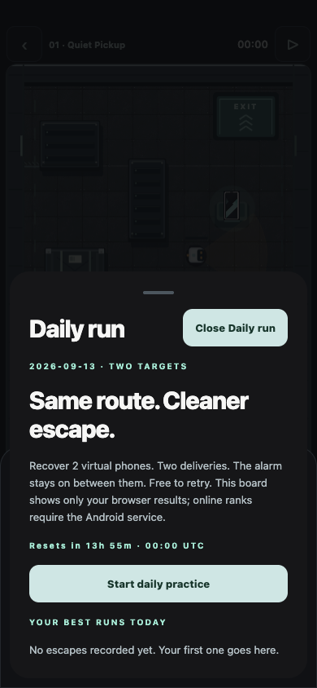
A reason to try another run
Recover a different virtual phone in each mission.
Finish the collection, then improve your stars or attempt the daily route.
The daily route resets at 00:00 UTC. Everyone uses the same loadout.
Habit and retention are hypotheses to test with outside players.
Notes:
Screenshot: local browser daily practice. Live ranks are separate. Ranking uses one best server-replayed complete run per wallet, score descending then ticks ascending; exact ties share rank. Sources: shared/daily.ts, server/ranked-service.ts. No real-player retention data claimed.

Slide 5
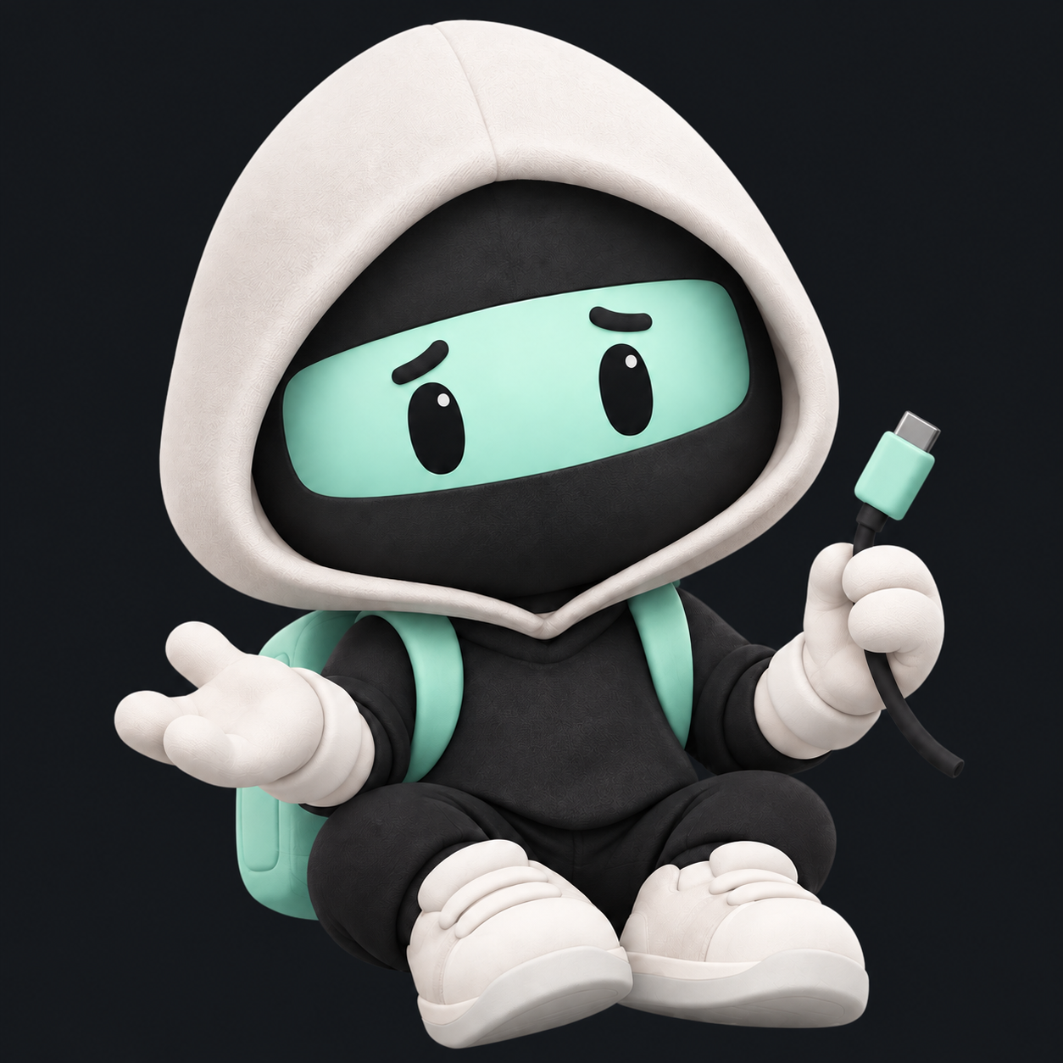
Solana integration
Mobile Wallet Adapter opens wallet approval on Android.
The backend checks devnet transfers before granting campaign access and owned outfits.
It replays submitted inputs before accepting a ranked score.
TEST SKR has no monetary value. Physical Phantom payment testing is pending.
Notes:
Sources: src/wallet, src/commerce, server/service.ts, server/ranked-service.ts. Normal native app has a hard paywall. Judge APK grants only offline campaign access; it cannot authorize online purchases or results. No live mainnet or completed physical wallet round trip is claimed.

Slide 6
Review build and remaining proof
83 client / gameplay tests pass
52 backend tests pass
12 deterministic simulation routes pass
Signed arm64 Android builds and source are included.
Next gates: outside-player feedback, a complete device playthrough, a physical devnet wallet round trip and the final three-minute demo.
Private source: github.com/bluntbrain/steal-a-seeker-clockin
Notes:
Evidence: tests/*.test.ts, server/*.test.ts, verification and release manifests. Test counts from September 13, 2026 run. Automated current browser pointer route cleared missions 1–3 but failed mission 4 timing phases; no all-12 browser or real-player completion claim. Owner must grant confirmed judges access to the private repository.

