Slide 1
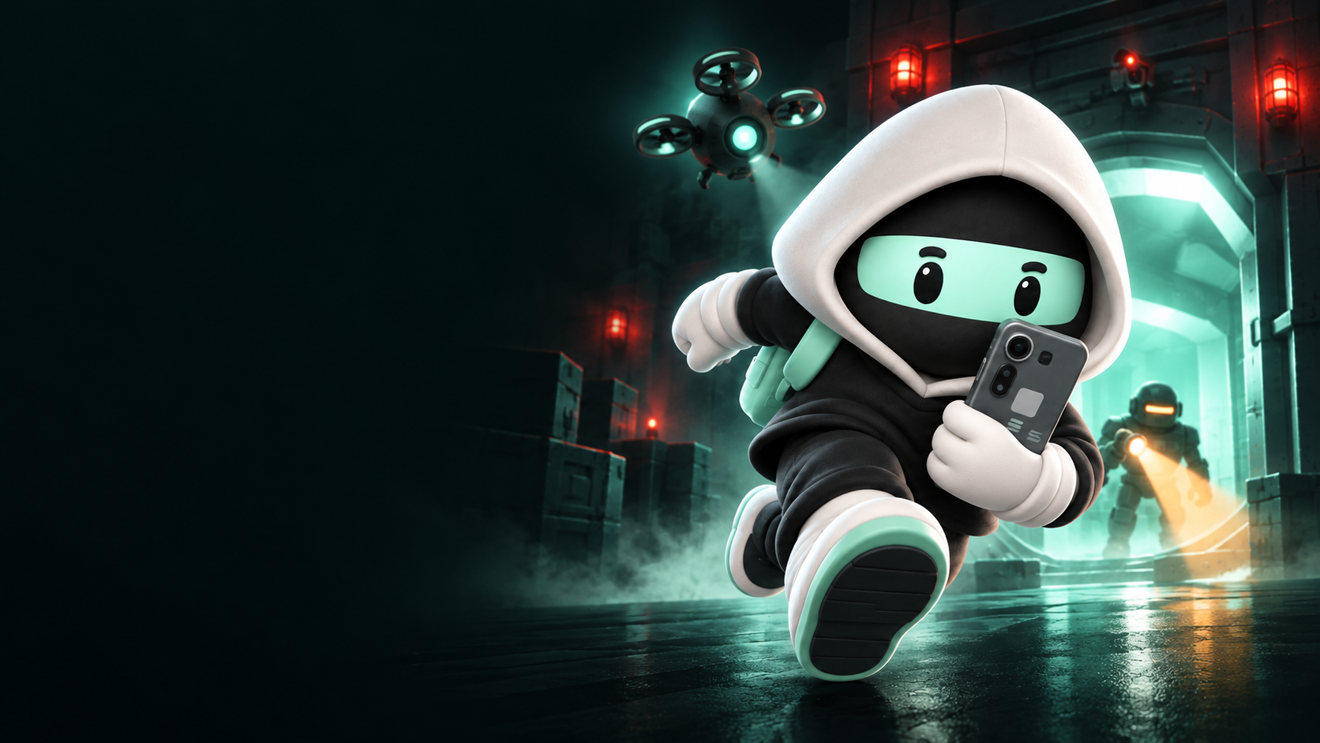
CLOCK IN 2026 / SOLANA MOBILE
STEAL
A SEEKER
Take the phone.
Make the escape.
A mobile stealth-action game
Ishan Lakhwani · bluntbrain
Notes:
Steal a Seeker submission deck, updated 27 September 2026. Original generated cover artwork made for this deck with OpenAI image generation, using assets/paywall-v3/courier-heist.png as the character reference. Marketing art, not captured gameplay. Created by Ishan Lakhwani / bluntbrain.

Slide 2
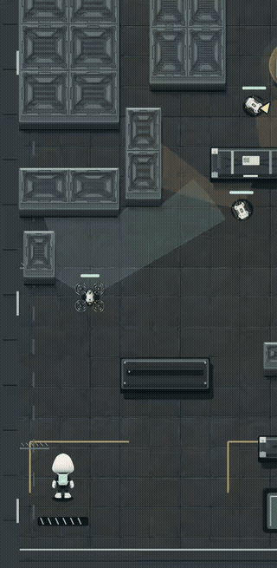
THE PLAYER EXPERIENCE
A simple input.
A risky escape.
01
Tap the floor to move.
Use cover to choose your approach.
02
Tap an enemy to fire.
Stop the drone before it reports you.
03
Steal the phone. Escape.
Pickup brings the response.
REAL BROWSER GAMEPLAY / CAPTURED 27 SEP 2026 / PLAYS IN SLIDESHOW
02
Notes:
Embedded animated GIF of actual current browser gameplay captured via canvas MediaRecorder on 27 September 2026 at local isolated origin. Two excerpts at original speed: move toward cover, then shoot the scout drone. Silent recording; no fabricated actions. Canvas capture omits the outer HUD. Browser footage is separate from the published Android version. MP4 also supplied in assets/gameplay.mp4. Sources: src/game and current dist build.

Slide 3
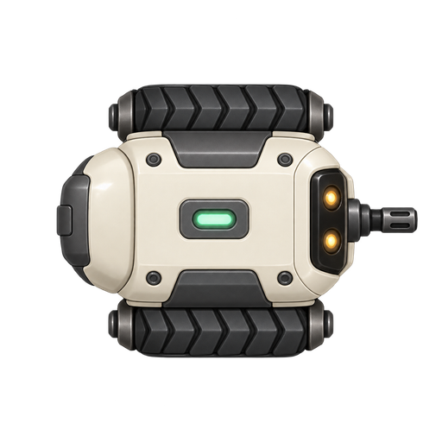


ENCOUNTER DESIGN
Read the threat. Choose the response.
Patrol
Scout drone
Heavy
Use cover. Move when it aims.
Interrupt its location broadcast.
Get behind its protected front.
STEAL A SEEKER / CLOCK IN 2026
03
Notes:
Actual game sprites from assets/guards-v2 and assets/drones-v2. Current code implements patrol shooting and cover collision, scout reporting rather than firing, and heavy front protection with rear vulnerability. Sources: src/game/guards.ts, src/game/level.ts and current gameplay code. Artwork is shown enlarged for explanation; these are not screenshots of in-game sprite scale.

Slide 4
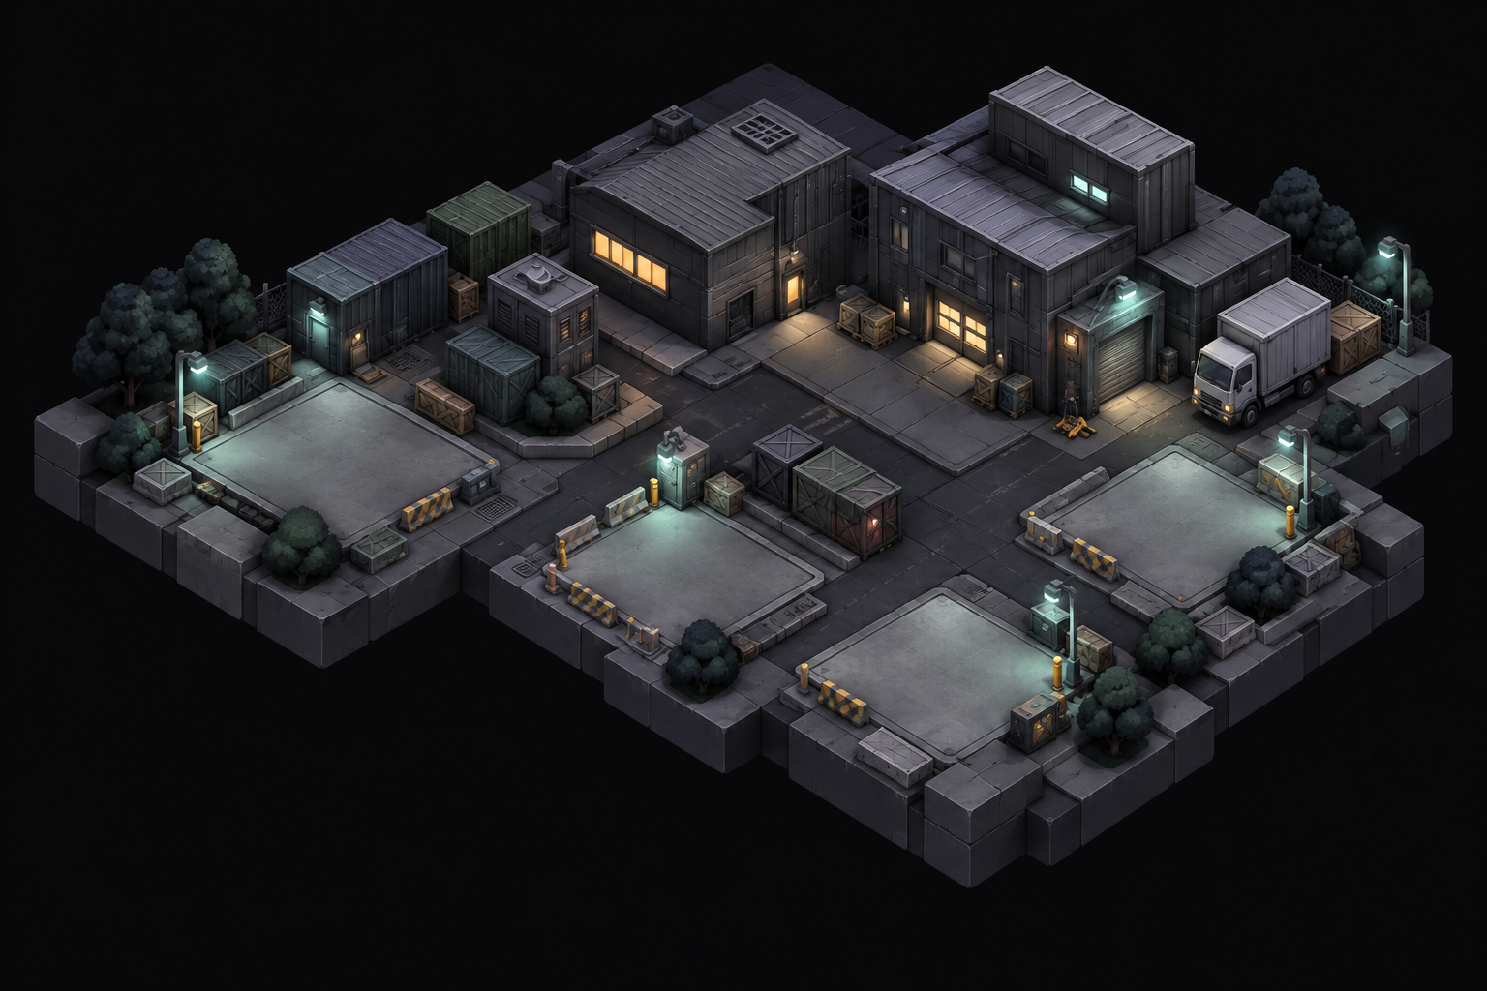
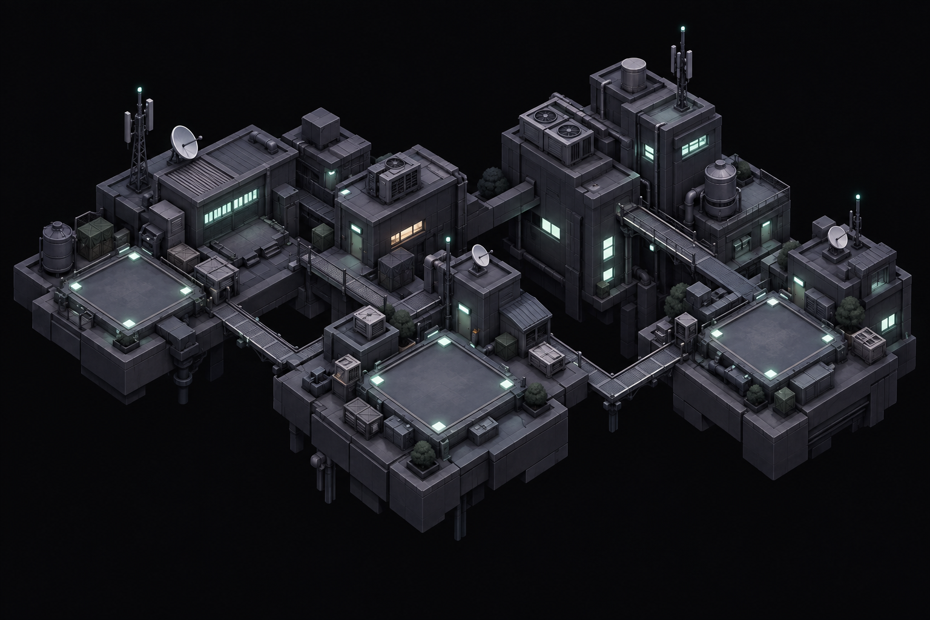
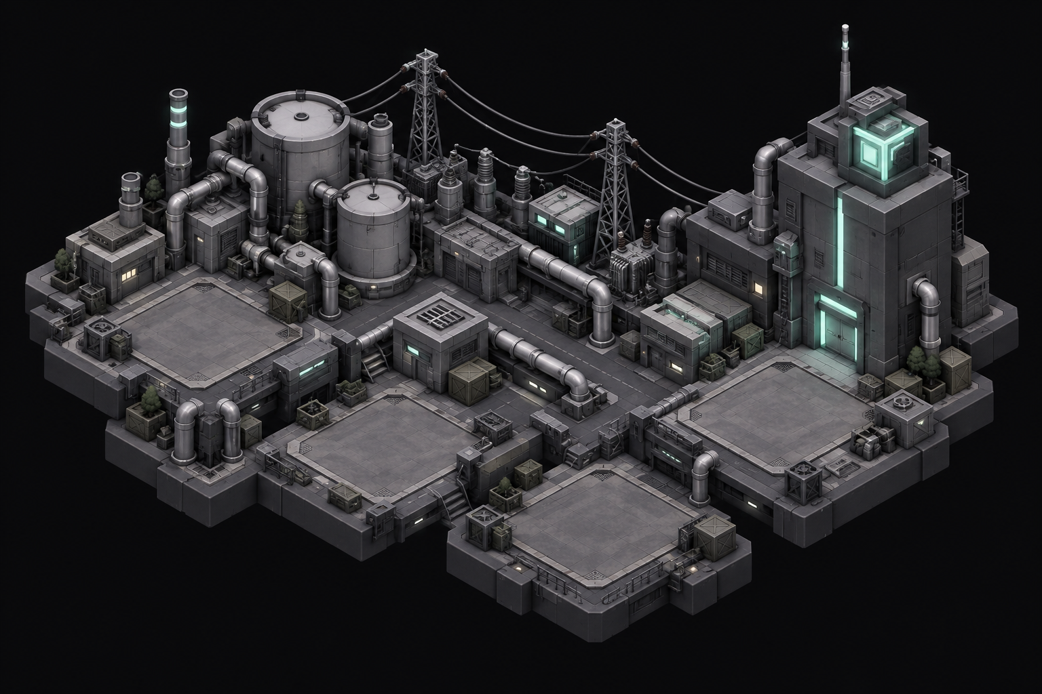
CAMPAIGN
Twelve heists. Twelve phones to collect.
01—04
05—08
09—12
Warehouse
Rooftops
Powerworks
Clear a mission → recover its Seeker → view it in Hideout.
STEAL A SEEKER / CLOCK IN 2026
04
Notes:
Twelve campaign levels in three districts, four per district. Each mission unlocks a distinct virtual Seeker phone design in the collection. These are in-game collectibles, not physical-phone prizes or NFTs. Original district map art: assets/world-v3. Sources: src/game/level.ts, phone collection catalog and Hideout UI.

Slide 5
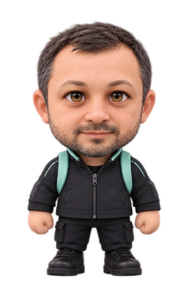
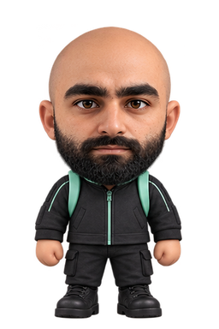


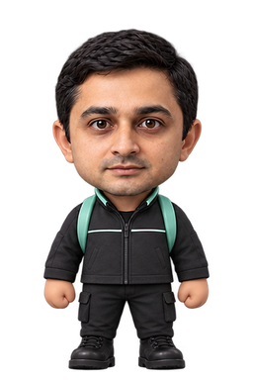
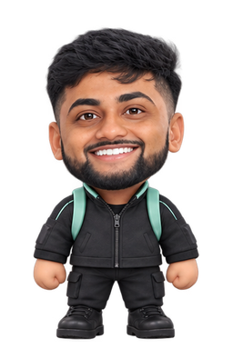
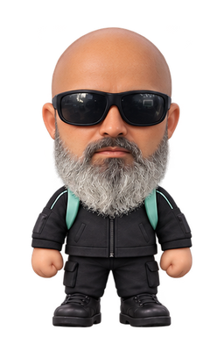
IDENTITY & COLLECTION
Play your way. Keep the same stats.
Solana-inspired characters, courier outfits and collectible phones.
Toly
Mert
Chase
Lily
Vibhu
Akshay
Beeman
Cosmetic unlocks do not improve combat stats.
STEAL A SEEKER / CLOCK IN 2026
05
Notes:
All seven existing game character assets are retained. Sources: assets/solana-skins/manifest.json and cosmetic catalog. These are fan-made Solana-inspired cosmetics; inclusion does not imply endorsement or a partnership. Current Solana character pricing is 3000 earned credits or 100 SKR (SOL alternative available via live quote). Stats remain the same.

Slide 6
REPLAY VALUE
One weekly league. Three ranked missions.
3
5
1
ranked missions
attempts per mission
best escape per mission
Game Pass unlocks weekly ranked play.
The server replays runs before accepting scores.
Weekly refresh · Cosmetic purchases do not change ranked stats.
STEAL A SEEKER / CLOCK IN 2026
06
Notes:
Sources: shared weekly competition logic, server ranked-service and current app weekly league UI. Three missions per weekly competition; five attempts per mission; best escaped run per mission counts. Weekly refresh Monday. Game Pass required for ranked play. Token prize distribution is not active and is not represented as a current feature. No retention or active-player metrics are claimed.

Slide 7

SOLANA INTEGRATION
SKR buys something useful inside the game.
Game Pass + cosmetic unlocks
SKR or SOL purchases. A free campaign to start.
01
02
03
Choose
Approve
Confirm
Live price in the app.
Mobile Wallet Adapter.
Backend checks the receipt.
Mainnet payments · Wallet sign-and-send · Purchases can be restored
STEAL A SEEKER / CLOCK IN 2026
07
Notes:
Verified live backend health/catalog on 27 September 2026: https://seeker-api-production-41b3.up.railway.app/health and /catalog; mainnet, testPricing false. Mobile Wallet Adapter signAndSendTransactions in native wallet code. Backend verifies finalized payment receipts and prevents duplicate grant; restore/reconciliation paths exist. SKR and SOL supported for pass and skins; credit packs have live token quotes. Sources: src/commerce, src/wallet, server services. This slide describes implementation and current configuration, not a newly completed physical-device payment test. No staking/yield or active reward distribution claim.

Slide 8
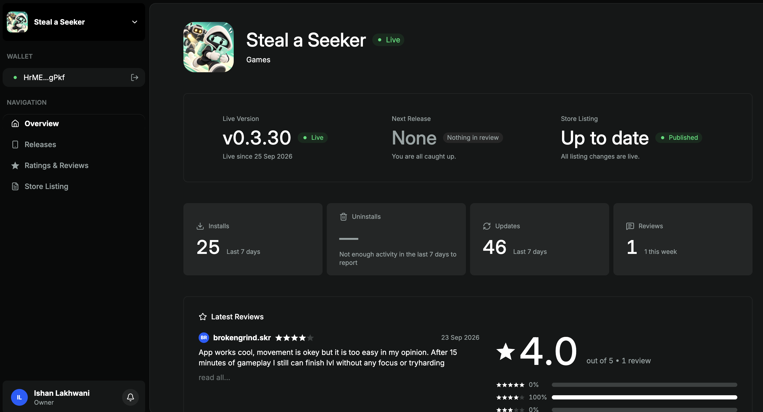
STORE RELEASE
Live in the Solana dApp Store.
v0.3.30
Live since 25 Sep 2026
25
installs · last 7 days
4.0 / 5
from 1 review
PUBLISHER DASHBOARD SNAPSHOT SUPPLIED 27 SEP 2026
08
Notes:
Evidence: user supplied Screenshot 2026-09-27 at 2.23.21 PM.png; unmodified full screenshot embedded, also assets/store-published.png. Screenshot shows v0.3.30 Live since 25 September 2026; store listing Published/up to date; 25 installs in last 7 days, 46 updates in last 7 days, 1 review rated 4/5. Installs are not unique active users and updates are not additional installs. No total historical users or retention claim. Current browser development footage elsewhere may contain later changes than the published Android version.

Slide 9
LEARNING FROM REAL PLAYERS
The first review exposed the right problem.
“It is too easy in my opinion.”
brokengrind.skr · 23 Sep 2026 · 4/5
What changed
What we still need to prove
Shared alerts and persistent pursuit.
Distinct enemy roles and counterplay.
Visual teaching for movement and combat.
Do new players understand the controls?
Does the challenge feel fair?
Do they return for another run?
STEAL A SEEKER / CLOCK IN 2026
09
Notes:
Short exact excerpt from the user-provided publisher dashboard review by brokengrind.skr, dated 23 September 2026. Current project source and update history support shared alerts, persistent pursuit, role-specific enemies and visual tutorial work. These changes have not yet established improved retention or difficulty satisfaction. Existing QA evidence and current browser gameplay were reviewed; this is not a claim of completed new end-to-end physical-device QA.

Slide 10
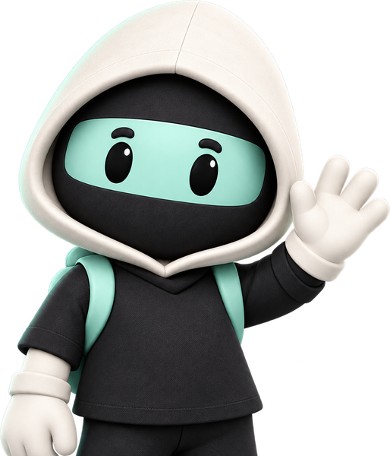
AVAILABLE ON SOLANA MOBILE
Your next
heist is waiting.
On your Seeker, open the dApp Store
and search “Steal a Seeker”.
Play the free campaign.
Tell us where the game gets better—or breaks.
ISHAN LAKHWANI / BLUNTBRAIN / CLOCK IN 2026
10
Notes:
Store availability supported by user-provided publisher dashboard. User instruction: users should search for/download the app on Seeker; no fabricated store deep link. Original courier art asset from assets/leaderboard-v3/courier-wave.png. Free campaign verified in app source. Deck does not claim official endorsement.

