Slide 1
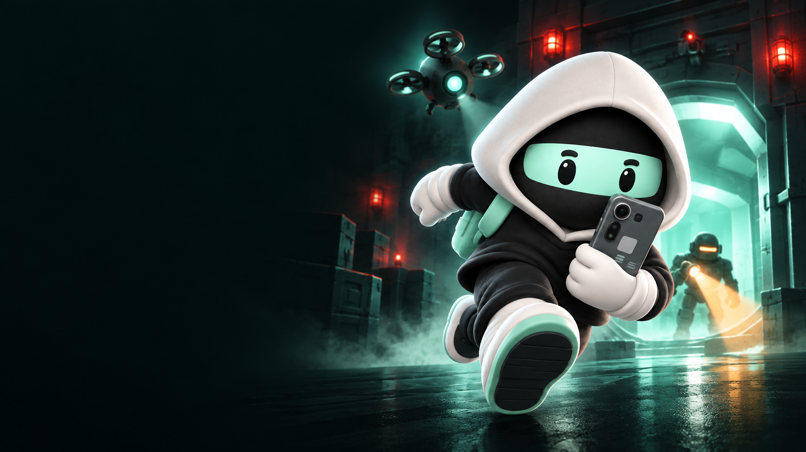
CLOCK IN 2026 / SOLANA MOBILE
STEAL
A SEEKER
A reason to pick up
your Seeker again.
Short heists. A reason to return.
Ishan Lakhwani · bluntbrain
Notes:
Steal a Seeker submission deck, updated 29 September 2026. Original generated cover artwork made for this deck with OpenAI image generation, using assets/paywall-v3/courier-heist.png as the character reference. Marketing art, not captured gameplay. Created by Ishan Lakhwani / bluntbrain.

Slide 2
THE OPPORTUNITY · FOUNDER THESIS
Owning a Seeker is the start.
Wanting to use it is the opportunity.
My bet: a game can be one of the first reasons to come back.
Easy to start
Worth another try
Something to return for
A clear goal and familiar touch controls.
An escape to master. A score to beat.
A collection to finish. A new weekly challenge.
The test: do players choose to open it again?
STEAL A SEEKER / CLOCK IN 2026
02
Notes:
Founder thesis, not a measured finding about Seeker device usage. No device-usage or retention data has been supplied. Games are proposed as one useful entry point to repeat use, not the only or proven best one. Product rationale: accessible first session, mastery and recurring content. Retention remains to be measured.

Slide 3
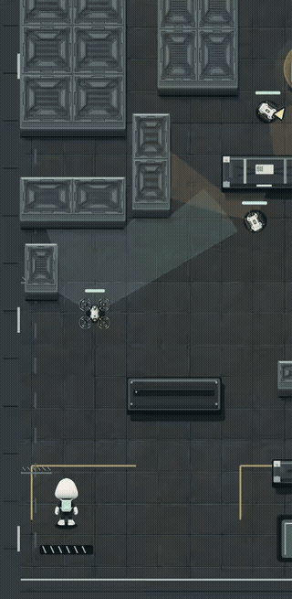
MAKE THE FIRST SESSION UNDERSTANDABLE
A simple input.
A risky escape.
01
Tap the floor to move.
Use cover to choose your approach.
02
Tap an enemy to fire.
Stop the drone before it reports you.
03
Steal the phone. Escape.
Pickup brings the response.
REAL BROWSER GAMEPLAY / CAPTURED 27 SEP 2026 / PLAYS IN SLIDESHOW
03
Notes:
Embedded animated GIF of actual current browser gameplay captured via canvas MediaRecorder on 27 September 2026 at local isolated origin. Two excerpts at original speed: move toward cover, then shoot the scout drone. Silent recording; no fabricated actions. Canvas capture omits the outer HUD. Browser footage is separate from the published Android version. MP4 also supplied in assets/gameplay.mp4. Sources: src/game and current dist build.

Slide 4
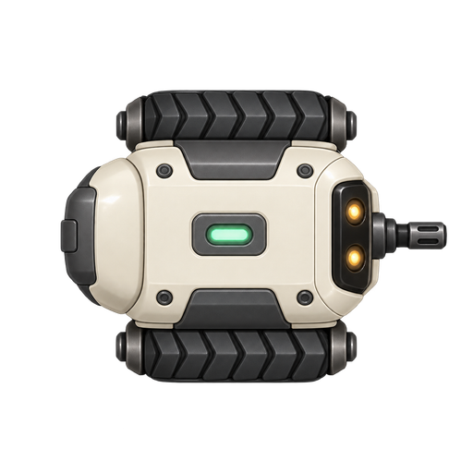


ENCOUNTER DESIGN
Read the threat. Choose the response.
Patrol
Scout drone
Heavy
Use cover. Move when it aims.
Interrupt its location broadcast.
Get behind its protected front.
STEAL A SEEKER / CLOCK IN 2026
04
Notes:
Actual game sprites from assets/guards-v2 and assets/drones-v2. Current code implements patrol shooting and cover collision, scout reporting rather than firing, and heavy front protection with rear vulnerability. Sources: src/game/guards.ts, src/game/level.ts and current gameplay code. Artwork is shown enlarged for explanation; these are not screenshots of in-game sprite scale.

Slide 5
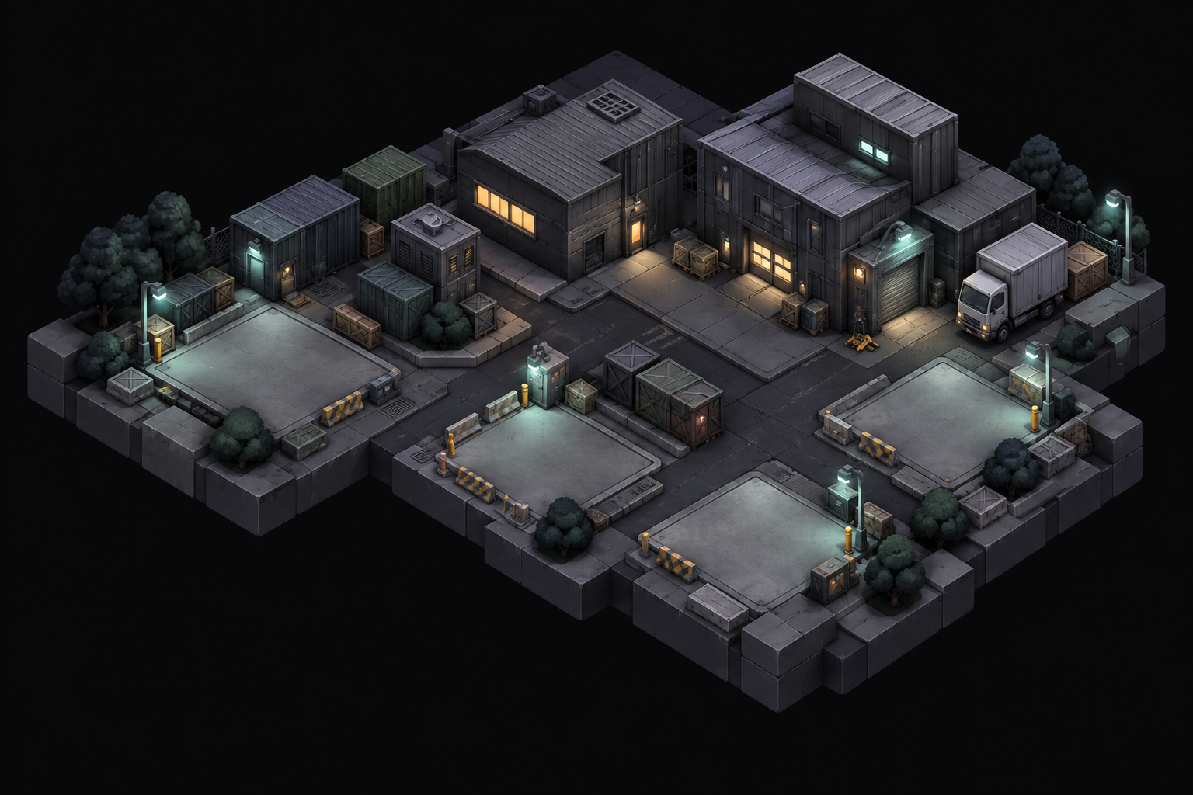
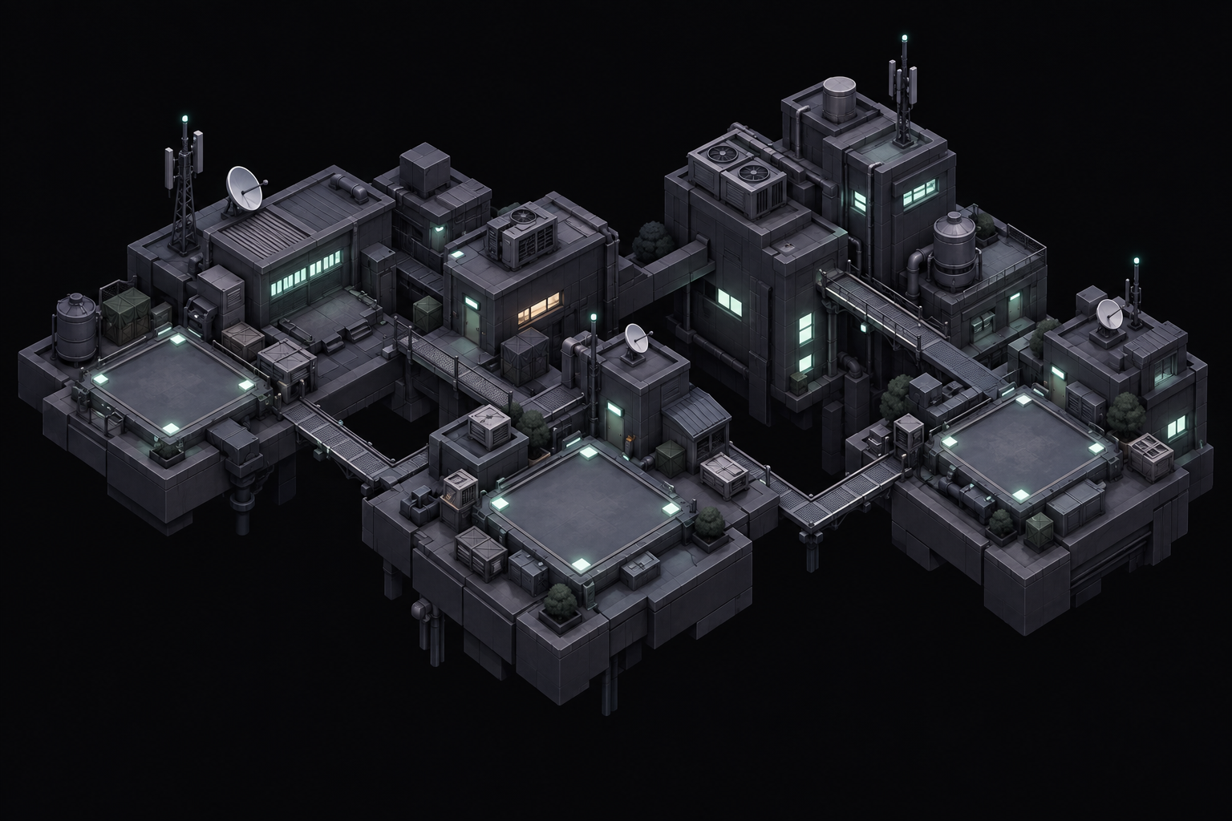
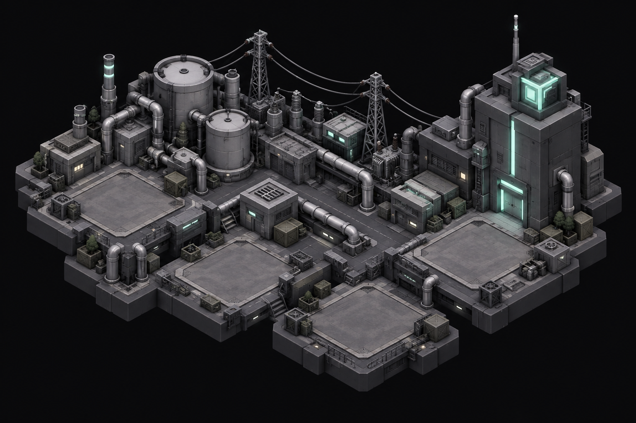
A REASON TO KEEP PLAYING
Twelve heists. Twelve phones to collect.
01—04
05—08
09—12
Warehouse
Rooftops
Powerworks
Clear a mission → recover its Seeker → view it in Hideout.
STEAL A SEEKER / CLOCK IN 2026
05
Notes:
Twelve campaign levels in three districts, four per district. Each mission unlocks a distinct virtual Seeker phone design in the collection. These are in-game collectibles, not physical-phone prizes or NFTs. Original district map art: assets/world-v3. Sources: src/game/level.ts, phone collection catalog and Hideout UI.

Slide 6
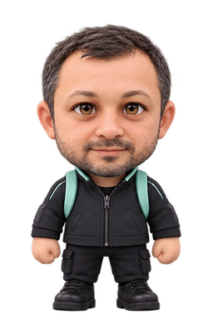
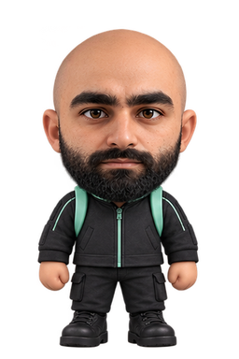
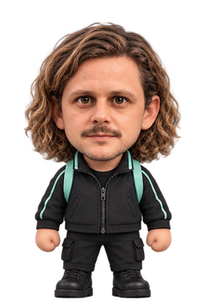

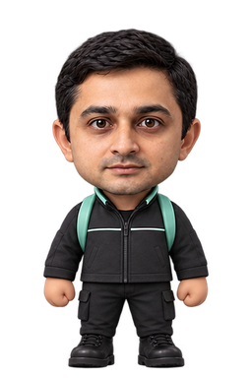
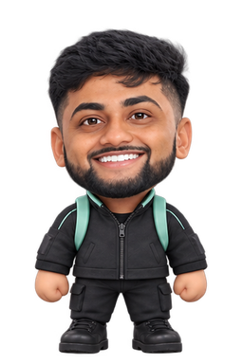
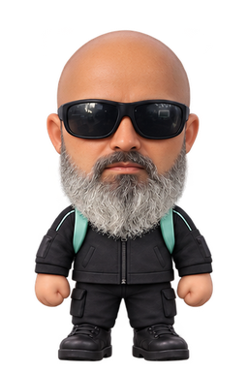
IDENTITY & COLLECTION
Play your way. Keep the same stats.
Solana-inspired characters, courier outfits and collectible phones.
Toly
Mert
Chase
Lily
Vibhu
Akshay
Beeman
Cosmetic unlocks do not improve combat stats.
STEAL A SEEKER / CLOCK IN 2026
06
Notes:
All seven existing game character assets are retained. Sources: assets/solana-skins/manifest.json and cosmetic catalog. These are fan-made Solana-inspired cosmetics; inclusion does not imply endorsement or a partnership. Current Solana character pricing is 3000 earned credits or 100 SKR (SOL alternative available via live quote). Stats remain the same.

Slide 7
A REASON TO COME BACK
One weekly league. Three ranked missions.
3
5
1
ranked missions
attempts per mission
best escape per mission
Game Pass unlocks weekly ranked play.
The server replays runs before accepting scores.
Weekly refresh · Cosmetic purchases do not change ranked stats.
STEAL A SEEKER / CLOCK IN 2026
07
Notes:
Sources: shared weekly competition logic, server ranked-service and current app weekly league UI. Three missions per weekly competition; five attempts per mission; best escaped run per mission counts. Weekly refresh Monday. Game Pass required for ranked play. Token prize distribution is not active and is not represented as a current feature. No retention or active-player metrics are claimed.

Slide 8

SOLANA INTEGRATION
SKR buys something useful inside the game.
Game Pass + cosmetic unlocks
SKR or SOL purchases. A free campaign to start.
01
02
03
Choose
Approve
Confirm
Live price in the app.
Mobile Wallet Adapter.
Backend checks the receipt.
Mainnet payments · Wallet sign-and-send · Purchases can be restored
STEAL A SEEKER / CLOCK IN 2026
08
Notes:
Verified live backend health/catalog on 27 September 2026: https://seeker-api-production-41b3.up.railway.app/health and /catalog; mainnet, testPricing false. Mobile Wallet Adapter signAndSendTransactions in native wallet code. Backend verifies finalized payment receipts and prevents duplicate grant; restore/reconciliation paths exist. SKR and SOL supported for pass and skins; credit packs have live token quotes. Sources: src/commerce, src/wallet, server services. This slide describes implementation and current configuration, not a newly completed physical-device payment test. No staking/yield or active reward distribution claim.

Slide 9
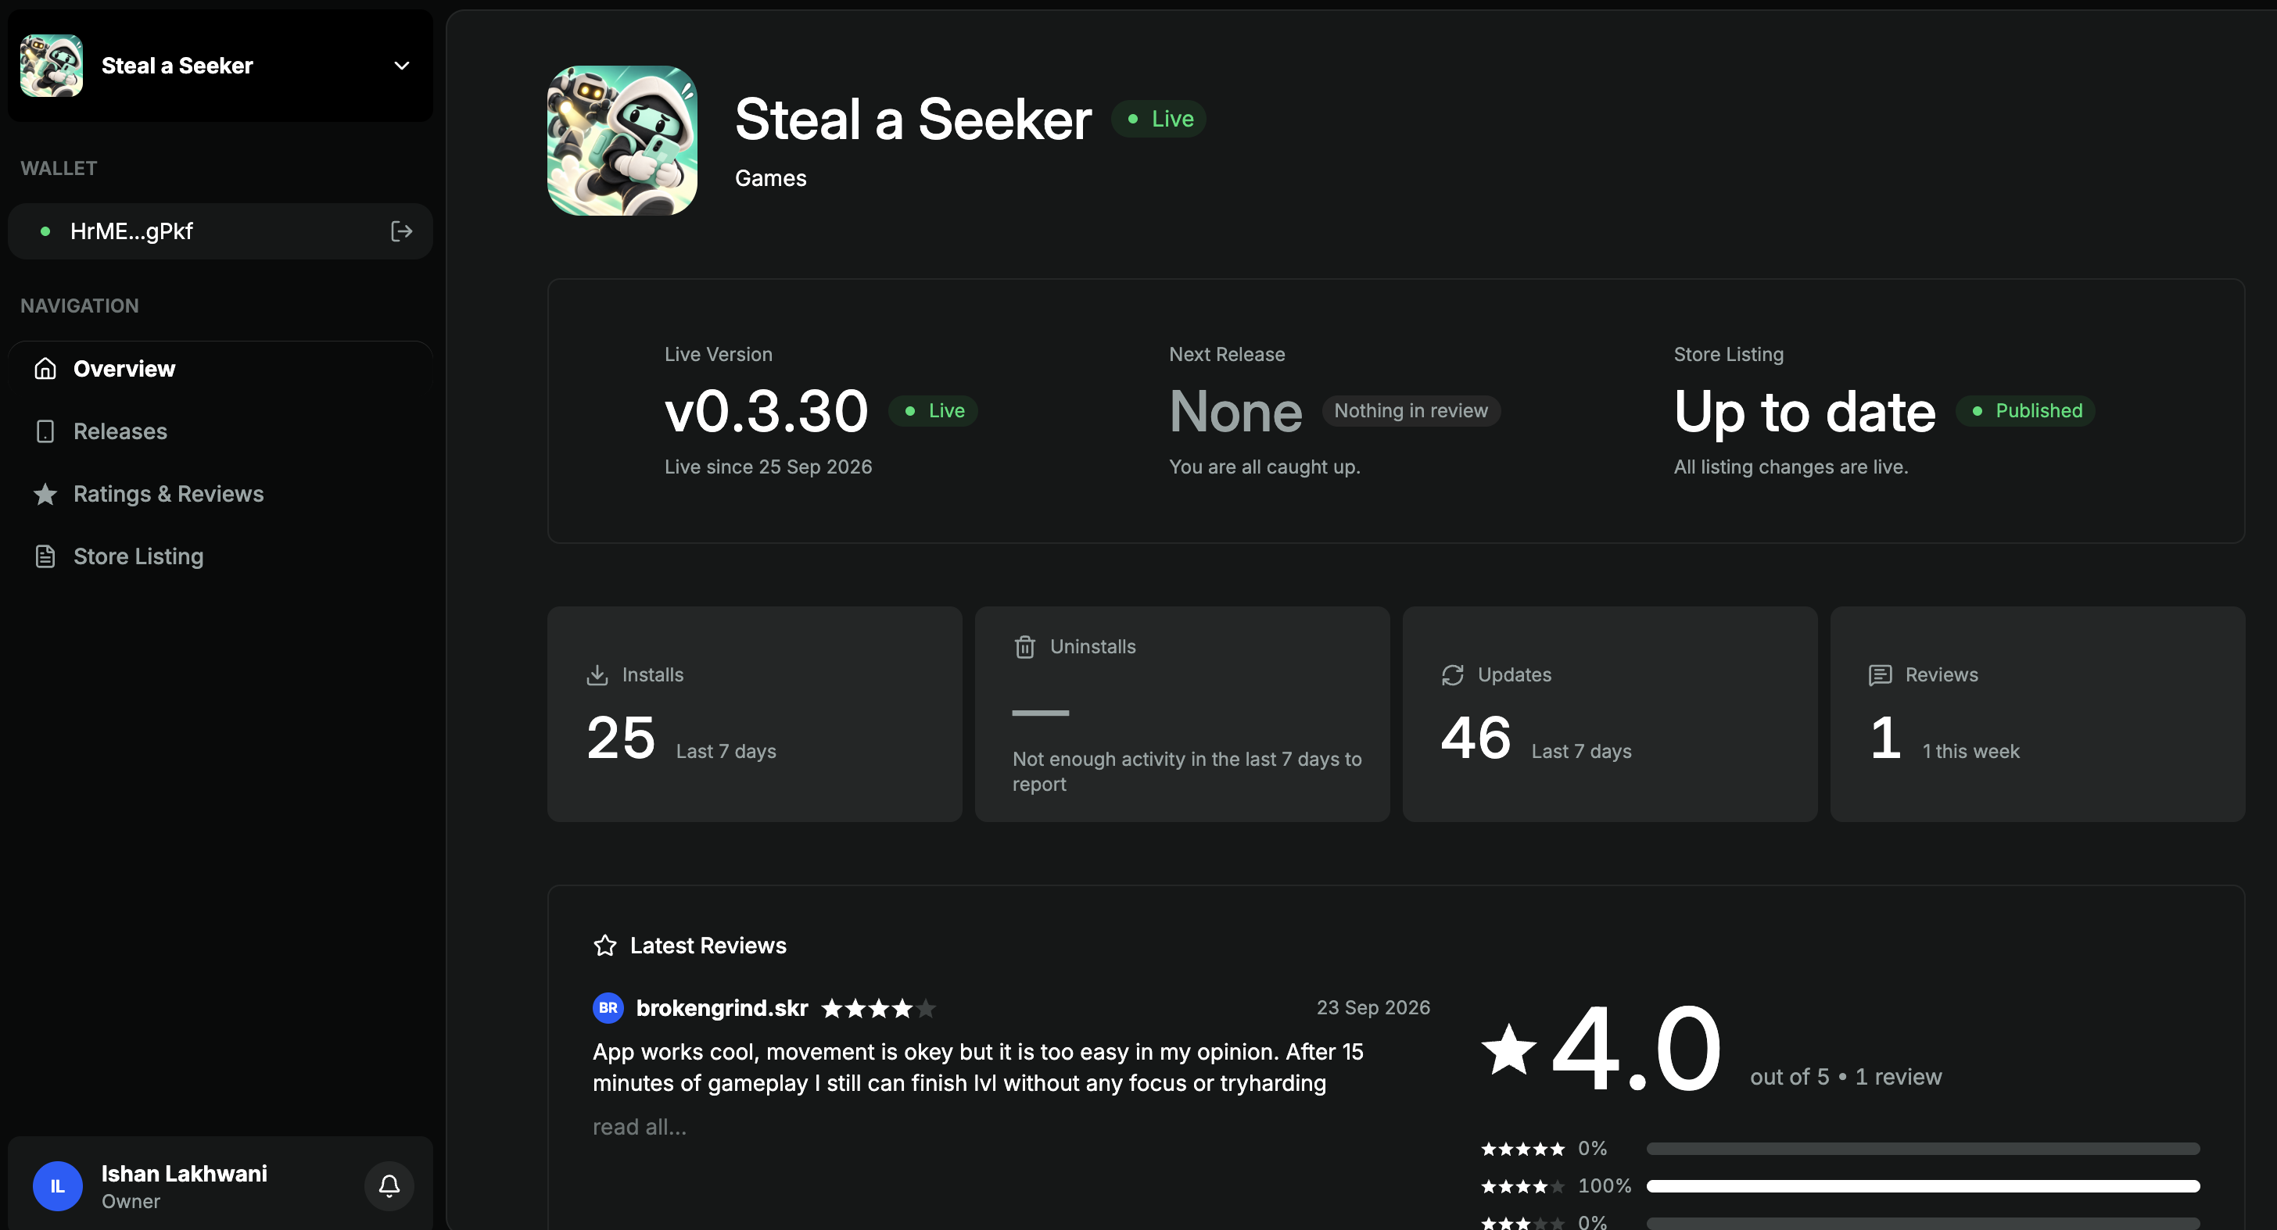
STORE RELEASE
Live in the Solana dApp Store.
v0.3.30
Live since 25 Sep 2026
25
installs · last 7 days
4.0 / 5
from 1 review
PUBLISHER DASHBOARD SNAPSHOT SUPPLIED 27 SEP 2026
09
Notes:
Evidence: user supplied Screenshot 2026-09-29 at 2.23.21 PM.png; unmodified full screenshot embedded, also assets/store-published.png. Screenshot shows v0.3.30 Live since 25 September 2026; store listing Published/up to date; 25 installs in last 7 days, 46 updates in last 7 days, 1 review rated 4/5. Installs are not unique active users and updates are not additional installs. No total historical users or retention claim. Current browser development footage elsewhere may contain later changes than the published Android version.

Slide 10
LEARNING FROM REAL PLAYERS
Early feedback is shaping the game.
“It is too easy in my opinion.”
brokengrind.skr · 23 Sep 2026 · 4/5
What changed
What we still need to prove
Shared alerts and persistent pursuit.
Distinct enemy roles and counterplay.
Visual teaching for movement and combat.
Do new players understand the controls?
Does the challenge feel fair?
Do they return for another run?
STEAL A SEEKER / CLOCK IN 2026
10
Notes:
Short exact excerpt from the user-provided publisher dashboard review by brokengrind.skr, dated 23 September 2026. Current project source and update history support shared alerts, persistent pursuit, role-specific enemies and visual tutorial work. These changes have not yet established improved retention or difficulty satisfaction. Existing QA evidence and current browser gameplay were reviewed; this is not a claim of completed new end-to-end physical-device QA.

Slide 11
THE BUILDER
Seven years of mobile work.
A longer-term bet on Seeker.
7+
What that means for this game
Teach through action, not a wall of text.
Make taps, hits and rewards feel responsive.
Use player feedback to improve the next release.
years building mobile apps
Steal a Seeker is my starting point.
Ishan Lakhwani · bluntbrain
I plan to keep building for Seeker—and learn
which experiences people return to.
STEAL A SEEKER / CLOCK IN 2026
11
Notes:
Founder experience: user states on 29 September 2026 that he has built mobile apps daily for more than seven years and plans to keep building for Seeker. Self-reported professional background, not independently audited here. UX principles connect to the game tutorial, interaction feedback and iteration described elsewhere. No claim of universal psychology expertise or proven retention. Long-term development is intent, not a guaranteed release schedule.

Slide 12
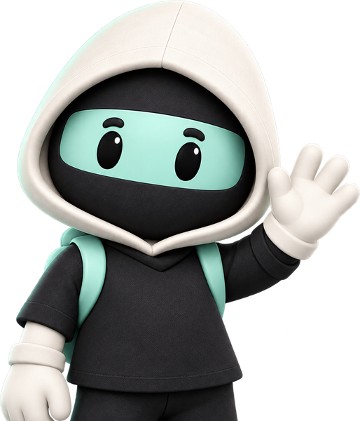
BUILDING FOR SOLANA MOBILE
Give Seeker owners
a reason to return.
On your Seeker, open the dApp Store
and search “Steal a Seeker”.
Play the free campaign. Share honest feedback.
Help shape what I build next for Seeker.
ISHAN LAKHWANI / BLUNTBRAIN / CLOCK IN 2026
12
Notes:
Store availability supported by user-provided publisher dashboard. User instruction: users should search for/download the app on Seeker; no fabricated store deep link. Original courier art asset from assets/leaderboard-v3/courier-wave.png. Free campaign verified in app source. Deck does not claim official endorsement.

