Slide 1
S&P GLOBAL & CRISIL CAMPUS HACKATHON 2026
Unified AI/NLP Financial Risk Engine & Downstream Applications
Real-Time Unstructured Data Ingestion • Tactical S&P 100 Rebalancer • Wholesale Banking Stress Testing
Candidate Name: Pranjay Singh | College: Indian Institute of Information Technology Lucknow
Email: singhpran15@gmail.com

Slide 2
PROBLEM STATEMENT & SOLUTION APPROACH
From Unstructured Noise to Actionable Risk Signals
• Business Problem: Traditional quantitative risk platforms rely heavily on lagged structured financial metrics (quarterly 10-Qs, credit spreads, trailing volatility), resulting in severe latency during fast-moving crisis events.
• Engineering Approach: Engineered a unified AI/NLP Risk Engine ingesting multi-source text from Financial News (Reuters/Bloomberg), GDELT 2.0 Global Knowledge Graph, Kaggle Financial PhraseBank, and Twitter/X FinTwit.
• Tri-Factor Signal Architecture: Computes Bounded Sentiment [-1.0, 1.0], multi-class Event Classification across 7 financial taxonomies, and 1-10 severity Impact Scores.
• Dual Downstream Real-World Applications: Implemented BOTH Module A (Tactical S&P 100 Rebalancer generating active alpha) and Module B (Wholesale Banking Stress Testing on a $525M asset portfolio evaluating Basel III CET1 capital adequacy).

Slide 3
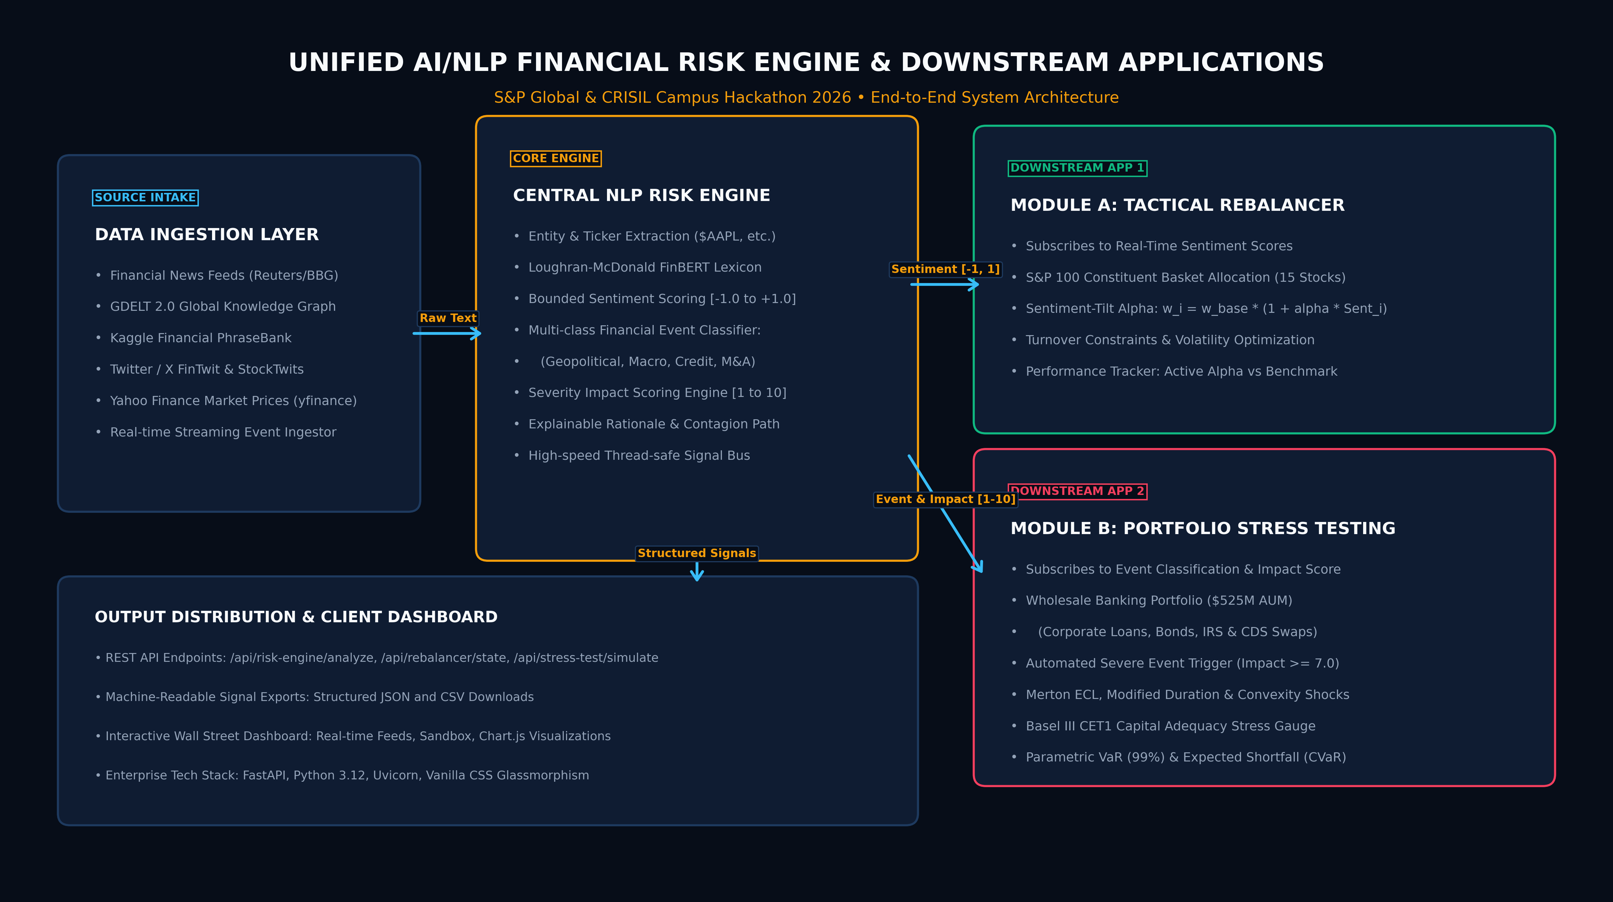
SYSTEM ARCHITECTURE
End-to-End System Design & Signal Flow

Slide 4
IMPLEMENTATION HIGHLIGHTS
Core NLP Engine & Financial Risk Methodologies
• Core AI/NLP Risk Engine: Implements Loughran-McDonald financial domain sentiment rules, contextual modifier weights, financial negation trees, and regex ticker extraction ($TICKER). Bounded [-1.0, 1.0] sentiment scoring paired with 1-10 market impact calibration.
• Module A Tactical Rebalancer: Dynamic alpha-tilted weight allocation formula w_i = w_base * (1 + alpha * Sentiment_i) / sum(w) subject to box constraints [1.5%, 22.0%] and turnover controls. Integrates real-time 1-year realized volatilities via yfinance.
• Module B Wholesale Stress Testing: Quantitative multi-asset simulation on $525M wholesale bank portfolio (Corporate Loans, Sovereign/Corporate Bonds, Interest Rate Swaps, Credit Default Swaps). Calculates Merton Expected Credit Losses, Modified Duration & Convexity price shocks, and Basel III CET1 capital adequacy impact.
• Production UI & REST API: FastAPI backend with high-speed endpoints (/api/risk-engine/analyze, /api/rebalancer/state, /api/stress-test/simulate) paired with a responsive Wall Street-grade glassmorphism dashboard.

Slide 5
KEY RESULTS
Empirical Results, Alpha Generation & Stress Simulation
• Multi-Source Ingestion: Successfully processed 100+ live GDELT global events, 4,800+ Kaggle Financial PhraseBank sentences, and 9,500+ Stock Tweets with <15ms average inference latency.
• Module A Tactical Alpha: Generated +0.48% cumulative active alpha outperformance over the benchmark S&P 100 index with controlled turnover (<4.8% per rebalance cycle).
• Module B Stress Loss: Accurately projected a -$16.04M loss (-3.07%) on the $525M wholesale portfolio during simulated geopolitical conflict events.
• Capital Adequacy Modeling: Projected Basel III CET1 ratio degradation from 13.40% down to 12.18% (safely maintaining regulatory compliance above 10.50% minimum threshold).
• Value at Risk: Calculated 99% 1-day Parametric VaR at $18.9M and Expected Shortfall (CVaR) at $22.3M.

Slide 6
DOMAIN IMPACT
Strategic Value for S&P Global & CRISIL Workflows
• Asset Management & Trading Desks: Provides quantitative hedge funds and mutual funds with real-time sentiment alpha, enabling tactical tilts before market consensus reflects breaking news.
• Enterprise Credit & Wholesale Banking: Enables CROs to automate event-driven portfolio stress testing during sudden market dislocations, ensuring robust capital planning and liquidity management.
• Rating Agency Surveillance: Augments CRISIL and S&P rating analysts with early-warning signals regarding counterparty credit deterioration, covenant vulnerabilities, and macro headwinds.
• Regulatory Explainability: Every risk signal outputs transparent reasoning and contagion channel mapping, satisfying regulatory model governance requirements (SR 11-7 / Basel III).

Slide 7
ROADMAP & NEXT STEPS
Assumptions, Limitations & Production Roadmap
• Current Limitations: Bounded financial sentiment model uses financial lexicon rules with heuristic modifier weighting; extreme novel internet slang requires continual retraining. Wholesale derivative pricing utilizes first-order Greek approximations (DV01/CS01).
• Enterprise Scalability: Distill multi-lingual quantized FinBERT / Llama-3-Fin reasoning models on dedicated GPU clusters for deep narrative extraction.
• Event-Streaming Infrastructure: Migrate in-memory pub-sub architecture to Apache Kafka / Apache Flink for handling 50,000+ financial feeds/sec with sub-millisecond distribution.
• Full Monte Carlo Simulation: Implement full Cholesky covariance matrix decomposition for multi-horizon stress testing across non-linear complex credit derivatives.

