Slide 1
Chapter 10
Drawing Regions

Slide 2
Pictures
Drawing Pictures
  Pictures are composed of Regions
    Regions are composed of shapes
  Pictures add Color
  data Picture = Region Color Region
  | Picture `Over` Picture
  | EmptyPic
  deriving Show
We must be careful to use SOEGraphics, but SOEGraphics has its own Region datatype.
import SOEGraphics hiding (Region)
import qualified SOEGraphics as G (Region)

Slide 3
Recall the Region Datatype
data Region =
Shape Shape -- primitive shape
| Translate Vector Region -- translated region
| Scale Vector Region -- scaled region
| Complement Region -- inverse of a region
| Region `Union` Region -- union of regions
| Region `Intersect` Region -- intersection of regions
| Empty
How do we draw things like the intersection of two regions, or the complement of a region? These are hard things to do efficiently. Fortunately, the G.Region interface uses lower-level support to do this for us.

Slide 4
G.Region
The G.Region datatype interfaces more directly to the underlying hardware.
It is essentially a two- dimensional array or “bit-map”, storing a binary value for each pixel in the window.

Slide 5
Efficient Bit-Map Operations
There is efficient low-level support for combining bit-maps using a variety of operators. For example, for union:
These operations are fast, but data (space) intensive, and this space needs to be explicitly allocated and de-allocated, a job for a much lower-level language.
+
=

Slide 6
G.Region Interface
createRectangle :: Point -> Point -> IO G.Region
createEllipse :: Point -> Point -> IO G.Region
createPolygon :: [Point] -> IO G.Region
andRegion :: G.Region -> G.Region -> IO G.Region
orRegion :: G.Region -> G.Region -> IO G.Region
xorRegion :: G.Region -> G.Region -> IO G.Region
diffRegion :: G.Region -> G.Region -> IO G.Region
deleteRegion :: G.Region -> IO ()
drawRegion :: G.Region -> Graphic
These functions are defined in the SOEGraphics library module.

Slide 7
Drawing G.Region
To draw things quickly, turn them into a G.Region, then turn the G.Region into a graphic object, and then use all the machinery we have built up so far to display the object.
drawRegionInWindow ::
Window -> Color -> Region -> IO ()
drawRegionInWindow w c r =
drawInWindow w
(withColor c (drawRegion (regionToGRegion r)))
All we need to define, then, is: regionToGRegion.
  But first, let’s define what it means to draw a picture.

Slide 8
Drawing Pictures
Pictures combine multiple regions into one big picture. They provide a mechanism for placing one sub-picture on top of another.
drawPic :: Window -> Picture -> IO ()
drawPic w (Region c r) = drawRegionInWindow w c r
drawPic w (p1 `Over` p2) = do drawPic w p2
drawPic w p1
drawPic w EmptyPic = return ()
Note that p2 is drawn before p1, since we want p1 to appear “over” p2.

Slide 9
Summary
We have a rich calculus of Shapes, which we can draw, take the perimeter of, and tell if a point lies within.
We defined a richer data type Region, which allows more complex compositions (intersection, complement, etc.).
  We gave Region a mathematical semantics as a set of points in the 2-dimensional plane.
  We defined some interesting operators like containsR which is the characteristic function for a region.
  The rich nature of Region makes it hard to draw efficiently, so we use a lower level datatype G.Region.
  We enriched this even further with the Picture type.
G.Region is low level, relying on features like overwriting and explicit allocation and deallocation of memory.
We can think of Region as a high-level interface to G.Region that hides low-level details.

Slide 10
Turning a Region into a G.Region
Experiment with a smaller problem to illustrate an efficiency problem.
data NewRegion = Rect Side Side -- abstracts G.Region
regToNReg :: Region -> NewRegion
regToNReg (Shape (Rectangle sx sy))
= Rect sx sy
regToNReg (Scale (x,y) r)
= regToNReg (scaleReg (x,y) r)
where scaleReg (x,y) (Shape (Rectangle sx sy))
= Shape (Rectangle (x*sx) (y*sy))
scaleReg (x,y) (Scale s r)
= Scale s (scaleReg (x,y) r)

Slide 11
A Problem
Consider
(Scale (x1,y1)
(Scale (x2,y2)
(Scale (x3,y3)
... (Shape (Rectangle sx sy))
... )))
If the scaling is n levels deep, how many traversals does regToNReg perform over the Region tree?

Slide 12
We’ve Seen This Before
Believe it or not we have encountered this problem before. Recall the definition of reverse:
reverse [] = []
reverse (x:xs) = (reverse xs) ++ [x]
where [] ++ zs = zs
(y:ys) ++ zs = y : (ys ++ zs)
How did we solve this? We used an extra accumulating parameter:
reverse xs = revhelp xs []
where revhelp [] zs = zs
revhelp (x:xs) zs = revhelp xs (x:zs)
We can do the same thing for Regions.

Slide 13
Accumulate the
Scaling Factor
regToNReg2 :: Region -> NewRegion
regToNReg2 r = rToNR (1,1) r
where rToNR :: (Float,Float) -> Region -> NewRegion
rToNR (x1,y1) (Shape (Rectangle sx sy))
= Rect (x1*sx) (y1*sy)
rToNR (x1,y1) (Scale (x2,y2) r)
= rToNR (x1*x2,y1*y2) r
To solve our original problem, repeat this for all the constructors of Region (not just Shape and Scale) and use G.Region instead of NewRegion. We also need to handle translation as well as scaling.

Slide 14
Final Version
regToGReg1 :: Vector -> Vector -> Region -> G.Region
regToGReg1 loc sca (Shape s) = shapeToGRegion loc sca s
regToGReg1 (x,y) sca (Translate (u,v) r)
= regToGReg1 (x+u, y+v) sca r
regToGReg1 loc (x,y) (Scale (u,v) r)
= regToGReg1 loc (x*u, y*v) r
regToGReg1 loc sca Empty = createRectangle (0,0) (0,0)
regToGReg1 loc sca (r1 `Union` r2)
= let gr1 = regToGReg1 loc sca r1
gr2 = regToGReg1 loc sca r2
in orRegion gr1 gr2
Assuming, of course, that we can define:
shapeToGRegion :: Vector -> Vector -> Shape -> G.Region
and write rules for Intersect, Complement etc.

Slide 15
A Matter of Style
While the function on the previous page shows how to solve the problem, there are several stylistic issues that could make it more readable and understandable.
The style of defining a function by patterns becomes cluttered when there are many parameters (other than the one which has the patterns).
The pattern of explicitly allocating and deallocating (bit-map) G.Region’s will be repeated in cases for intersection and for complement, so we should abstract it, and give it a name.

Slide 16
Abstract the Low-Level
Bit-Map Details
primGReg loc sca r1 r2 op
= let gr1 = regToGReg loc sca r1
gr2 = regToGReg loc sca r2
in op gr1 gr2

Slide 17
Redo with a Case Expression
regToGReg :: Vector -> Vector -> Region -> G.Region
regToGReg (loc@(x,y)) (sca@(a,b)) shape =
case shape of
Shape s -> shapeToGRegion loc sca s
Translate (u,v) r -> regToGReg (x+u, y+v) sca r
Scale (u,v) r -> regToGReg loc (a*u, b*v) r
Empty -> createRectangle (0,0) (0,0)
r1 `Union` r2 -> primGReg loc sca r1 r2 orRegion
r1 `Intersect` r2 -> primGReg loc sca r1 r2 andRegion
Complement r -> primGReg loc sca winRect r diffRegion
where winRect :: Region
winRect = Shape (Rectangle
(pixelToInch xWin) (pixelToInch yWin))
regionToGRegion :: Region -> G.Region
regionToGRegion r = regToGReg (0,0) (1,1) r
Pattern renaming

Slide 18
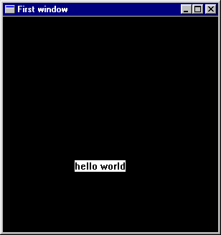
Shape to G.Region: Rectangle
shapeToGRegion
:: Vector -> Vector -> Shape -> IO G.Region
shapeToGRegion (lx,ly) (sx,sy) (Rectangle s1 s2)
= createRectangle (trans(-s1/2,-s2/2)) (trans (s1/2,s2/2))
where trans (x,y) = ( xWin2 + inchToPixel (lx+x*sx),
yWin2 - inchToPixel (ly+y*sy) )
s1
s1/2
S2/2
s2
( xWin2,
yWin2)
( xWin,
yWin )

Slide 19
Ellipse
shapeToGRegion1 (lx,ly) (sx,sy) (Ellipse r1 r2)
= createEllipse (trans (-r1,-r2)) (trans ( r1, r2))
where trans (x,y) =
( xWin2 + inchToPixel (lx+x*sx),
yWin2 - inchToPixel (ly+y*sy) )
r2
r1

Slide 20
Polygon and RtTriangle
shapeToGRegion1 (lx,ly) (sx,sy) (Polygon pts)
= createPolygon (map trans pts)
where trans (x,y) =
( xWin2 + inchToPixel (lx+x*sx),
yWin2 - inchToPixel (ly+y*sy) )
shapeToGRegion1 (lx,ly) (sx,sy) (RtTriangle s1 s2)
= createPolygon (map trans [(0,0),(s1,0),(0,s2)])
where trans (x,y) =
( xWin2 + inchToPixel (lx+x*sx),
yWin2 - inchToPixel (ly+y*sy) )

Slide 21
A Matter of Style, 2
shapeToGRegion1 has the same problems as regToGReg1
  The extra parameters obscure the pattern matching.
  There is a repeated pattern, we should give it a name.
shapeToGRegion (lx,ly) (sx,sy) s = case s of
Rectangle s1 s2 -> createRectangle (trans (-s1/2,-s2/2))
(trans ( s1/2, s2/2))
Ellipse r1 r2 -> createEllipse (trans (-r1,-r2))
(trans ( r1, r2))
Polygon pts -> createPolygon (map trans pts)
RtTriangle s1 s2 -> createPolygon
(map trans [(0,0),(s1,0),(0,s2)])
where trans (x,y) = ( xWin2 + inchToPixel (lx+x*sx),
yWin2 - inchToPixel (ly+y*sy) )

Slide 22
Drawing Pictures,
Sample Regions
draw :: Picture -> IO ()
draw p = runGraphics (
do w <- openWindow "Region Test" (xWin,yWin)
drawPic w p
spaceClose w
)
r1 = Shape (Rectangle 3 2)
r2 = Shape (Ellipse 1 1.5)
r3 = Shape (RtTriangle 3 2)
r4 = Shape (Polygon [(-2.5,2.5), (-3.0,0),
(-1.7,-1.0),
(-1.1,0.2), (-1.5,2.0)] )

Slide 23
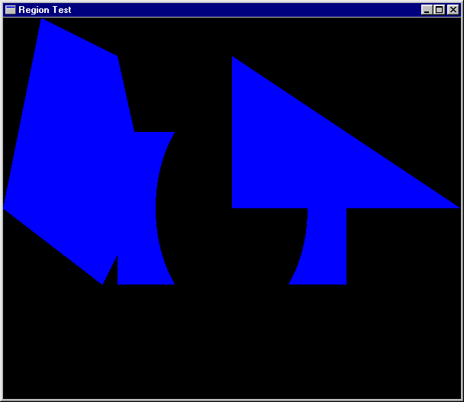
Sample Pictures
reg1 = r3 `Union` -- RtTriangle
r1 `Intersect` -- Rectangle
Complement r2 `Union` -- Ellipse
r4 -- Polygon
pic1 = Region Cyan reg1
Main1 = draw pic1
Recall the precedence
of Union and Intersect

Slide 24
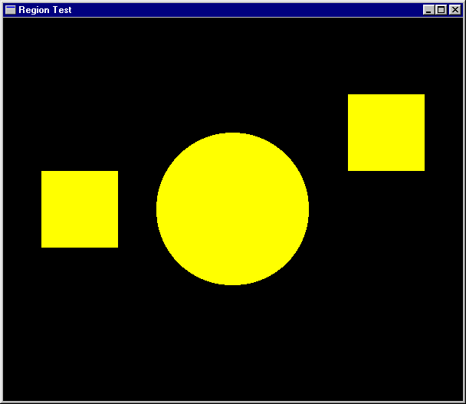
More Pictures
reg2 = let circle = Shape (Ellipse 0.5 0.5)
square = Shape (Rectangle 1 1)
in (Scale (2,2) circle)
`Union` (Translate (2,1) square)
`Union` (Translate (-2,0) square)
pic2 = Region Yellow reg2
main2 = draw pic2

Slide 25
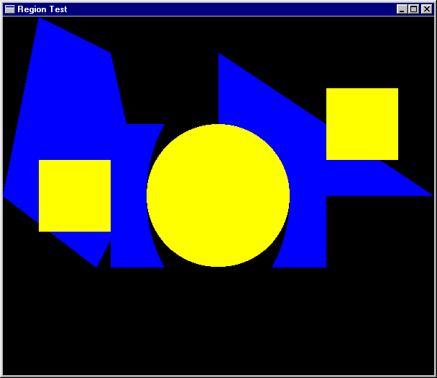
Another Picture
pic3 = pic2 `Over` pic1
main3 = draw pic3

Slide 26
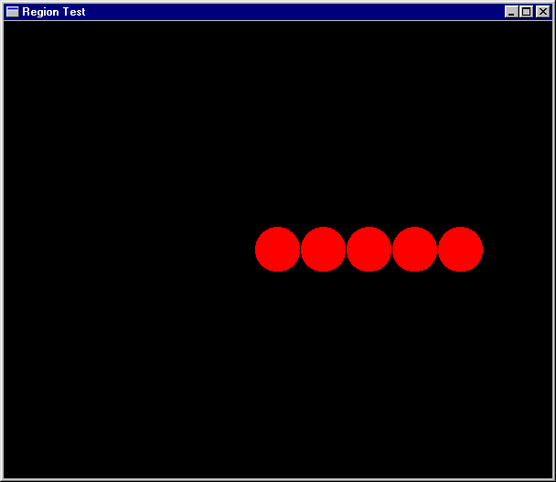
Separate Computation From Action
oneCircle = Shape (Ellipse 1 1)
manyCircles
= [ Translate (x,0) oneCircle | x <- [0,2..] ]
fiveCircles =
foldr Union Empty
(take 5 manyCircles)
pic4 = Region Magenta
(Scale (0.25,0.25)
fiveCircles)
main4 = draw pic4

Slide 27
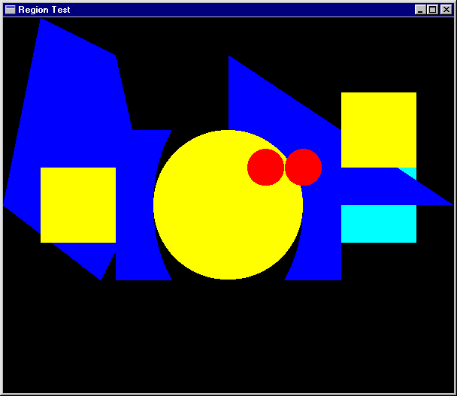
Ordering Pictures
pictToList :: Picture -> [(Color,Region)]
pictToList EmptyPic = []
pictToList (Region c r) = [(c,r)]
pictToList (p1 `Over` p2)
= pictToList p1 ++ pictToList p2
pic6 = pic4 `Over` pic2 `Over` pic1 `Over` pic5
pictToList pic6 - - - >
[(Magenta,?), (Yellow,?),(Cyan,?),(Cyan,?)]
Recovers the Regions from top to bottom.
Possible because Picture is a datatype that can be analyzed.

Slide 28
An Analogy
pictToList EmptyPic = []
pictToList (Region c r) = [(c,r)]
pictToList (p1 `Over` p2) = pictToList p1 ++ pictToList p2
drawPic w (Region c r) = drawRegionInWindow w c r
drawPic w (p1 `Over` p2) = do { drawPic w p2
; drawPic w p1}
drawPic w EmptyPic = return ()
Something interesting to prove:
drawPic w = sequence .
(map (uncurry (drawRegionInWindow w))) .
reverse .
pictToList

Slide 29
Pictures that React
Find the topmost Region in a Picture that “covers” the position of the mouse when a left button click appears.
Search the picture list for the first Region that contains the mouse position.
Re-arrange the list, bringing that one to the top.
adjust :: [(Color,Region)] -> Vertex ->
(Maybe (Color,Region), [(Color,Region)])
adjust [] p = (Nothing, [])
adjust ((c,r):regs) p =
if r `containsR` p
then (Just (c,r), regs)
else let (hit, rs) = adjust regs p
in (hit, (c,r) : rs)

Slide 30
Doing it Non-recursively
adjust2 regs p
= case (break (\(_,r) -> r `containsR` p) regs)
of
(top,hit:rest) -> (Just hit, top++rest)
(_,[]) -> (Nothing, [])
This is from the Prelude:
break:: (a -> Bool) -> [a] -> ([a],[a])
For example:
break even [1,3,5,4,7,6,12] ➔ ([1,3,5],[4,7,6,12])

Slide 31
Putting it all Together
loop :: Window -> [(Color,Region)] -> IO ()
loop w regs =
do clearWindow w
sequence [ drawRegionInWindow w c r |
(c,r) <- reverse regs ]
(x,y) <- getLBP w
case (adjust regs (pixelToInch (x - xWin2),
pixelToInch (yWin2 - y) )) of
(Nothing, _ ) -> closeWindow w
(Just hit, newRegs) -> loop w (hit : newRegs)
draw2 :: Picture -> IO ()
draw2 pic = runGraphics (
do w <- openWindow "Picture demo" (xWin,yWin)
loop w (pictToList pic))

Slide 32
Try it Out
p1,p2,p3,p4 :: Picture
p1 = Region Magenta r1
p2 = Region Cyan r2
p3 = Region Green r3
p4 = Region Yellow r4
pic :: Picture
pic = foldl Over EmptyPic [p1,p2,p3,p4]
main = draw2 pic

Slide 33
A Matter of Style, 3
loop2 w regs
= do clearWindow w
sequence [ drawRegionInWindow w c r |
(c,r) <- reverse regs ]
(x,y) <- getLBP w
let aux (_,r) = r `containsR`
( pixelToInch (x-xWin2),
pixelToInch (yWin2-y) )
case (break aux regs) of
(_,[]) -> closeWindow w
(top,hit:bot) -> loop w (hit : (top++bot))
draw3 pic = runGraphics (
do w <- openWindow "Picture demo" (xWin,yWin)
loop2 w (pictToList pic)
)

