Slide 1
Chapter 12
Qualified Types

Slide 2
Motivation
What should the principal type of (+) be?
  Int -> Int -> Int -- too specific
  a -> a -> a -- too general
It seems like we need something “in between”, that restricts “a” to be from the set of all number types, say Num = {Int, Integer, Float, Double, etc.}.
Recall that the type signature a -> a -> a
is really shorthand for (∀ a) a -> a -> a
Qualified types generalize this by qualifying the type variable, as in (∀ a ∈ Num) a -> a -> a,
which in Haskell we write as Num a => a -> a -> a

Slide 3
Type Classes
“Num” in the previous example is called a type class, and should not be confused with a type constructor or a value constructor.
“Num T” should be read “T is a member of (or an instance of) the type class Num”.
Haskell’s type classes are one of its most innovative features.
This capability is also called “overloading”, because one function name is used for potentially very different purposes.
There are many pre-defined type classes, but you can also define your own.

Slide 4
Example: Equality
Like addition, equality is not defined on all types (how do we test the equality of two functions, for example?).
So the equality operator (==) in Haskell has type
Eq a => a -> a -> Bool. For example:
42 == 42 ➔ True
`a` == `a` ➔ True
`a` == 42 ➔ << type error! >>
(types don’t match)
(+1) == (\x->x+1) ➔ << type error! >>
((->) is not an instance of Eq)
Note: the type errors occur at compile time!

Slide 5
Equality, cont’d
Eq is defined by this type class declaration:
class Eq a where
(==), (/=) :: a -> a -> Bool
x /= y = not (x == y)
x == y = not (x /= y)
The last two lines are default methods for the operators defined to be in this class.
A type is made an instance of a class by an instance declaration. For example:
instance Eq Int where
x == y = intEq x y -- primitive equality for Ints
instance Eq Float where
x == y = floatEq x y -- primitive equality for Floats

Slide 6
Equality, cont’d
But user-defined data types can also be made instances of Eq. For example:
data Tree a = Leaf a | Branch (Tree a) (Tree a)
instance Eq (Tree a) where
Leaf a1 == Leaf a2 = a1 == a2
Branch l1 r1 == Branch l2 r2 = l1==l2 && r1==r2
_ == _ = False
But something is strange here: is “a1 == a2” on the right-hand side correct? How do we know that equality is defined on the type “a”???

Slide 7
Equality, cont’d
But user-defined data types can also be made instances of Eq. For example:
data Tree a = Leaf a | Branch (Tree a) (Tree a)
instance Eq a => Eq (Tree a) where
Leaf a1 == Leaf a2 = a1 == a2
Branch l1 r1 == Branch l2 r2 = l1==l2 && r1==r2
_ == _ = False
But something is strange here: is “a1 == a2” on the right-hand side correct? How do we know that equality is defined on the type “a”???
Solution: Introduce a constraint on “a”, namely that it also be an instance of the type class Eq.

Slide 8
Constraints / Contexts are Propagated
Consider this function:
x `elem` [] = False
x `elem` (y:ys) = x==y || x `elem` ys
Note the use of (==) on the right-hand side of the second equation. So the principal type for elem is:
elem :: Eq a => a -> [a] -> Bool
This is inferred automatically by Haskell, but as always, it is recommended that you provide your own type signature for all functions.

Slide 9
Example from Regions
Useful slogan:
“polymorphism captures similar structure over different values, while type classes capture similar operations over different structures.”
For a simple example, recall from Chapter 8:
containsS :: Shape -> Point -> Bool
containsR :: Region -> Point -> Bool
These are similar ops over different structures. So:
class PC t where
contains :: t -> Point -> Bool
instance PC Shape where
contains = containsS
instance PC Region where
contains = containsR

Slide 10
Numeric Classes
Haskell’s numeric types are embedded in a very rich, hierarchical set of type classes.
For example, the Num class is defined by:
class (Eq a, Show a) => Num a where
(+), (-), (*) :: a -> a -> a
negate :: a -> a
abs, signum :: a -> a
fromInteger :: Integer -> a
Where Show is a type class whose main operator is
show :: Show a => a -> String
See the Numeric Class Hierarchy in the Haskell Report on the next slide.

Slide 11
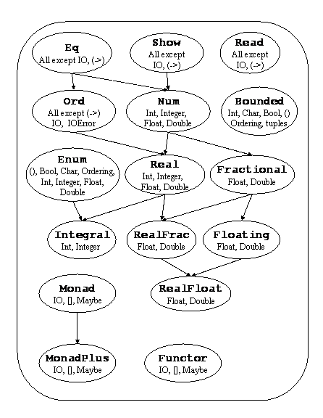
Haskell’s Numeric
Class Hierarchy

Slide 12
Coercions
Note this method in the class Num:
fromInteger :: Num a => Integer -> a
Also, in the class Integral:
toInteger :: Integral a => a -> Integer
This explains the definition of intToFloat:
intToFloat :: Int -> Float
intToFloat n = fromInteger (toInteger n)
These generic coercion functions avoid a quadratic blowup in the number of coercion functions.
Also, every integer literal, say “42”, is really shorthand for “fromInteger 42”, thus allowing that number to be typed as any member of Num.

Slide 13
Derived Instances
Instances of the following type classes may be automatically derived:
Eq, Ord, Enum, Bounded, Ix, Read, and Show
This is done by adding a deriving clause. For example:
data Tree a = Leaf a | Branch (Tree a) (Tree a)
deriving (Show, Eq)
This will automatically create an instance for
Show (Tree a) as well as one for Eq (Tree a) that is precisely equivalent to the one we defined earlier.

Slide 14
Reasoning About Type Classes
Most type classes implicitly carry a set of laws.
For example, the Eq class is expected to obey:
(a /= b) = not (a == b)
(a == b) && (b == c) ⊇ (a == c)
Similarly, for the Ord class:
a <= a
(a <= b) && (b <= c) ⊇ (a <= c)
(a <= b) && (b <= a) ⊇ (a == b)
(a /= b) ⊇ (a < b) || (b < a)
These laws capture the properties of an equivalence class and a total order, respectively.
Unfortunately, there is nothing in Haskell that enforces the laws – its up to the programmer!

