Slide 1

Dynamic Pricing Strategies for Revenue Management & Price Optimization.
HackBout Hackathon
Team ALBATROSS (Team-id : 04)
Paras Varshney (paras.varshney97@gmail.com)
Devi Sai Prashanthi (devisai2000@gmail.com)

Slide 2
Outline
Objective
Scope
Introduction
Equipment/Tools Required
Implementation Details
Summary

Slide 3
Objective
Our objective for this project is to understand and identify various trends in market revenue management and optimize price using dynamic pricing strategies to enhance user experience and parallely generating positive revenue from the product.

Slide 4
Scope
The major scope for this research project is to improve the current Pricing System based on traditional Revenue Management System (RMS) to a better and optimized pricing system through Machine Learning Techniques which mainly focuses on dynamic pricing on time series predictions.
This Project has various real life applications with simple alterations in
Hotel Revenue Management System,
Airlines Ticket Pricing,
eCommerce,
Transportation and Logistics, etc.

Slide 5
Introduction
Dynamic pricing is the practice of setting a price for a product or service based on current market conditions of demand and supply.
"Pricing is actually pretty simple...Customers will not pay literally a penny more than the true value of the product." - Ron Johnson (ex-CEO JCPenney).[6]
Types of Dynamic Pricing:
Cost Based
Competitor Based
Demand Based

Slide 6
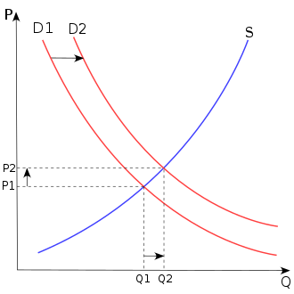
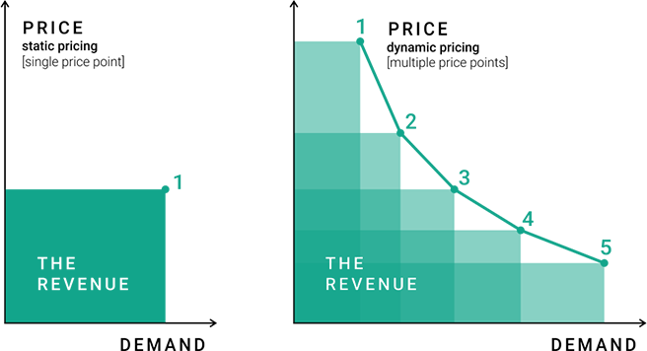
Supply - Demand Curve
Static vs Dynamic Pricing
Price or Cost
Demand or Quantity
Fig 1: [4] Supply Demand Curve
Fig 2: [5] Difference Between Static and Dynamic Pricing

Slide 7
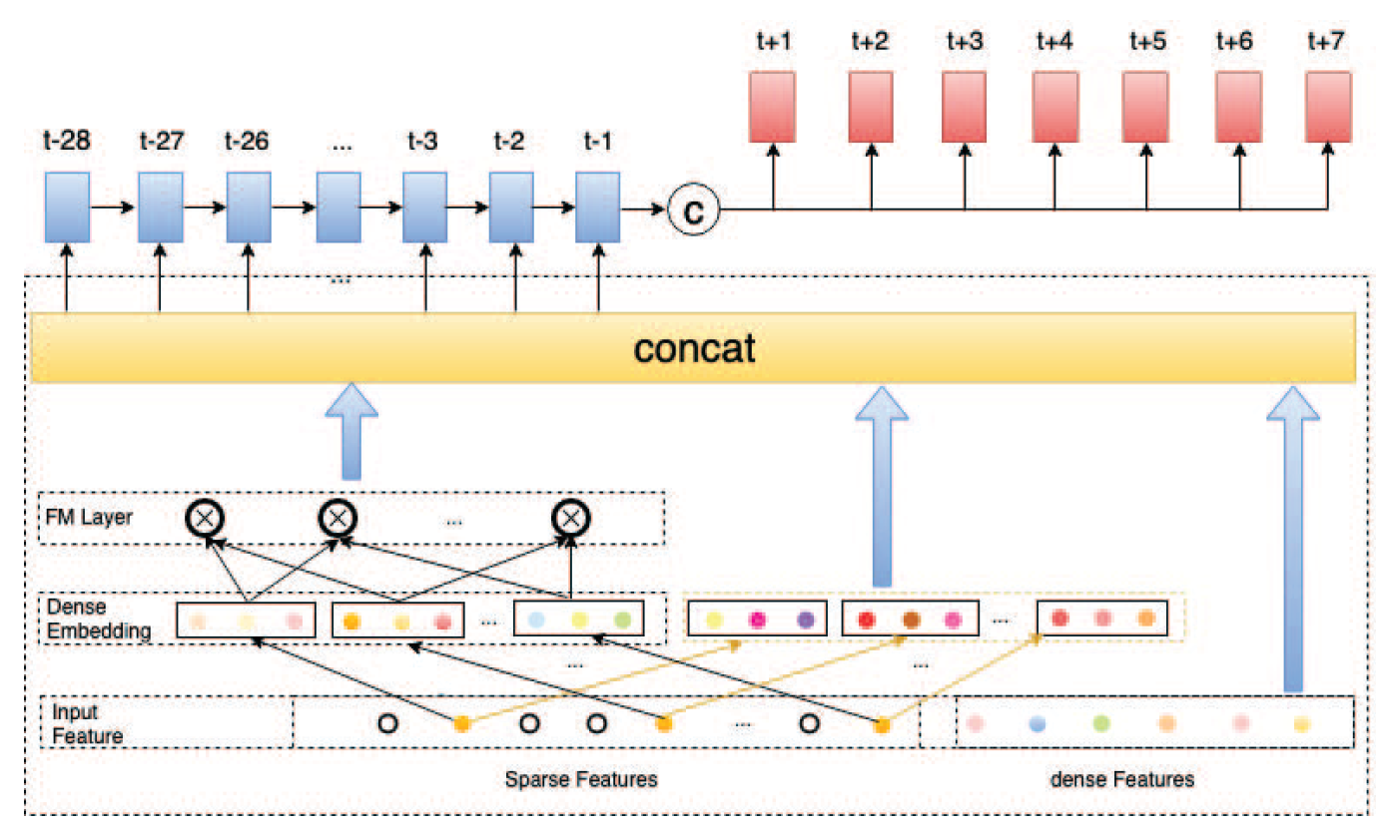
Approach to solve the problem
A Proposed DeepFM + seq2seq model.
Fig 4: [1] The proposed DeepFM+seq2seq model for occupancy prediction
Notes:
Deep Factorization Machine.

Slide 8
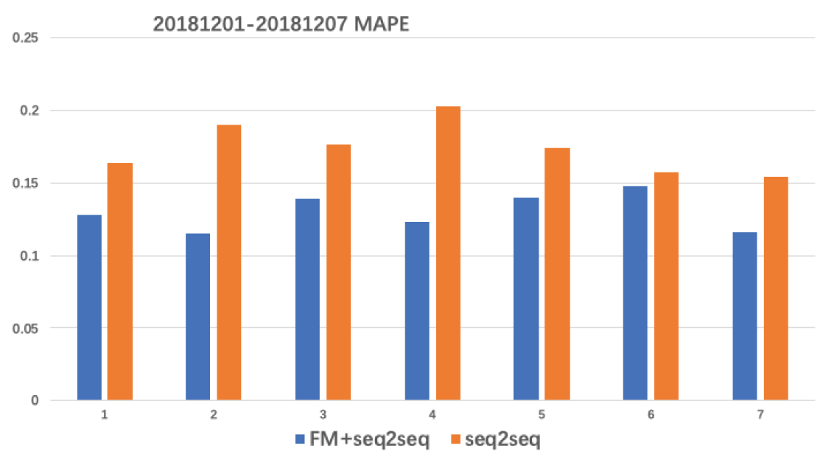
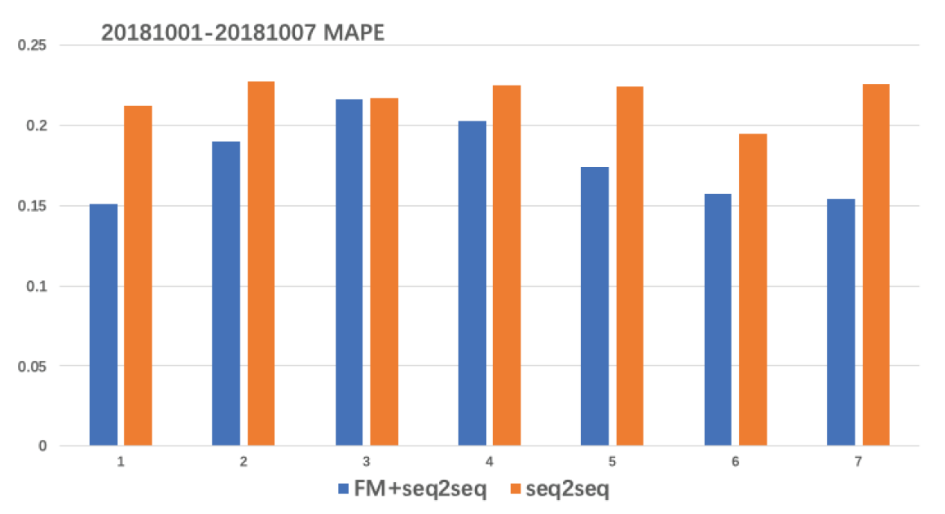
Approach to solve the problem
Results and Inferences-1:
ALGORITHMS | Dataset A MAPE (in %) | Dataset B MAPE (in %)
Single Exponential Smoothing(SES) | 25.55 | 28.94
Moving MA) | 23.68 | 33.44
Additive Holt-Winters | 25.55 | 31.19
Multiplicative Holt-Winters | 26.56 | 30.71
Prophet | 23.17 | 32.53
XGBoost | 20.70 | 27.39
seq2seq | 17.25 | 21.72
DeepFM+seq2seq | 12.62 | 17.52
Figure 5[1]:The Comparison between seq2seq and DFM+seq2seq forecasting models for offseason and on season occupancy prediction
Table 1[1]: Comparison of different prediction methods on Dataset A and Dataset B
Notes:
MAPE = Mean Absolute Percentage Error.

Slide 9
Equipment/Tools Required
Software Tools Required:
Python3 Programming Environment https://www.python.org
Jupyter Notebook or any similar IDE https://jupyter.org
Hardware Requirements:
A Computer with CPU/GPU for algorithmic computations.
Dataset Requirements:
Airbnb open Dataset.
Hotels Datasets for testing and evaluations.
E-Commerce retail sales Dataset.

Slide 10
Implementation Details
Deeper understanding about dynamic pricing concepts and their applications.
Research Papers analysis to learn different approaches for price optimization and revenue management.
Experimentation with new techniques for improving the results of existing models.
Phase 1
Phase 2
Phase 3

Slide 11
Implementation Details Contd…
Implement new proposed model in real time.
Test and Evaluate the results on unknown data for POC.
Communicate the final results and share with the community.
Phase 4
Phase 5
Phase 6
Notes:
Proof of Concept.

Slide 12
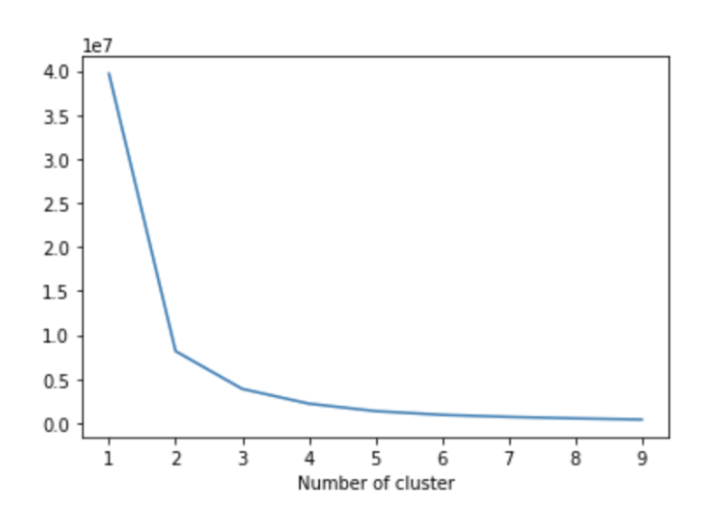
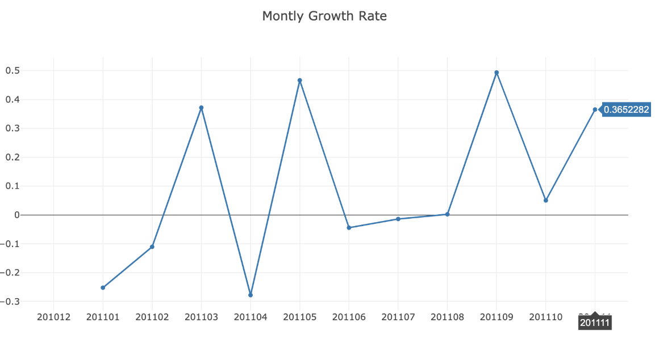
Implementation Details Contd…
Understanding of revenue generation:
Revenue = Active Customer Count * Order Count * Average Revenue per Order
Airbnb dataset is used for training, validating & testing.
Recency - Frequency - Monetary (RFM) Value calculation.

Slide 13
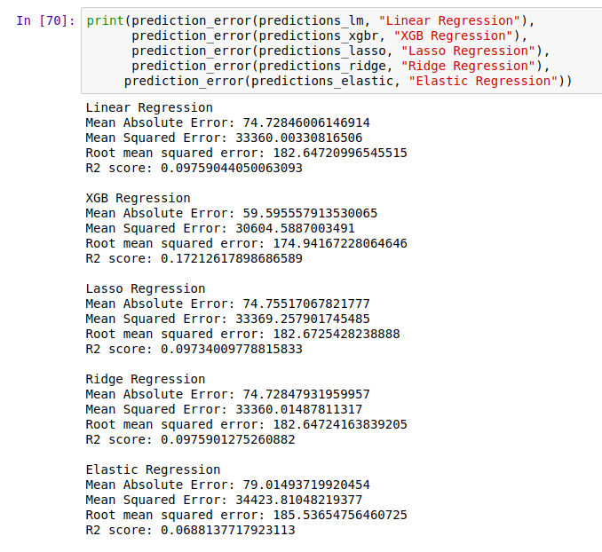
Implementation Details Contd…

Slide 14

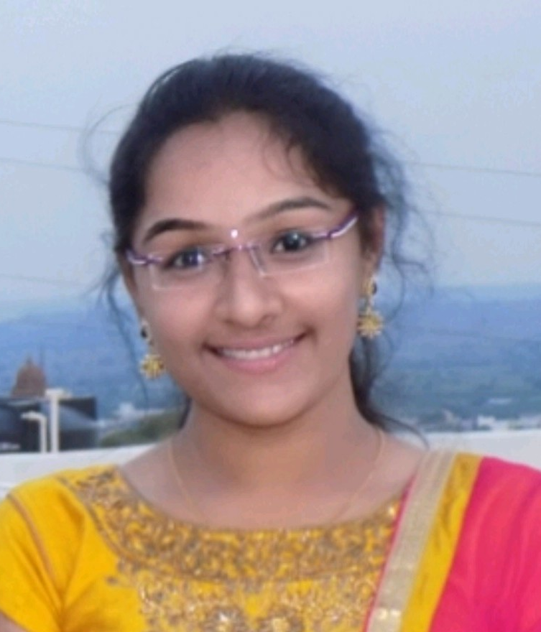
Thank you!
Any questions?
Paras Varshney
Contact: paras.varshney97@gmail.com, +91-7358337024
Indian Institute of Information Technology Design & Manufacturing, Kurnool, A.P.
LinkedIn: https://www.linkedin.com/in/pv009
Kaggle: https://www.kaggle.com/paras007
GitHub: https://github.com/paras009
Devi Sai Prashanthi
Contact: devisai2000@gmail.com, +91-7358337901
Indian Institute of Information Technology Design & Manufacturing, Kurnool, A.P.
LinkedIn: https://www.linkedin.com/in/dsp09/
Kaggle: https://www.kaggle.com/prashu919
GitHub: https://github.com/dsp09

