Slide 1
The Theory of Affordances
PARAS VARSHNEY
ROLL NO. 116CS0036
DEPARTMENT OF COMPUTER SCIENCE AND ENGINEERING
DESIGNING INTELLIGENT SYSTEMS

Slide 2
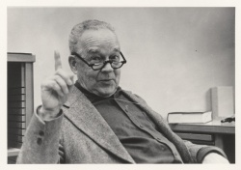
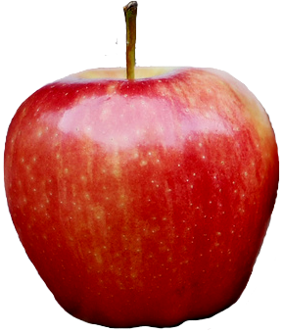
Introduction
“Affordance” is the term coined by “James Jerome Gibson” during 1977-1979.
According to Gibson J.J., “The affordances of the environment are what it offers the animal, what it provides or furnishes, either for good or ill. The verb to afford is found in the dictionary, but the noun affordance is not. I have made it up. I mean by it something that refers to both, the environment and the animal in a way that no existing term does.”
Gibson J.J. was a Psychology Ph.D. holder from Cornell University, Ithaca, NY where he proposed the concept of ecological psychology.
Ecological Psychology: “It’s not what is inside the head that is important, it’s what the head is inside of”.
  Animals stand in a relation to the environment.
  To explain behaviours it is necessary to study the environment in which behaviours take place.
Nutrition
Animal
Environment
DESIGNING INTELLIGENT SYSTEMS

Slide 3
Topic
IIITDM, KURNOOL
DESIGNING INTELLIGENT SYSTEMS

