Slide 1
Reconstructing the 12-lead ECG
from a reduced set of leads
A masked-lead transformer trained on PTB-XL | 21,799 clinical ECGs | 4.9M parameters
Notes:
The question: how few electrodes can you place and still recover a diagnostically useful 12-lead ECG? Trained one model to handle any subset of leads, then measured where it succeeds and where it fails.

Slide 2
Approach
One model, any electrode configuration
01
02
03
Masked-lead training
Predict 8, derive 4
Score hidden leads only
Randomly hide leads each sample, 1 to 7 visible. The model learns every electrode configuration at once instead of one fixed set.
III, aVR, aVL and aVF are exact linear functions of I and II. The network predicts only the 8 independent leads; the rest follow by algebra.
Correlation averaged over all 12 includes leads handed to the model as input. Those score ~1.0 and hide the real reconstruction quality.
Einthoven and Goldberger identities hold exactly (error 0.0), because the dependent leads are computed rather than predicted.
Notes:
Predicting all 12 wastes capacity reproducing arithmetic and yields traces that violate Einthoven's law slightly — visibly wrong to a cardiologist.

Slide 3
Accuracy scales with electrode count
Held-out test set, fold 10 (2,198 records). Correlation on hidden leads only.
Where the gains come from
1 → 2 leads: +0.061
The largest single jump. One extra electrode.
4 → 7 leads: +0.019
Three more electrodes buy a third as much.
Diminishing returns set in at 4 leads.
Notes:
Reported number is Pearson r on leads the model could not see.

Slide 4
Which leads, not how many
Exhaustive search over all 28 two-lead and 56 three-lead subsets
Two limb leads
Two chest leads
I + II
r = 0.856
V2 + V5
r = 0.910
Both lie in the frontal plane — they span only two dimensions.
Spread across the transverse plane — the missing third dimension.
The principle is spatial diversity, not lead count.
The worst subsets pair electrodes pointing the same way — I+V6, V5+V6, I+II. The best spread across septal, anterior and lateral positions.
Hardware caveat: precordial leads are referenced to the Wilson central terminal (average of RA, LA, LL), so V2 cannot be recorded without the three limb electrodes — which give I and II for free. Rank configurations by electrode count, not lead count.
Notes:
Best buildable 4-electrode configuration is I+II+V3 at r=0.925, which beats I+II+V2. If you add one chest electrode, put it at V3.

Slide 5
Clinical accuracy: ST-segment error
Correlation is dominated by the QRS complex and barely sees the ST segment — which is what indicates ischaemia.
6.0%
0.5%
of records exceed the 0.1 mV
threshold at 1 lead
at 4 leads
(I+II+V2+V5)
Pathology costs accuracy
Abnormal records carry 1.5–1.9× the error of normal ones. PTB-XL is 44% normal ECGs, so any dataset-wide average understates error on exactly the cases that matter.
Notes:
Measured at I+II. Conduction disturbance and hypertrophy are worst — both alter voltage relationships between leads in ways a model trained mostly on normal conduction has no basis to reproduce.

Slide 6
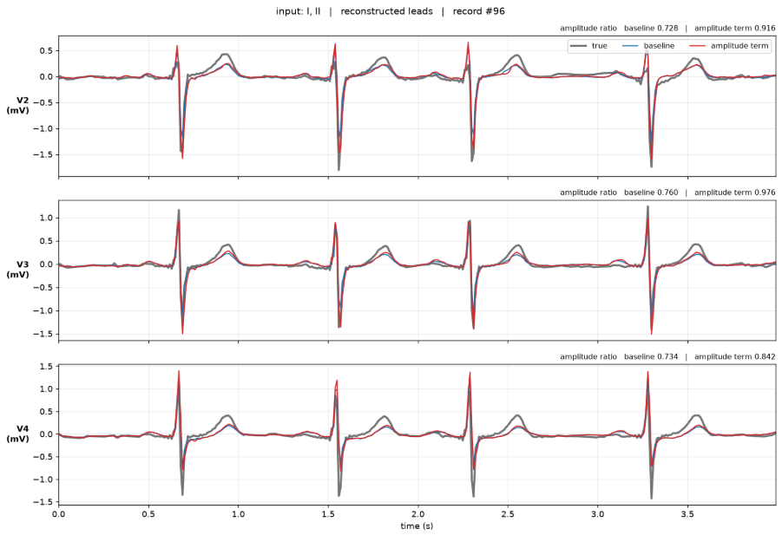
Precordial amplitude is biased toward the population mean
Not random error — the direction of the error depends on the patient.
Lead V4, binned by the patient's true amplitude
Small hearts inflated 36%, large hearts shrunk 40%. Correlation between true amplitude and error: −0.71.
Record #96 — grey true, blue baseline, red with amplitude term
Notes:
Averaged over the dataset the ratio is 0.94, which sounds like a 6% error. The truth is plus or minus 40% depending on the patient, averaging out to 6%. Adding an amplitude term to the loss shifts every bin up by ~0.04 but leaves the correlation at −0.705: it rescales, it does not make the prediction patient-specific. Precordial amplitude depends on body habitus and heart position, which are absent from the limb leads, so predicting the population mean is the correct Bayes estimate — not a fixable bug.

Slide 7
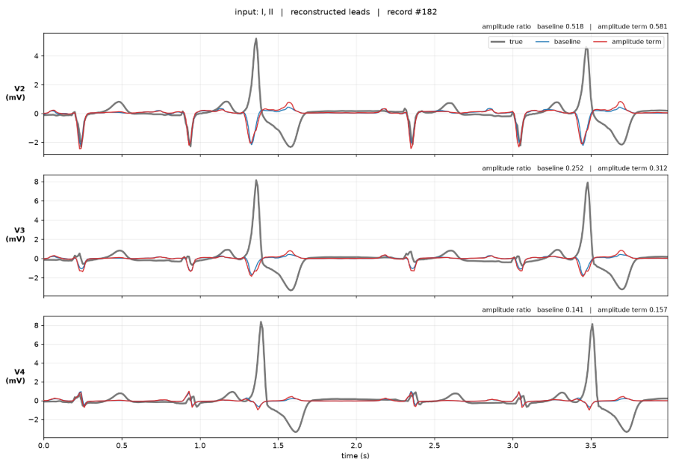
The failure no metric caught
Two ectopic beats, reproduced as almost nothing
Record #182
Sinus beats reconstruct acceptably. The two large ectopic complexes — reaching +8 mV in V3 and V4 — come back essentially flat.
0.14
amplitude ratio, V4
A ventricular focus near the chest wall produces an enormous precordial deflection while the limb-lead signature stays modest. From I and II the model cannot know it happened.
Two beats in ten seconds barely move a correlation. Every aggregate metric in this deck passes this record.
Notes:
Morphology suggests ventricular ectopy or a paced beat. A model that renders sinus rhythm faithfully and silently flattens ectopy is a specific safety failure, and it is invisible to correlation, RMSE and ST error alike.

Slide 8
What this means in practice
Consequences of the two findings above
Voltage criteria are unusable
Hypertrophy is diagnosed by absolute precordial voltage. This model shrinks exactly the high voltages that define it. Hypertrophy is the worst-scoring diagnostic class, at 0.065 mV ST error.
Lead II is the weakest lead
r = 0.81, below every precordial. Predicting it requires the frontal QRS axis, which spans −30° to +90° across patients and is unobservable from one lead.
Tail risk, not mean error
Single-lead ST error averages 41 μV but reaches 107 μV at p95 and 132 μV for infarction — above the 100 μV diagnostic threshold.
Reconstruction is indistinguishable from measurement
A synthesised trace looks identical to a recorded one. A clinician cannot tell which leads were inferred — a real risk of false confidence.
Notes:
All four were found by inspecting reconstructions. None would have surfaced from the metrics alone.

Slide 9
Where this goes next
Ranked by expected value, highest first
Patient-specific calibration
Addresses the main finding
One recorded 12-lead snapshot per patient fixes a per-lead gain. This targets the amplitude bias directly: the unrecoverable quantity is a per-patient scale, and one snapshot measures it.
Amplitude-aware objective — tested
Does not fix the bias
Penalising standard-deviation mismatch lifts the mean ratio 0.94 → 0.99 but leaves the conditional bias unchanged (−0.705 vs −0.708). It rescales; it does not inform.
Downstream classification
Decides the architecture
Three-way test: classifier on true 12-lead, on reconstructed 12-lead, and on raw 2 leads. Determines whether reconstruction adds information or is an expensive identity function.
Pretrain, then fine-tune
Strongest variant
Masked-lead prediction is a strong self-supervised objective. Keep the encoder, discard the decoder, fine-tune for diagnosis directly.
Notes:
Scaling to MIMIC-IV-ECG (~800k records) for pretraining is the other large available win, and 500 Hz data would test whether the 100 Hz result holds.

Slide 10
What holds up
Rhythm
Morphology
Ischaemia
Usable from 1 lead
Needs 3–4 leads
Needs 4+ leads
Rate, atrial fibrillation, ectopy and conduction intervals need one clean lead. Already an FDA-cleared consumer capability.
r = 0.925 at I+II+V3, four electrodes. Comparable to EASI-derived 12-leads used in bedside monitors.
ST error falls below a fifth of the diagnostic threshold only at I+II+V2+V5. At 1–2 leads the tail is unsafe.
5 electrodes reconstruct a diagnostically usable 12-lead ECG. 2 electrodes do not.
PTB-XL fold 10, n = 2,198 | 100 Hz | transformer, 4.9M parameters | trained on a single RTX 4050
Notes:
Ten-electrode carts remain the standard; this halves that count.

