Slide 1
Malware Detection with machine learning
Brett Luskin
Data 606 – capstone Spring 2020
Notes:
Hi, my name is Brett Luskin, and my Capstone project is Malware Detection with Machine Learning.

Slide 2
Recap
Network Intrusion Detection System (NIDS) using UNSW-NB15 Dataset
No Domain Knowledge
Benchmark using existing research
Implement new method
Notes:
As a quick recap if you didn’t see my introductory video, this project is about creating a Network Intrusion Detection System using the UNSW-NB15 Dataset. The dataset was created by Nour Moustafa for research purposes and is a mix of real network traffic with synthetic attack data. Also, I have no previous experience with cyber security, so hopefully this will be a learning experience for me and for anyone who follows along. The focus will be more on the data science techniques that have been learned throughout the course of the Master’s program here at UMBC. I’m going to benchmark my results using existing research, and because this dataset is still fairly new, created in 2017, there are still some methods that we can implement that aren’t well researched.

Slide 3
Signature versus anomaly detection
Signature detection: NIDS based on a database of existing known attacks
Anomaly detection: NIDS based on detecting unknown attacks using profile parameters ref: Janarthanan, Zargari
Notes:
One note about Network Intrusion is that there is signature based detection versus anomaly based detection. In short, this means you either have a detection system that looks for attacks based on attacks that are already known or you have a detection system that is just looking for suspicious activity based on the profile of the data coming in. A perfect anomaly detection system is preferred because it hopefully can prevent attacks by unknown methods.

Slide 4

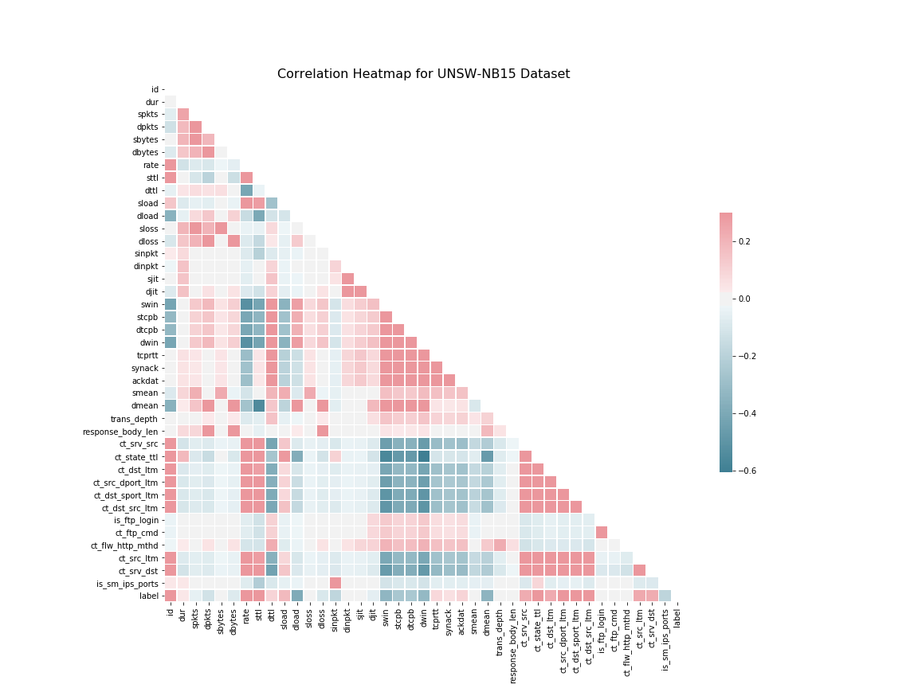
Initial eda
45 numeric features 4 categorical
175,341 items
68% attacks
9 types of attacks
Notes:
A quick general look at the dataset. There are 45 numeric features that include the id and label. There are 4 categorical features that include the attack type. 175,341 rows, 68% of which are attacks of 9 different varieties. I run a correlation heatmap just to see if I can find anything interesting, but because of my lack of domain knowledge and the large amount of features it is not very helpful. If there were no research available, I might start looking at some of highly correlated or negatively correlated features, but because of the research I can just move on.

Slide 5
Research Directed eda
The Significant Features of the UNSW-NB15 and the KDD99 Data Sets for Network Intrusion Detection Systems
Moustafa ; Slay
Feature Selection in UNSW-NB15 and KDDCUP’99 Datasets
Janarthanan ; Zargari
Notes:
There are two papers I used about feature selection with this dataset. Feature reduction on a dataset this size is important because it can mean faster training times and faster implementation when you have a detection system in use. You want something lightweight because if you have a large network, you obviously don’t want it to be bogged down by your intrusion detection system. The first paper there, by Moustafa and Slay, identified eight features of high importance to the dataset. The second paper, by Janarthanan and Zargari identified five features of high importance. Only one feature showed up in both papers.

Slide 6
Source time-to-live
Time-To-Live (TTL) tells a network router whether the packet has been in the network too long and should be discarded
Initially set by sender (source)
Only common feature from both papers
Notes:
Source Time-To-Live! What is that? Time-to-Live tells a router whether the packet has been in the network too long and should be discarded. It is initially set by the sender. So basically the sender is telling the network how long it should let this packet hang out. Not suspicious at all.

Slide 7

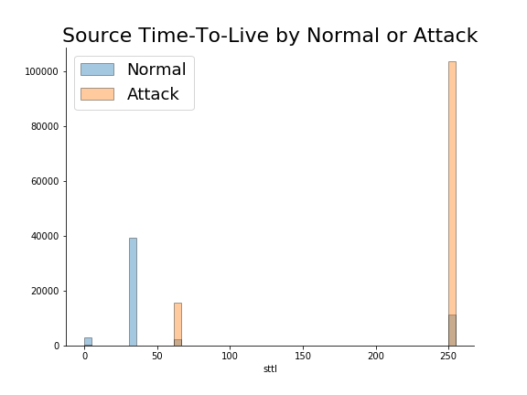
Source time-to-live
Percent of bad traffic with STTL greater than 50: 89.73%
Percent of bad traffic with STTL less than 50: 0.71%
Two types of attack not present at all less than 50
Notes:
So as you can suspect, this is a highly informative feature of the data. You’ll notice the data clustering around certain times, that is due to a conventional practice when setting the STTL. It’s not important to know exactly what it means, just know that that is why you see the data cluster like that. The big takeaway is that break point where the data splits into largely normal network traffic versus largely malicious traffic. I could see this being the first node in a decision tree and already getting pretty accurate results.

Slide 8
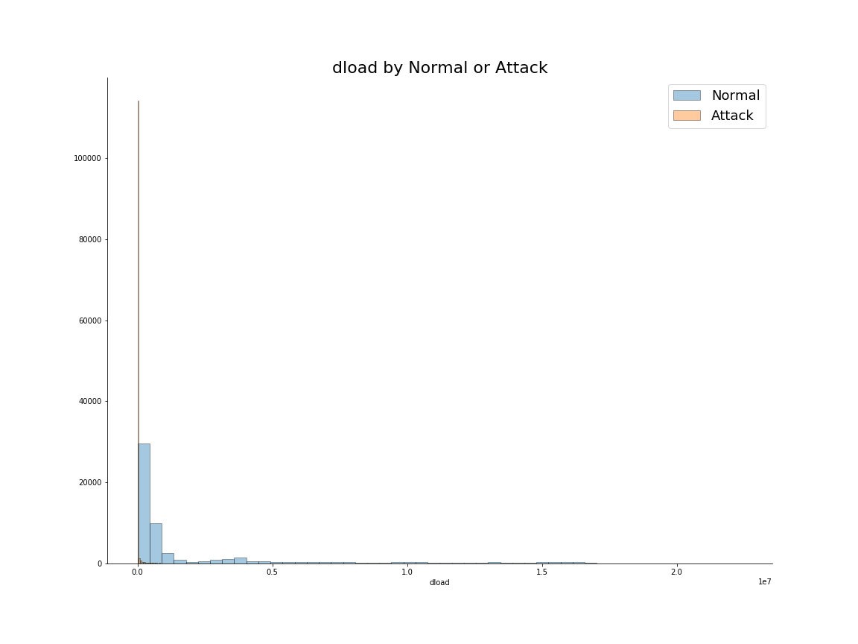
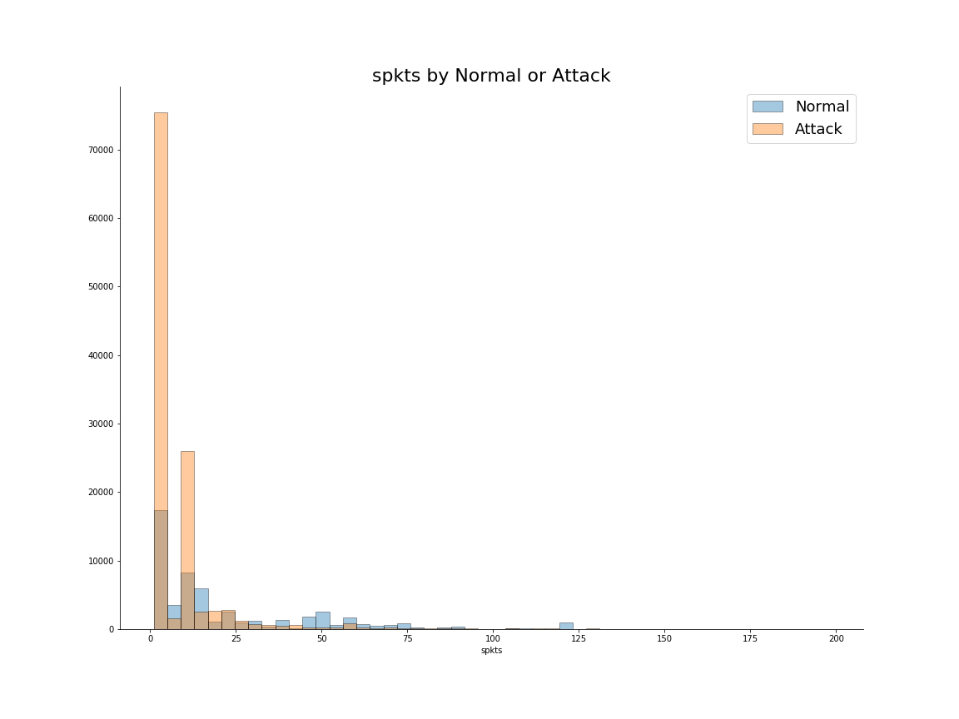
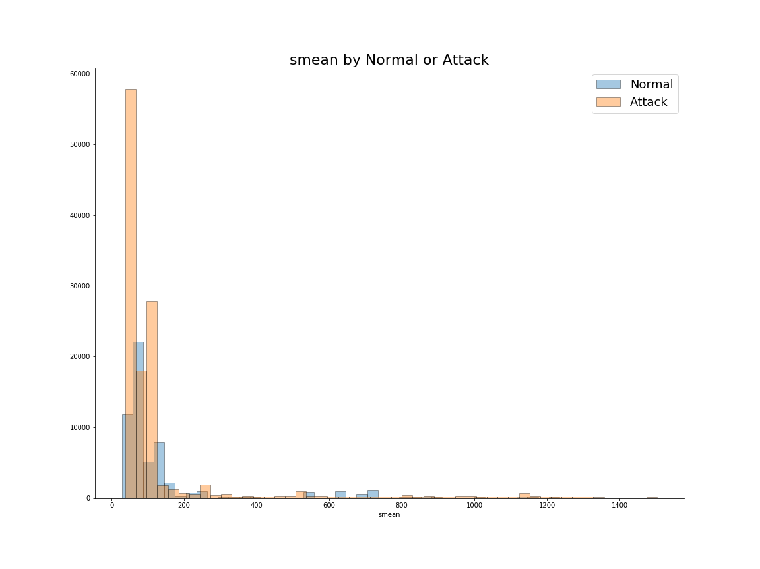
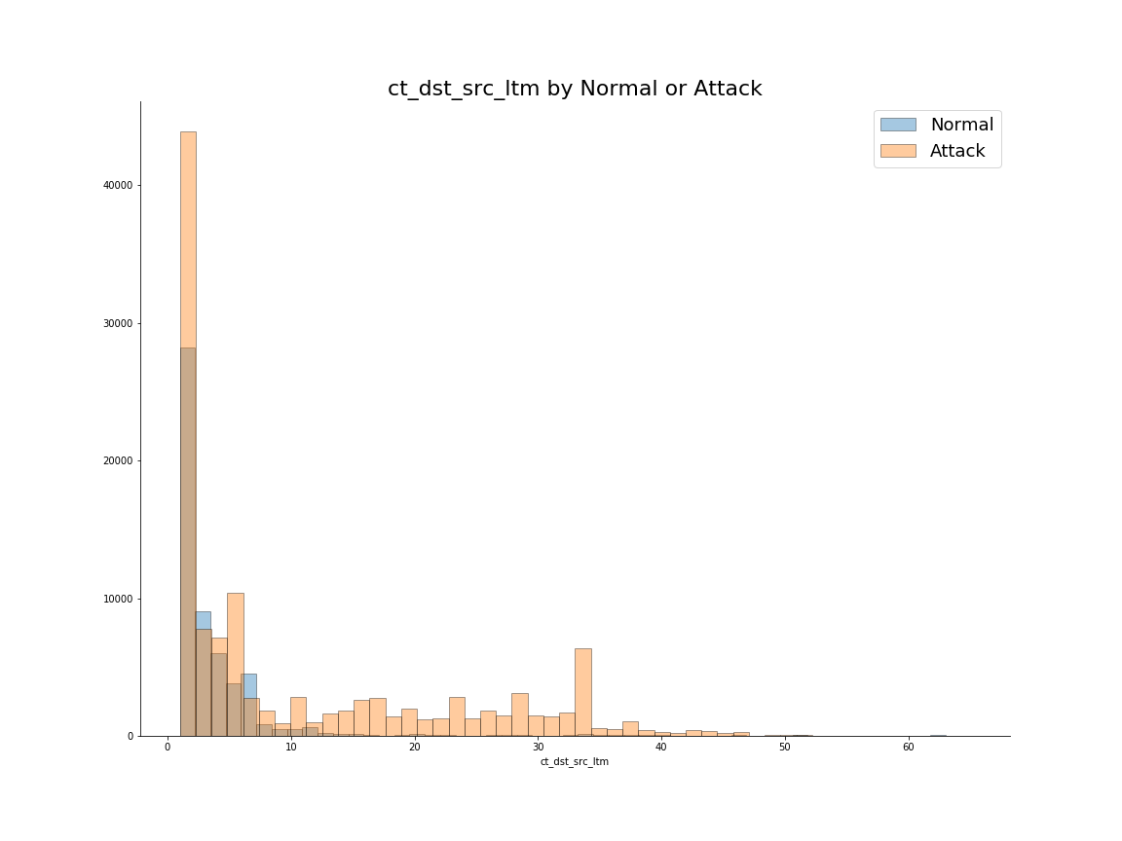
additional features identified in research
Notes:
I performed the same type of analysis on the other features in the papers, but nothing was like Source Time to Live in such a stark contrast of what is and what isn’t an attack.

Slide 9
Eda conclusion
Source Time to Live is King
Engineered features are included already
Notes:
So my EDA concludes with that about the features, I already know what the best feature is, but I’ll be interested to run my own PCA. The other thing of note about the dataset is that it includes some engineered features already, so I don’t think it will be necessary to do much feature engineering, although I won’t close myself off to it while I’m building the models.

Slide 10
Machine learning and Neural network Research
Algorithm | Accuracy | False Alarm Rate
Logistic Regression | 83.15% | 18.48%
Naïve Bayes | 81.20% | 18.30%
Artificial Neural Network | 81.50% | 22.10%
EM Clustering | 78.40% | 23.70%
Feed Forward Neural Network | 99.50% | 0.47%
Notes:
The other part of my research was on the existing algorithms that have been documented. You can see from the table here what has been done and what the accuracy and False Alarm Rates are. I have to say that given the knowledge of STTL, they really don’t seem to be performing as well as I thought they should. Of course, the Neural Network is near perfect. When I first looked at this project in January, I didn’t see any papers on Neural Networks, it was only in the past couple weeks that I saw it. That being said, not every type of algorithm and neural net has been implemented on the data, so I will try some new methods on the dataset. That being said, there is one other topic I’d like to mention briefly regarding the research.

Slide 11
reproducibility
“Whether or not a paper detailed the hyperparameters used was found to be significant, and we can intuit why. If you don’t tell the reader what the settings were, the reader has to guess.”
Ed Raff
https://thegradient.pub/independently-reproducible-machine-learning/
Notes:
Reproducibility is important because if you want me to take your results seriously, I need to be able to get the same thing. So for instance, in that Neural Network paper, they say they use a Feed Forward Neural Network with 10 layers and 3 activation functions. Well, I can try to do that, but without knowing the specific hyperparameters of your model then I’ll just have to try some stuff. Now, there are things like grid search and Optuna now for Pytorch, but it would be much easier to reproduce if we knew right away what you were doing. So that will be another point of emphasis when I do my final Deliverable, is making sure my code and particularly the hyperparameters are available and easy to understand and reproduce. I encourage everyone to read the paper linked here by UMBC’s own Ed Raff on reproducibility. It is both highly informative and entertaining.

Slide 12
References
T. Janarthanan and S. Zargari, "Feature selection in UNSW-NB15 and KDDCUP'99 datasets," 2017 IEEE 26th International Symposium on Industrial Electronics (ISIE), Edinburgh, 2017, pp. 1881-1886.
D. Jing and H. Chen, "SVM Based Network Intrusion Detection for the UNSW-NB15 Dataset," 2019 IEEE 13th International Conference on ASIC (ASICON), Chongqing, China, 2019, pp. 1-4.
N. Moustafa and J. Slay, "The Significant Features of the UNSW-NB15 and the KDD99 Data Sets for Network Intrusion Detection Systems," 2015 4th International Workshop on Building Analysis Datasets and Gathering Experience Returns for Security (BADGERS), Kyoto, 2015, pp. 25-31.
N. Moustafa, J. Slay and G. Creech, "Novel Geometric Area Analysis Technique for Anomaly Detection Using Trapezoidal Area Estimation on Large-Scale Networks," in IEEE Transactions on Big Data, vol. 5, no. 4, pp. 481-494, 1 Dec. 2019.
L. Zhiqiang, G. Mohi-Ud-Din, L. Bing, L. Jianchao, Z. Ye and L. Zhijun, "Modeling Network Intrusion Detection System Using Feed-Forward Neural Network Using UNSW-NB15 Dataset," 2019 IEEE 7th International Conference on Smart Energy Grid Engineering (SEGE), Oshawa, ON, Canada, 2019, pp. 299-303.
https://github.com/blusk44/Capstone606/tree/master/Delivery-2
Notes:
Finally, here are my references. The files and code for this presentation are found at the github address linked here as well.

